Slide 1
Technical Infrastructure Monitoring
Service Overview

Slide 2
TIM: Summary
Service Overview
Datatag & Alarm Configuration
Process, Equipment & Sub-Equipment
JMS Brokers
Ecosystem
TIM – Service Overview
2

Slide 3
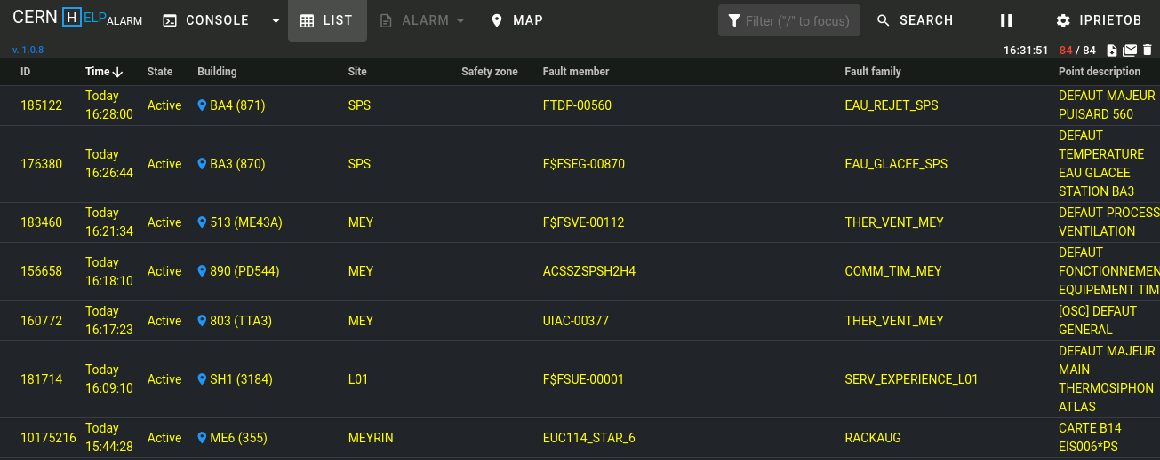
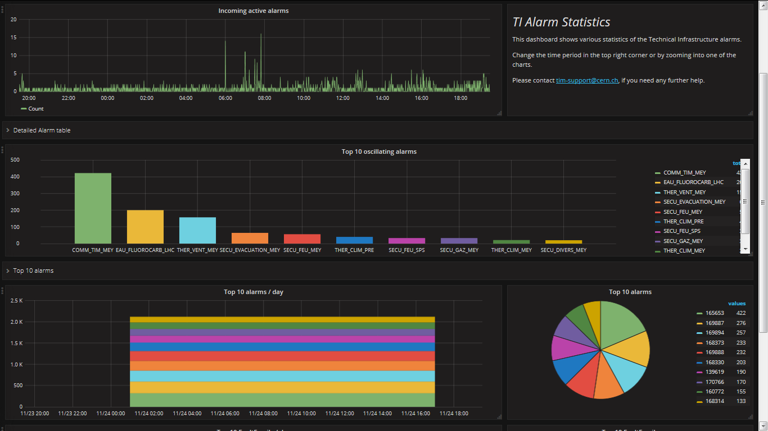

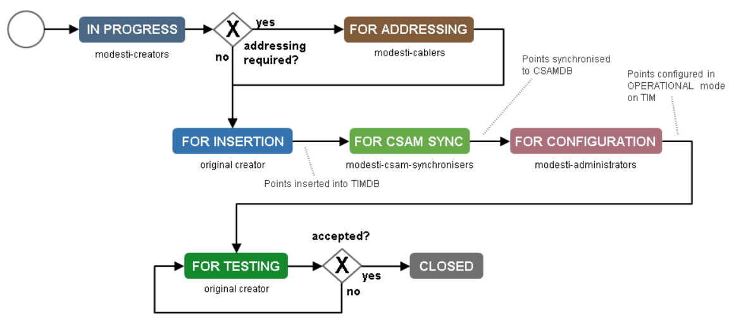




TIM: Overview
Monitoring service based on C2MON (CERN Control and MONitoring platform) framework
Receives data tags and alarms from multiple heterogeneous systems and propagates them to client applications
HelpAlarm
Grafana
TIM / C2MON
TIM Viewer
HelpAlarm
…
DIP Publisher
Clients
MODESTI
JMS (ActiveMQ)
Server
Redundant
Servers
Elasticsearch
Configuration
JMS (ActiveMQ)
…
Data
Acquisition
Oracle
NxCALS
OPC
DIP
CMW
TIM – Service Overview
2

Slide 4
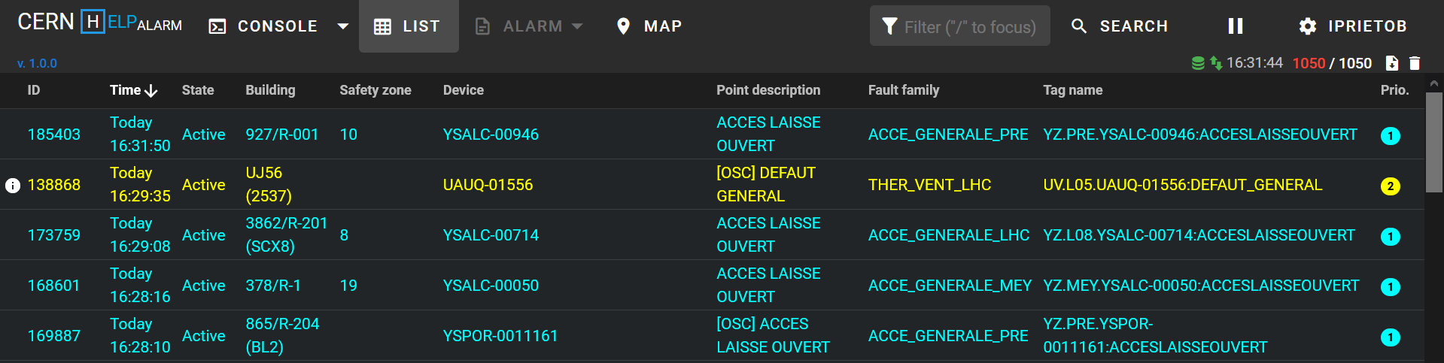
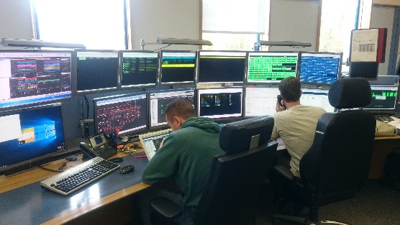
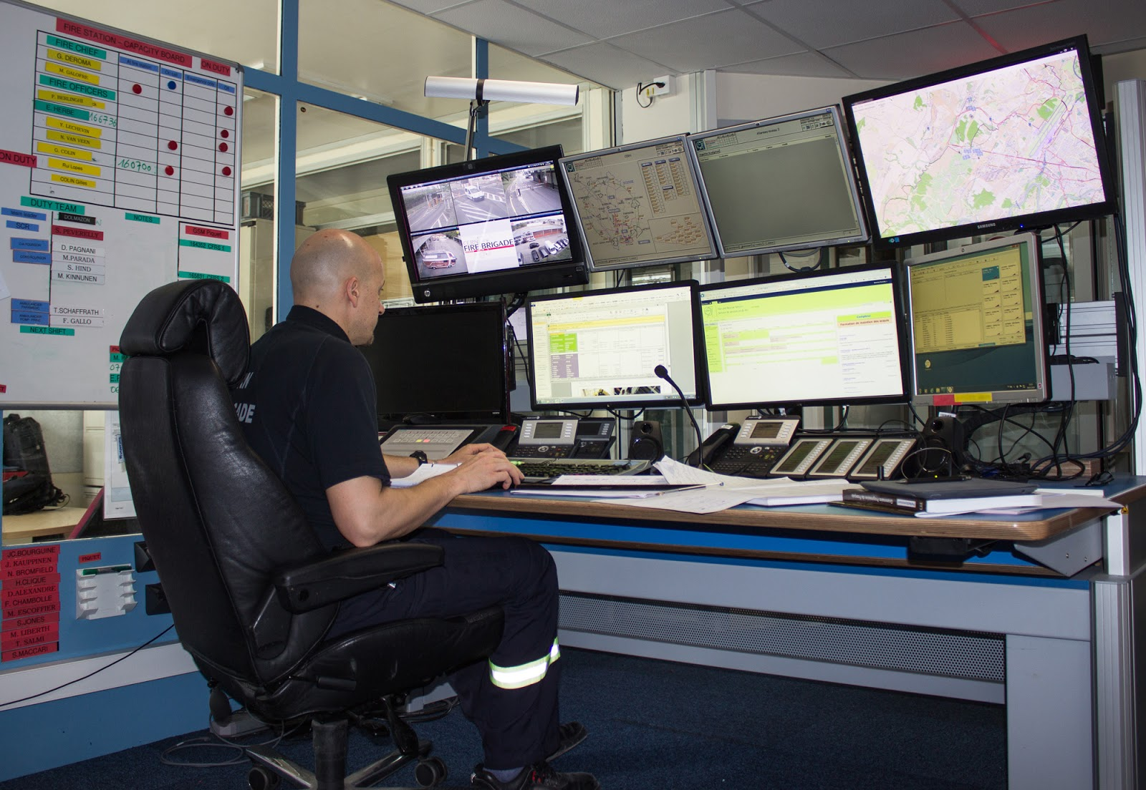
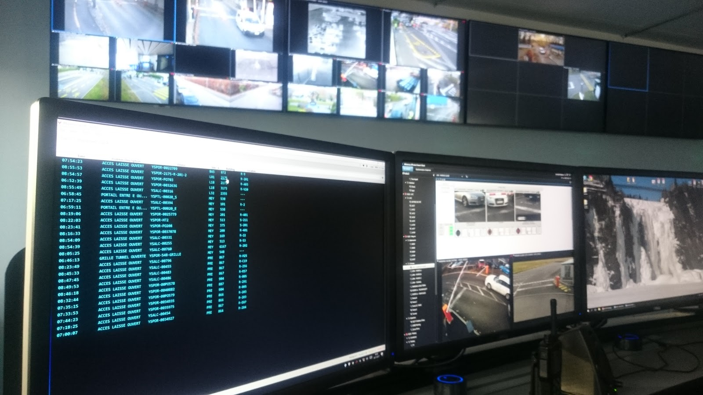
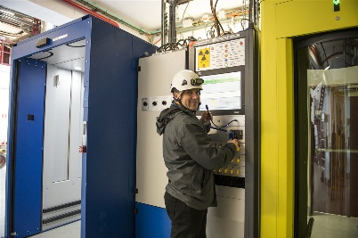
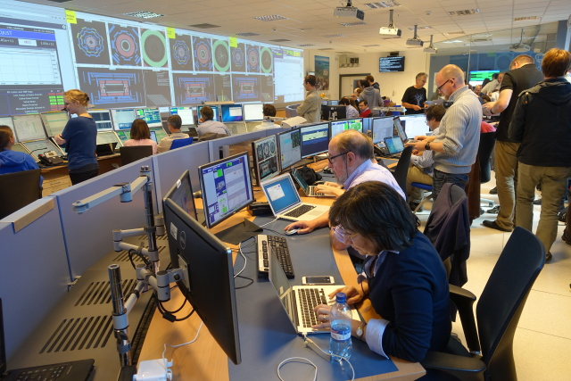


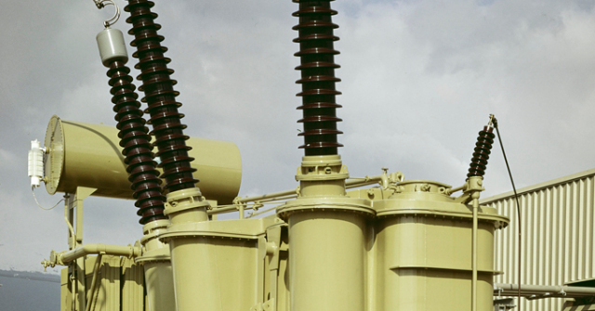
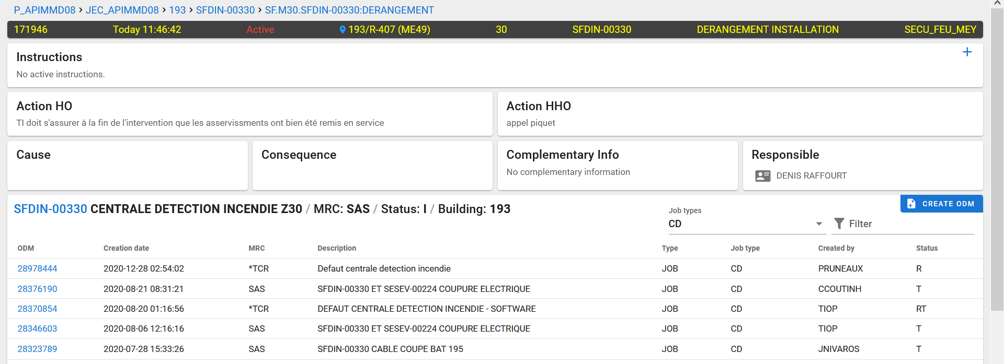
TIM: Overview
Monitoring service based on C2MON (CERN Control and MONitoring platform) framework
Receives data tags and alarms from multiple heterogeneous systems and propagates them to client applications
Critical service: main tool used by BE-OP-TI (CCC) for monitoring Technical Infrastructure and critical applications
TIM
CSAM Alarms
CERN Guards
Access System
HelpAlarm
TI Operators
ATLAS SLIMOS
CRYO Systems
Computer Center
Follow-up of major incidents with expert groups
Electrical Grid (2018)
Alarm details (Single Alarm Page)
TIM – Service Overview
3

Slide 5
TIM: Overview
Monitoring service based on C2MON (CERN Control and MONitoring platform) framework
Receives data tags and alarms from multiple heterogeneous systems and propagates them to client applications
Critical service: main tool used by BE-OP-TI (CCC) for monitoring Technical Infrastructure and critical applications
Used by:
  Different access groups to monitor their equipment and send alarms
  Software solution for SPS Personal Protection System (SPS-PPS)
  Alarm gateway for CERN Safety Alarm Monitoring System (CSAM) & WinCC OA
  SPECTRUM Network alarms
TIM – Service Overview
5

Slide 6
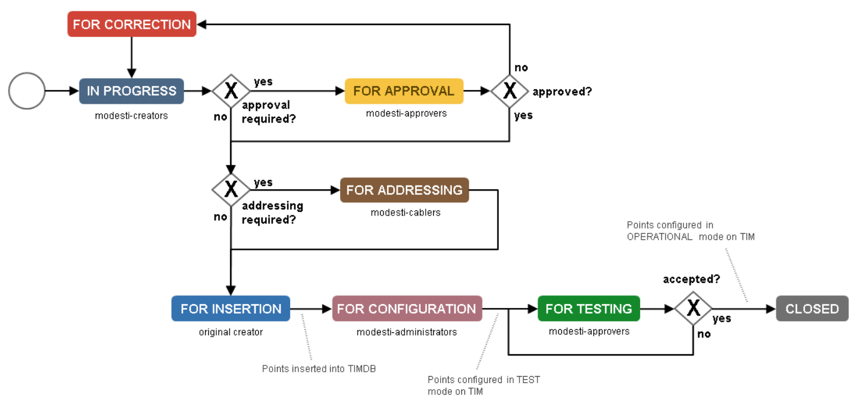
TIM: Datatag & Alarm Configuration (MoDESTI)
Web application to add/remove/modify data tags and alarms in TIM
Plugin-based, provides customizable workflows (BPMN 2.0, Activiti) for multiple domains (CSAM, TIM, WINCCOA, PSEN, SPECTRUM, RULES)
TIM – Service Overview
6

Slide 7
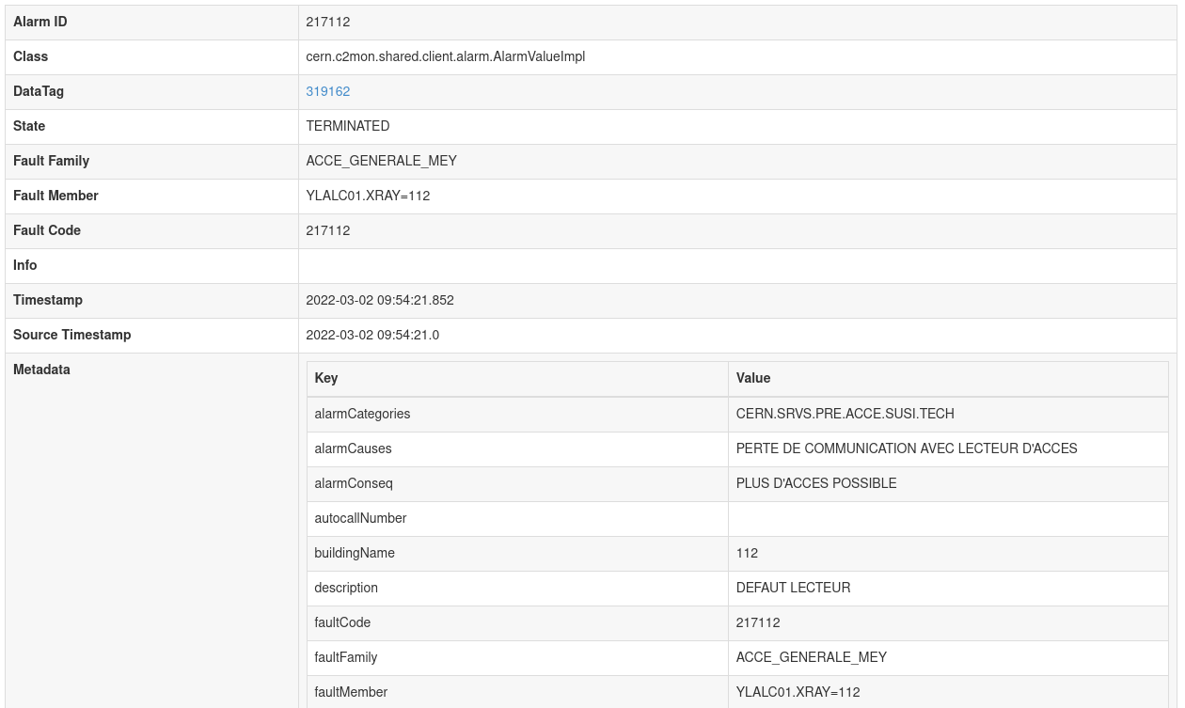
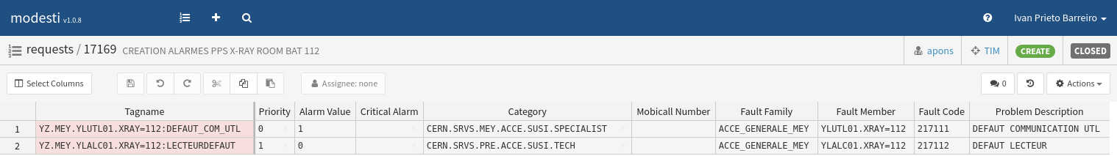
TIM: Datatag & Alarm Configuration (MoDESTI)
Web application to add/remove/modify data tags and alarms in TIM
Plugin-based, provides customizable workflows (BPMN 2.0, Activiti) for multiple domains (CSAM, TIM, WINCCOA, PSEN, SPECTRUM, RULES)
Datatag & Alarm information as Metadata
TIM – Service Overview
7

Slide 8
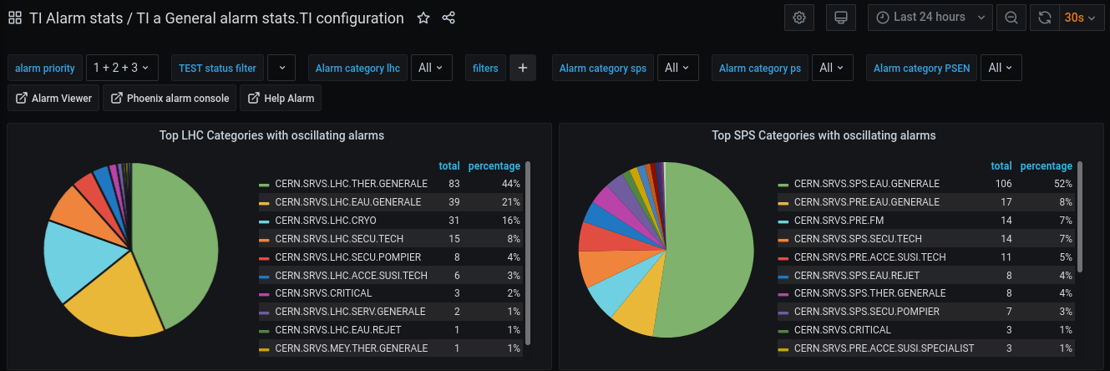
TIM: Datatag & Alarm Configuration (MoDESTI)
Web application to add/remove/modify data tags and alarms in TIM
Plugin-based, provides customizable workflows (BPMN 2.0, Activiti) for multiple domains (CSAM, TIM, WINCCOA, PSEN, SPECTRUM, RULES)
Datatag & Alarm information as Metadata
Visualization & Filtering in Grafana using Metadata
TIM – Service Overview
8

Slide 9
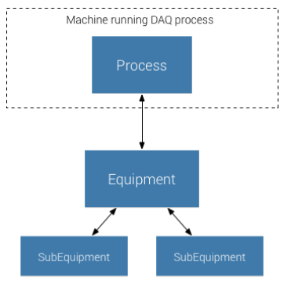
TIM DAQs: Process, Equipment, Sub-equipment
A Process represents a single Data Acquisition Process (DAQ)
An Equipment is a piece of physical sensory hardware, or any other kind
of data source (middleware service or DB).
A Process can have one or more Equipments.
A Sub-Equipment is a logical separated data source withing an Equipment.
An equipment can optionally contain one or more Sub-Equipments.
1..n
0..n
Source: https://c2mon.web.cern.ch
TIM – Service Overview

Slide 10
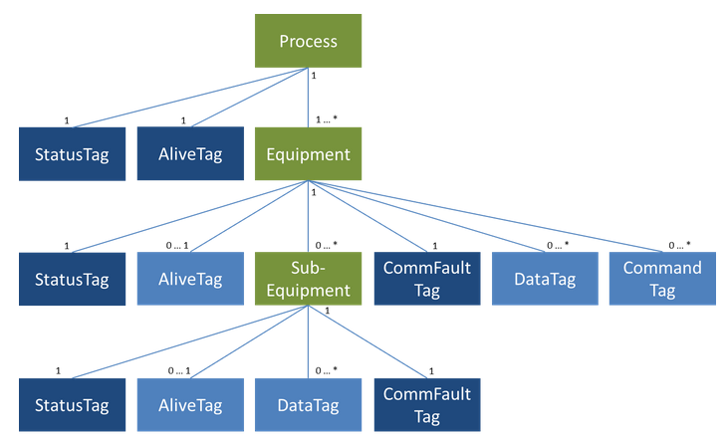
TIM DAQs: Process, Equipment, Sub-equipment
A Process represents a single Data Acquisition Process (DAQ)
An Equipment is a piece of physical sensory hardware, or any other kind
of data source (middleware service or DB).
A Process can have one or more Equipments.
A Sub-Equipment is a logical separated data source withing an Equipment.
An equipment can optionally contain one or more Sub-Equipments.
1..n
Process / equipment monitoring
StatusTags, AliveTags, CommFaultTags: Monitoring the connection between:
    DAQ and Server
    DAQ and data source
Command tags: Start, stop, restart DAQ process remotely
DataTags:
    Belong to Equipments/Sub-equipments
    Some datatags (Boolean) can also be alarms
0..n
Source: https://c2mon.web.cern.ch
TIM – Service Overview

Slide 11

TIM: JMS Brokers
JMS Brokers
    DAQ JMS: One JMS queue per DAQ instance
    Client JMS: One JMS topic per DAQ instance
Clients
Client JMS
(Topics)
Servers
DAQ JMS
(Queues)
DAQs
TIM – Service Overview

Slide 12
TIM: JMS Brokers
JMS Brokers
    DAQ JMS: One JMS queue per DAQ instance
    Client JMS: One JMS topic per DAQ instance
Special case: WinCC OA
    Redundant alarm-legacy-acceptor transforms old SonicMQ
    format to ActiveMQ compatible JMS message.
    Data is sent to alarm legacy topics. One topic per project.
    Alarmsource DAQ is subscribed to alarm legacy topics.
    Performs filtering and alerting if unknown alarms
    are received.
    Data is sent as Datatag message via JMS queue to C2MON
Clients
Client JMS
(Topics)
Servers
1
WinCC OA
1
alarm-legacy-acceptor
2
DAQ JMS
(Queues)
3
4
alarmsource DAQ
DAQs
TIM – Service Overview

Slide 13
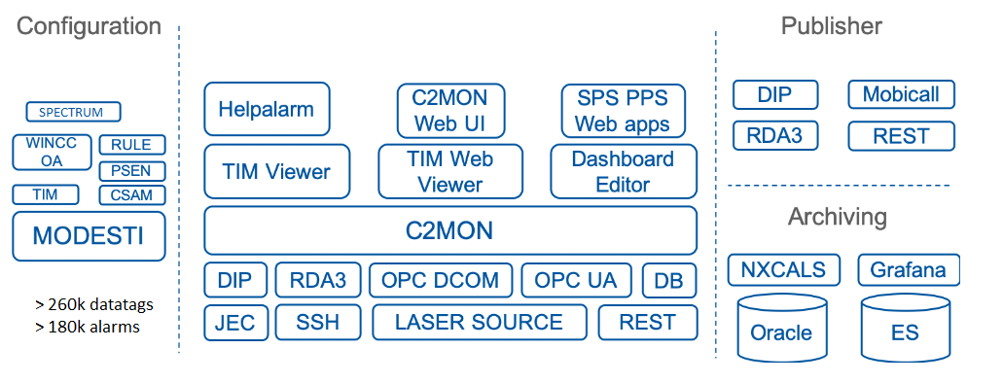
TIM: Ecosystem
TIM – Service Overview
12

Slide 14

TIM: Questions
TIM – Service Overview
<número>

