Slide 2
CTTB Industrial Controls Forum - #4
Alarm Management at EN/EL
7th April 2022
Anargyros KIOUKOS
Tiago SILVA
EN-EL-CBS

Slide 3
Agenda
CERN’s Electrical Network
PSEN – Supervision of the Electrical Network
Alarm configuration workflow
Lifecycle of an alarm
Alarm management tools
  PSEN Alarm Screen
  Help Alarm instructions
  Alarm masking
  Alarm inhibition
  Test/Production alarms
Conclusion

Slide 4
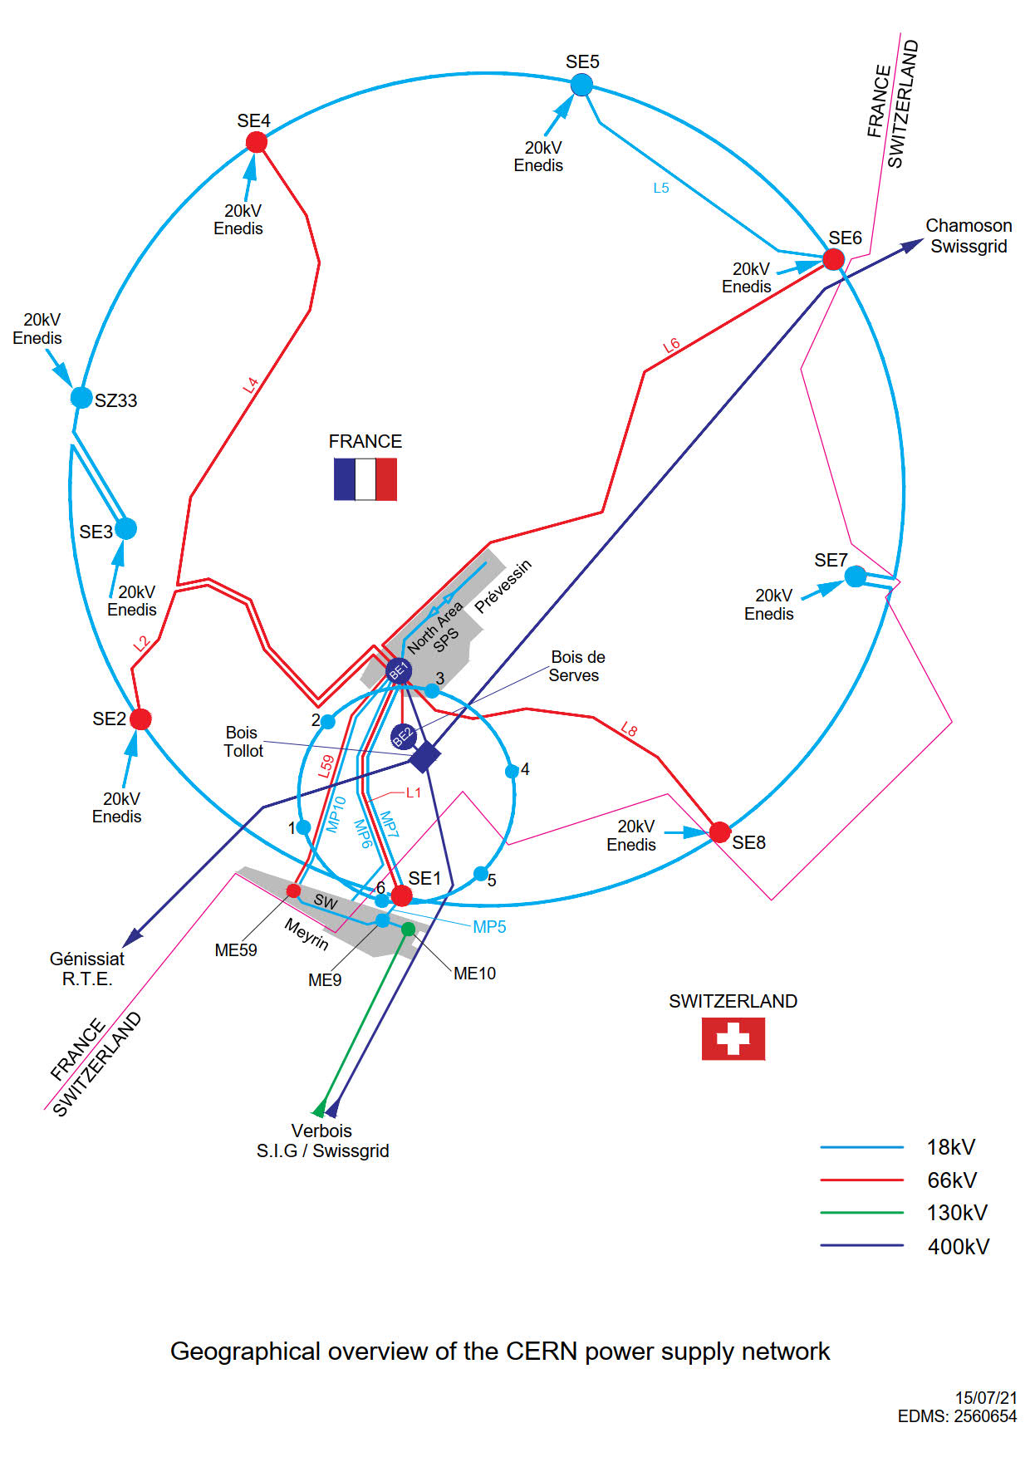
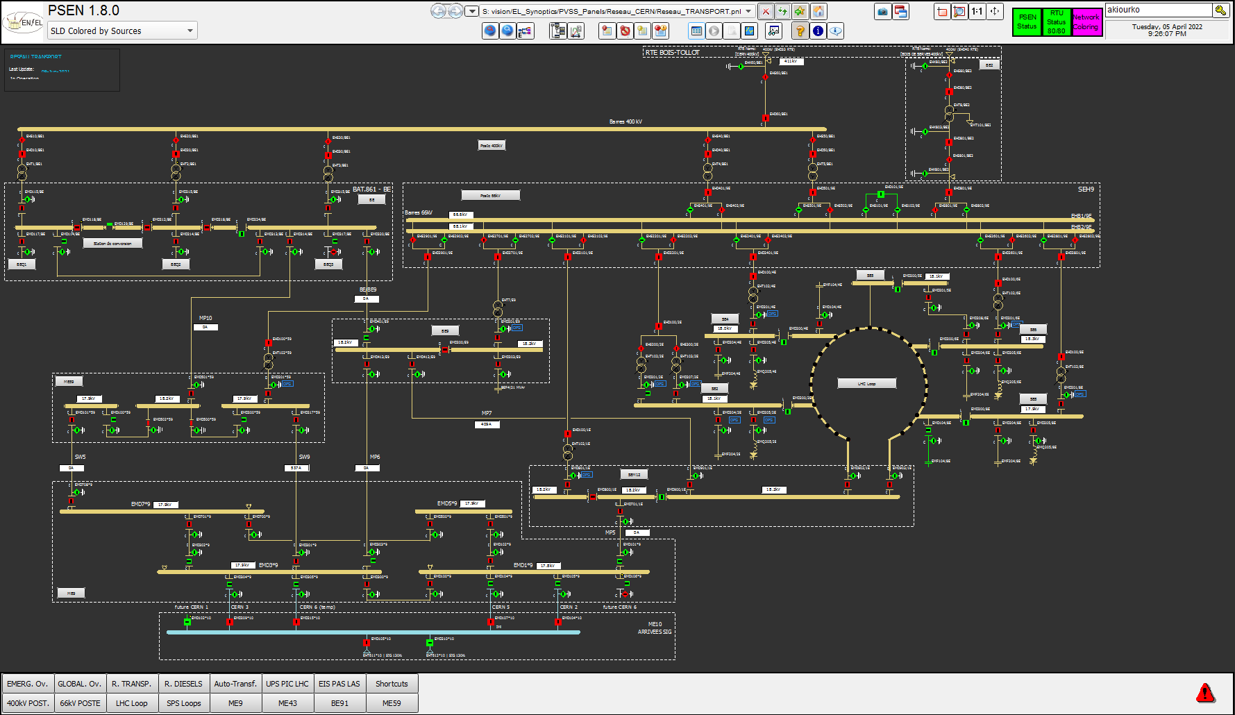
CERN’s Electrical Network

Slide 5
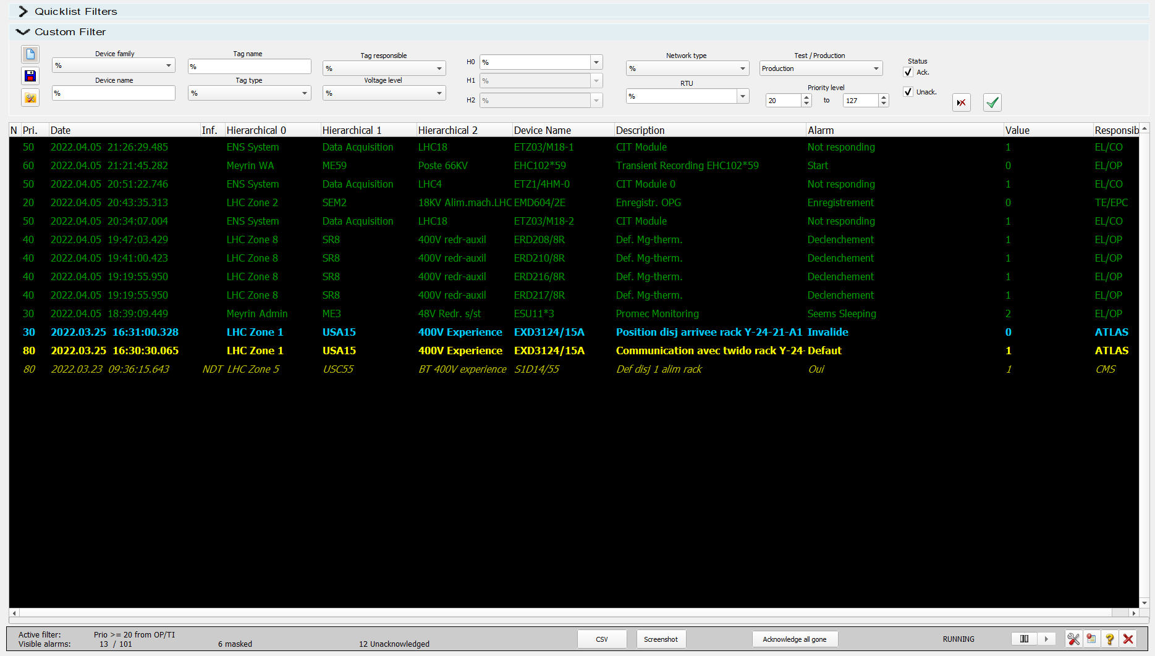
PSEN
WinCC OA based SCADA developed by BE/ICS
Monitoring CERN’s Electrical Network
320,000 data points
24,500 devices
125,000 alarm states

Slide 6
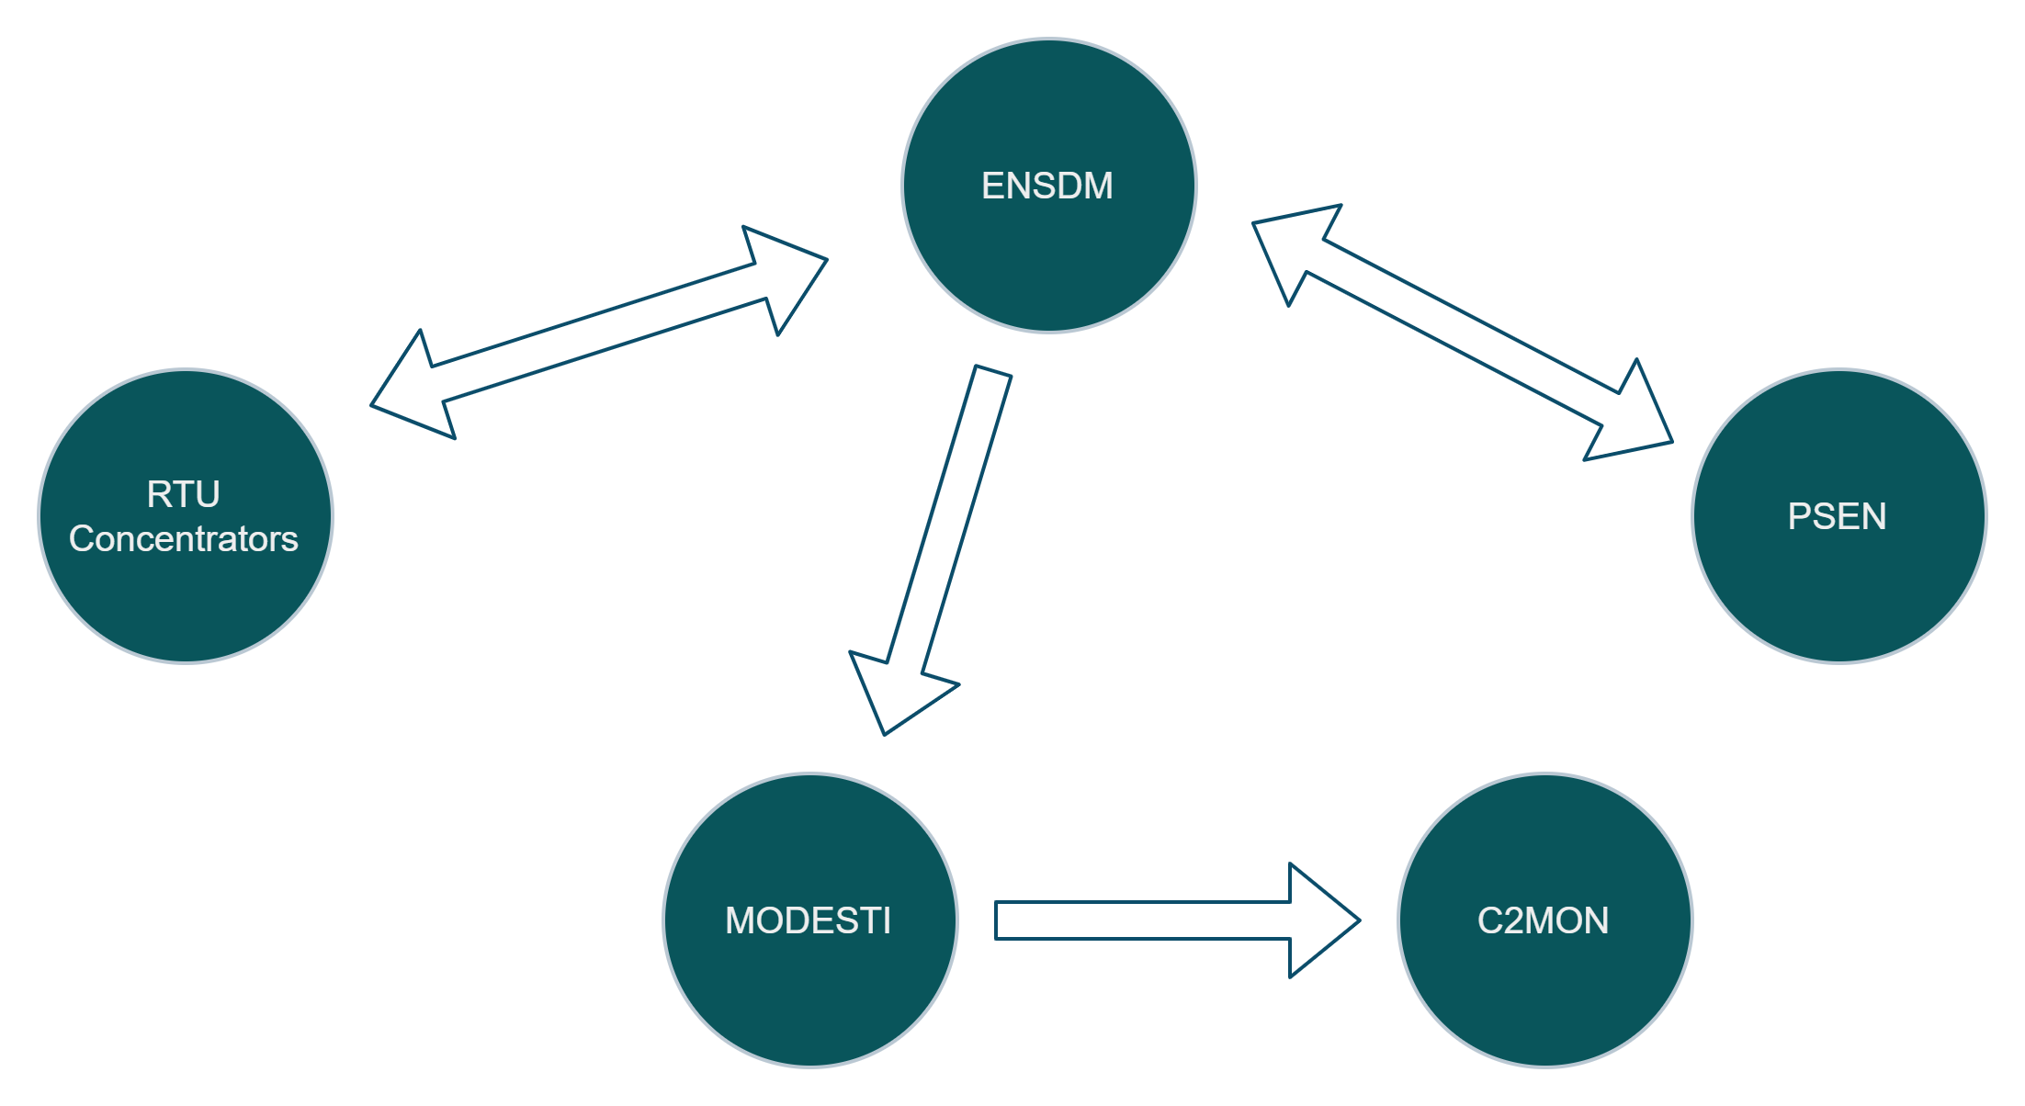
Alarm Configuration workflow
Alarm configuration stored in configuration system (ENSDM)
Sent to PSEN (weekly)
Sent to RTUs (anytime)
Sent to MODESTI (weekly)
Can be created from templates or manually
Can be imported from data concentrators
Can be back fed from PSEN

Slide 7
Life cycle of an alarm
An alarm arrives to CCC
OP-TI operator takes action on the alarm based on
  Priority: when to call
    Level 0 Prio. 1 to 19 Information only (not seen by OP-TI)
    Level 1 Prio. 20 to 59 Call during normal working hours
    Level 2 Prio. 60 to 119 Immediate call
    Level 3 Prio. 120 to 125 For OP-TI usage during alarm avalanches and Major Events
  Responsible: who to call
    EL/CO EL/OP EL/MT
    OP/TI BE/RF EN/CV TE/EPC
    ATLAS CMS ALICE LHCb
    ATLAS+EL/CO CMS+EL/CO
Alarm is acknowledged
Intervention (onsite or remote) on the faulty equipment
Alarm gone

Slide 8
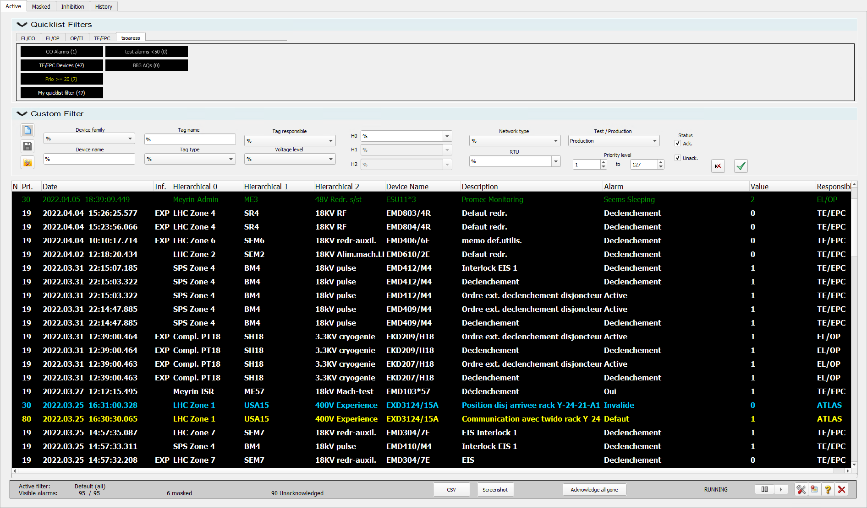
PSEN Alarm Screen
Alarm list displayed 24/7 in CCC used by OP-TI to manage electrical network related alarms, and by EN/EL to manage the electrical network and maintain its equipment.

Slide 9
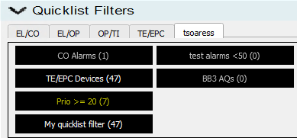
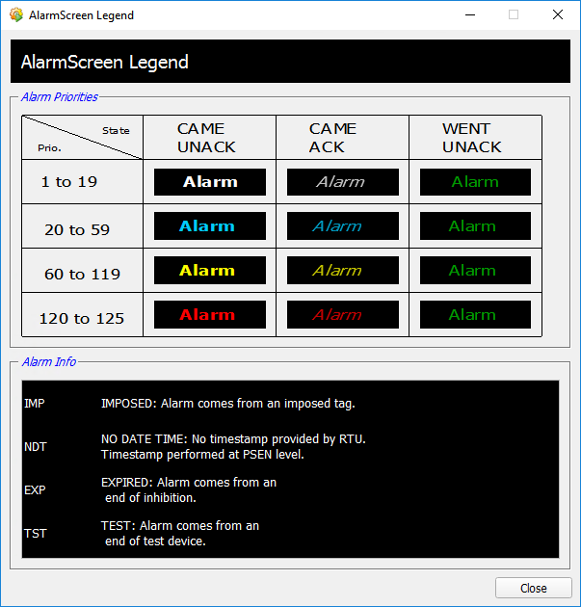

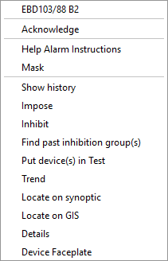
PSEN Alarm Screen – Main features
Main features:
Quick filters
Custom Filters
Pause/run modes
CSV and snapshot extractions
Actions on alarms
Legend
Alarm info
IMP – Imposed
NDT - No Date Time
EXP – Expired
TST - Test
Notes:
Filters are manageable, so new quick filters can be created from custom filters.
From the actions on alarms, I highlight 3, which will bring us to the main functionality used for EL alarm management

Slide 10
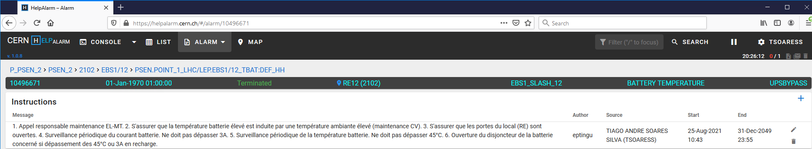
Help Alarm Instructions
The Help Alarm application allows to store alarm instructions on a specific alarm or equipment. Instructions typically help operators or equipment responsibles to treat the alarm.
An ‘X’ mark in the alarm indicates that there it has an instruction associated.
Action “Help Alarm Instructions” takes the user to the help alarm application
  To view existing instructions
  To create/edit/delete instructions

Slide 11
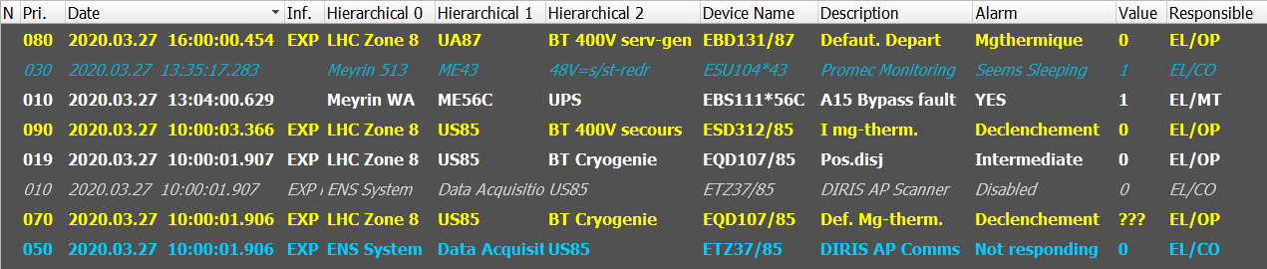
Alarm Masking
Of exclusive usage by TI Operators in CCC, to hide alarms that are uninteresting to see or deserve no action, in order to clear or reduce the number of alarms present in the active alarm screen.
The Masked Alarm screen:
  Dedicated alarm screen listing only the alarms which have been masked by users.
  Pale background to allow distinction from active alarm screen.
The Mask action:
  Hides an alarm from the active alarm screen and moves it to the dedicated masked alarm screen.
  Same alarm states and actions are possible in a masked alarm.
  Unmask is possible, to bring back the alarm to the active alarm screen.
  (Un)Masking actions are system wide and not per user.

Slide 12
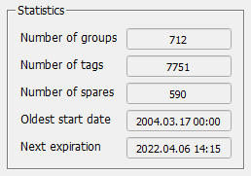
Alarm Inhibition
An alarm management tool to avoid undesired alarms coming active in the alarm screen. Typical use cases: equipment out of service, spares, punctual issues, …
Deactivation of the alarm condition of a datapoint for well defined period of time
  Group of tags to inhibit
  Inhibition details: title, description, creator and responsible
  Reminder policy
  Start date and end date
Fully integrated with all other PSEN modules.
Notes:
In a highly dynamic system such as the electrical network at CERN, the alarm inhibition become a vital toll for most users.
In a dynamic system such as CERN’s electrical network, there are constantly works, equipment being put in and out of service, equipped spares, known issues with equipment, and more. All these situations often trigger alarms, for which the corrective actions are non-existent or will take place over a long period of time. During this time these alarms are known and undesired, and would be polluting the active alarm screen, making the alarm management a lot more difficult in the control room.
The alarm inhibition comes as a solution for these cases
Full integration in PSEN modules (inhibitions visible in tag lists, device faceplates, symbols, events, etc, as well as actions available from any of these places.

Slide 13
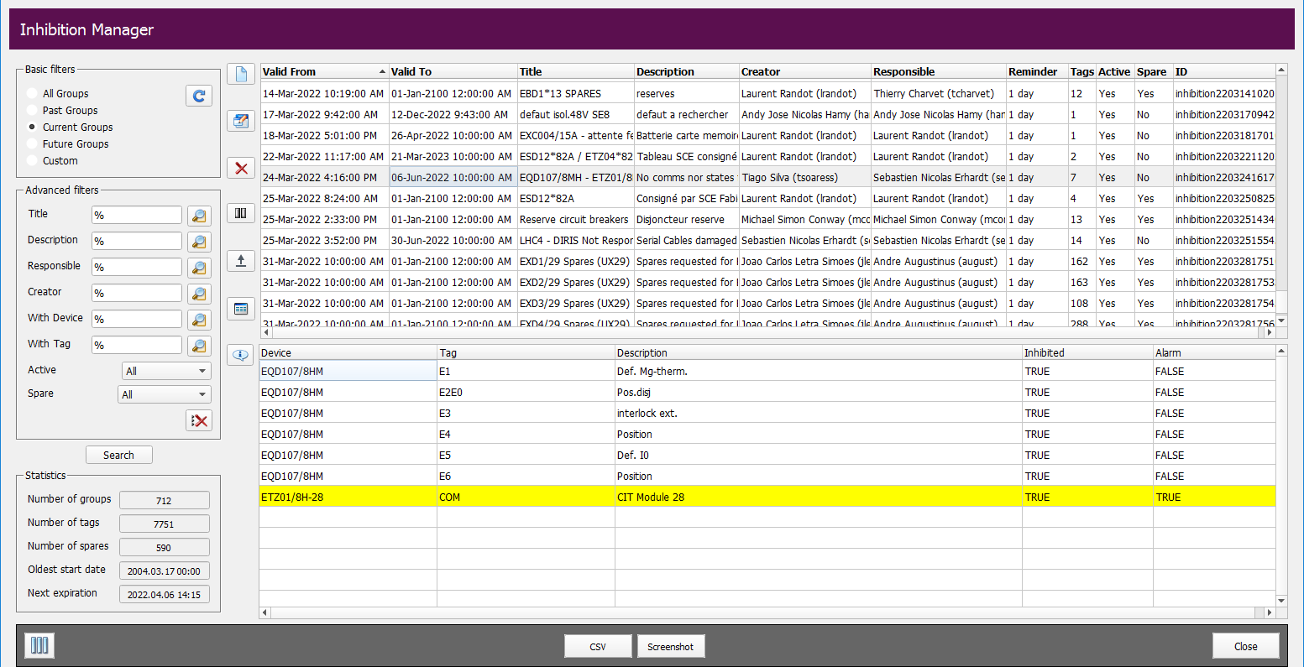
Alarm Inhibition
Notes:
In a highly dynamic system such as the electrical network at CERN, the alarm inhibition become a vital toll for most users.
In a dynamic system such as CERN’s electrical network, there are constantly works, equipment being put in and out of service, equipped spares, known issues with equipment, and more. All these situations often trigger alarms, for which the corrective actions are non-existent or will take place over a long period of time. During this time these alarms are known and undesired, and would be polluting the active alarm screen, making the alarm management a lot more difficult in the control room.
The alarm inhibition comes as a solution for these cases
Full integration in PSEN modules (inhibitions visible in tag lists, device faceplates, symbols, etc, as well as actions available from any of these places.

Slide 14

Test/Production Alarms
Alarm management tool to categorize equipment as “test” and “production” from the alarm point of view. Allows site teams to work with visible alarms without interfering CCC operators. Typical use cases: equipment maintenance, commissioning and test operations.
CCC operators work with “production” alarm screen only
TPA used at the equipment level
  Devices to move to “test mode”
  Reason: “Test/Maintenance” or “Commissioning”
  Comments, responsible, end date, reminder policy
Alarm condition remains active in “test mode”
Contributes to the device integration workflow
  Newly devices are automatically integrated in test mode
  Devices are moved to production once commissioning is done
Fully integrated with all other PSEN modules.
Notes:
In a dynamic system such as CERN’s electrical network, there are constantly works, new equipment being put in service, tested, commissioned, maintenance ongoing in existing equipment, and more. All these situations often trigger known alarms, which must be seen by the maintenance and commissioning teams for the purpose of their activities, but which pollute the active alarm screens of the TI operations in the CCC, who care only for real alarms with specific corrective actions.
The TPA module offers the necessary functionality to manage these situations.
Full integration in PSEN modules (test/production mode is visible in tag lists, device faceplates, events, etc, as well as actions available from any of these places.

Slide 15
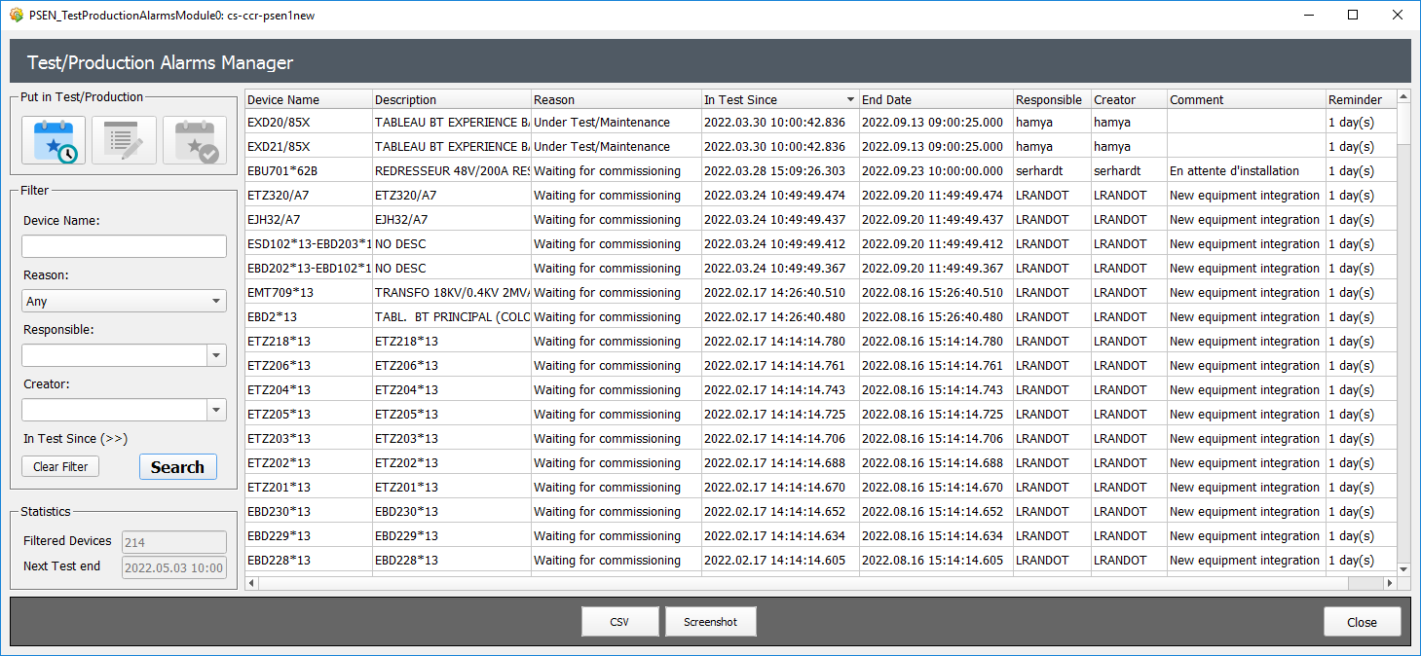
Test/Production Alarms
Notes:
In a dynamic system such as CERN’s electrical network, there are constantly works, new equipment being put in service, tested, commissioned, maintenance ongoing in existing equipment, and more. All these situations often trigger known alarms, which must be seen by the maintenance and commissioning teams for the purpose of their activities, but which pollute the active alarm screens of the TI operations in the CCC, who care only for real alarms with specific corrective actions.
The TPA module offers the necessary functionality to manage these situations.
Full integration in PSEN modules (test/production mode is visible in tag lists, device faceplates, events, etc, as well as actions available from any of these places.

Slide 16
Conclusion
Tools provided allow EL and CCC operators to have a efficient alarm management in such a dynamic electrical network.
Joint work between EN/EL and BE/ICS on developing the tools to match users needs.
Training and user support to enable the usage of the tools to the full potential.
Overall satisfaction with the alarm management tools, for their functionality and reliability.

