Slide 1
VACUUM ALARM SYSTEMS
André Rocha
TE-VSC-ICM

Slide 2
Content
Overview Alarm Systems used in the Vacuum Control System
LASER alarms
  Configuration architecture
  Configuration DB data model
  Configuration using vacuum framework database engineering tool
Vacuum Alarm Panel
  Basic Functionality
  Architecture
Vacuum User Notifications
  Basic Functionality
  Architecture
Conclusions
2

Slide 3
ALARM SYSTEMS IN VACUUM
DEFAULT ALARMS
USER ALARMS
Defined by Machine Responsibles
Defined by Users
LASER ALARMS
VACUUM ALARM PANEL
USER NOTIFICATIONS
Graphical Representation
UI Separated from vacuum SCADA
Offline configuration
For accelerator operations (CCC)
Graphical Representation
Directly accesible from vacuum SCADA
Can be changed at runtime
For vacuum operations
No Graphical Representation
Rely on email servers
Can be changed at runtime
For vacuum operations
3

Slide 4

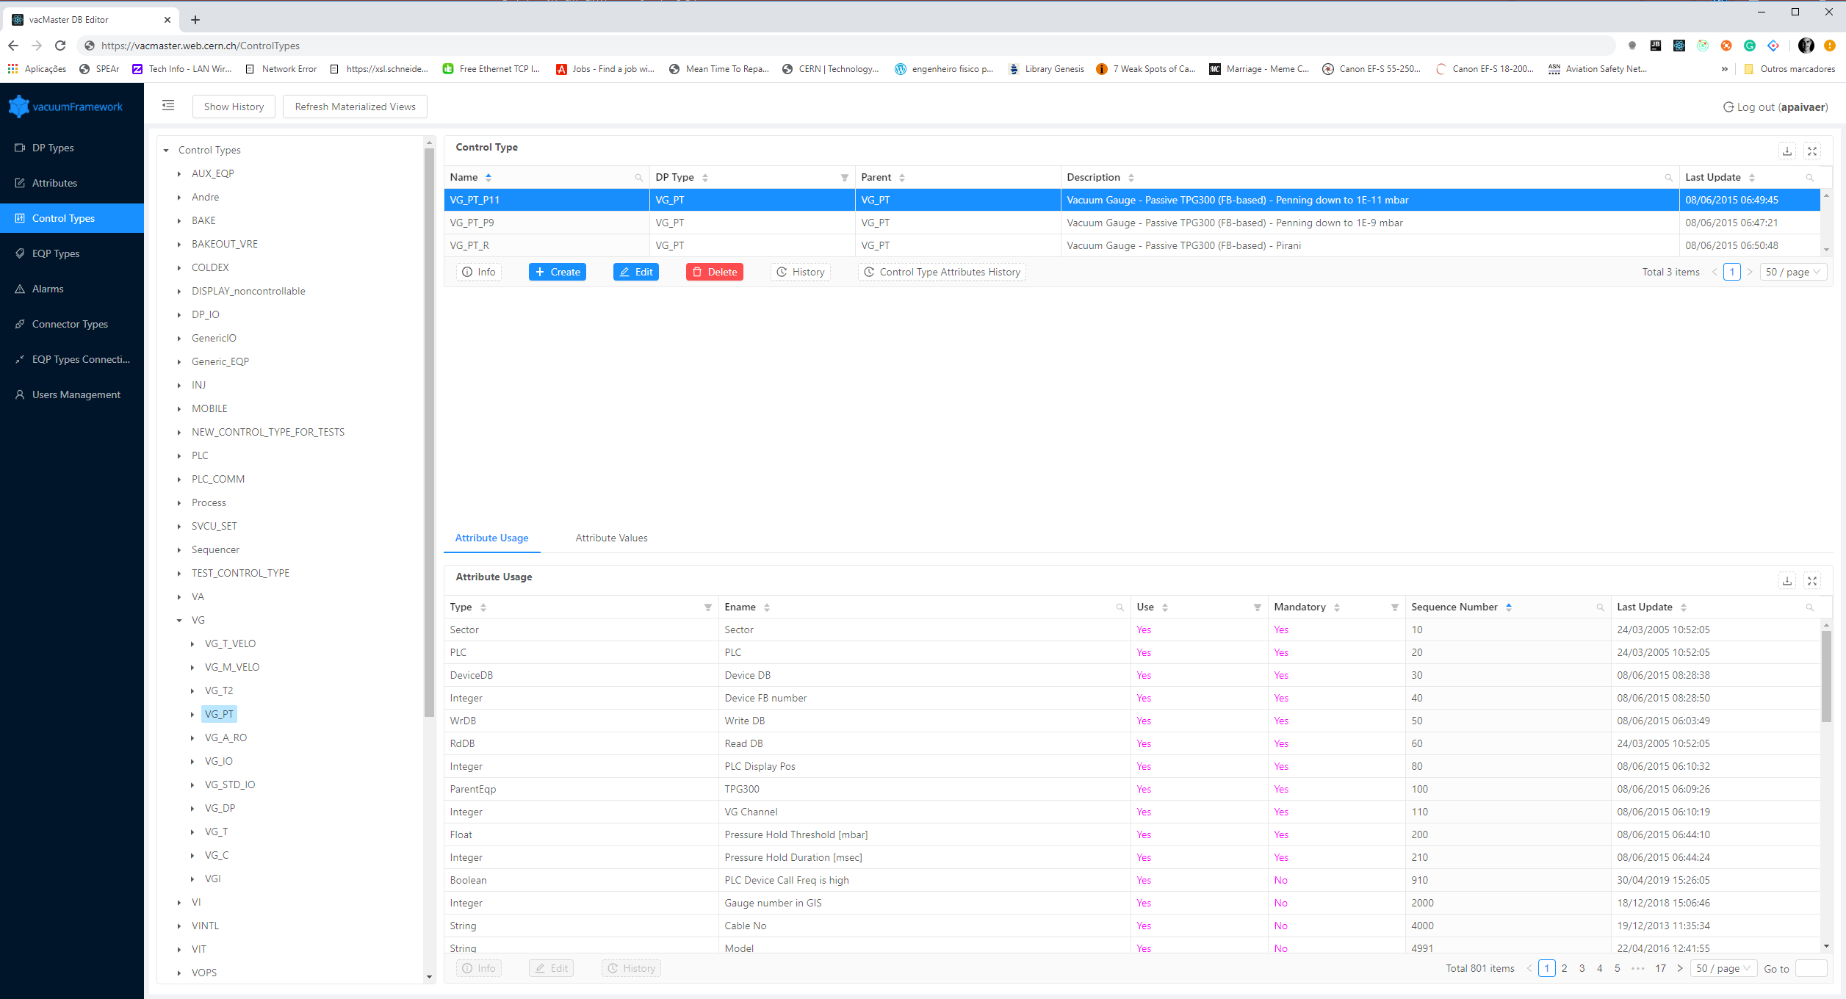

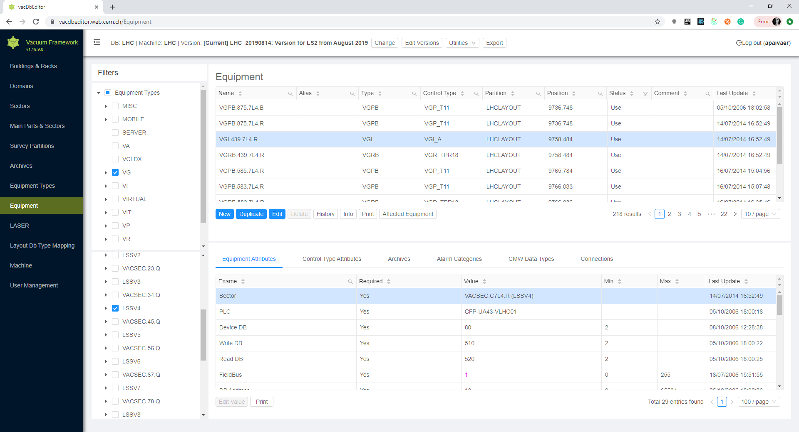

VACUUM AND LASER ARCHITECTURE
vacCC Master
vacFW DB engineering tools
Master
vacCC Exporter
SCADA
DP CONFIG
Import
S7
LASER CONFIG
Datapoints
vacCC Machine
LHC
SPS
CPS
LASER Manager
LASER configuration
Alarm attributes
LASER
4

Slide 5
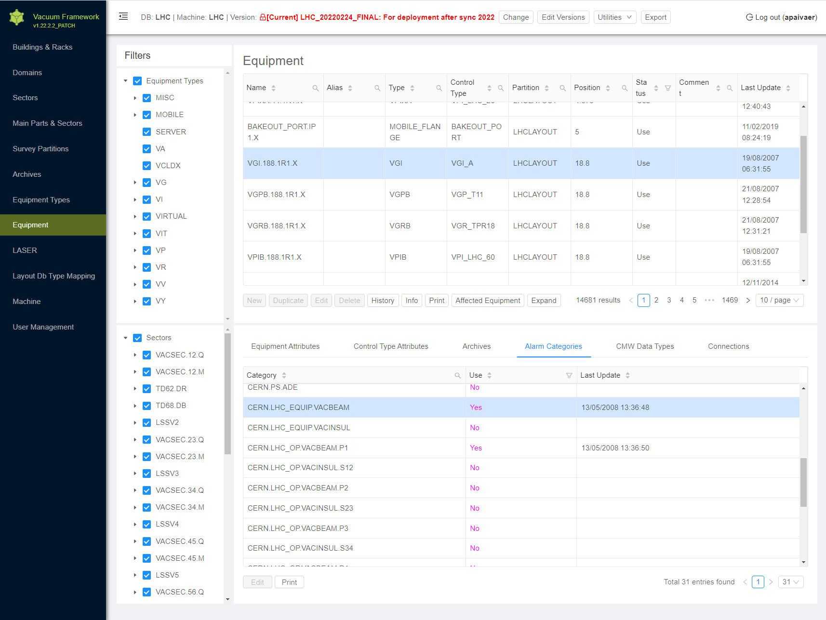
LASER CONFIGURATION IN VACUUM
Configuration is fully automated
When a device is added to the control system using the Vacuum Controls Configurator, LASER configuration is automatically generated without any user input.
The user may only choose to override where the alarm is published (alarm category)
5

Slide 6
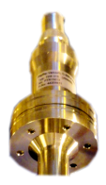
LASER CONFIGURATION DB MODEL
Datapoint Elements
Alarms
Alarm Attributes
Fault Family: VAC_PRESSURE_{machine}
Fault Member: {mainPart}_{sector}_{eqp}
Fault Code: 1
Description: Device is OFF
AL1
Device OFF
Vacuum Device
Control Type
Datapoint type
Fault Family: VAC_PRESSURE_{machine}
Fault Member: {mainPart}_{sector}_{eqp}
Fault Code: 2
Description: Device is in error
VG_P9
VG_P9
AL2
Device Error
Fault Family: VAC_PRESSURE_{machine}
Fault Member: {mainPart}_{sector}_{eqp}
Fault Code: 3
Description: Pressure Too High
AL3
High Pressure

Slide 7
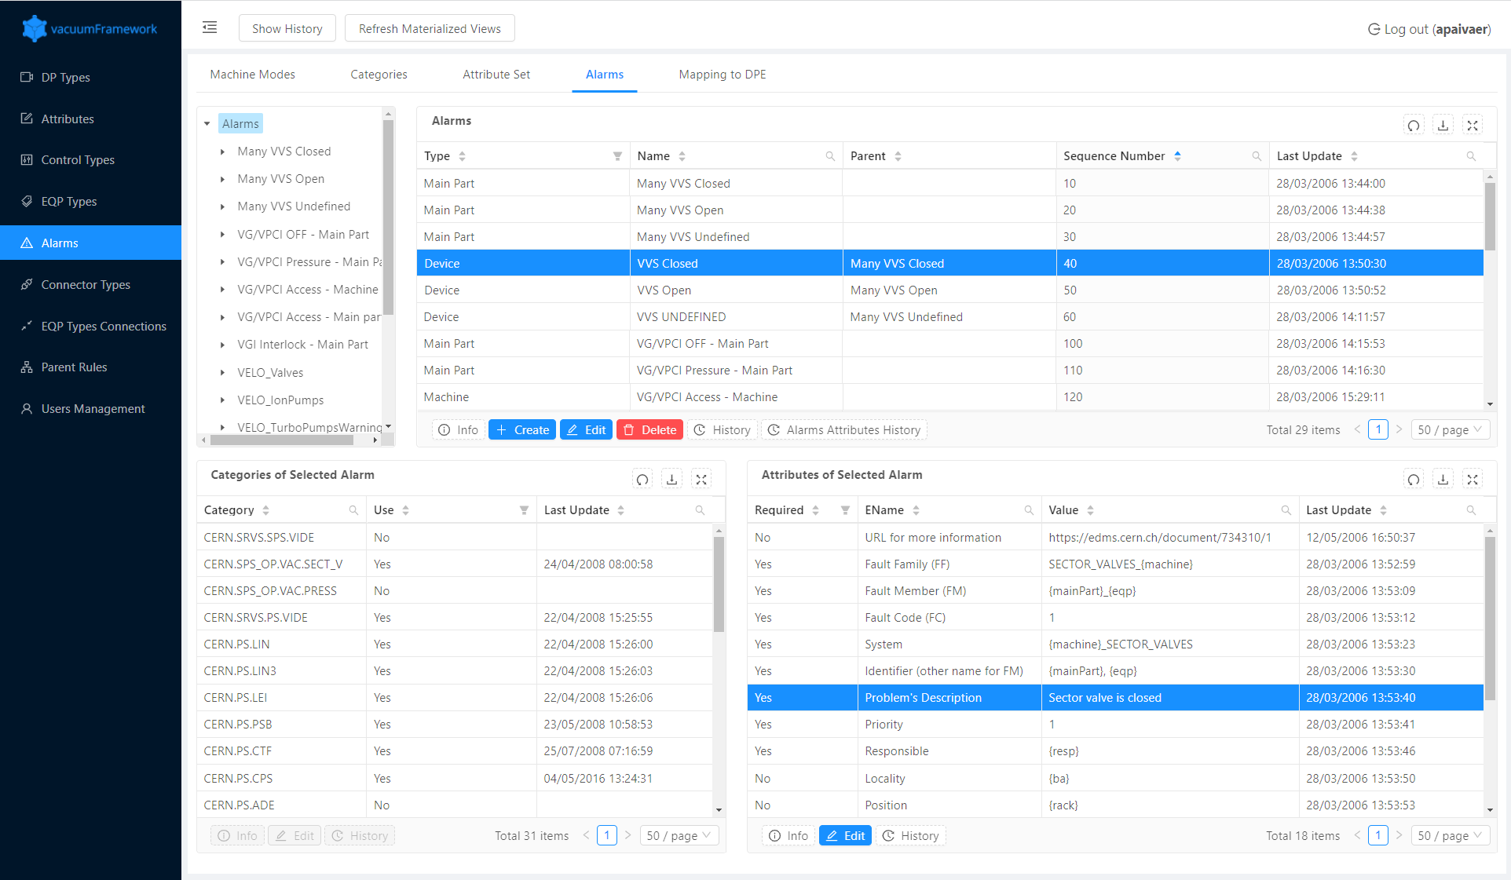
LASER ALARM DECLARATION
Default configurations in Vacuum Controls Configurator Master
Declaration of alarms
Declaration of alarm attributes
  Some attributes depend on context
  FM: {mainPart},{eqp} will be replaced during export of configuration as LSS2, VVGST.3.6R2.R
7

Slide 8
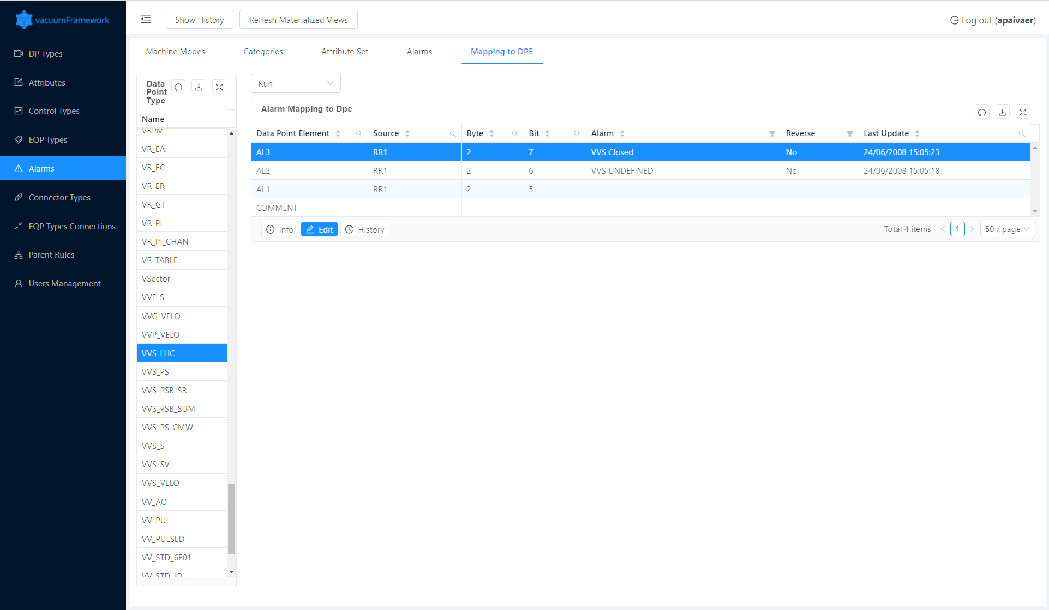
LASER ALARM DECLARATION
Association of alarms to Datapoint Elements
Boolean datapoint elements can be associated with alarm instances
Device developers specify which datapoint element and bit contains the alarm
8

Slide 9
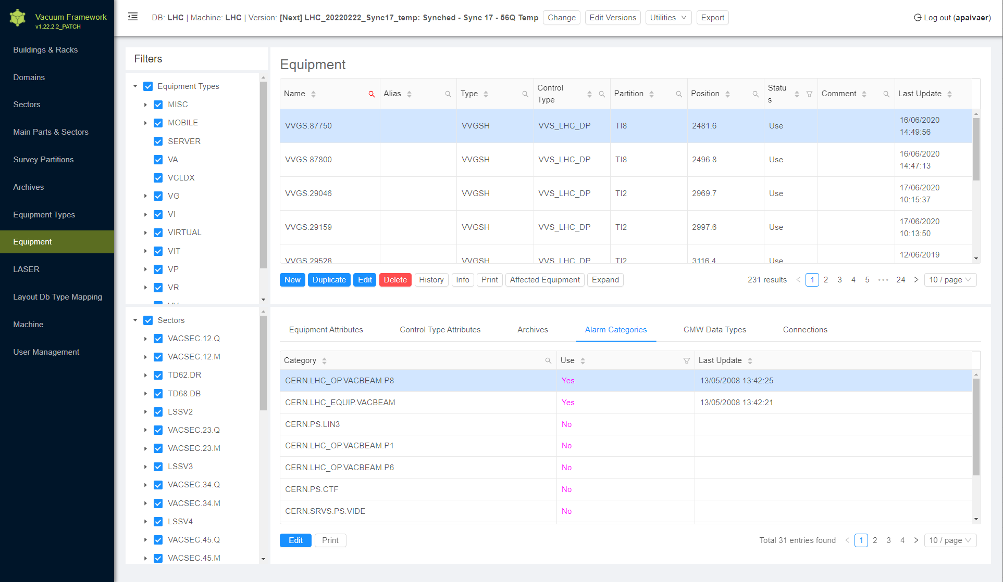
LASER ALARM DECLARATION
9

Slide 10
VACUUM ALARM PANEL
Developed for the VELO SCADA application
  User request to have alarm panel inside the application due to the complexity of the process
  Generic, pure WinCC-OA alarm panel – no dependency on any database / framework
Basic functionality
  Supports Digital Boolean Calculated
    Alarm tracks single bit from source word
  4 alarm status: active, not active, acknowledged, went
  Alarm Priority
    Different color displayed in alarm panel
    Sorting
Intended to be a temporary solution
Not Active
Alarm bit = 1
Alarm bit = 0
Active
User ack
User ack
Alarm bit = 0
Alarm bit = 1
Acknowledged
Went
10

Slide 11
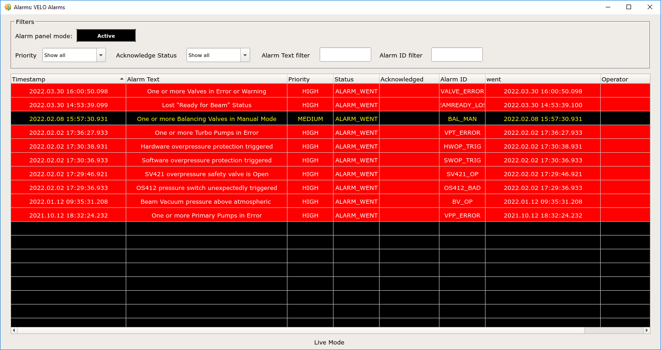
11

Slide 12
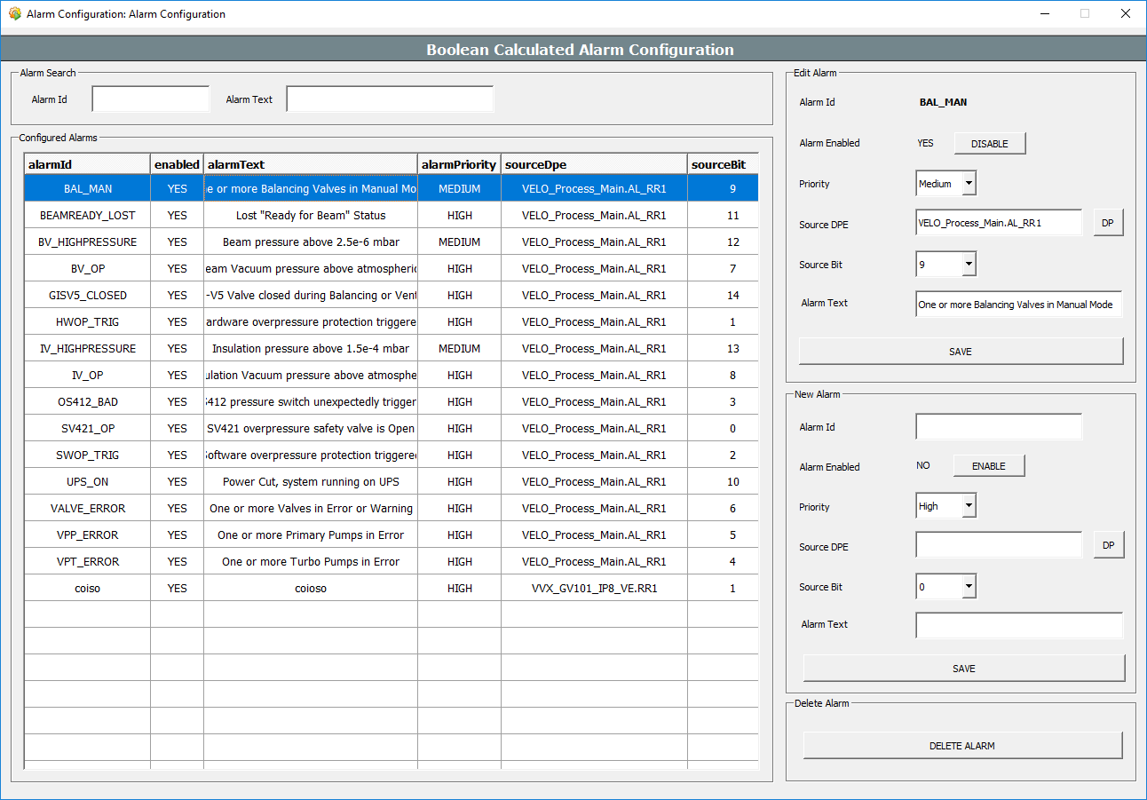
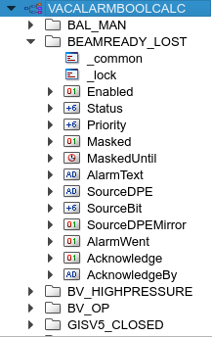
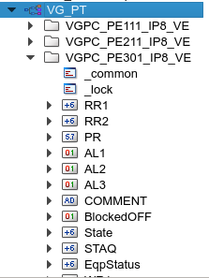
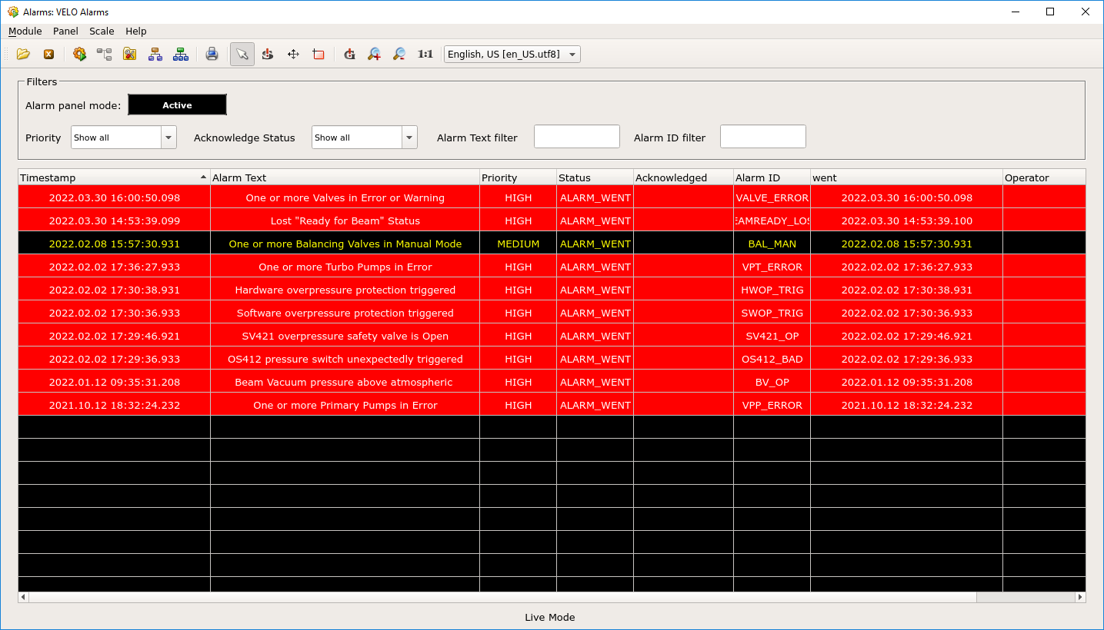
VACUUM ALARM PANEL ARCHITECTURE
Alarm Configuration Panel
WinCC-OA Alarm Datapoints
WinCC-OA Process Datapoints
Create/edit/delete
Subscribe to configuration / ack
Alarm Panel
Write alarm status
Subscribe
Subscribe to changes in source DPEs
ack
Boolean Calculated Alarm Engine
(Control Manager)
Calculates alarm statuses from raw datapoints
12

Slide 13
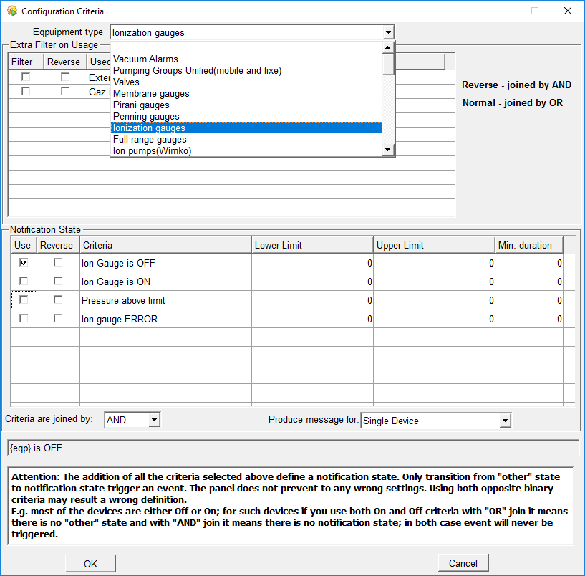
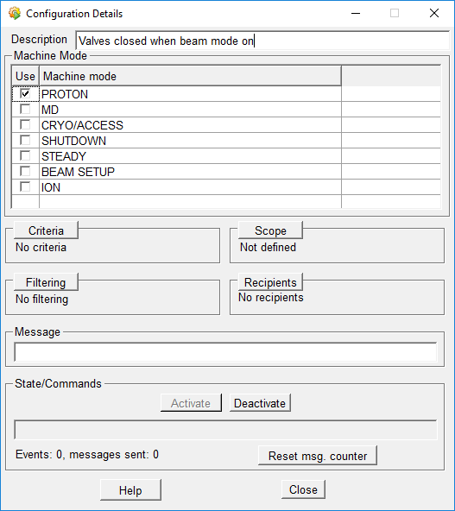
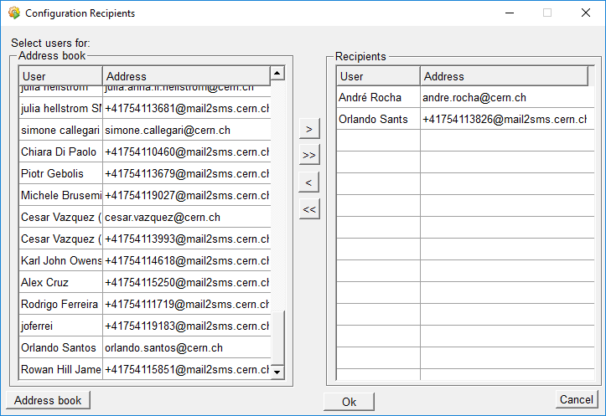
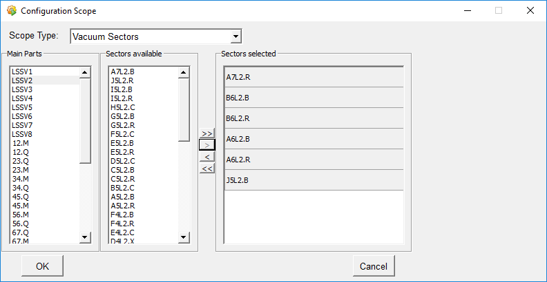
VACUUM USER NOTIFICATIONS
Allows users to have individualized notification configurations
Advanced alarm scoping:
  Machine mode (RUN, STEADY, PROTON RUN, MD, etc..)
  Device type (Gauge, Valve, Controller, etc)
  Alarm Criteria (depends on device type)
  Location scope (Global, Main Part, Sector)
Filtering on:
  Minimum duration
  Hystheresis
  Number of messages (Grouping)
Email based
13

Slide 14
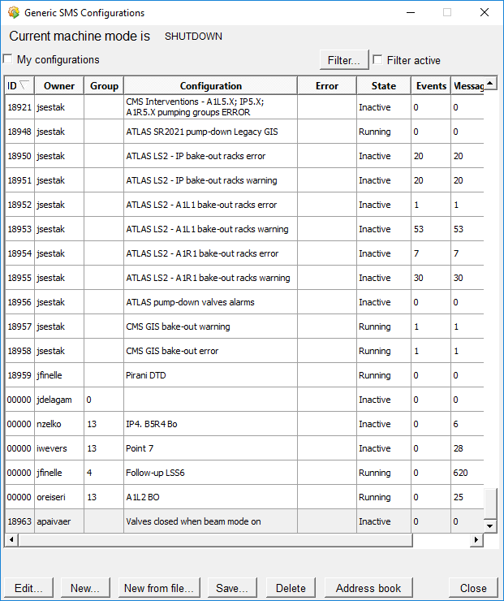
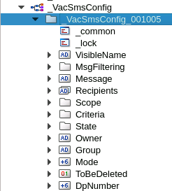

USER NOTIFICATIONS ARCHITECTURE
C++ Library
Functional Types
Functional Type Alarm Criteria
isOf type
Eqp
checkCriteria()
Notification Config
Criteria(Eqp, sector, criteria)
List of equipment
criteriaMatch
Message Pool
Filtering
Grouping
WinCC-OA Configuration
dpeChange
createConfig
getMessageQueue
WinCC-OA Process Datapoints
Usernotifications.ctl
(Control Manager)
Create/edit/delete
Subscribe
Subscribe
Send email
User Notification Configuration
14

Slide 15
Conclusion
3 Different alarm systems coexist in the vacuum control system to meet the needs of different users:
  LASER:
    CCC Operators
    Offline automated configuration via vacFW DB engineering tool
    System alarms defined by equipment type developers
  Vacuum Alarm Panel
    Vacuum Operators
    Online manual configuration
    System alarms defined by system administrator
    Future work: replace this with generic alarm panel solution of BE-ICS
  User notifications
    Offer high level of customization
    Vacuum operators
    Online manual configuration
    Alarms defined by users
15

