Slide 1
Alarms Management
EN-CV-CL
Doru Nitu (EN-CV), Diogo Monteiro (EN-CV)
CTTB Industrial Controls Forum - #4
07-04-2022

Slide 2
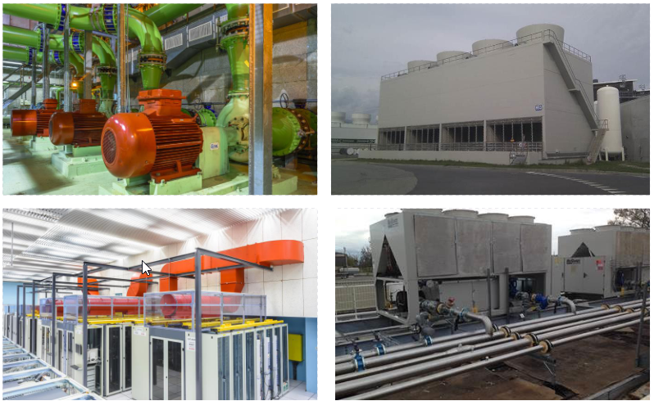
Cooling and Ventilation Group at CERN (EN-CV)
  Operation and maintenance of cooling, ventilation, air conditioning and fluid distribution systems for CERN’s accelerator complex and experimental areas.
  Type of installations (examples):
  Pumping stations
  Cooling towers
  Computer centre air conditioning
  Chilled water production
  The alarms of all the CV plants are monitored by the (CCC) CERN Central Control Room.
  The newest control systems in CV are built using UNICOS framework.
  Their corresponding Process Alarms are available on the SCADA server for the CV process experts;
  A summary of these Process Alarms are reported to the CCC (CERN Central Control Room) for intervention and call to CV experts if needed. This subset is called CCC alarms

Slide 3
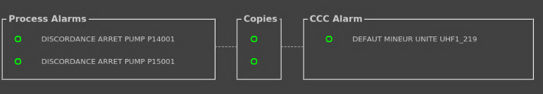
Process alarms – UNICOS systems - Purpose
  Monitoring and interlock of equipment and groups of equipment (units)
  The implementation of the logic of the alarm is done in the PLC based on a series of conditions, and its effect is then applied to the field object.
  The Process Alarms can be of the following types: AL (alarm, no interlock), FS (Full Stop Interlock), TS (Temporary Stop Intelock), SI (Start Interlock).
  The Process Alarms are also grouped in three subsets, MAJ, MIN, P_MAJ for each functional unit of the system – these 3 subsets are sent to the TIM (C2MON) via CV_LASER and visible in CCC
  Each process alarm has a copy that can be blocked, in order to allow maintenance operation on a subpart of the system without creating a CCC alarm and triggering unwanted actions
  Each of the process alarm has also a time delay that can be configured;
  The CV operator is able to block/mask the desired process alarms;
  The CV operator can access the diagnostic data for each alarm;
  The ulterior adding/removing of a process alarm will not influence the number of the CCC alarms being sent to TIM
Notes:
Here we have a MIN CCC alarm subset example

Slide 4

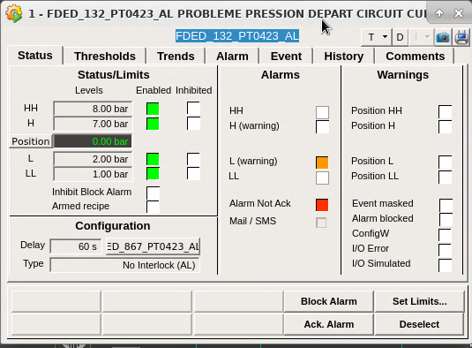

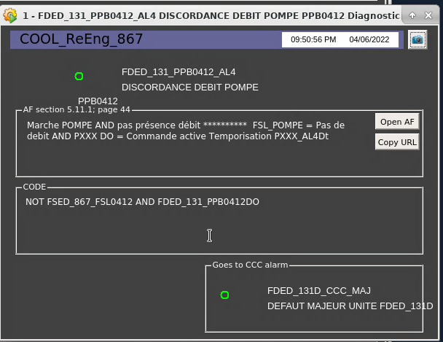
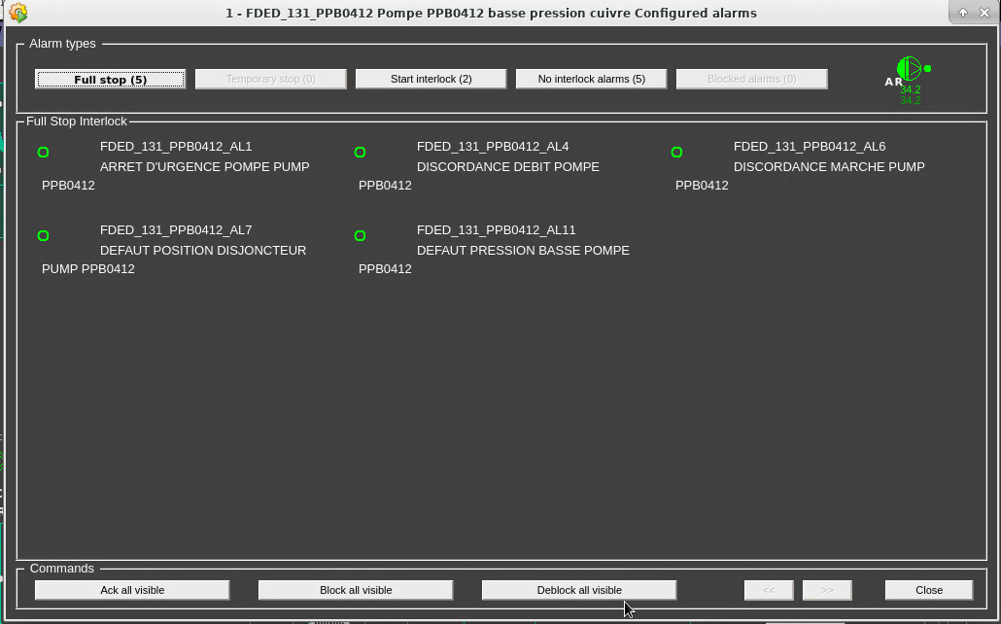
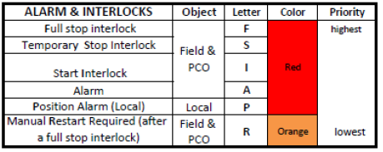
Process alarms – UNICOS systems - Display
  The graphic representation of the process alarms under WINCCOA comes in different forms:
Digital alarm object
Analog alarm object
Field object/ unit alarm list
Alarm faceplate
Alarm color codes

Slide 5

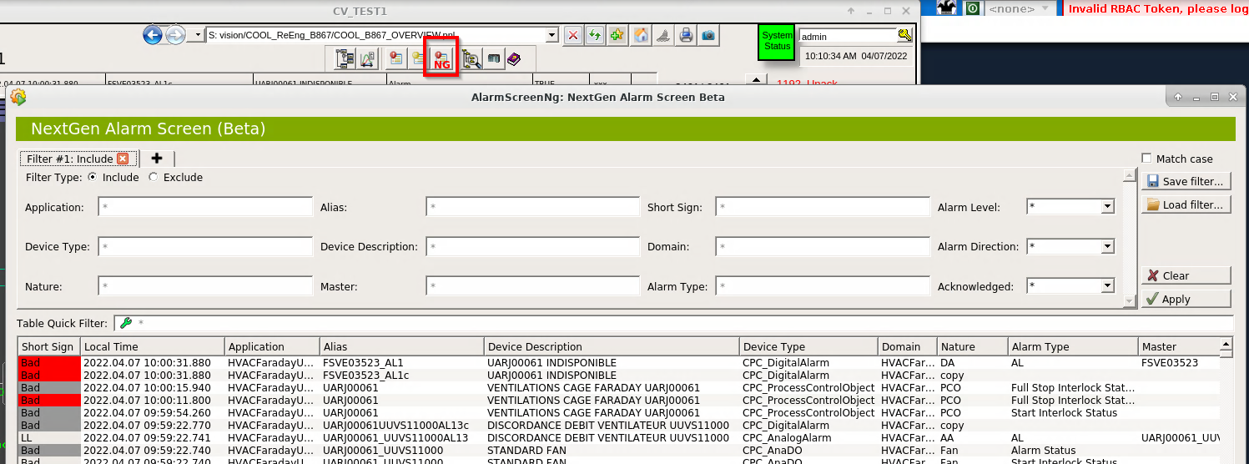
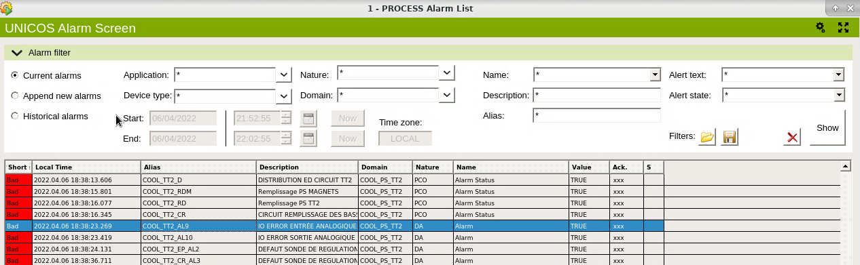
Process alarms – UNICOS systems – Alarm Screen
  Alarm List – list of all the alarm messages of a control system in WinCCOA
  New list entries are appended when an alarm appears, disappears or it is acknowledged
  It has extensive filter capabilities, and it is important to use filtering for increase efficiency of diagnose. The “NextGen” Alarm Screen has been developed and will replace the current one.

Slide 6
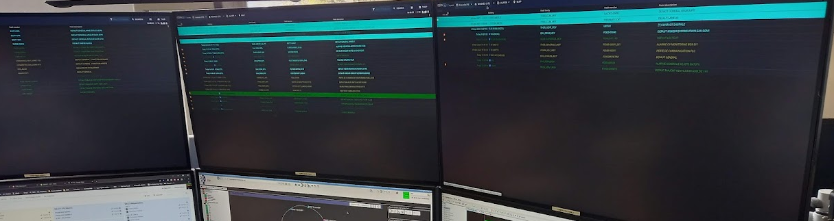
CCC Alarm management inside EN-CV
  Importance and objective
  Continuous monitoring of numerous CV systems (controlled by over 650 PLC’s)
  Triggering of corresponding actions when an alarm event is produced
  The tool TI (Technical Infrastructure) operators are using to monitor the CCC alarms from EN-CV is HelpAlarm

Slide 7
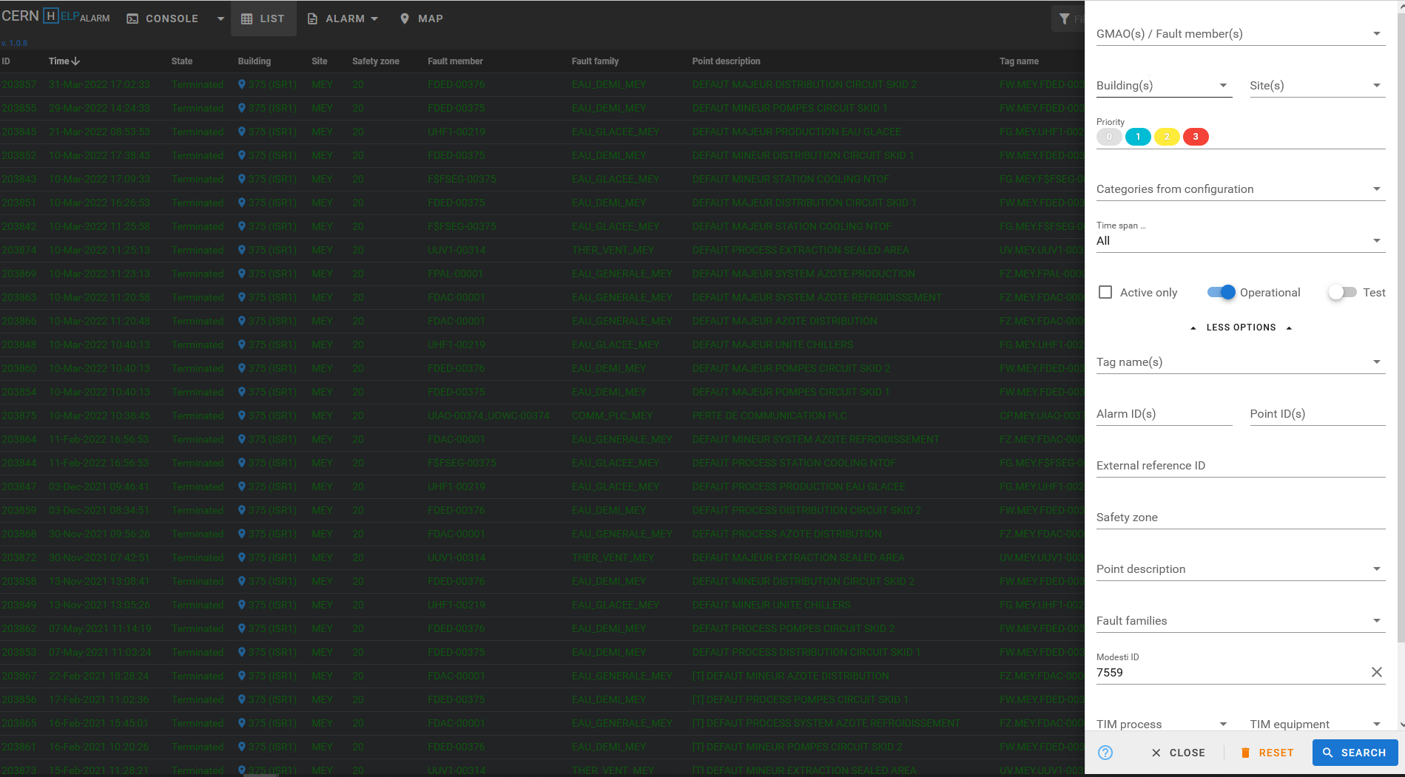
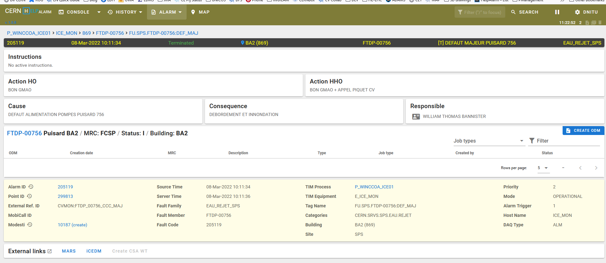
CCC Alarms EN/CV - User interface

Slide 8
CCC Alarms EN/CV - User interface
  HelpAlarm -> https://helpalarm.cern.ch
  The HelpAlarm UI can be used from anywhere to access the EN/CV alarms.
  Just connect to:
    https://helpalarm.cern.ch from CERN intranet (GPN / TN)
    http://cern.ch/timalarms outside of CERN
  It can display alarms using various filtering choices, either MODESTI request number, active alarms, test alarms, etc.
  There is as well an online help link that has more information about how to query an alarm using HelpAlarm.

Slide 9
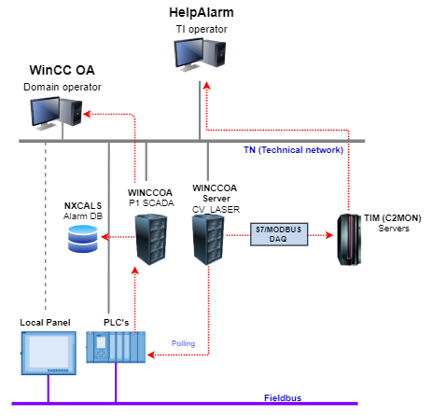

CCC Alarms EN/CV - Dataflow
  Current status – UNICOS systems:
    Over 350 PLCs are built with UNICOS Framework
    The alarms are transferred from the PLC to the WinCC OA machine CV_LASER which, via a DAQ TIM (data acquisition system compatible with WinCCOA) transfers the alarms to the TIM Servers
    The alarms are then accessible using HelpAlarm
    The two systems / machine guarantees:
      CCC Alarm transmission when P1_SCADA machine (for example) is updated or not available
      Process alarm availability when CV_LASER machine is updated or not available
  UNICOS systems

Slide 10
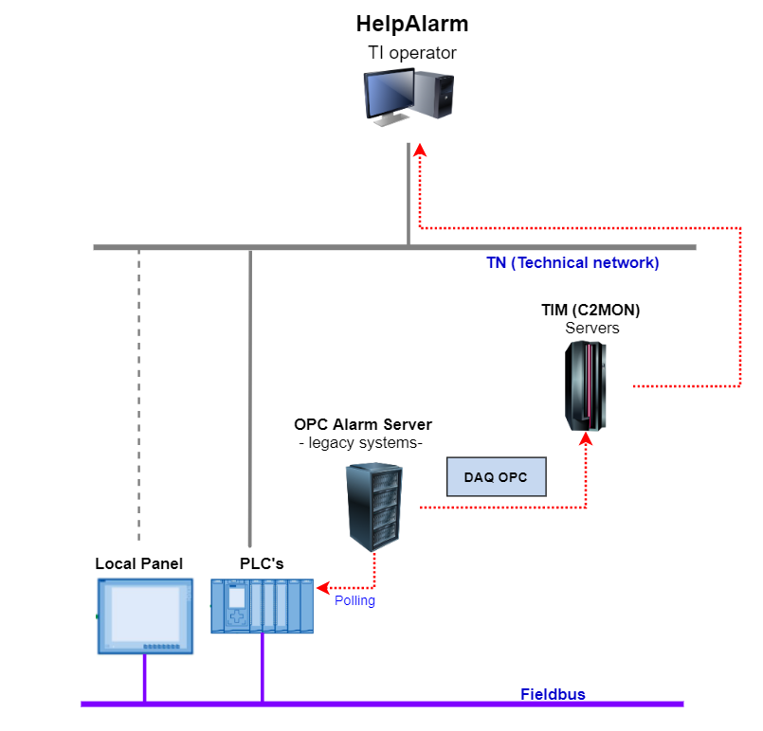
CCC Alarms EN/CV - Dataflow
  Legacy systems (OPC based)
  Current status – Legacy systems
      PCVue (SCADA) Applications OPC – 115 PLCs, 2 PLC types (Siemens / Schneider) , 3 systems, 6 VMs
      CCC (SCADA-less) Applications OPC – 200 PLCs, 2 PLC types, 8 systems, 10 VMs
      Older systems that are not sending alarms / data via OPC architecture.
    The alarms are polled from the PLCs by the corresponding OPC Alarm Server machine and afterwards accessed via a DAQ OPC by the TIM (C2MON) Servers
    The alarms are then accessible using HelpAlarm
    Not a lot of information about non-OPC systems alarms management, they are also configured in MODESTI using TIM domain and various protocols (see MODESTI help link)
Doru Nitu / Diogo Monteiro | Alarms Management in EN/CV
10

Slide 11
CCC Alarms EN/CV - Quality
  UNICOS systems – quality assured by full chain monitoring
  PLC CV_LASER machine communication check
    There’s a verification on the middle layer, the CV_LASER machine, that generates a communication alarm if the PLC is not communicating anymore;
    This alarm is being sent by CV_LASER to TIM(C2MON) and visible in HelpAlarm;
  CV_LASER TIM (C2MON) machine communication check
    There’s a verification at the TIM (C2MON) level, that generates a communication alarm if the CV_LASER is not communicating anymore;
    This alarm shall be visible in HelpAlarm as well;

Slide 12
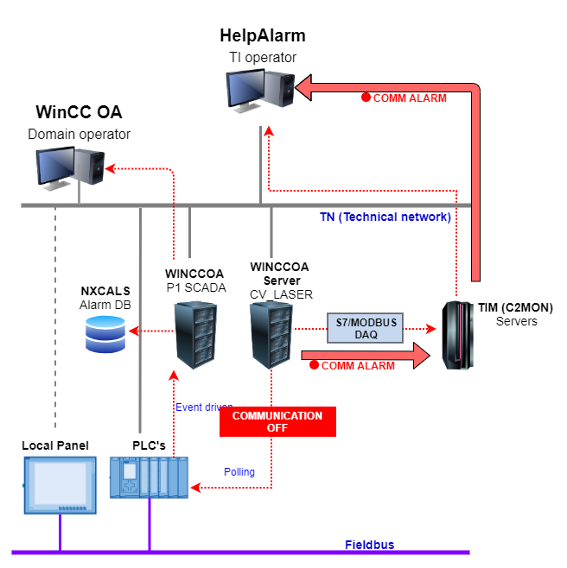
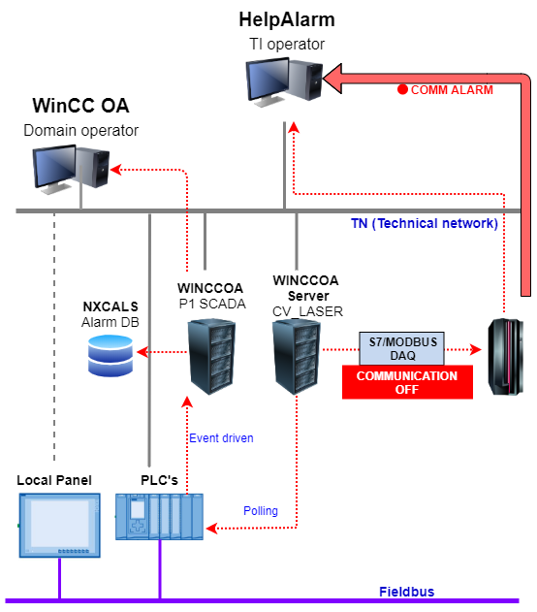
CCC Alarms EN/CV - Quality
  UNICOS systems – quality assured by full chain monitoring
  PLC CV_LASER machine communication check
    There’s a verification on the middle layer, the CV_LASER machine, that generates a communication alarm if the PLC is not communicating anymore;
    This alarm is being sent by CV_LASER to TIM(C2MON) and visible in HelpAlarm;
  CV_LASER TIM (C2MON) machine communication check
    There’s a verification at the TIM (C2MON) level, that generates a communication alarm if the CV_LASER is not communicating anymore;
    This alarm shall be visible in HelpAlarm as well;
Doru Nitu / Diogo Monteiro | Alarms Management in EN/CV
12

Slide 13
CCC Alarms EN/CV - Quality
  LEGACY systems – OPC data quality assured by full chain monitoring
    WATCHDOG OPC
    Each OPC server has its own internal “watchdog” value
    TIM (C2MON) is monitoring the increasing of this value to consider the OPC Server as active
    If OPC server is considered active, the OPC tags can be monitored
    There is also a partial implementation of a watchdog between the PLC and TIM (C2MON), for the TIM to evaluate the PLC status as well, alongside the OPC Server status.
  PLC OPC Alarm server machine communication check
    Every OPC alarm tag has a quality attribute (BAD, UNCERTAIN, GOOD)
    Based on this attribute we could evaluate the connection status between the PLC and the OPC Alarm Server

Slide 14

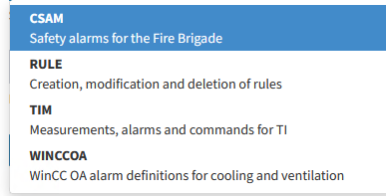
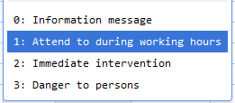
CCC Alarms EN/CV - Declaration
HOW do we declare the CCC alarms?
  Using Modesti website: https://modesti.cern.ch/ to declare alarms for TIM (C2MON) framework
  Definition of domain: there are several “domains” for which we can create alarms
  Definition of alarm level - there are several levels of priority for the alarms, from 0 to 3
Inside EN-CV we usually define alarms with level 1 or 2 (for WinCCOA / TIM domains, rarely level 3 (CSAM – safety alarms)
14

Slide 15
CCC Alarms EN/CV - Declaration
  Alarm identification – we identify each alarm event with a series of defined attributes like description, GMAO code, location, responsible person, system/subsystem, and we define actions to be taken by the TI operators during working and outside working hours
  Actions taken by TI (Technical Infrastructure) operators: creating ODM’s (ordre de maintenance) based on the GMAO codes linked to the alarm, which trigger various actions depending on the alarm
15

Slide 16
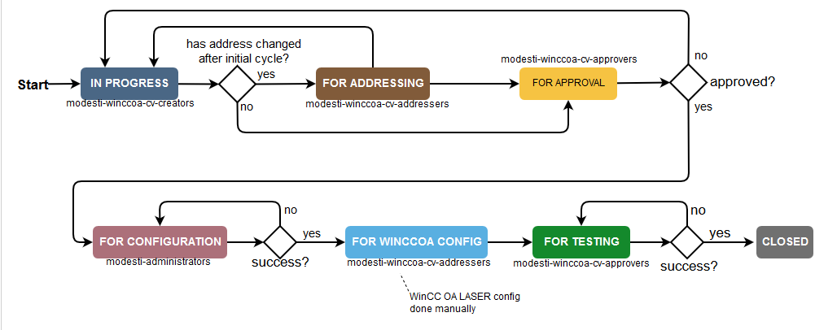
CCC Alarms EN/CV - Activation
  Activation procedure
  Specific procedure, depending on the MODESTI “domain” (TIM, WINCCOA etc.)
  Alarm declaration is validated by TI operator
  WinCC OA addressing, and transmission is done by BE-ICS
  There is an intermediate step, “FOR TESTING”, in which the alarms are active and visible for the TI operators
  The alarms are tested by the EN/CV-CL members in collaboration with TI operators
  They become active once the test is validated
WinCCOA Domain

Slide 17
Alarm management EN/CV - Challenges
  Challenges:
    The WINCCOA alarms addressing require configuration both in MODESTI and in the WinCC (CV_LASER configuration)
    Middle layer (CV_LASER) introduces complexity and time delays in alarm declaration
    OPC server lacks the alarm subset grouping that WINCCOA alarms have
  Would other groups be interested in a unified approach?

Slide 18

Questions?
Thank you!

