Slide 1

IPPOG
1/7
International Particle Physics Outreach Group (IPPOG) Collaboration)
IPPOG : Global network of particle physicists active in education and outreach
Main aims: (1) Networking and coordination of global activities, (2) Exchange information, experiences and best practices in outreach activities (3) Share resources
Members : 24 country representatives, 5 experiments, 1 international laboratory (CERN)
Flagship activity : International particle physics masterclasses
First EPPOG Meeting Sep. 1997 at CERN, DG Chris Llewellyn-Smith: ”the particle physics community has a moral obligation to inform the public on its activities. To do this well experiences must be shared among countries in view of the need to optimize the use of resources”

Slide 2
Statistics International Masterclasses
2/7
2005
2006
2007
2008
2009
2010
2011
2012
2013
2014
2015
2016
2017
2018
18
countries
52
58
institutes
225
72
masterclasses
307
3k
students
14k
12
video conferences
82

Slide 3
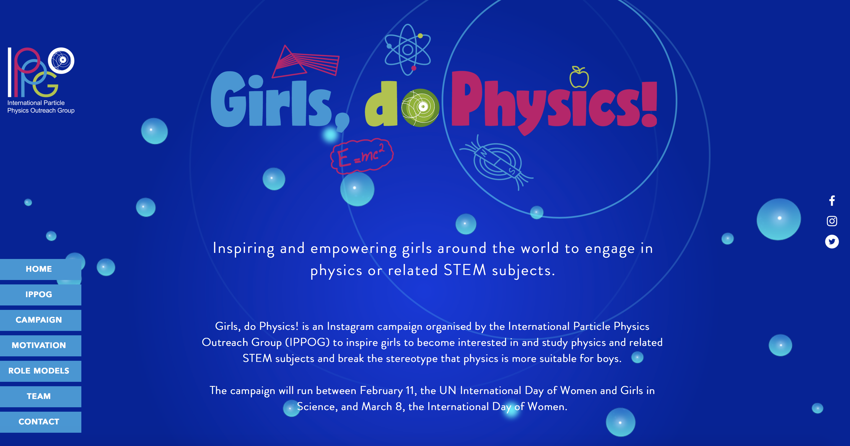
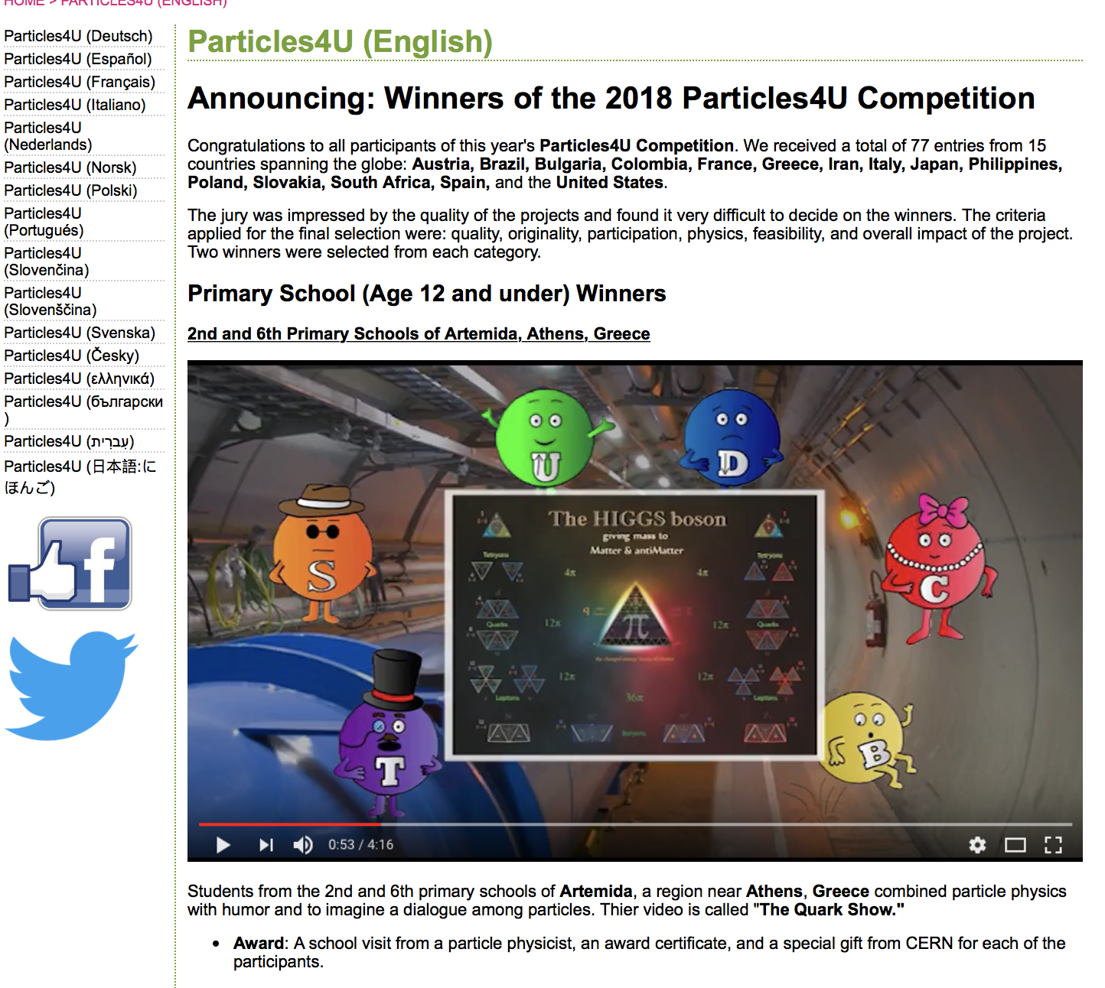
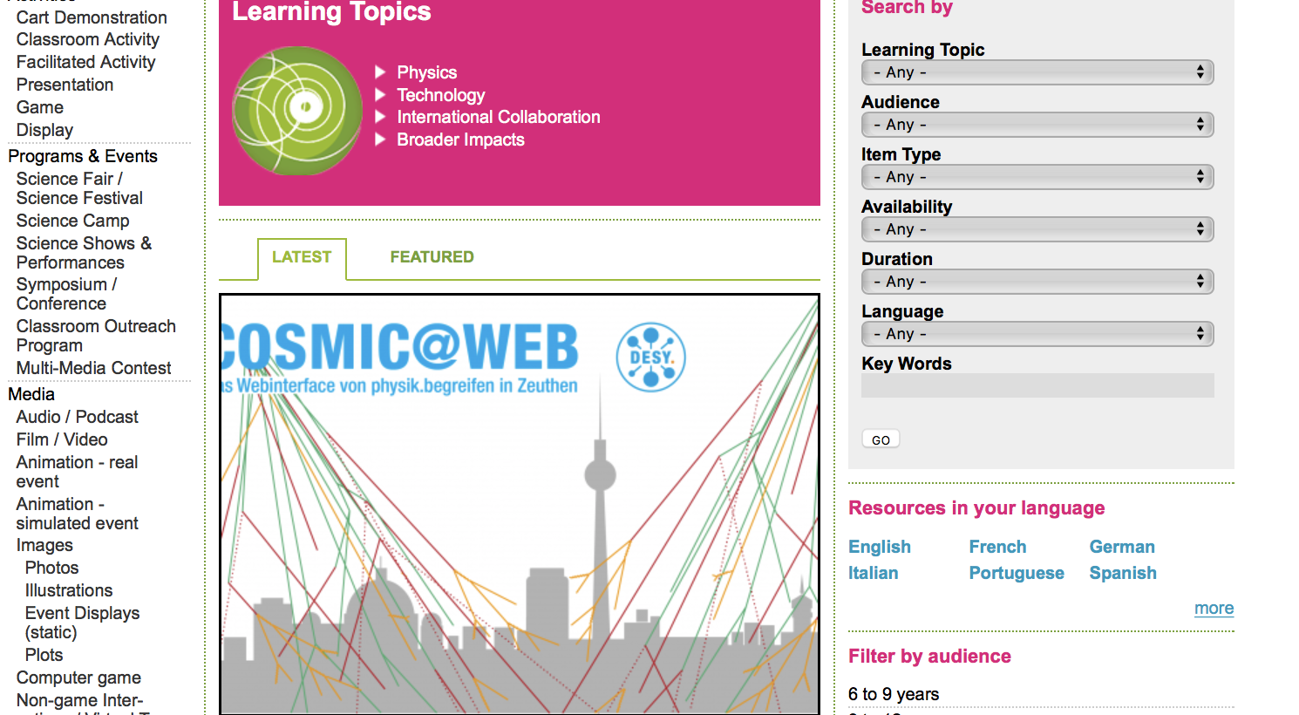
3/7
Benefits through this program
Flagship program - International Masterclass can be brought to India: Allow school and college students to access LHC and several other mega sciences data and learn aspects of frontier science. Such classes are held in several countries at different times of the year and have been a huge success. For example, In 2018, the masterclasses were attended by over 14,000 students from 225 institutes in 52 nations in the entire year.
Access and Sharing of outreach resources (Like the ones in Vigyan Samagam and more)
Maximum the impact of mega science projects: The mega sciences projects require substantial funding and investments. This collaboration will allow to maximize the impact of education and outreach efforts related to particle physics
Foster the acceptance and value of the scientific method and evidence-based decision making in society.

Slide 4
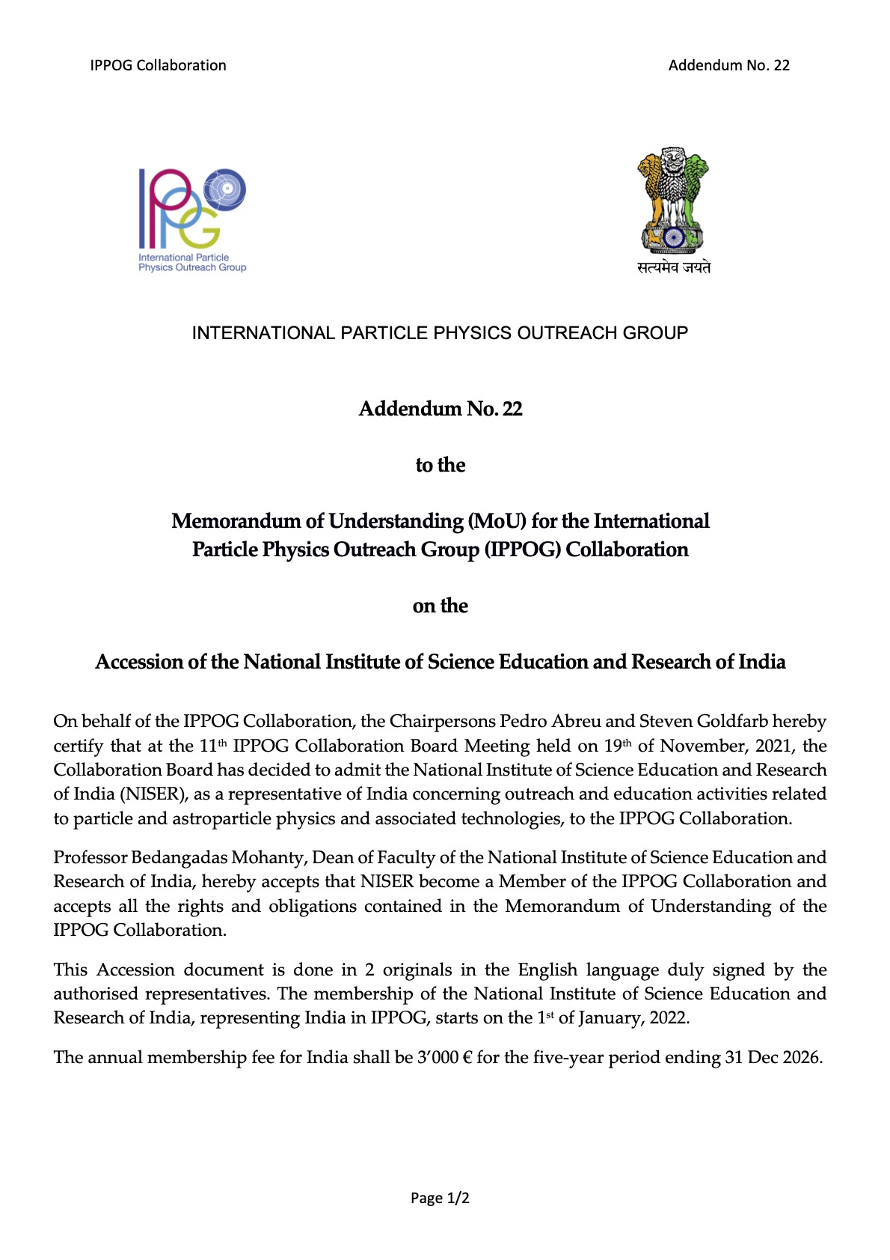
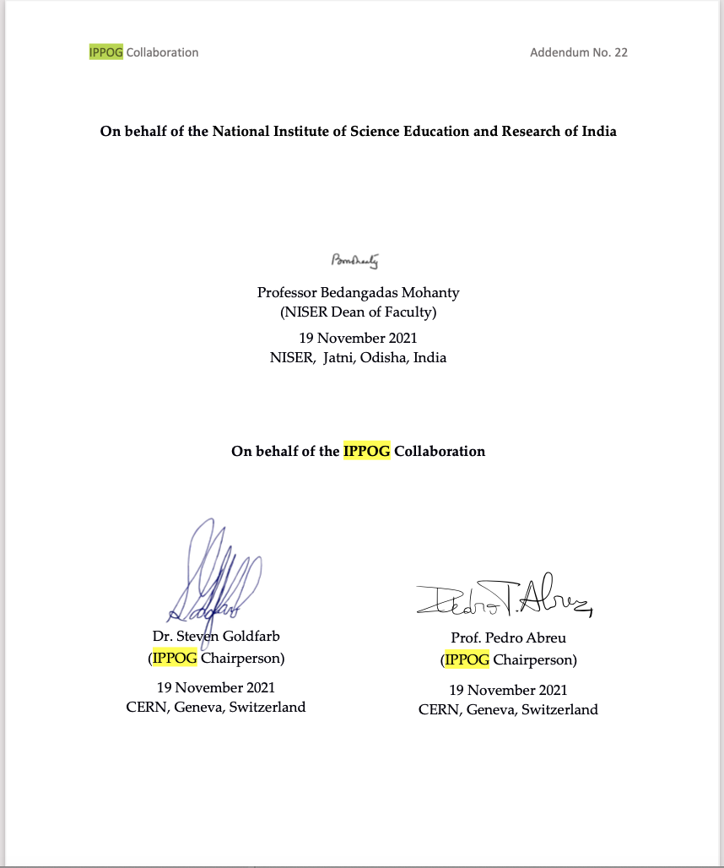
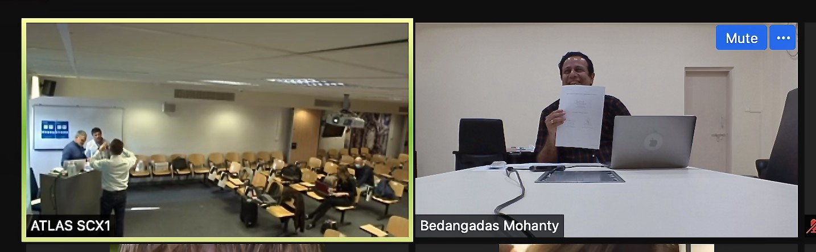
4/7
India
Part of
IPPOG

Slide 5
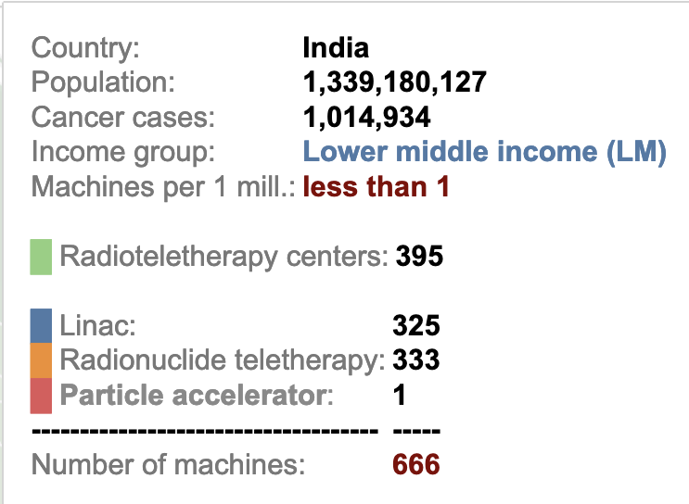
Centre for Medical and Radiation Physics
5/7
Cater to the need for well trained Medical Physicist in the country
1st In Odisha
Skill set to be developed
Use of diagnostic and treatment radiation equipment
Quality assure the radiation machines
Quality assure radiation treatment planning
Quality assure radiation treatment delivery
In-depth knowledge on the radiation machine structure and function
Understand the principles and physical laws governing the biological effects of radiation
Solve radiation therapy technology related problems
Appropriate domain knowledge on areas that are clinically applicable
Teach junior technicians in radiation therapy
Teach trainee oncologist on the relevant aspects of medical physics
Masters Course on Medical Physics
Number of students : 10/year
After BSc + JAM + interview
1st Year – Core Physics
2nd Year – Core Medical Physics
3rd Year – Internship in hospital
Maximum number of cancer patients that can be treated annually is ~ 500 per teletherapy equipment.
Only about ~ 1000 registered Medical Physicists in country
Bedanga Mohanty, NISER

Slide 6
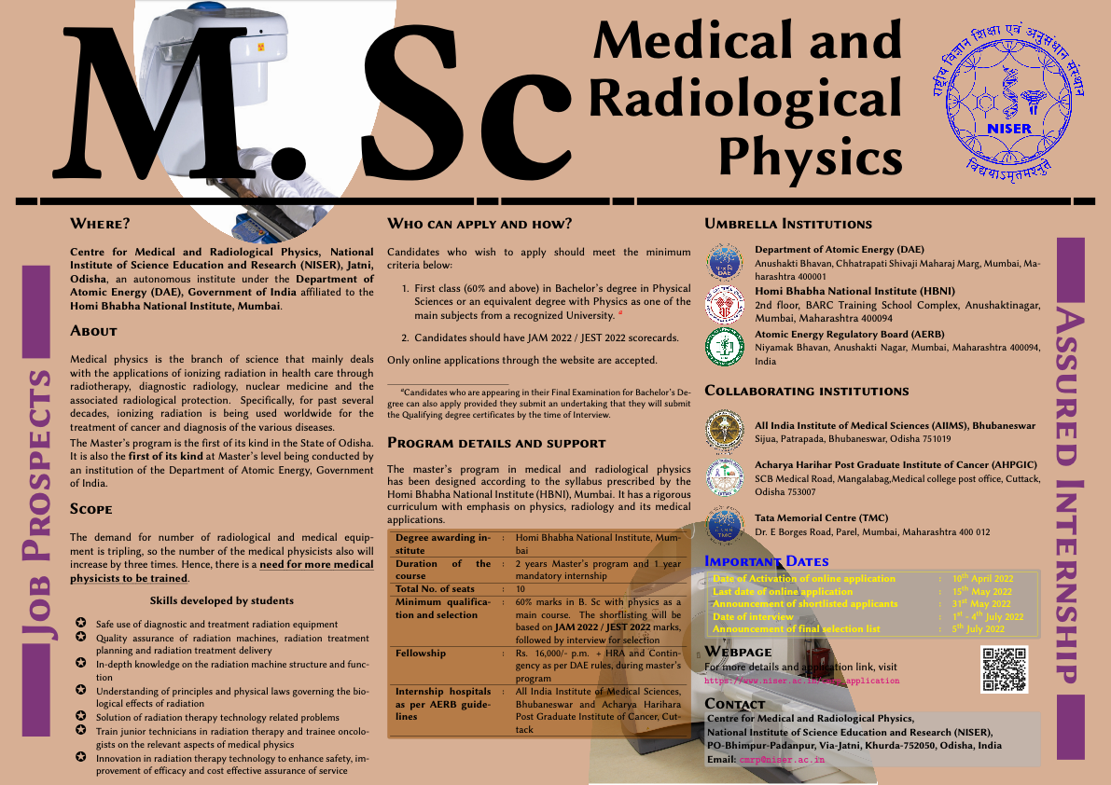
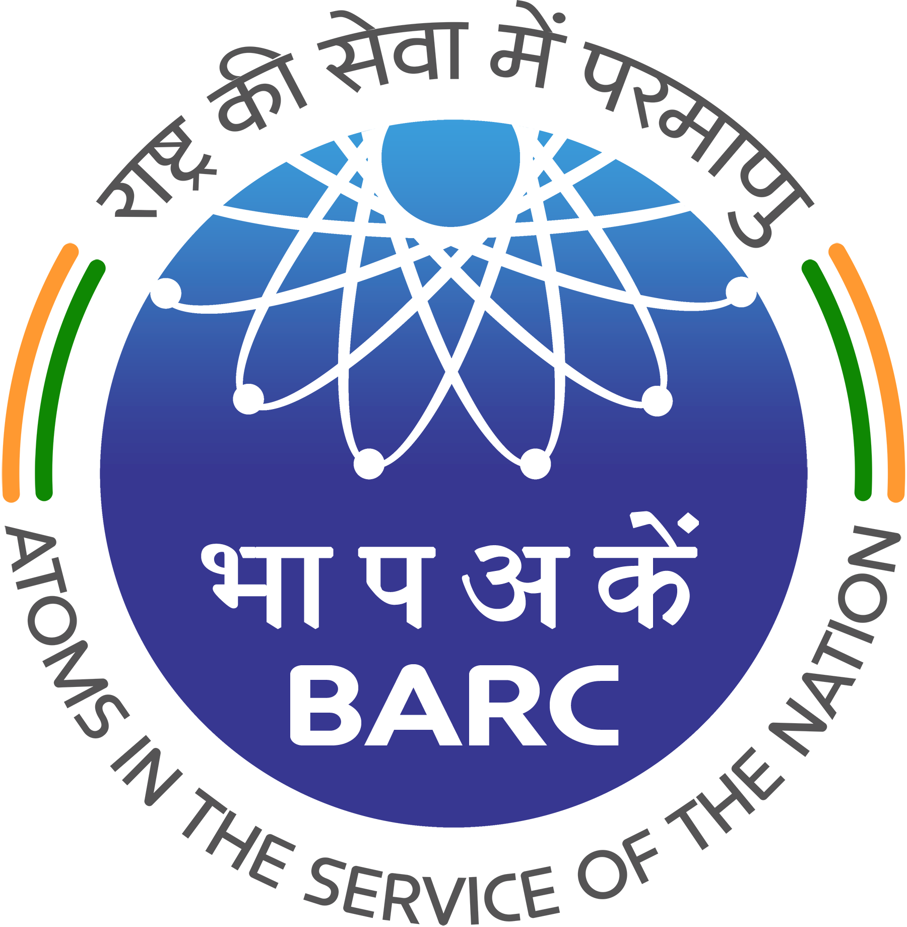



6/7
Bedanga Mohanty, NISER

Slide 7
7/7
Thanks
IPPOG
CMRP
Speakers
All participants
All volunteers

