Slide 1
Angular distributions and rotations of frames
In vector meson decays to lepton pairs
Sandro Palestini, CERN
Quarkonium production: Probing QCD at the LHC, Vienna 18-21 April 2011

Slide 2
Reference frames, angular variables
The z axis is directed along the beam.
The lab frame is oriented so that the J/ψ is in the x-z plane.
The y and y’ axes are parallel.
Different choices are possible for the the direction of z’ (and x’)
x’
l⁺
J/ψ rest frame
θ’
ϕ’
z’
y’
x
Collision axis
y
z
lab frame

Slide 3
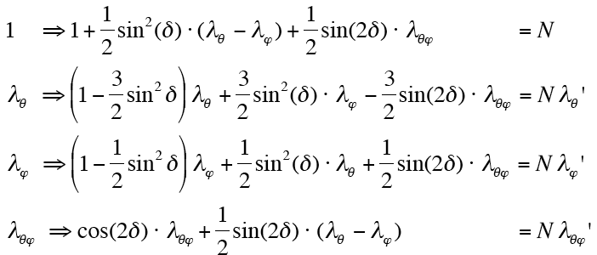
Functional form of the angular distribution for decays of 1⁻ ⁻ states to lepton pairs decays
dN/dΩ ∝ [ 1 + λ_{θ} cos²(θ)
+ λ_{ϕ} sin²(θ) cos(2ϕ)
+ λ_{θϕ} sin(2θ) cos(ϕ) ]/ (1+λ_{θ}/3)
It is valid in any frame (eg: CS or H, only the y-axis direction is fixed) under general conditions, but of course the three coefficients have different values in different frames:
Rotation of frame as x’=x cos(δ)-z sin(δ) etc.,
Between CS and H frames, the rotation angles approximates ~ 90 deg over large areas of ATLAS or CMS acceptance

Slide 4
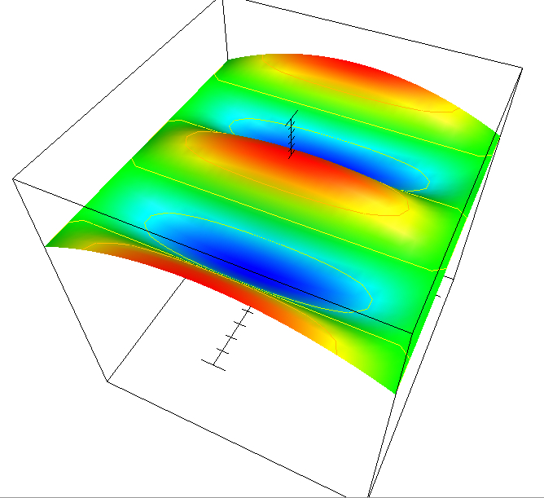
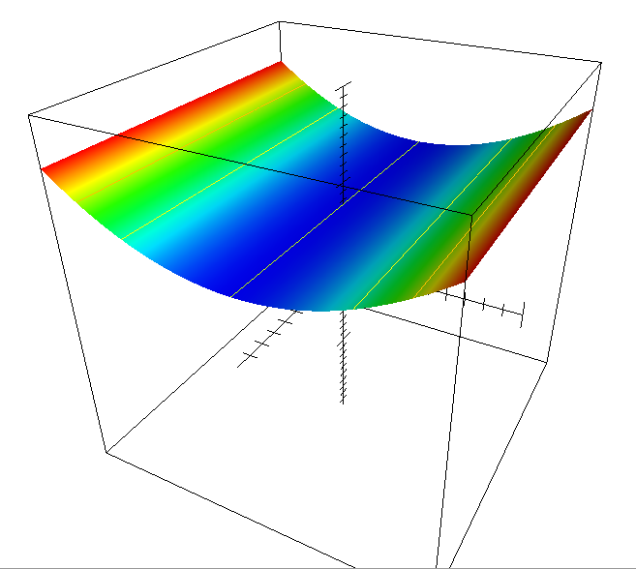
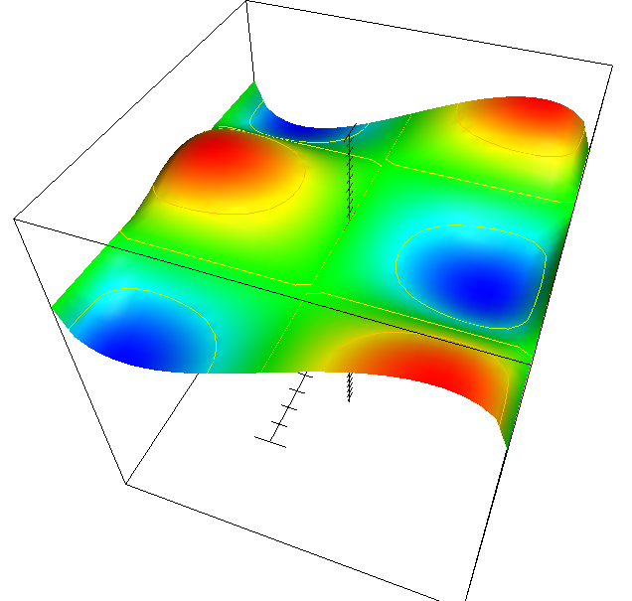
Modes defined by the coefficients
dσ/dΩ
cos(θ)
φ
λ_{θ}=+1, λ_{ϕ}=0, λ_{θϕ}=0
λ_{θ}=0, λ_{ϕ}=+0.5, λ_{θϕ}=0
λ_{θ}=0, λ_{ϕ}=0, λ_{θϕ}=+0.5
Acceptance requirements for angular polarization study:
λ_{θ} : benefits from large coverage in cos(θ),
and coverage in φ to disentagle from λ_{ϕ} (see below)
λ_{ϕ} : needs coverage in φ for rather small |cos(θ)|.
λ_{θϕ}: needs coverage in φ for |cos(θ)|≈ 0.3-0.9

Slide 5
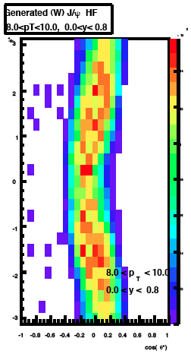
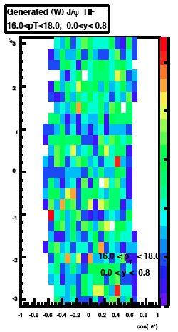
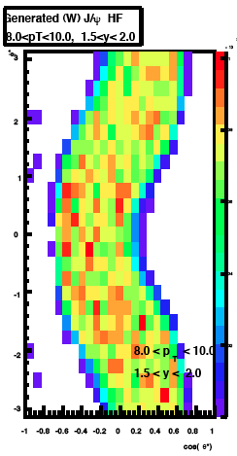
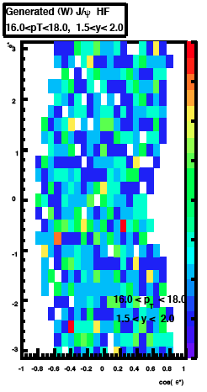
Expected 2D distributions of events in representative bins in y, p_{T}
Helicity frame
φ ➔
y = 0 − 0.8
λ_{ϕ} : coverage already at low p_{T}
λ_{θϕ} and in particular λ_{θ}: improved cove-rage in regions of large p_{T} and/or large rapidity
cos(θ) ➔
φ ➔
y = 1.5 − 2
[Monte Carlo with uniform angular distribution generation, ATLAS-inspired acceptance. Negative y, or opposite lepton charge convention give opposite curvatures]
p_{T}= 8 − 10 GeV/c
p_{T}= 16 − 18 GeV/c

Slide 6
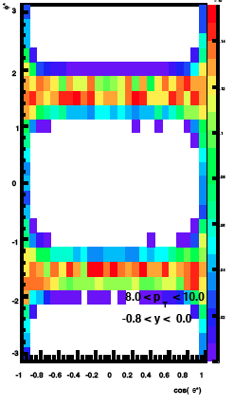
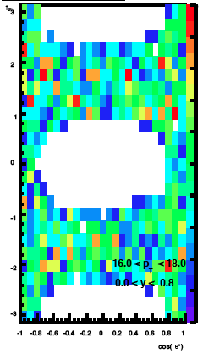
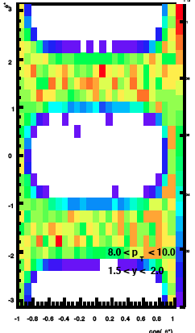
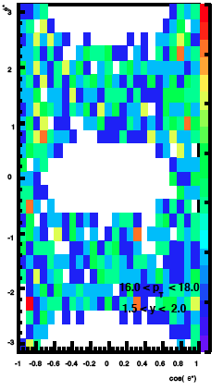
2D distributions in representative bins in y, p_{T}
C-S frame
φ ➔
y = 0 − 0.8
Good coverage for λ_{θϕ};
λ_{θ} and λ_{ϕ} entangled at low-moderate p_{T}/ y :
  For ϕ≈±π/2, we are sensitive to the combination: (λ_{θ}+λ_{ϕ})/(1-λ_{ϕ})
[not useful if λ_{θ}≈-λ_{ϕ}]
cos(θ) ➔
cos(θ) ➔
φ ➔
y = 1.5 − 2
p_{T}= 8 − 10 GeV/c
p_{T}= 16 − 18 GeV/c

Slide 7
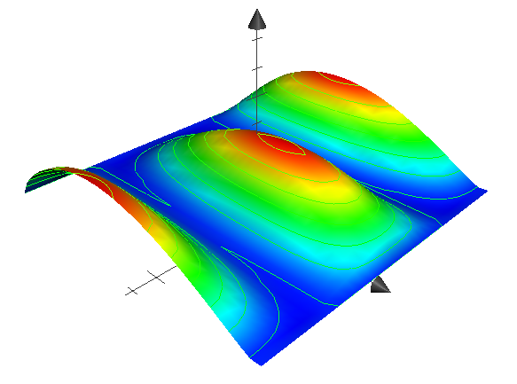
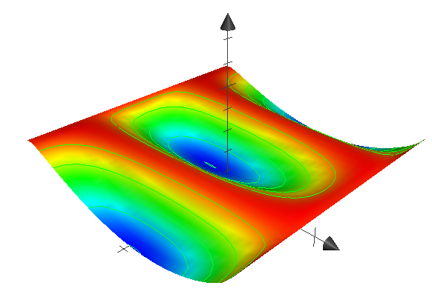
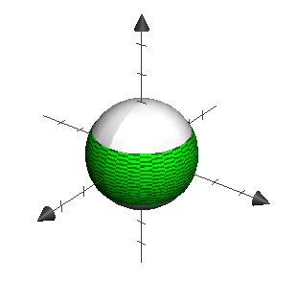
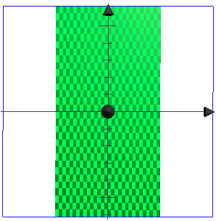
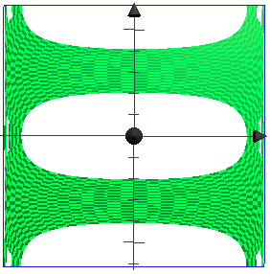
Examples of angular distributions for λ_{θ} + λ_{ϕ}=0
dσ/dΩ
dσ/dΩ
φ
cos(θ)
cos(θ)
φ
λ_{θ}=-0.5, λ_{ϕ}=+0.5, λ_{θϕ}=+0.2
λ_{θ}=+0.5, λ_{ϕ}=-0.5, λ_{θϕ}=+0.2
Illustration of acceptance for intermediate p_{T}, low y
H frame
CS frame
z
φ
cos(θ)
y
x
Approximate acceptance as depending on |P_{muon}|
Approximate rotation between frames with 90 deg.

Slide 8

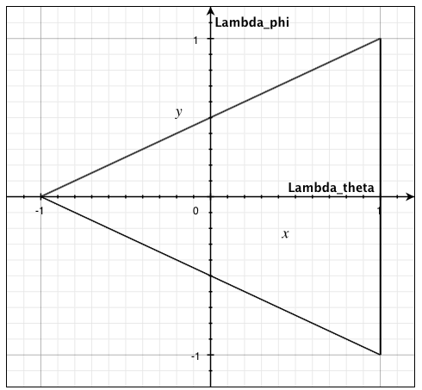
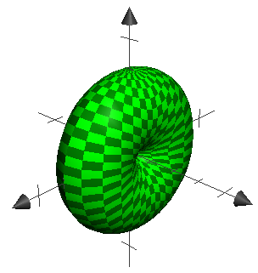
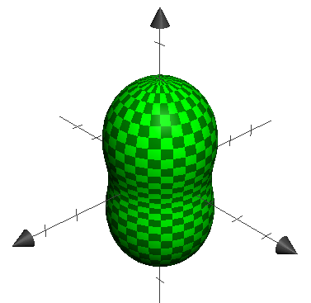
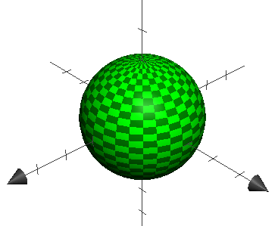
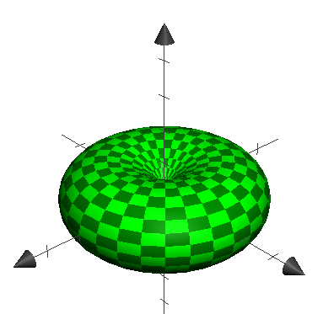
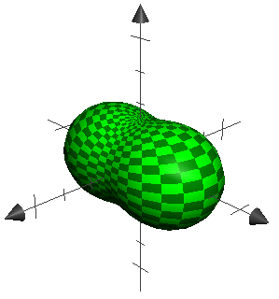
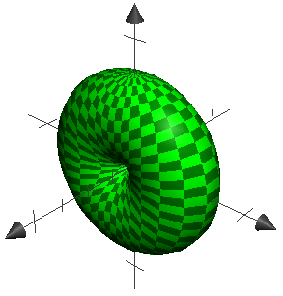
General properties of the coefficients
From general principles, in any frame:
Also, for any given set [λ_{θ}, λ_{ϕ}, λ_{θϕ}] in a frame F, we could rotate to a new frame F’ where λ’_{θϕ} = 0
L-y
Allowed triangle and angular distribution pattern in λ_{θ}, λ_{ϕ} plane (λ_{θϕ}=0)
L-z
“T-z”
uniform
Donuts & peanuts
L-x

Slide 9
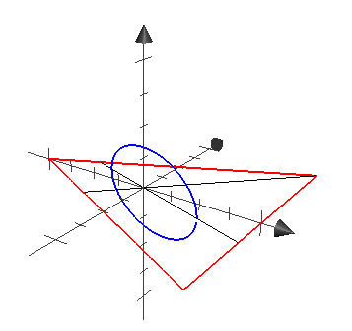
Rotation in the space of the coefficients
It is convenient to consider the transformations of the coefficients of the angular distribution under rotation of frame as a geometrical rotation in the 3D space of the coefficients:
  The transformations are described as ellipses in the space of the coefficients, normal to the plane λ_{θ}λ_{ϕ} , and wound about the line λ_{θ}=λ_{ϕ,} λ_{θϕ}=0.
λ_{θϕ}
λ_{ϕ}
λ_{θ}

Slide 10
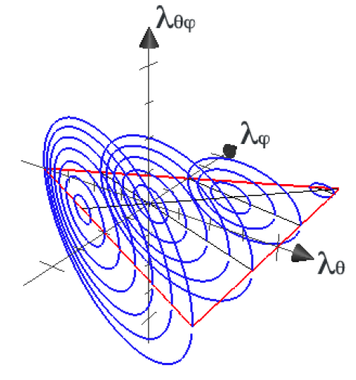
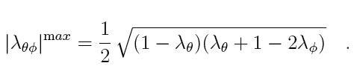
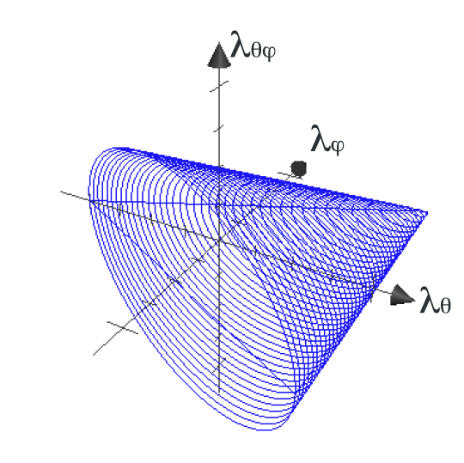
  A rotation by π/2 (typical between CS and H frame) links opposite points on the ellipses.
  The ellipses fill a conical volume
    (we are dealing with inclusive processes … )
  The conical surface defines the maximum range allowed by for |λ_{θϕ}| for any given values of λ_{θ}, λ_{ϕ} :
  This expression completes the bounds/consistency relations between coefficients, together with:

Slide 11
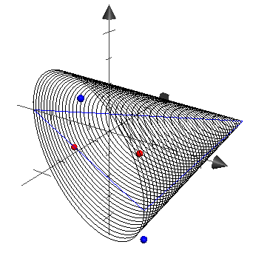
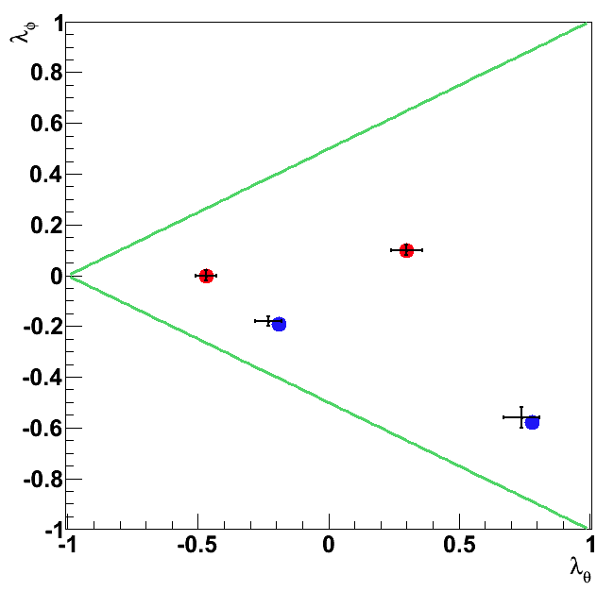
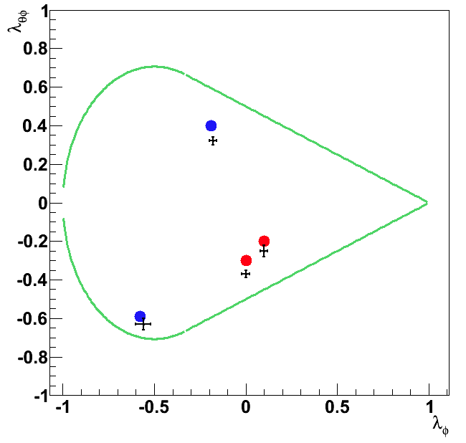
Bounds/consistency relations between coefficients
The conical bound is tighter than the bounds usually shown.

Slide 12
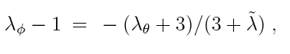
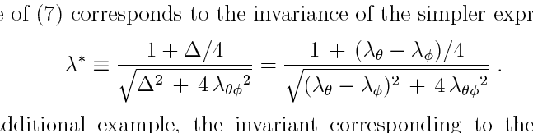
Invariant combinations of the coefficients
Relevance of invariants discussed yesterday
An invariant may be seen as related to a property of an ellipsis, rather than to a point that loops along the ellipsis as frames are rotated.
~
First example: related to known invariant λ
The plane containing any ellipsis defines a correlation between λ_{θ} and λ_{ϕ} :
in other words: the value of λ =(λ_{θ}+3λ_{ϕ})/(1‐λ_{ϕ}) is invariant.
A new invariant may be related to other properties, such as size of axes of ellipsis, or the range covered by the coefficients. They involve the third coefficient λ_{θϕ}. An example is:
~
λ_{θϕ}
λ_{ϕ}
λ_{θ}

Slide 13
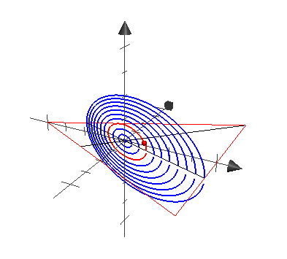
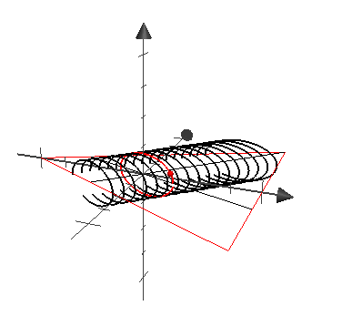
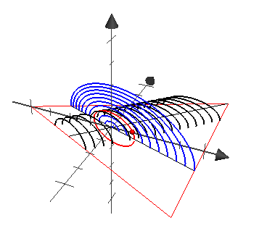
~
λ specifies a plane, λ* specifies a cylinder (elliptical)
Each of them alone does not specify the intrinsic angular distribution (but provides a relevant information)
Together, they specify the intrinsic angular distribution
The phase along the ellipsis specifies how the intrinsic angular distribution is oriented relative to (e.g.) the H and the CS frames

Slide 14
Summary
A geometrical description for the transformation of the coefficients of the angular distributions under rotations of frames (in the production plane).
Better bounds/consistency relations between the coefficients.
A new discussion of invariants, a new invariant depending on the three coefficients of the angular distribution.

Slide 15
Acknowledgements and references:
Thanks to the organizers for the nice workshop.
P. Faccioli, C. Lourenço, J. Seixas and H.K. Woehri, PRL 105, 061601; PR D81, 111502; EPJ C69, 657.
S.P., PR D83, 031503 (arXiv:1012.2485).
Nir Amram for the plots on detector acceptance.

