Slide 1


The bright side of the moon
The LHC accelerator is a quarkonium factory,
even for the bottomonium family !
The LHC experiments are the best ever built in HEP !
The quality of the data and the speed of the analyses are truly outstanding ☺
We are, or will soon be, performing exceptionally high quality measurements
Carlos Lourenço
“Concluding remarks”
Vienna, April 21st, 2011
Up and down.
But in the end it's only round and round.

Slide 2
Money is a hit
However, the LHC has not been built for quarkonium studies…
and those of us crazy enough to study quarkonium physics
are facing a big challenge in securing enough resources
to turn a fantastic dream into concrete reality
We need reliable help from the theory community to ensure that our measurements
will have a huge impact in the progress of the field
We need responsible and accountable advise on the list of top priority measurements, with the theory concepts turned into robust phenomenological predictions that can be clearly and unambiguously falsified
Expensive measurements can only be justified if they are model killers or if they provide accurate values of free parameters in the theories
Money it’s a crime
Share it fairly but don’t take a slide of my pie

Slide 3
Us and them
This meeting was a workshop,
with many opportunities for people to discuss ideas,
problems and solutions, in and out of the meeting room
Many of us will follow up the discussions, exchanging existing knowledge and expertise; and refining the questions, in the absence of answers
A few eye-opening publications will see the day thanks to discussions held in this week;
that will be a very good measure of the success of the workshop
We are pragmatic (and also very busy) people → we will not have proceedings
But we will list the “capabilities and priorities” that shape the “perspectives and challenges” for the future of quarkonium production physics at the LHC
The potential capabilities of each LHC experiment convoluted with the “wish list” of the theorists (translated in an experimentalist’s language) should be turned into an extremely valuable work plan, aimed at ensuring that the wind blows in the right direction
Every year is getting shorter never seem to find the time.
Plans that either come to naught or half a page of scribbled lines

Slide 4
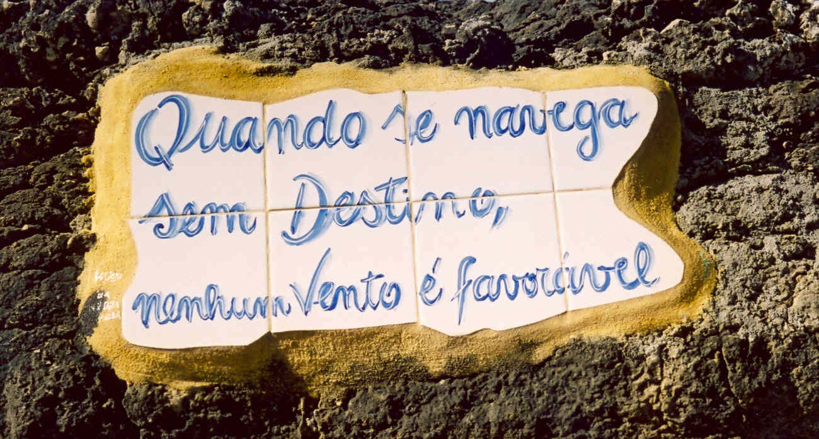
When you sail without destiny,
no wind is favorable
The time is gone, the song is over,
Thought I'd something more to say.

Slide 5
Someone else had something more to say !
Dear Carlos, Hermine,
I am sorry I had to leave the workshop earlier and I did not say bye to you.
I thank you for organising it, I had a great time, learnt a lot of new things and sincerely enjoyed the atmosphere and attitude of the physicists, beyond nationalistic and competitive views but honestly interested in the physics.
I am in favour of creating a LHC-wide quarkonia group and will certainly participate to the next meeting wherever it will be, and I promise I will be less shy ;)
Finally, Hermine I am looking forward to your comparison plots, as they are always carefully made and extremely interesting.
Happy Easter ! [ a satisfied customer ]
I wish you were here

Slide 6
Someone else had something more to say !
Dear Chris, Dietrich, Wolfgang, Brigitte, Jožko, Valentin,
and many other Austrians !
I thank you for organising it
The fact that everything went so smoothly is not a sign of absence of problems…
but a sign that a few people worked in the shadow to remove all the stones
from our path, so that we could concentrate on the scientific discussions !
Carlos & Hermine [ satisfied organizers ]
We wish to come back...

Slide 7

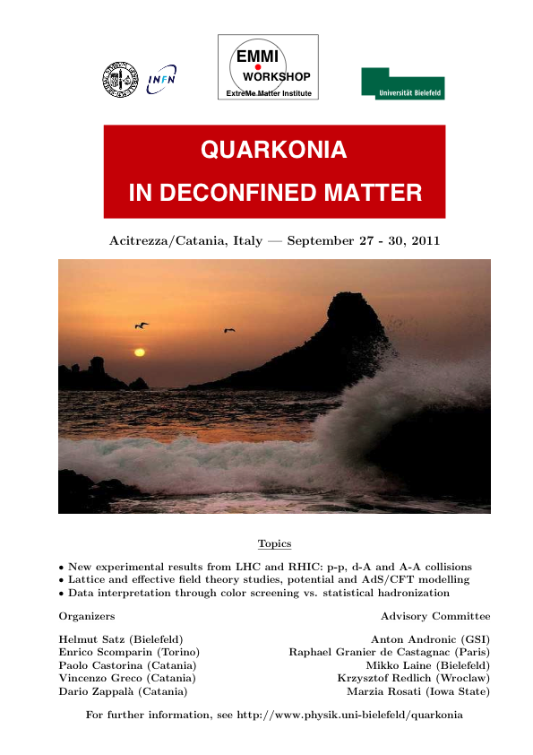
We will meet again

Slide 8
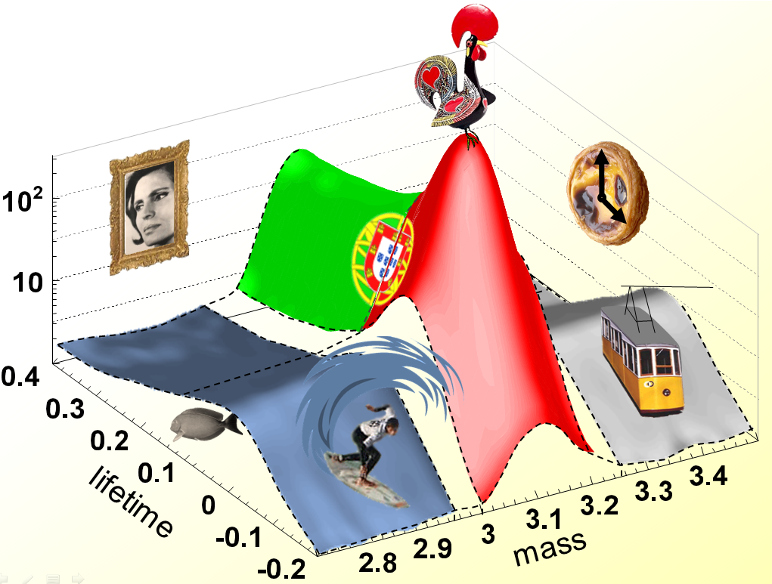
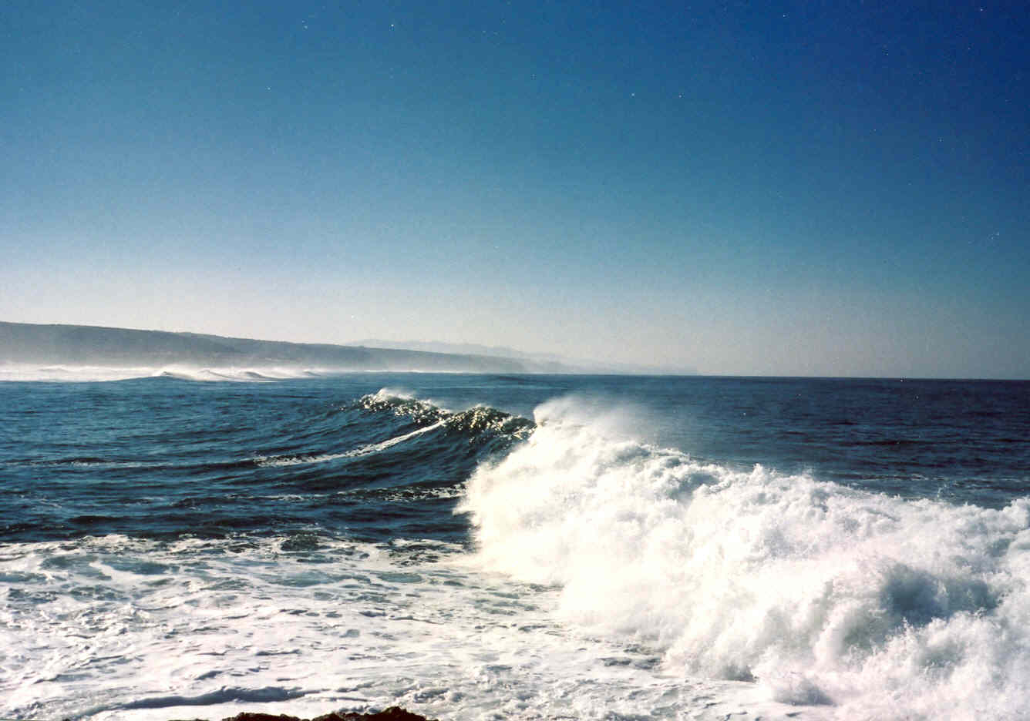


Lisbon story ?
Quarkonium polarization
and other spin physics at the LHC
Ericeira / Lisboa, Portugal – April 2012 (?)
So long and…
thanks for all the peanuts and donuts

