Slide 1
Prompt and non-prompt J/ψ differential cross sections with CMS
Luca Martini
(Università di Siena & INFN Pisa)
on behalf of the CMS collaboration
Quarkonium Production Probing QCD at the LHC 19th April 2011, Vienna - Austria

Slide 2
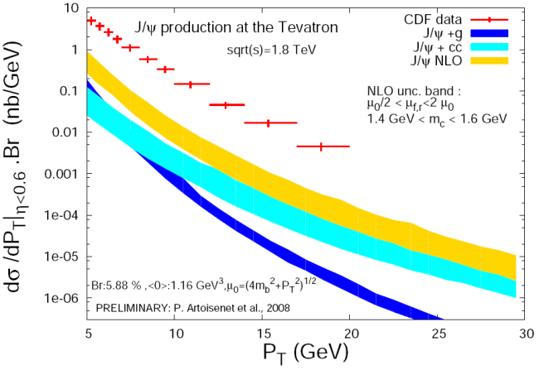
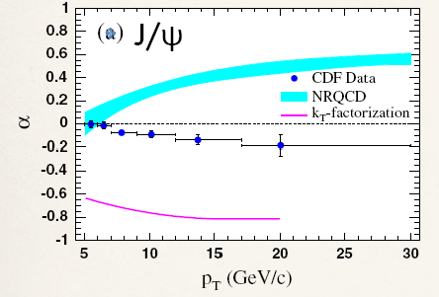
The quarkonium production puzzle
J/ψ mesons are produced in 2 ways:
  Prompt:
    Directly from pp collisions
    “Feed-down” from heavier states as χ_{c} and ψ’
  Non-prompt from b-hadron decays
None of the existing theoretical models satisfactorily describes both prompt cross section and polarization measurements at TeVatron
Opportunity at LHC to provide valuable input to understanding of quarkonium production including reach to higher p_{T} region
Phys. Rev. Lett. 99 (2007) 132001

Slide 3
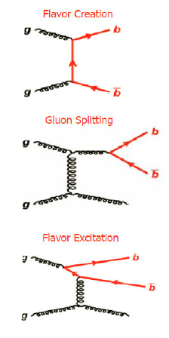
The Non-prompt fraction: b→ J/ψ
Instead, the fixed-order next-to-leading-log (FONLL) approach, with the improved measurements of the b→ J/ψ fragmentation and decay, are in good agreement with CDF data
Non-prompt production can lead directly to the measurement of the b-hadron cross section
α_{s}²
α_{s}³
α_{s}³
M . Cacciari et al.,
JHEP 0404, 068 (2004)

Slide 4
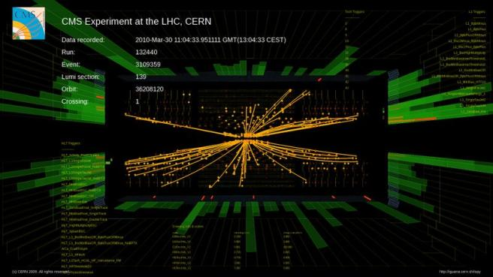
The ﬁrst CMS measurements of differential inclusive, prompt and non-prompt J/ψ production cross sections in pp collisions are shown here
  through the dimuon decay channel
  at the centre-of-mass energy of 7 TeV
  in the rapidity range |y| < 2.4
  with an integrated luminosity of 314 nb⁻¹
CERN-PH-EP-2010-046

Slide 5
The CMS detector

Slide 6
The CMS detector
weight: 12500 t
overall diameter: 15 m
overall length: 21.6 m
CALORIMETERS
ECAL Scintillating PbWO₄ Crystals
SOLENOID
B = 3.8 T
HCAL Plastic scintillator
Brass
TRACKER
MUON
ENDCAPS
MUON BARREL
Pixels
Silicon Strips
Cathode Strip Chambers (CSC)
Resistive Plate Chambers (RPC)
Drift Tubes
(DT)
Resistive Plate
Chambers (RPC)

Slide 7
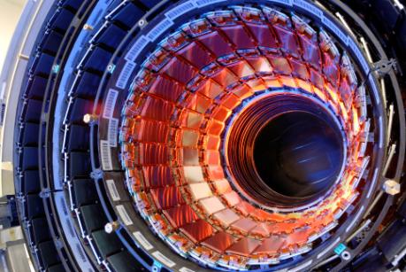
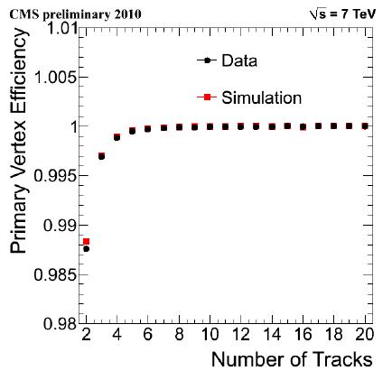
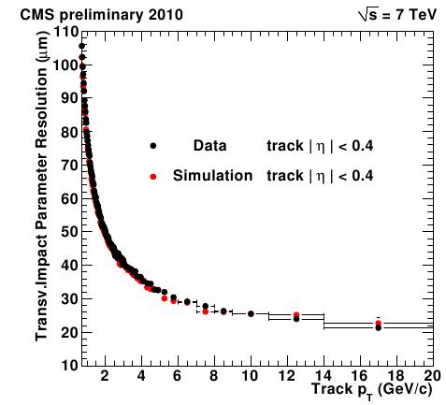
Inner Tracker:
Pixel and strips
Pixel: 3 barrel layers + 2 disks each side
Strips: 10-12 barrel and endcaps layers
Excellent p_{T} resolution ≈ 1% (2% at high η, because of the increasing material thickness traversed and the shorter lever arm)
Tracking efficiency > 99% for central muons
Excellent vertex reconstruction and impact parameter resolution

Slide 8
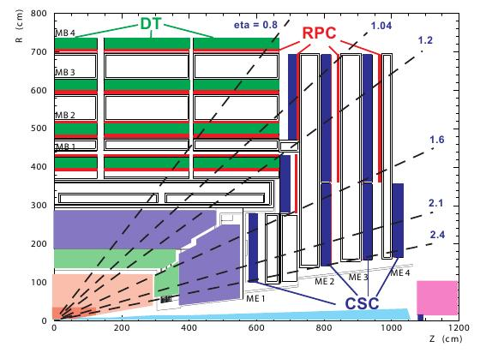
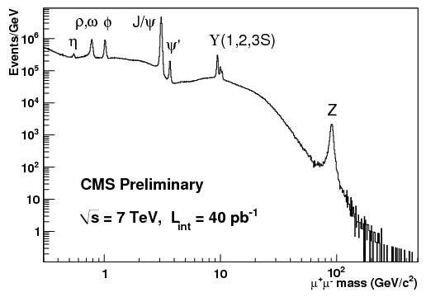
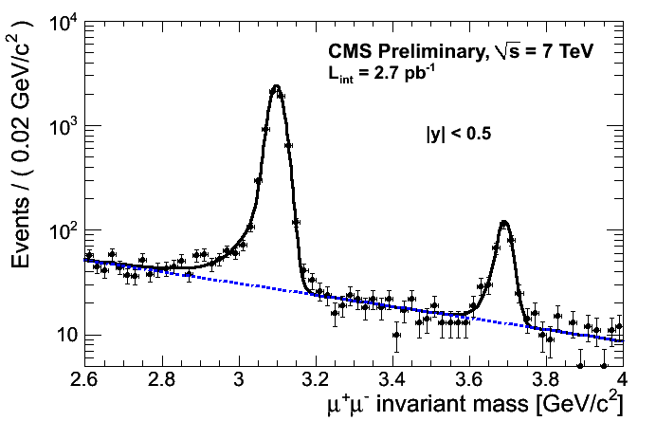
Reconstructed Muons in CMS
Match between muon segments and a silicon track
Large rapidity coverage: |η| < 2.4
We use muons reconstructed with two methods: using several segments in the muon stations; or using a silicon tracker track matched to a muon segment. The latter method allows access to lower p_{T} muons
Selections are based on track quantities (number of pixel and strips hits, χ² of the fit, …) for high quality reconstructed muon objects
40 /pb

Slide 9
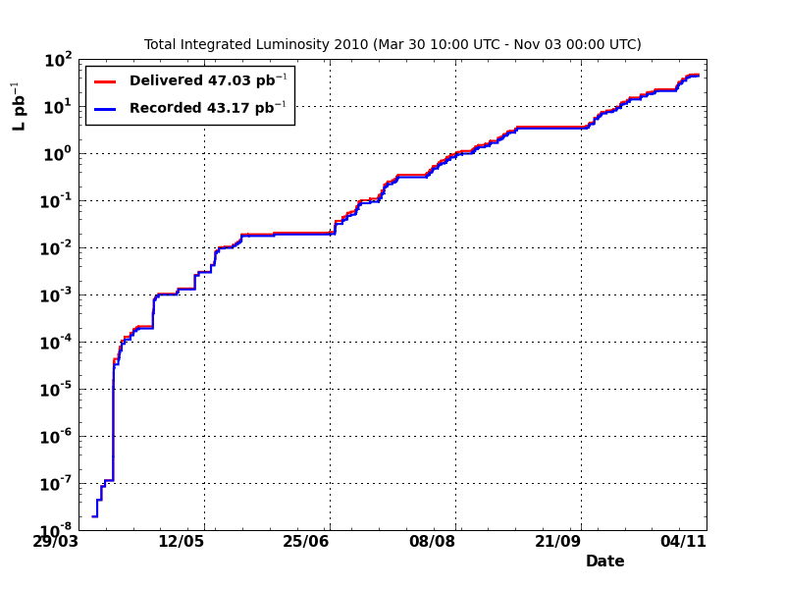
CMS Muon Triggers and data sample
2-level trigger:
L1 (100 kHz): Hardware, involving only the muon stations
HLT (250 Hz): Software, adding the tracker information
Data acquired with a double-muon trigger with only L1 requirements, no minimum p_{T} requested, available unprescaled up to 314 nb⁻¹
Single muon triggers for efficiency measurements
Pile-up negligible

Slide 10
The J/ψ Cross-Section measurements

Slide 11
J/ψ production cross section
N_{fit} = number of reconstructed dimuons in a given bin
A = geometrical and kinematical acceptance
ε = trigger and reconstruction efficiencies
L = integrated luminosity
Δp_{T} = transverse momentum bin size
Δy = rapidity bin size

Slide 12

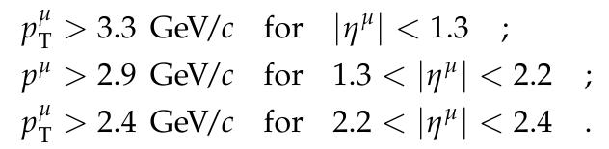
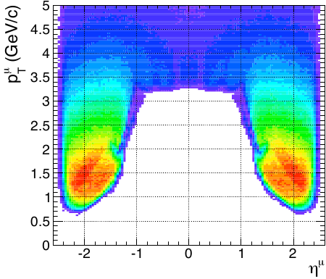
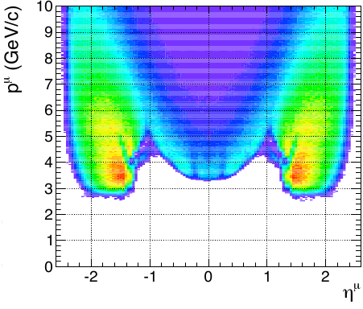
Acceptance
MC based study on detectable muons:

Slide 13
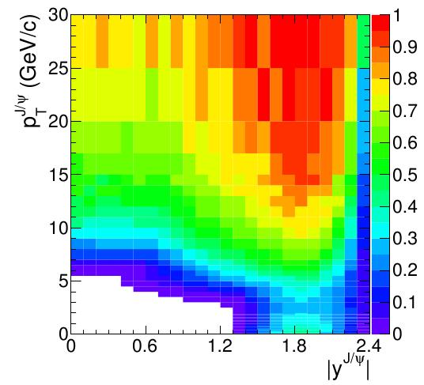
Effect of the polarization
The J/ψ polarization influences the detector acceptance;
5 different polarization scenarios:
  Unpolarized
  Collins-Soper (transverse & longitudinal)
  Helicity (transverse & longitudinal)
Main systematic uncertainties:
  kinematical distributions (< 3%)
  b-hadron fraction (< 3.1%)
Acceptance, unpolarized scenario

Slide 14
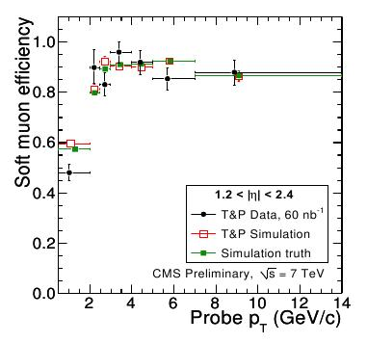
Efficiencies:
The Tag & Probe method
Data-driven study:
  Take events from a resonance,
  like a J/ψ meson
  Tag a well reconstructed muon
  Probe the second muon to test if it passes the cut under study
CMS MUO-10-002
Factorization hypothesis tested on MC:
  ρ reflects the non-factorization (correlations and finite size of the single muon efficiency bins); ε_{vertex} is the dimuon vertex efficiency
Main systematic uncertainties:
  Limited statistics (<12%)
  Correlations (<8%)

Slide 15
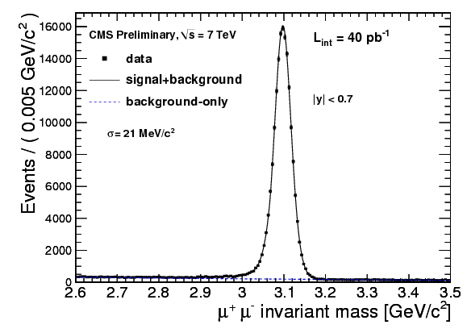
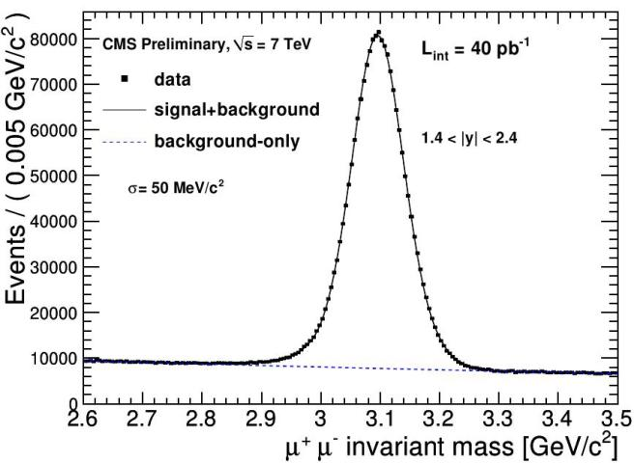
Extracting the number of J/ψ:
The Invariant Mass Fit
Signal = Crystal Ball (for final state radiation)
Background = Exponential
27000 J/ψ mesons could be reconstructed in 314 /nb, including very low p_{T} events, thanks to the silicon tracker based reconstruction method
Main systematic uncertainty:
  choice of signal shape (<8.8%)

Slide 16
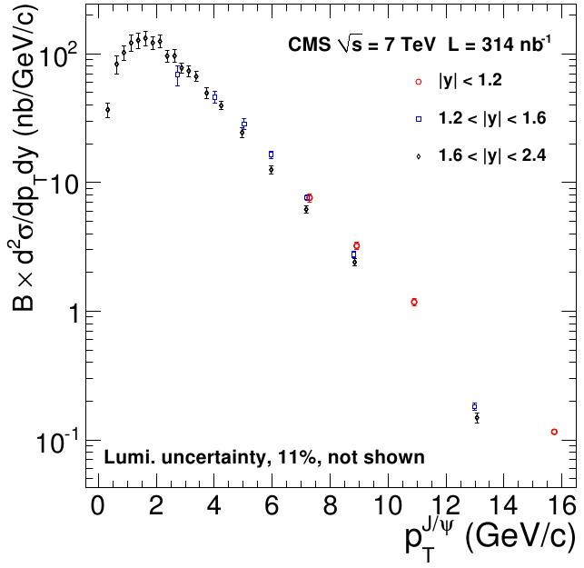
Inclusive Cross Section Results
3 different rapidity bins
Inclusive cross section for p_{T} in [6.5, 30], |y| < 2.4:

Slide 17
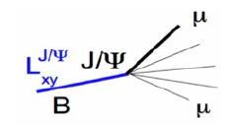
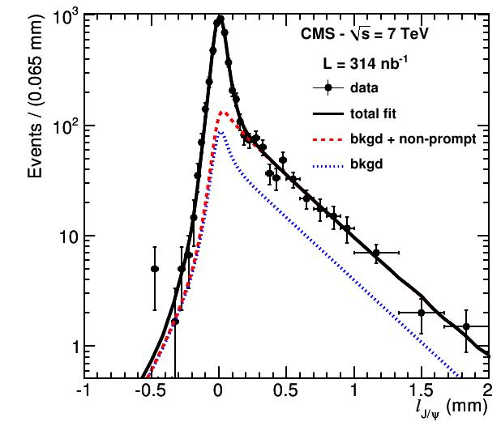
Non Prompt Fraction: mass and decay length 2d fit
Measurement of the prompt/non-prompt components with a 2D ML fit: invariant mass and “pseudo-proper” decay length:
l_{J/ψ} = L_{xy} ∙ m_{J/ψ} / p_{T}
Decay length parametrization:
  Prompt events: δ-function
  Non-prompt events: MC templates
  Background events: asymmetric functional pre-fitted in the side bands
All convoluted with a resolution function

Slide 18
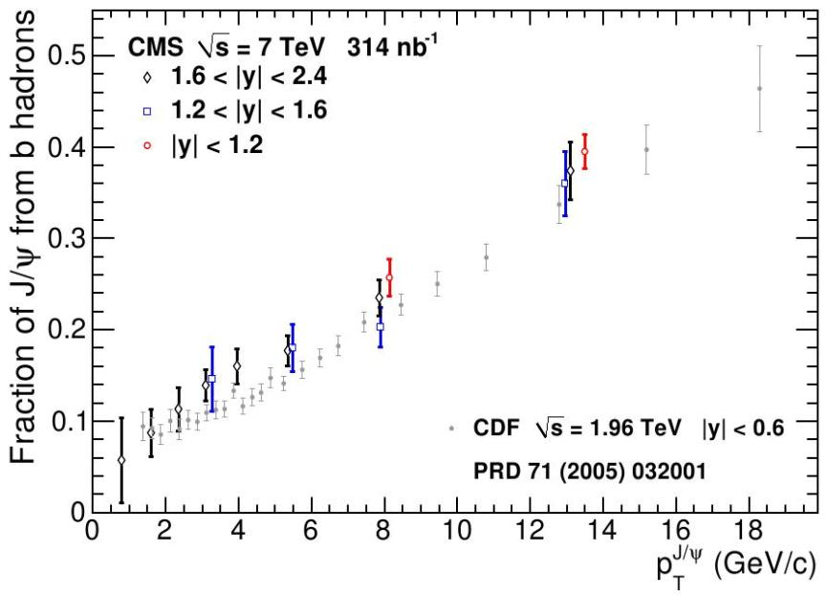
Fraction of the J/ψ cross section originating from b-hadron decays
Main systematic uncertainties:
  Resolution model (0.8 up to 30% for the lowest p_{T} bin in the endcap)
  Primary vertex (0.3 up to 60% for the lowest p_{T} bin in the endcap)

Slide 19
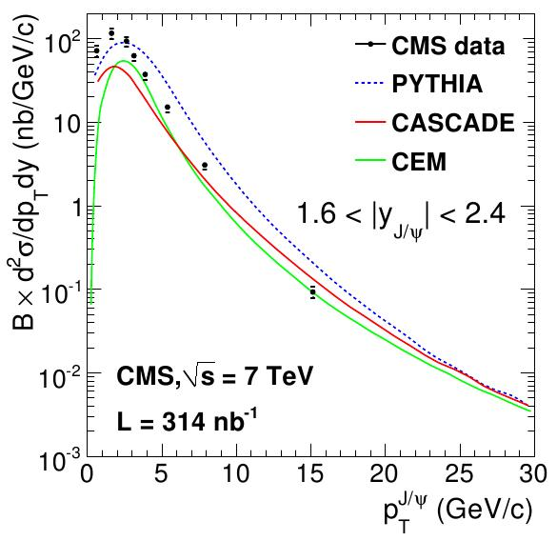
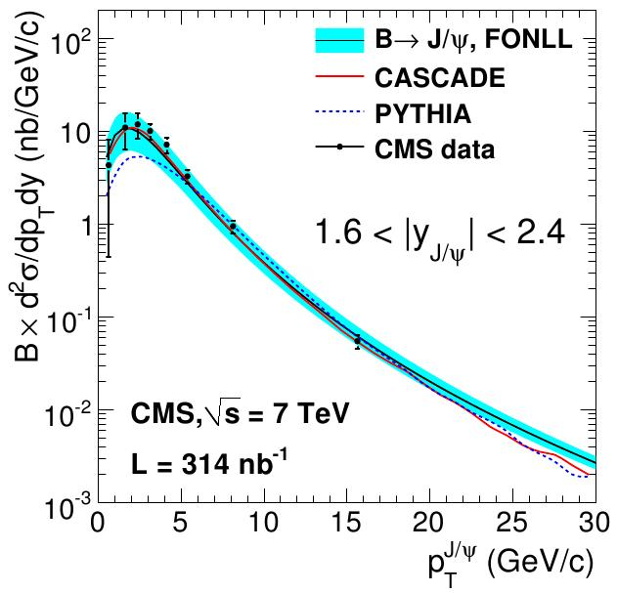
Prompt and Non Prompt Results
prompt
non prompt
In 6.5 < p_{T} < 30 GeV/c and |y| < 2.4:
prompt : 70.9 ± 2.1 (stat) ± 3.0 (syst) ± 7.8 (lum.) nb
non prompt : 26.0 ± 1.4 (stat) ± 1.6 (syst) ± 2.9 (lum.) nb

Slide 20
Conclusions
First measurement of the double differential J/ψ production cross section, in the dimuon decay channel, with L = 314 /nb
The inclusive cross section has been divided into
  prompt (direct and feed-down decays from heavier states)
  non-prompt (from b decays)
For the non-prompt case, there is good agreement between data and the FONLL and CASCADE calculations, both in shape and in absolute normalization
The measured prompt J/ψ cross section is not well described by any of the models we have considered
An improved study with the full 2010 data, including the ψ’ cross section measurement, is ongoing. Stay tuned !

Slide 21
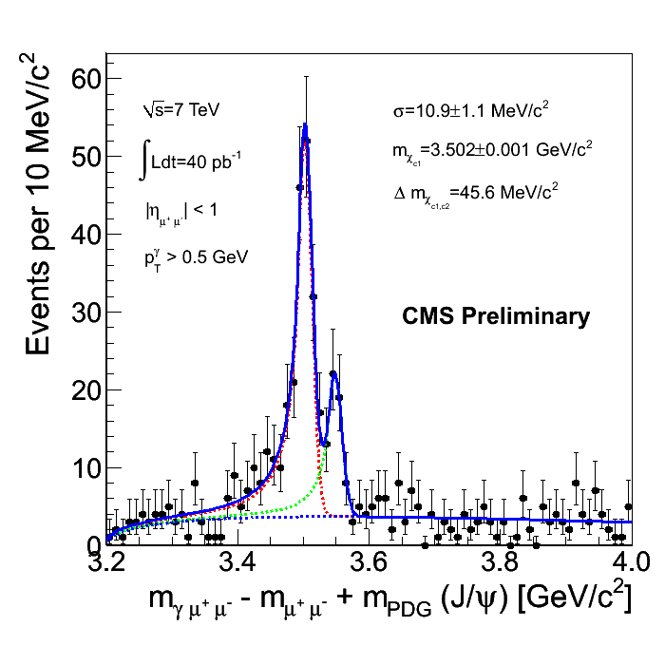
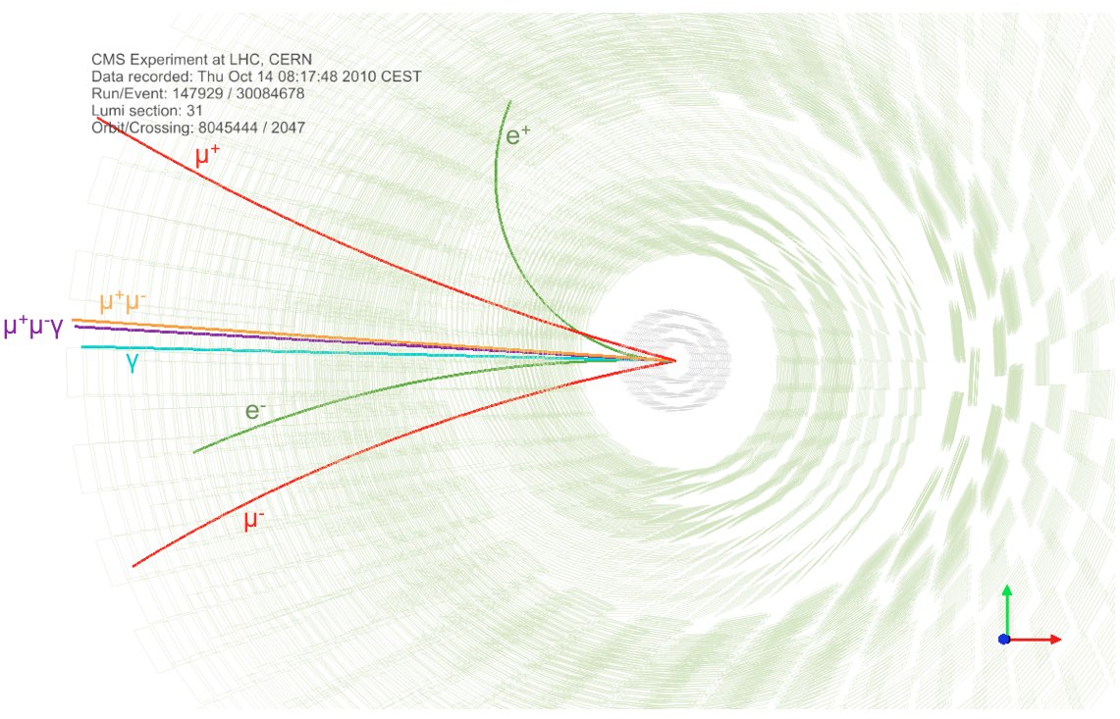
Outlook:
CMS can resolve the χ_{c1} and χ_{c2} states
CMS has observed the χ_{c1} and χ_{c2} charmonium mesons through their radiative decay to J/Ψ + γ
The photons are reconstructed using the photon conversion reconstruction technique.

Slide 22
Backup

Slide 23
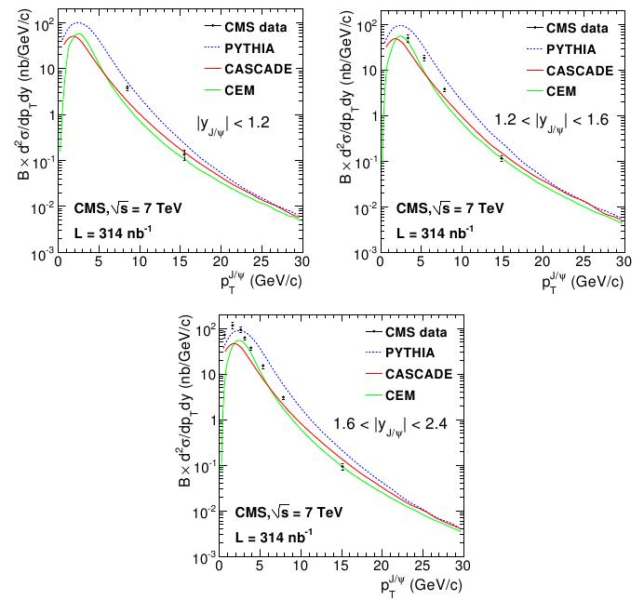
Prompt Cross Section

Slide 24
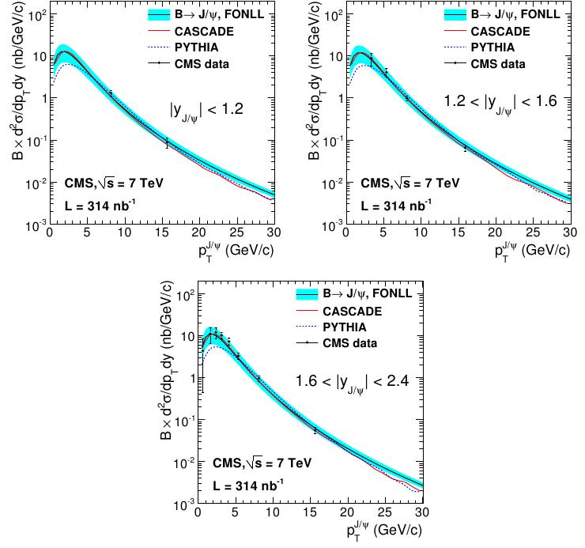
Non Prompt Cross Section

Slide 25
