Slide 1


J/ψ production studies in LHCb
Quarkonium Production
Vienna, Austria
18-21 April 2011
Patrick Robbe, LAL Orsay, 18 Apr 2011
For the LHCb Collaboration

Slide 2
Outline
The LHCb detector
Prompt J/ψ and J/ψ from b cross-section measurement with 5.2 pb⁻¹ data.
Double J/ψ observation.
Exclusive J/ψ production.

Slide 3
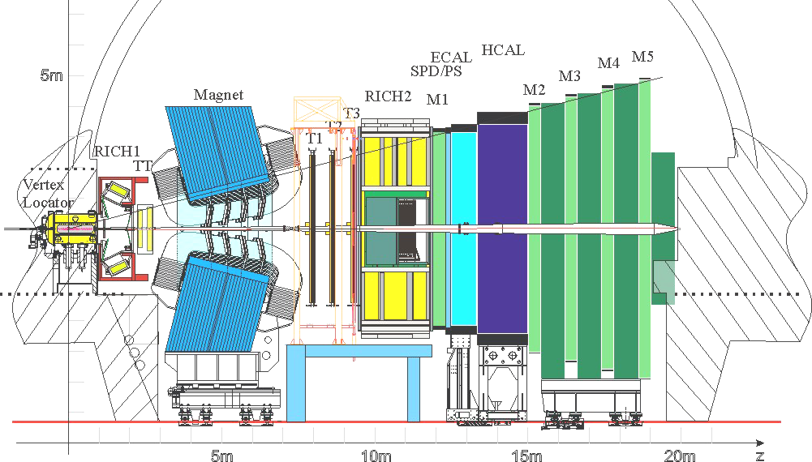
The LHCb Detector
Acceptance: 1.9<η<4.9 for charged tracks.

Slide 4
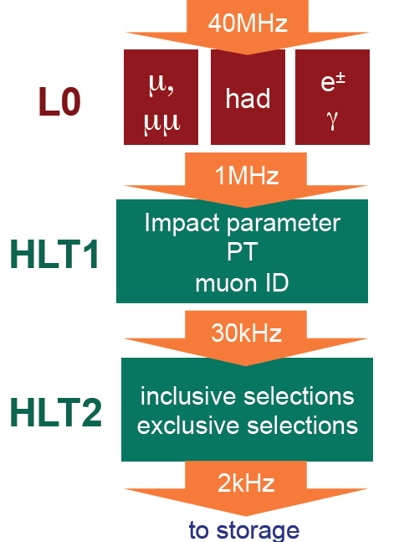
The LHCb Trigger
Level 0: Hardware triggers
From Muon system & calorimeters
High Level Trigger (HLT) 1: Software triggers
Add information from VELO and tracking
stations to Level 0 information
Find primary vertices, etc.
HLT2: Software triggers
Use all of the detector information to make
inclusive and exclusive selections

Slide 5
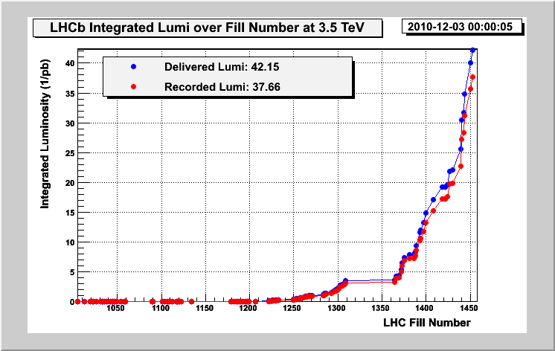
Data Taking
Data used in the J/ψ cross-section
measurement
Full data sample (37pb⁻¹) is used for double J/ψ observation and
exclusive cross-section measurement.

Slide 6
J/ψ cross-section measurement
Double differential cross-section measurement, as a function of the transverse momentum p_{T} and of the rapidity y:
  14 p_{T} bins, p_{T} < 14 GeV/c
  5 y bins, 2<y<4.5
Separately for:
  Prompt J/ψ = direct J/ψ + J/ψ from χ_{c} and ψ(2S) feed-down,
  J/ψ from b decays.
Use (5.2±0.5) pb⁻¹ of data collected end of September 2010 at LHCb, with two different trigger settings, with pp collisions at center-of-mass energy of 7 TeV:
  2.2 pb⁻¹ with standard muon trigger,
  3 pb⁻¹ with the lifetime unbiased muon trigger lines pre-scaled to cope with instantaneous luminosity increase.

Slide 7
Trigger and Selection
Single Muon:
p_{T}>1.4 GeV/c
L0 Trigger:
Di-Muon:
p_{T,1}>0.56 GeV/c, p_{T,2}>0.48 GeV/c
HLT1 Trigger:
Single Muon:
Confirm L0 single Muon and p_{T}>1.8 GeV/c
(Pre-scaled by 0.2 in 3pb⁻¹ of data)
HLT2 Trigger:
Di-Muon:
Confirm L0 Di-Muon and M_{μμ}>2.5 GeV/c²
Di-Muon:
M_{μμ}>2.9 GeV/c²
Global Event Cuts (GEC): reject events with very large multiplicities (93% efficiency)
Selection:
μ tracks:
● well reconstructed tracks identified as muons in muon detector,
● p_{T} > 0.7 GeV/c,
● Track fit quality (χ²/nDoF < 4).
Reconstructed J/ψ:
● mass window: 0.15 GeV/c²,
● vertex fit quality (p(χ²)>0.5%).
Event: at least one reconstructed Primary Vertex (PV): to compute proper-time

Slide 8
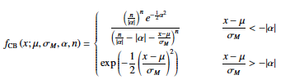
J/ψ Sample
N = 564603 ± 924
Crystal Ball function:
Each mass distributions obtained in the 70 bins are fit with:
  A Crystal Ball function for the signal to take the radiative tail into account,
  An exponential function for the background.

Slide 9
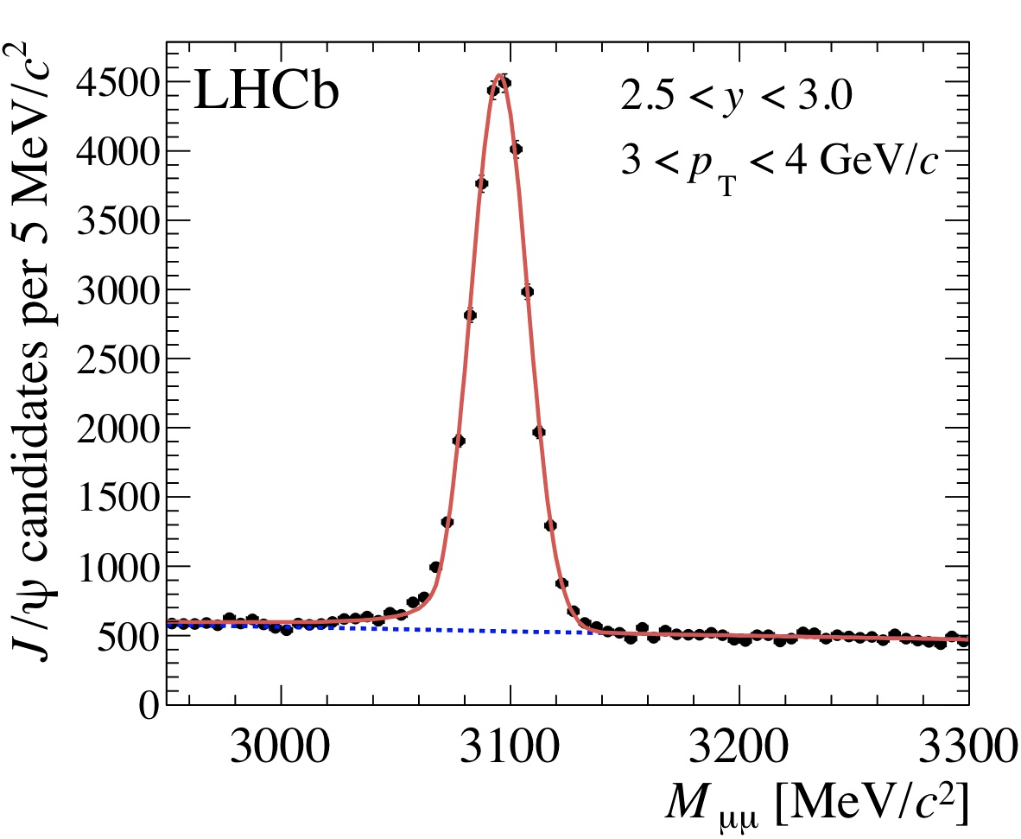
J/ψ Mass fit example
Mass resolution: 12.3 ± 0.1 MeV/c²
Mean mass: 3095.3 ± 0.1 MeV/c²
(stat error only)

Slide 10
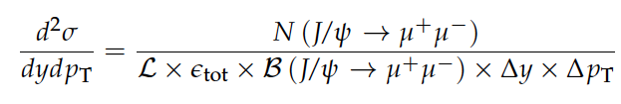
Cross-section Measurement
Computed as:
With:
  N(J/ψ➝μ⁺μ⁻): number of reconstructed signal events, separately prompt and from b.
  L: integrated luminosity (5.2 pb⁻¹)
  ε_{tot}: total detection efficiency, including acceptance, reconstruction, selection and trigger efficiencies.
  B(J/ψ➝μ⁺μ⁻): (5.94 ± 0.06) %
  Δy = 0.5, Δp_{T}=1: bin sizes.

Slide 11
Separation prompt J/ψ / J/ψ from b
Fraction of J/ψ from b is given by fit of t_{z}:
PV

Slide 12
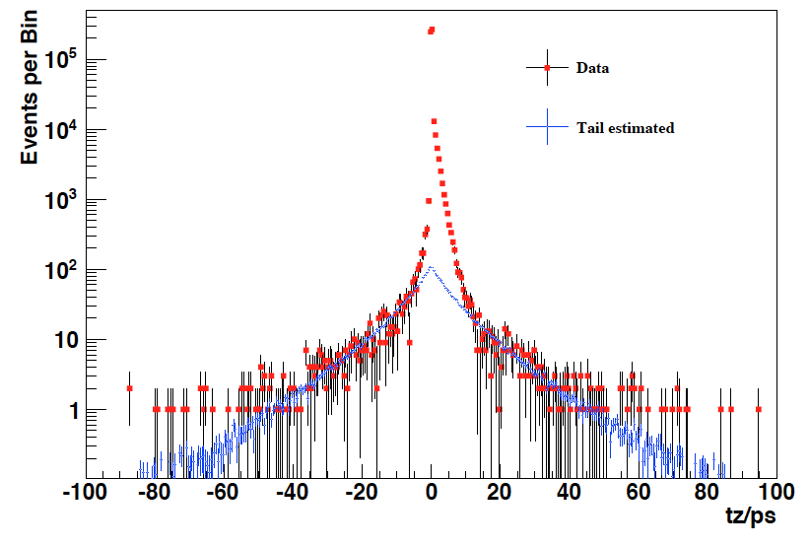
t_{z} tail
Origin of the tail are signal J/ψ associated with the wrong Primary Vertex.
The shape of the tail contribution is determined directly from data, simulating an uncorrelated PV using the one of the next event:
Sideband subtracted
With “next event” method

Slide 13
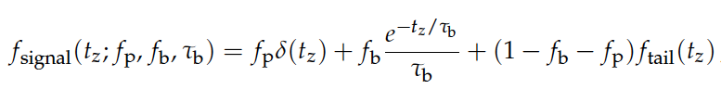
t_{z} signal and background functions
Signal:
Convolved by resolution function: Sum of 2 Gaussians
Background: fit with function describing the shape seen in the J/ψ mass sidebands: 3 positive exponentials and 2 negative exponentials.

Slide 14
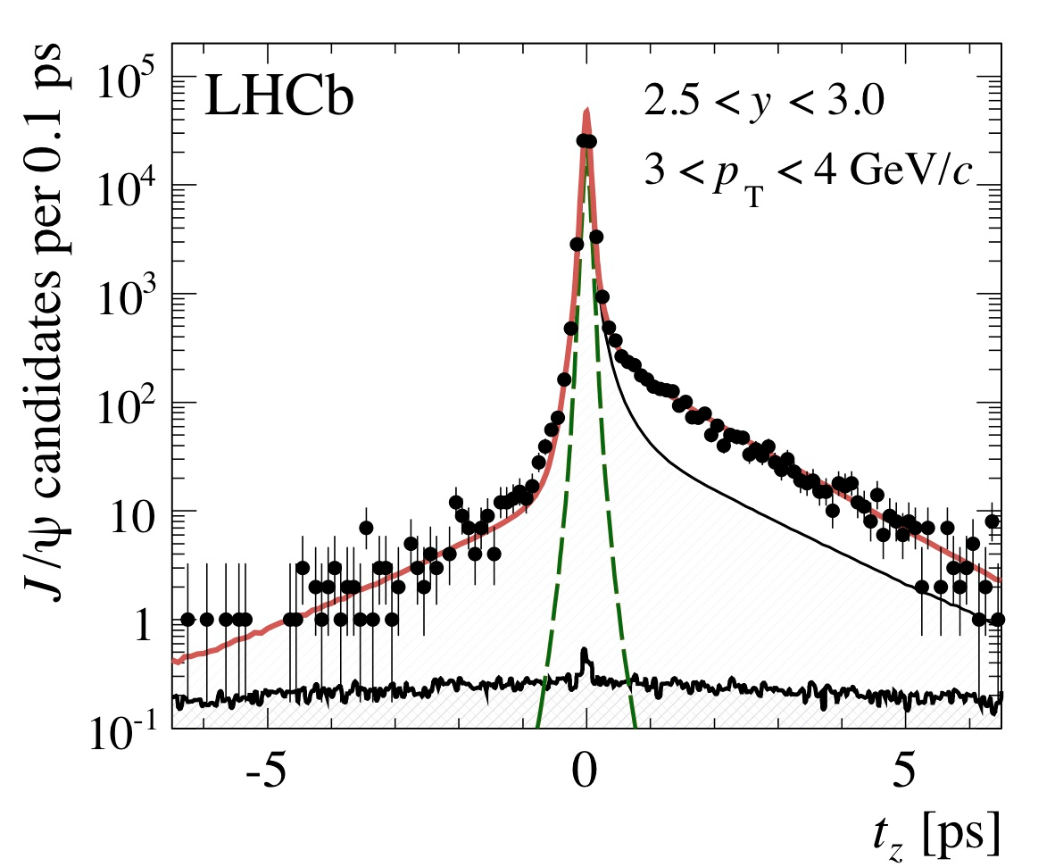
t_{z} fit
Fit is performed in all analysis bins to extract number of prompt J/ψ and of J/ψ from b.
For example, 3<p_{T}<4 GeV/c, 2.5<y<3.
t_{z} resolution: 53 fs

Slide 15
Efficiencies
Efficiencies are computed from Monte Carlo and are extensively checked on data, with control samples.
Efficiencies are checked in Monte Carlo to be equal for prompt J/ψ and J/ψ from b in each (p_{T},y) bin. Small differences are treated as systematic uncertainties.
LHCb Simulation
LHCb Simulation
unprescaled trigger
prescaled trigger

Slide 16
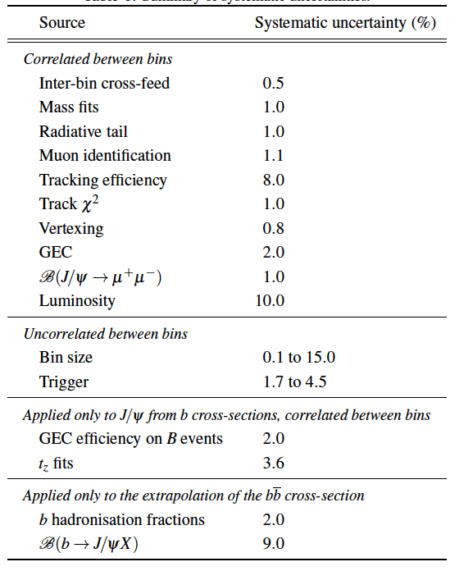
Systematics
Source of systematic uncertainties considered:

Slide 17

Polarization
J/ψ are not polarized in the LHCb simulation.
3 extreme polarization cases studied, in the helicity frame where the angular distribution of J/ψ muons is:
Differences between 3% and 30% depending on the bin: quote 3 different results of the prompt J/ψ cross-section, one for each polarization case (λ_{θ} and λ_{θ} equal to 0).
Also studied effect of φ dependance: gives up to 25% larger difference in the high rapidity bin.
λ_{θ}=+1
λ_{θ}=0
λ_{θ}=-1
17

Slide 18
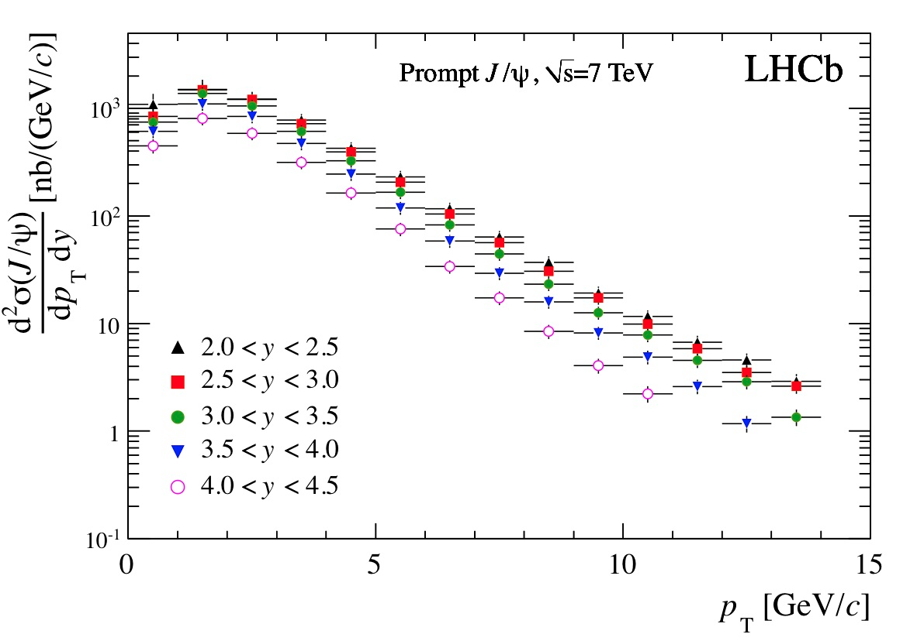
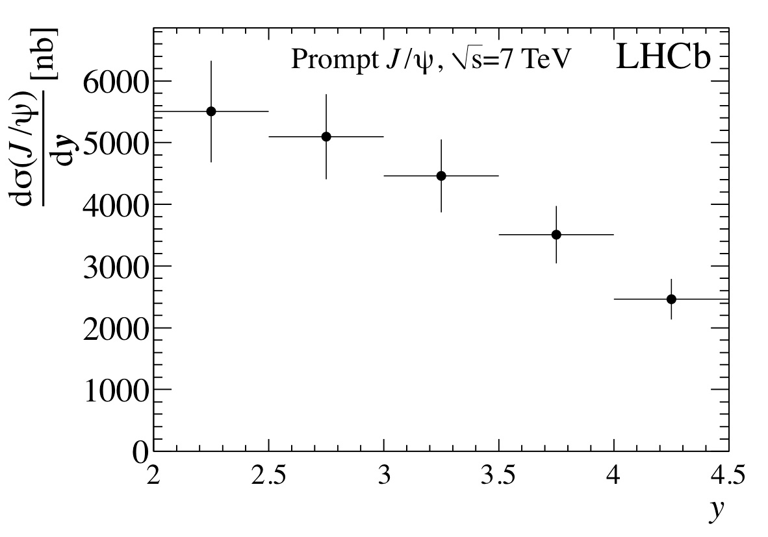
Results: prompt J/ψ cross-section
Unpolarized J/ψ
Integrated over the acceptance:
(stat)
(syst)
(polar)

Slide 19
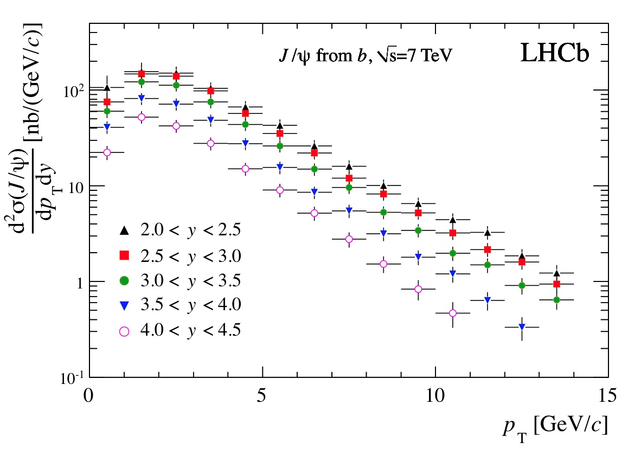
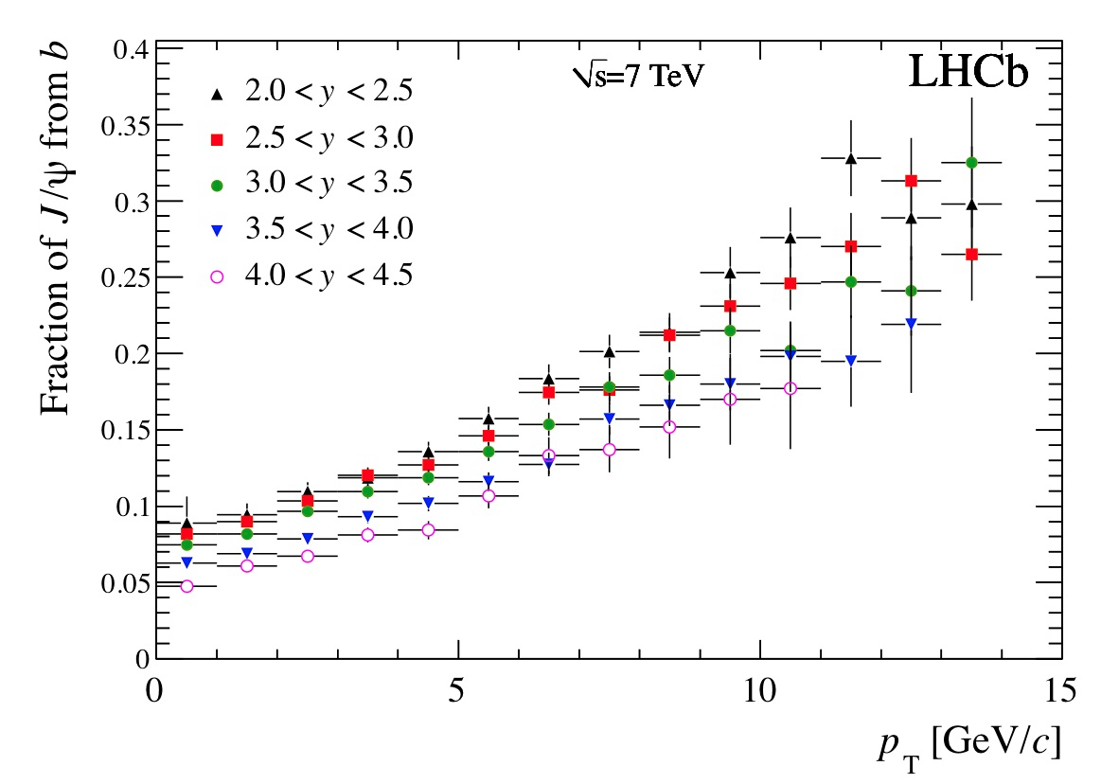
Results: J/ψ from b cross-section
Integrated over the acceptance:

Slide 20



Results: bb cross-section
From the J/ψ from b cross-section, extrapolate to the total bb cross-section in 4π:
α_{4π}: extrapolation factor computed from Pythia 6.4, no uncertainty associated to it, equal to 5.88.
B(b➝J/ψ X)=(1.16±0.1)%: measured at LEP, with 9% uncertainty.
With Tevatron measured hadronization fractions, we estimate B(b➝J/ψ X)=(1.08±0.05)%: assign 2% uncertainty due to hadronization fractions.
Result:
LHCb published value from b➝D⁰μνX (Phys.Lett.B694 (2010) 209)
20

Slide 21
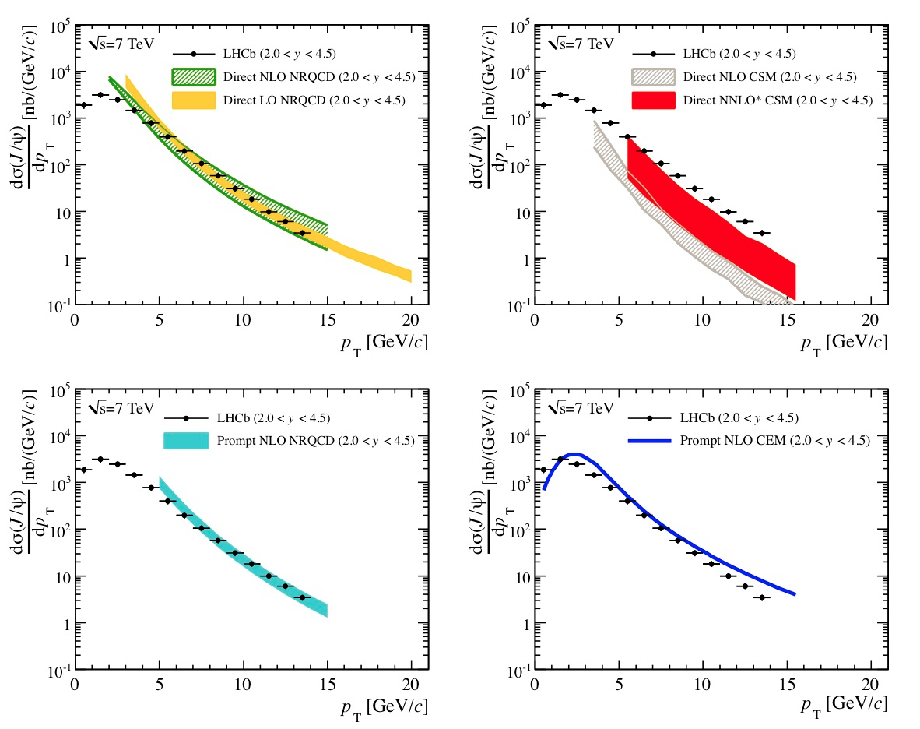
Prompt J/ψ comparison with theory
P. Artoisenet
[PoS ICHEP 2010
(2010) 192]
M. Butenschön
and
B. Kniehl
[Phys. Rev. Lett. 106 (2011)
022301, arXiv:1009.5662 [hep-ph]]
J.-P. Lansberg
[Eur. Phys.
J. C 61 (2009) 693,
arXiv:0811.4005
[hep-ph]]
K. T. Chao et al.
[Phys. Rev. Lett. 106 (2011) 042002, arXiv:1009.3655 [hep-ph]]
R. Vogt
[Phys. Rep. 462 (2008) 125,
arXiv:0806.1013 [nucl-ex]]

Slide 22
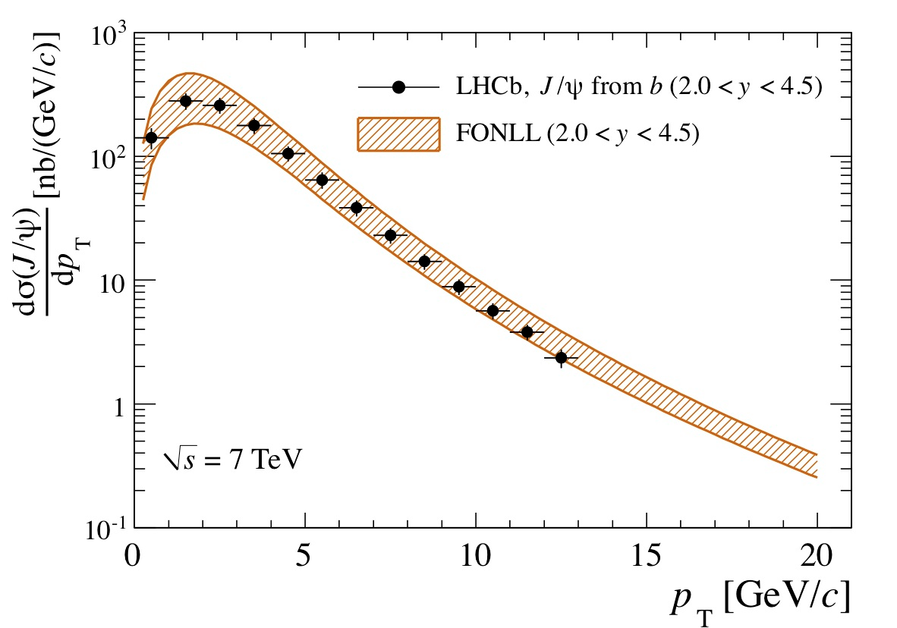
J/ψ from b comparison with theory
M. Cacciari

Slide 23
Double J/ψ production observation
Observed in NA3 (π-platinum) in 1982.
Theoretical predictions [A.V. Berezhnoy et al., arXiv:1101.5881]
  In 4π : σJ/ψ,J/ψ = 24.5 nb
  In LHCb acceptance (2<y<4.5) : σJ/ψ,J/ψ = 4.34 – 4.15 nb
Analysis performed in the range
  2<y<4.5
  p_{T}<10 GeV/c
  With the full 2010 dataset.

Slide 24
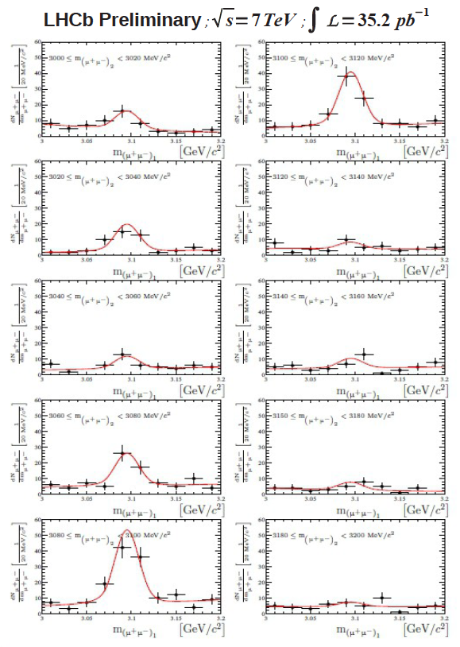
Selection
4 muons from the same vertex,
Fit M(μ⁺μ⁻)₁ in bins of M(μ⁺μ⁻)₂, with:
  Double Crystal Ball for the signal (with tail parameters fixed from the simulation and mass and width from the single J/ψ sample),
  Exponential for the background.

Slide 25
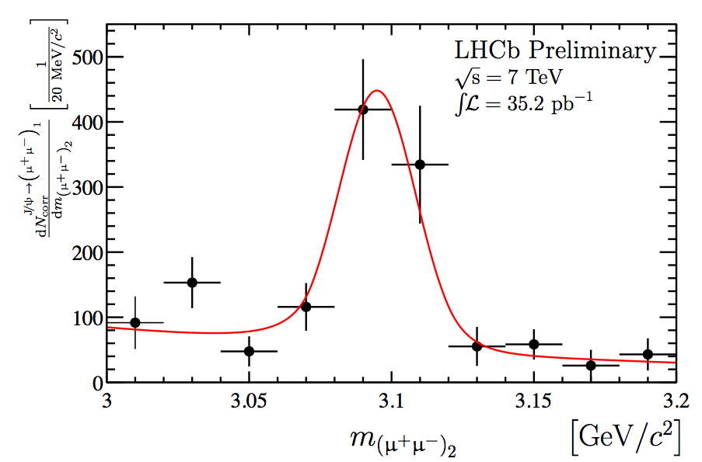
Cross-section determination (1)
Correct each event with ε⁻¹.
Fit M(μ⁺μ⁻)₁ event yields projected M(μ⁺μ⁻)₂ distribution:
N = 667.1 ± 127.0

Slide 26
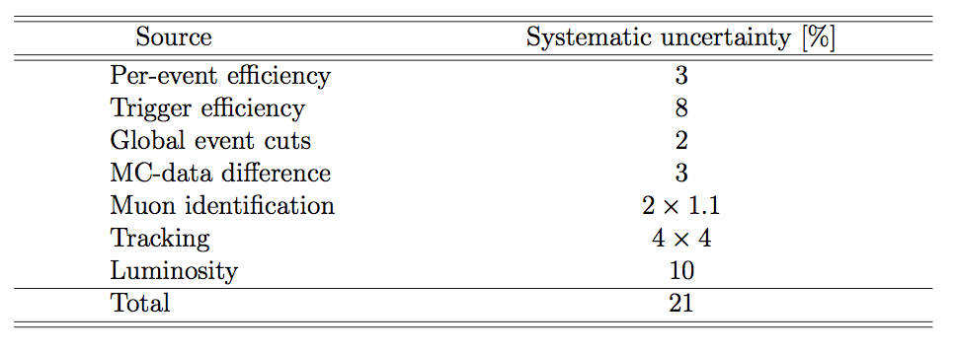

Cross-section determination (2)
Source of systematic uncertainties
Results
= 5.6 ± 1.1 ± 0.5 ± 0.9 (tracking) ± 0.6 (lumi) nb

Slide 27
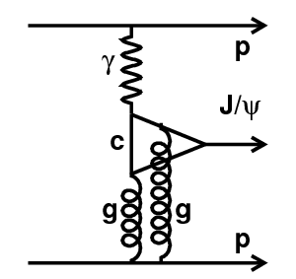
Exclusive J/ψ production
Production of 1 J/ψ and nothing else: possible if one colourless object is exchanged.
Unambiguous evidence of pomeron, search for odderon.
Selection:
  No backward tracks (gap of 2 units of rapidity)
  Only 2 forward muons.
  p_{T}(μμ)<900 MeV/c
  No photons

Slide 28
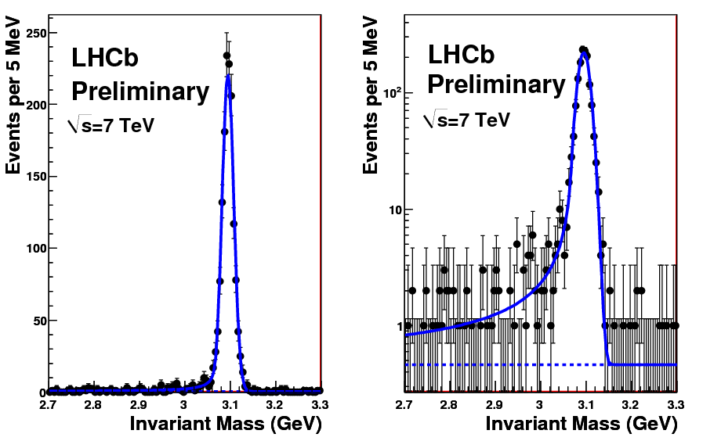
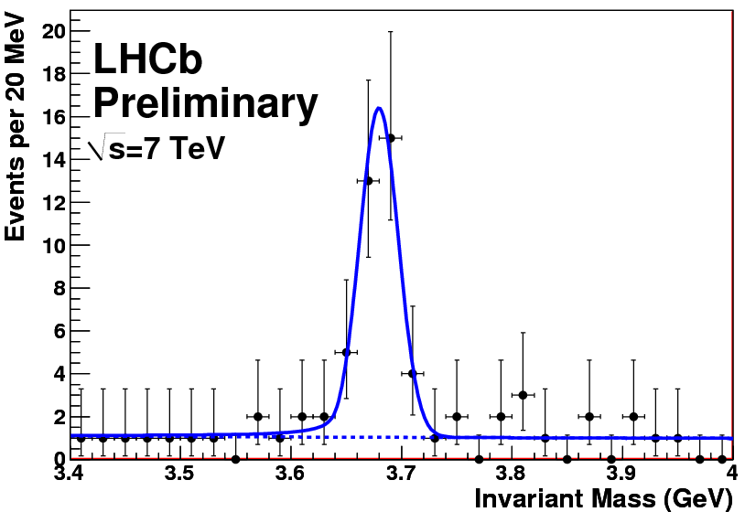
Exclusive J/ψ mass spectrum
J/ψ
ψ (2S)

Slide 29
Exclusive J/ψ cross-section
σ(J/ψ → μ⁺μ⁻, 2<η(μ⁺),η(μ⁻)<4.5) = 474 ± 12 ± 45 ± 92 pb
σ(ψ(2S) → μ⁺μ⁻, 2<η(μ⁺),η(μ⁻)<4.5) = 12.2 ± 1.8 ± 1.2 ± 2.4 pb
σ(ψ(2S))/σ(J/ψ) = 0.20 ± 0.03
  CDF: σ(ψ(2S))/σ(J/ψ) = 0.14 ± 0.09
  HERA: σ(ψ(2S))/σ(J/ψ) = 0.166 ± 0.012
  Theory predictions:
    σ(J/ψ → μ⁺μ⁻, 2<η(μ⁺),η(μ⁻)<4.5)
      Starlight (Klein and Nystrand): 292 pb
      SuperChic (Harland-Lang, Khoze, Ryskin, Stirlin): 330 pb
      Motyka and Watt: 330 pb
      Schafer and Szczurek: 710 pb
    σ(ψ(2S) → μ⁺μ⁻, 2<η(μ⁺),η(μ⁻)<4.5)
      Starlight (Klein and Nystrand): 6 pb
      Schafer and Szczurek: 17 pb

Slide 30
Conclusions
Conclusions
J/ψ cross-section measurement at LHCb with 5 pb⁻¹ of data, as a function of p_{T} and y, [arXiv:1103.0423], submitted to EPJC.
Large uncertainties due to unknown J/ψ polarization: future polarization measurement will address this issue.
Observation of double J/ψ production in hadronic collisions [LHCb-CONF-2011-009].
Observation of central exclusive production of J/ψ [Conference note in preparation].

Slide 31
Comparison with theory
x 70%
x 70%

Slide 32
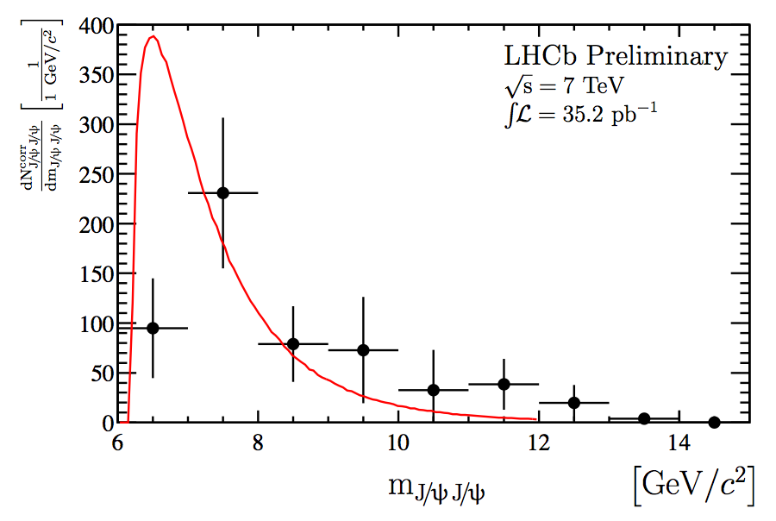
M(J/ψ J/ψ)

