Slide 2
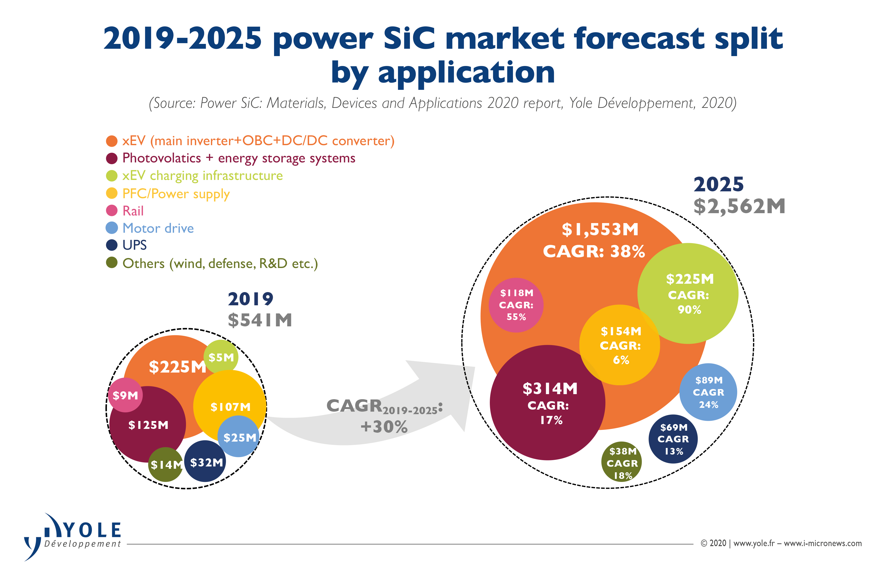
High quality, low defect density SiC is available up to 200 mm wafers
Compound Annual Growth Rate (CAGR)

Slide 3
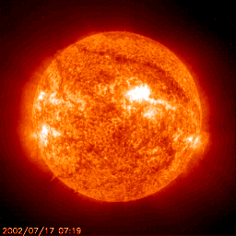
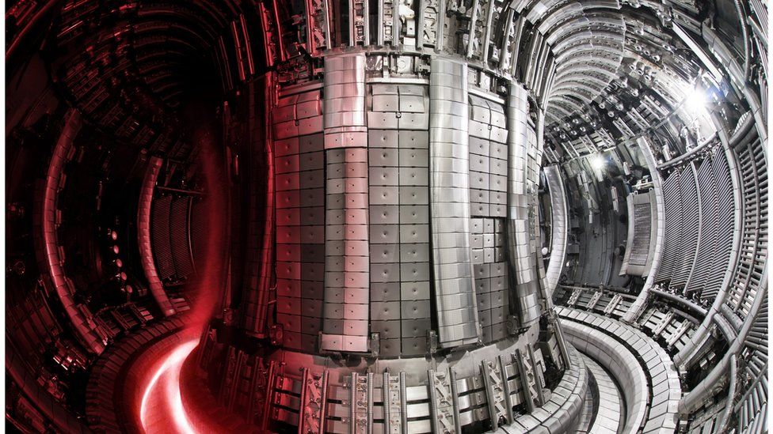
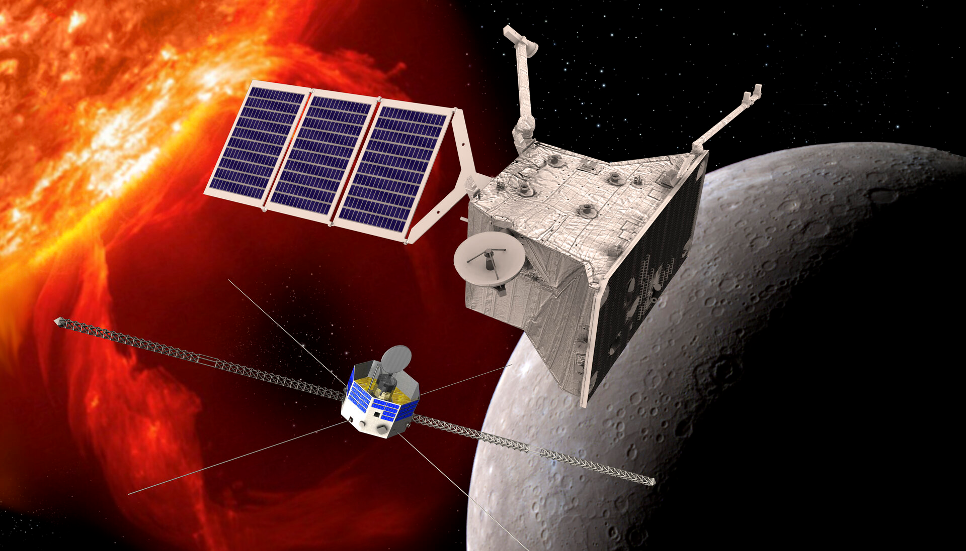
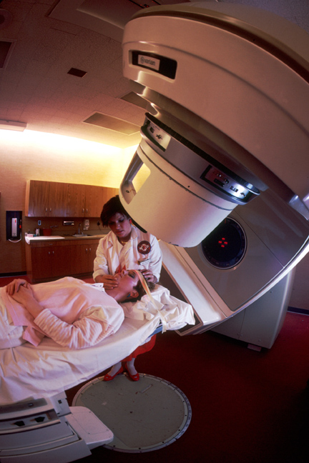
Many potential applications in sensors
Nuclear fusion reactors
-Plasma diagnostic
Aerospace
-Sensors and electronics
Medical
-Dosimetry in FLASH therapy and microdosimetry

Slide 4
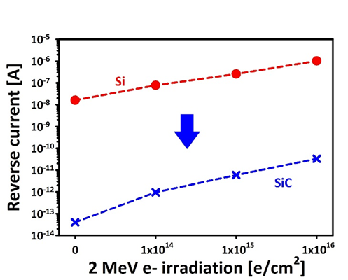
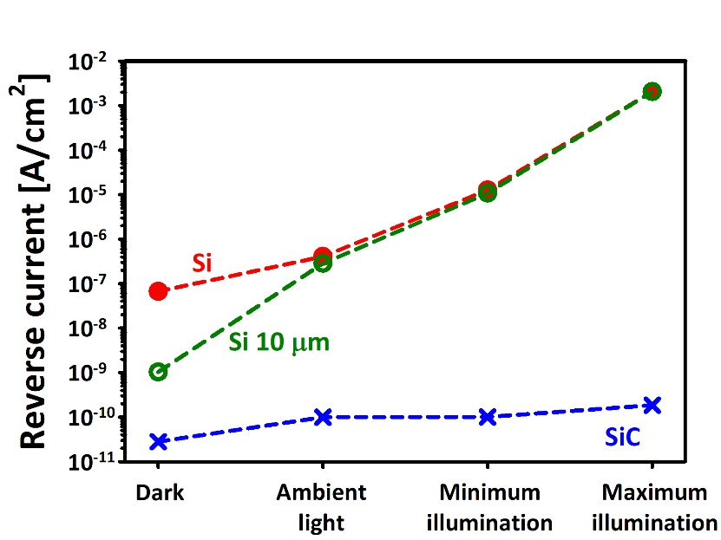
Advantage of using SiC
Wide bandgap that reduces the leakage current, maintaining low noise levels even at high temperatures.
Insensitive to visible light.
High atomic displacement threshold (~20 eV for C, and ~40 eV for Si), which should make the material more radiation resistant;
Fast saturated electron drift velocity (2x10⁷ cm/s at room temperature), twice faster than silicon;
High thermal conductivity (490 Wm⁻¹K⁻¹), which is three times higher than that of Si, and ten times higher than that of GaAs.

Slide 5
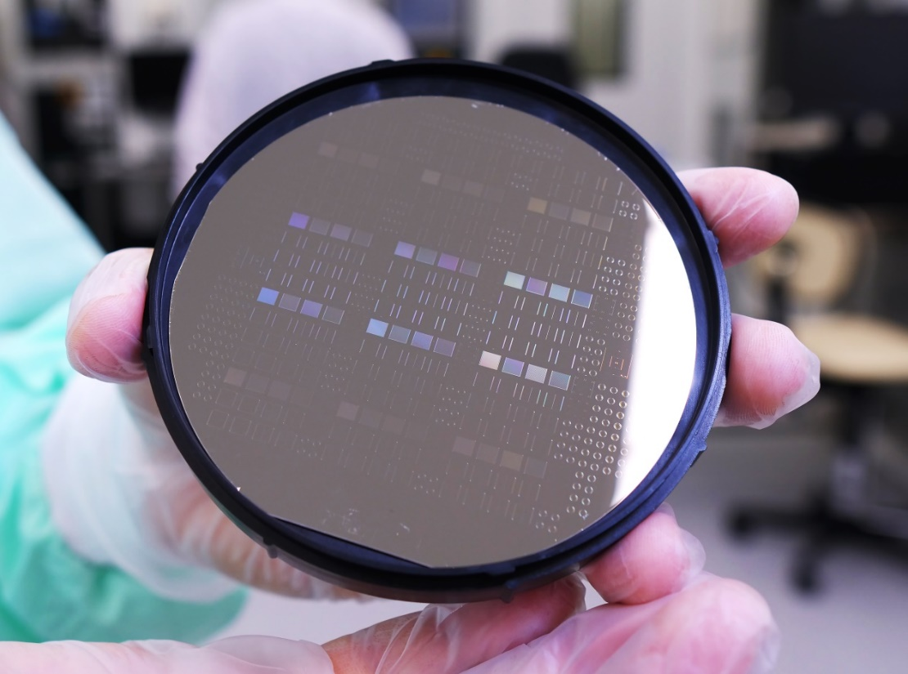
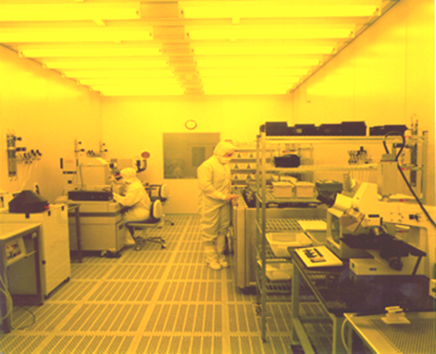
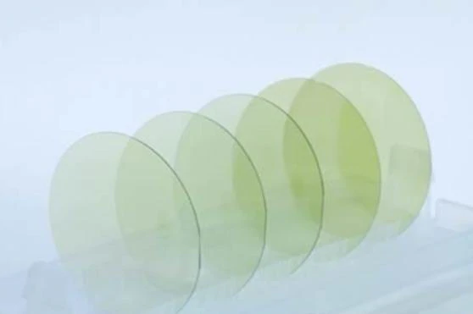
SiC detectors fabricated at the IMB-CNM clean room
Technology based on :
SiC rectifiers for space
  Bepi-Colombo & Solar orbiter missions
  Main contractors EADS, Airbus, ALTER
DOI: 10.1109/TDMR.2009.2029090

Slide 6
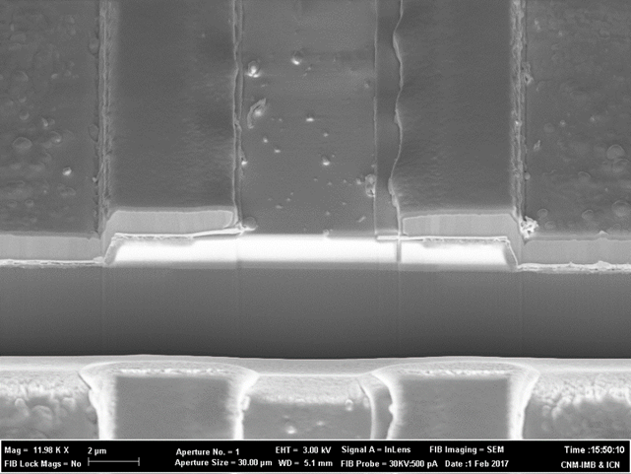
Detector technology SiC
SiC based “P on N” diode fabricated on 4H-SiC on a 50um high resistivity n-type doped epi-layer. 100 or 150mm wafers.
The technology has been optimized with high temperature processers and metal contacts.
J.M. Rafí et al 2018 JINST 13 C01045

Slide 7
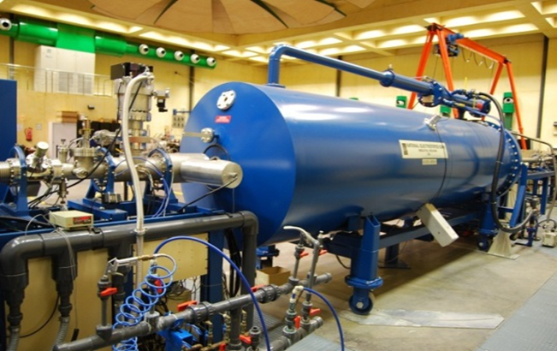
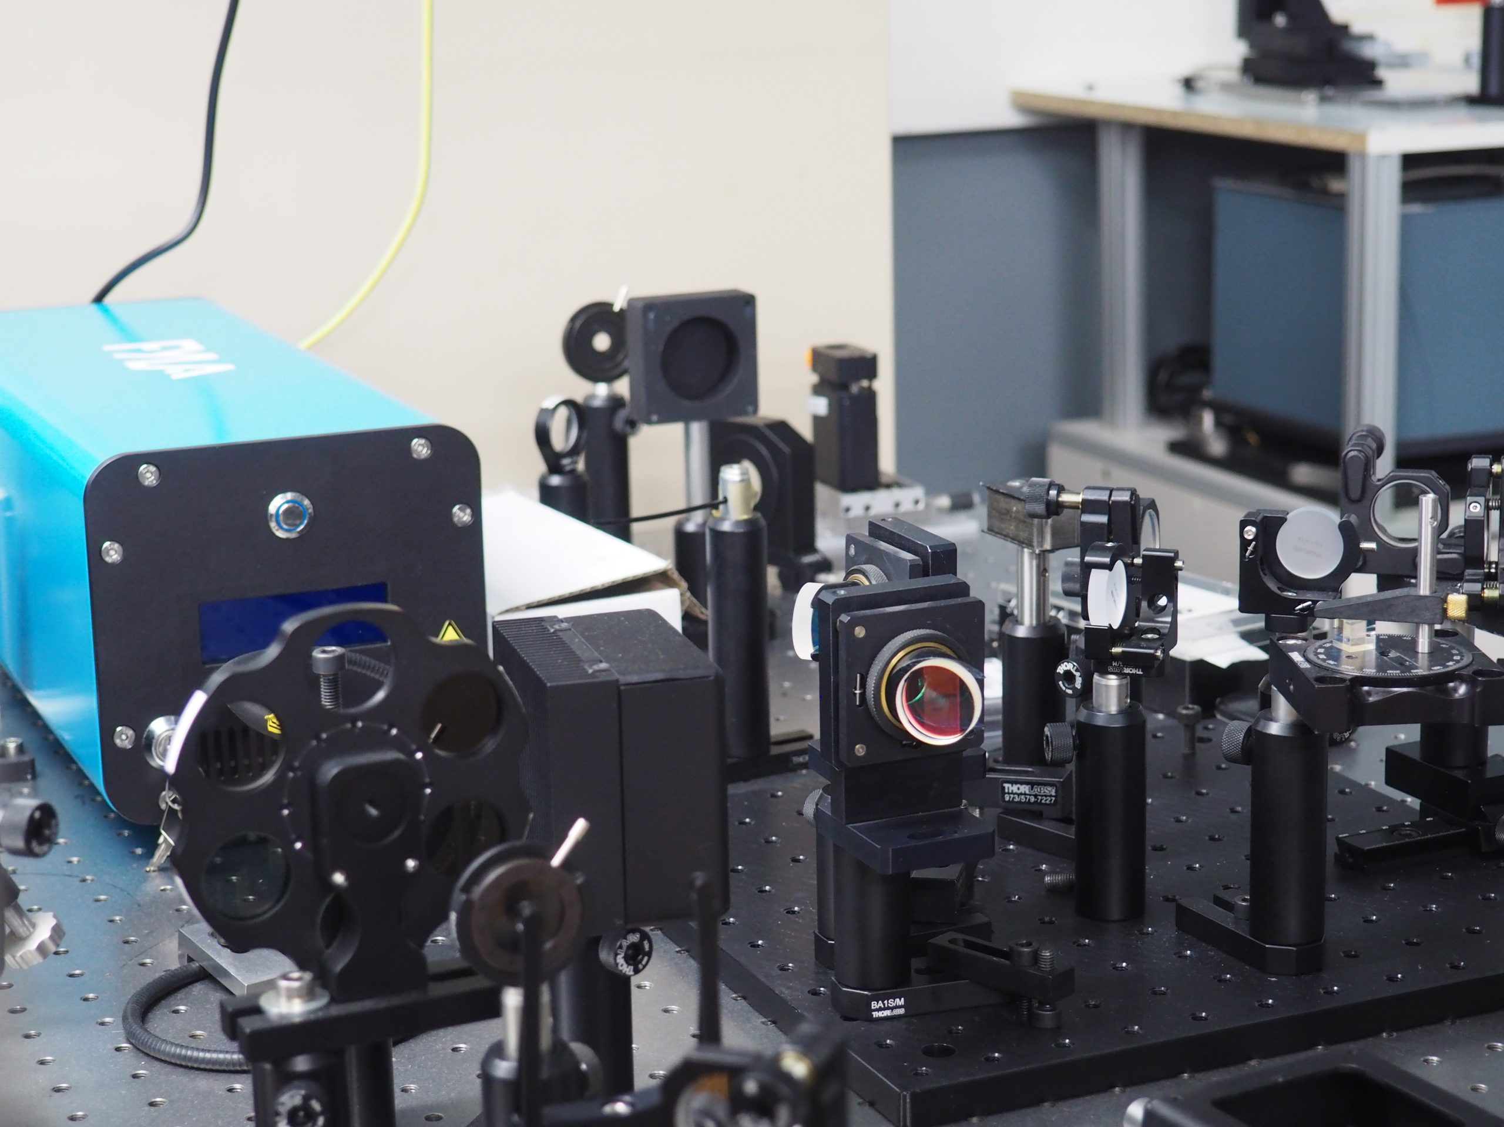
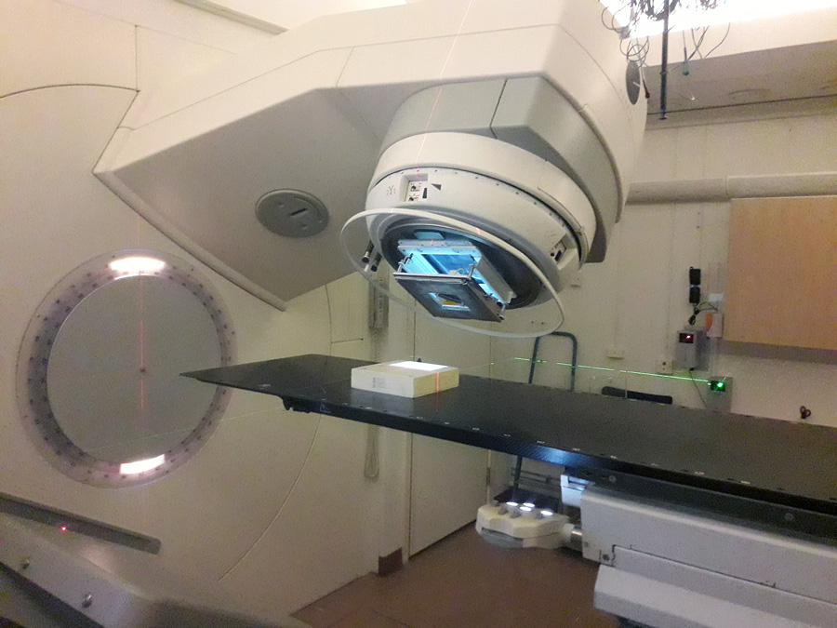
Testing at different facilities
SiC measurements at high temperature at the 3 MeV Tandem.
TPA-TCT, with two photons producing one electron-hole pair, and the energy is deposited at the laser focal point, so this permits a 3D spatial resolution.
FLASH effect conditions* : Irradiations with con Ultra-High Dose Rate pulsed radiation reduce adverse effects in healthy tissues. Tested in PTB, Germany electron FLASH.
*Favaudon et al., Sci Transl Med 6 (2014)

Slide 8

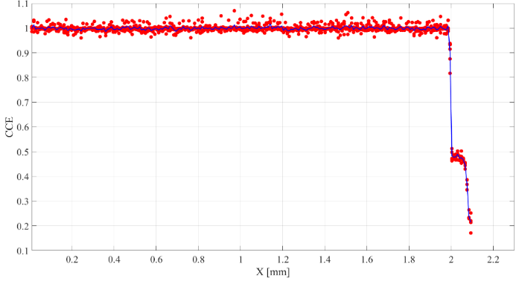
CCE homogeneity study
M.C. Jiménez-Ramos, J. García López , A. García Osuna
Homogeneity IBIC measurements on the microprobe line at CNA with He²⁺ @ 3.5 MeV.
The mean standard deviation is ~1%.
Jiménez-Ramos M.C et al., Radiation Physics and Chemistry 177 (2020) 109100b

Slide 9

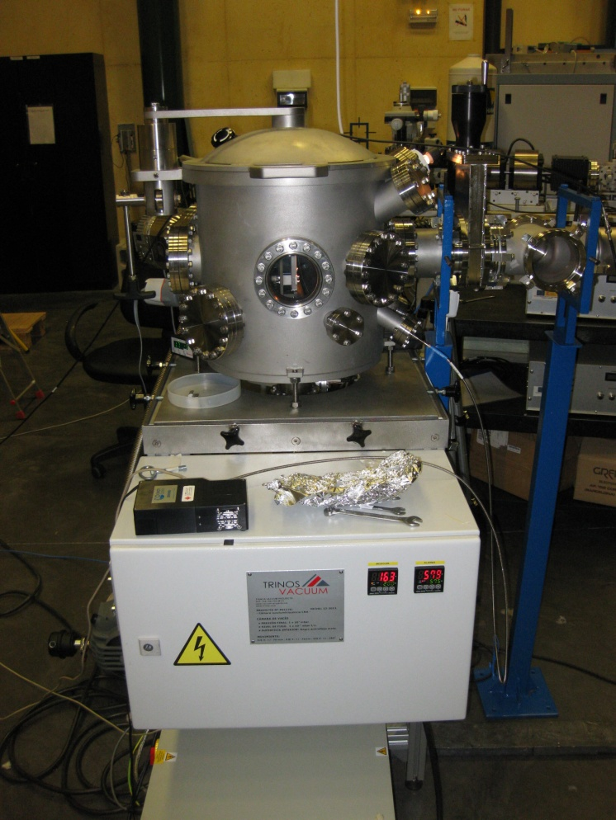

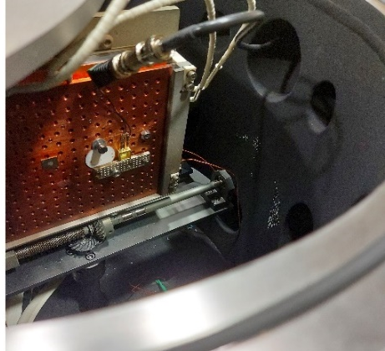
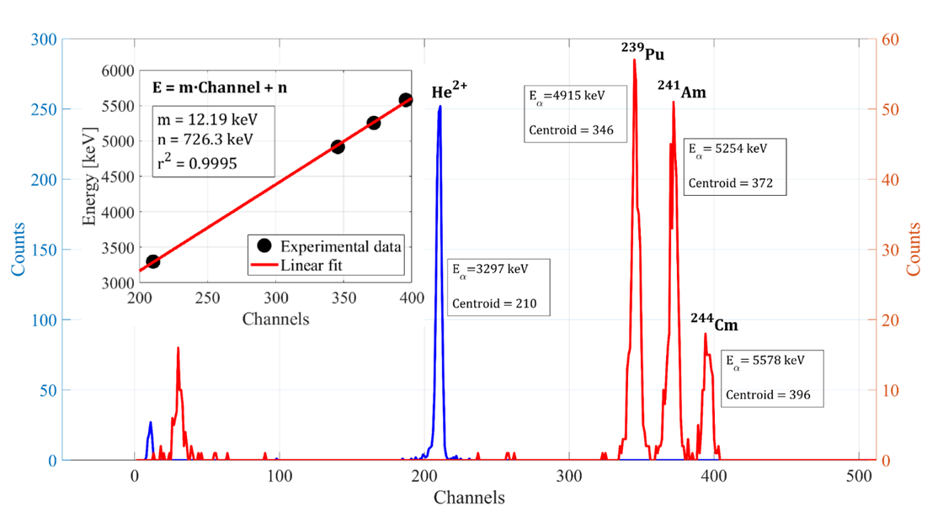
High temperature setup
Detectors mounted on a special package certified for high temperature.
Tested with thermal cycles during various days.
TO257 package
Ag Sintering
Gold bondings
Calibration with He2⁺ ions
Vacuum chamber for high temperature measurements.
Furnace accommodated inside the chamber (RT-500 ºC)

Slide 10
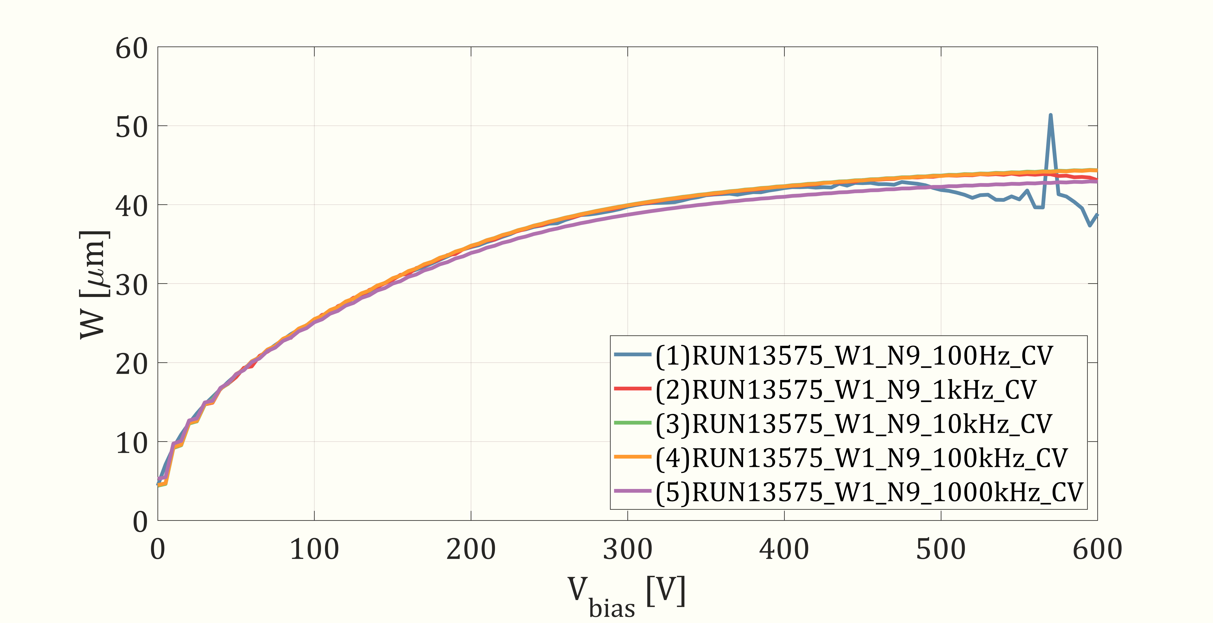
Alpha source measurement at RT for setting the operation voltage
²⁴⁴Cm emisión ~ 5,8 MeV
Range ~ 19 μm
At 40 V the depletion zone is thick enough to completely stop the 5.8 MeV alpha particles and the CCE signal saturate.
Both electronic noise and reverse current increase at higher voltages during high temperature measurements, so it was decided to perform the experiments at 40 V.

Slide 11

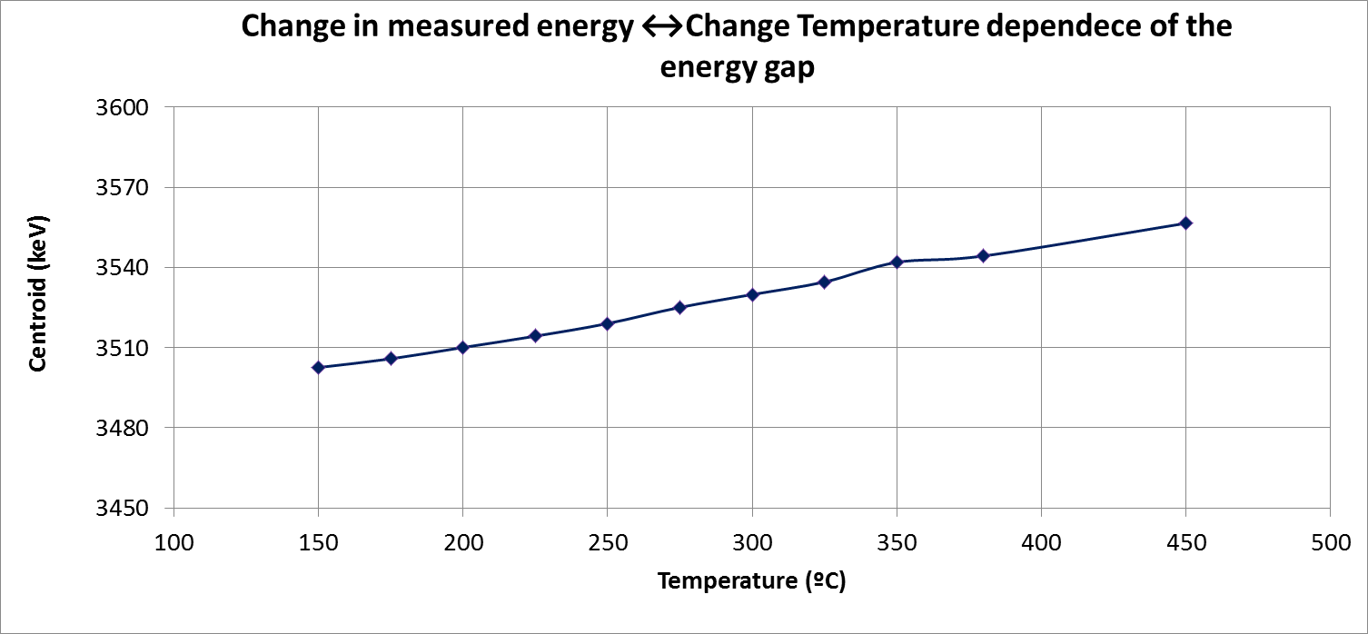
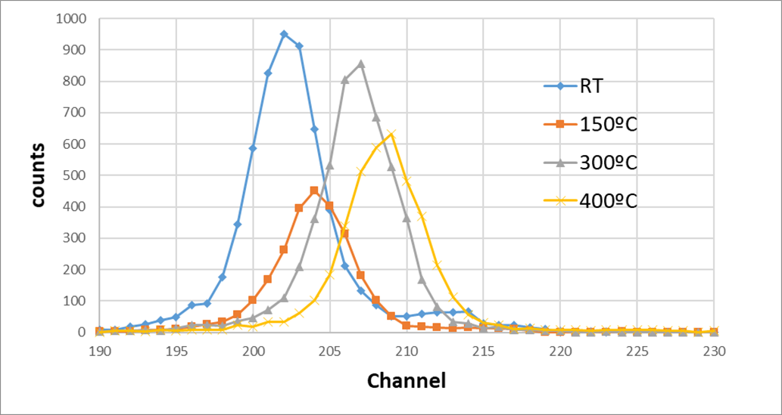
Measurements done at : TAMARA Temperature Analysis Measurements And Radiation Applications
Measurements from RT to 450ºC
IBIC using 3.5 MeV alphas

Slide 12
Pair creation energy vs T
The increase of energy collected vs T is excepted:
Pressure and Temperature Dependence of Energy Gap in SiC and Si 1-x Ge x.
DOI: 10.33899/rjs.2019.163296

Slide 13
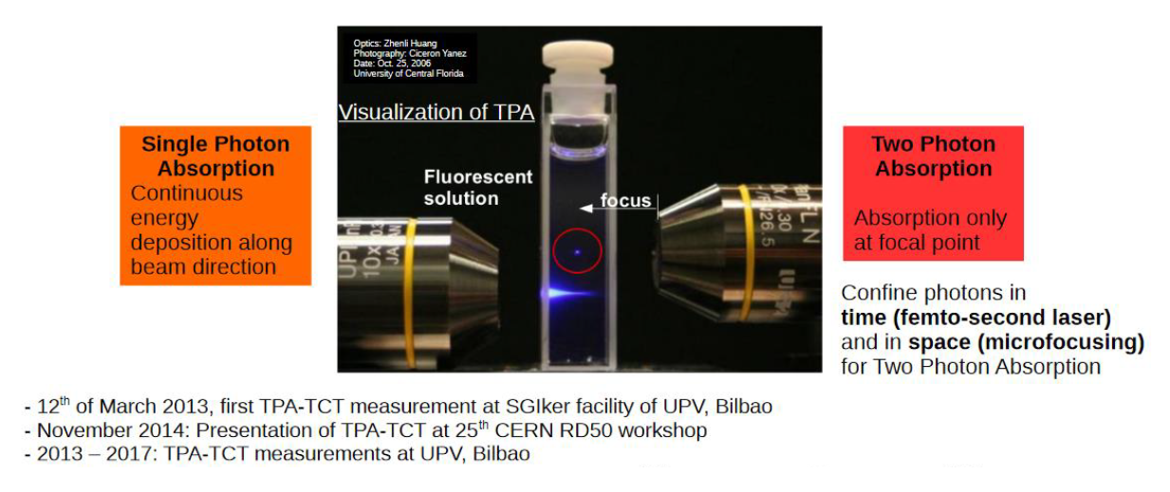
Two Photon Absorption TPA
Metal opening
Wave length (800nm) adapted to the SiC bandgap for the TPA
I. Vila et al., “TPA-TCT: A novel transient current technique based on the two photon absorption (TPA) process,” in Proc. 25th RD Workshop. Geneve, Switzerland: CERN, 2014, pp. 17–19.
Esteban Curras et al., Caracterization of neutron irradiated IMB-CNM SiC planar diodes with TPA-TCT, RD50 workshop 2022

Slide 14

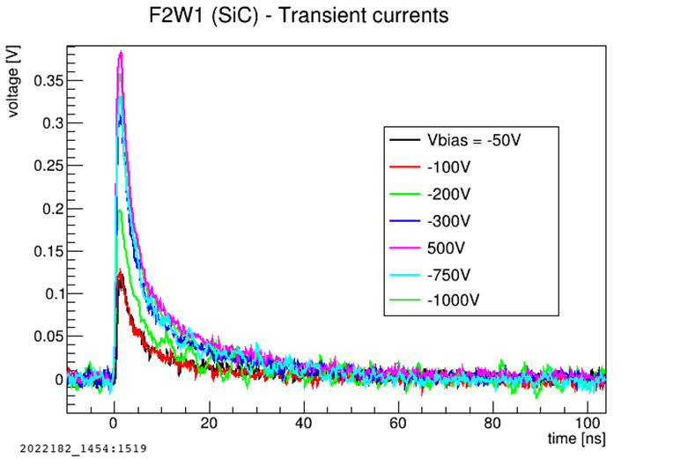
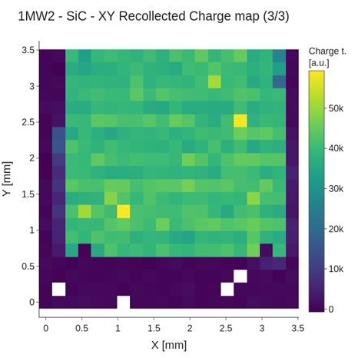

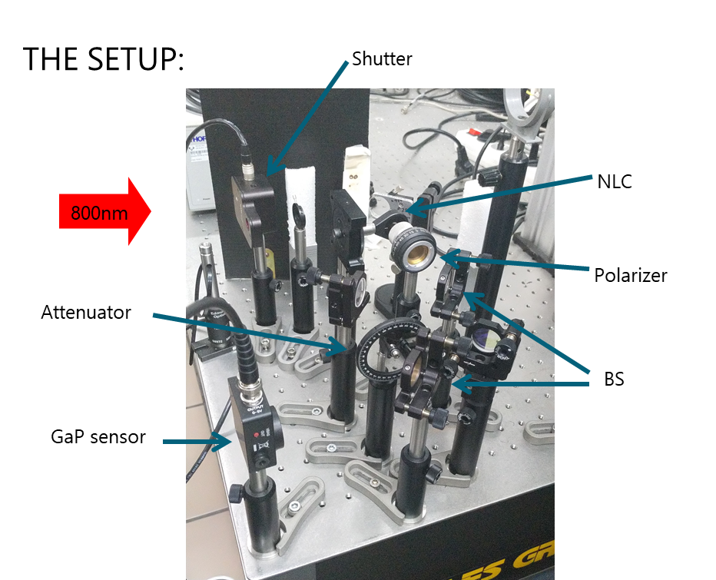
First measurements of SiC diodes with TPA
Rise time on the order of few hundreds of ps
C. Quintana, I. Vila, R. Montero
Ref: http://dpnc.unige.ch/seminaire/talks/fernandez.pdfhttp://dpnc.unige.ch/seminaire/talks/fernandez.pdf

Slide 15
Depletion width vs bias: non irradiated
Neff=1.3 E14/cm2 in agreement with the nominal doping
Diode fully depleted between 300-500 volts
Homogeneity in the sensor depletion

Slide 16
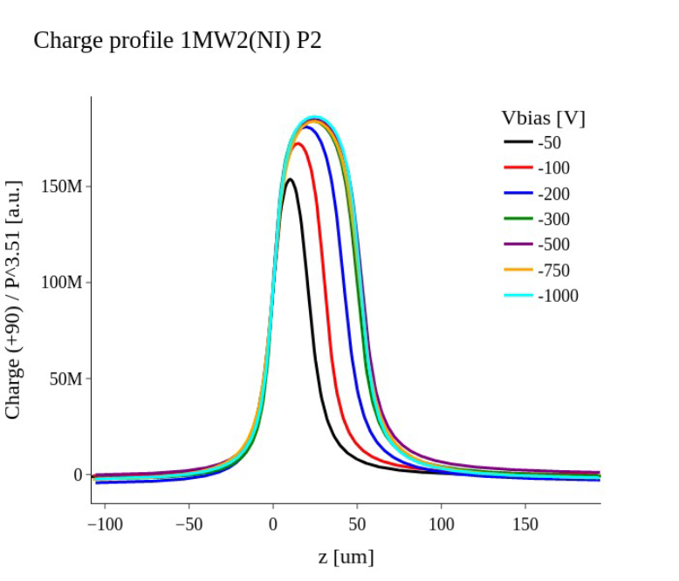
Z-scan charge profiles: non-irradiated diodes
depletion
50um
Z-scan
300um
Detector is 50um thick, nominal value

Slide 17
Z-scan charge profiles: irradiated diodes
Neutron-irradiated (ATI Vienna) July/Aug 2021
Fluences are in 1MeV neutron equivalent /cm2
The diode behavior lost!
Capacitor-like charge collection
No charge collection saturation with bias voltage

Slide 18
Depletion width vs bias: irradiated
Both figures show that the depletion width is constant for the irradiated detectors.
The depletion width is different if we compare irradiated and non-irradiated detectors, but also between the irradiated ones

Slide 19
Charge collection efficiency
Dependence with irradiation:
Charge collection increases with bias
Charge collection decreases with irradiation.
Lost of charge due to signal trapping in the resistive electrode (metal opening for TPA).

Slide 20

FLASH radiotherapy: dosimetry
FLASH effect (Favaudon et al., Sci Transl Med 6 (2014)): Irradiations with con Ultra-High Dose Rate pulsed radiation reduce adverse effects in healthy tissues.
Need real-time, highly precise dosimeters
CNM is a partner in the European project EMPIR-UHDPulse (2019-2023) for metrology in UHDR beams
FLASH: h(> 40Gy/s) while keeps same tumor control & "need real-time, highly precise dosimeters since standard dosimeters saturate"
C. Fleta and G. Pellegrini

Slide 21

First tests of CNM’s SiC diodes in conventional RT dosimetry
50kV X-rays, 0 V bias
F. Gomez USC
(~ 18kGy max. dose @ 3.5h)
Linearity deviation with 50 kV X-rays integrated dose delivered is less than 1.5%
Medium-term stability with integrated dose up to 18 kGy X-rays is better than 0.3%

Slide 22
Electron beam
9 MeV electrons, 40 V bias.
Reference dosimeter: PPC40 @ -400 V
SiC diodes fabricated at CNM show good performance as dosimeters in conventional RT beams where they are a promising alternative to other semiconductor materials.
Currently tests are being performed to evaluate their capabilities in Ultra-High Dose Rate beams.
Linearity deviation with dose per pulse of 9 MeV electrons up to 2.5 mGy is less than 1.5%
F. Gomez USC

Slide 23
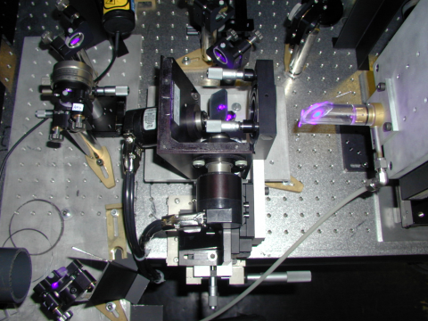
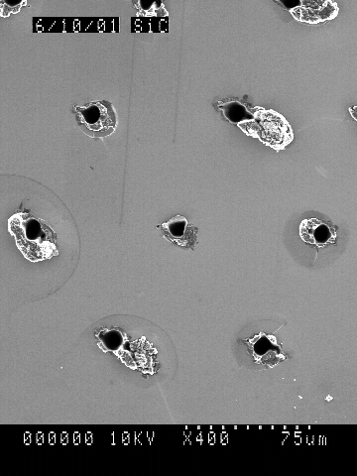
3D in SiC material
Reduce electrode distance keeping a thick substrate
New Deep RIE for Si and SiC materials will be available soon in our Clean Room
Laser drilling seems a possible solution
Possibility to fabricate 3D detectors or other MEMS structure
Laser drilling [1]
SiC
diameter :8μm.
depth :300μm.
G. Pellegrini, “Technology development of 3D detectors for high energy,” PhD Thesis, University of Glasgow, 2003.
S. Nida et al., “Silicon carbide X-ray beam position monitors for synchrotron applications,” Journal of Synchrotron Radiation, vol. 26, no. 1, pp. 28-35, 2019.

Slide 24
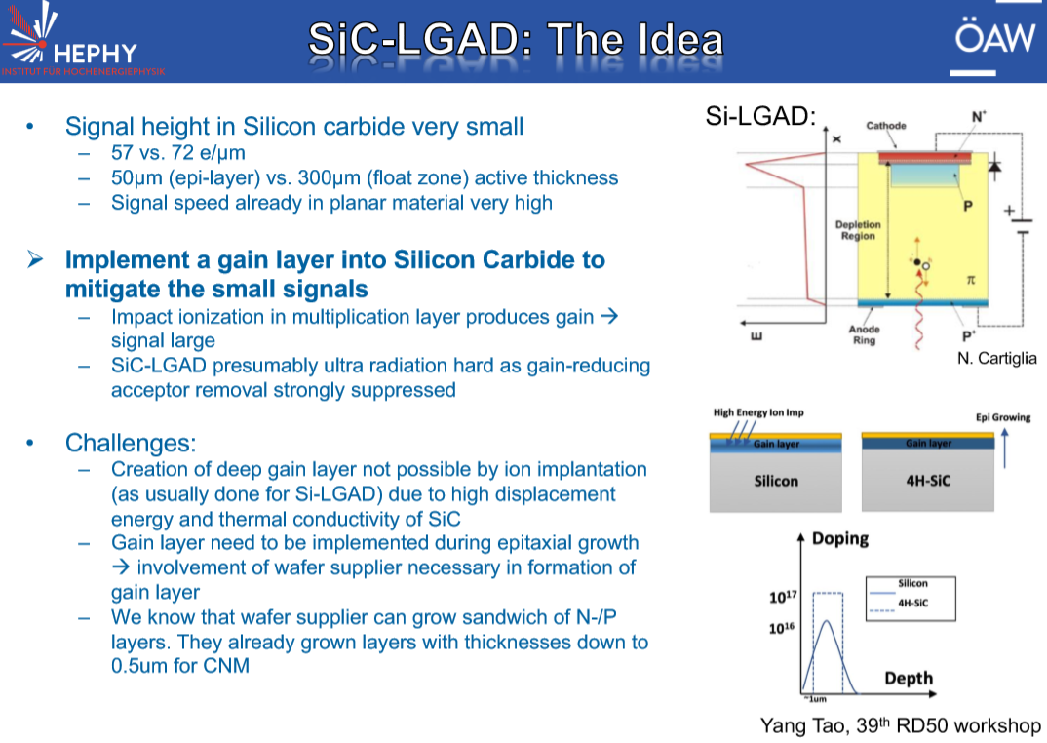


Slide 25
Future work
Fusion :
Test irradiated detectors at high temperature
Understand the use of Graphene as a contact (TPA, high T, etc…)
Explore other application related to fusion (IFMIF –DONES)
Test sensors in fusion facilities (DIII-D San Diego, CA,).
Medical Flash:
Study the limit of SiC dosimetry in FLESH therapy (in collaboration with PTW)
Fabricate new sensors for micro-dosimetry to measure LET (National project submitted, NEWDOSI project started in 2022 and UHDR EU project TWAC for development of compact electron accelerators
Large strip SiC sensors and LGAD for beam monitoring (U. if Vienna and MedAustron)
HEP:
Test beam of irradiated detectors : strip configuration.
Understand the annealing at high temperature.
Fabricate SiC detectors with internal gain (LGAD)
Exploratory detector concepts based on 2D materials, e.g. grapheme

Slide 27
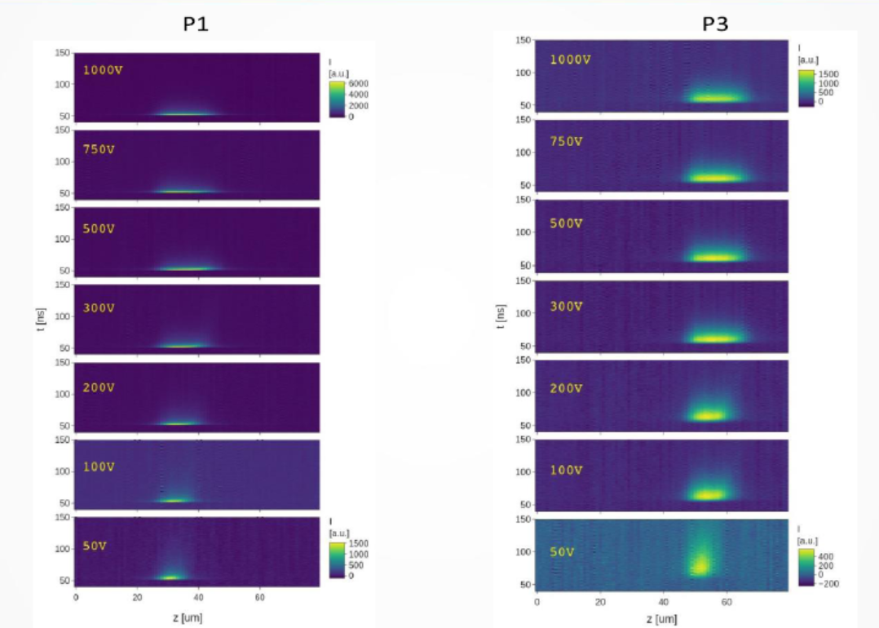

Slide 28
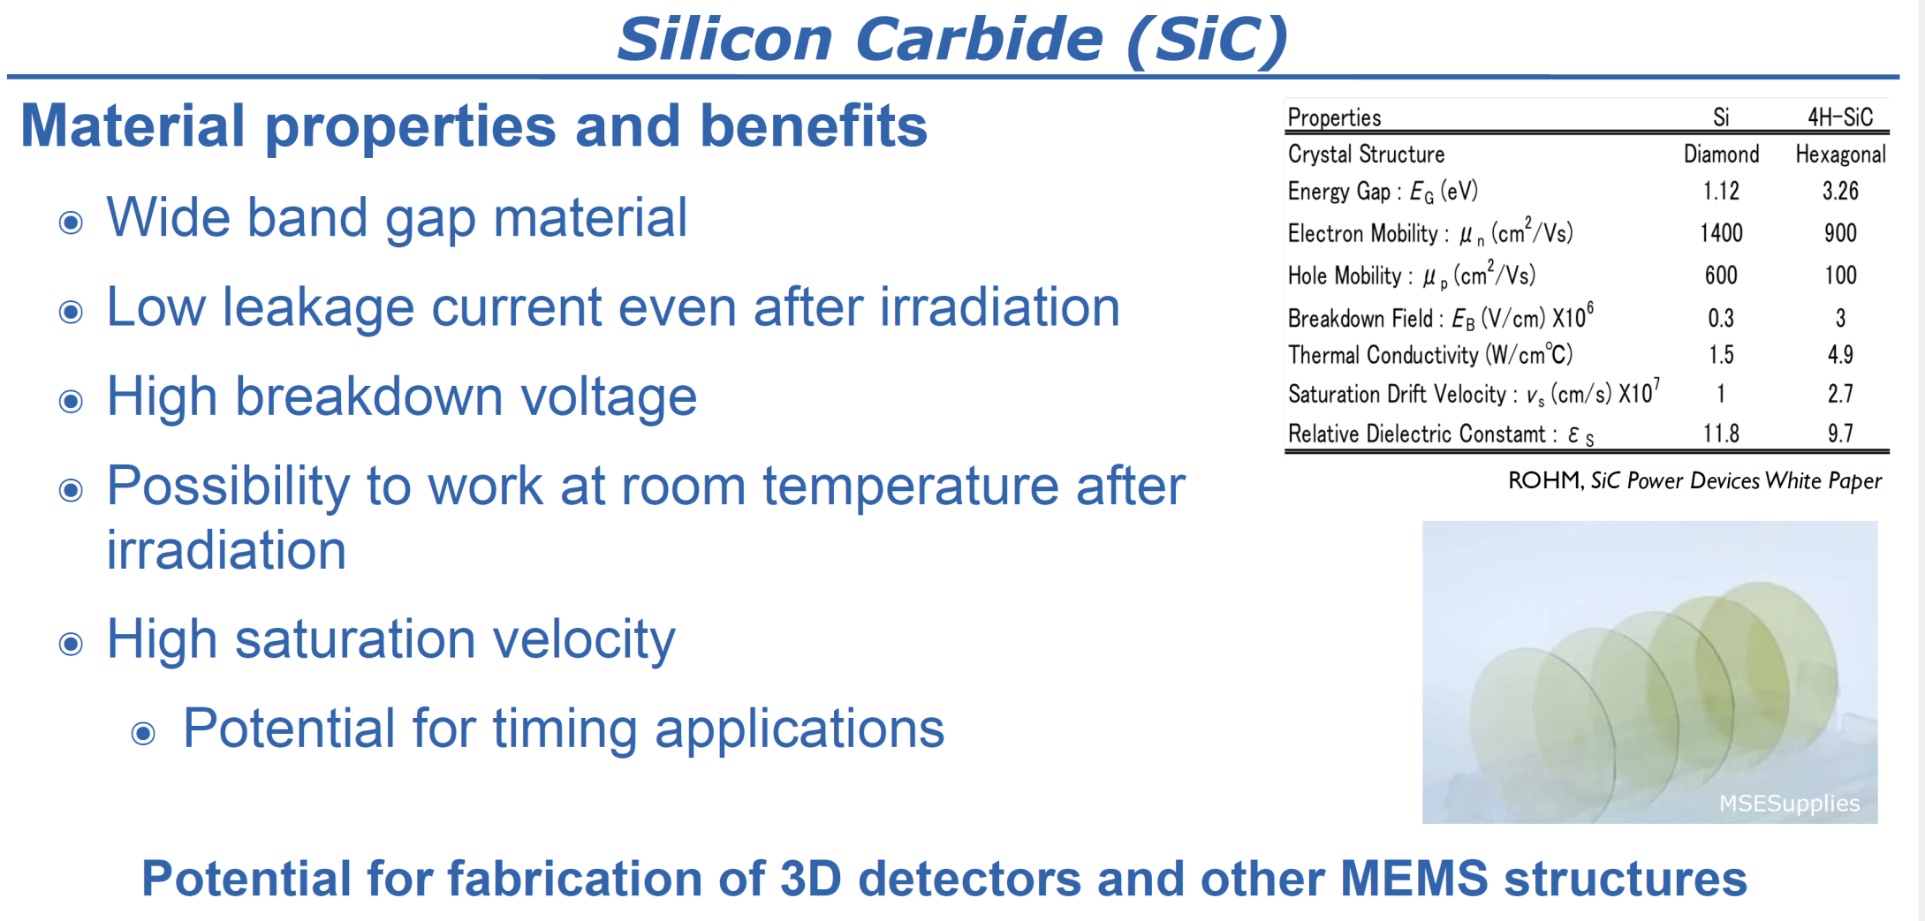

Slide 29


Irradiation campaign
2 MeV electron irradiation (e/cm²)
1x10¹⁴ | 1x10¹⁵ | 1x10¹⁶
Neutron irradiation (n/cm²)
5x10¹³ | 1x10¹⁴ | 5x10¹⁴ | 1x10¹⁵ | 2x10¹⁵
24 GeV/c proton irradiation (p/cm²)
8.6x10¹³ | 1.5x10¹⁴ | 1x10¹⁵ | 1.7x10¹⁵ | 2.5x10¹⁵
2 MeV electron irradiations were carried out at Takasaki-JAEA electron accelerator in Takasaki, Japan.
Neutron irradiations were performed at JSI research reactor in Ljubljana, Slovenia
4 GeV/c proton irradiations were carried out at CERN PS-IRRAD facility in Geneva, Switzerland.
This project has received partial funding from the European Union’s Horizon 2020 Research and Innovation programme under Grant Agreement no. 654168.

Slide 30
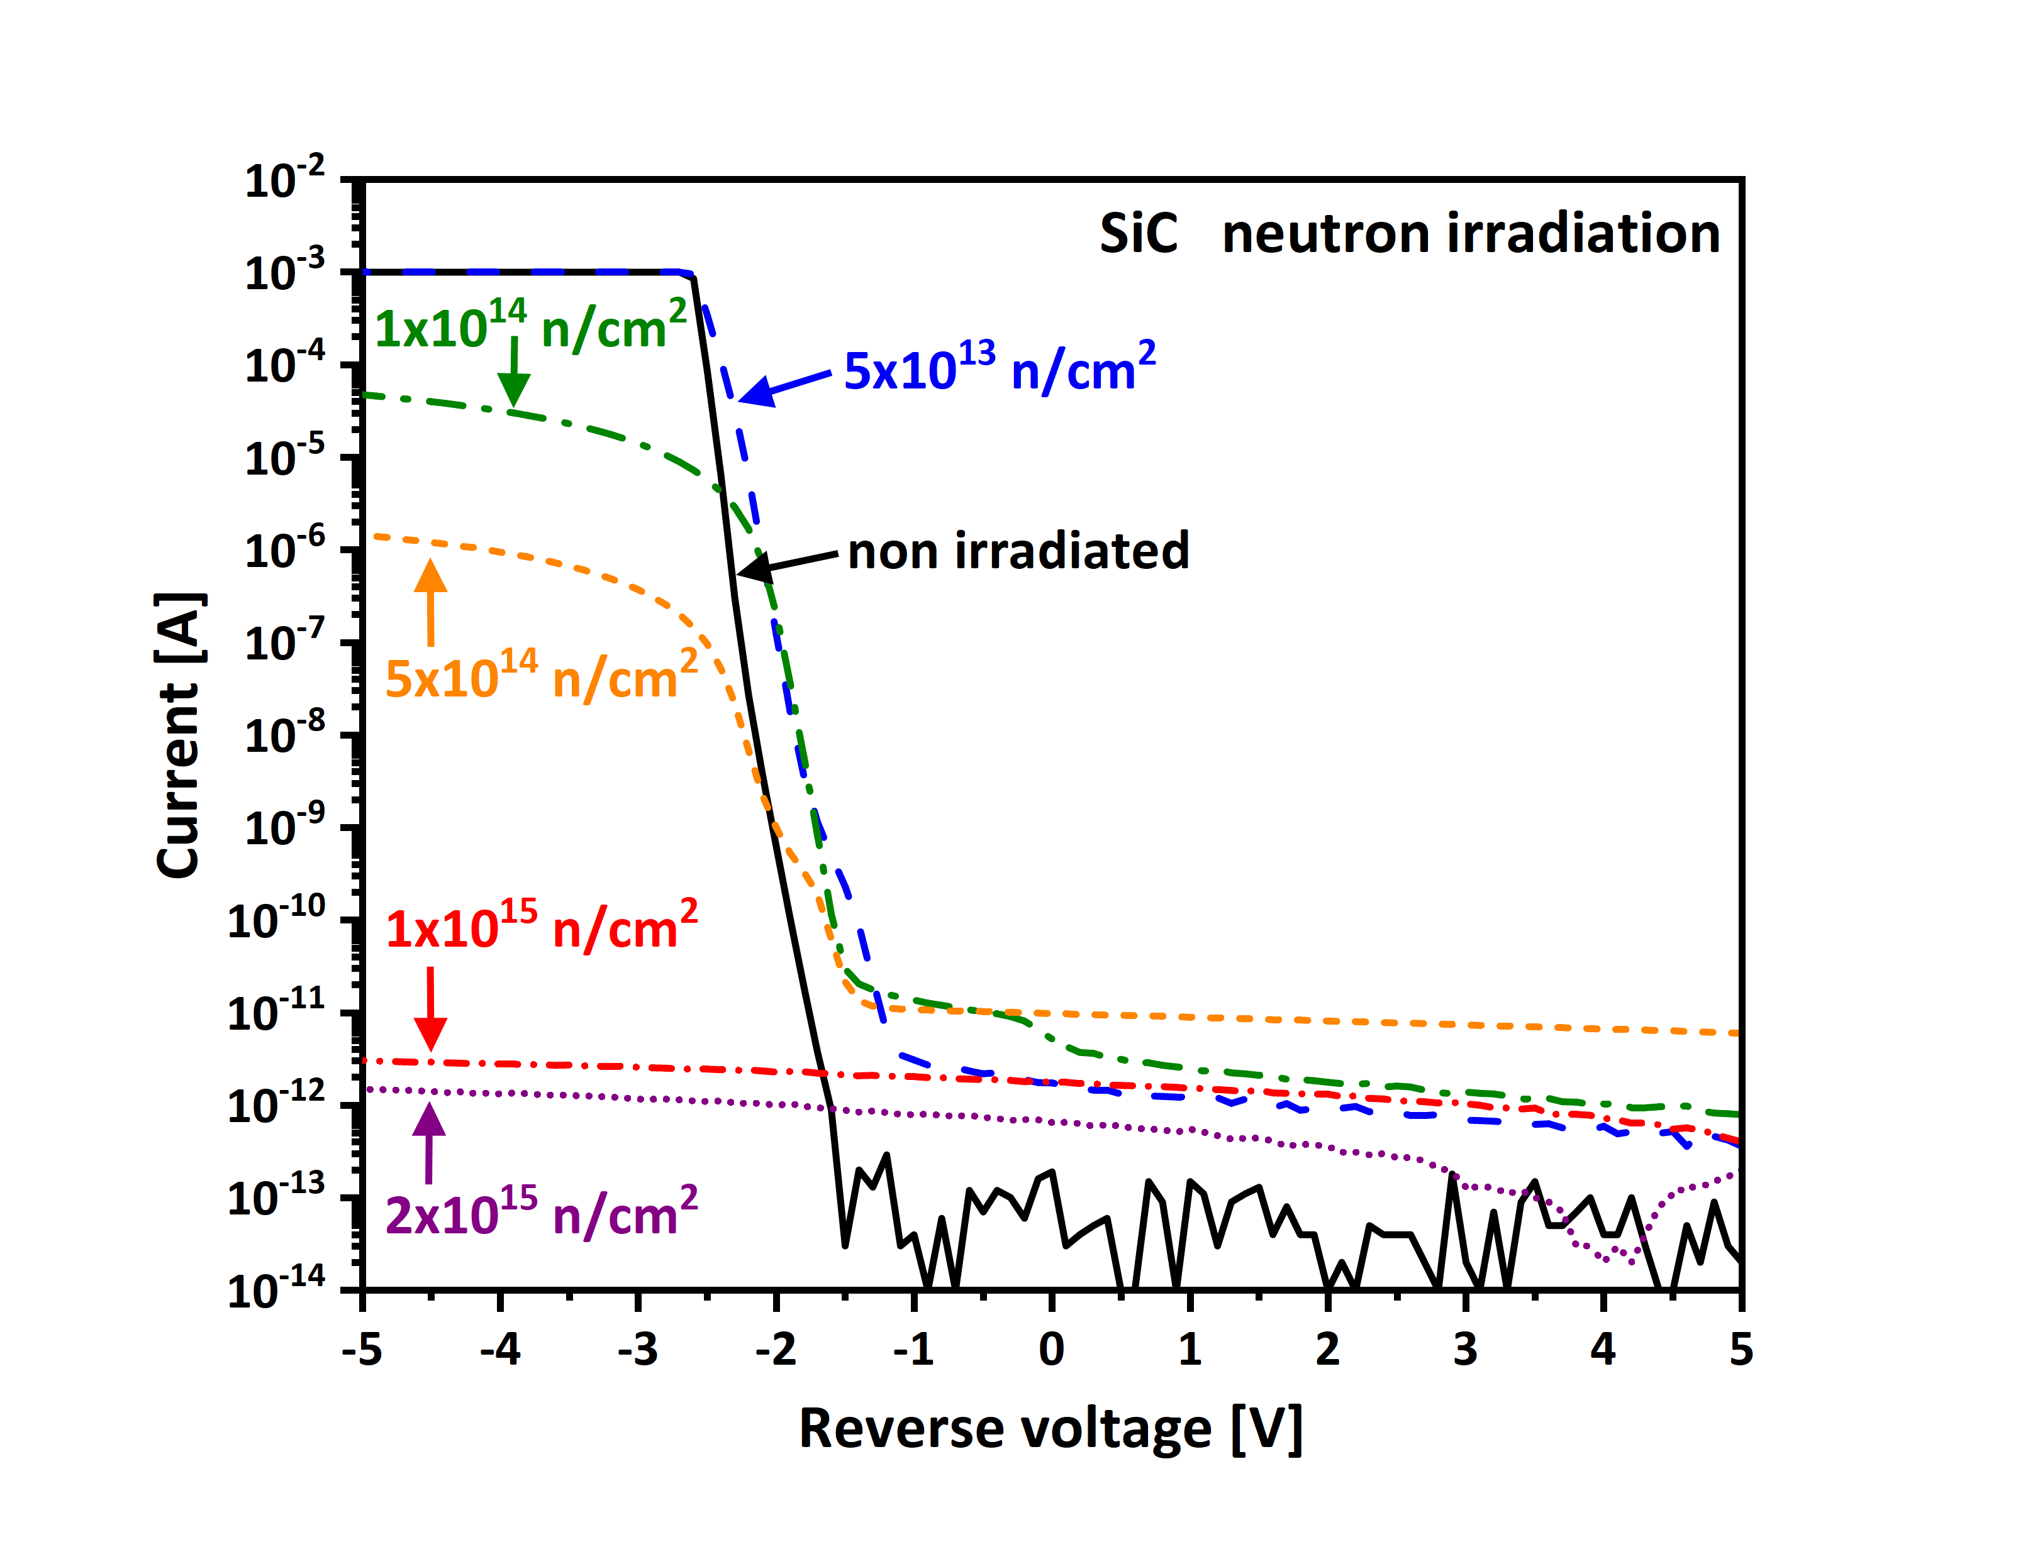
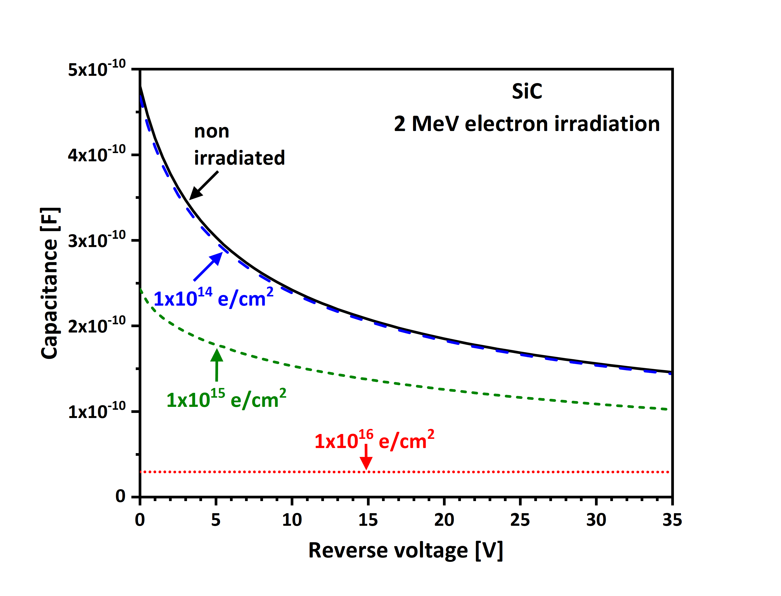
Electrical characterization after irradiation
J.M. Rafí et al 2018 JINST 13 C01045

Slide 31
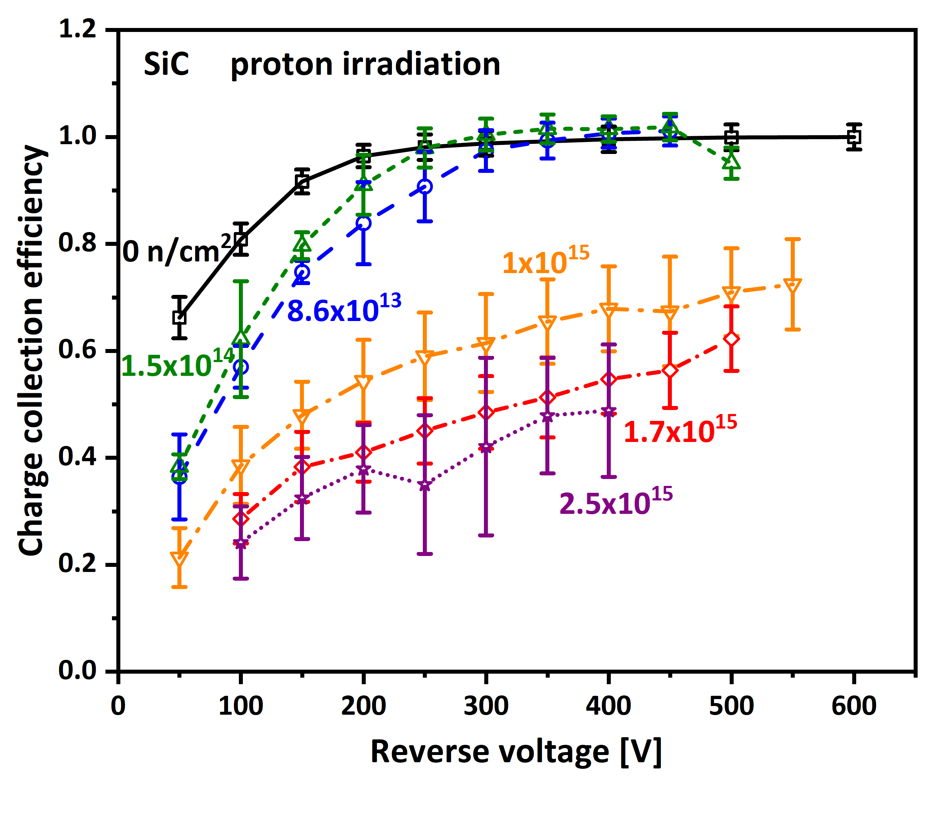
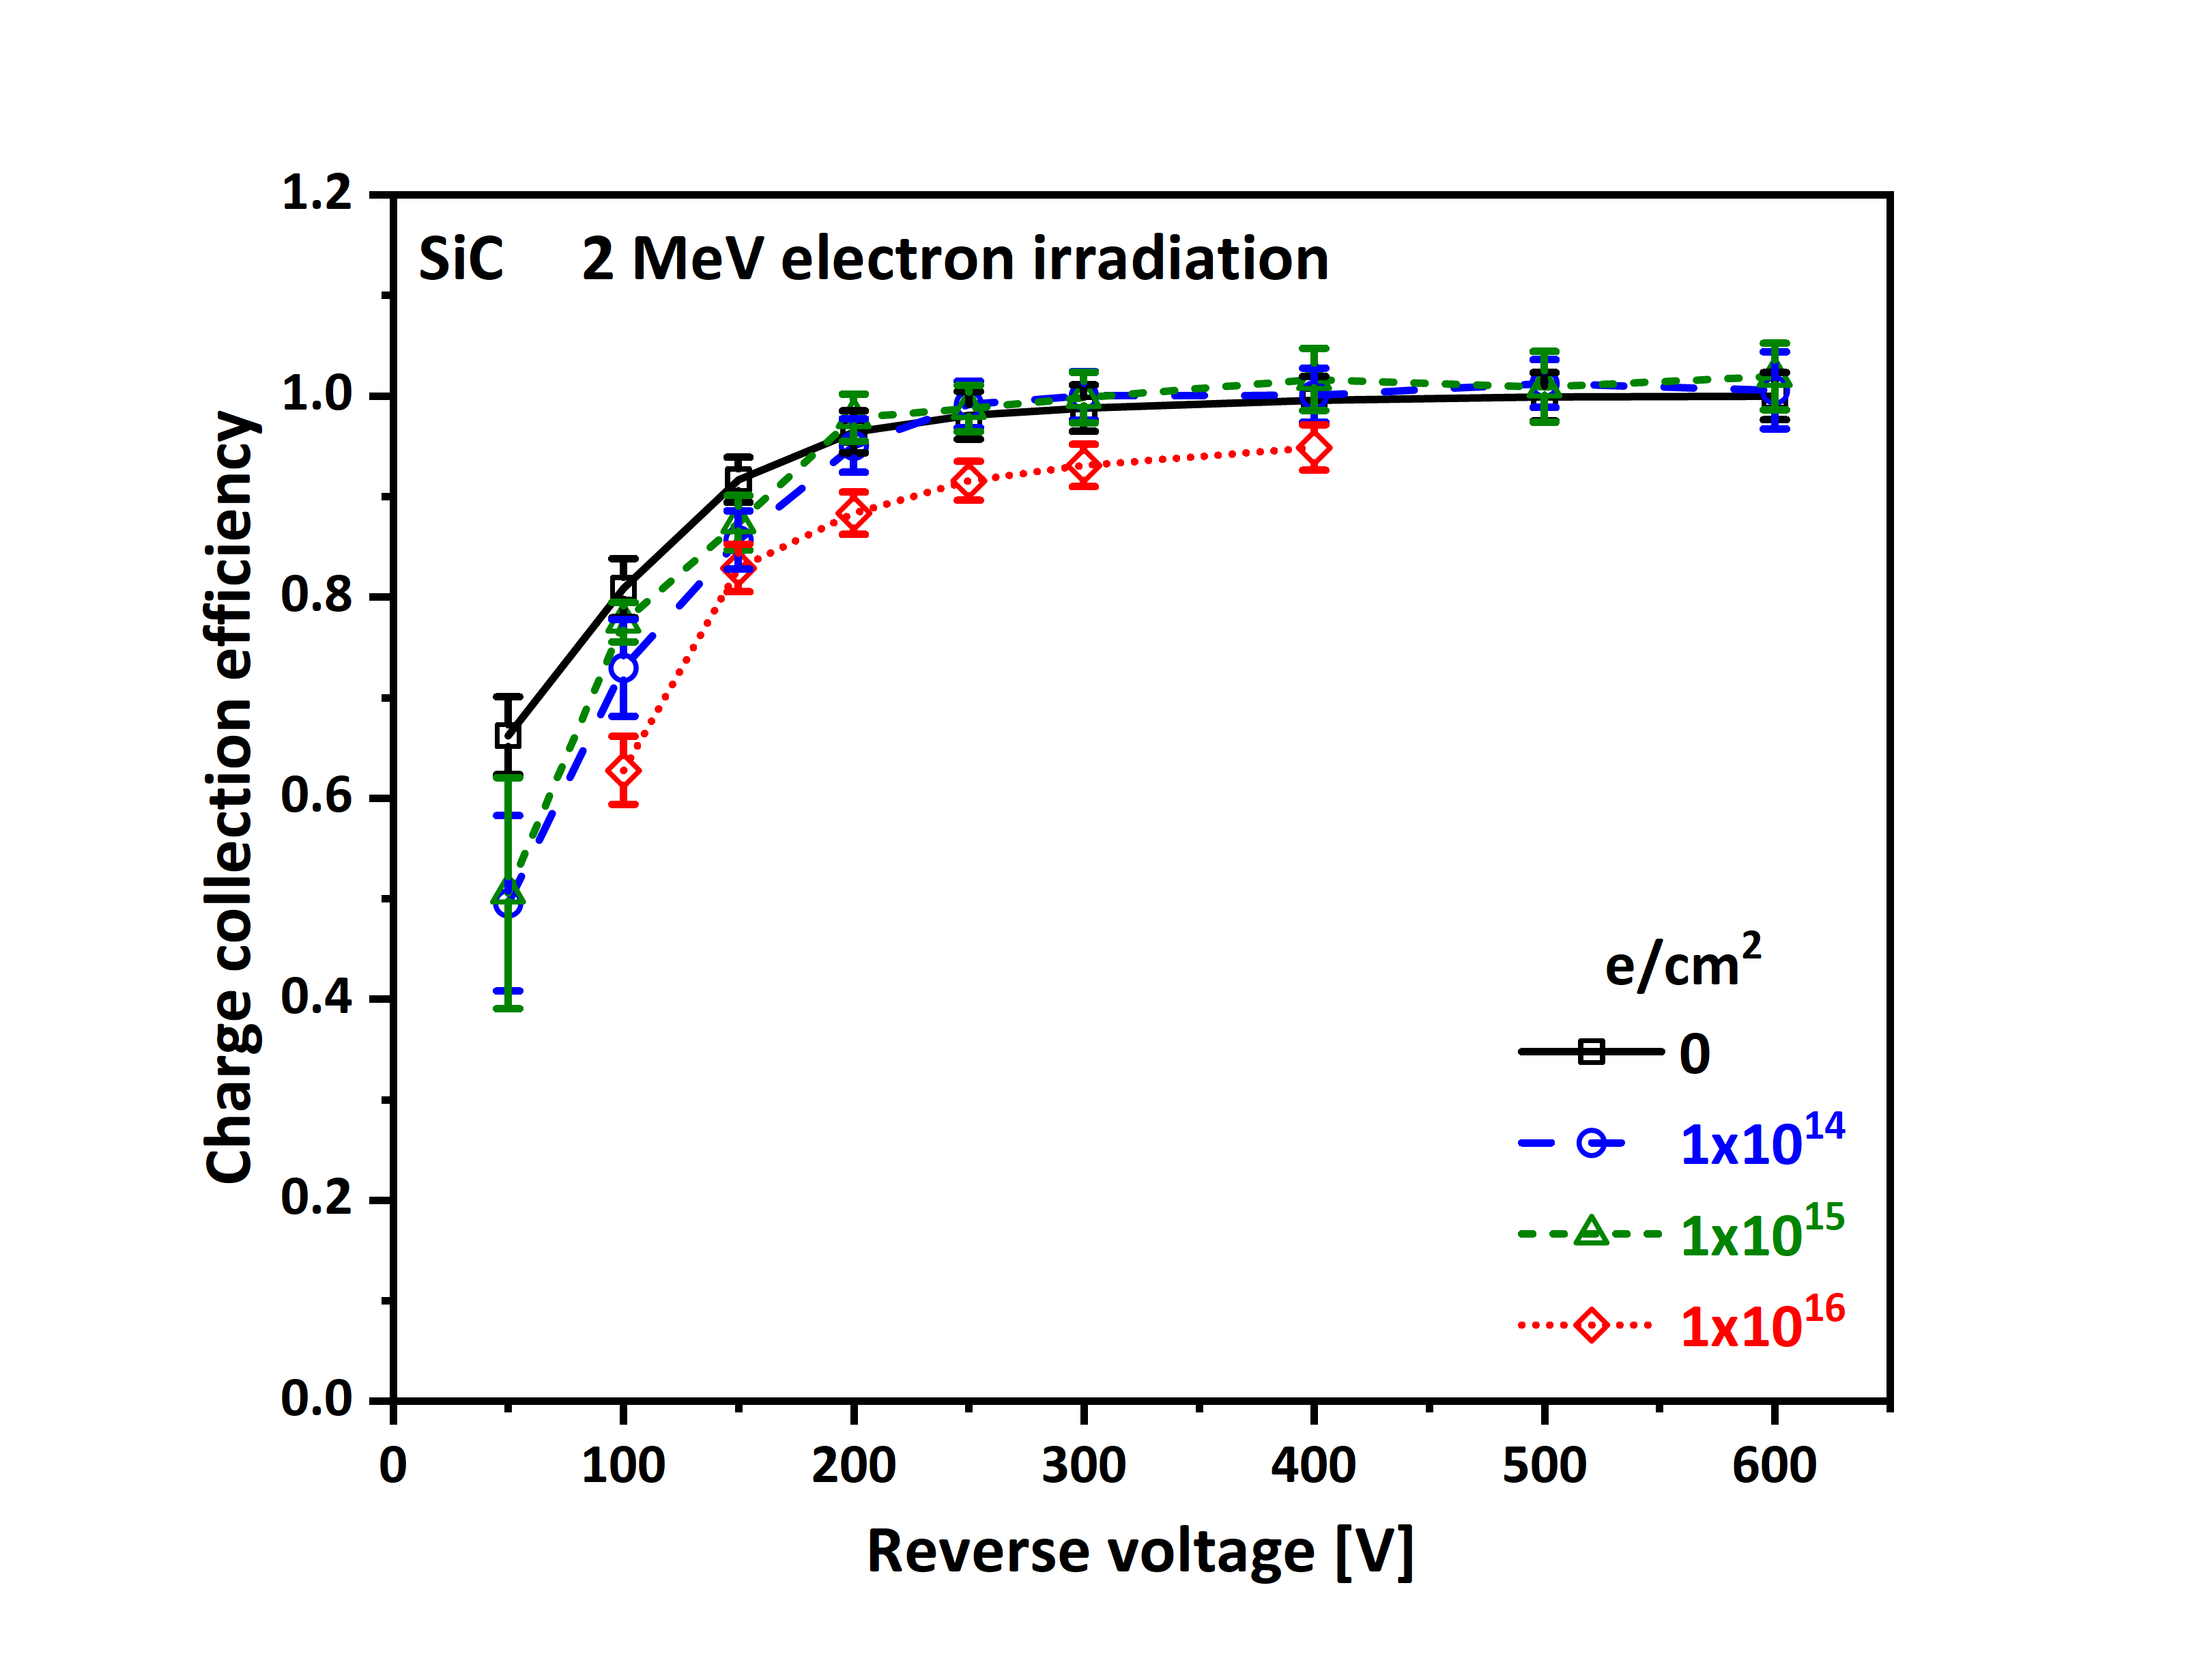
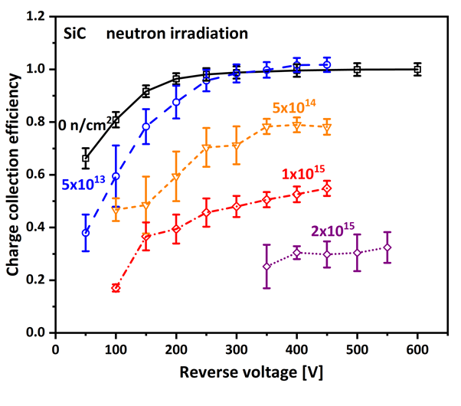
CCE characterization
Detectors tested with 5MeV alpha particles and at room temperature
J.M. Rafí et al IEEE TNS, vol. 67, no. 12, december 2020

Slide 32
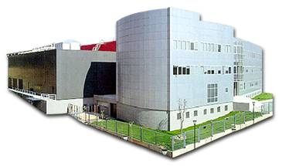
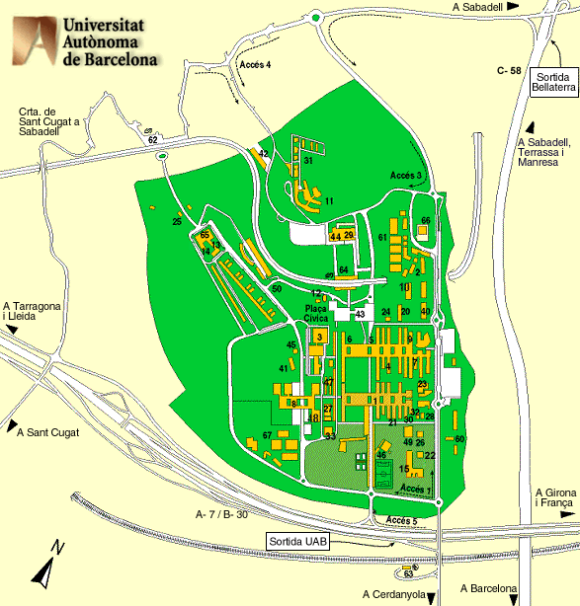

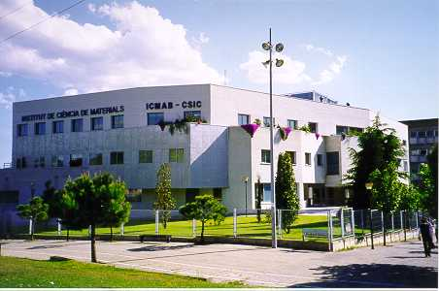
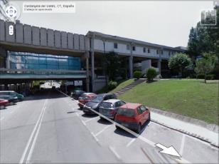
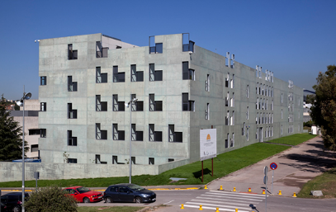
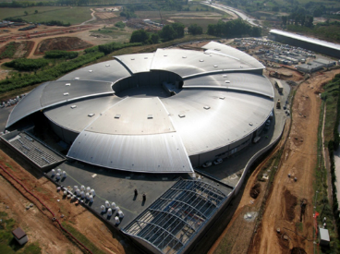
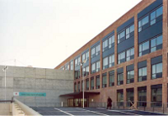
Ecosystem
PRUAB
Spin-off Incubator
IMB-CNM(CSIC)
Materials Science Institute (CSIC)
Sciences (UAB)
ICN2
Alba Synchrotron

Slide 33
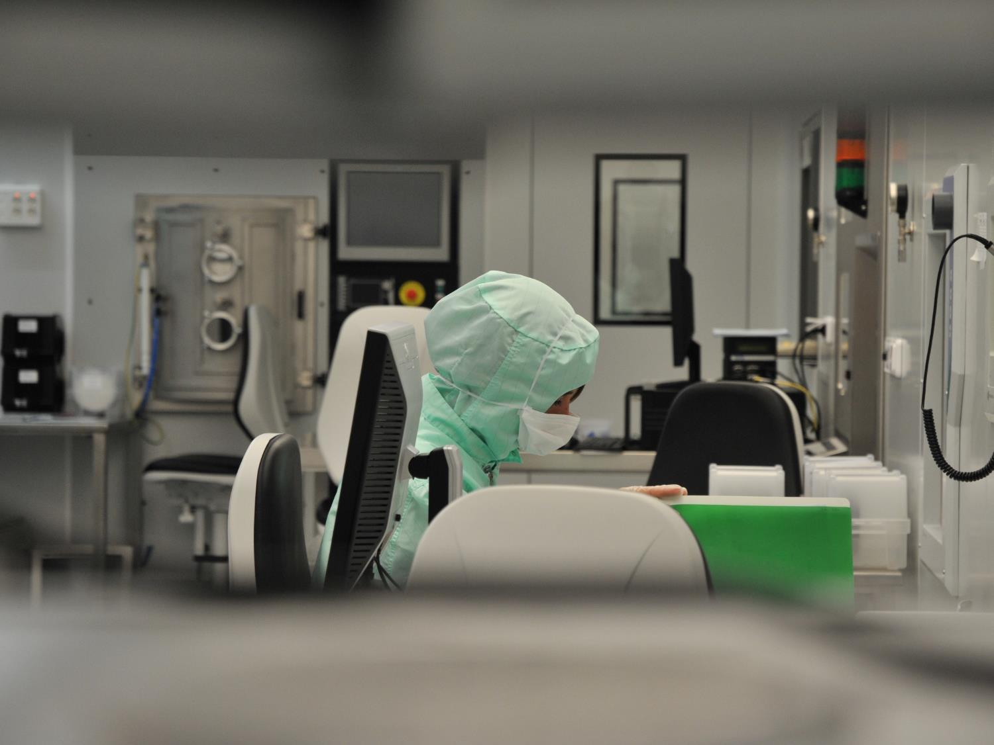
Largest R&D Clean Room in Spain
Clean Room
1,500 m²
40
total area
staff
190
40
equipment units
self service
3000
2500
Wafers/year
Hours self service
550
450
Runs/year
registered self service licenses

Slide 34
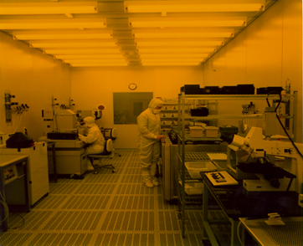
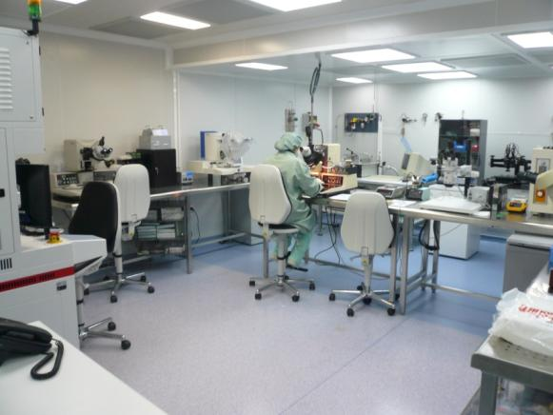
Integrated Micro & Nano Fabrication Clean Room
The main activities of IMB-CNM is basic and applied research and development, education and training in micro and nanotechnologies, components and systems.
Clean room
class 100 to 10.000
Technologies for Micro y Nano fabrication
3 Areas:
  CMOS (high purity, no contaminants)
  MNC (Noble Metals contaminants for Si)
  Nanolithography
Process size: 4'' and 6” wafers
Technologies: CMOS, MEMS/NEMS, power devices, radiation detectors
Silicon Micromachining
Microelectronic Packaging Area
200 m2, class 100
Wafer cutting, wire-bonding, bump-bonding

Slide 35
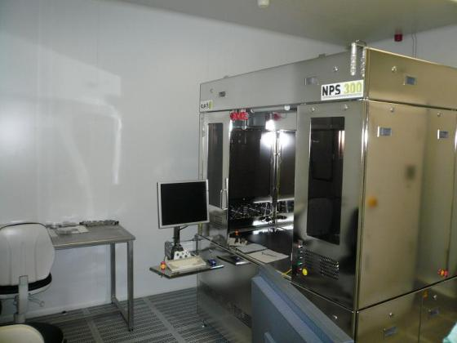
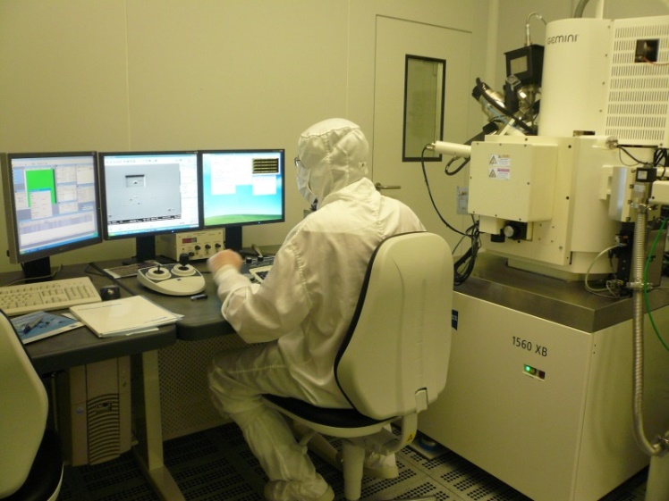
Clean Room Equipment
  Thermal processes, CVD and ALD
  Ion Implantation
  PVD and Metallisation (Sputtering and Evaporators)
  Optical Lithography:
    Proximity Aligners: single and double side
    Steppers: g-line and i-line
    Direct laser writing
  Nano-lithography (e-beam, NIL, FIB and AFM)
  Dry etching
  Wet and dry micromachining
  Wet etching and cleaning
  On-line test
  Conventional and advanced packaging
  Electrical characterization
Notes:
35

Slide 36
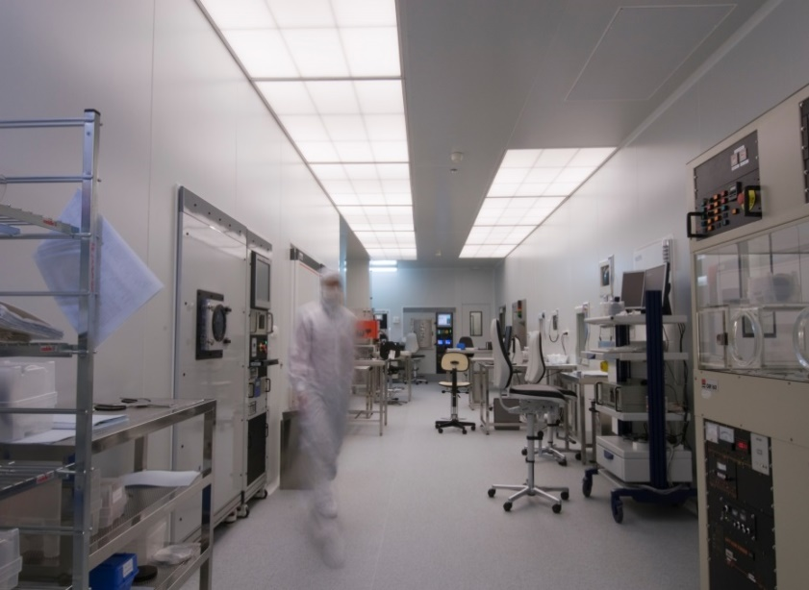
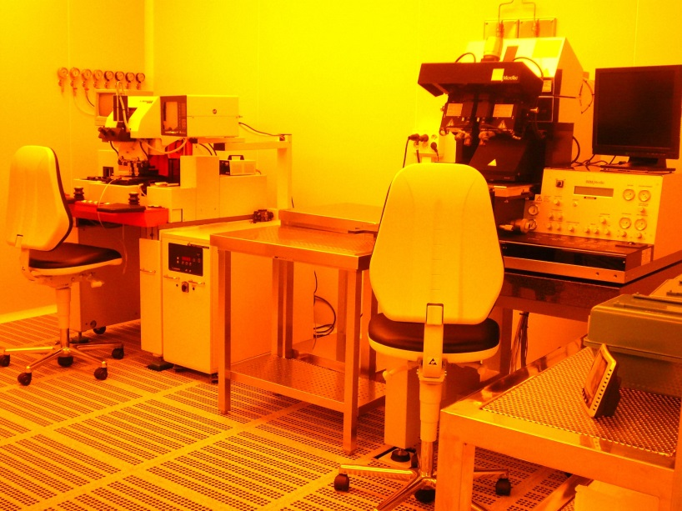



Slide 37



Experience in production
SiC rectifiers for space
  Bepi-Colombo & Solar orbiter missions
  Main contractors EADS, Airbus, ALTER
  400k€/year (2,800 k€ accumulated)
Beam monitors for Synchrotron accelerators
  position and intensity thin sensors (Alba cell, Alibava)
Radiation detectors
  Main contractor CERN (ATLAS experiment, RD50, TOTEM
  Other contractors: INFN, BNL, DESY, GSI, Xian University, .
Four Quadrant diodes for space
  Main contractor non disclosed
  In orbit since February 2019, full contract 650 k€

Slide 38



THE INCREASE OF CHARGE COLLECTED VS T IS EXPECTED
Measurements from RT to 450ºC
Change in the BandGap energy
Change in the pair creation energy
Change in measured energy
Properties of Advanced Semiconductor Materials: GaN, AIN, InN, BN, SiC, SiGe.
John Wiley & Sons. (2001).
$$E_{g}\left(T\right)=3.265−6.5×{10}^{−4}\frac{T^{2}}{T+1300} (eV)$$
$$ε_{4H−SiC}\left(T\right)=ε_{4H−SiC}\left(RT\right)\frac{E\left(RT\right)}{E\left(T\right)}$$
https://www.iue.tuwien.ac.at/phd/ayalew/node61.html

