Slide 1
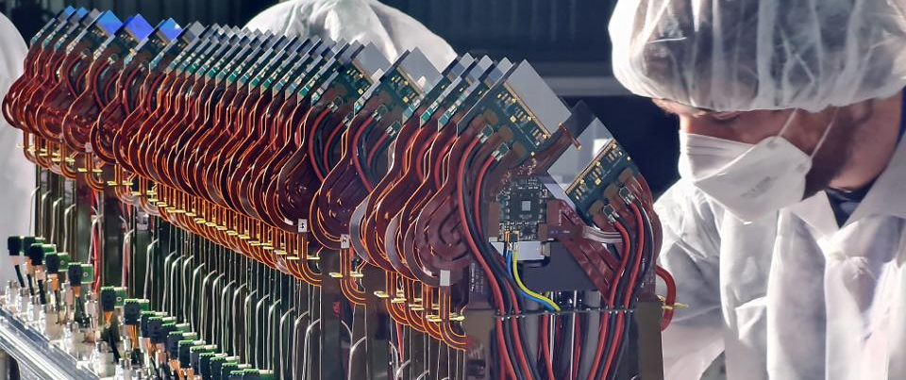
VELO Upgrade I
The LHCb Vertex Locator in Upgrade I
Valeriia (Lera) Lukashenko on behalf of LHCb VELO group
Nikhef, KINR NASU
Vertex 2022, Tateyama resort hotel

Slide 2
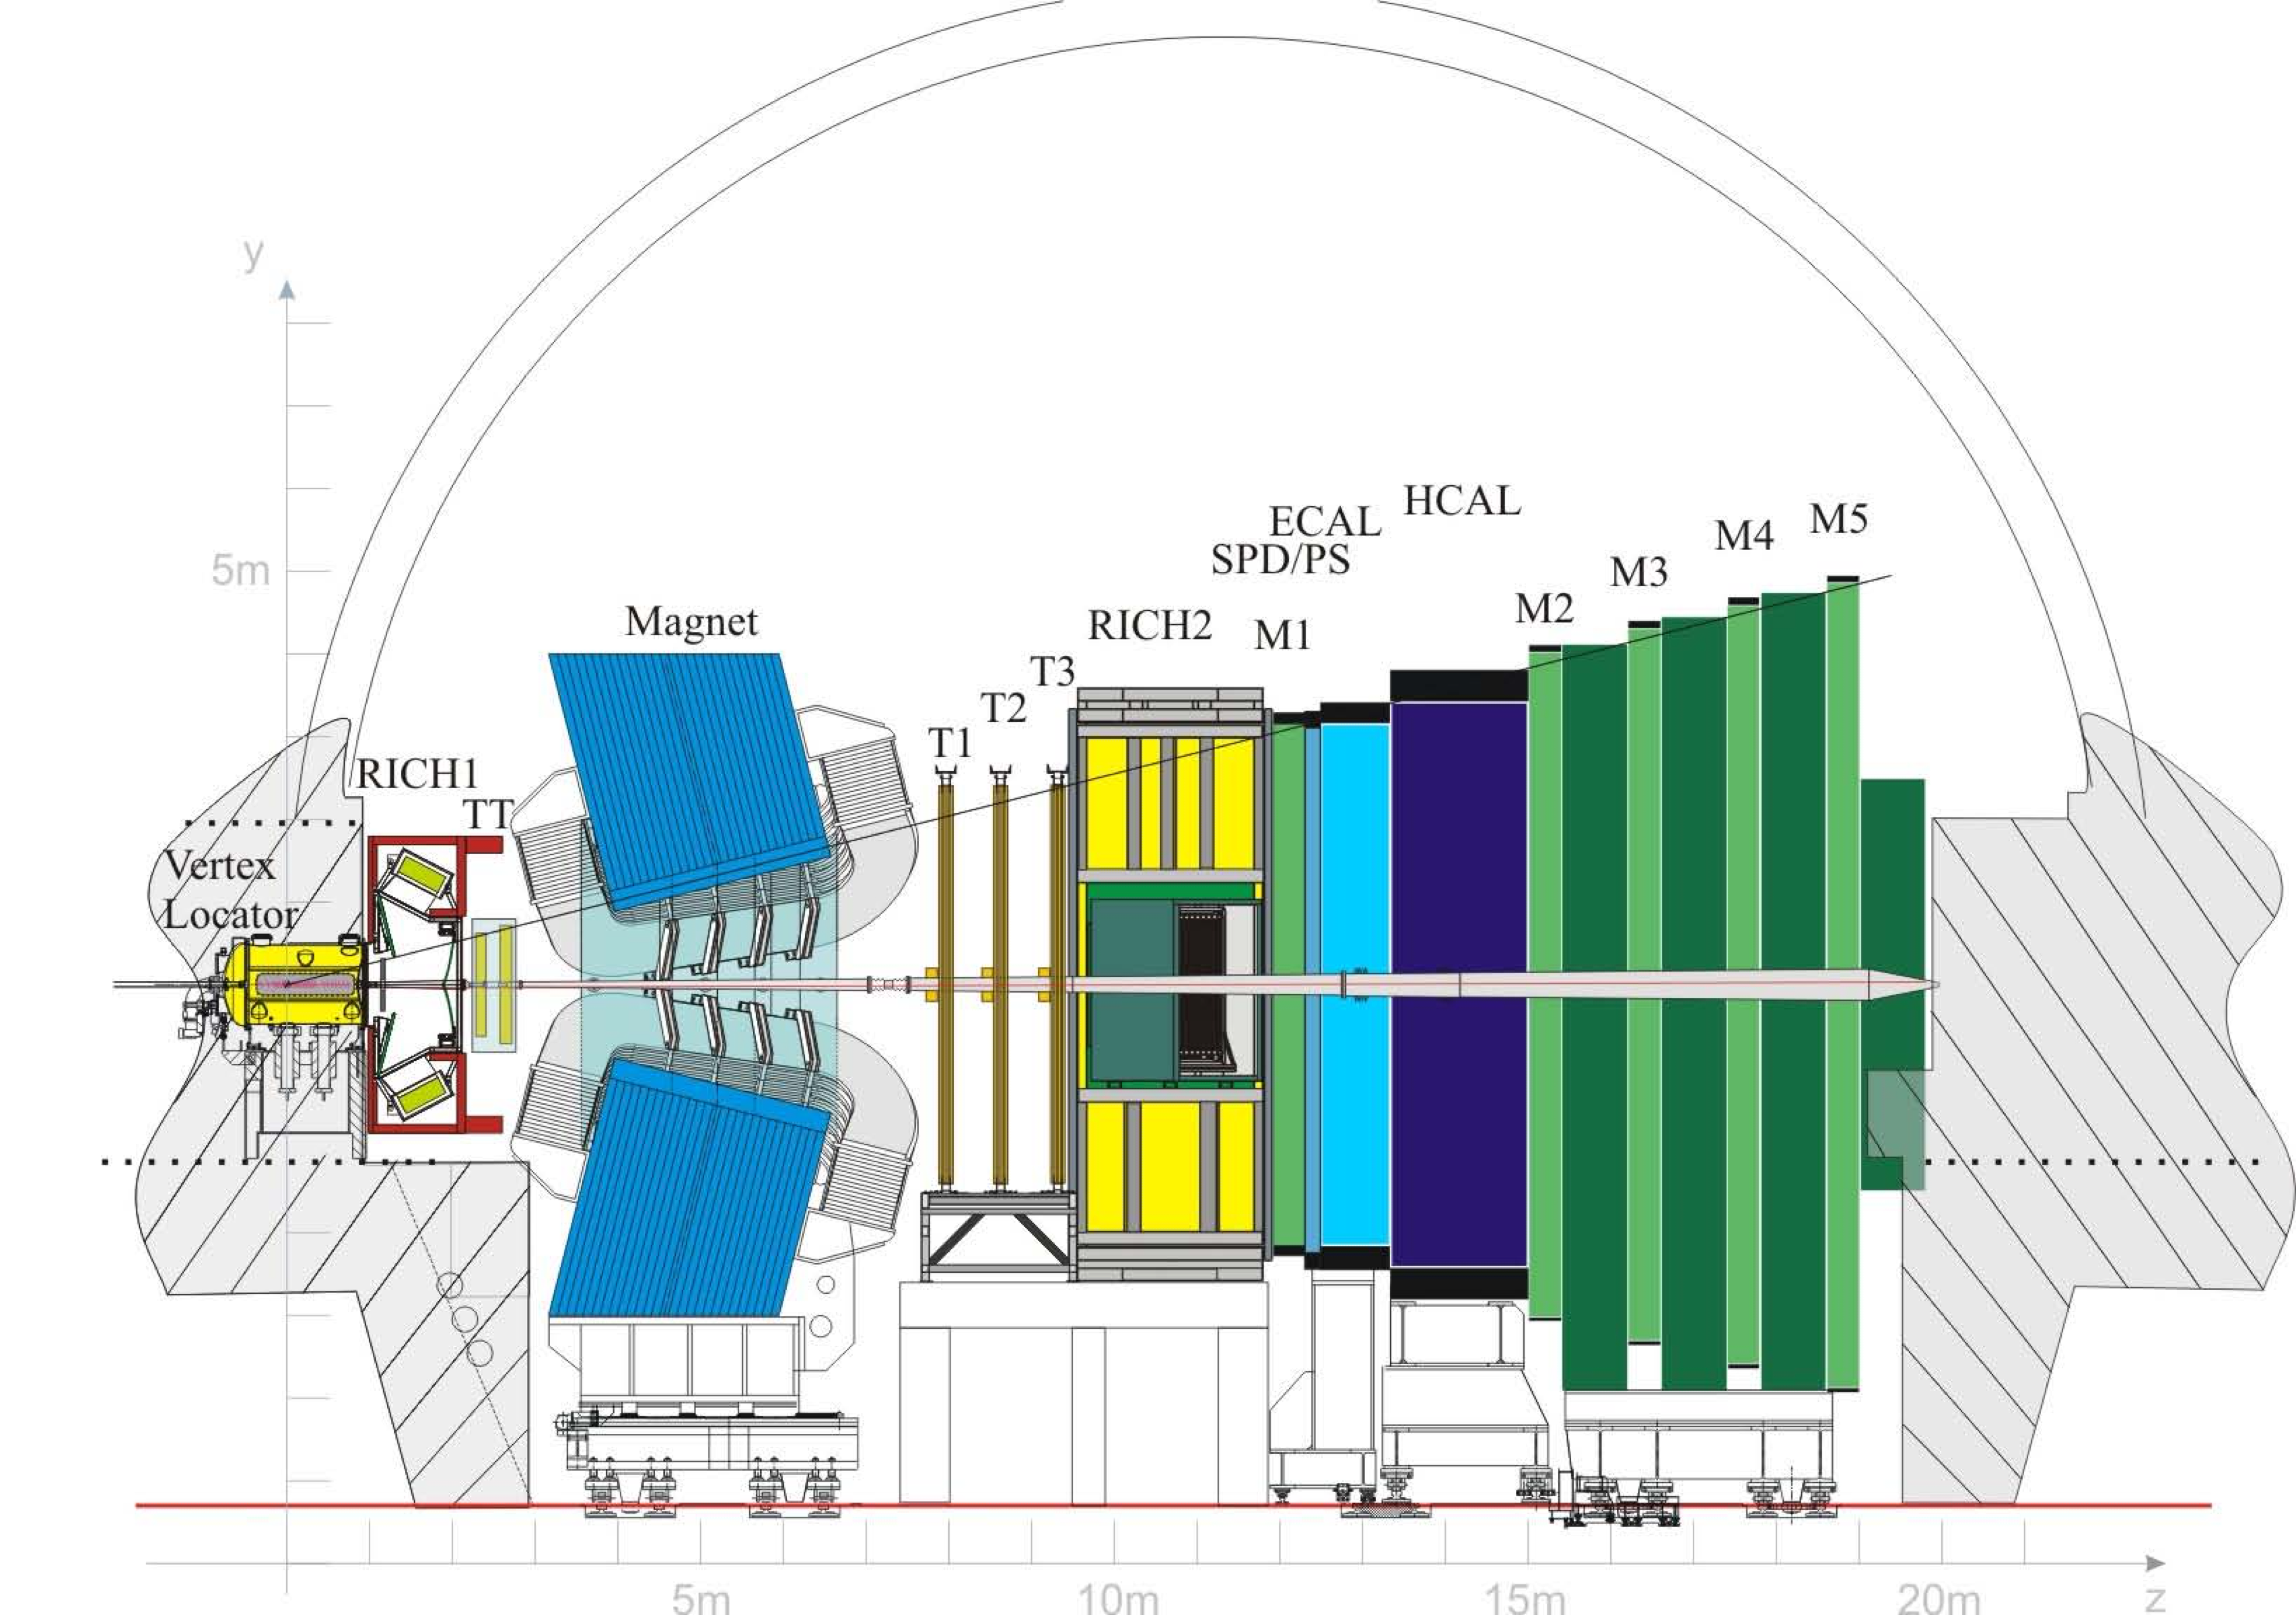
LHCb
9 $fb^{-1}$
Run 1
Run 2
Upgrade 1
Run 3
Run 4
Upgrade 2
2010
2012
2015
2018
2022
2024
2028
2030
2031
Vertex Locator (VELO)
Forward general purpose spectrometer: $2<η<5$
b-, c- physics as well as exotics searches

Slide 3
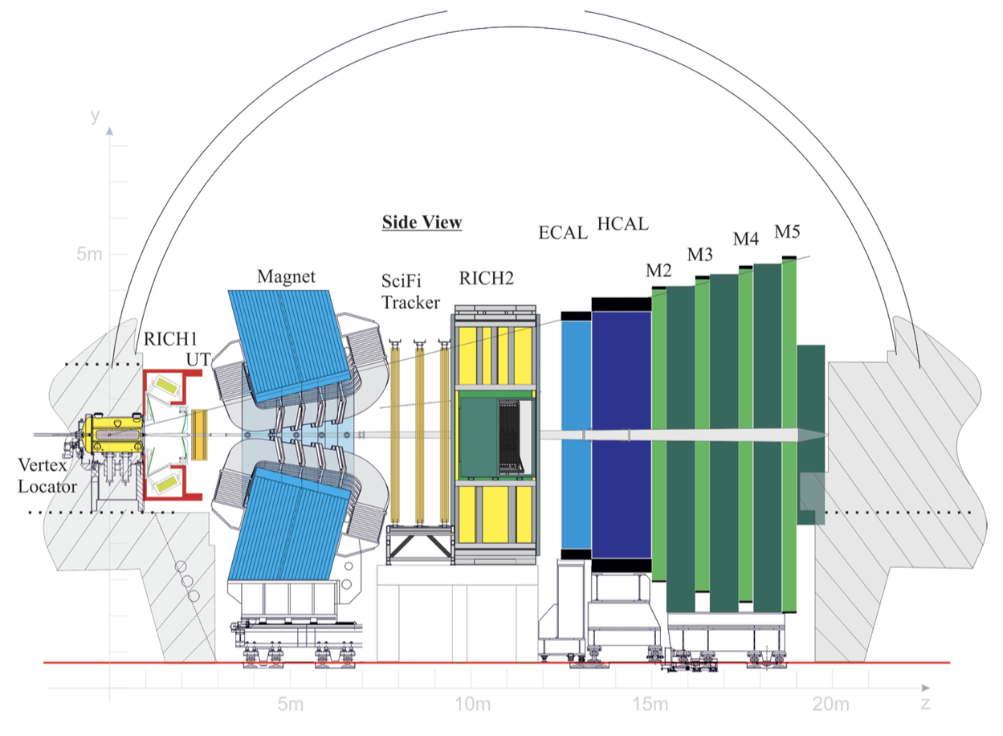
Upgrade1
50 $fb^{-1}$
Run 1
Run 2
Upgrade 1
Run 3
Run 4
Upgrade 2
2010
2012
2015
2018
2022
2024
2028
2030
2031
NEW
OLD
DAQ
Vertex Locator (VELO)
R/O electronics
5! Times increase in the operational $L$ and 5! times more interactions seen
Read-out from 1MHz to 40MHz
No hardware-level trigger
Detector Channels

Slide 4
VELO
50 $fb^{-1}$
Run 1
Run 2
Upgrade 1
Run 3
Run 4
Upgrade 2
2010
2012
2015
2018
2022
2024
2028
2030
2031
Vertex Locator (VELO)

Slide 5

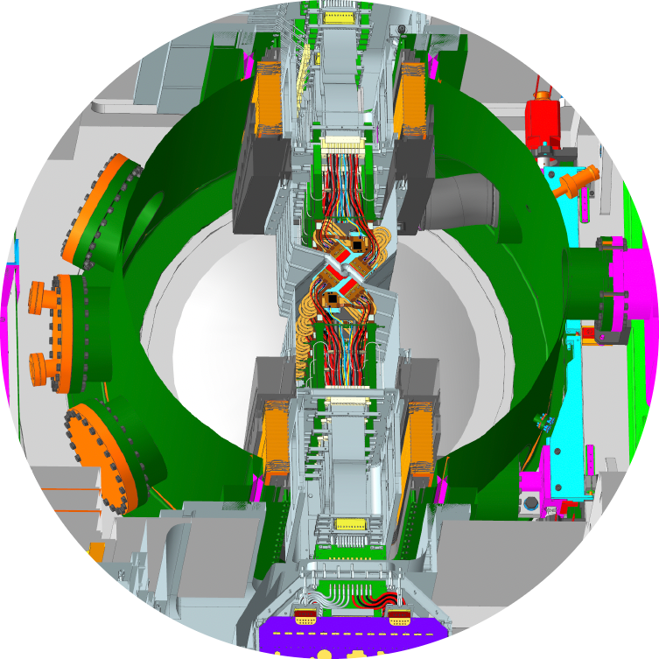
VELO
Run 1
Run 2
Upgrade 1
Run 3
Run 4
Upgrade 2
2010
2012
2015
2018
2022
2024
2028
2030
2031
RF-foil
primary vacuum
A-side
C-side
read-out
1 m
beam
modules
secondary vacuum
Notes:
RF-foil protests the primary vacuum of LHC from contamination. It also has a retraction mechanism to protect halves of RF-foil from touching. Co@ pipes for cooling are not shown in the picture but are above the readout. We reuse the old closing mechanism

Slide 6
VELO
Run 1
Run 2
Upgrade 1
Run 3
Run 4
Upgrade 2
2010
2012
2015
2018
2022
2024
2028
2030
2031
RF-foil
primary vacuum
A-side
C-side
read-out
1 m
beam
modules
secondary vacuum
Notes:
RF-foil protests the primary vacuum of LHC from contamination. It also has a retraction mechanism to protect halves of RF-foil from touching. Co@ pipes for cooling are not shown in the picture but are above the readout. We reuse the old closing mechanism

Slide 7
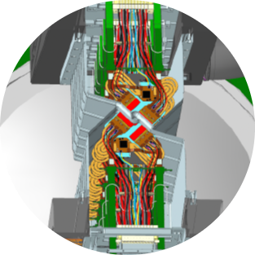
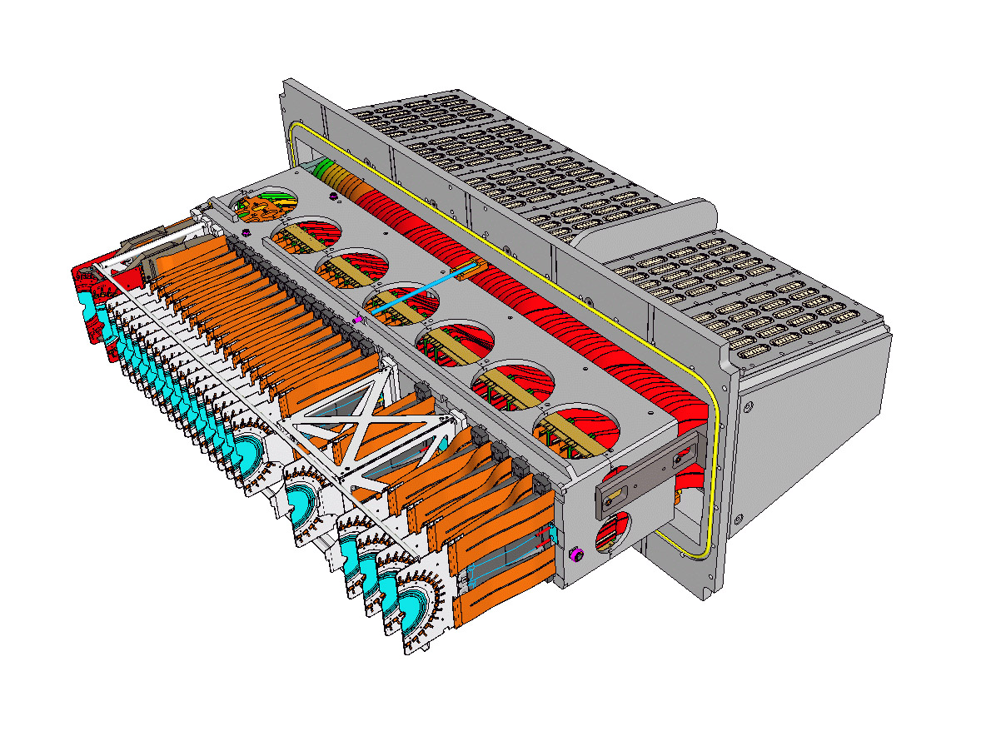
Halves
Run 1
Run 2
Upgrade 1
Run 3
Run 4
Upgrade 2
2010
2012
2015
2018
2022
2024
2028
2030
2031
Run 1+2
Run 3+4
Upgrade 1
# modules | 42(r, )+4r modules |  | 52 modules
geometry | r, |  | x,y
technology | strips |  | pixels
pitch
distance to beam from the first sensing element | ~8 mm |  | ~5 mm
readout rate | 70MHits/s |  | 900MHits/s
max fluence
sensor temperature | -8°C |  | -25°C
$$ϕ$$
$$ϕ$$
$$48×120μm$$
$$55×55μm$$
$$43×{10}^{13}1MeV⋅n_{eq}⋅cm^{-2}$$
$$800×{10}^{13}1MeV⋅n_{eq}⋅cm^{-2}$$
Notes:
The cooling is done the same way as before, but the technology had been improved.
There are 12 ASICs per module

Slide 8
Halves
Run 1
Run 2
Upgrade 1
Run 3
Run 4
Upgrade 2
2010
2012
2015
2018
2022
2024
2028
2030
2031
Run 1+2
Run 3+4
Upgrade 1
# modules | 42(r, )+4r modules |  | 52 modules
geometry | r, |  | x,y
technology | strips |  | pixels
pitch
distance to beam from the first sensing element | ~8 mm |  | ~5 mm
readout rate | 70MHits/s |  | 900MHits/s
max fluence
sensor temperature | -8°C |  | -25°C
$$ϕ$$
$$ϕ$$
$$48×120μm$$
$$55×55μm$$
$$43×{10}^{13}1MeV⋅n_{eq}⋅cm^{-2}$$
$$800×{10}^{13}1MeV⋅n_{eq}⋅cm^{-2}$$

Slide 9
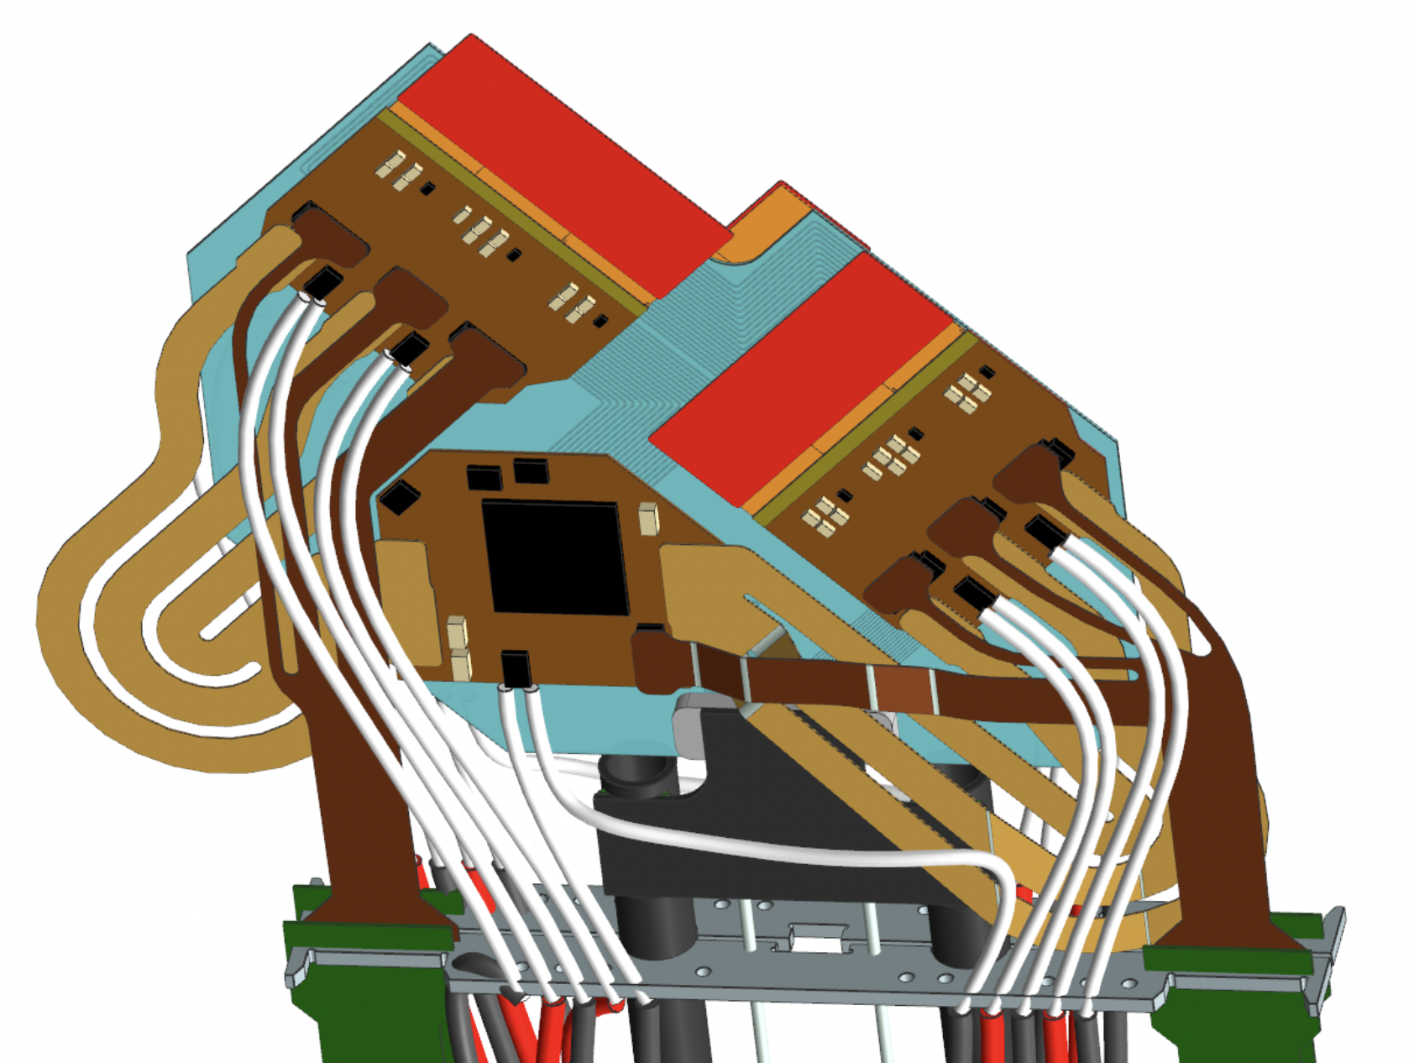
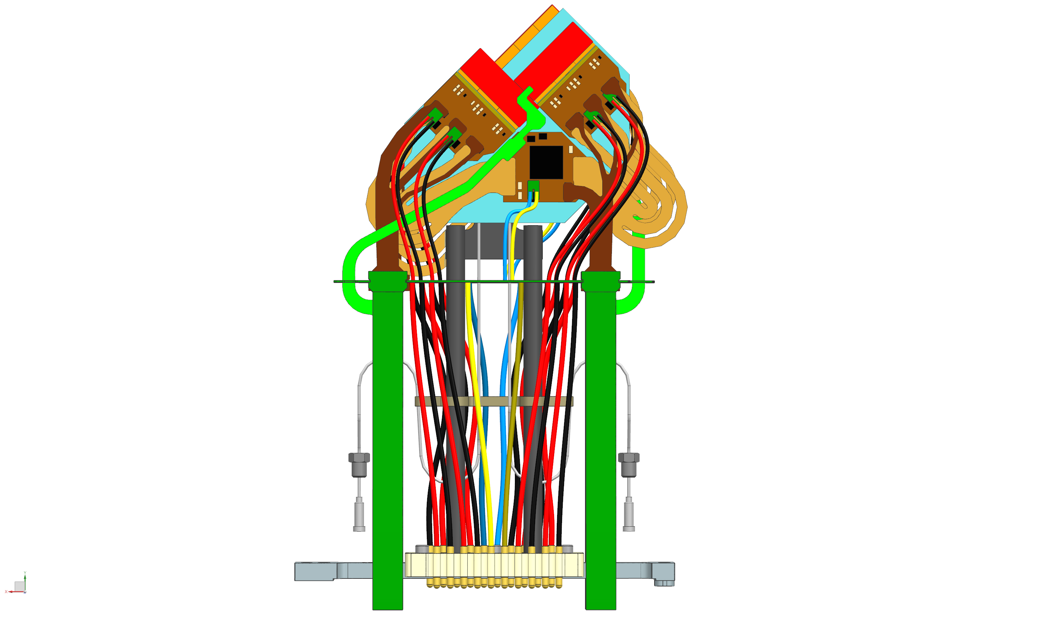
Readout
Run 1
Run 2
Upgrade 1
Run 3
Run 4
Upgrade 2
2010
2012
2015
2018
2022
2024
2028
2030
2031
air
secondary
vacuum
data cables
DAQ
Vacuum Feedthrough
Board
Opto & Power Board
data cables
optical fibers
256x256p
~300m
Notes:
The transition of the data, Low Voltage (LV) and High Voltage (HV) is achieved
with a custom-made VFB made from a 12 layered 2mm thick PCB. The feedthrough
has connectors soldered both on the in air and vacuum sides, enabling a
quick connection of the OPB and module, respectively.
The VFB is built by inserting the PCB into two half-moon holders, making a
connection between the PCB and the rest of the vacuum flange. Araldite 2011 is
used to glue everything in place and left for curing. Afterwards both sides are one
by one potted using Araldite 2020 making the whole object leak-tight.

Slide 10
Readout
Run 1
Run 2
Upgrade 1
Run 3
Run 4
Upgrade 2
2010
2012
2015
2018
2022
2024
2028
2030
2031
air
secondary
vacuum
data cables
DAQ
Vacuum Feedthrough
Board
Opto & Power Board
data cables
optical fibers
256x256p
~300m

Slide 11
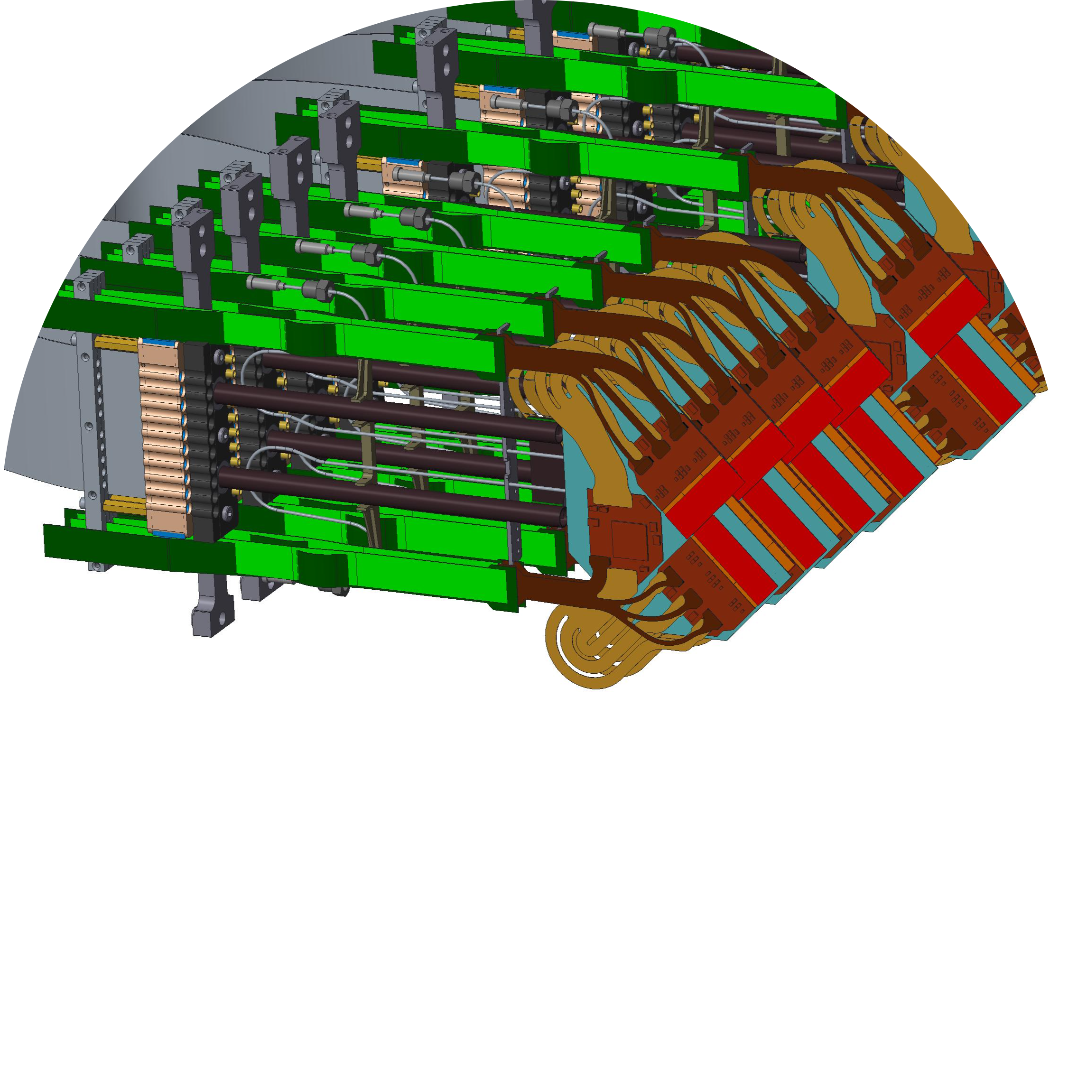
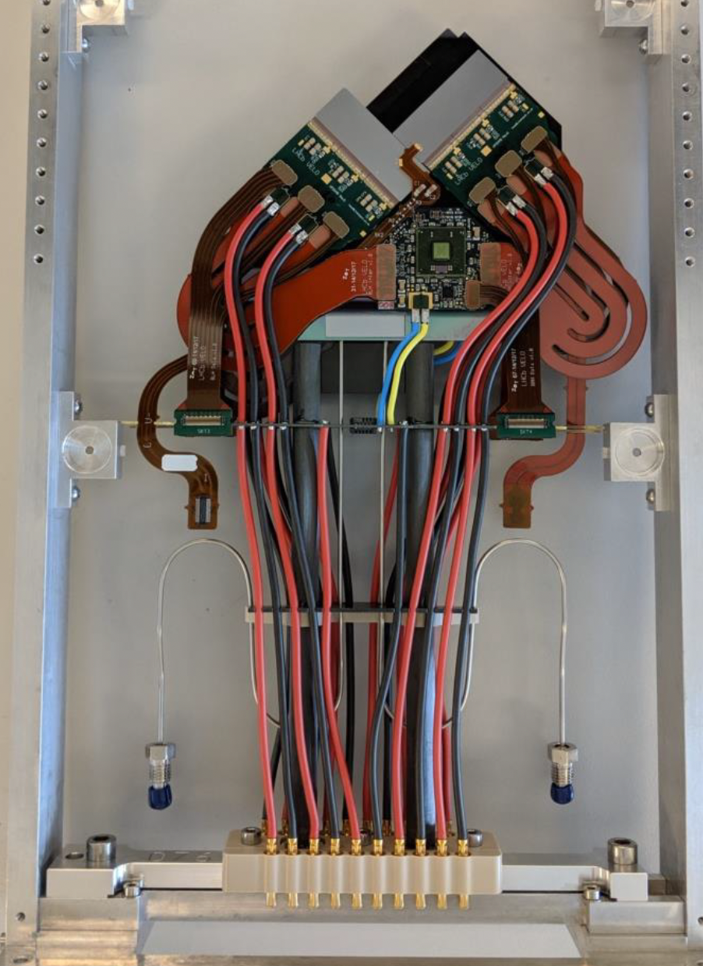
Module
Run 1
Run 2
Upgrade 1
Run 3
Run 4
Upgrade 2
2010
2012
2015
2018
2022
2024
2028
2030
2031
HV
microchannel
substrate
sensor tile
VeloPix
front end
hybrids
Interconnection
tapes
GBTx
data
cables
carbon-fiber legs
CO2
LV
Notes:
Sensors are from both sides - 6 sensors per side. 3 sensors per ASIC

Slide 12
RF-foil
Run 1
Run 2
Upgrade 1
Run 3
Run 4
Upgrade 2
2010
2012
2015
2018
2022
2024
2028
2030
2031
RF-foil
primary vacuum
A-side
C-side
read-out
1 m
beam
modules
secondary vacuum
Notes:
RF-foil protests the primary vacuum of LHC from contamination. It also has a retraction mechanism to protect halves of RF-foil from touching. Co@ pipes for cooling are not shown in the picture but are above the readout. We reuse the old closing mechanism

Slide 13
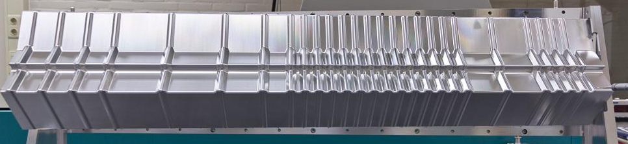
RF-foil
Run 1
Run 2
Upgrade 1
Run 3
Run 4
Upgrade 2
2010
2012
2015
2018
2022
2024
2028
2030
2031

Slide 14
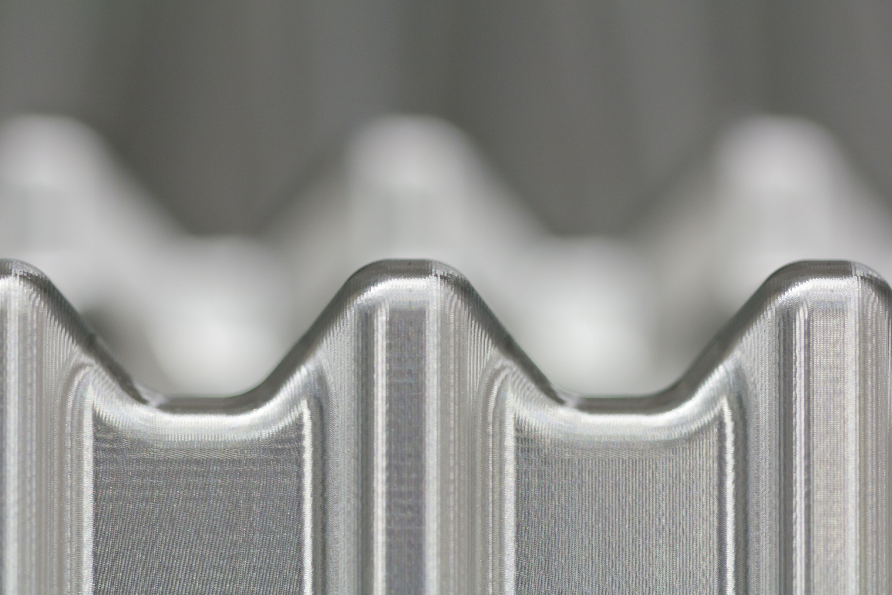
RF-foil
Run 1
Run 2
Upgrade 1
Run 3
Run 4
Upgrade 2
2010
2012
2015
2018
2022
2024
2028
2030
2031
$$\overset{⃗}{p}$$
VELO material budget
Notes:
The material budget of the upgraded VELO is evaluated by following straight-line tracks
from the origin to the plane z = 835 mm. For each volume traversed by the track, the
radiation length of the material and the length of the track segment inside the volume
are recorded.

Slide 15
RF-foil
Run 1
Run 2
Upgrade 1
Run 3
Run 4
Upgrade 2
2010
2012
2015
2018
2022
2024
2028
2030
2031
$$150μm$$
$$\overset{⃗}{p}$$
VELO material budget

Slide 16
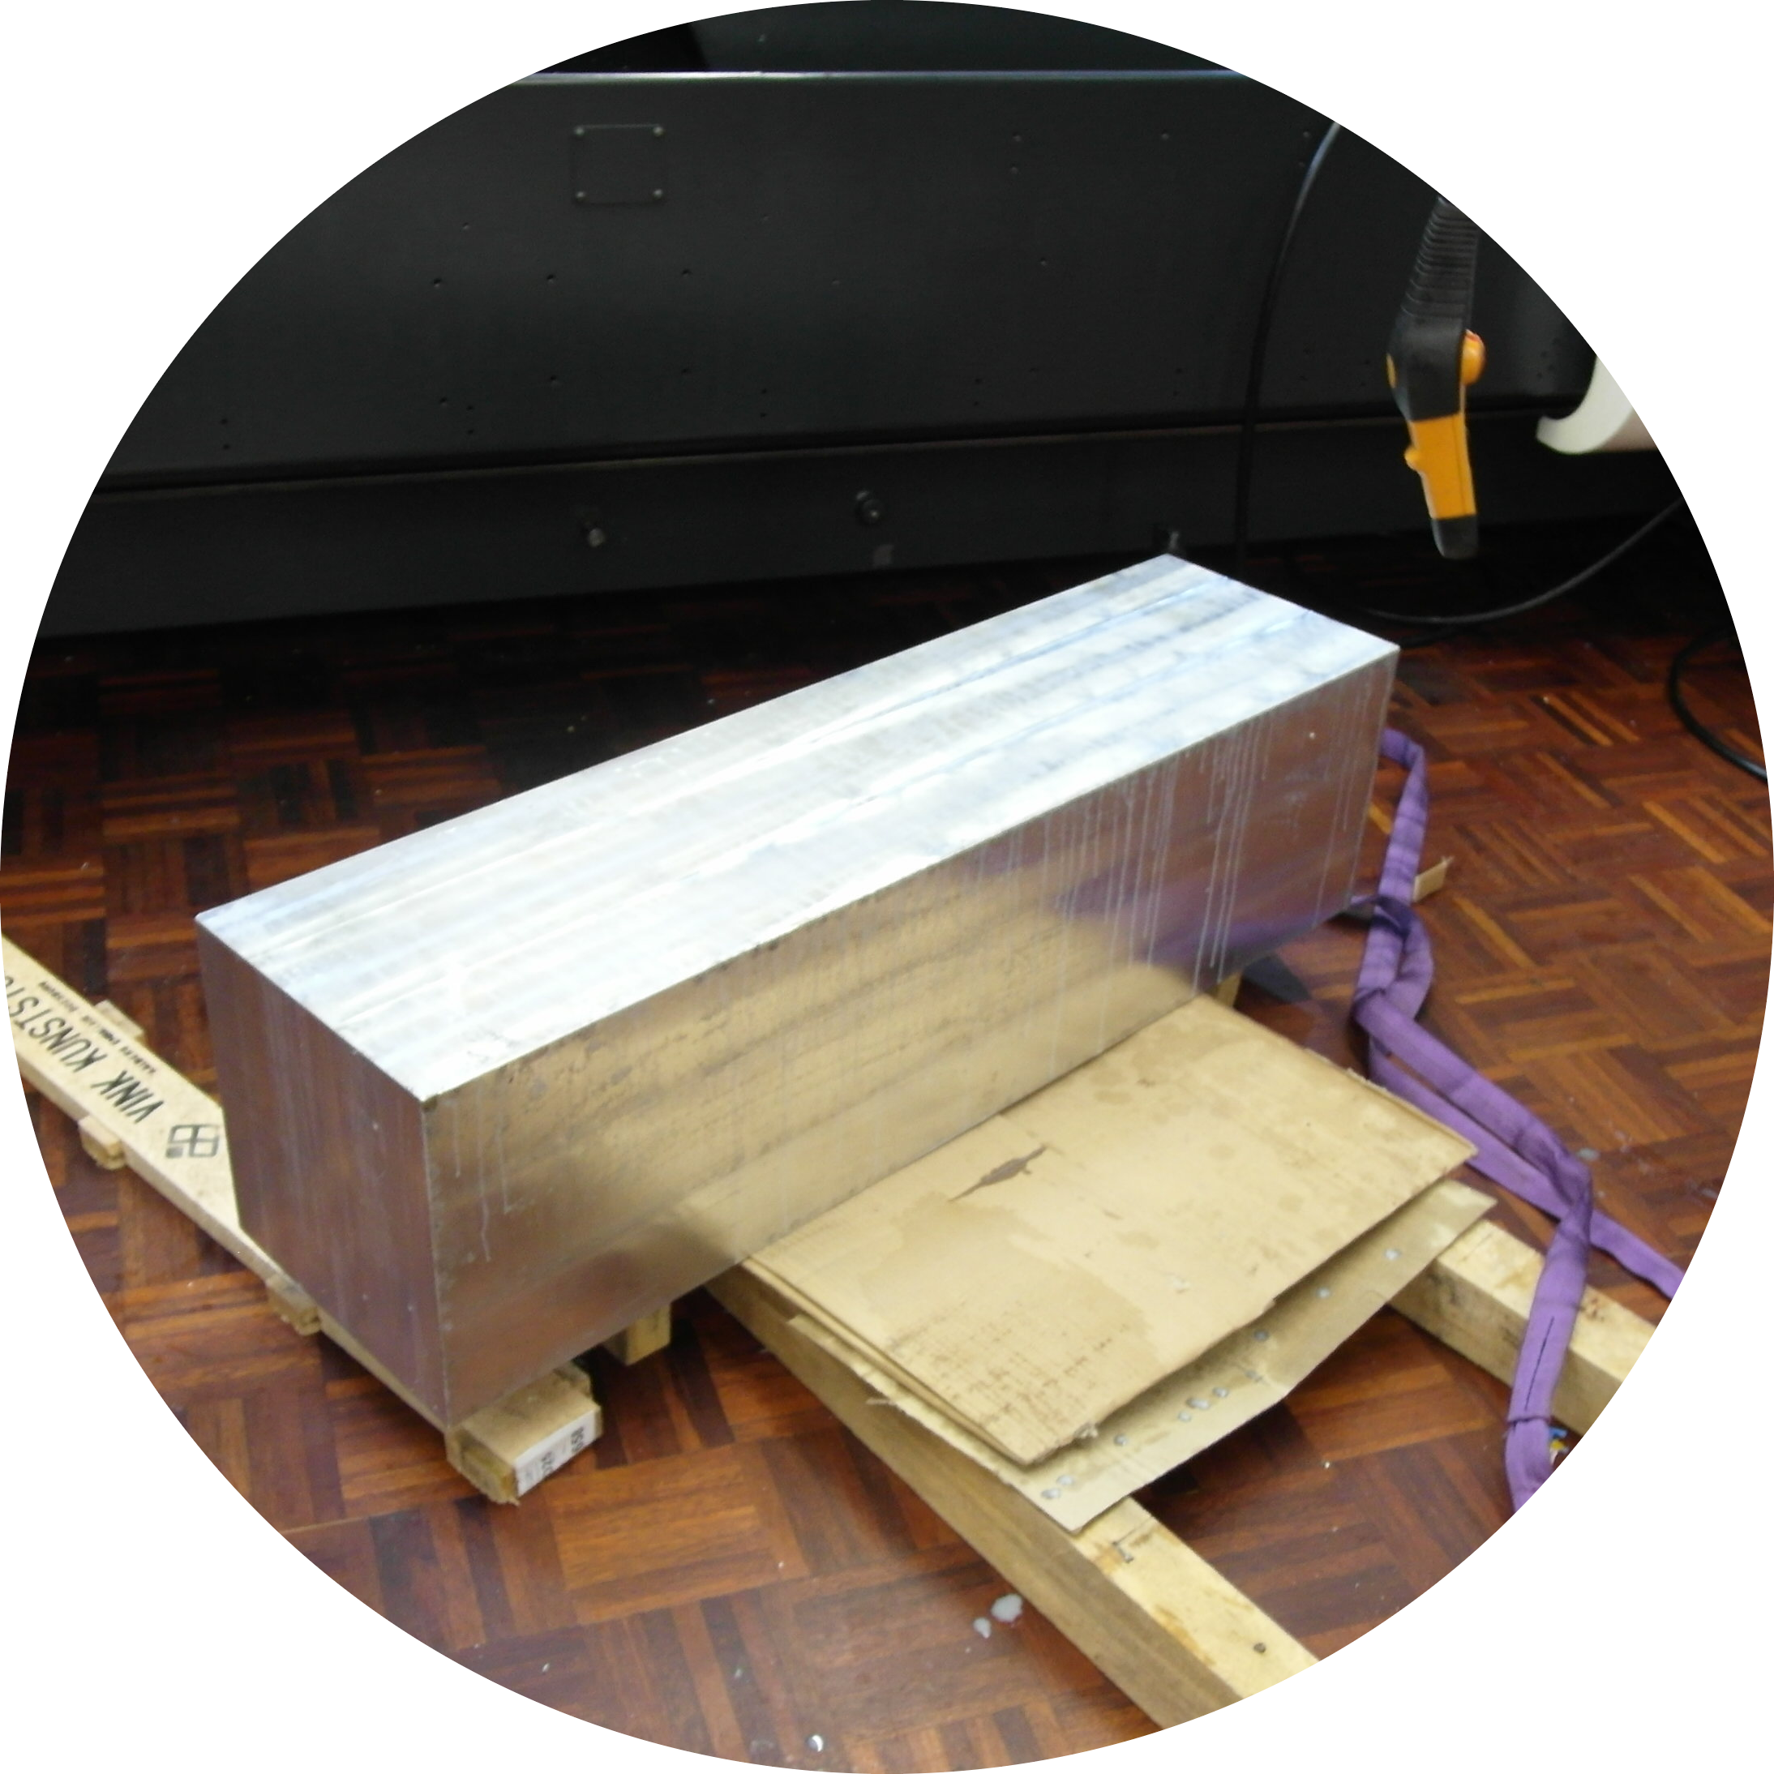
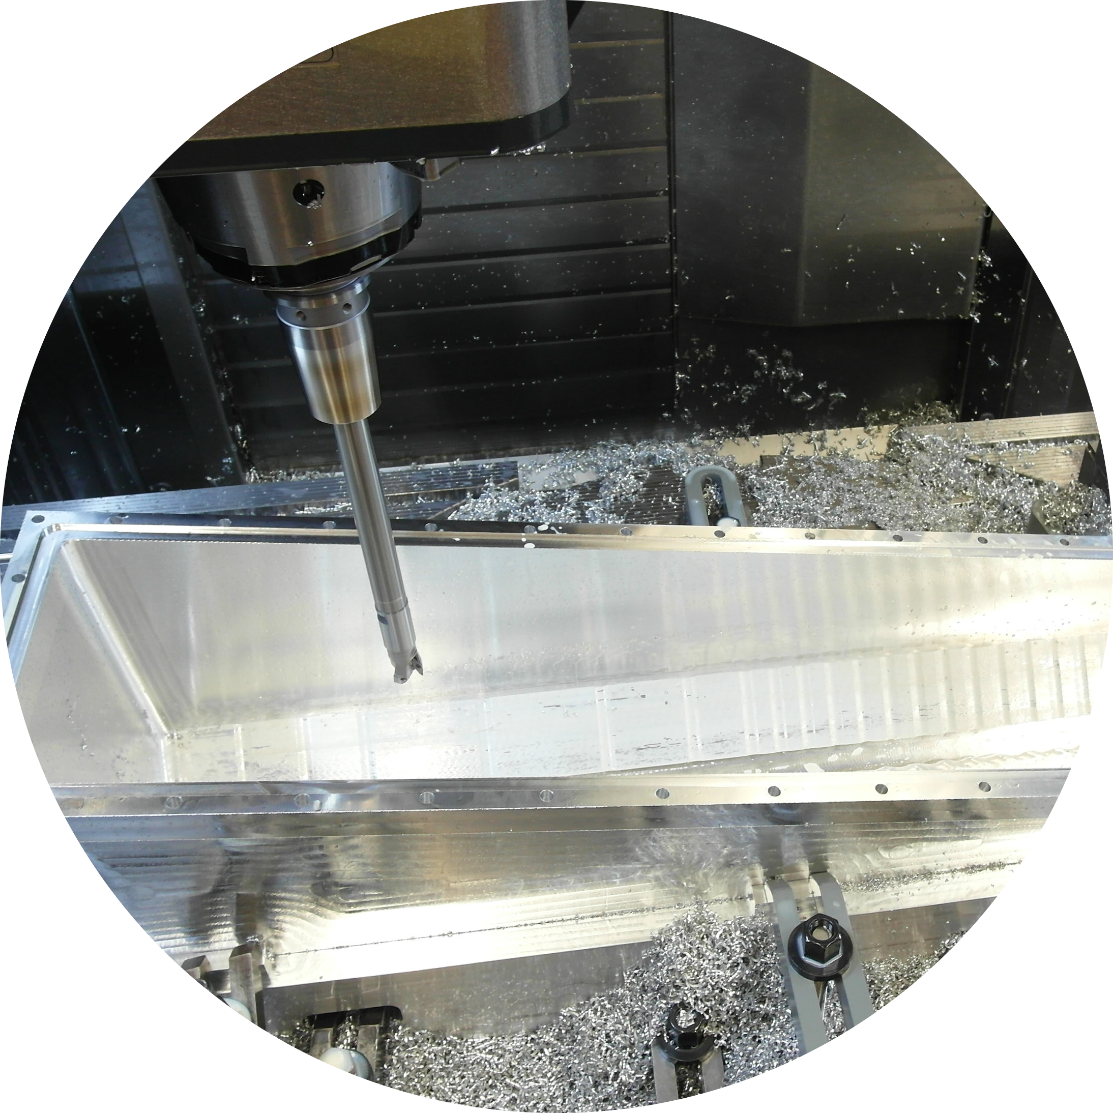
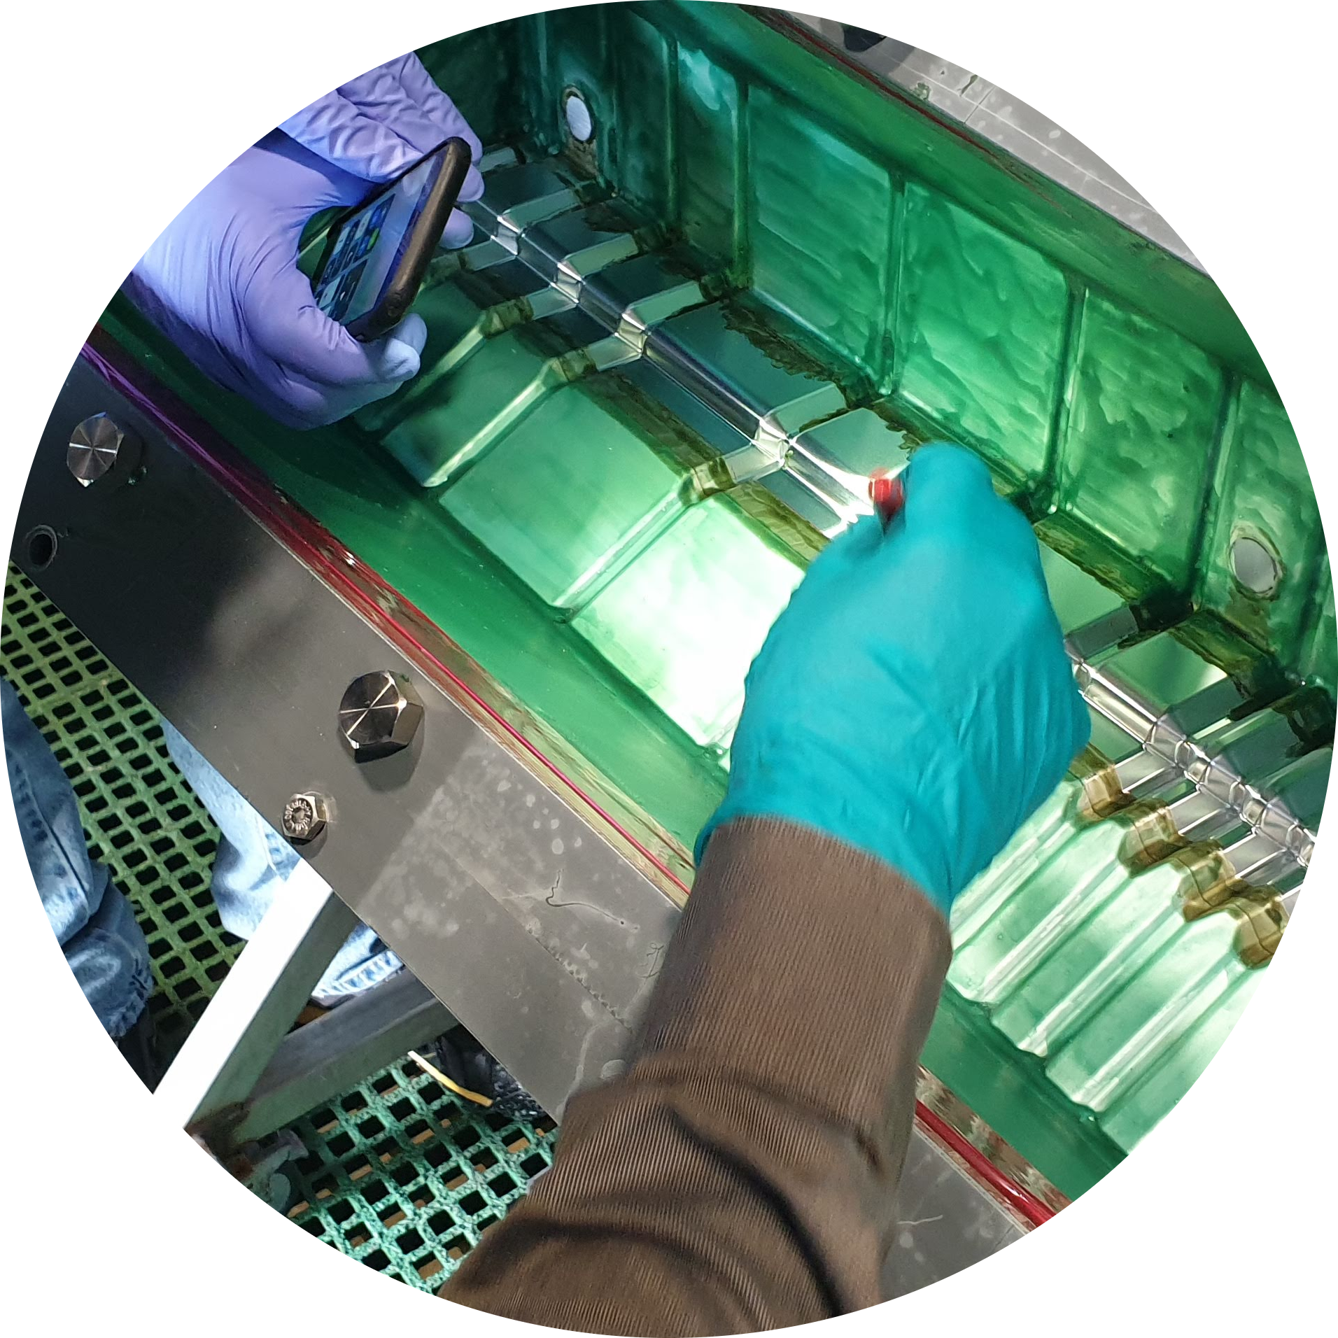
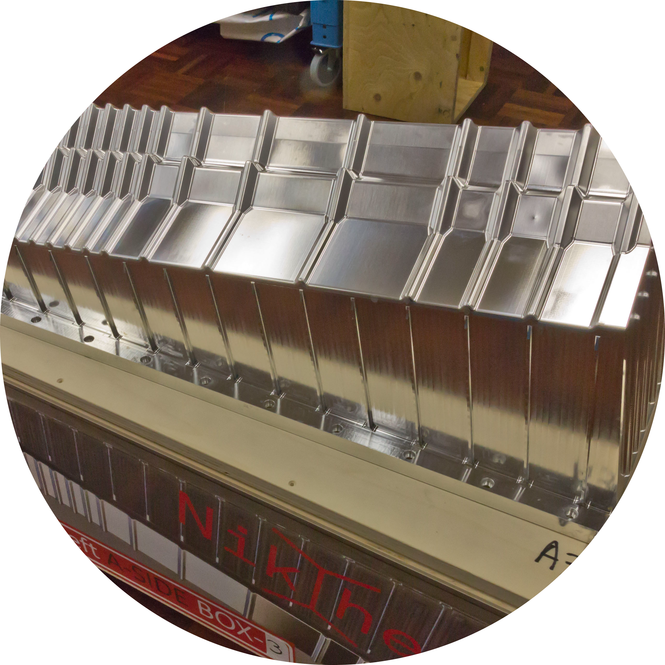
RF-foil
Run 1
Run 2
Upgrade 1
Run 3
Run 4
Upgrade 2
2010
2012
2015
2018
2022
2024
2028
2030
2031
$$250μm$$
$$150μm$$
block of aluminium
milling
etching
done

Slide 17
Run 1
Run 2
Upgrade 1
Run 3
Run 4
Upgrade 2
2010
2012
2015
2018
2022
2024
2028
2030
2031
Run 2
Upgrade 1
Run 3
2018
2019
2020
2021
2022
Velo A
Velo C

Slide 18
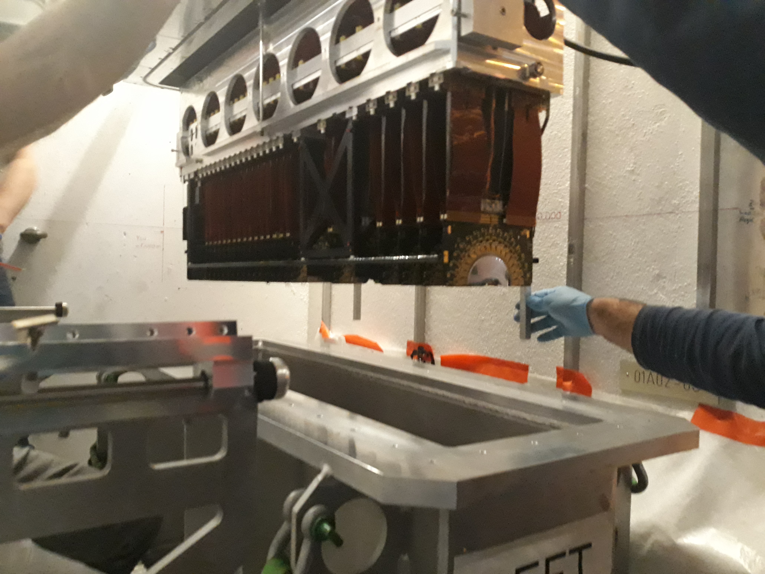
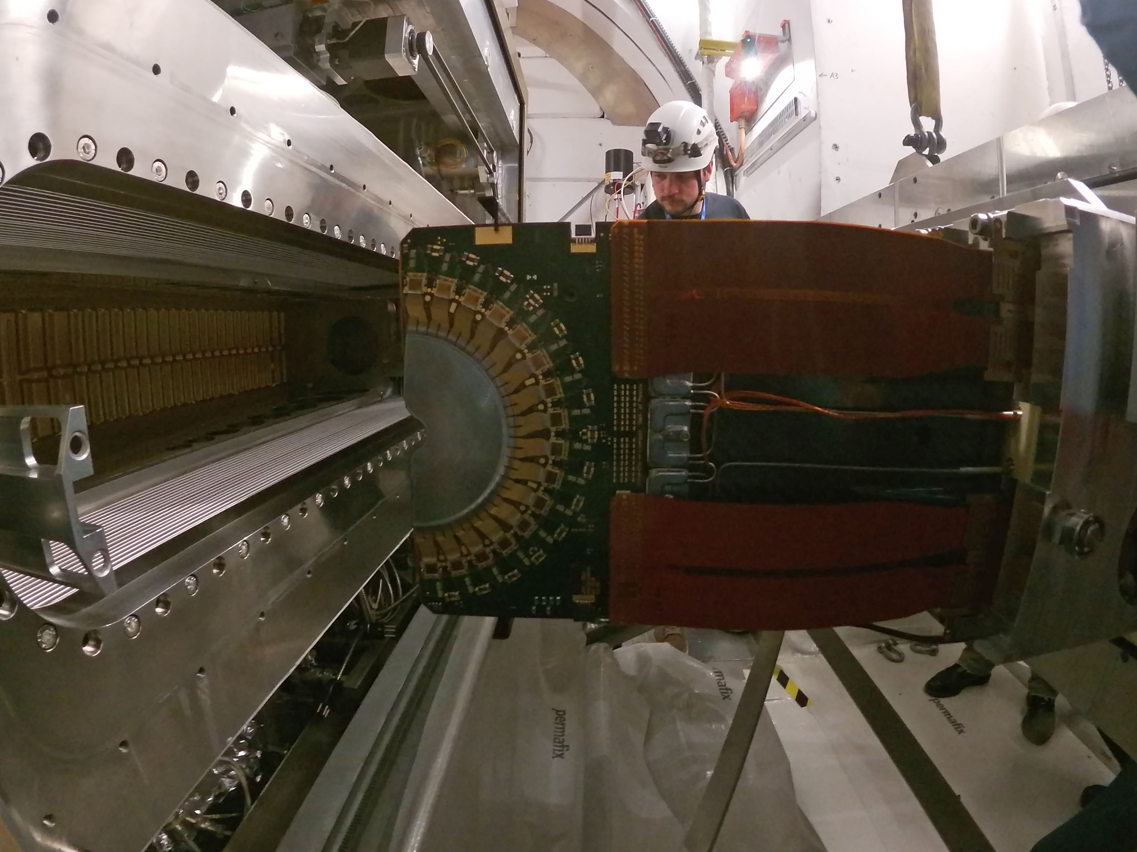
Production Assembly
Installation
remove old VELO
Run 2
Run 3
2018
2019
2020
2021
2022
Velo A
Velo C

Slide 19
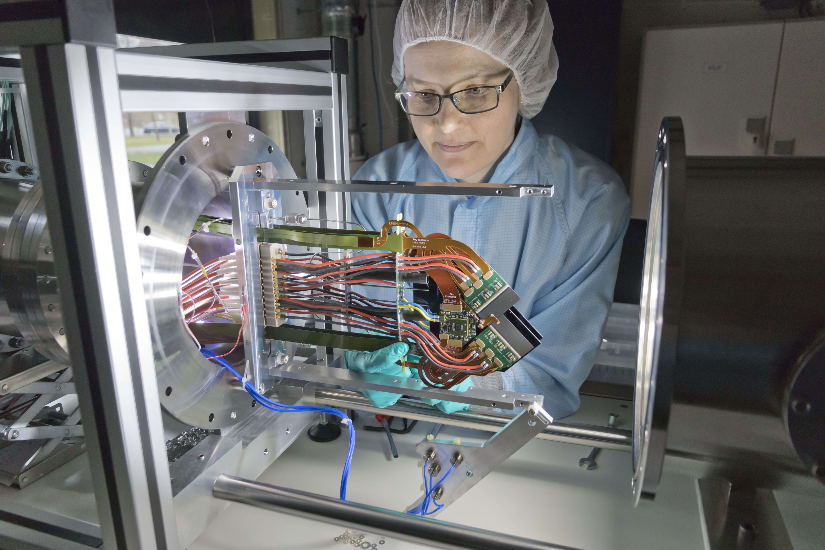
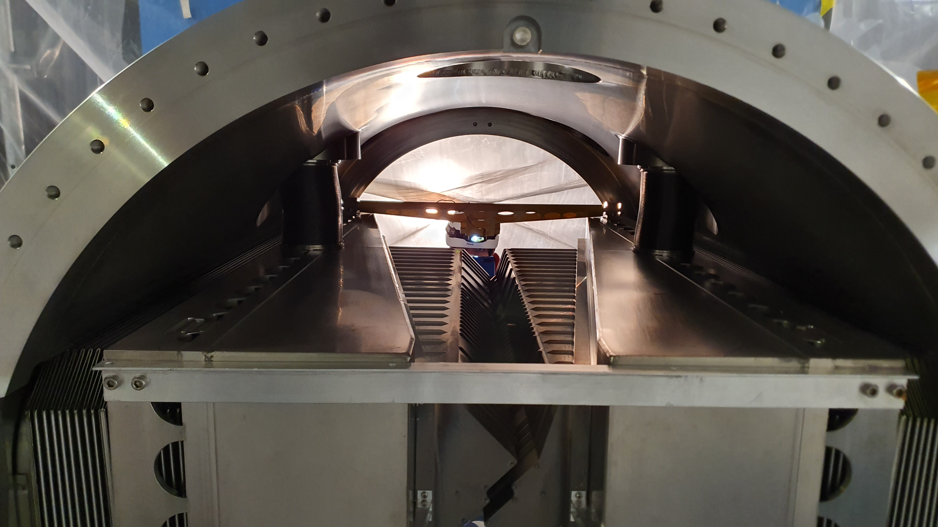
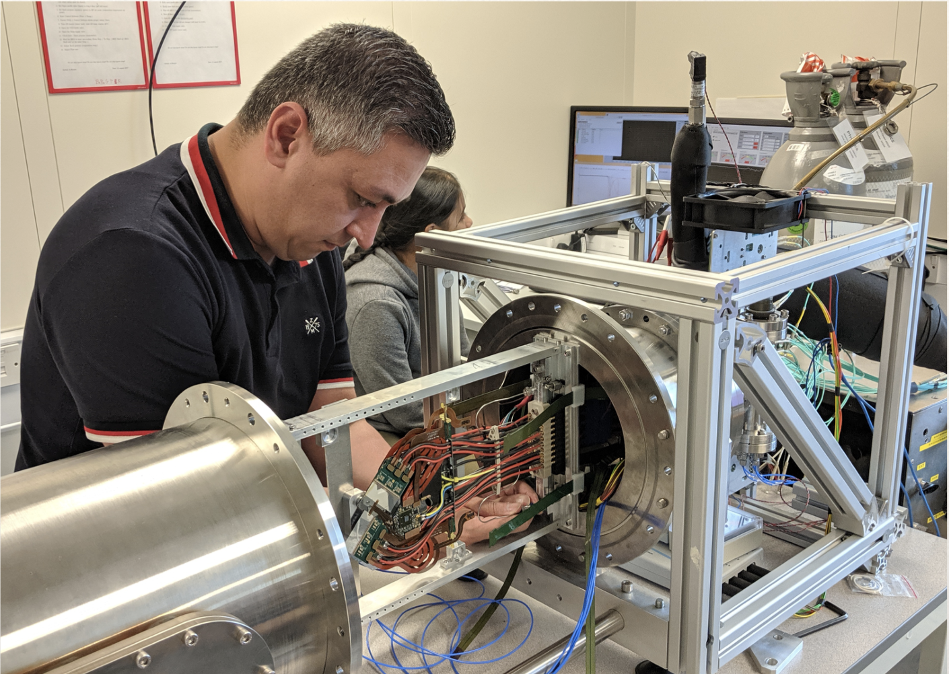
Production Assembly
RF-foil
install
Installation
remove old VELO
Run 2
Run 3
2018
2019
2020
2021
2022
Velo A
module production
Velo C
module production
Nikhef
RF-foil in place
University of Manchester

Slide 20
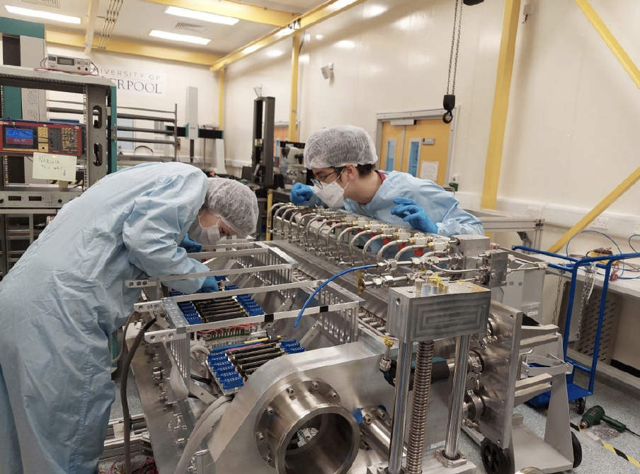
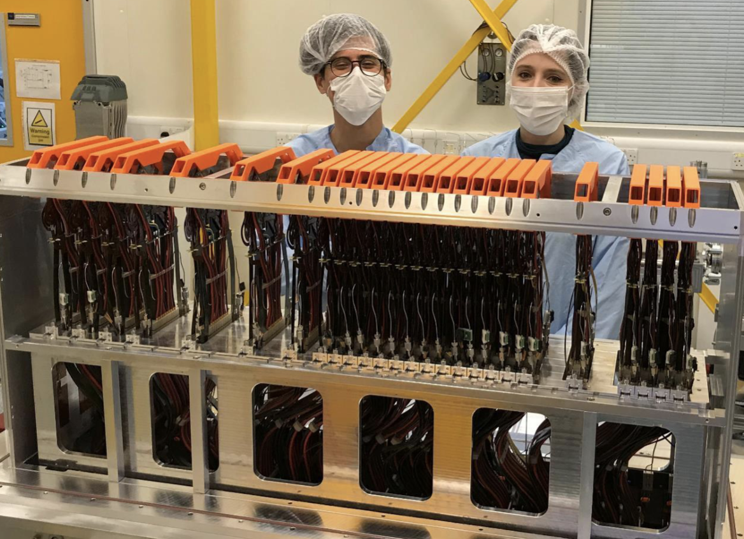
Production Assembly
RF-foil
install
Installation
remove old VELO
Run 2
Run 3
2018
2019
2020
2021
2022
Velo A
module production
assembly
Velo C
module production
assembly
time constraints because of COVID-19 :
  install C-side in late February-early March
  use technical stop in May to install side A
team effort: Liverpool experts with support of experts from Nikhef, Manchester, Oxford and CERN
University of Liverpool

Slide 21
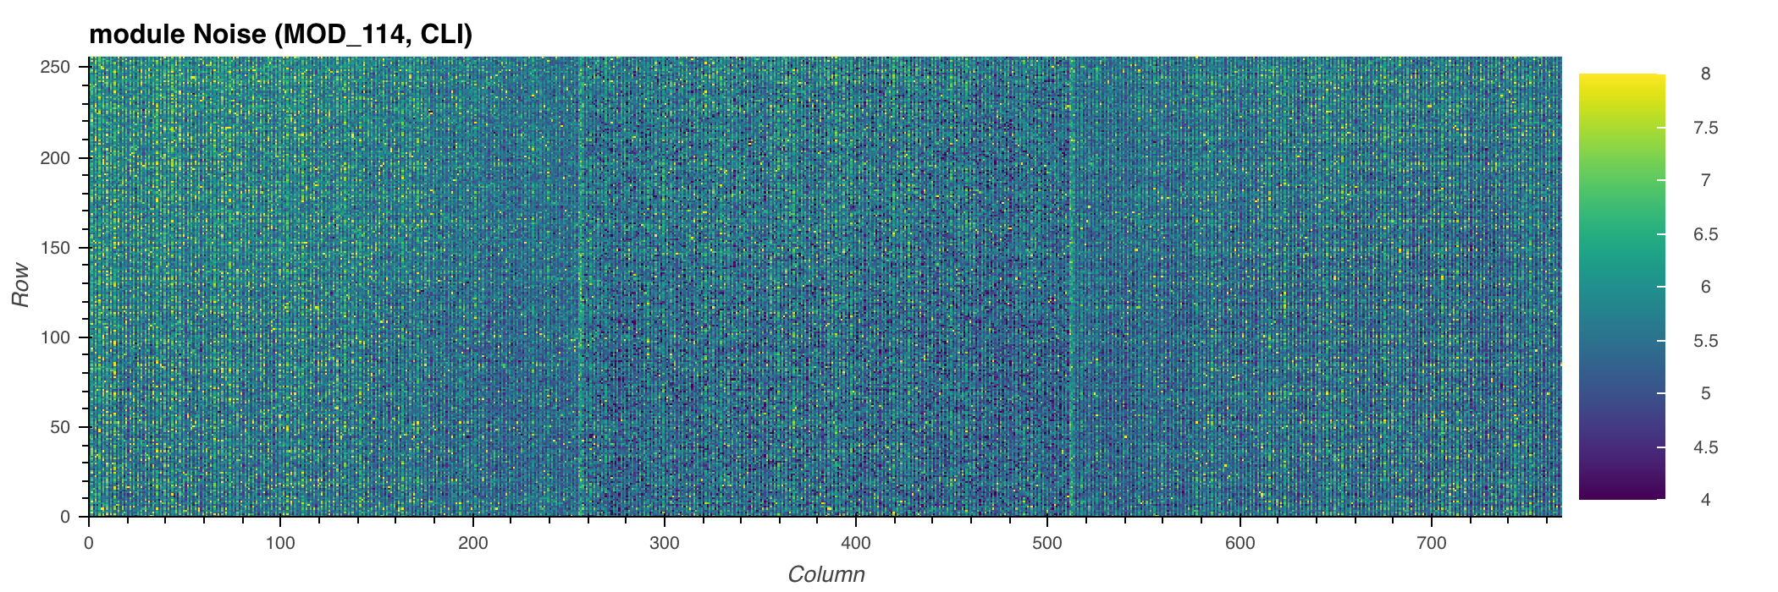
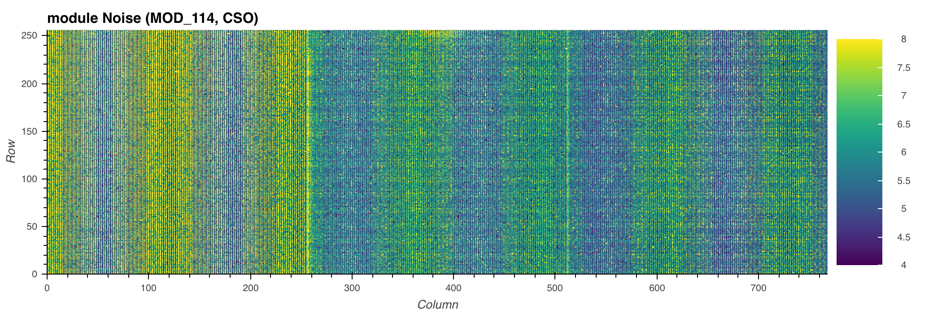
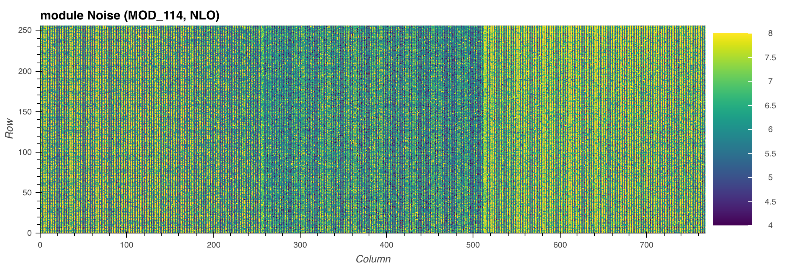
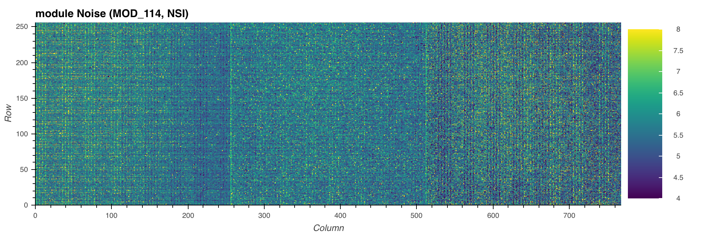
Production Assembly
RF-foil
install
Installation
remove old VELO
Run 2
Run 3
2018
2019
2020
2021
2022
Velo A
module production
assembly
Velo C
module production
assembly
front ASIC 1
Tests
Perform electrical and noise tests per module before installation
Install modules and test cooling loop
Test half under vacuum
Cooling tests with powered modules
Electrical and noise tests after installation
Metrology with and without cooling
front ASIC 2
back ASIC 1
back ASIC 2
noise scans

Slide 22
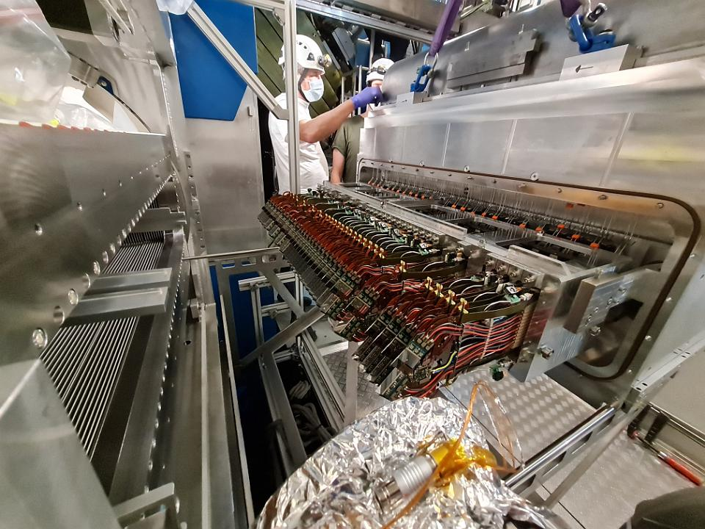
Production Assembly
RF-foil
install C
install A
install
Installation
remove old VELO
Run 2
2018
2019
2020
2021
2022
Velo A
module production
assembly
commissioning
Velo C
module production
assembly
commissioning
Before installation
Repeat warm electrical and noise tests
Metrology
After installation
Leaks check
Connection to the safety alarm matrix
Communication test
Mapping check
VELO at Point 8

Slide 23
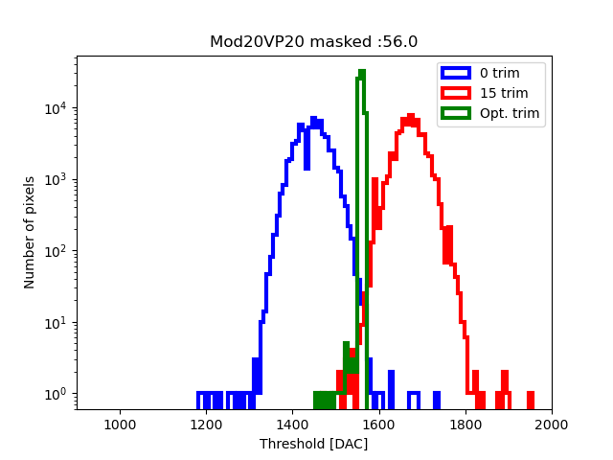
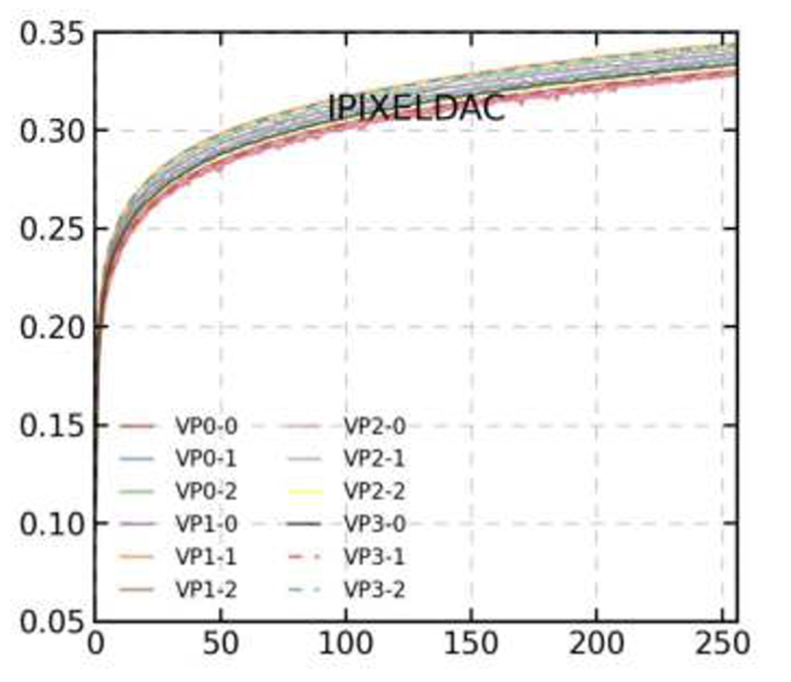
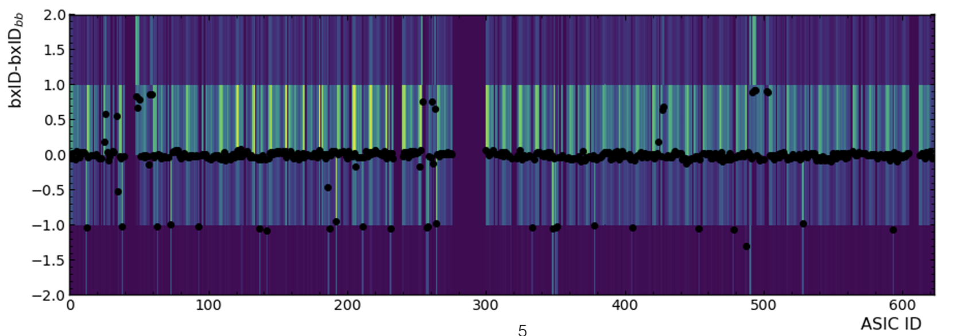
Commissioning and calibration
IV curve
Equalisation
LHCb work in progress
LHCb work in progress
DAC scans
Time Alignment
LHCb work in progress
LHCb work in progress
V

Slide 24
Commissioning and calibration
IV curve
Equalisation
LHCb work in progress
LHCb work in progress
DAC scans
Time Alignment
LHCb work in progress
LHCb work in progress
V

Slide 25
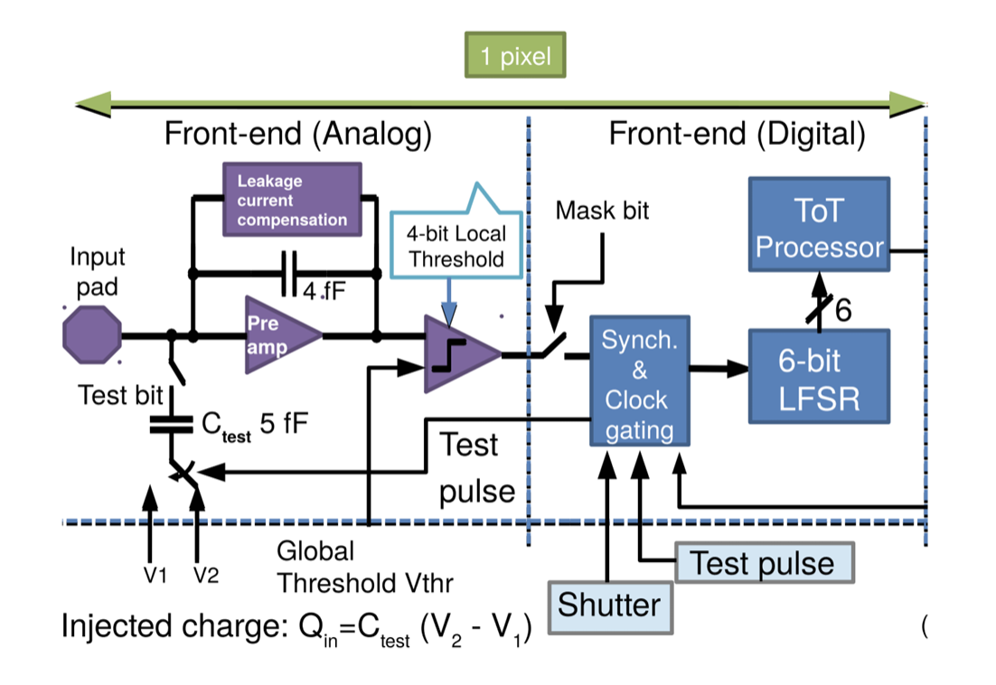
Equalisation
Aim: equalise the per pixel discriminator behaviour
such that they all respond the same to a given quantity
Get s-curves with extreme trims 0 and 15
Extrapolate respond between 0 and 15
Define one threshold for all pixels
Choose trim per pixel + mask to reach
the same threshold
$$Th_{local}=trim×Th_{global}$$
global threshold $Th_{global}$ is defined per ASIC
trim is defined per pixel

Slide 26
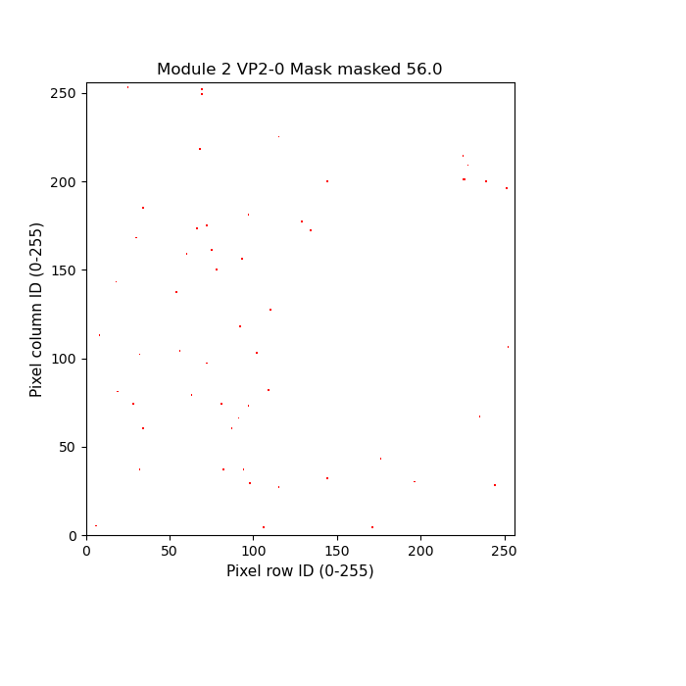
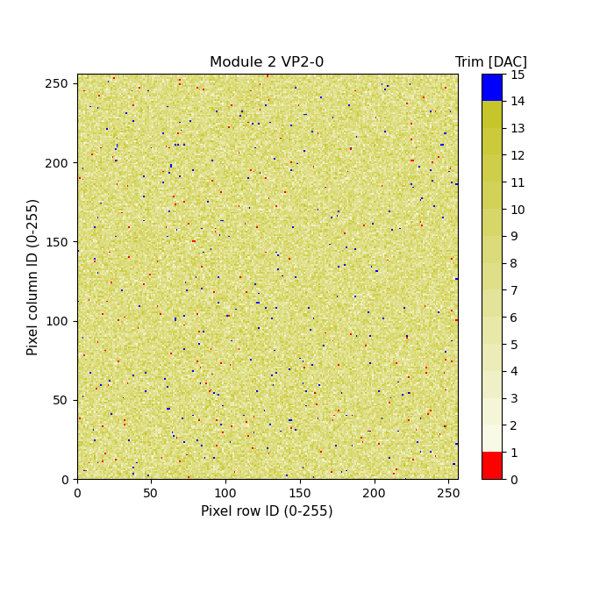
Equalisation
Aim: equalise the per pixel discriminator behaviour
such that they all respond the same to a given quantity
LHCb work in progress
Get s-curves with extreme trims 0 and 15
Extrapolate respond between 0 and 15
Define one threshold for all pixels
Choose trim per pixel + mask to reach
the same threshold
LHCb work in progress
LHCb work in progress

Slide 27
Time Alignment and BXID spread
Aim: all ASICs respond at the same time
signal
bxid
$$25ns$$
$$25ns$$
$$25ns$$
time aligned
signal
signal
bxid
bxid
different bxid
difference within the same bxid

Slide 28
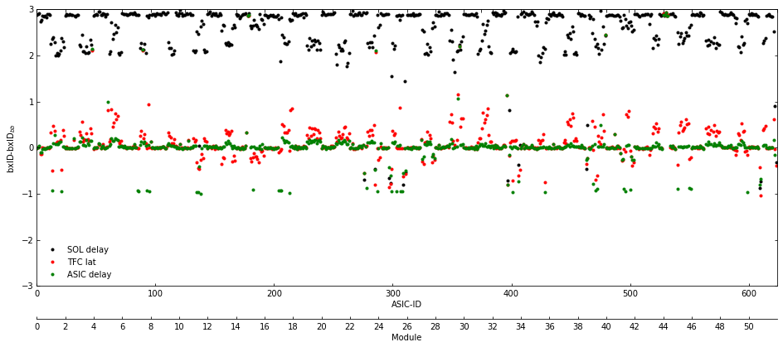
Time Alignment and BXID spread
Aim: all ASICs respond at the same time
BXID-BXIDbb
Overall delay: add latency to catch all
LHCb work in progress
Timing and trigger control system delay/ASIC : different bxid
ASIC delay : adjust inside one bxid
ASIC ID
Module
BXID : VELO locally
BXIDbb : beam-beam BXID from LHC
1 BXID = 25 ns

Slide 29
But then BXID spread came
LHCb work in progress
Module 22
Asic: VP0-1
threshold: 1700
Also seen in analogue test pulse
1 BXID = 25 ns

Slide 30
Time Alignment and BXID spread
Aim: all ASICs respond at the same time
Threshold is global not per ASIC
Perform DAC scan
Get new threshold voltage
Retake equalisation

Slide 31
Time Alignment and BXID spread
Aim: all ASICs respond at the same time
Threshold is global not per ASIC
Perform DAC scan
Get new threshold voltage
Retake equalisation
LHCb work in progress
V
V
V

Slide 32
Time Alignment and BXID spread
Aim: all ASICs respond at the same time
Threshold is global not per ASIC
Perform DAC scan
Get new threshold voltage
Retake equalisation
LHCb work in progress
V
V
showed improvement with
bxid spread analogue test pulse
V

Slide 33
Time Alignment and BXID spread
Aim: all ASICs respond at the same time
SOL 40 delay: add latency to catch all
TFC delay/ASIC fix : different bxid
ASIC delay : adjust inside one bxid

Slide 34
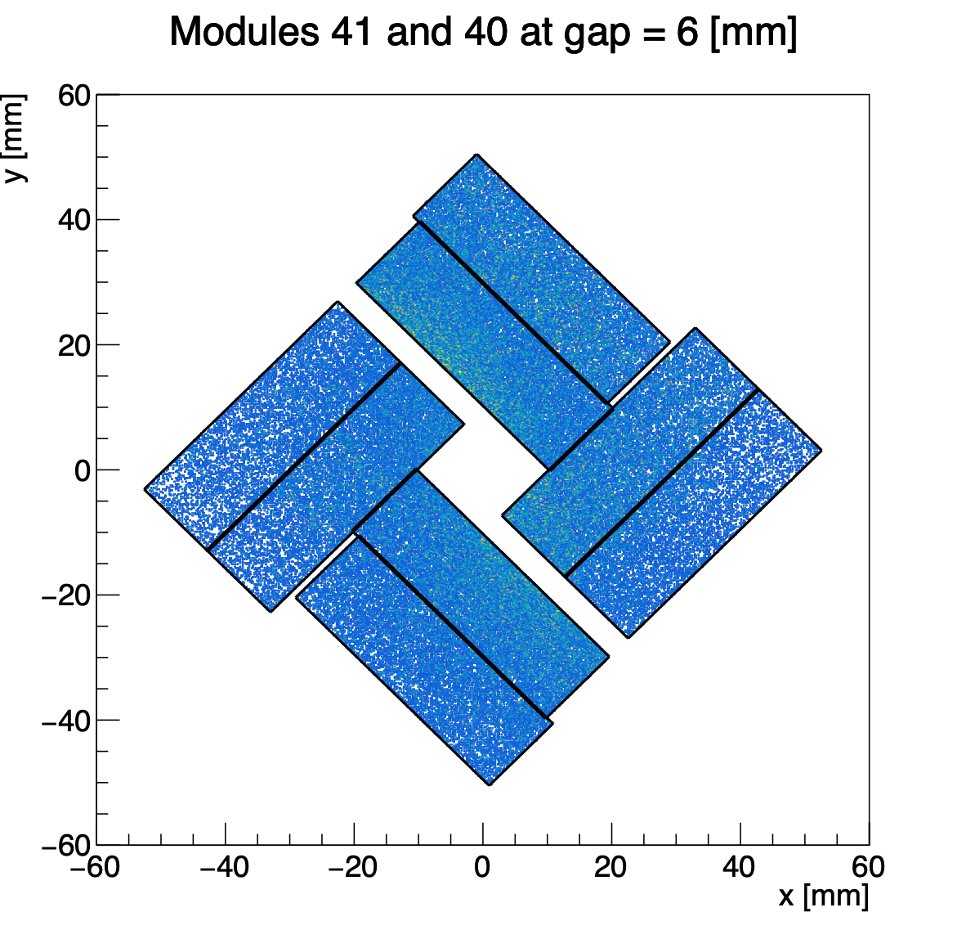
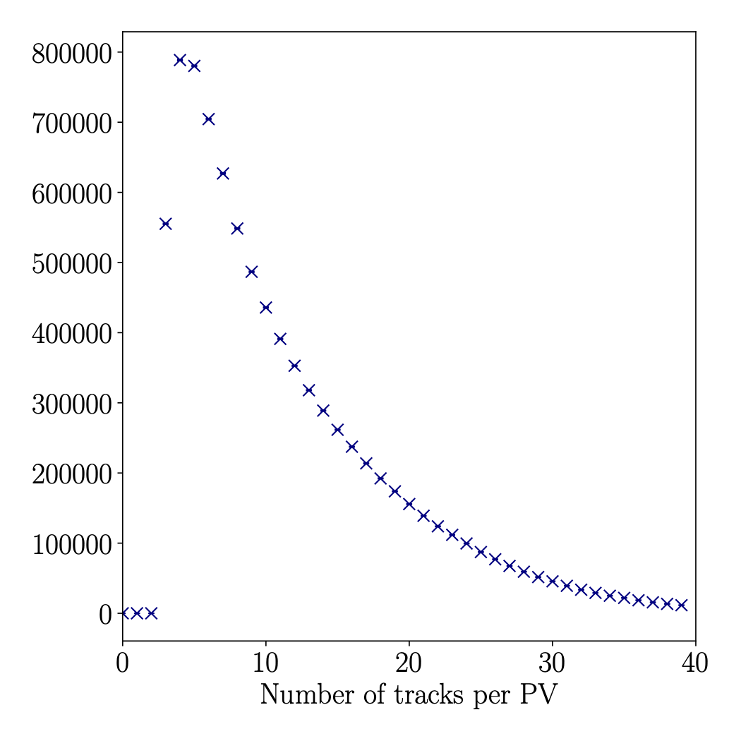
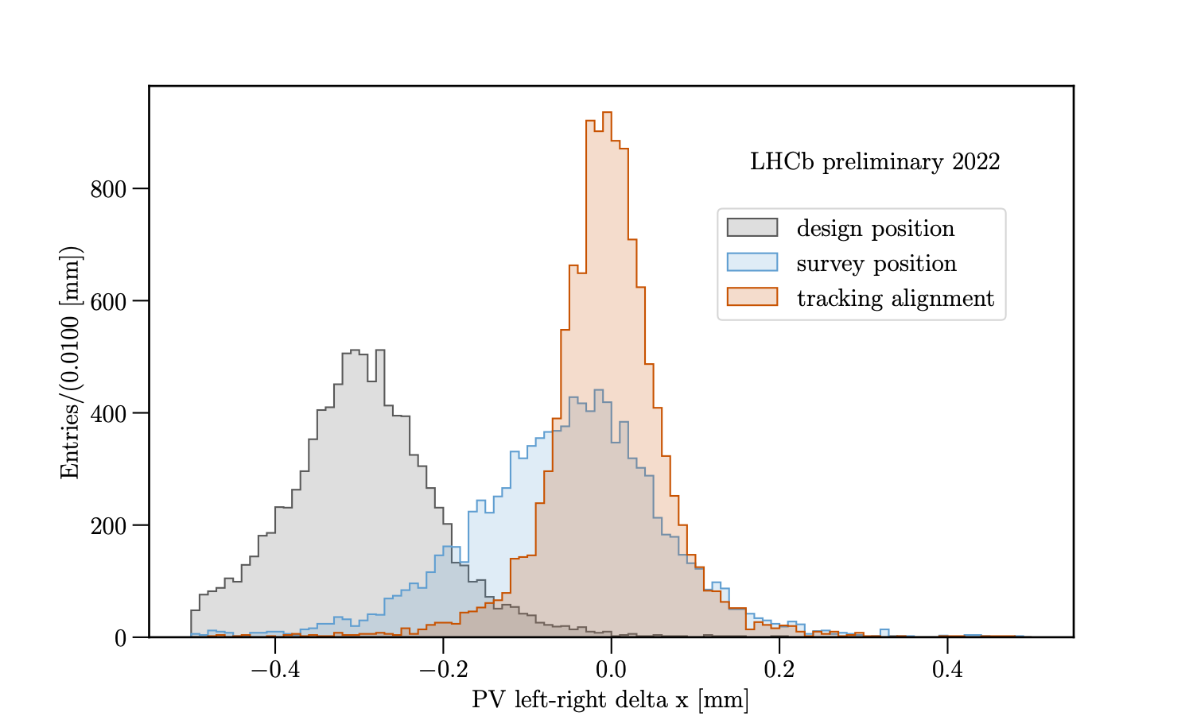
VELO opens it’s eyes
First glance at new data
Real-time data quality with online monitoring - Monet
LHCb work in progress
LHCb work in progress
VELO partially closed
Number of tracks per primary vertex
cluster map
number of tracks per primary vertex
vertex position alignment

Slide 35
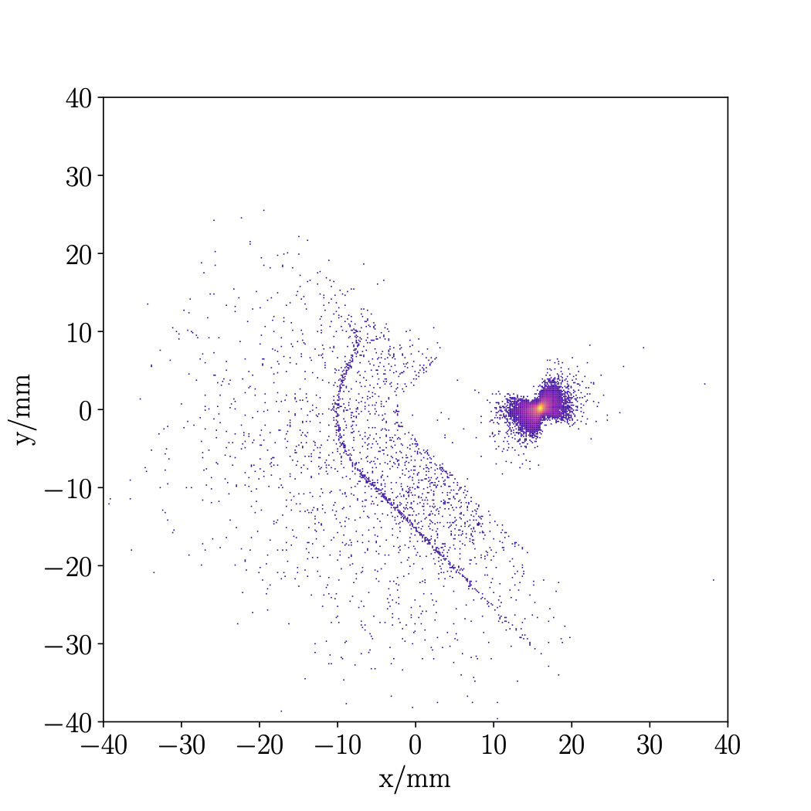
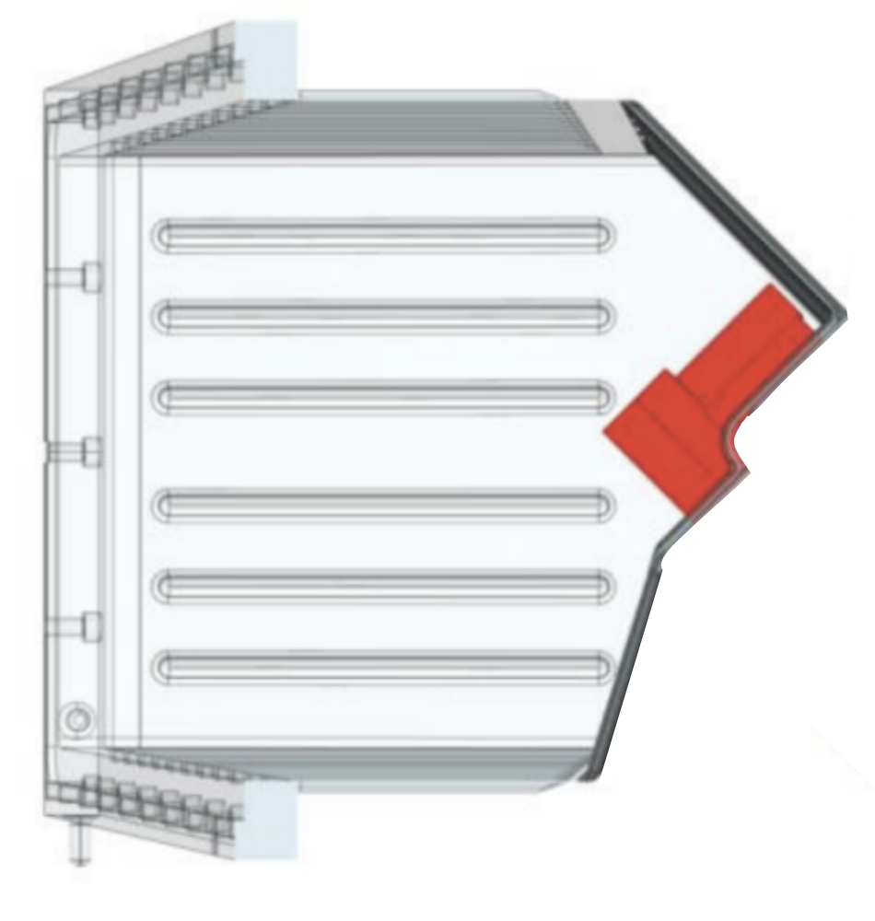
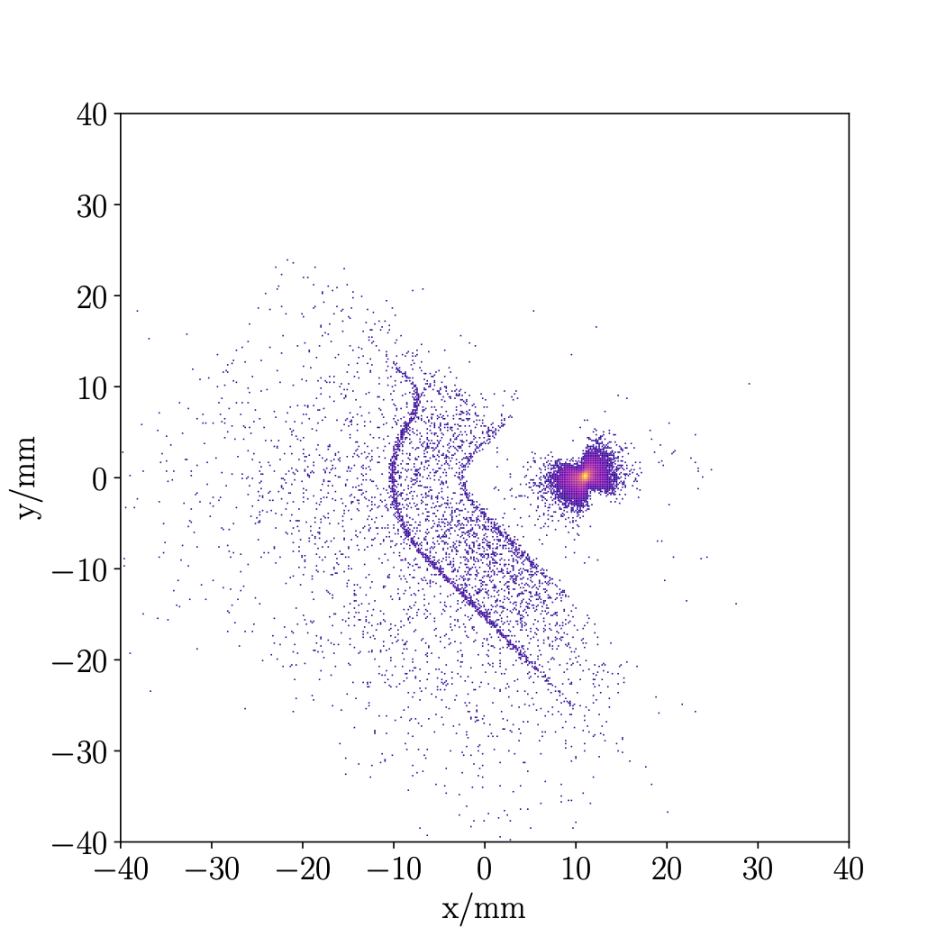
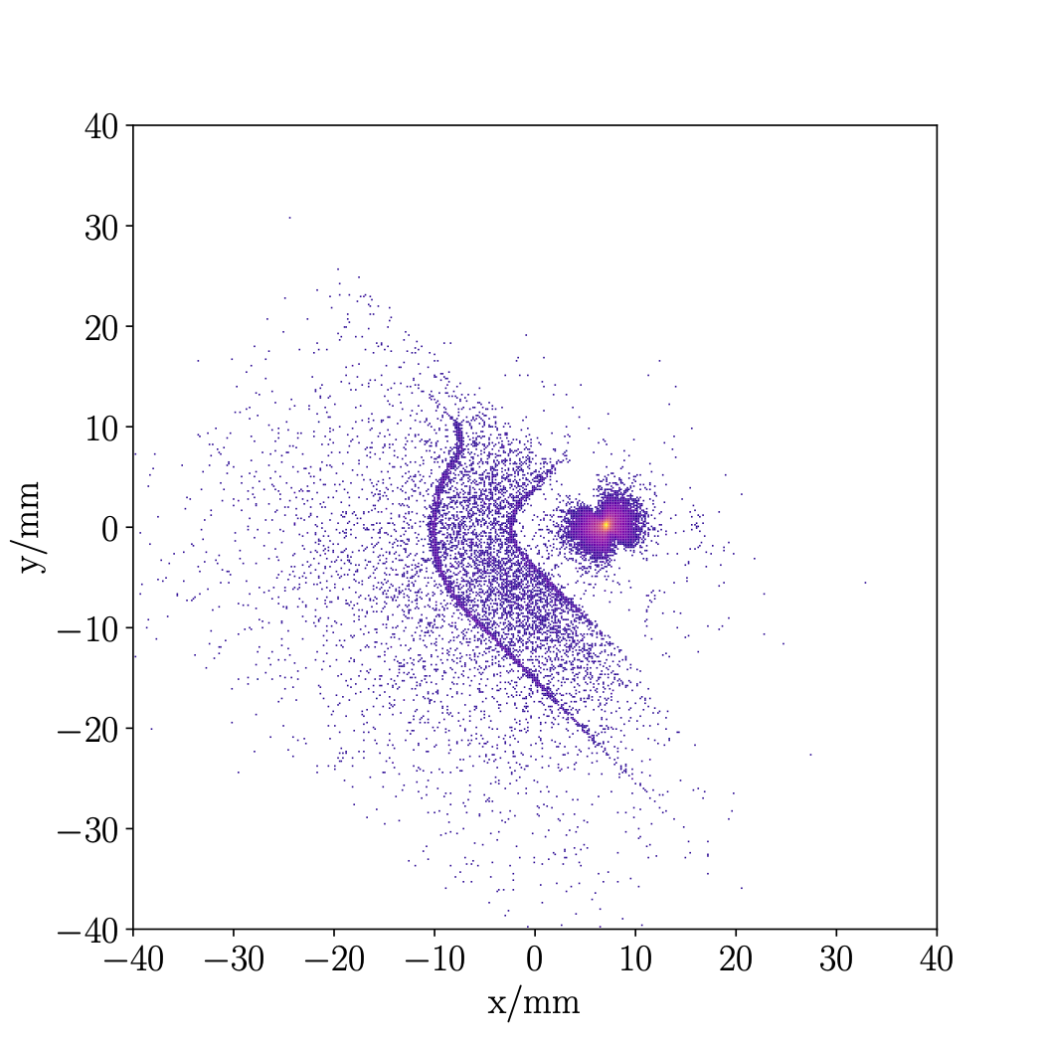
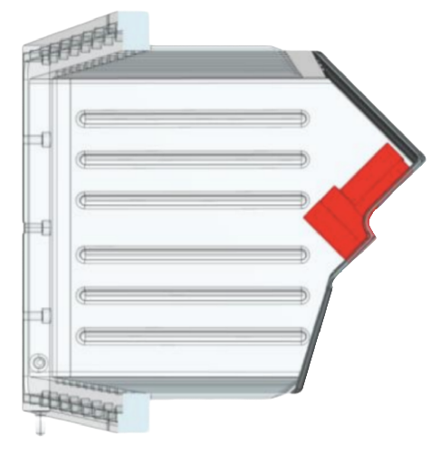
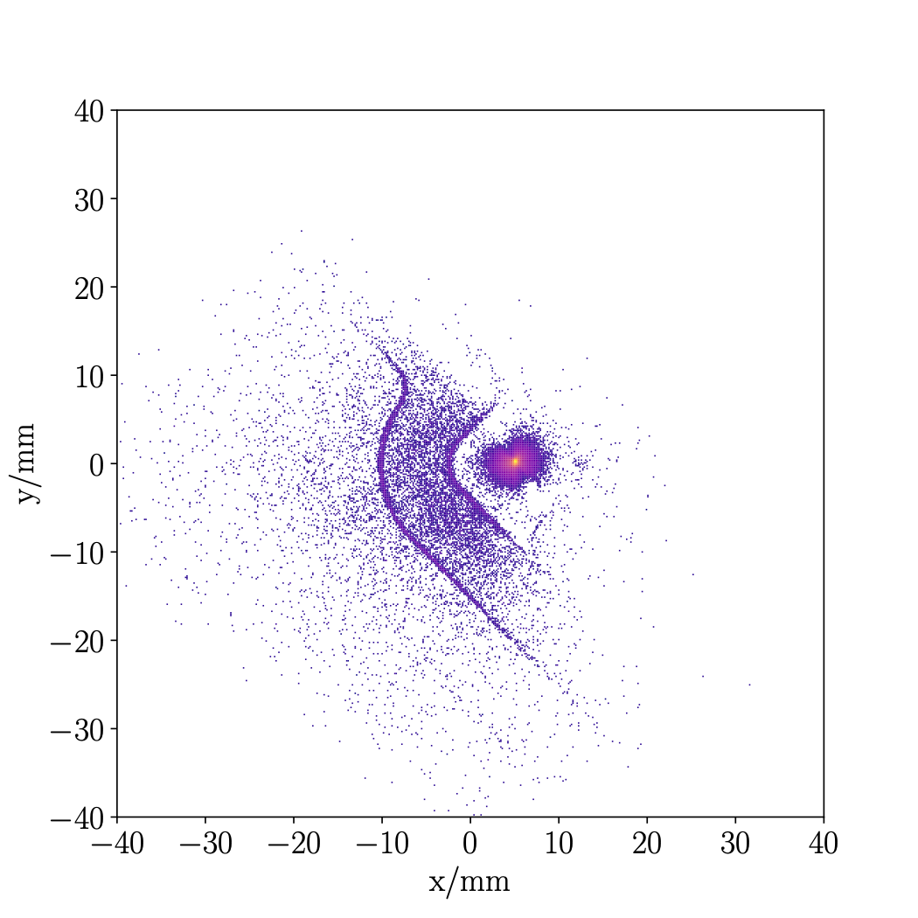
First closure October 2022
At low intensity beam
hadronic vertices
not up to scale
LHCb preliminary
gap
gap 30 mm
LHCb preliminary
gap 20 mm
LHCb preliminary
gap 12 mm
LHCb preliminary
gap 8 mm

Slide 36
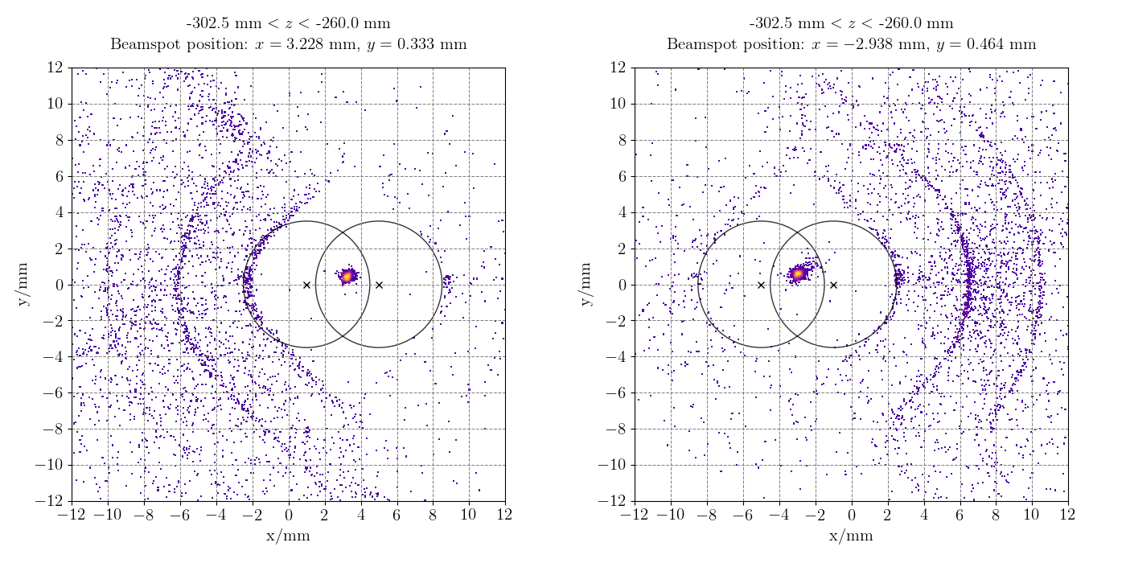
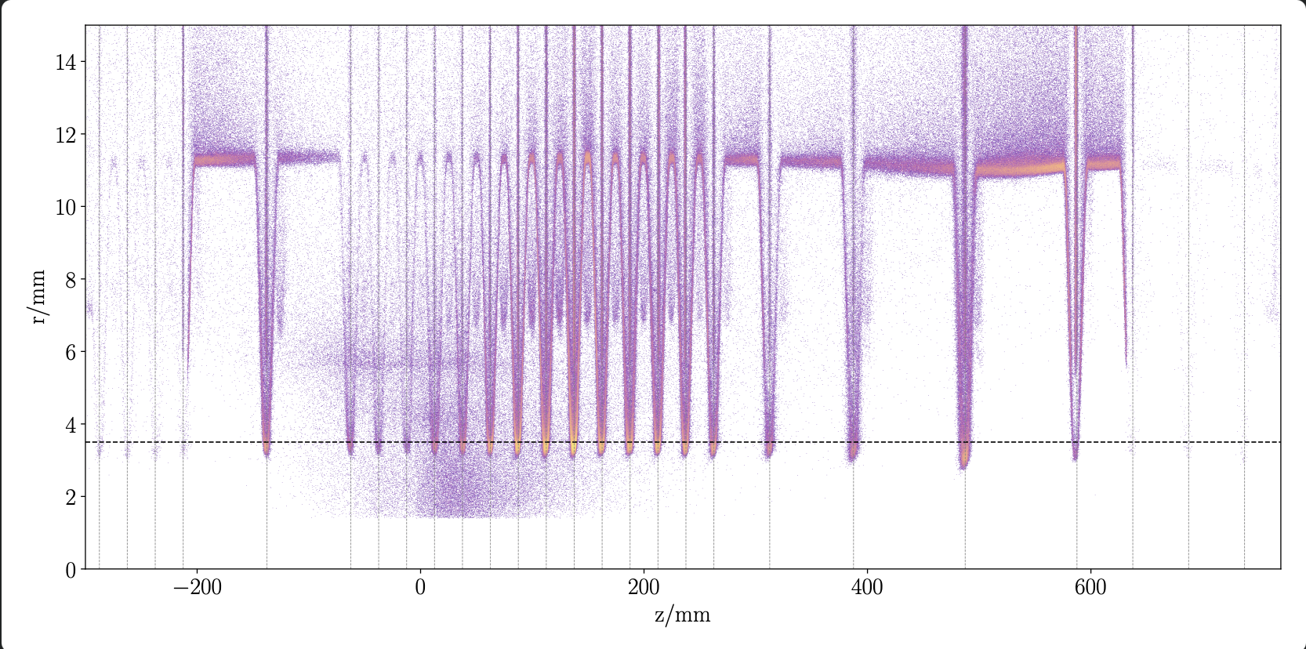
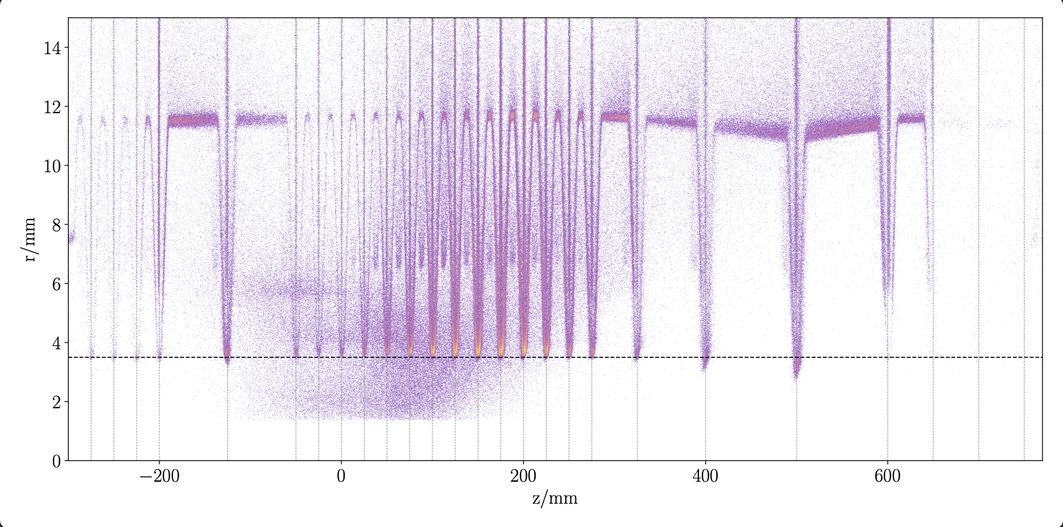
Metrology with beam
LHCb work in progress
Velo C
Velo A
LHCb preliminary
LHCb preliminary
Notes:
Here RF-foil is expanded beyond the nominal bound of 3.5 mm . You can also sea beam angle on the gifs.

Slide 37
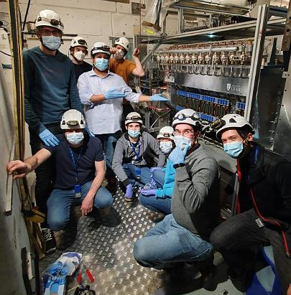
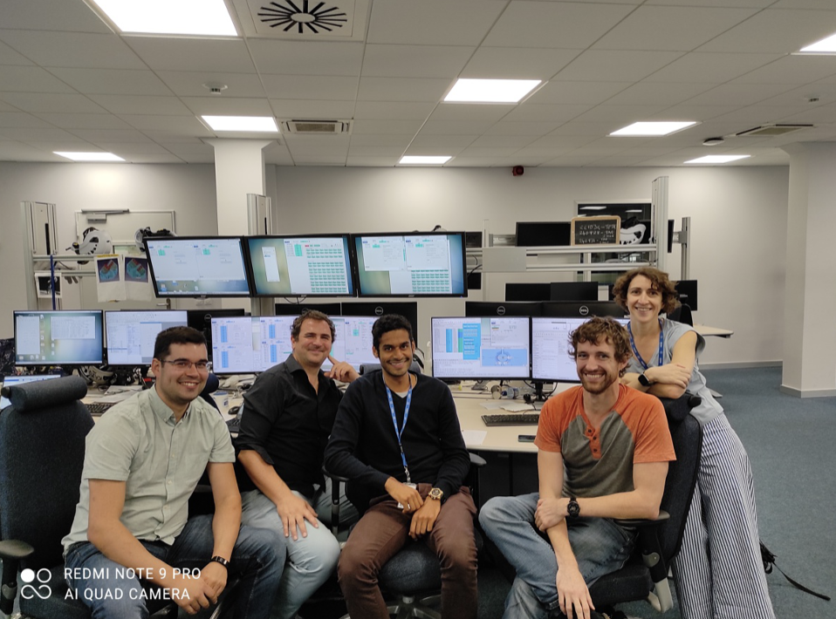
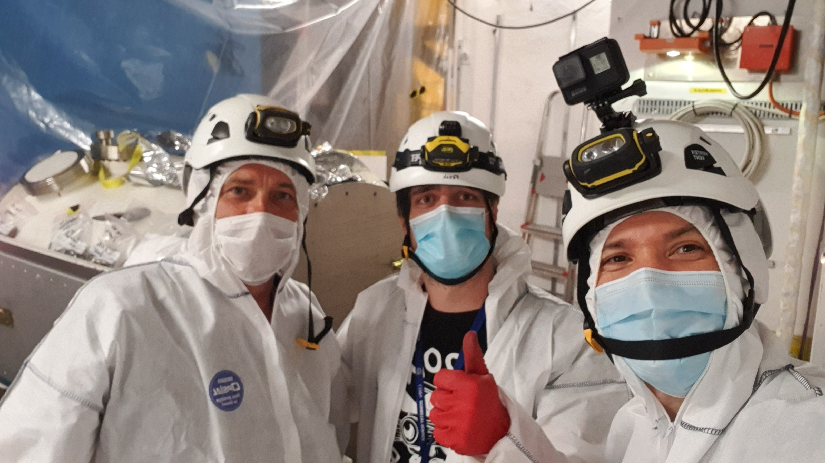
Conclusions
Despite COVID-19 delay VELO has arrived
A lot of progress in commissioning, but still some mysteries to solve - this talk did not cover a lot in configuration, firmware, monitoring, overall improvement of stability, cooling, etc.
First data has been seen!
And of course this is all a result of hard work of many-many people

Slide 38
ありがとう
(arigatō)
G. Bogdanova
A. Leflat
V. Volkov

Slide 39
Backup

Slide 40

Module
Run 1
Run 2
Upgrade 1
Run 3
Run 4
Upgrade 2
2010
2012
2015
2018
2022
2024
2028
2030
2031
256x256p
900 MHits/s
900 MHits/s
256x256p

Slide 41

Cooling
Run 1
Run 2
Upgrade 1
Run 3
Run 4
Upgrade 2
2010
2012
2015
2018
2022
2024
2028
2030
2031
subcooled liquid
Gas

Slide 42


Safety
interlock VELO
trigger alarm for the shifter and piquet

Slide 43


Slide 44

Experiment Control System
Timing and Fast control
Overall delay
Timing and Fast control
Timing and Fast control

Slide 45


Equalisation
Aim: equalise the per pixel discriminator behaviour
such that they all respond the same to a given quantity
Scan with extreme trims 0 and 15
Compute the quantity to equalise on
Choose the aim
Extrapolate respond between 0 and 15
Compute trim per pixel + mask
trim 0
trim 0
trim 15
baseline - mean

Slide 46
Equalisation
Aim: equalise the per pixel discriminator behaviour
such that they all respond the same to a given quantity
Scan with extreme trims 0 and 15
Compute the quantity to equalise on
Choose the aim
Extrapolate respond between 0 and 15
Compute trim per pixel + mask
trim 0
trim 15
noise rate

Slide 47

Equalisation
Aim: equalise the per pixel discriminator behaviour
such that they all respond the same to a given quantity
aim
Scan with extreme trims 0 and 15
Compute the quantity to equalise on
Choose the aim
Extrapolate respond between 0 and 15
Compute trim per pixel + mask

Slide 48
Equalisation
Aim: equalise the per pixel discriminator behaviour
such that they all respond the same to a given quantity
Scan with extreme trims 0 and 15
Compute the quantity to equalise on
Choose the aim
Extrapolate respond between 0 and 15
Compute trim per pixel + mask

Slide 49
Equalisation
Aim: equalise the per pixel discriminator behaviour
such that they all respond the same to a given quantity
Scan with extreme trims 0 and 15
Compute the quantity to equalise on
Choose the aim
Extrapolate respond between 0 and 15
Compute trim per pixel + mask

