Slide 1
µMegas used at n_TOF

Slide 2
µMGAS principles
µMGAS is a two stage ionization chamber (improved version of a ionization with frish-grid)
  1st : ionization&drift (low field)
  2nd : amplification (high field)
Converted needed to ionize the gas
  (n,α) ¹⁰B, ⁶Li
  Elastic recoil in the foil or in the gas
  (n,f) ²³⁵U or any other fissioning nuclide

Slide 3
µMGAS advantages
Thanks to its two stages µMGAS is a very versatile detector.
  By playing on the applied voltages can be sensitive from X-ray to fission fragments
  Gas mixture can also enhanced or diminish sensitivity to some particles:
  Gas easily available at CERN:
      Ar + 10%CF4 + 2%iCH4 (fast, and good resolution)
      He + 2% iCH4 (slower, not so good resolution but almost insensitive to γ-flash)

Slide 4
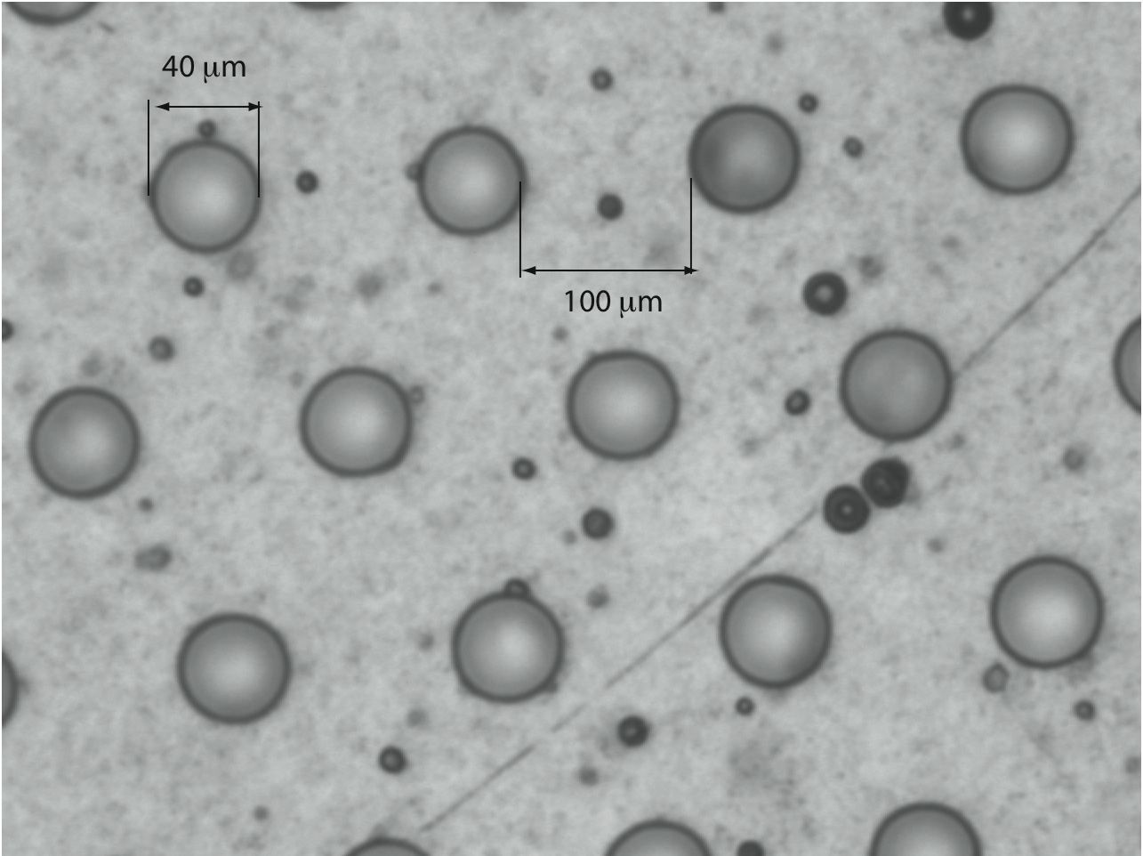
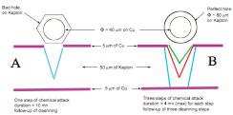
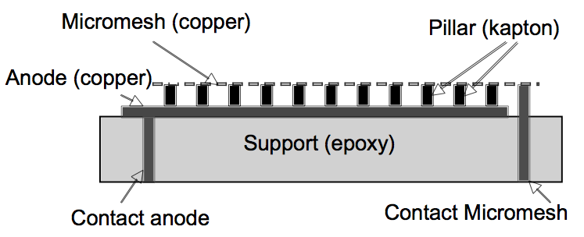
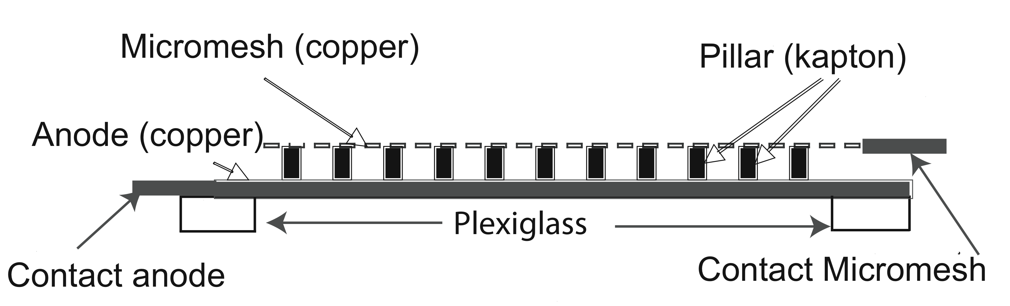
The micromesh technology
Micromesh is built by chemical treatments applied on coppered kapton
Support removed to increase the transparency

Slide 5
The monitoring µMGAS used in 2010
¹⁰B₄C (~0.7 µm) on a 1 µm coppered kapton(12.5 µm)
5/25/5 µm (Cu/kapton/Cu) micromesh
~18.5 mg ²³⁵UF₄ (70 mm diam.) on 20 µm Al
5/50/5 (Cu/kapton/Cu) micromesh
Entrance and exit windows: 12.5 µm kapton
Gas (~1 atm): Ar (88%) + CF₄ (8%) + iCH₄ (2%)

Slide 6
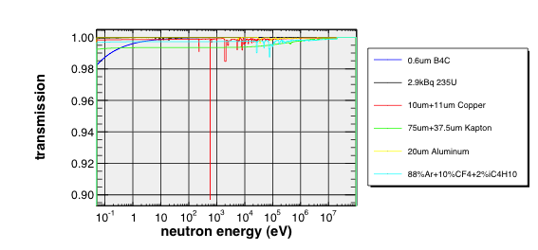
Transmission from monitoring µMGAS
(from Raul Sarmento)

Slide 7
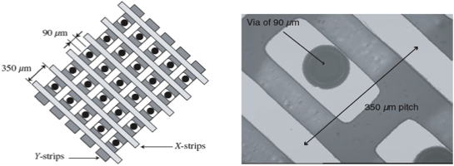
The XY-MGAS
Charges are collected through strips used to create an X–Y structure out of electrically connected pads
n_TOF XY µMGAS consists in:
  106x106 strips with a pitch of 550 µm
  Strips are read by means of two 96 channels Gassiplex cards
  The effective center of the detector is not the geometrical one

Slide 8
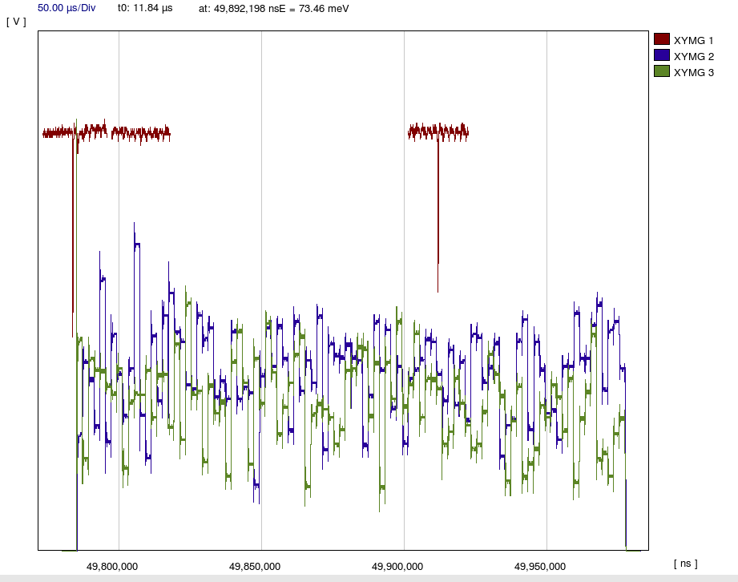
XY-signals

Slide 9
Ongoing work with µMGAS
Fabrication of a new XY-MGAS since the current one shown some malfunctioning zones this year.
Mounting and electric connection of fission tagging µMGAS has to be improved.
Electronic needs to be improved:
  signal is built by combining the energy output of a preamp and a TFA -> signal is too slow and the preamp is not suited for big signals or high count rate.

