Slide 1


Flux from FLUKA and MCNP simulation
M. Calviani (CERN)
n_TOF Analysis Meeting – November 2010

Slide 2


Why two Monte Carlo codes
FLUKA2010
Our reference simulation code due to the validity at high energy, but …
Grouped neutron cross-section <20 MeV (260 groups) → no detailed information on the resonant absorption dips in the fluence due to the material between spallation target and neutron window (!! Still accurate !!)
MCNPX 2.6.0
Pointwise neutron cross-section → detailed description of the neutron fluence in the keV energy range (!! limited by the knowledge of the materials and accuracy of the geometric implementation !!)
Accuracy of the high energy models ??

Slide 3
Neutron fluence in the Experimental Area
Procedure for the extraction of the data (fluence+beam profile) in the EAR1, valid for both Monte Carlo codes:
Full simulation of the spallation target from proton
Full decoupling between the two codes
Full cascade and propagation in the target zone
Dump of neutrons and photons at the beginning of the TOF tube after the neutron window
Deterministic propagation to EAR1 assuming “perfect” collimators, i.e. no streaming and multiple scattering from them
At present the absolute scale is given by FLUKA simulations, and MCNPX simulations are used – as requested – to obtain the shape of the absorption dips in the keV range
High energy disagreement can be due to the model selection and tweaking possible in MCNPX (LAQGSM code); FLUKA model much better benchmarked at these energies and higher

Slide 4
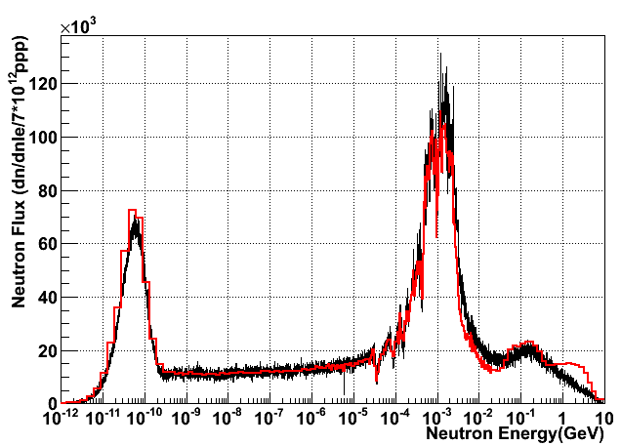
Simulation comparison (1/5)
FLUKA2010
MCNPX 2.6.0
Data rescaled in the eV range → small disagreement at thermal and at HE → to be investigated

Slide 5
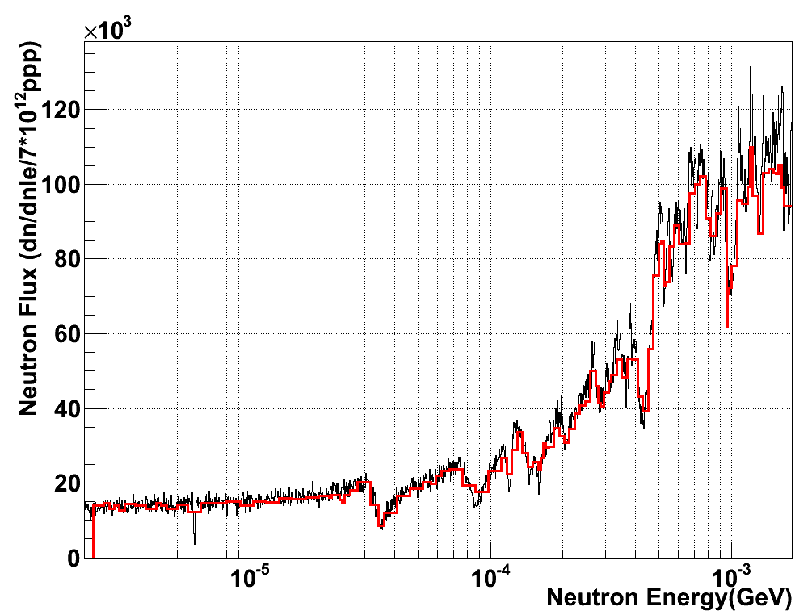
Simulation comparison (2/5)
FLUKA2010
MCNPX 2.6.0

Slide 6
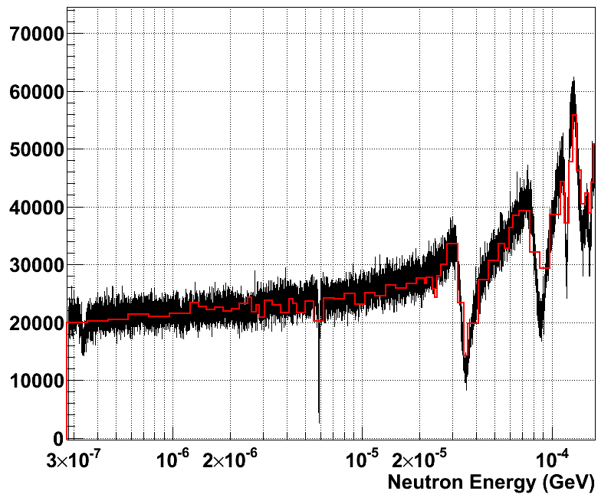
Simulation comparison (3/5)
FLUKA2010
MCNPX 2.6.0
Discrepancy in the dips mainly due to lack resolution in the FLUKA grouped cross-section

Slide 7
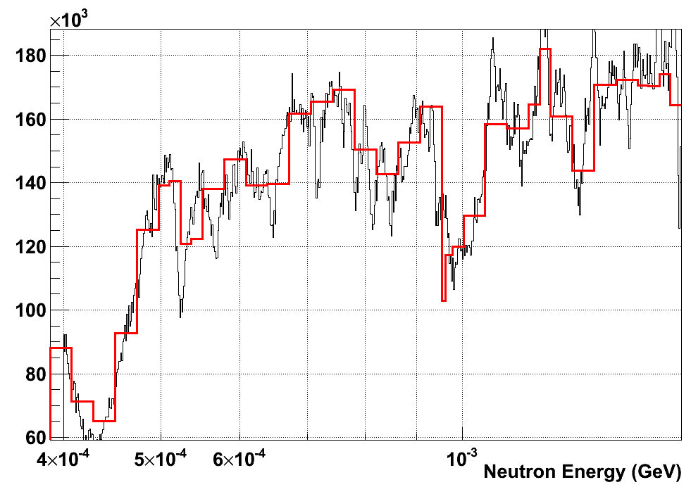
Simulation comparison (4/5)
Question: how much can we trust the definition of materials, especially in this region?
FLUKA2010
MCNPX 2.6.0

Slide 8
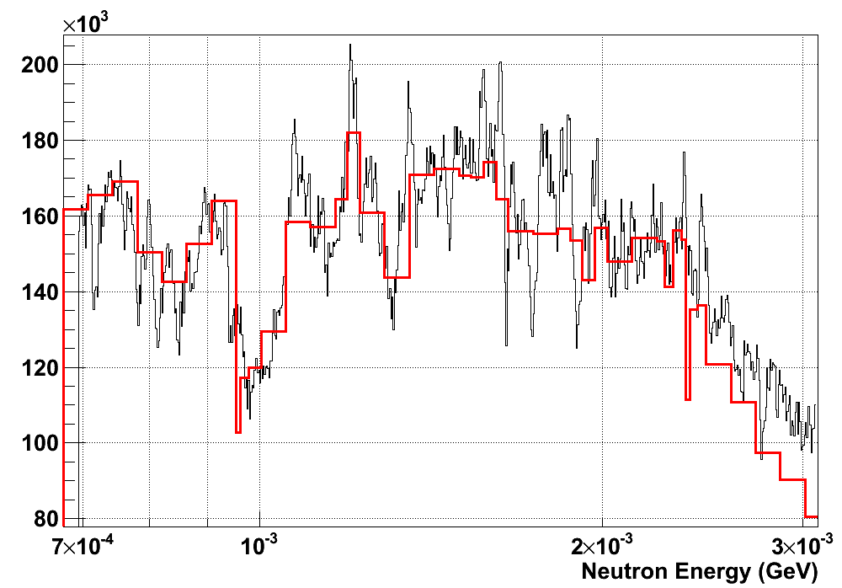
Simulation comparison (5/5)
Question: how much can we trust the definition of materials, especially in this region?
FLUKA2010
MCNPX 2.6.0

Slide 9
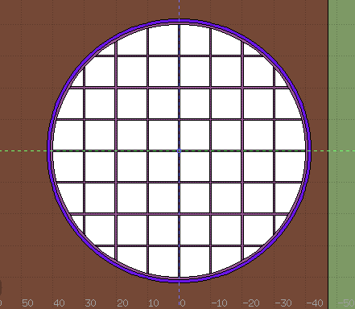
Eventual updates
Revision of the 1st collimator position according to the surveyors observations (take with care) and eventually study the sensitivity
Rotation of the neutron window:
in reality (from the very beginning of the experiment) it is 45 deg with respect to the present position in the simulations
→ Both these upgrade will not significantly affect the results, but worth checking, especially for dips in the keV range
Present simulation status
“Reality” as observed with geometers in April 2010

Slide 10
Conclusion
Data from both simulation now available
Evaluated fluence using a combination of both data and simulation?
Future benchmark calculations?

