Slide 1
Utrecht update
22-3-2022

Slide 2
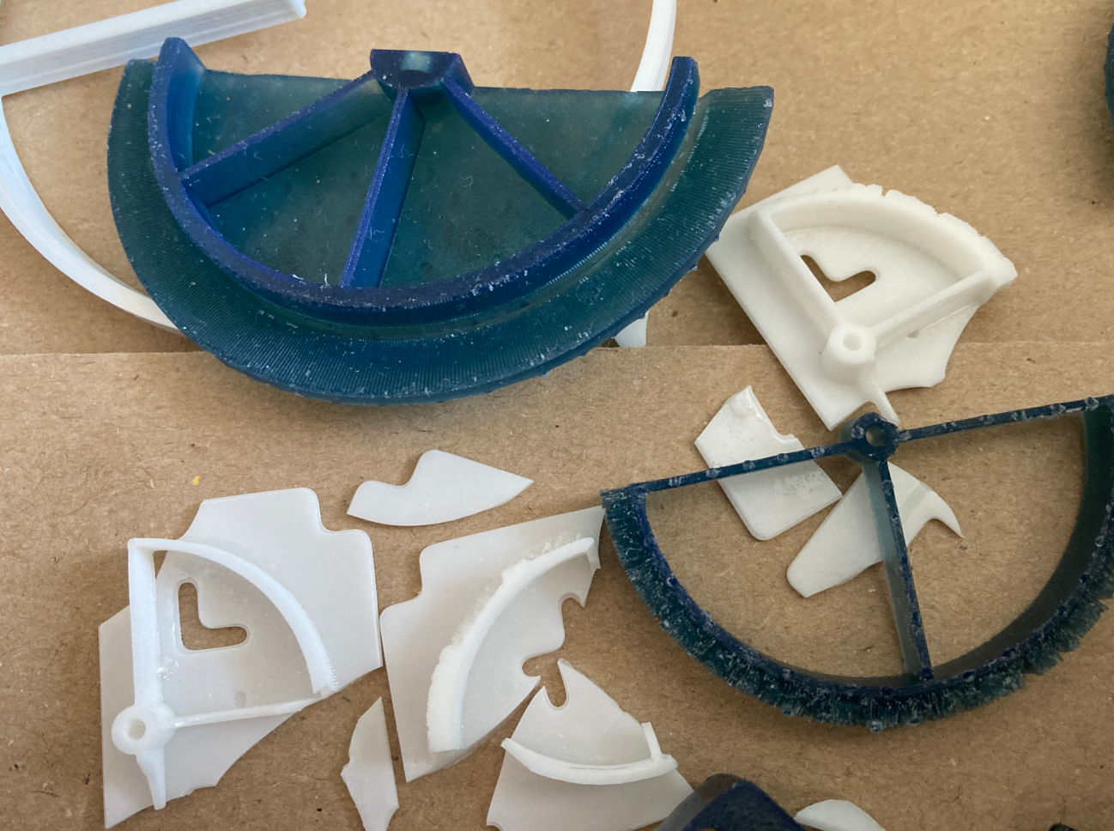
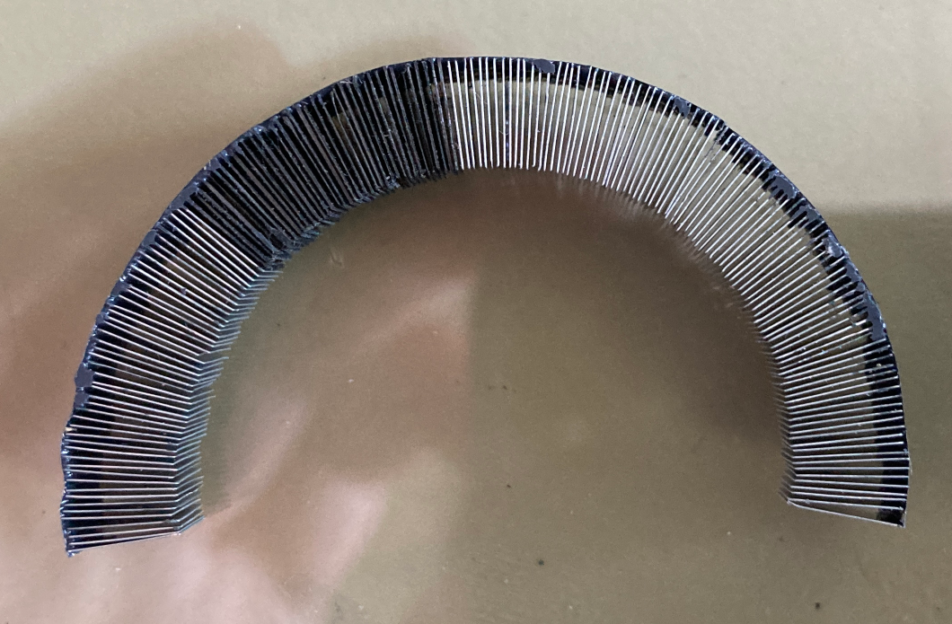
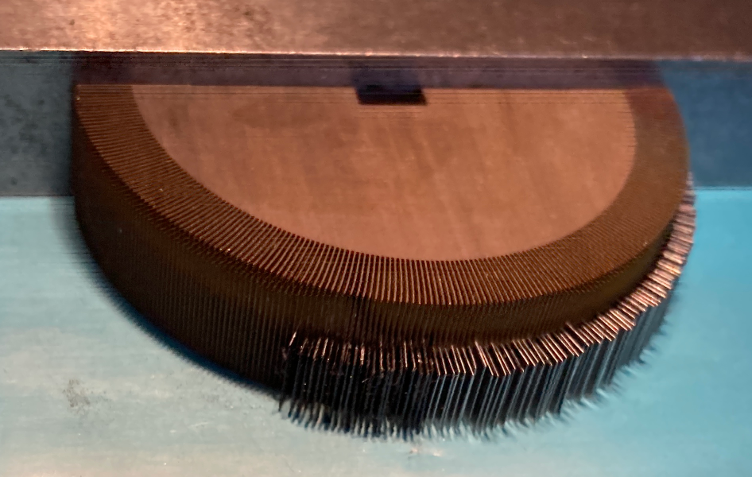
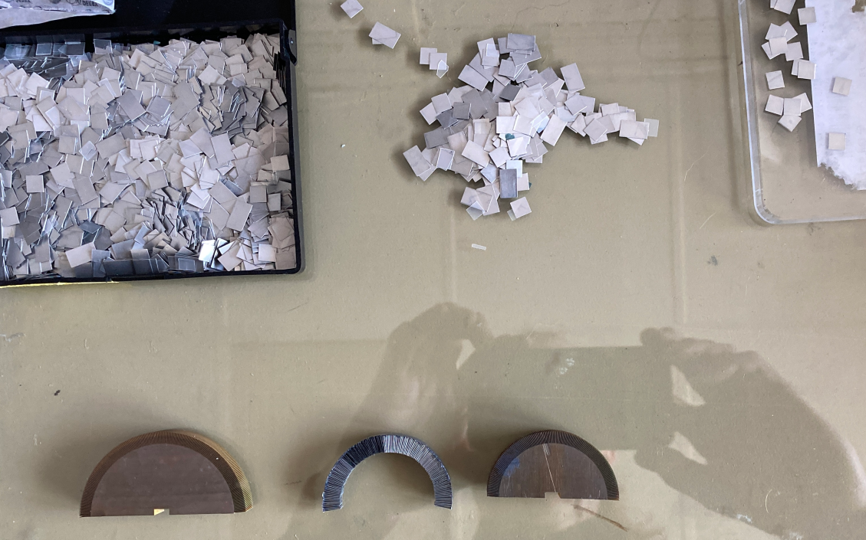
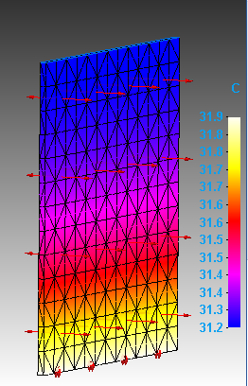
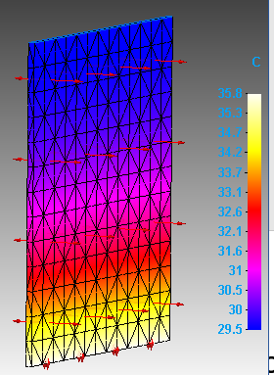
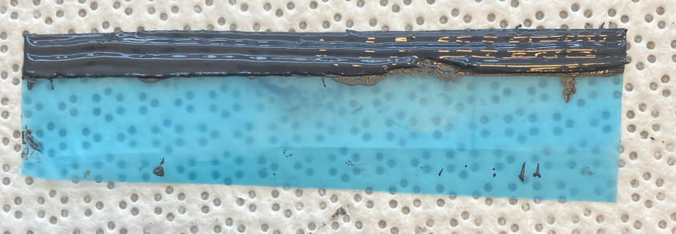
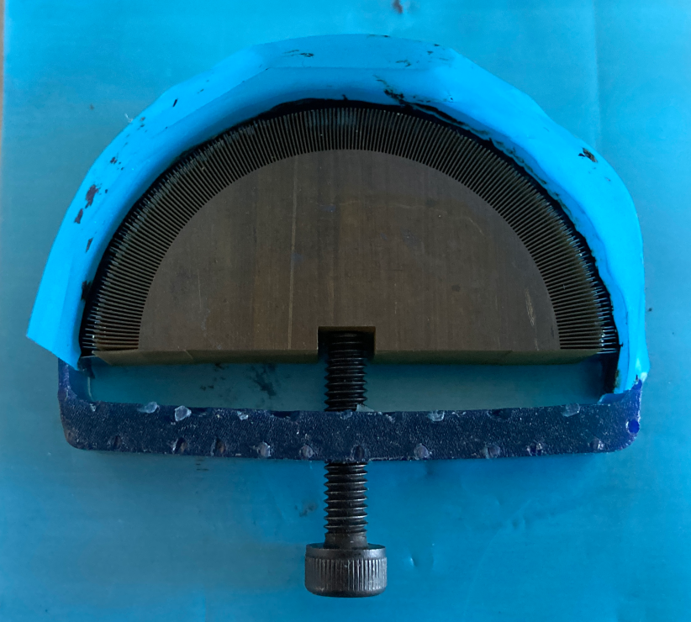
BBM4 (cooler fins to have a comparison to the carbon foam)
Wil continue coming weeks , Pending BBM3 (updated carbon foam) we can interrupt and switch to other if higher priority
Tried to 3d print molds on formlabs
and wanhaoD7 -failed-
Molds now made with wire EDM
Only had enough carbon
for a small section other fins AL
Aprox 0.5 mm conductive glue
One part broke off wil add
Carbon fleece on next
AL 210 W/m-k dt=0.7
Carbon 20 W/m-k dt=6

Slide 3
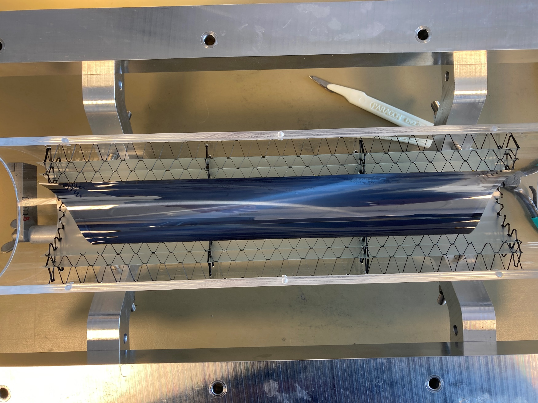
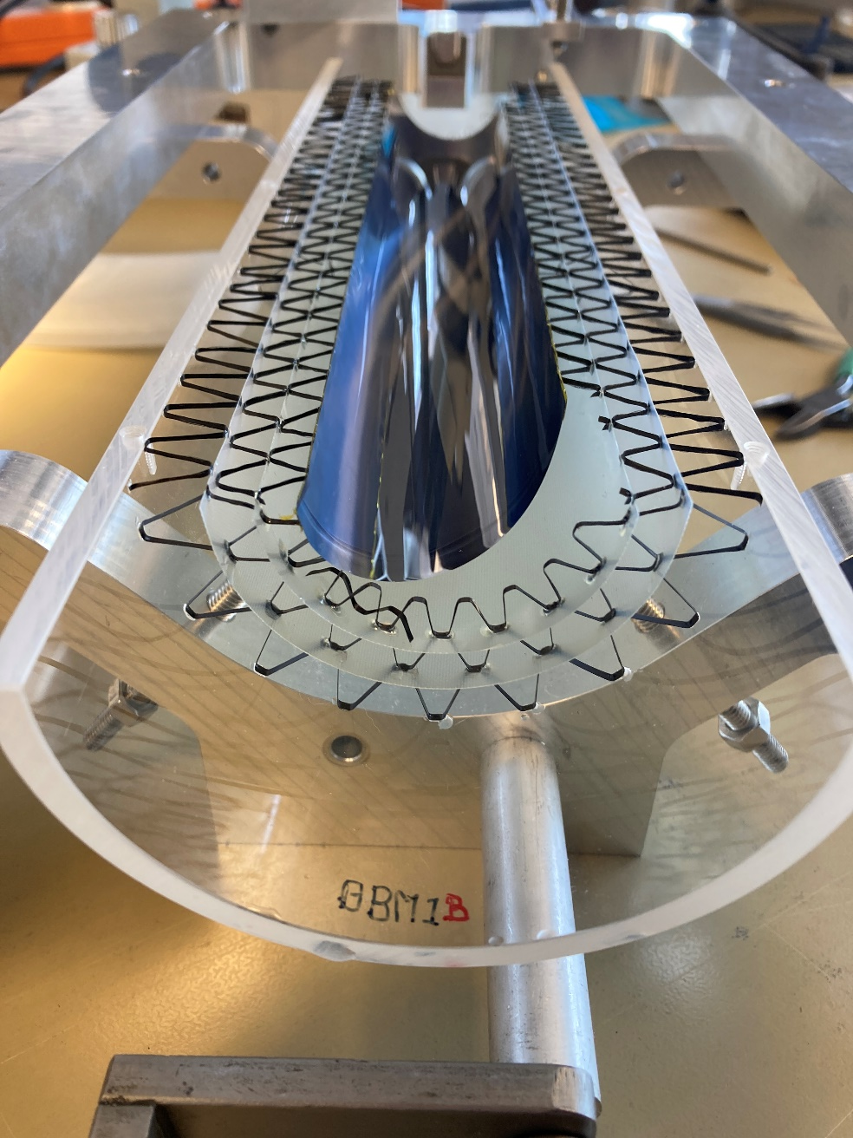
Demonstration of silicon layer with carbon fibre support structure done with “tape to mandrel” method

Slide 4
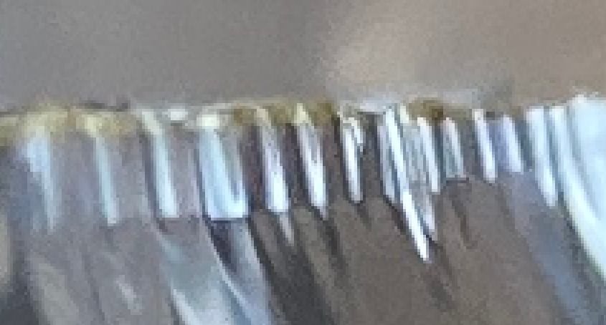
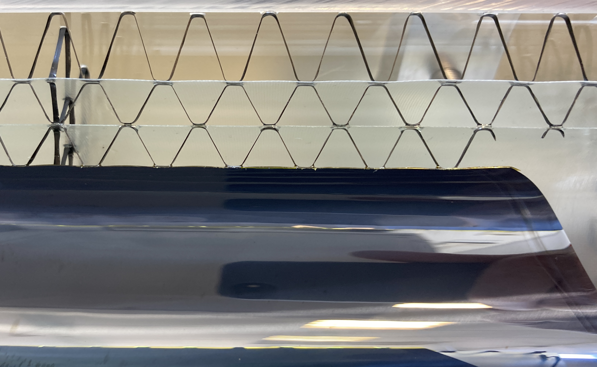
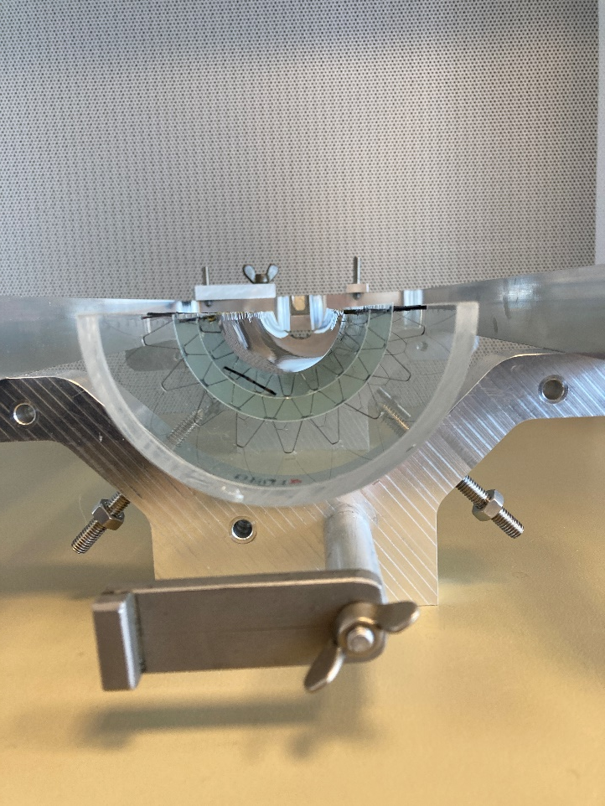
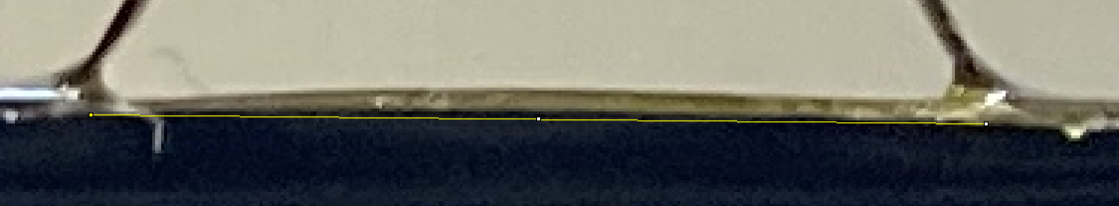
Carbon Foam longerons with carbon flece used on BBM2 where L2 0.69g L1/0 0.5 g
Carbon fibre Longerons are L2 0.063g and L1/0 0.046g
So its about 10X lighter excluding glue but it bends out between support could be fixed with additional carbon fiber strip
Zooming in on light reflections
Bends aprox 45mu between supports
(measured on calibrated pixel distance)

Slide 5
Vacuum grabbing (spoiler failed….)

Slide 6
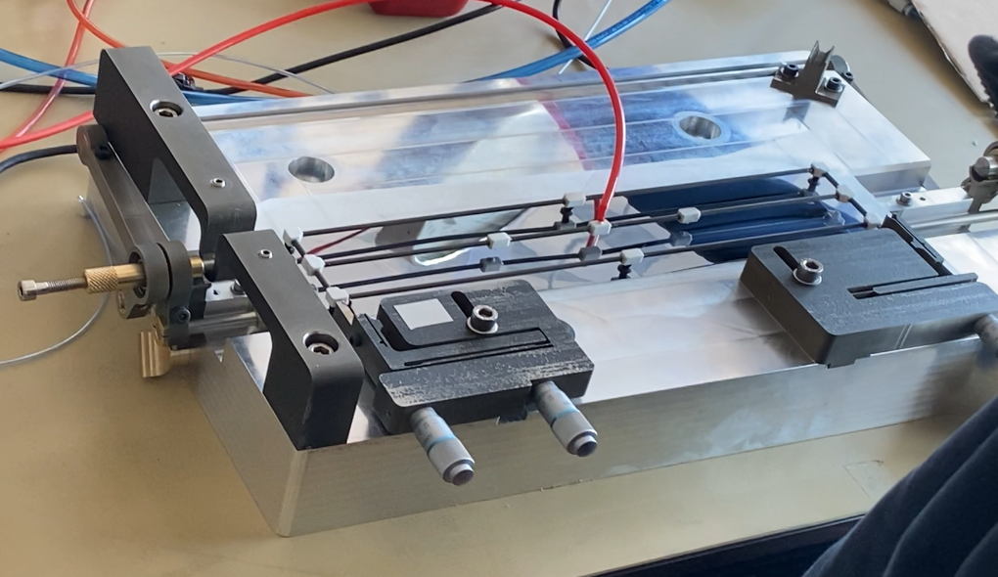
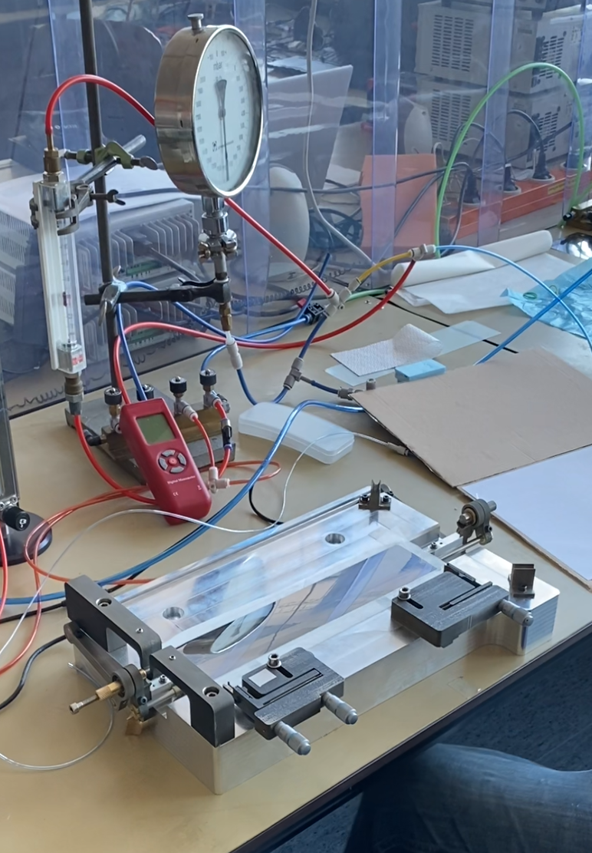
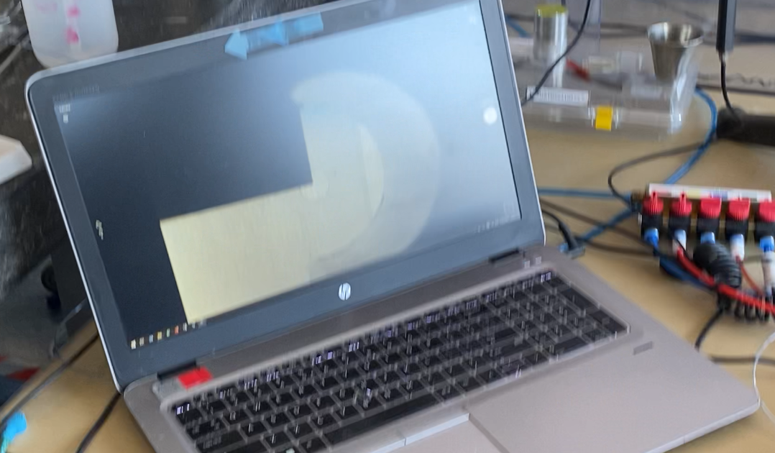
Alignment grabber
Silicon on tool
Align edges with camera

Slide 7
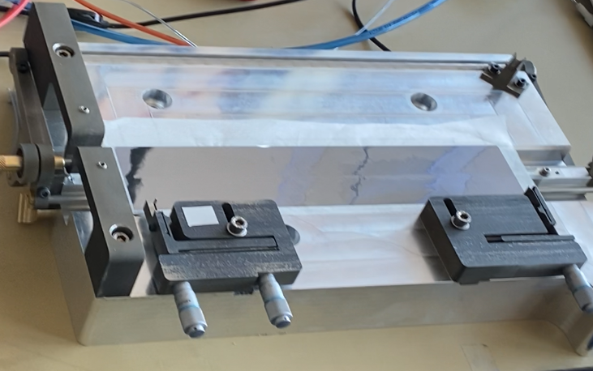
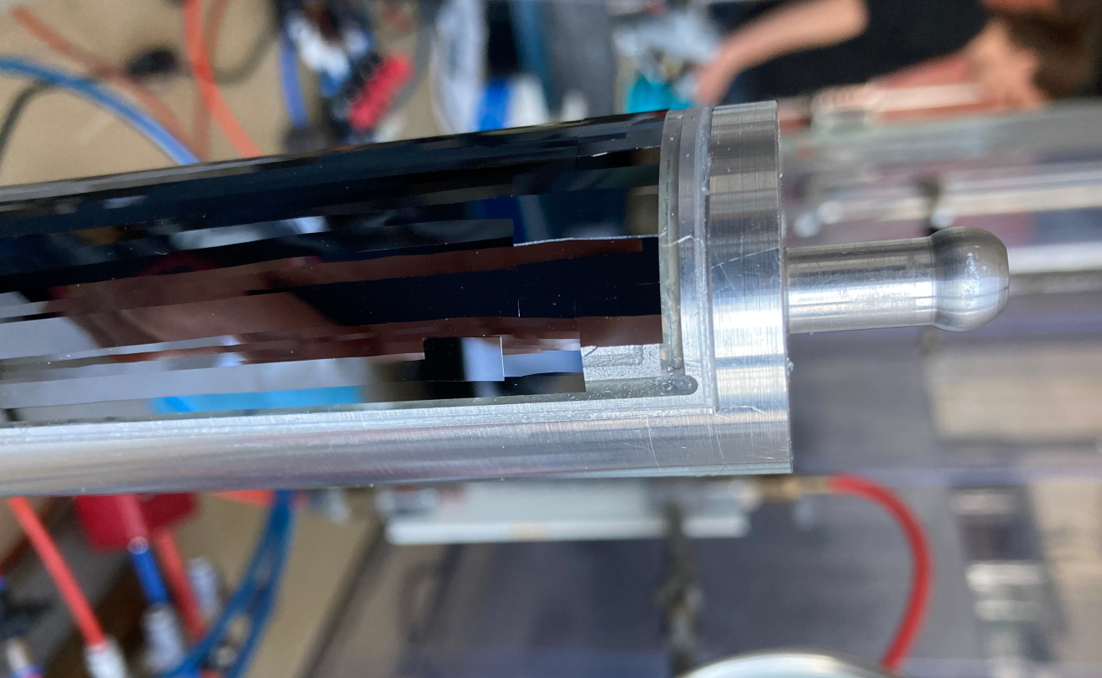
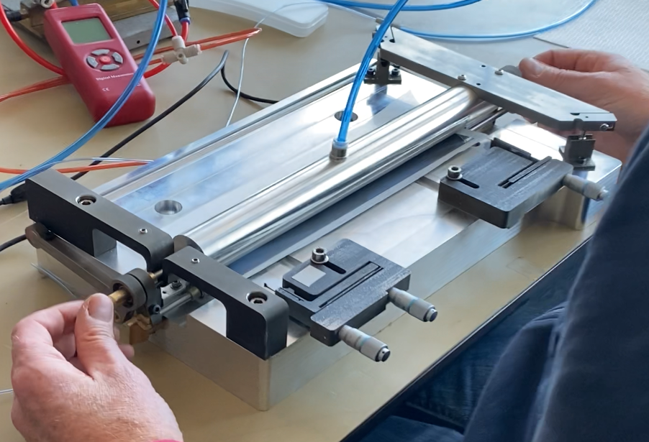
After alignment silicon is held with vacuum from
below (see small distortion in mirror)
First piece of silicon probably Broke on bending second piece broke when applying the vacuum silicone rubber seal on mandrel broke when cleaning of broken silicon
Place manderel and Lock roller assembly to mandrel
Bend and switch vacuum to mandrell
Bellow seal of 100mu silicone rubber
Inflatable to touch silicon

Slide 8
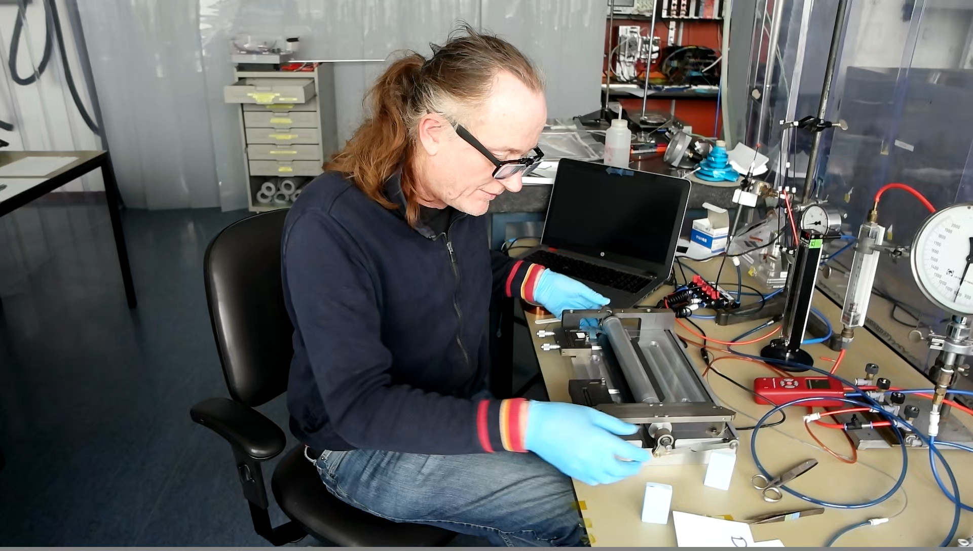
Once you have a piece which is not breaking on first try, bending seems not a problem……
(sorry had no time to edit video and its in dutch)

