Slide 1
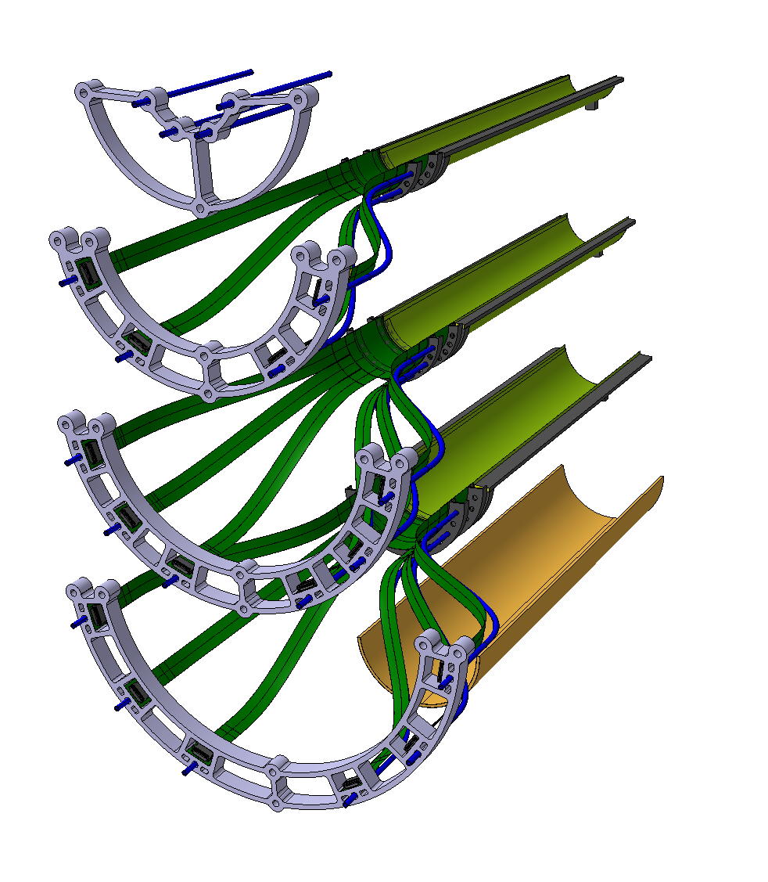
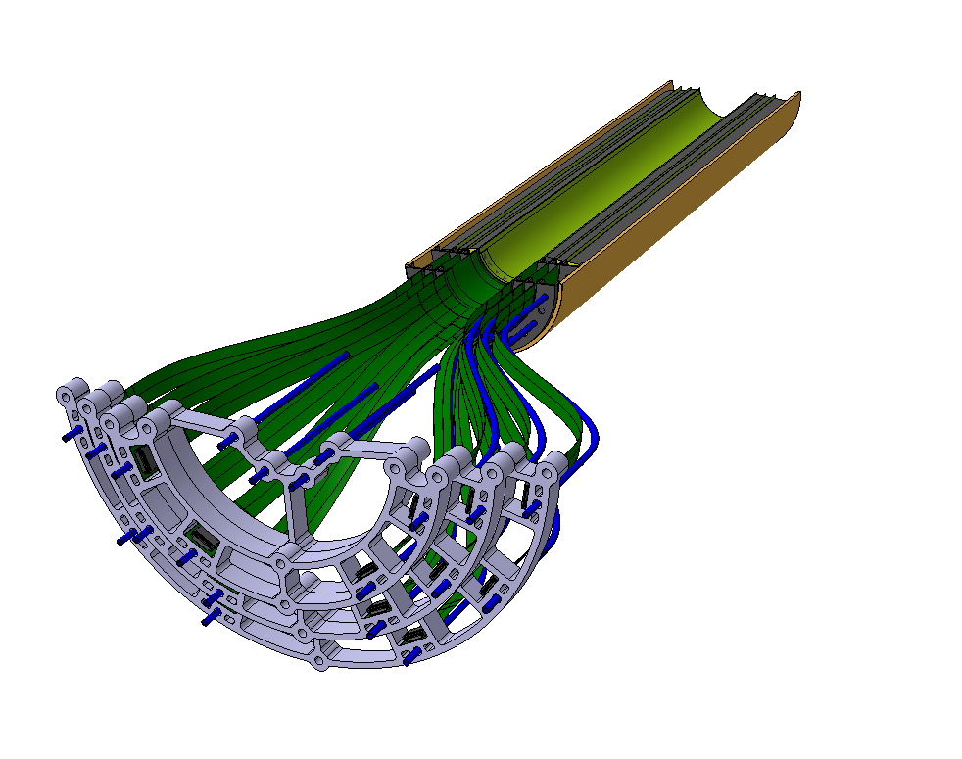
ITS3 : Patch panel
FPC, patch panels and distributed air pipes for each layers
> Pipes between layers were too small

Slide 2
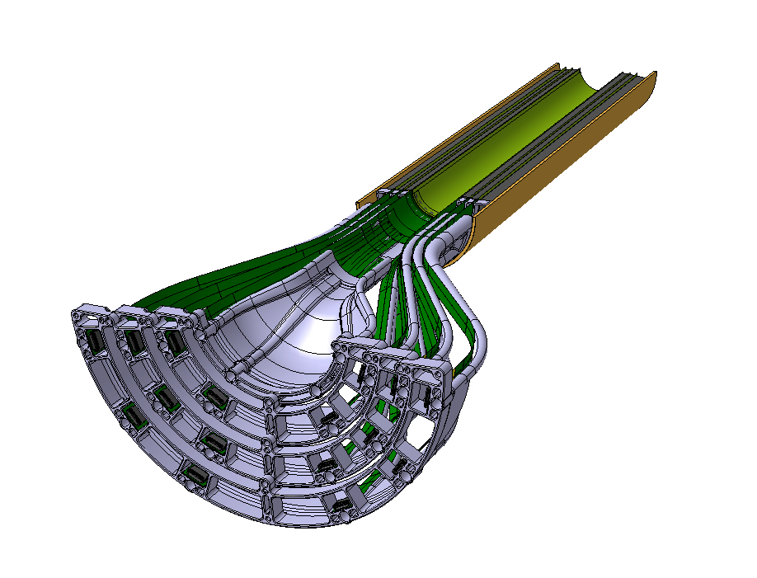
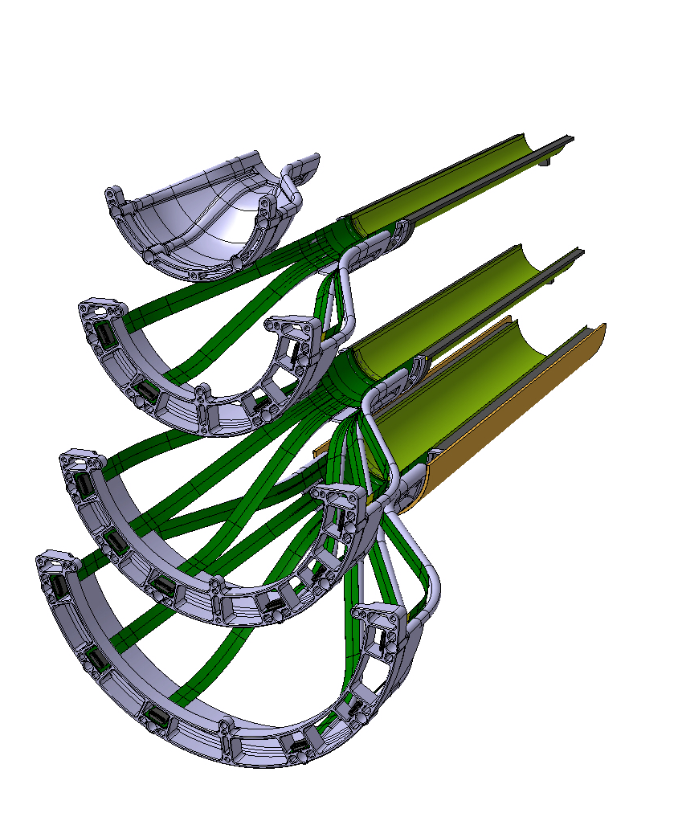
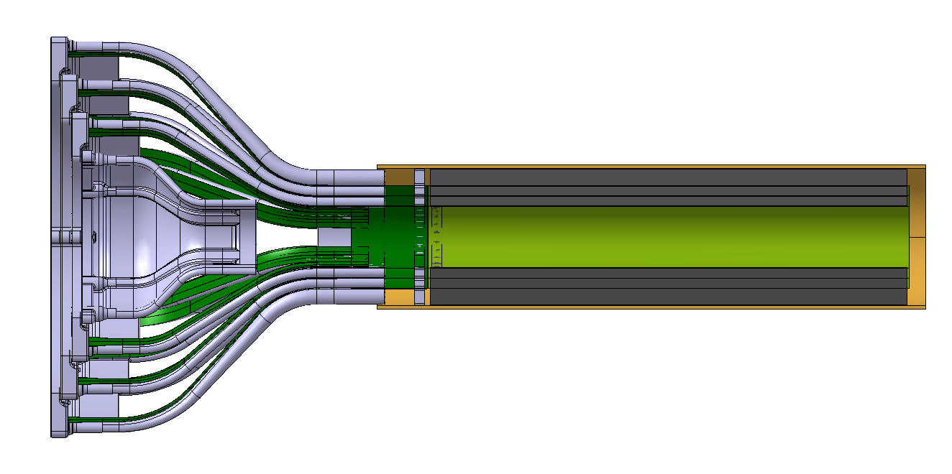
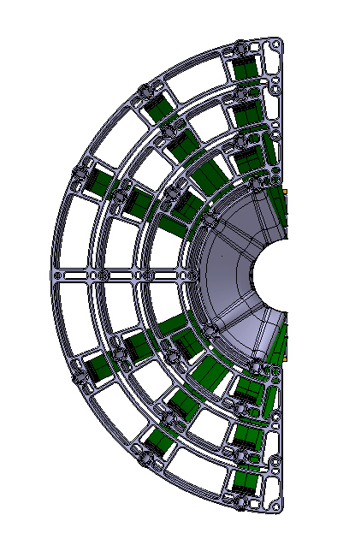
ITS3 : Patch panel + air duct

Slide 3
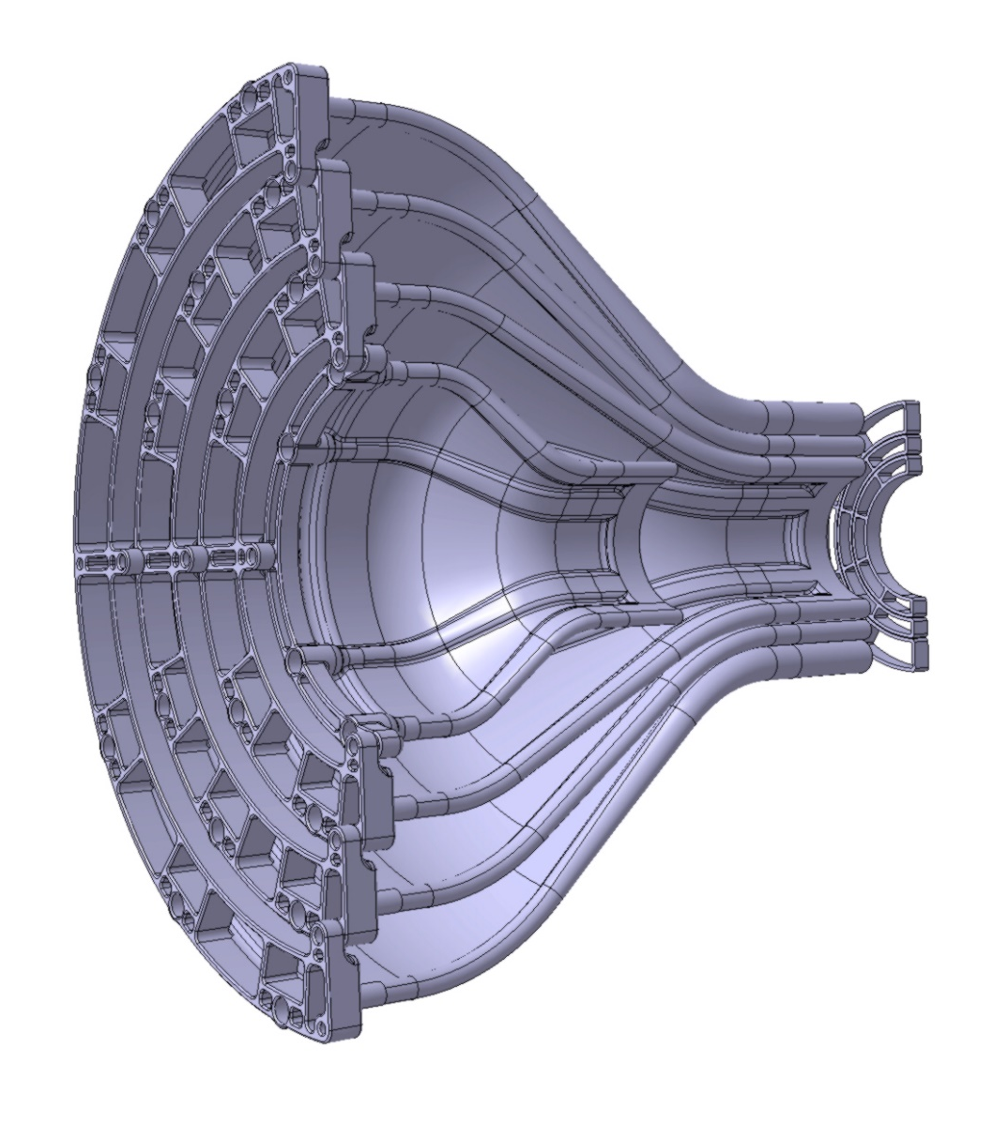
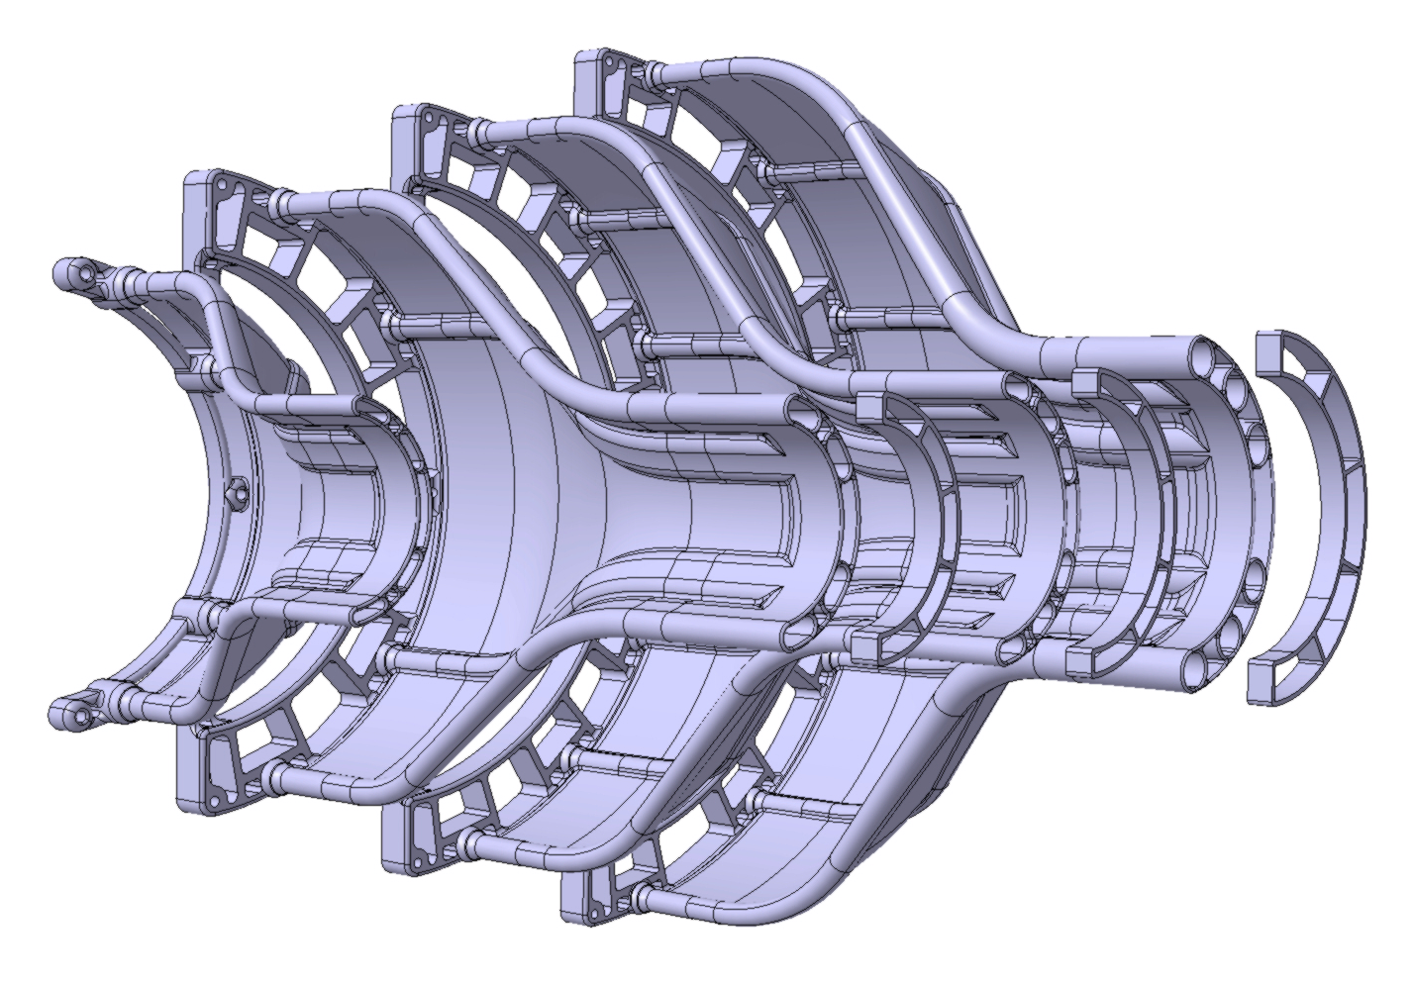
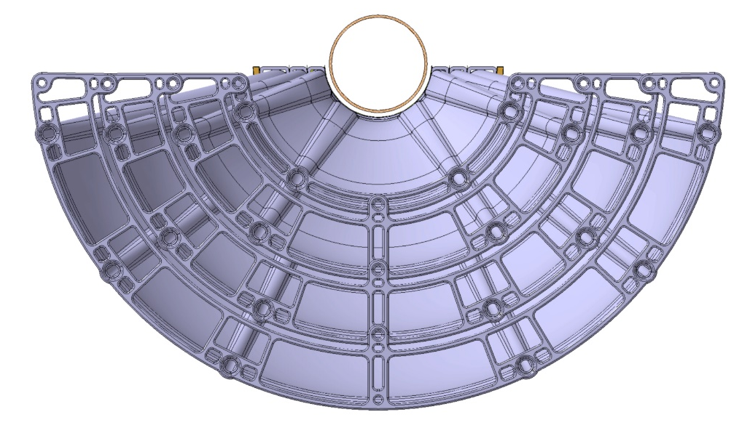
ITS3 : Patch panel + air duct
FPC half rings
Transition from Ø4-6 mm pipe (same plastic pipe as ITS2) to maximum possible radius
Beam Pipe air flow – L0 – L1 – L2

Slide 4
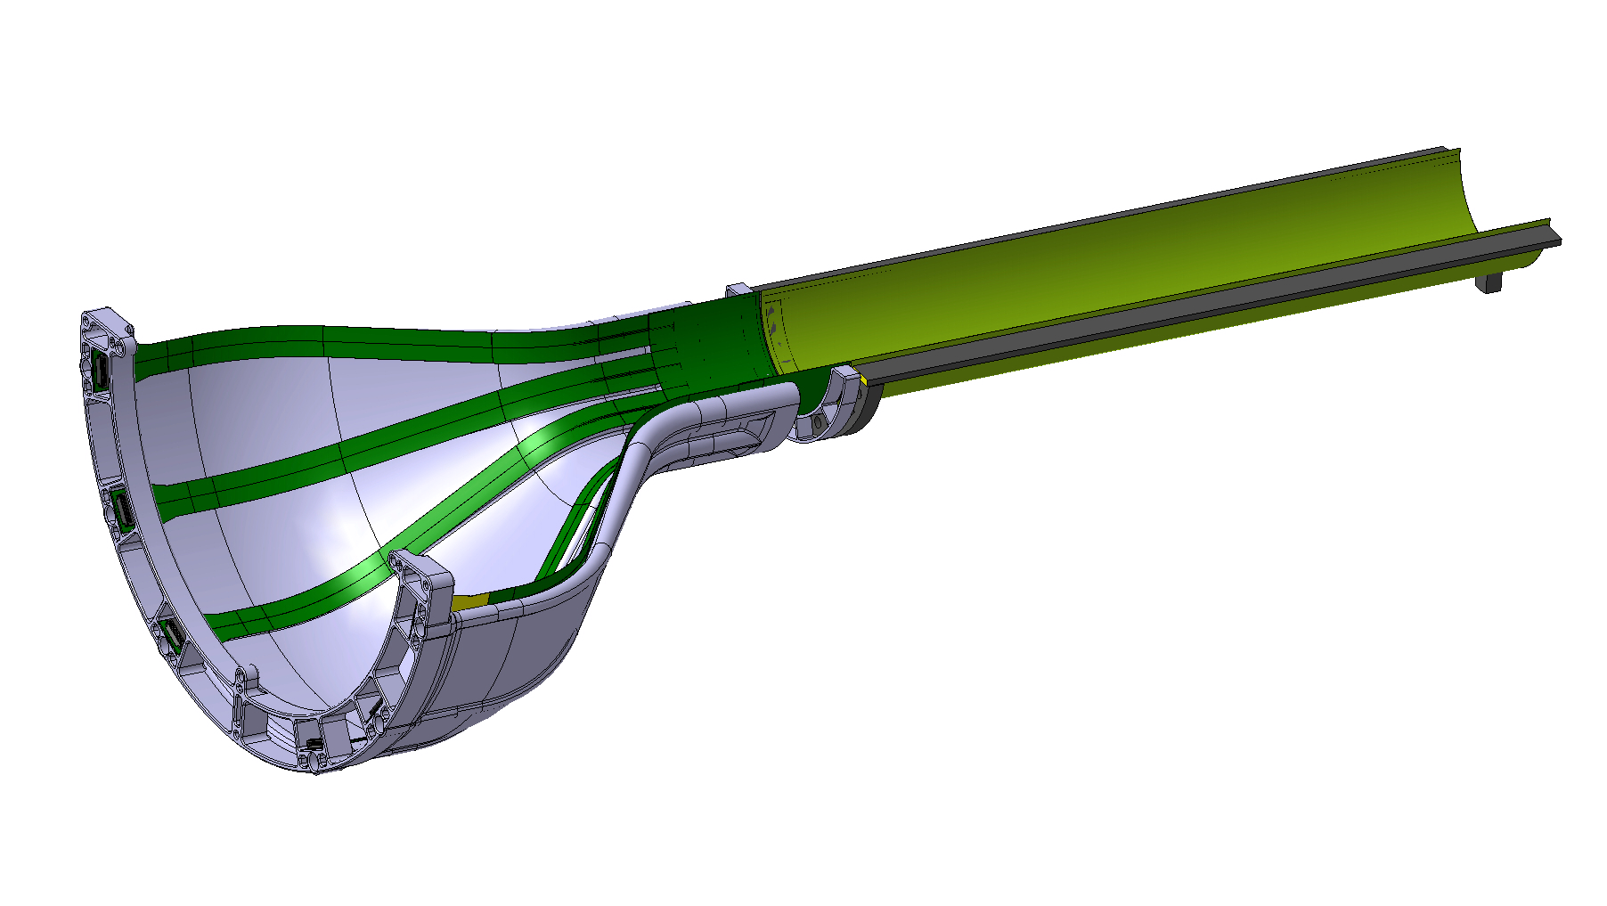
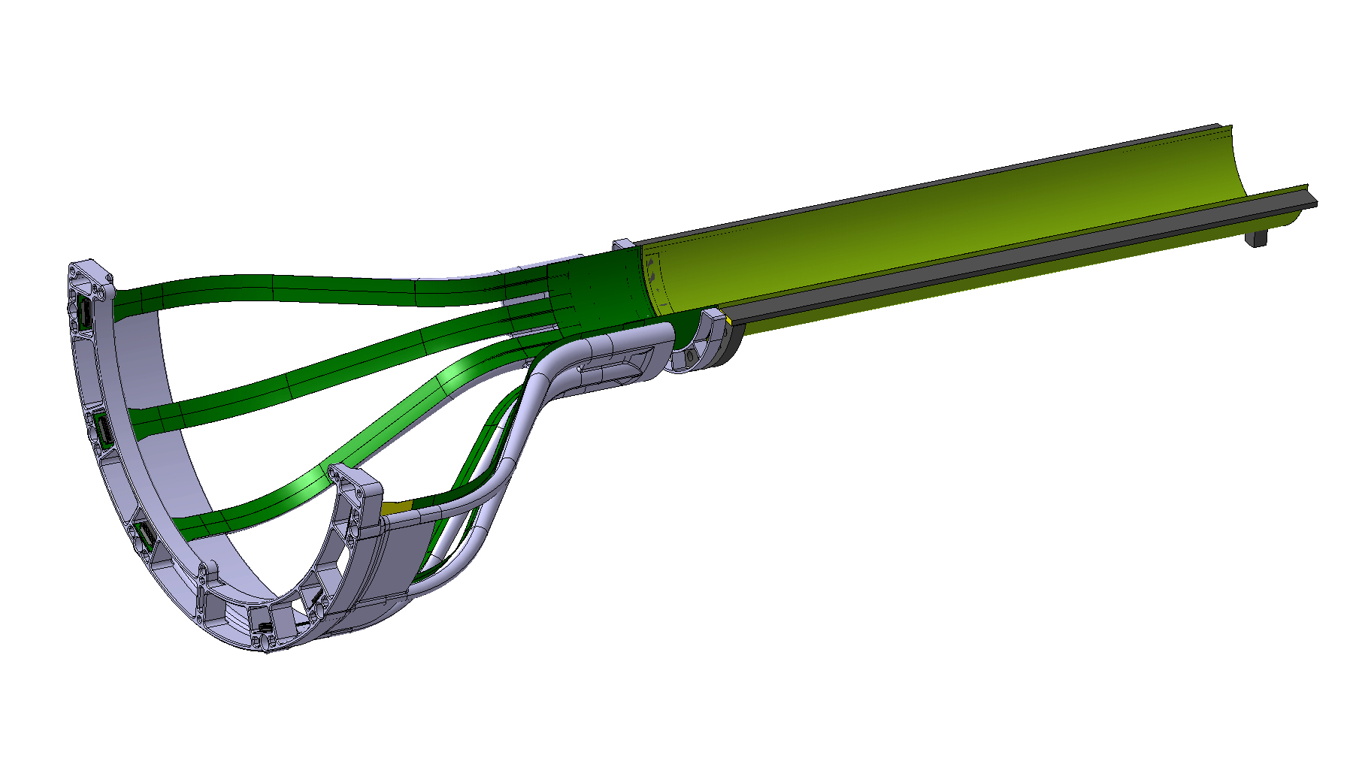
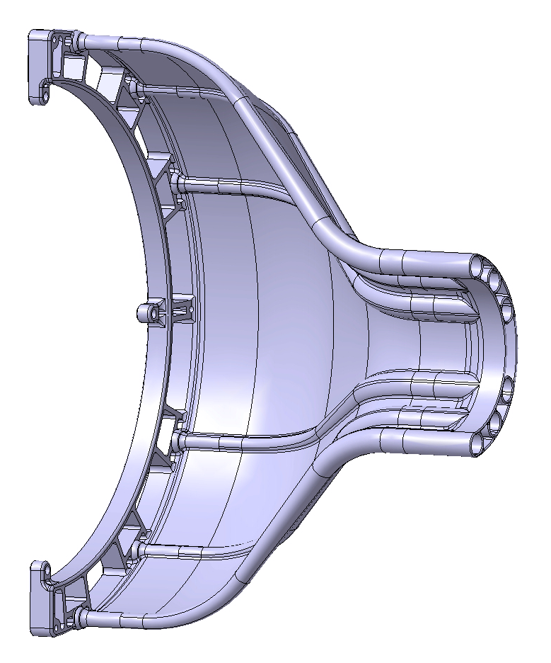
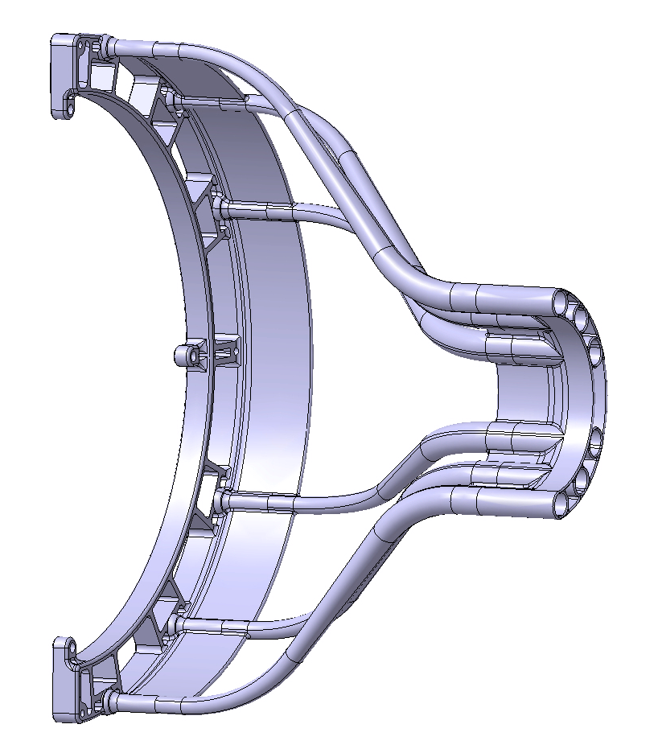
ITS3 : Patch panel + air duct
Full shell = rigid link between half ring and patch panel
Pipe only = flexible link ( soft 3d printed material to be tested )

Slide 5
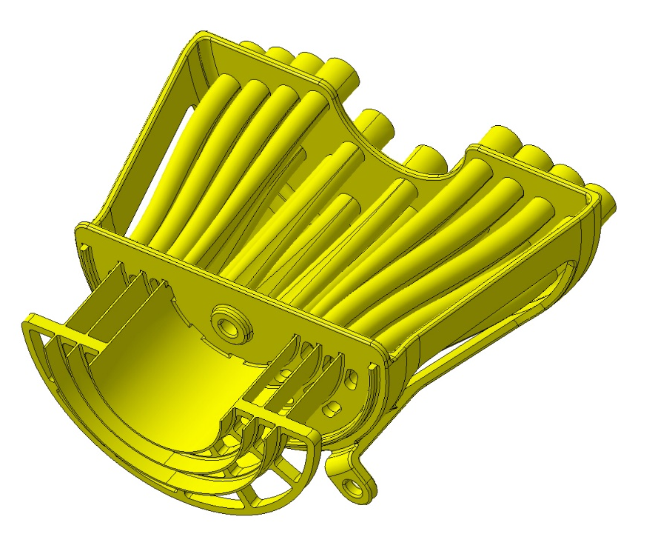
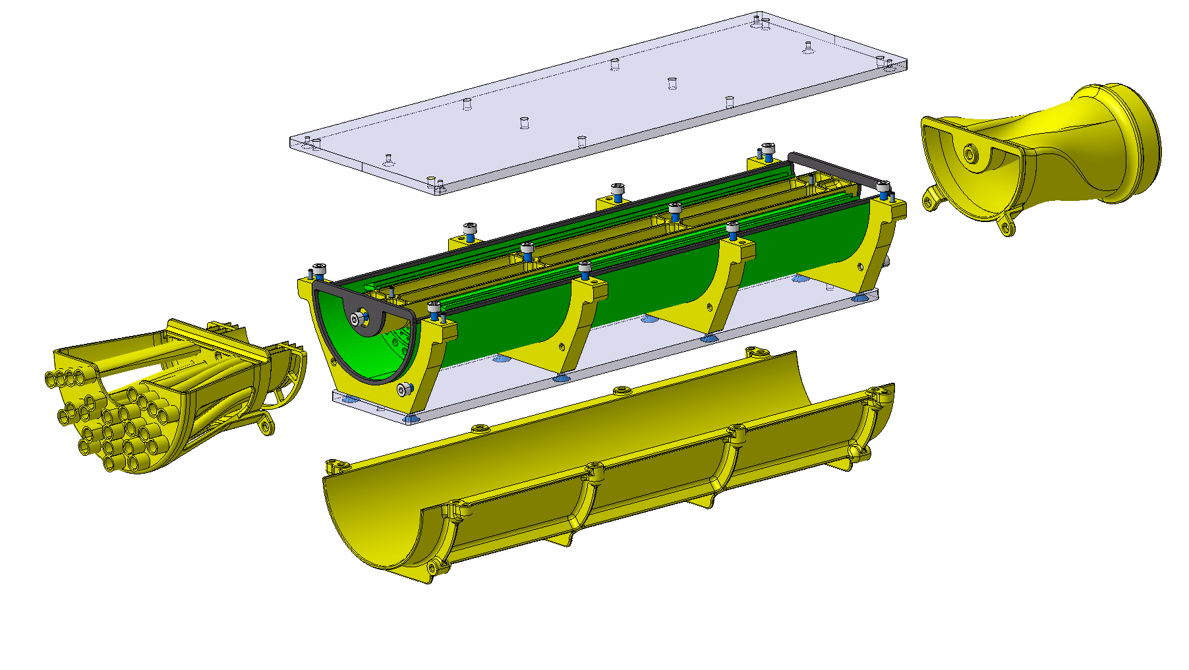
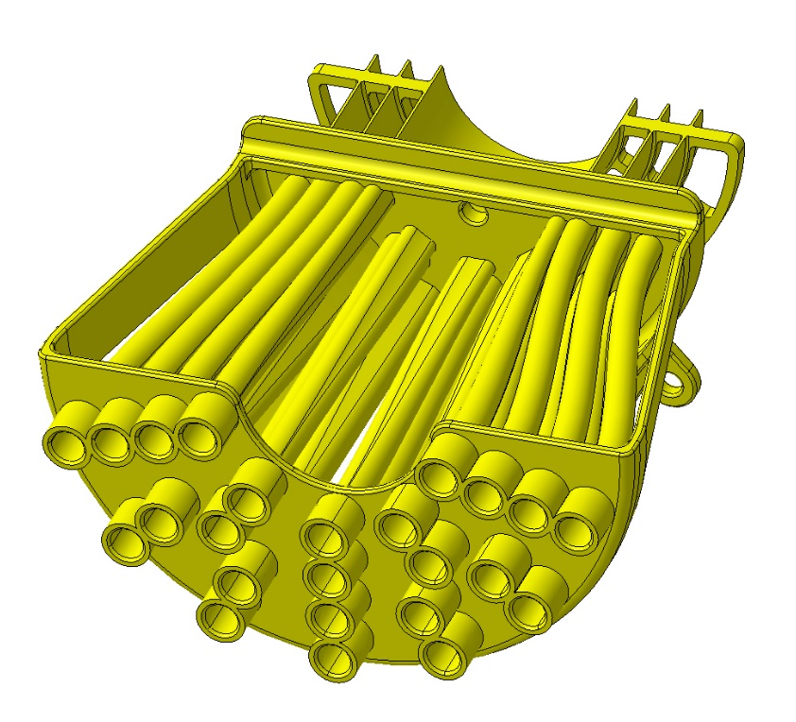
ITS3 : Wind Tunnel
Different air pipes configuration possible for each layers

Slide 6
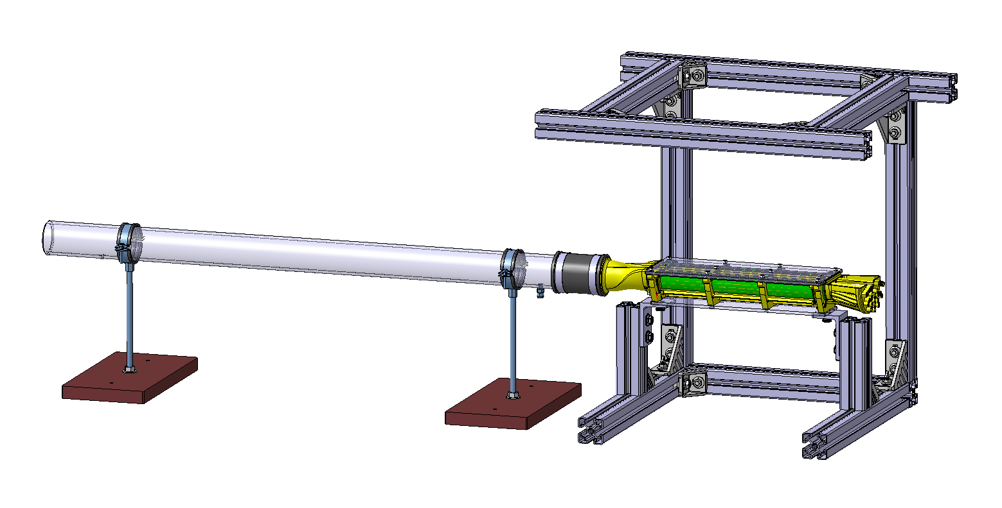
ITS3 : Wind Tunnel set up

