Slide 1
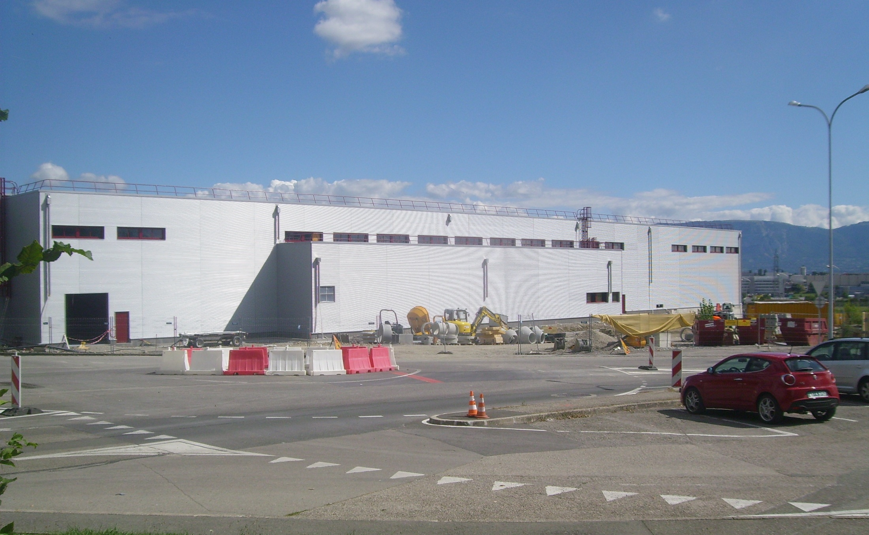
The Linac4 Project at CERN
M. Vretenar for the Linac4 team
PIMS kick-off meeting 17.11.2010

Slide 2
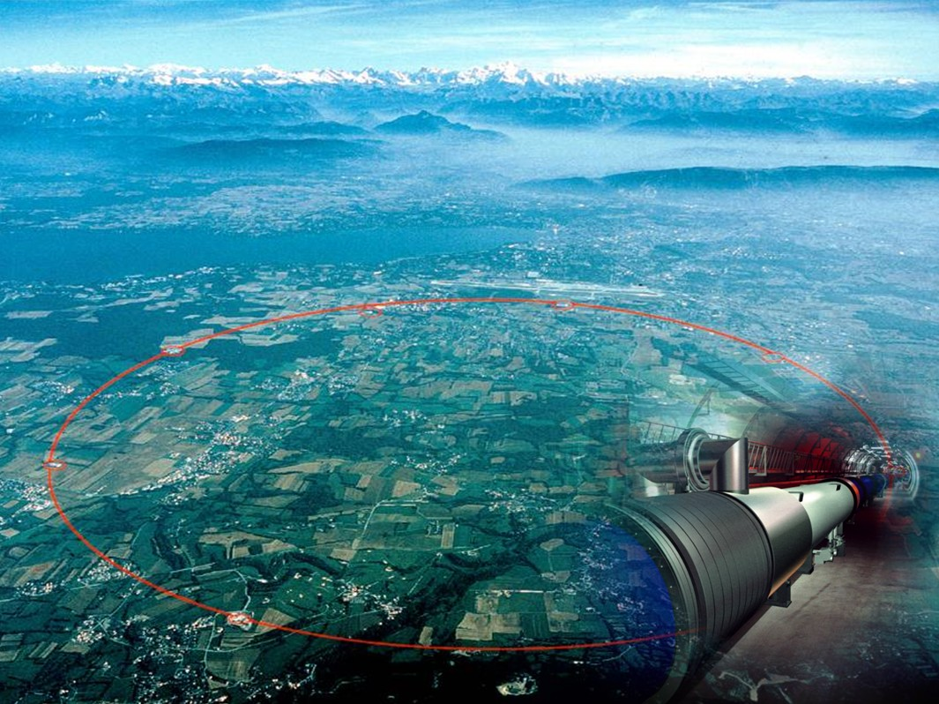
LHC Luminosity Upgrade
 | Luminosity (cm⁻²s⁻¹) | Beam intensity @ injection (*)
Present (October 2010) | >2 x10³²
Nominal | 10³⁴ | 1.1 x10¹¹
Upgraded | ~5 x10³⁴ | ~2.4 x10¹¹
(*) protons per bunch, in 3 μm emittance
foreseen in near future
requires upgrade of both LHC and injectors, to be achieved by 2020
At the moment, the injectors can provide only the intensity required for the nominal luminosity
Upgrade program to reach ~5 x10³⁴, to be completed by 2020
Notes:
Important parameter is the peak luminosity – most important term on lumi formula is brightness (n. of protons in the given emittance – density of the beam) – density is created in the injector, where we have to fight against space charge (couplomb repulsion).

Slide 3
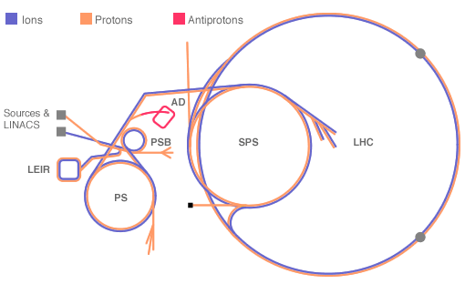
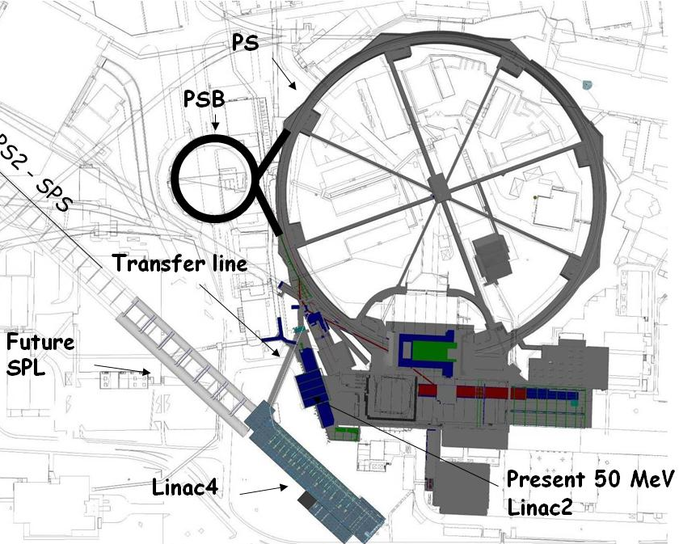
Limitations to injector intensity
Three bottlenecks identified for higher intensity from the LHC injectors:
Space charge tune shift at PSB injection (50 MeV).
Space charge tune shift at PS injection (1.4 GeV).
Electron cloud and other instabilities in SPS.
1
3
2
Low injection energy into the PSB is the first and most important bottleneck → decision (2007) to build a new linac (Linac4) increasing injection energy from 50 to 160 MeV (no space for upgrade of Linac2).
Linac4 alone can only allow reaching 1.7x10¹¹ ppp out of the PS (“ultimate” intensity) → need to address the other bottlenecks with a specific program.
Additional steps: a) upgrade of PSB final energy to 2 GeV; b) upgrade (coating, new RF) of SPS.
Notes:
No space for energy upgrade

Slide 4
Linac4 – motivations, parameters
Energy 160 MeV → factor 2 in βγ² from Linac2 → x2 intensity in PSB with same tune shift (ΔQ~N/βγ²).
Use LEP RF frequency of 352 MHz → recuperate some klystrons and RF equipment.
Repetition frequency 2 Hz (1.1 Hz max. PSB), upgradable to 50 Hz with new power supplies and additional cooling installed.
Beam current 40 mA in 400 μs: >2 present PSB maximum.
Higher intensity in PSB for the LHC upgrade.
Consolidation: more modern and sustainable machine than Linac2 (worries for long-term operation of Linac2 – vacuum, RF).
Flexible operation and reduced loss with new technologies (chopping, H- injection).
Higher intensity for non-LHC users.
Prepare for a possible high-intensity upgrade (neutrino facility).
duty cycle 0.8x10⁻³
designed for 10%

Slide 5
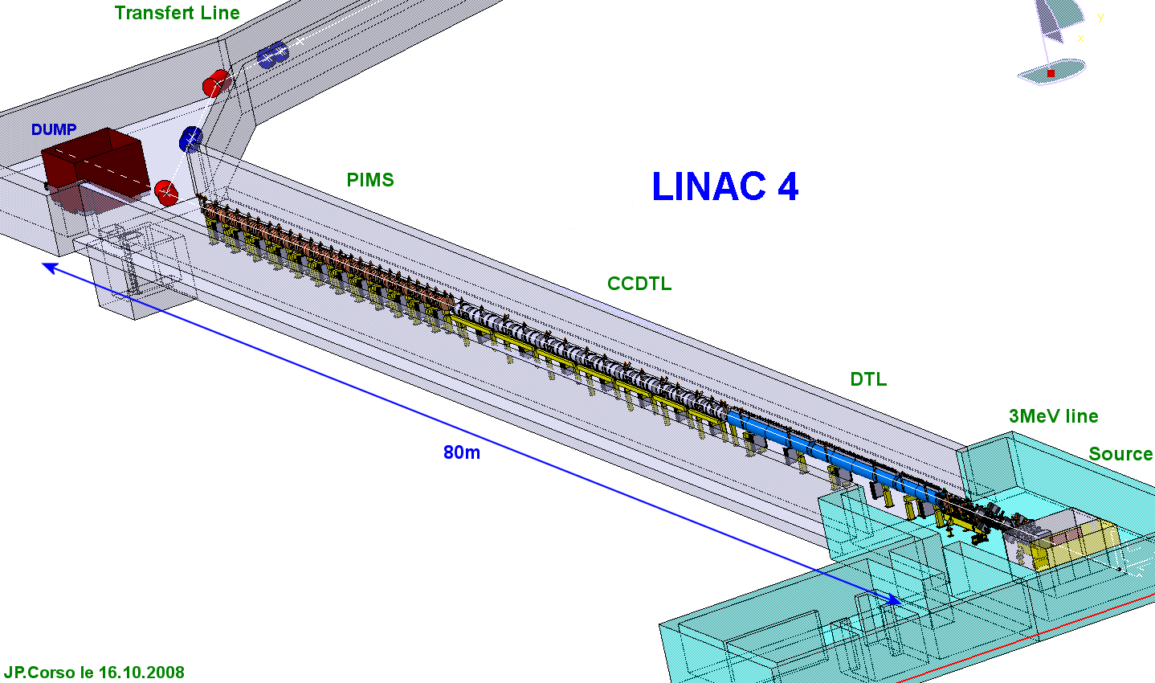
Linac4 description
Conventional (normal-conducting) layout:
Pre-injector (source, magnetic LEBT, 3 MeV RFQ, chopper line)
Three types of accelerating structures at 352 MHz (for optimum efficiency at a standardised RF frequency). Focusing by a combination of permanent and conventional quadrupoles.
Beam dump at linac end, switching magnet towards transfer line – PSB.
Transfer line to PSB
160 MeV
100 MeV
50 MeV
Linac length ~ 80 m
3 MeV

Slide 6
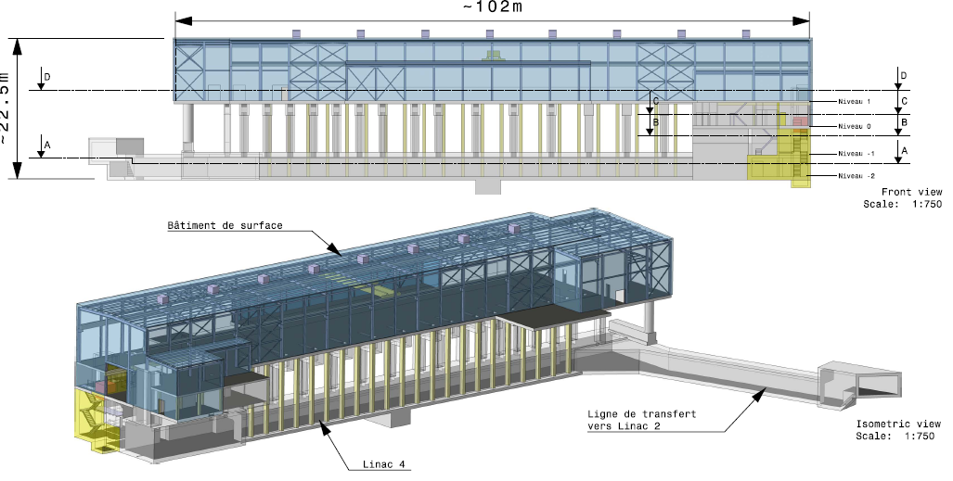
Linac4 civil engineering
ground
Overall floor surface of Linac4 installations = 3’305 m2 (over 4 levels)

Slide 7
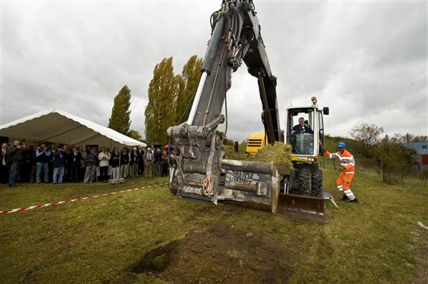
Linac4 groundbreaking
Groundbreaking (and start of civil engineering works) 16.10.2008
1 year and 4 months after approval of the project

Slide 8
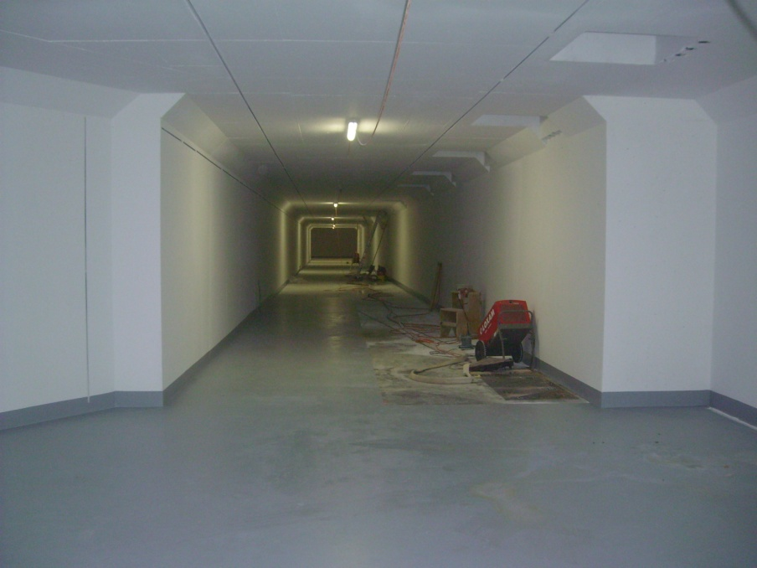
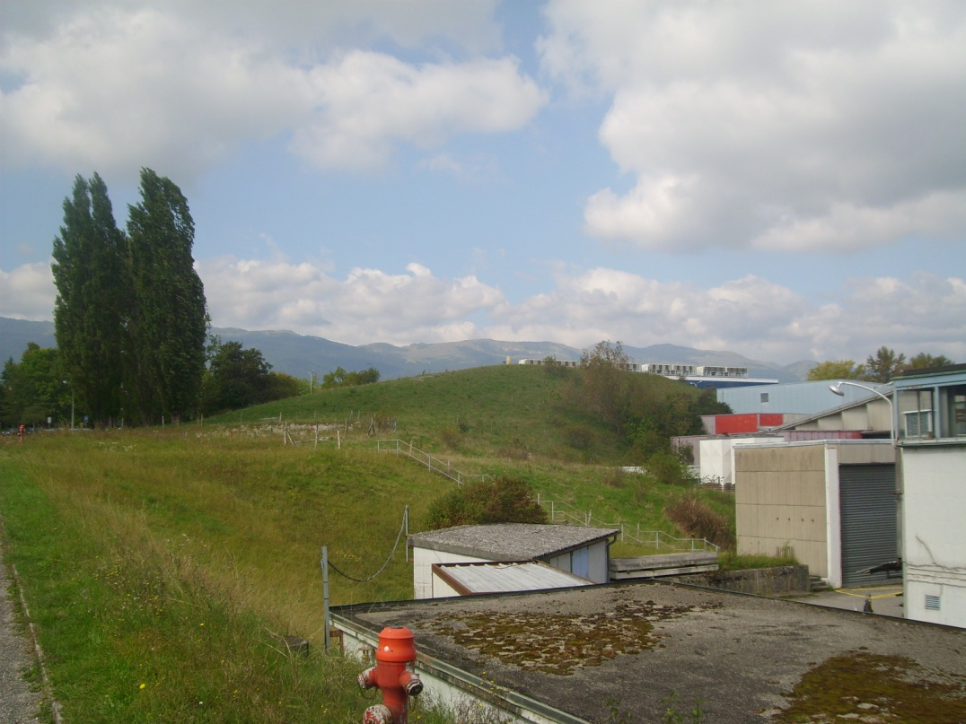
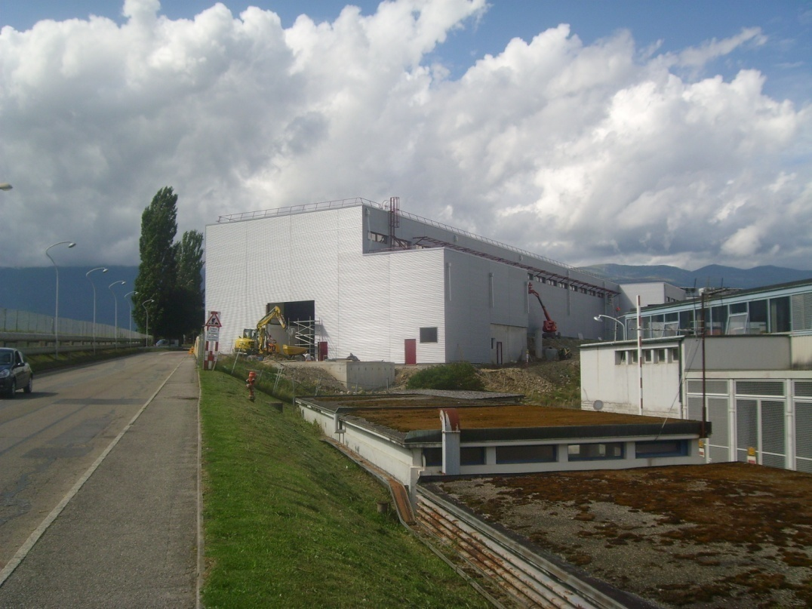
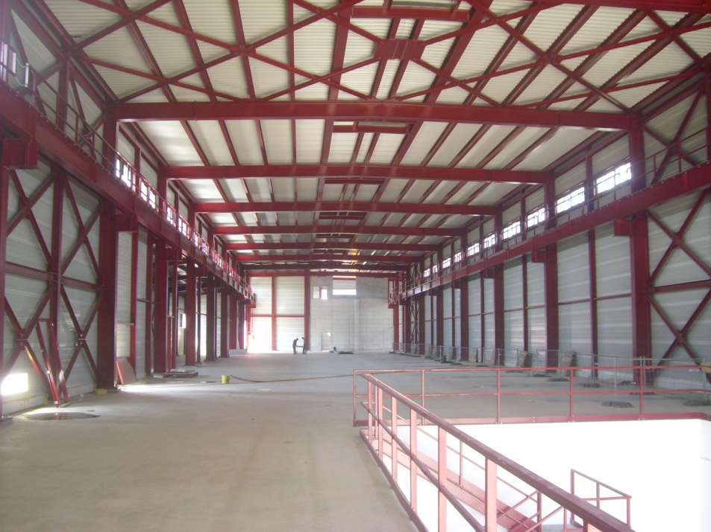
Building construction
“Mount-Citron”, September 2008

Slide 9
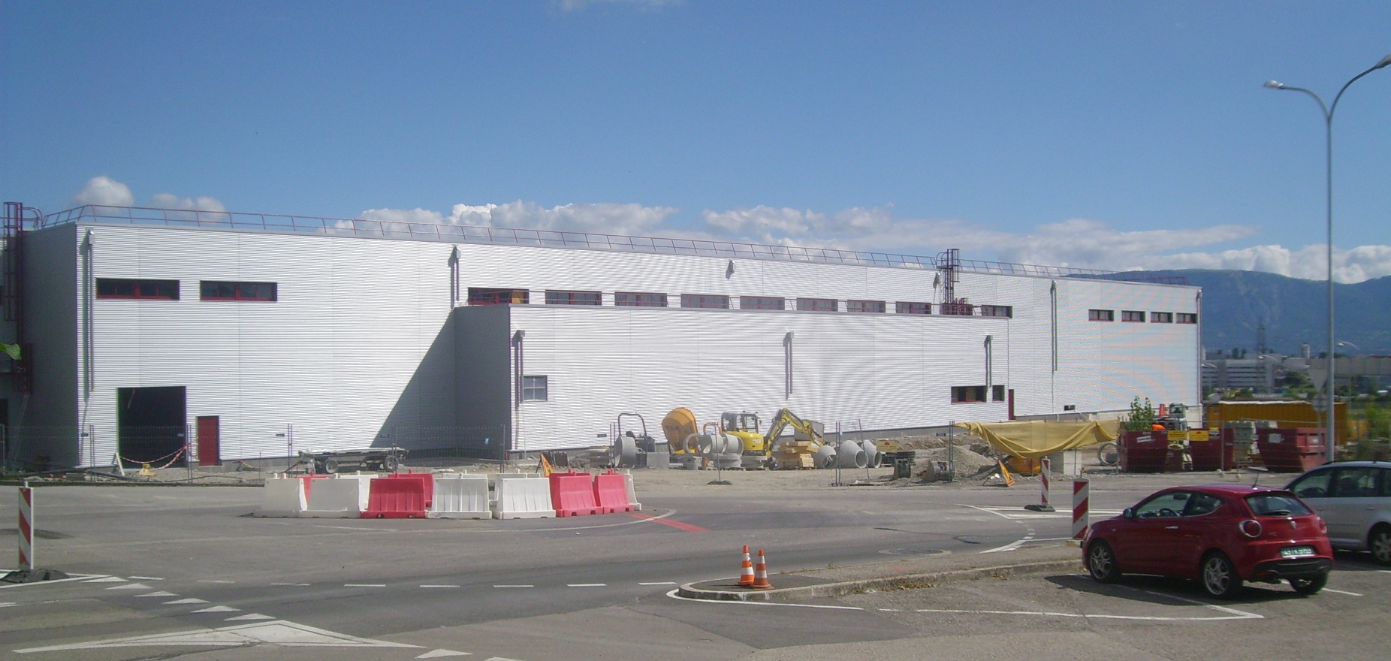
Construction status
Civil engineering completed (in exactly 2 years!).
Installation of infrastructure (crane, lift, false floor, electrical and cooling networks, safety equipment, cabling, waveguides, …) during 2011.

Slide 10
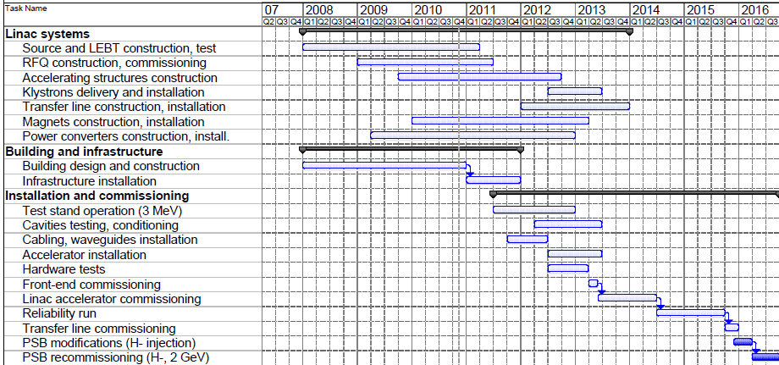
Linac4 – schedule
Building delivery
2013/14:
Commissioning
2014/15:
Reliability run
2011:
Infrastructure installation
2012/13:
Accelerator installation
End 2014:
Linac4 ready
2016: foreseen shutdown for connection to PSB

Slide 11
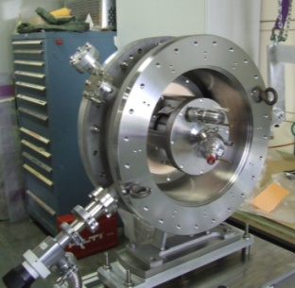
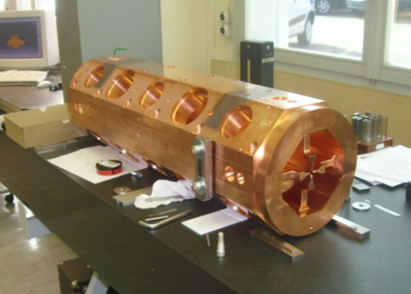
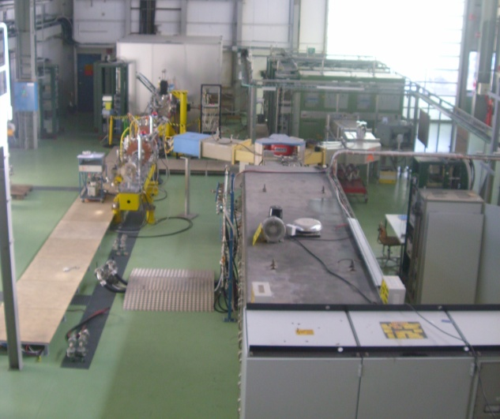
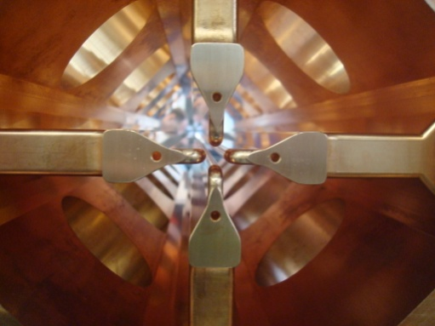
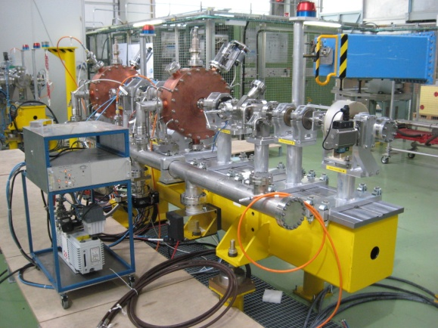
Linac4 – Low energy test stand
3 MeV TEST STAND in the PS South Hall
Ion source and beam transport assembled and under test.
Radio Frequency Quadrupole being built at CERN (2011).
Chopping line built and tested (w/o beam).
LEP klystron (+ modulator) installed, tested in pulsed op.
Testing of RF structures (PIMS prototype) at 2 Hz.

Slide 12
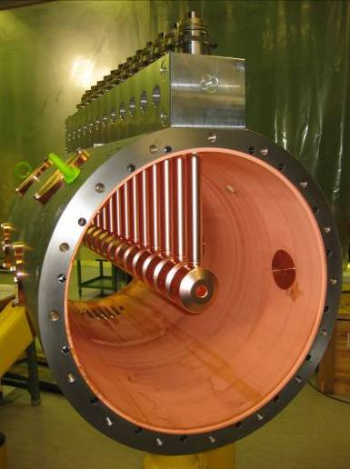
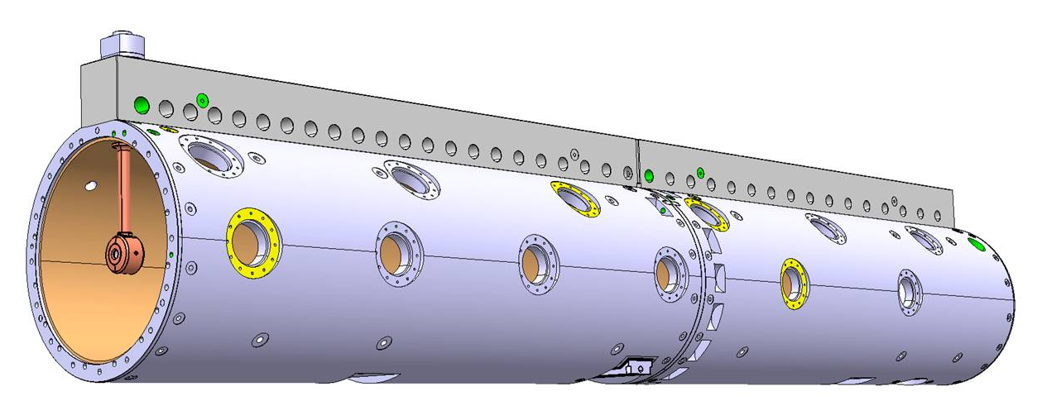
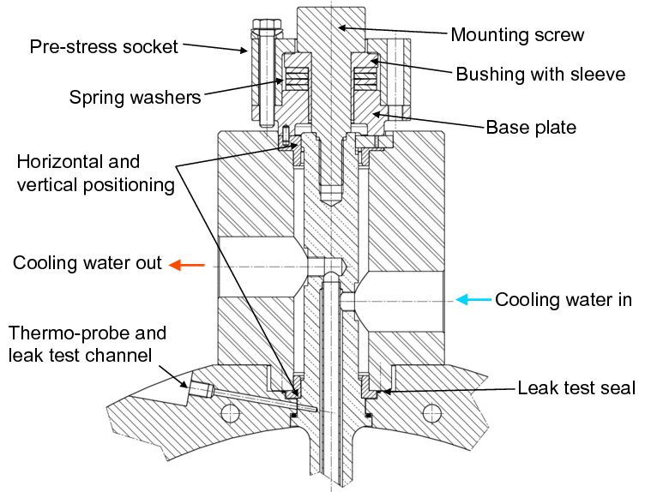
Linac4 – Drift Tube Linac
3-50 MeV, 3 tanks.
Design Completed and tested on a prototype (1m, 12 drift tubes) at full RF power (10% duty cycle).
Main features: DTs rigidly mounted on a girder, with special mounting mechanism, only metallic joints and no adjustment. Tank in Cu-plated Stainless steel. PMQs in vacuum.
Construction started (DTs with ESS-Bilbao).
Tank1 ready for test in 2011.
Important improvements with respect to present DTL linacs (1 patent pending)

Slide 13
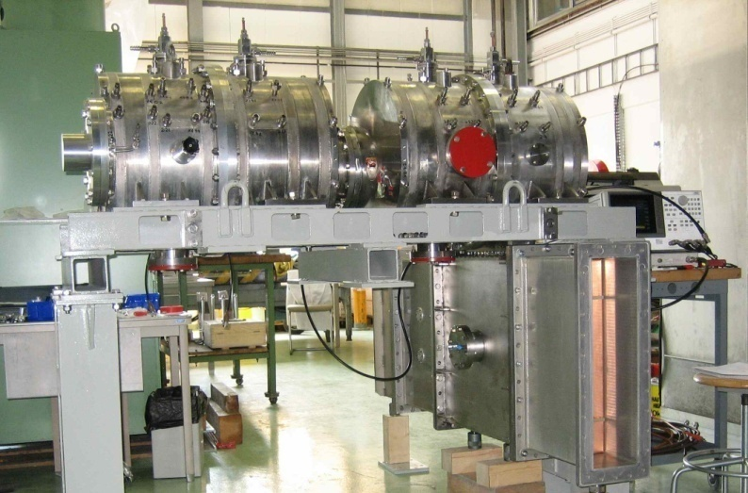
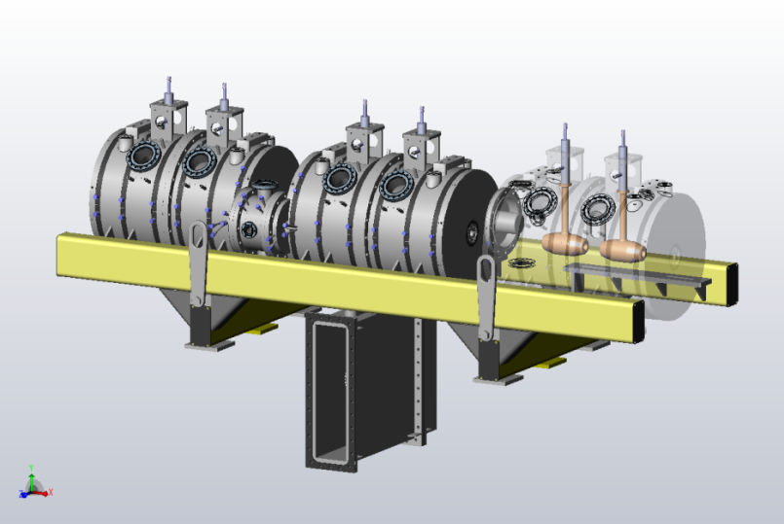
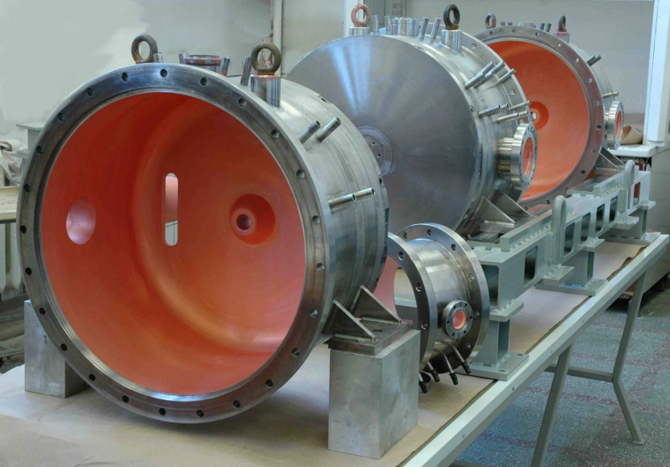
Linac4 – Cell-coupled DTL
50-100 MeV, 7 modules of 3 tanks each.
Design completed and tested on a prototype (2 tanks, 4 drift tubes) at full RF power (10% duty cycle).
Main features: Focusing by PMQs (2/3) and EMQs (1/3) external to DTs. Tanks with 2 DTs connected by coupling cells.
Construction started at VNIITF (Snezinsk) and BINP (Novosibirsk) in January 2010.
Module#1 to be delivered to CERN for testing in January 2011.
Structure used for the first time in a particle accelerator

Slide 14
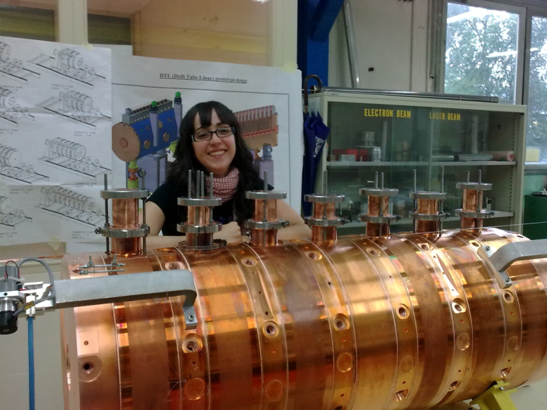
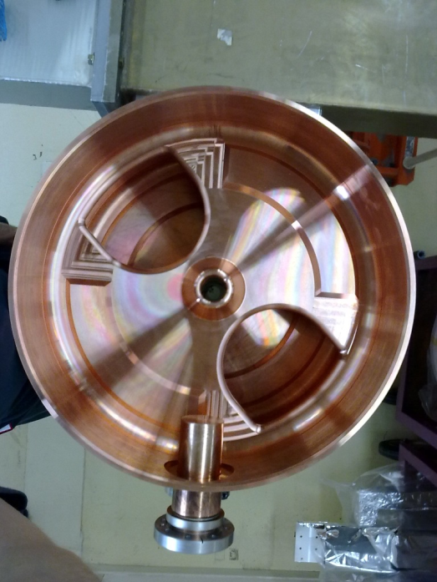
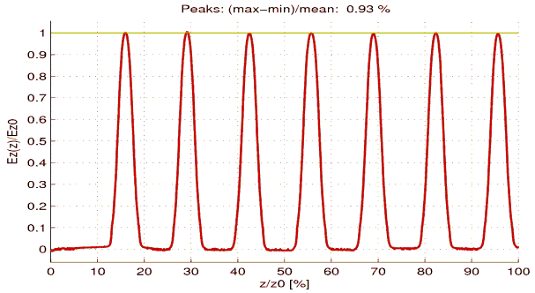
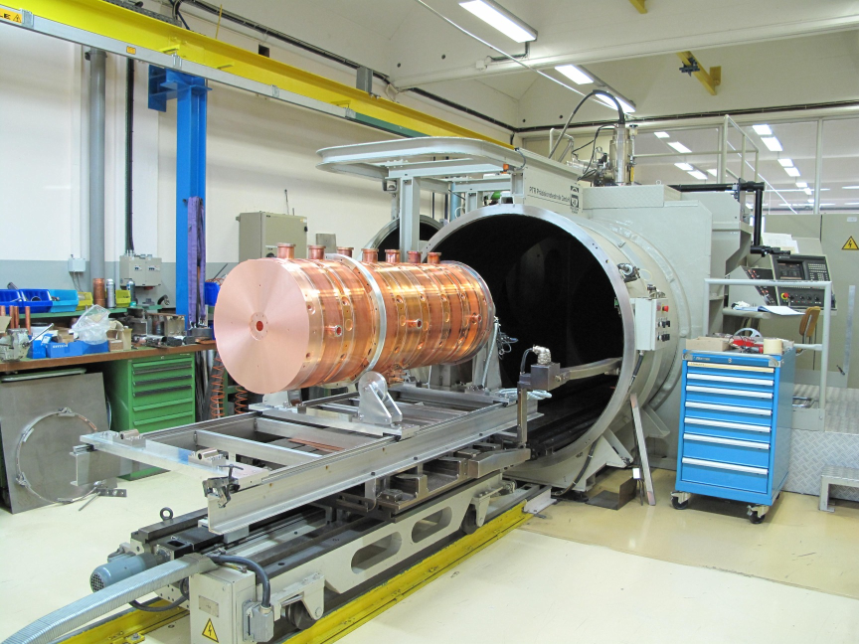
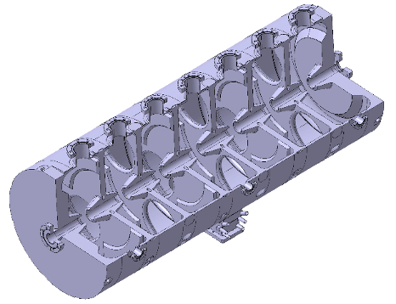
Linac4 – Pi-Mode Structure
100-160 MeV, 12 tanks of 7 cells each.
Design completed, tank #1 completed and tuned, tested (to this week!) at full RF power.
Main features: Focusing by external EMQs, tanks of 7 cells in pi-mode. Full-Cu elements, EB-welded.
Construction will start at beginning 2011 in collaboration with Soltan Institute (Warsaw) and FZ Julich.
Structure used for the first time in a proton accelerator

Slide 15
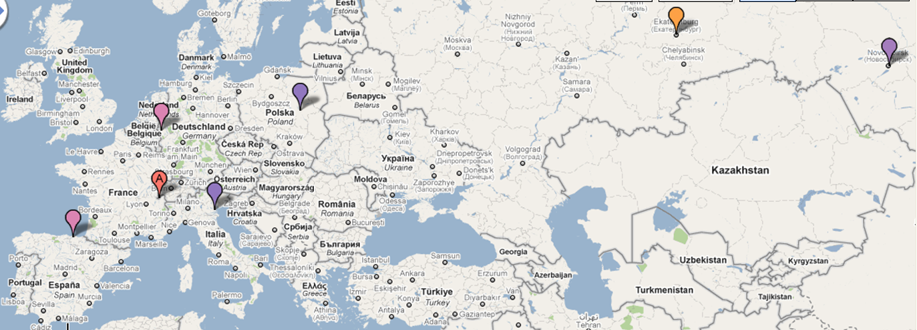
Accelerating structures
Construction of the Linac4 accelerating structure – an European enterprise (and beyond…)
Drift Tube Linac (DTL):
prototype from INFN/LNL (Italy), drift tubes from ESS-Bilbao (Spain), tanks and assembly at CERN
Cell-Coupled DTL:
tanks from VNIIEF (Snezinsk), drift tubes and assembling from BINP (Novosibirsk)
PI-Mode Structure (PIMS): tanks from Soltan Institute (Poland), EB welding from FZ Juelich (Germany), assembly and final EB welding at CERN.
Notes:
Distribute the work but keep control… integration at the component level.

Slide 16







Linac4 – External Contributions
Network of agreements to support Linac4 construction. Relatively small fraction of the overall budget, but access to specialized manpower !
Integration at the component level.
RFQ RF design, RF amplifiers, modulator construction from French Special Contribution. started.
Prototype modulator, RF tuners, couplers, waveguides from India, in progress
Agreement with DESY to access drawings of H- source
completed
45 keV 3 MeV 50 MeV 100 MeV 160 MeV
Transfer line vacuum chambers and supports from Pakistan, agreed
H
-
LEBT
RFQ
chopper line
DTL
CCDTL
PIMS
transfer line to PSB
source
80 m
Chopper line built in a EU Joint Research Activity
completed
Construction of CCDTL in Russia, via an ISTC Project
started
Collaboration agreement with Soltan Institute (Poland) and FZ Julich (D) for PIMS construction, in preparation.
Participation of ESS-Bilbao in DTL construction,
started

Slide 17

Linac4 – virtual tour

