Slide 1
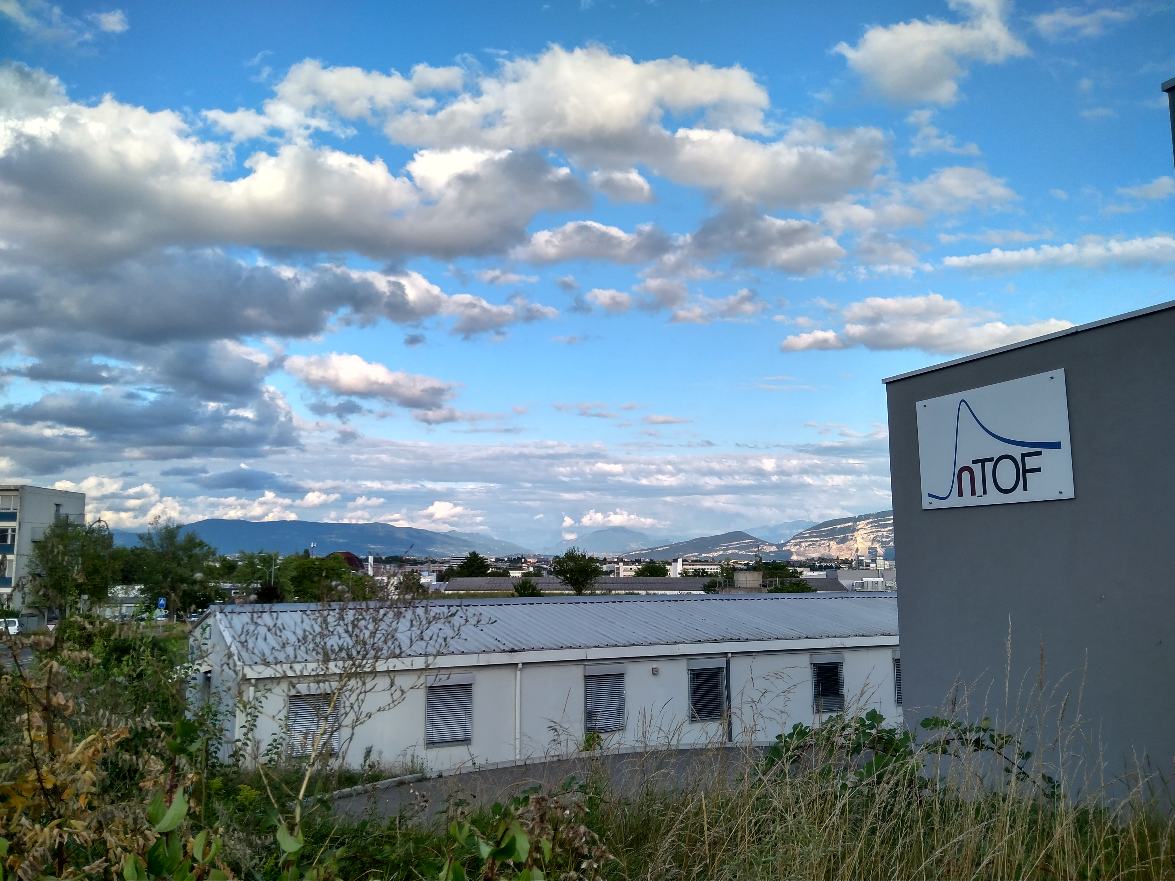



STATUS REPORT OF THE n_TOF FACILITY
Nikolas Patronis n_TOF Physics Coordinator CERN & Univ. of Ioannina | Michael Bacak n_TOF Run Coordinator CERN

Slide 2
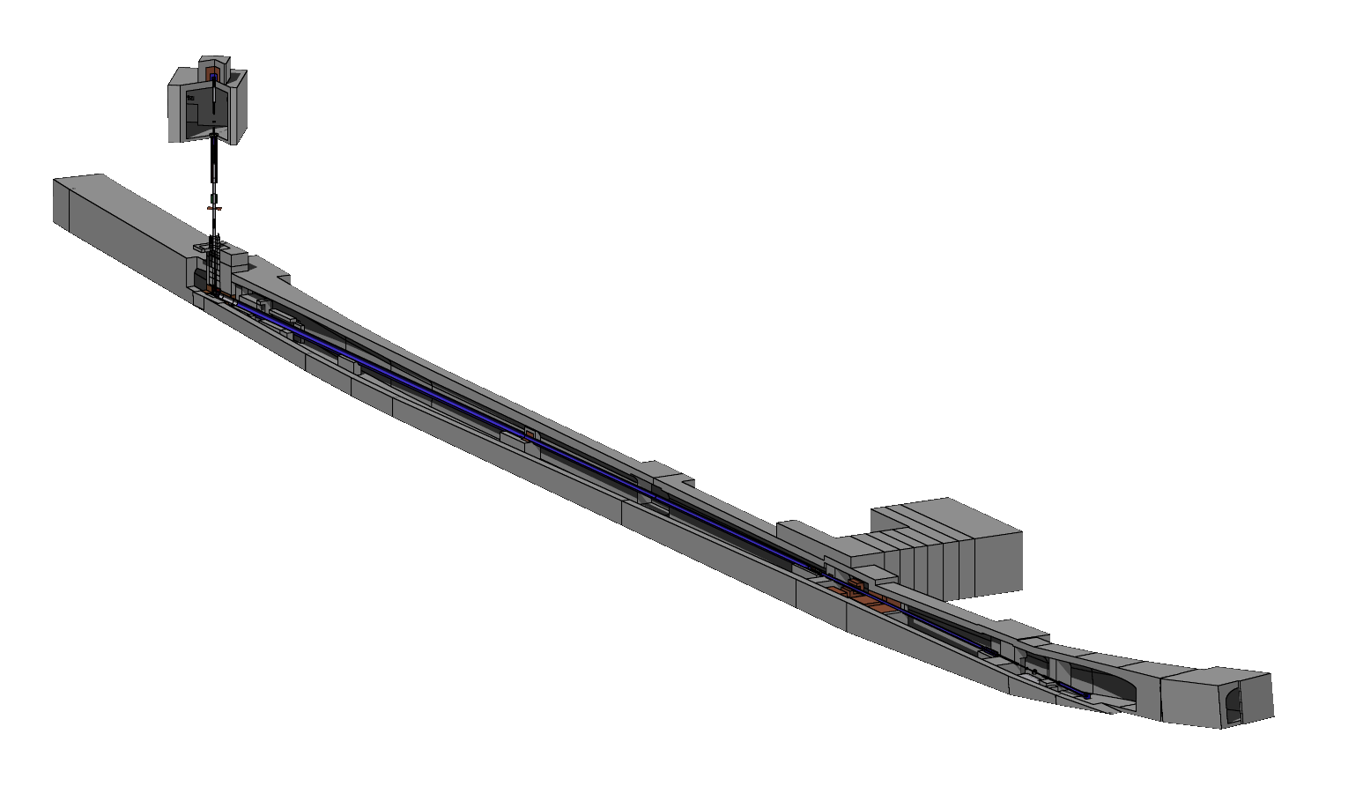
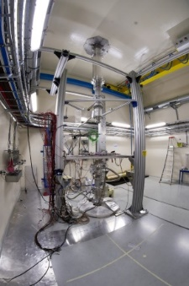
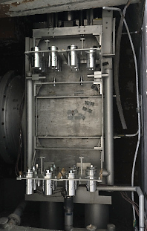
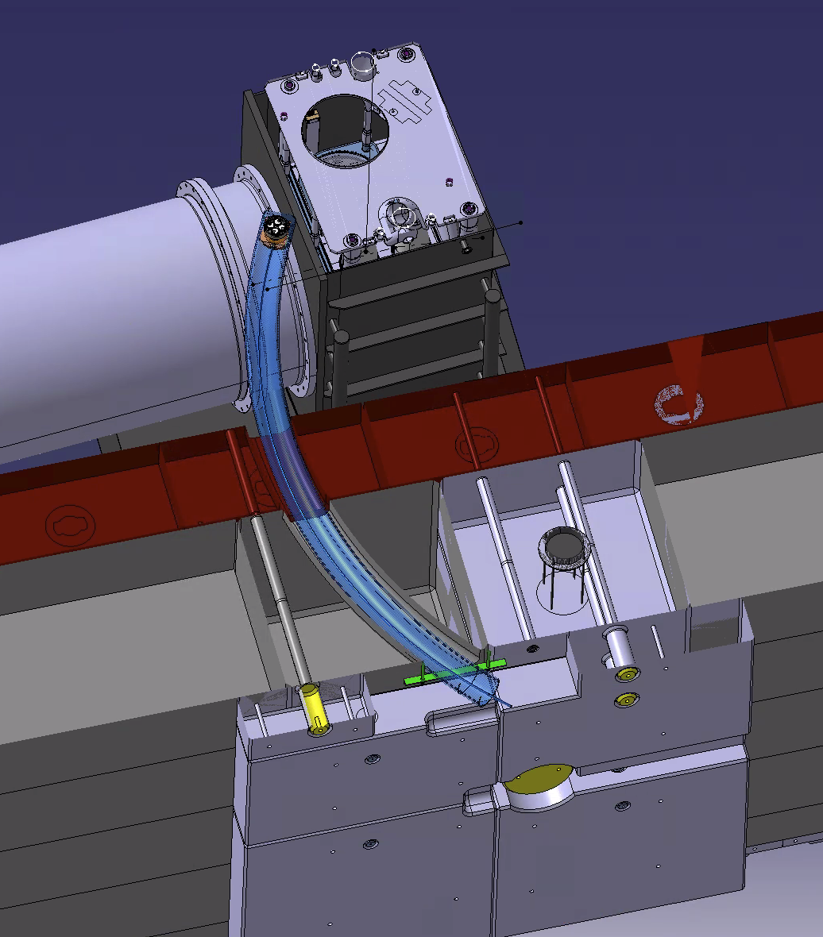
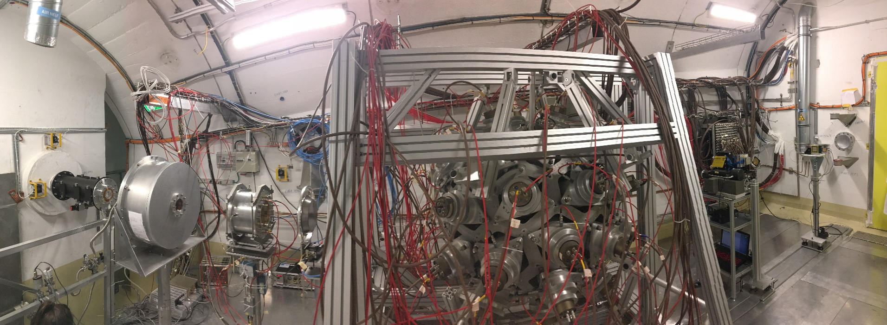
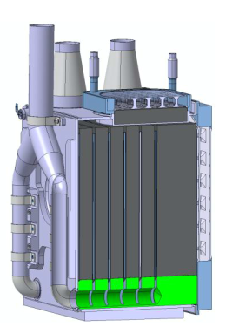
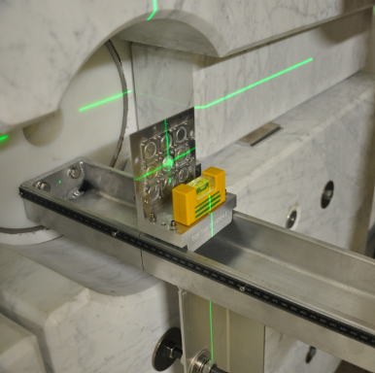
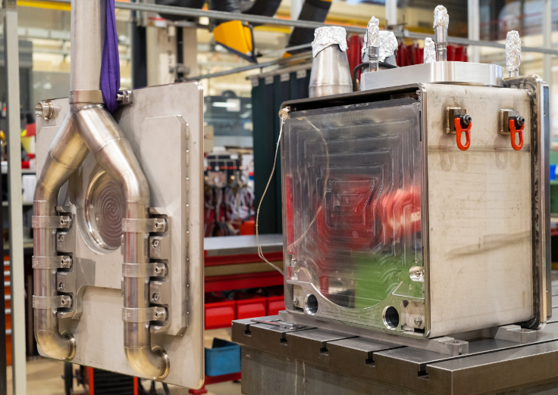


The n_TOF facility: EAR1 + EAR2 + NEAR
EAR2 (2014)
20 GeV
Protons
Neutrons
NEAR (2021)
Neutrons
Pb target
EAR1
Nikolas Patronis PS-SPS-AD User Meeting #1 2

Slide 3
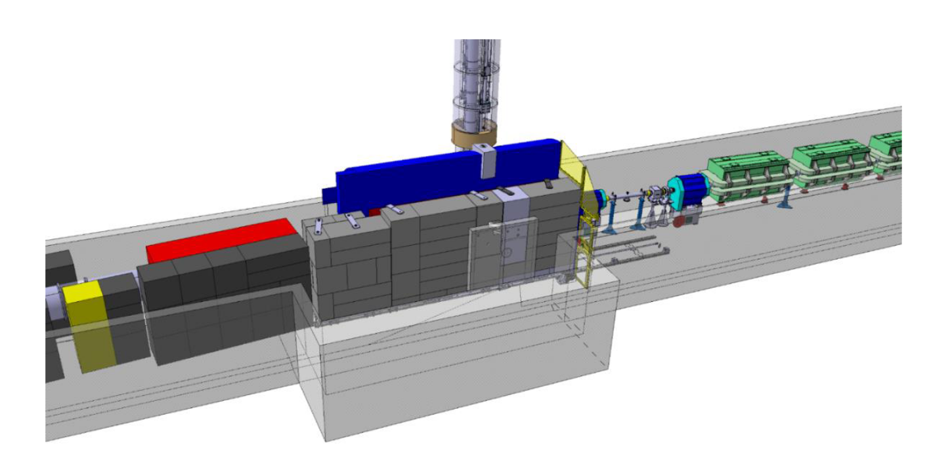
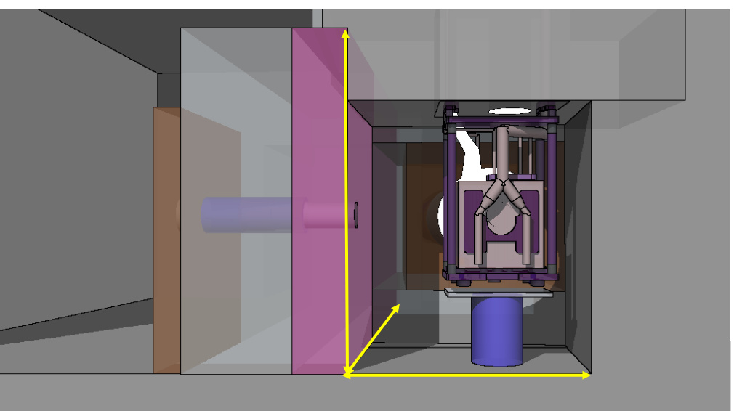
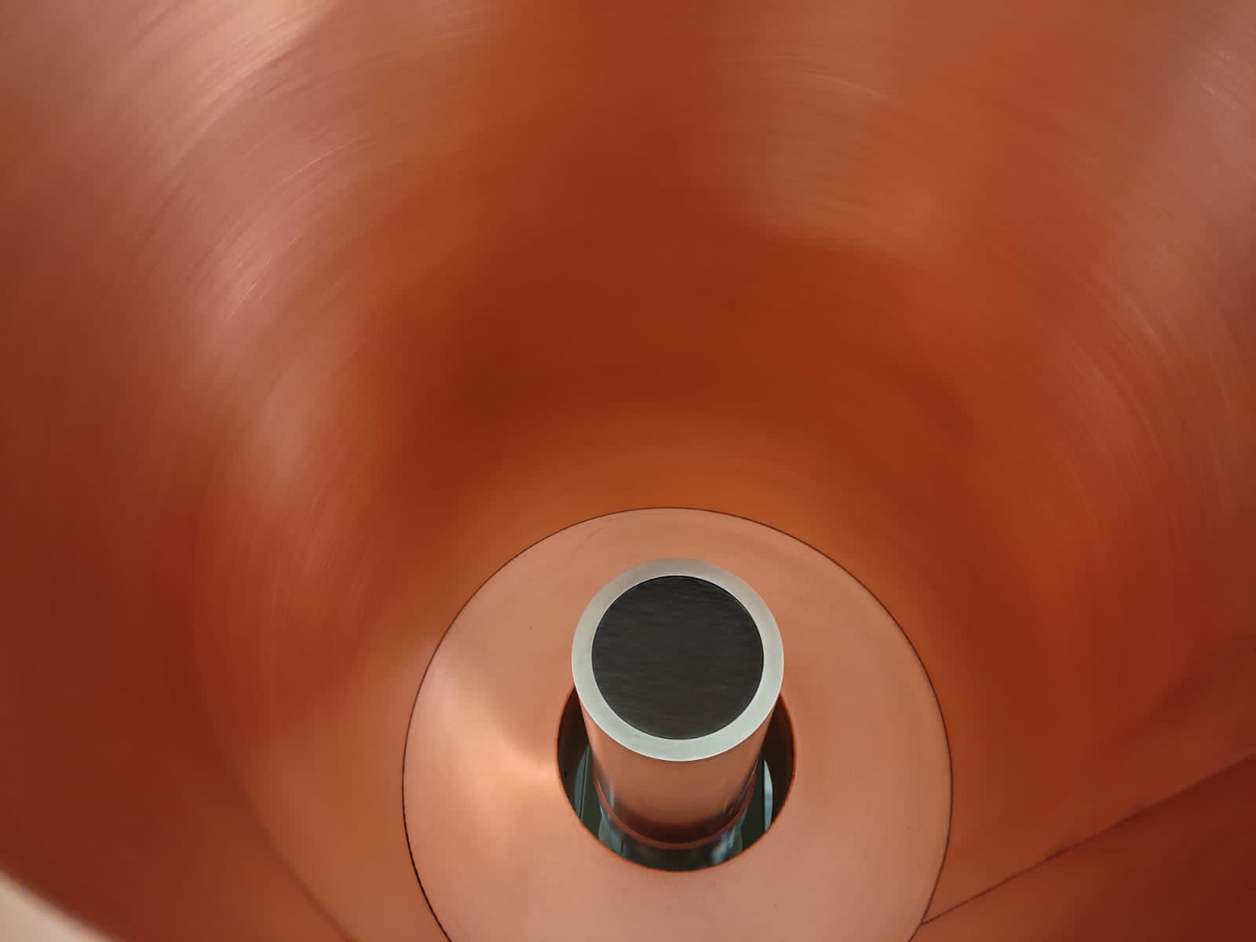
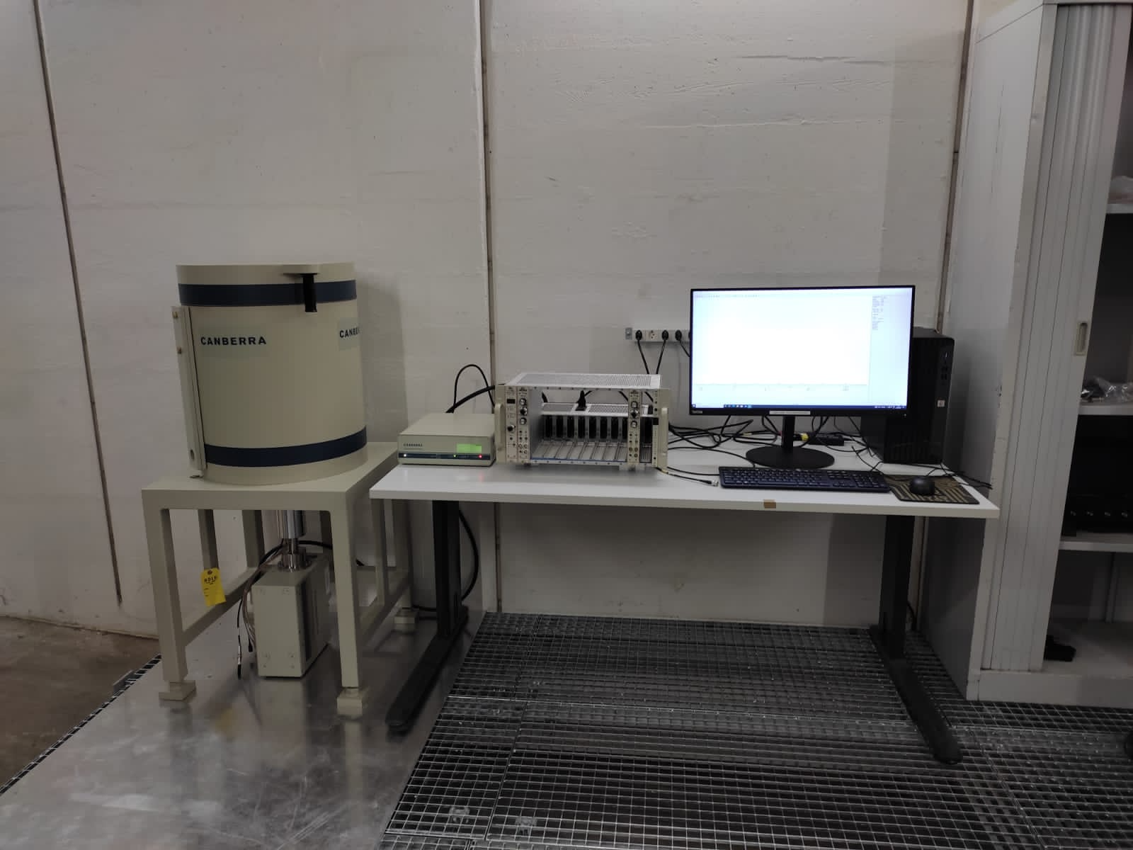
The n_TOF facility: NEAR
The NEAR Station is the n_TOF facility’s new high-flux irradiation station.
Two regions of activities
The irradiation area i-NEAR. Located next to the lead spallation target: high neutron dose material studies.
The activation area a-NEAR. Located just outside the target bunker shielding, at only 3m distance from the target: nuclear astrophysics studies, electronics irradiation studies
proton beam
GEAR: γ-ray spectroscopy using 55% HPGe el. cooled
Nikolas Patronis PS-SPS-AD User Meeting #1 3

Slide 4
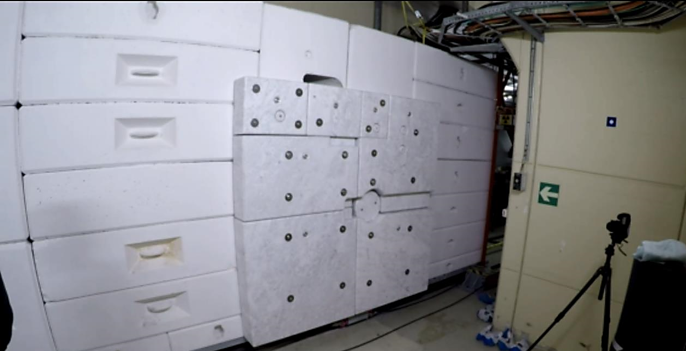
The n_TOF facility: NEAR
The NEAR Station is the n_TOF facility’s new high-flux irradiation station.
Two regions of activities
The irradiation area i-NEAR. Located next to the lead spallation target: high neutron dose material studies.
The activation area a-NEAR. Located just outside the target bunker shielding, at only 3m distance from the target: nuclear astrophysics studies, electronics irradiation studies
proton beam
GEAR: γ-ray spectroscopy using 55% HPGe el. cooled
Nikolas Patronis PS-SPS-AD User Meeting #1 4

Slide 5
The n_TOF facility
Detector developments
Radiative capture reactions (n, γ)
Fission reactions (n, f)
Light particle emission reactions (n, cp)
EAR2
EAR2
²³⁹Pu
EAR2
Imaging
STEFF
²³⁵U
EAR2
²⁴¹Am
²⁴⁶Cm
²⁴⁴Cm
STEFF
²³⁵U
C6D6
²³⁰Th
²⁴¹Am
NEAR
²³⁴U
²³⁶U
²³²Th
²³⁷Np
STEFF
MGAS
EAR1
⁷⁶Ge
⁹⁴Zr
¹⁴⁰Ce
¹⁹⁷Au
⁸⁹Y
FIC0
³³S
²³⁷Np
³⁵Cl
¹⁴N
DDX
HPge
MGAS
MGAS
Si + MGAS
EAR1
HPGe
²⁴⁵Cm
²³³U
²⁴¹Am
²⁴³Am
FIC0
²³⁶U
¹⁶O
²⁴³Am
Si
⁷Be
²⁶Al
⁷Be
DFGIC
MGAS
FIC1
³³S
Si
EAR1
EAR2
²³⁵U
²³⁸U
MGAS
¹⁴⁷Pm
¹⁷¹Tm
²³⁵U
¹²C
²³⁴U
FIC2
²⁴⁰Pu
²⁴²Pu
C6D6
EAR1
RPT
Si
⁷⁹Se
DFGC
TARAT
X17
FIC0
¹⁸⁶Os
¹⁸⁷Os
¹⁸⁸Os
⁹⁰Zr
⁹¹Zr
⁹²Zr
⁹⁴Zr
⁹⁶Zr
²⁴Mg
²⁶Mg
²⁰⁸Pb
¹³⁹La
MGAS
²³⁵U
iTED
²³⁷Np
²³³U
²³⁴U
²⁰⁹Bi
^{nat}Pb
²³²Th
⁵⁹Ni
Si
²³⁵U
²⁴⁴Cm
RPT
²³²Th
²³⁴U
CVD
²³⁸U
EAR1
TAC
EAR2
²³⁹Pu
²⁴³Am
PPAC
PPAC
TAC
EAR2
²³⁷Np
²³⁷Np
²³⁰Th
TAC
MGAS
⁸⁷Sr
²⁴⁰Pu
PPAC
PPAC
¹⁵⁴Gd
⁷⁷Se
⁷⁸Se
⁶⁹Ga
⁷¹Ga
⁸⁹Yr
⁸⁸Sr
MGAS
⁹⁴Mo
⁹⁵Mo
⁹⁶Mo
¹⁵¹Sm
²⁰⁴Pb
²⁰⁶Pb
²⁰⁷Pb
²⁰⁹Bi
²³²Th
TAC
¹²C
MGAS
C6D6
⁷⁹Se
⁹⁴Mo
⁹⁵Mo
⁹⁶Mo
¹⁶⁰Gd
⁵⁰Cr
⁵³Cr
⁷⁹Se
⁹⁴Nb
C6D6
²³⁵U
¹⁴⁷Pm
²⁴²Pu
²⁰⁴Tl
⁷⁶Ge
⁷⁴Ge
⁷⁰Ge
TAC
²³³U
²⁰⁵Tl
³⁵Cl
¹⁴⁰Ce
⁸⁰Se
⁶⁸Zn
sTED
²⁴⁰Pu
²³⁷Np
²⁴³Am
²³³U
TAC
²³⁶U
⁶³Ni
⁶²Ni
⁵⁸Ni
⁵⁷Fe
²³⁸U
²⁵Mg
⁹²Zr
⁹³Zr
C6D6
EAR1
EAR1
C6D6
C6D6
C6D6
¹⁵⁷Gd
¹⁵⁵Gd
⁷²Ge
C6D6
C6D6
⁷⁹Se
⁹⁴Nb
¹⁶⁰Gd
⁶²Ni
⁵⁶Fe
C6D6
¹⁷¹Tm
⁷³Ge
¹⁷⁹Yb
TAC
⁵⁶Fe
²⁴¹Am
C6D6
C6D6
C6D6
C6D6
C6D6
C6D6
2001
2002
2004
2009
2010
2011
2012
2014
2015
2016
2017
2018
2021
2022
Phase 1
Phase 2
Phase 3
Phase 4
Nikolas Patronis PS-SPS-AD User Meeting #1 5

Slide 6
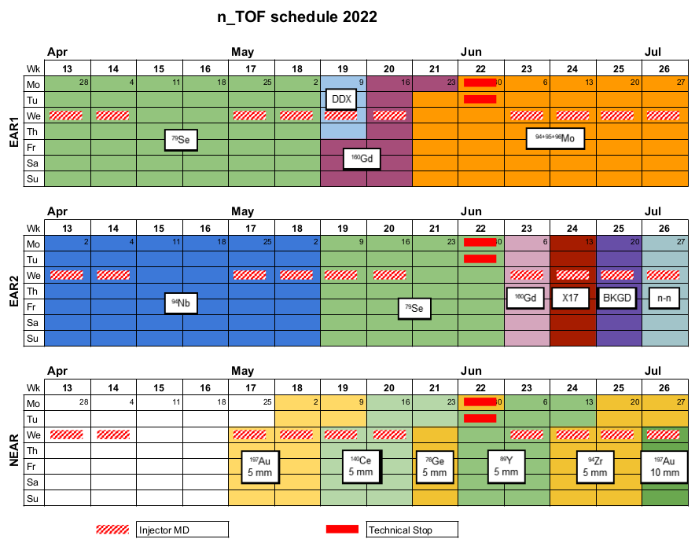
First beam at 14.03.2022
(2 weeks FTN line tests)
Physics start on 28.03.2022
Planning 2022
Almost exclusively (n,γ)
(n,γ) in the first months
LoI for detector tests
commissioning activities
First physics in 2022!
MACS shaped neutron activation
(begin affected by delivery problems)
Nikolas Patronis PS-SPS-AD User Meeting #1 6

Slide 7
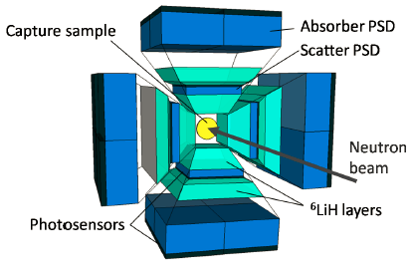
⁷⁹Se(n,γ) XS @ EAR1
⁸⁰Kr
⁸¹Kr
⁸²Kr
11 a
⁷⁹Br
⁸⁰Br
⁸¹Br
⁸²Br
Physics motivation:
  s-process nucleosynthesis (A~80)
  Stellar site thermometer
  Nuclear waste disposal and transmutation
  First measurement
Sample: ⁷⁸Se irr. @ ILL, PSI preparation & characterization
i-TED – n_TOF detector development
  combines compton imaging (n-background reduction)
  with Total Energy Deposition technique
  Advantageous for isotopes/energies with high (n,el)
  Gain (n,γ)/background wrt standard C₆D₆ detectors ~4-10
17 m
⁷⁶Se
⁷⁷Se
⁷⁸Se
⁷⁹Se
⁸⁰Se
⁸¹Se
3x10⁵y
⁷⁵As
⁷⁶As
26 h
Nikolas Patronis PS-SPS-AD User Meeting #1 7

Slide 8
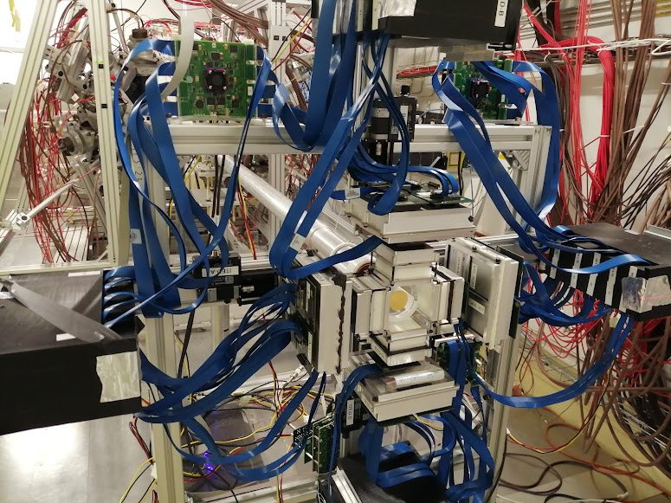
⁷⁹Se(n,γ) XS @ EAR1
⁸⁰Kr
⁸¹Kr
⁸²Kr
11 a
⁷⁹Br
⁸⁰Br
⁸¹Br
⁸²Br
Physics motivation:
  s-process nucleosynthesis (A~80)
  Stellar site thermometer
  Nuclear waste disposal and transmutation
  First measurement
Sample: ⁷⁸Se irr. @ ILL, PSI preparation & characterization
i-TED – n_TOF detector development
  combines compton imaging (n-background reduction)
  with Total Energy Deposition technique
  Advantageous for isotopes/energies with high (n,el)
  Gain (n,γ)/background wrt standard C₆D₆ detectors ~4-10
17 m
⁷⁶Se
⁷⁷Se
⁷⁸Se
⁷⁹Se
⁸⁰Se
⁸¹Se
3x10⁵y
⁷⁵As
⁷⁶As
26 h
Thanks to Jorge Lerendegui-Marco
Nikolas Patronis PS-SPS-AD User Meeting #1 8

Slide 9
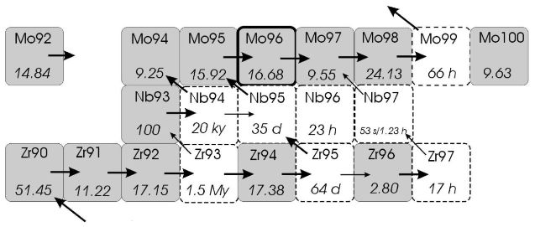
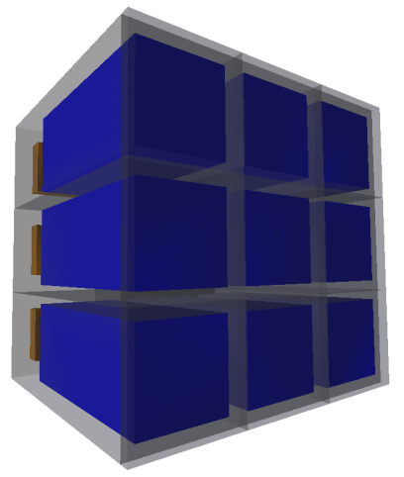
⁹⁴Nb(n,γ) XS @ EAR2
Physics motivation:
    The predicted s-process abundance of Mo-94 is five times
    less than the observed (SiC grains from Murchison met.)
    No exp. data in the resolved and un-resolved resonance energy region
    Nuclear waste disposal and transmutation
Sample: ⁹³Nb irr. @ ILL, PSI preparation & characterization
sTED – n_TOF detector development
  segmented TED detector – for high rates (EAR2)
  C₆D₆ liquid scintillators (future: investigating inorganic scint.)
  1/20 smaller volume (to resolve rate & γ-flash issues @ EAR2)
  SiPMs – smaller volume/mass for interaction with γ-flash
Nikolas Patronis PS-SPS-AD User Meeting #1 9

Slide 10
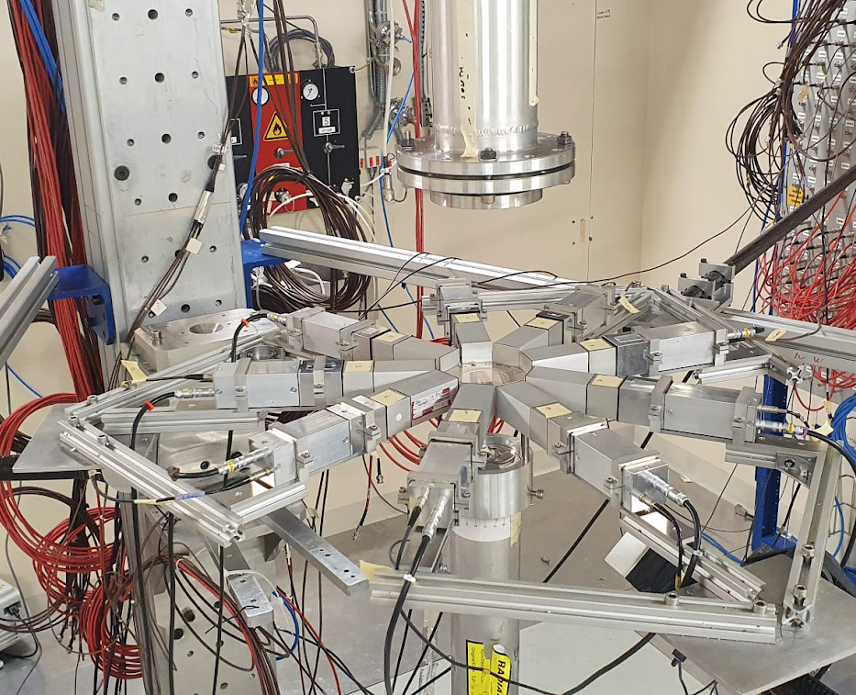
⁹⁴Nb(n,γ) XS @ EAR2
Physics motivation:
    The predicted s-process abundance of Mo-94 is five times
    less than the observed (SiC grains from Murchison met.)
    No exp. data in the resolved and un-resolved resonance energy region
    Nuclear waste disposal and transmutation
Sample: ⁹³Nb irr. @ ILL, PSI preparation & characterization
sTED – n_TOF detector development
  segmented TED detector – for high rates (EAR2)
  C₆D₆ liquid scintillators (future: investigating inorganic scint.)
  1/20 smaller volume (to resolve rate & γ-flash issues @ EAR2)
  SiPMs – smaller volume/mass for interaction with γ-flash
neutrons
Thanks to J. Balibrea-Correa, V. Babiano-Suarez
Nikolas Patronis PS-SPS-AD User Meeting #1 10

Slide 11
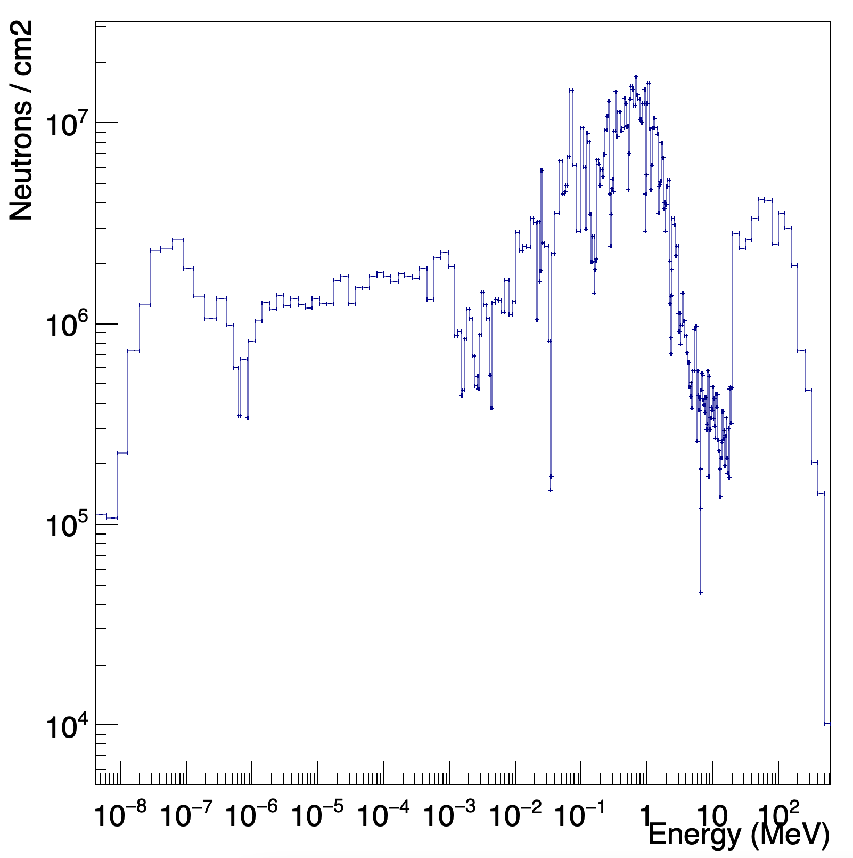
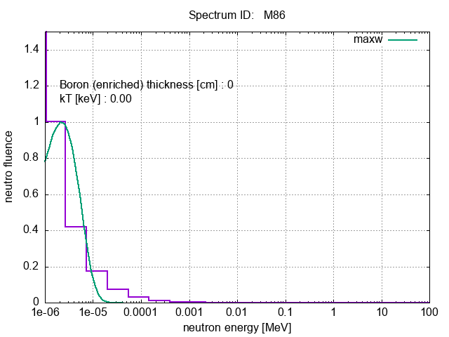
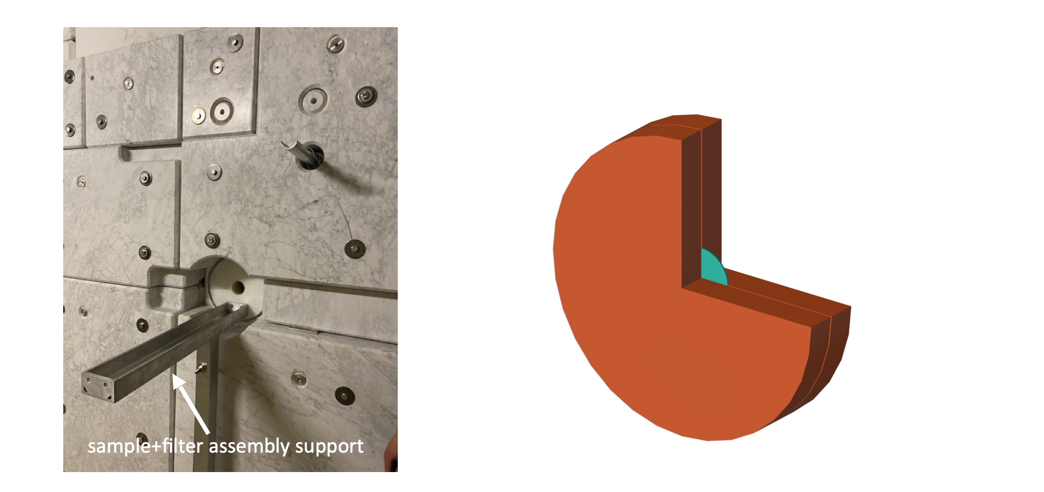
(n,γ) XS @ NEAR
Idea: By using different B₄C filters to shape neutron energy spectrum to match the Maxwell Boltzmann distribution for different stellar enviroments
PhD thesis work for Maria Elisso STAMATI
Nikolas Patronis PS-SPS-AD User Meeting #1 11

Slide 12
Thank you so much for your attention!

Slide 13
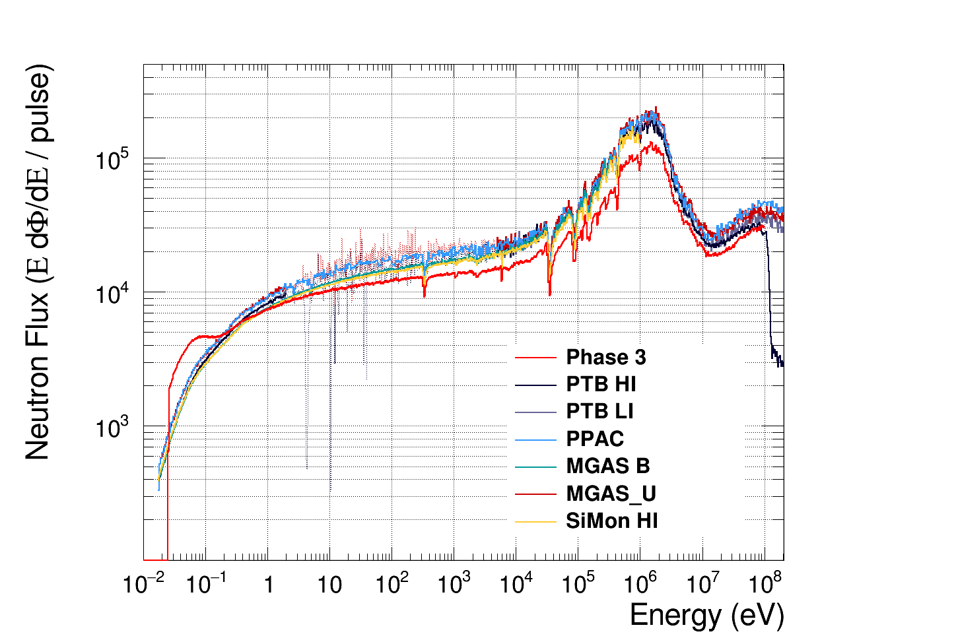
The n_TOF facility
High instantaneous neutron flux (EAR2: 10⁶n/cm²/10ms)
Well collimated neutron beam (two ⌀ options: 8 cm & 2 cm)
High energy resolution (~10⁻⁴)
Large energy range (meV – GeV)
EAR1
Nikolas Patronis IAEA/May 23-27, 2022 2

Slide 14
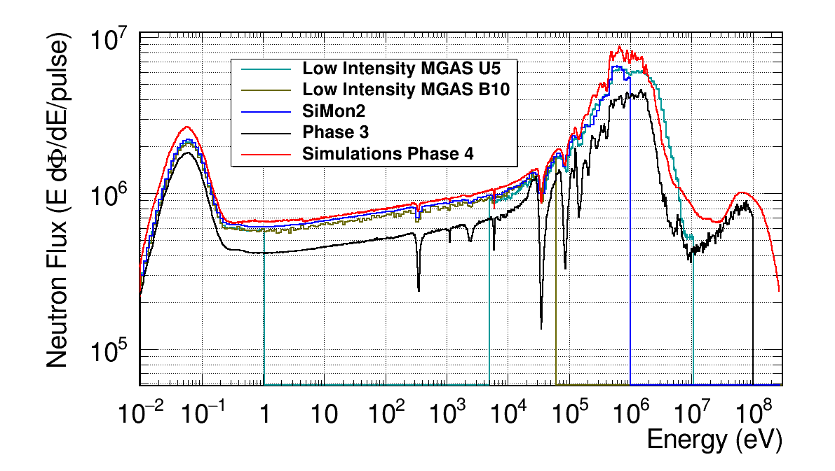
The n_TOF facility
High instantaneous neutron flux (EAR2: 10⁶n/cm²/10ms)
Well collimated neutron beam (two ⌀ options: 6 cm & 2 cm)
High energy resolution (~10⁻⁴)
Large energy range (meV – GeV)
EAR2
Nikolas Patronis IAEA/May 23-27, 2022 2

Slide 15
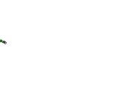
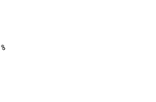

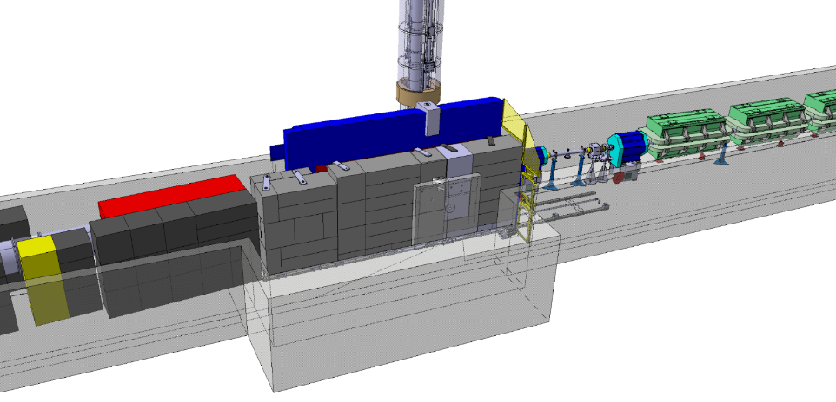
FTN line modofications during YETS 2022
Mobile part
Reconfiguration of the last elements in the FTN line

Slide 16
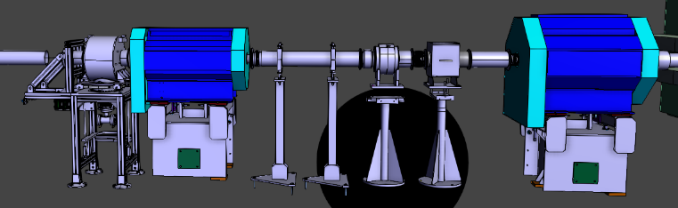
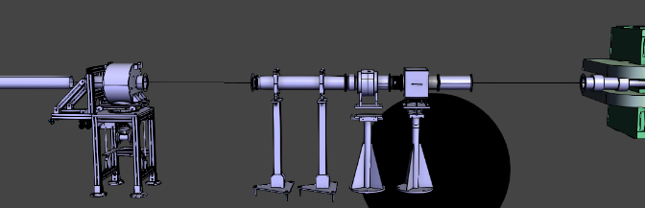
FTN line modofications during YETS 2022

