Slide 1
FiQuS Team Meeting – Gitlab Workflow
Erik Schnaubelt, March 17, 2022

Slide 2
Feedback - Experience with Git?
How experienced are you with Git?
  Used it before? For projects alone or in a group?
  Are you familiar with branching?
  Merge requests?
  Issue tracker?
  CI/CD?

Slide 3
Proposed Workflow I
Two repositories
  Private: FiQuS-Dev for all non-public developments (all stages of maturity)
    Our playground: we freely trial and error
  Public: FiQuS for everything that is published
    Note: Git keeps a history of everything (really deleting a pushed file is cumbersome, for complicated projects practically impossible and very bad practice)
How do we transition from FiQuS-Dev to FiQus?
  Maintain code quality standards?
  Testing that about to be published code is self-consistent?
  Double check that no code is published before paper?
Solution: branching in FiQuS-Dev

Slide 4
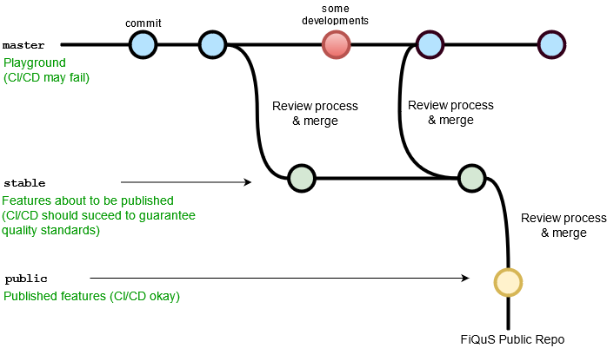
Proposed Workflow II
In master:
CI/CD can fail but keep an eye on linters etc.
Review process (master to stable):
CI/CD should run through including
  Linter (code quality standards)
  Tests (does code actually work)
  Reasonable test coverage
  Build (obviously)
  Gitlab code quality
Add/merge to be published files to stable branch
Corrections in stable branch okay
No special approval needed
Review process (stable to public):
Create merge request
Approval needed from other developer/responsible
Only approved if CI/CD okay
Note: Typically, the master branch is the release branch, there is a stable
branch and you have multiple development branches which
are then merged into stable (might follow this approach as well,
to be discussed).
In any case, I’ll make sure that you cannot push where you shouldn’t
(no worries about tests/linters etc. when developing! ☺)

Slide 5

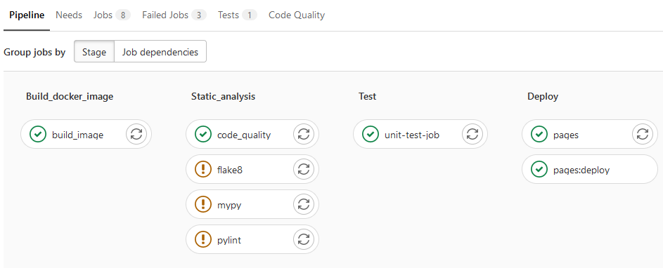
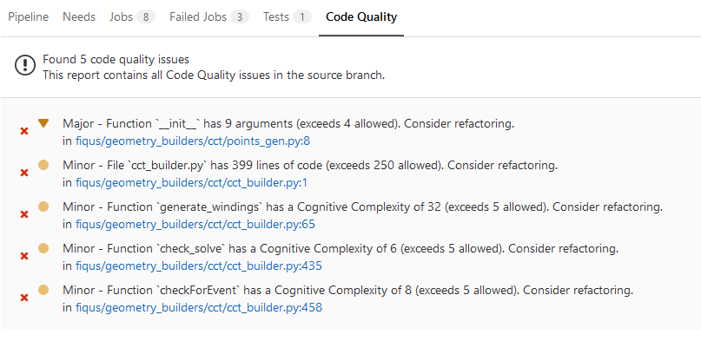
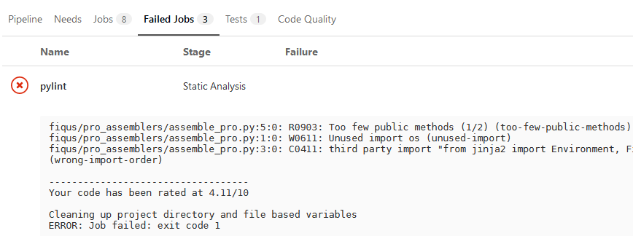
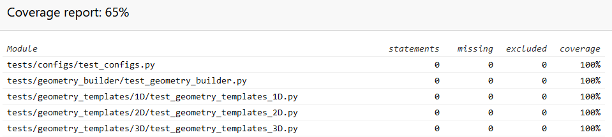
How do I check code quality?
You can run flake8, pylint, mypy and pytest locally, see documents/local_static_analysis.md
On the remote, click on the badges to see the latest pipeline and coverage report
For now, CI/CD pipeline allowed to fail (esp. in master branch while developing) but keep having a look

Slide 6
Outlook
In the short-time, a lot of this will need to be discussed and modified
  Might seem cumbersome at the moment (to me, too ;))
In the long-term, usage of these tools will be crucial
  To assure code quality (and with it the success of the tool!)
  For image of software to outside world
  To save time!!
    Automation of tests and merging
    Efficient procedures (minimize manual labor)
    Clear structure
    All of this will help newcomers and external collaborators
Always happy to hear your thoughts, questions etc.

