Slide 1
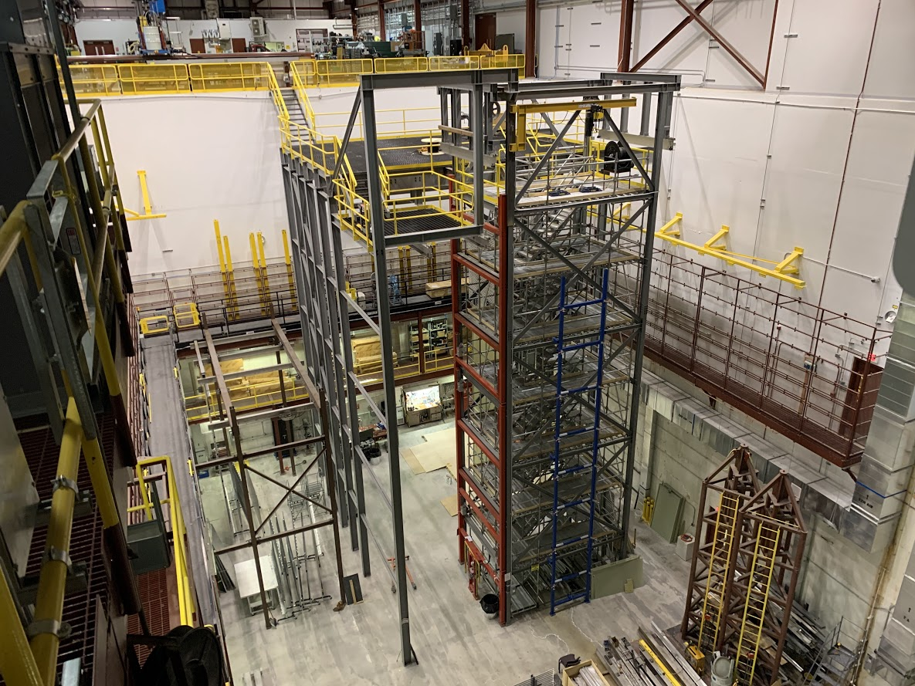
DUNE-FD1
Ash River Trial Assembly
Tom Wieber
University of Minnesota
Ash River FD1 Trial Assembly Area

Slide 2
FD1 Trial Assembly
Continue to conduct prototyping tests of mechanical assembly of the DUNE TPC
The long-term full-scale mockup steel structure has allowed different consortia:
  To test access
  Test mechanical connections
  Test lifting fixtures
  Perform cable tests
  Perform time and motion studies
  Understand shipping boxes/configurations
  Determine assembly procedure details
Is it physically possible
Chamfering, design revisions
Numerous iterations – e.g. EWFC, trolleys
Understand procedure for safe installation
Complete start to finish timing rarely happens, always some discussion
Safe extraction → manipulation → final delivery to cryostat
EDMS

Slide 3
FD1 Trial Assembly
ProtoDUNE trial structure at Ash River was used in preparation for changes required for ProtoDUNE 2
  Trolleys – APA/CPA/EWFC
  APA positioning system (lower APA)
  APA/EWFC connections
  Ground plane design
Tests of the new HV system designs and the new deployment system
  EWFC hoist system and trolley for ProtoDUNEII
  FC deployment tools design overhaul
Updated procedures and tooling for removing the existing TPC components
  Due to COVID – Ash River collaborated remotely with CERN during removals
Ash River Lab Manager (Installation Team Leader) responsibilities:
  Meeting participation
    Far detector design
    DUNE Technical Coordination
    Consortia
    LBNF/Far Site CF integration and final design meetings
  Collaboration meetings and project reviews as needed for DUNE Technical Coordination
  Assist with preparation of Technical Coordination documentation and review process associated with the installation and integration tasks

Slide 4
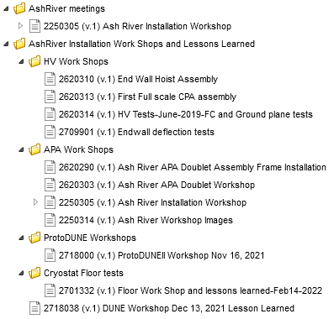
FD1/ProtoDUNEII Trial Assembly Documentation
Google Photo Albums
CPA Assembly November 2020
Mini-workshop June 2021
ProtoDUNEII Workshop November 2021
DUNE Workshop December 2021
CERN APA October-December 2021
Lessons learned
Involved Consortia
  APA
  HV
  Photon Detector
  DSS

Slide 5
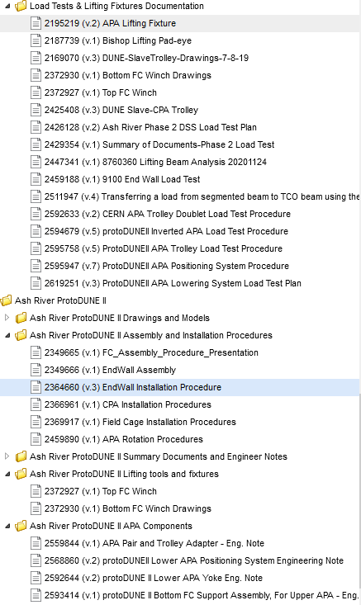
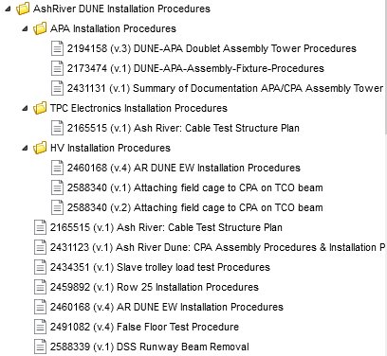
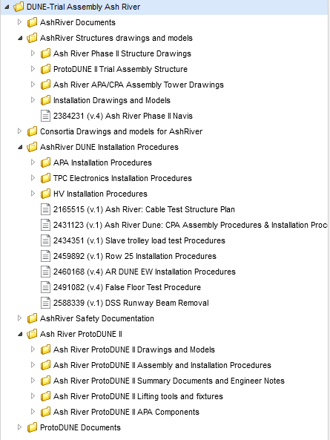
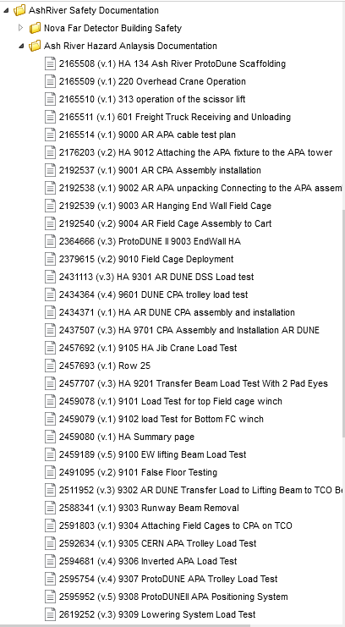
EDMS
Documentation needed at AR
Adaptable to CERN/SURF requirements
**Ash River pushes eng. Notes completion & submittables

Slide 6
Deliverables
Trial Assembly activities for the DUNE – Single Phase Detector (FD1) have generated updates/modifications to the installation plan with supporting documentation
  Updates approved by DUNE Technical Coordination
Periodic updates in the form of slide presentations have been presented at DUNE Collaboration meetings and/or weekly meetings, as appropriate
  Consortia
  Installation Coordination
  PMG
Installation procedures have been updated throughout the Trial Assembly process
Engineering notes & safety documentation
Ash River has provided documentation of its work in accordance with DUNE Project Office processes and procedures
Ash River provides material for DUNE Project monthly reports in a timely fashion
  Descriptive material
  Financial reporting
  Monthly task status reports
  Information needed for the DUNE Project monthly earned value management analysis and reporting
  This will include providing monthly accruals of costs and labor hours to the DUNE Project Office

Slide 7
Deliverables continued…
Few remaining items
  Most overlap/moved from ProtoDUNE→DUNE
  Awaiting fabrication
    FC deployment tools
  Ongoing test iterations
    Floor tests

Slide 8
FD1 Ash River/CERN ~6-30 months
CERN cold box
  4 APAs @ ~6 month intervals
  5 times
ProtoDUNEII decommissioning
  Late 2023-early 2024
  ASF experience

Slide 9
Backup slides

Slide 10
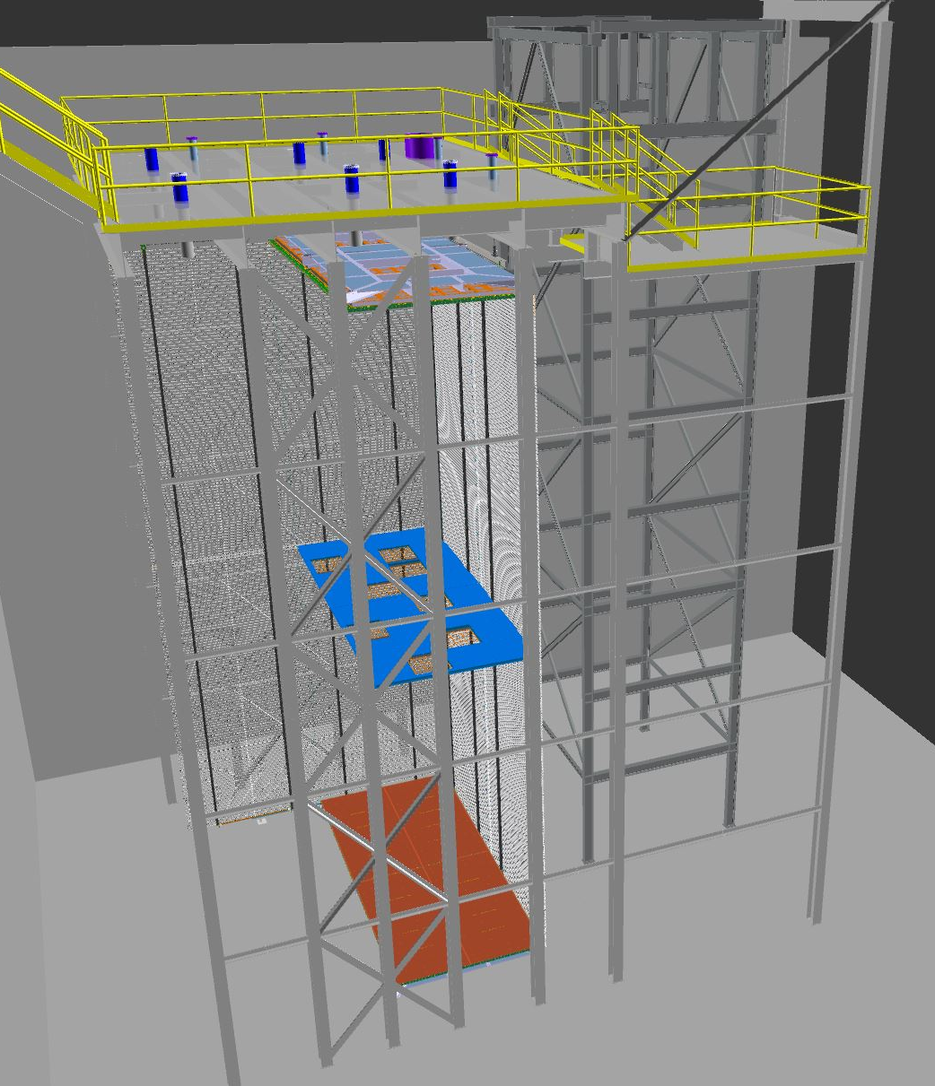
FD2 Mechanical Tests at Ash River?
We propose to do a full-scale mechanical mockup up of the final row 20 of FD2 all in sequence as explained in the FD2 Installation plan collaborating with FD2 consortia members.
FD2 False floor
Moving TPC components thru TCO
Cable tray and PDs on the wall of the cryostat
Row 20 CRP-SS16 and Cathode plane including cabling access and Super structure stability structure
HV Field cages (1 Side and 1 end wall)
Two bottom CRPs
Test access to all these components including cabling in the final row (Top CRP access via access hole)
T-CRP
TCO
Cathode
B-CRP
CRP-SS16 installed at Ash River in front of TCO

Slide 11
FD1 - HD Installation Progress
Ash River NCE ends
Next ~6 months
  ProtoDUNE II Installation and Integration @ CERN
~2-12 months
  DUNE FD1
~6-24 months
  DUNE FD 2
Training for DUNE
  Lead technicians and installation coordinators

Slide 12
FD1 – Tasks and Tentative budget
CERN ProtoDUNEII Installation
CERN APA coldbox testing
CERN Decommission ProtoDUNEII

Slide 13
FD1 @ Ash River ~2-12 months
APA trolley removal
  Possible
  Part revisions, fabrication, retest
  Procedure/HA revisions
    CERN approval process
APA/EW & CPA/EW connections
  Ash River & pDUNEII experience
  Parts @ Ash River
  Documentation
Full row 1 test
Repeat row 25
  Total tool fabricating new angles allowing access
Mock up cable feed through
  Verify a cabled doublet can reach the cross in both extreme position cases

Slide 14
FD1 @ Ash River ~2-12 months
FC deployment tools
  Latest revision in fabrication
  Cable vs. rope (dyneema)
  Ease of use/modifications
  Procedures/HA
  CERN usage
Endwall Assembly
  Final revisions re-testing
  Level assembly
  Communication
  Procedures/HA
  CERN usage
CPA manipulation
  Single FC retainer tool
  Use
  Procedure/HA
Fibers
  CERN experience to drive procedure/HA development

Slide 15
FD1 @ Ash River ~2-12 months
ASF @ Ash River drives:
  Refined and/or new procedures/HA
    Landing the ASF on the 4910 level
    Maneuvering around cavern to cleanroom
    Safe APA extraction onto assembly tower
  All procedures on assembly tower revisited
  Confirming/verification of all procedures moving to final position in ‘cryostat’
  Upper/lower APA from tower → ASF
    Protection
    CERN
Realistic time in motion studies to verify existing installation BOEs
ASF
  Deliverables required
    ASF Frame
    ASF cart (Jeff W&M?)
    Tugger tool
    APA connections (PSL)
  Safe opening
  Safe extraction
  Safe repackaging
  Procedures

Slide 16
FD1 Ash River/CERN ~6-30 months
CERN cold box
  4 APAs @ ~6 month intervals
  5 times
ProtoDUNEII decommissioning
  Late 2023-early 2024
  ASF experience

Slide 17
FD1(&FD2) Ash River Training
Mid 2024 – Mid 2025
  As consortia procedures/HA mature
    Workshops at Ash River
  Training for DUNE
    Lead technicians and installation coordinators
    Mold Ash River procedures to underground ready documents with ES&H
  Visit SURF to establish assembly readiness of cavern, cleanroom, coldbox, cryostat
Late 2025
  Decommission Ash River
Where is Tom at this point?

Slide 18
FD2 Mechanical Tests at Ash River
We propose to do a full-scale mechanical mockup up of the final row 20 of FD2 all in sequence as explained in the FD2 Installation plan collaborating with FD2 consortia members.
FD2 False floor
Moving TPC components thru TCO
Cable tray and PDs on the wall of the cryostat
Row 20 CRP-SS16 and Cathode plane including cabling access and Super structure stability structure
HV Field cages (1 Side and 1 end wall)
Two bottom CRPs
Test access to all these components including cabling in the final row (Top CRP access via access hole)
T-CRP
TCO
Cathode
B-CRP
CRP-SS16 installed at Ash River in front of TCO

Slide 19
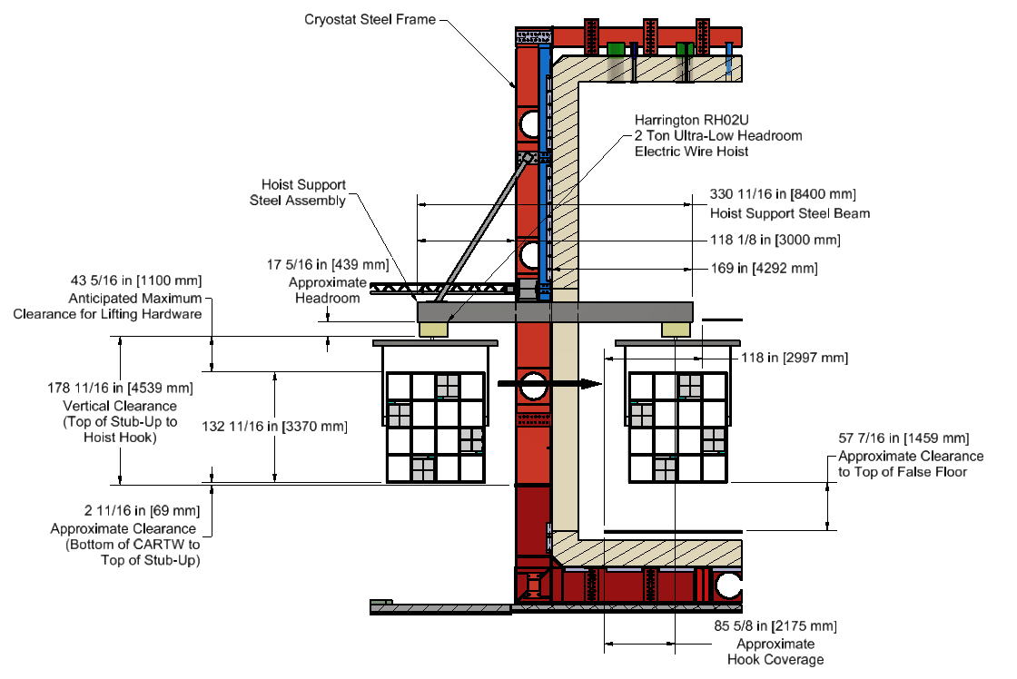
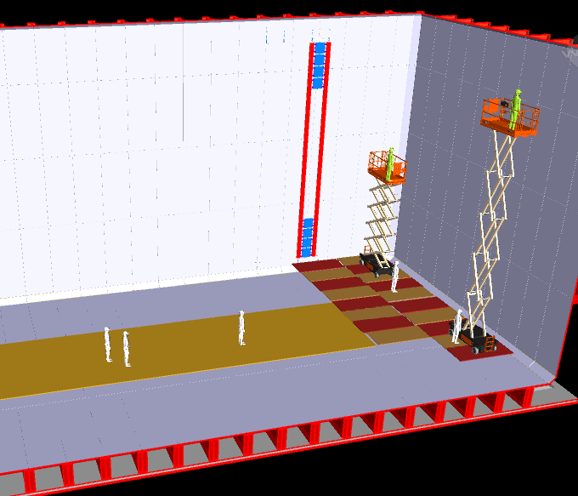
Step 1: Floor, cable trays, Ground Planes and PDs
The floor sections for FD1 while slightly different sized plywood can be used to mock-up the FD2 floor without additional costs.
Install appropriate bolt connections that will be available in the cryostat on Ash River cyrostat structure
Test installation procedures for cable trays, floor removable (and replacement) for cabling
Ramp in TCO area for moving equipment
TCO beam (will have to fabricate new beam)
Moving Cathode planes thru TCO
Cable trays and PDs on Row 1

Slide 20
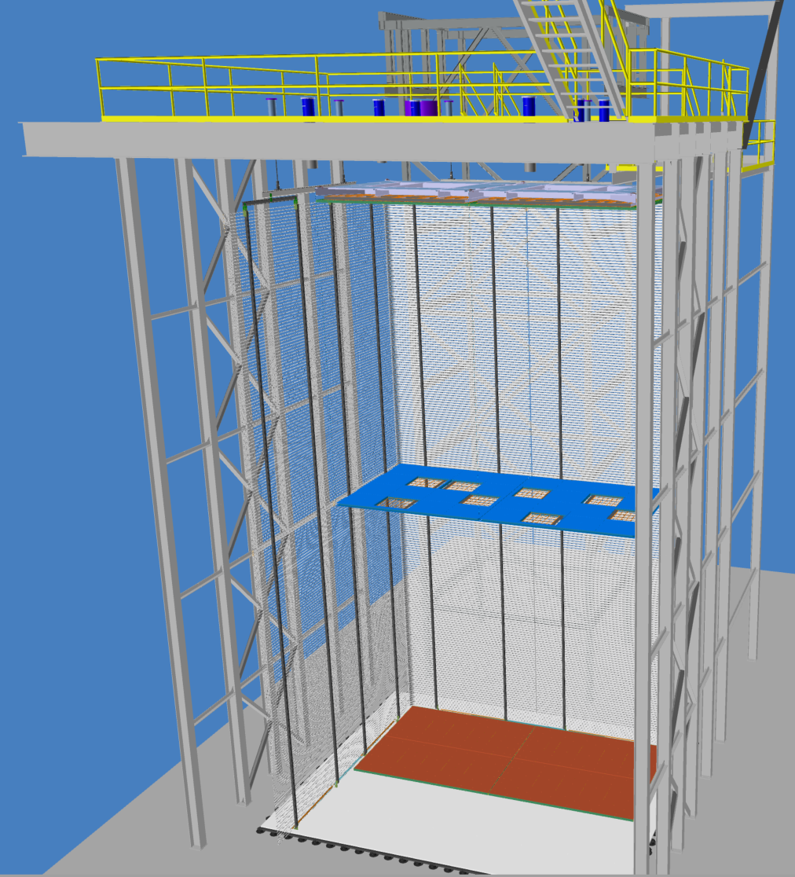
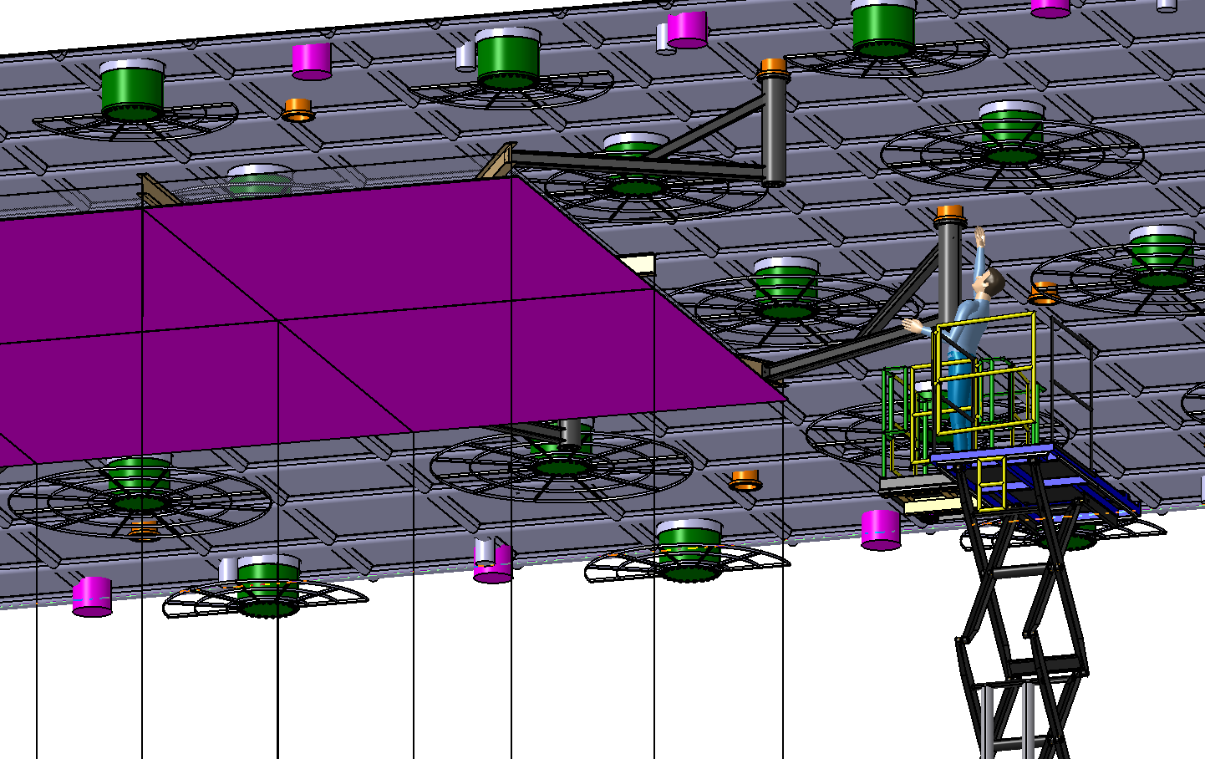
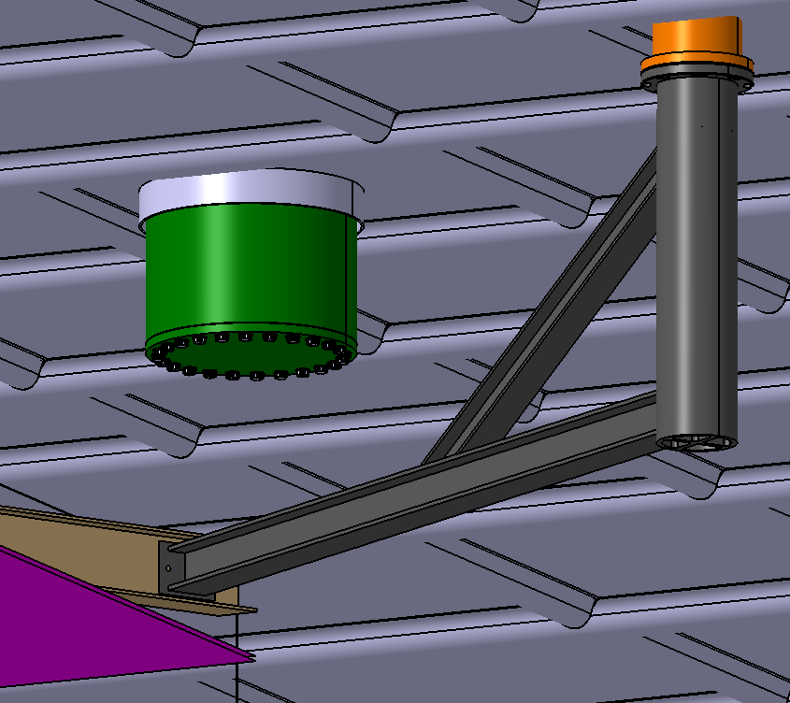
Step 2: Top CRP and Cathode Installation
This will be MUCH more difficult in the last row. The final CRP Super Structure and Cathode must be in the cryostat and the TCO beam removed before installation. Test goals
Position CRP Super structure
Install CRPs
Raise to proper elevation to install cathode
Raise to cabling position and test stabilization concept
CRP-SS16 and Cathode in final position

Slide 21
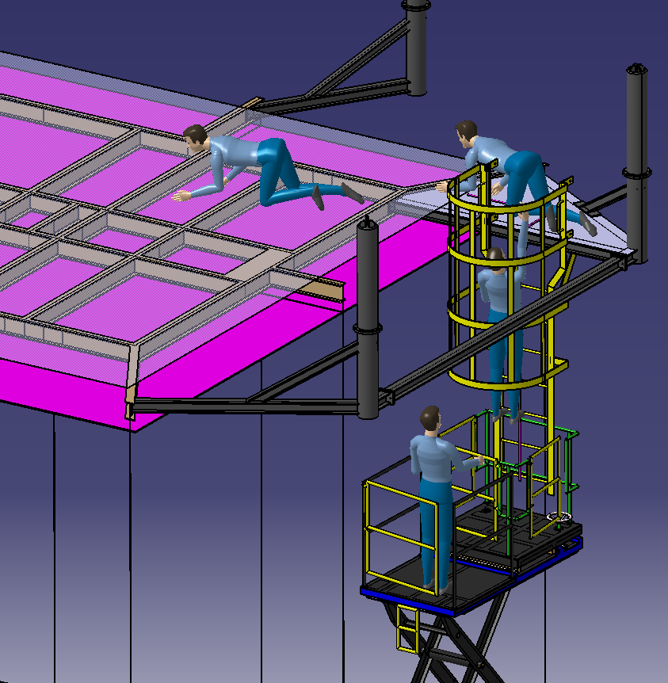
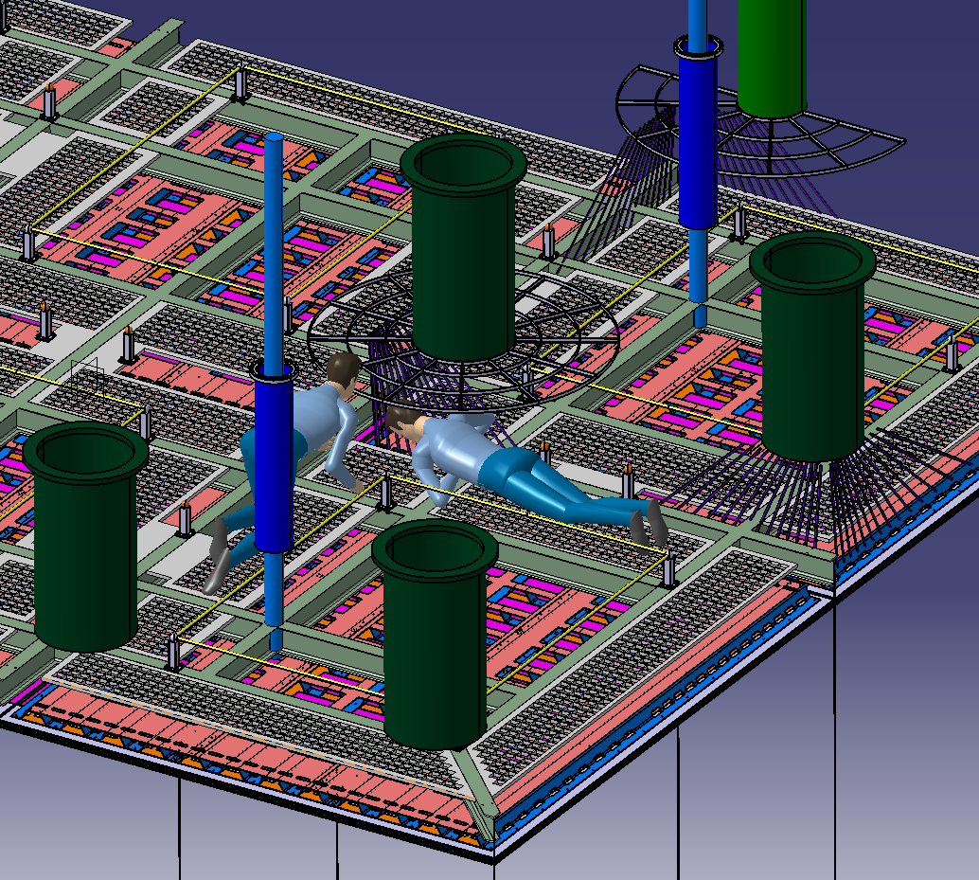
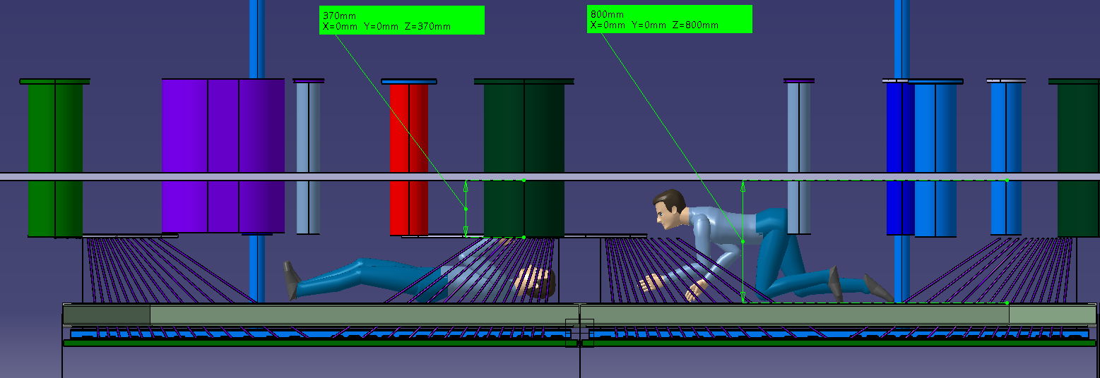
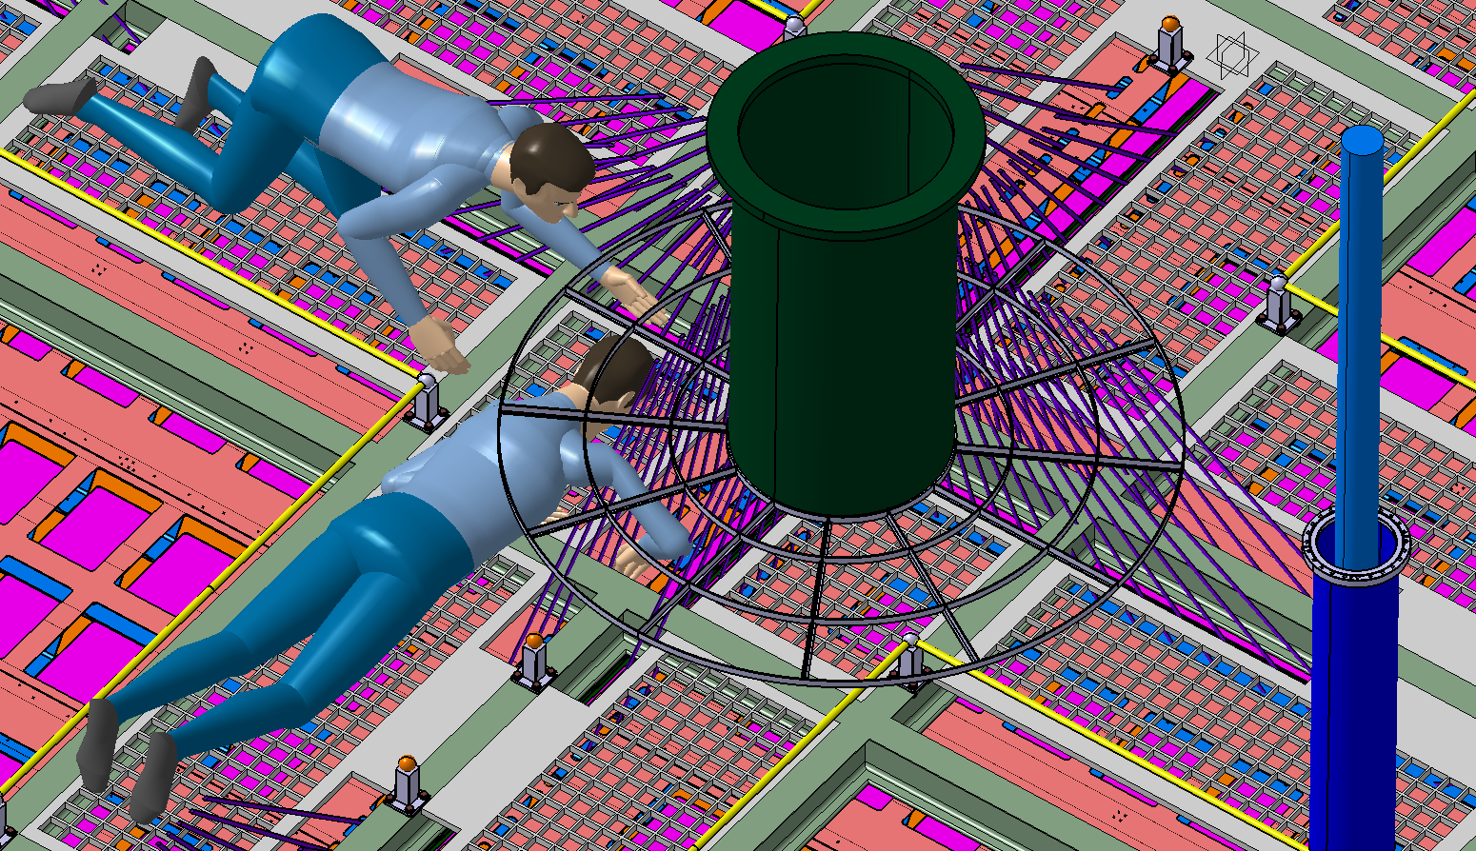
Step 2: Top CRP Cabling Access
Access to the last row of Super structures is the via oval shaped access port . But we can also test the access concept via a scissor lift.
Moving along the crawl ways proper tie off procedures
Getting a feel for how much everything moves

Slide 22
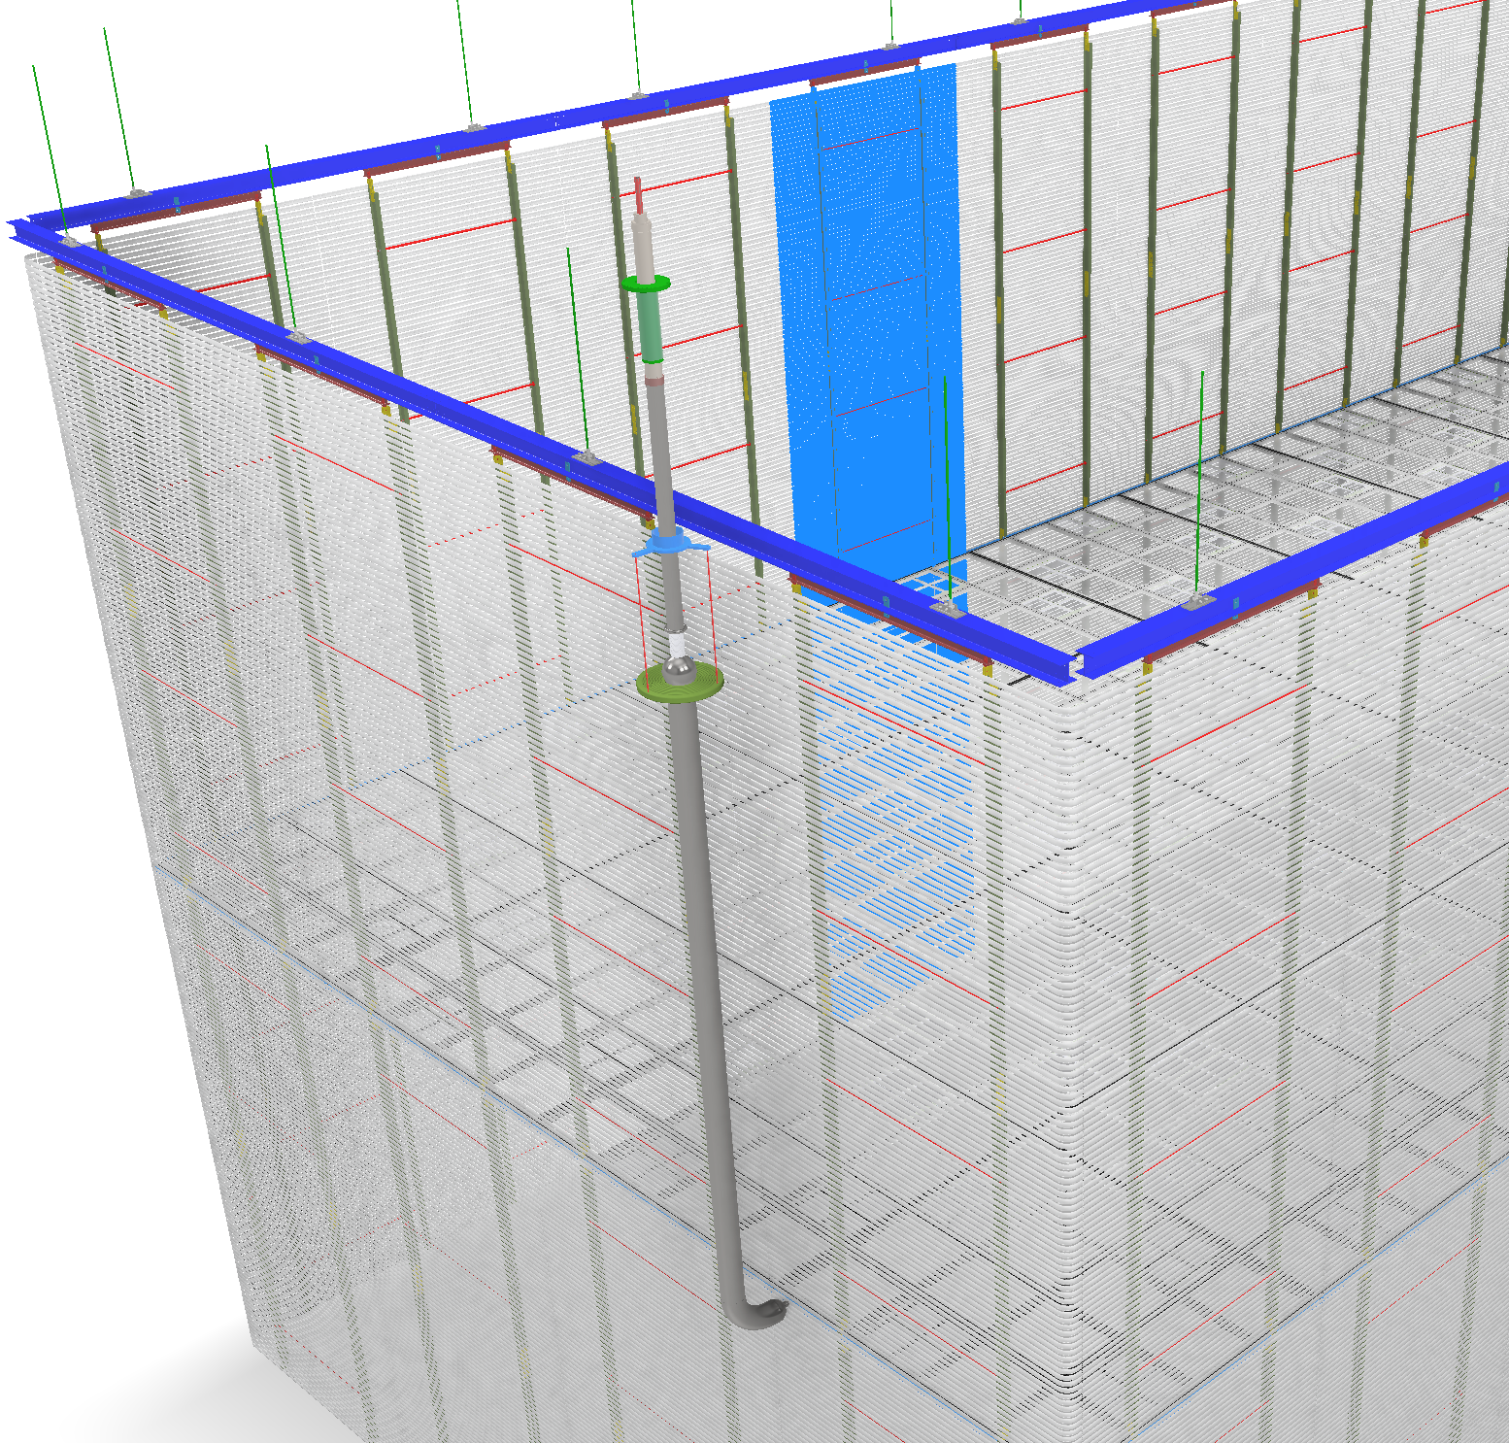
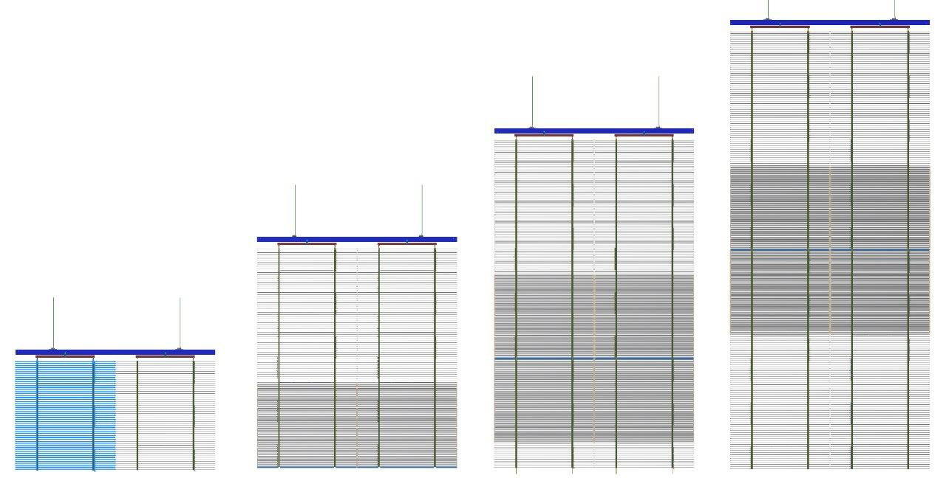
Step 3: HV Field Cage
We have the existing FD1 Field Cage so they can be modified to use for FD2 even though they would not be perfect
It is not 100% obvious but it appears that the east and west all HV Field Cages need to be installed before the last row can be installed.
Conceptually it can be moved to the east via the top hoist system on the I-Beam to give more clearance and allow the CRP to be raised.
What access is needed for mounting of fiber or defuser? What electrical connections need to be made between the Cathode and the Field Cage and how do you get access.
How is the last wall installed with only access via the TCO?

Slide 23
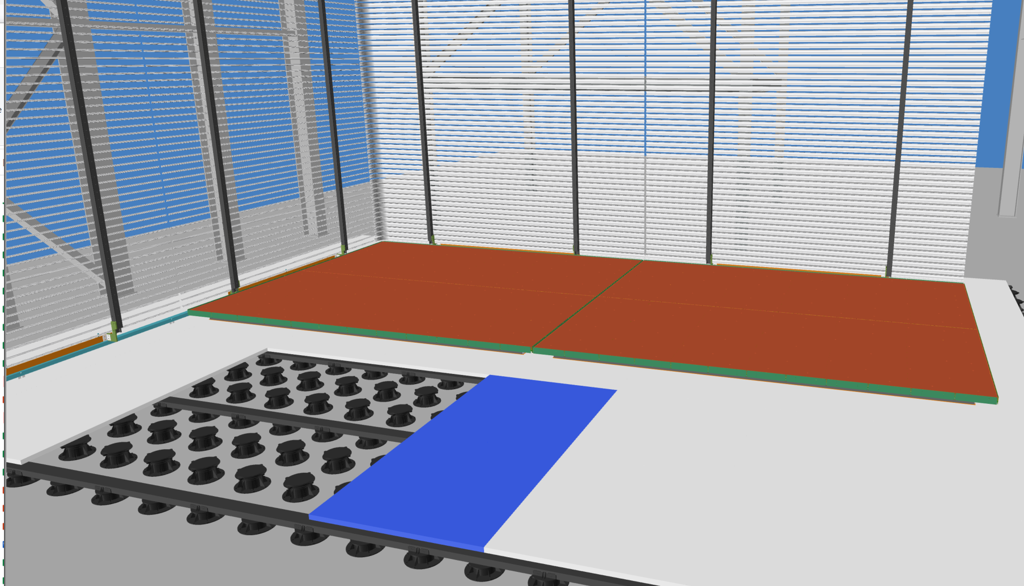
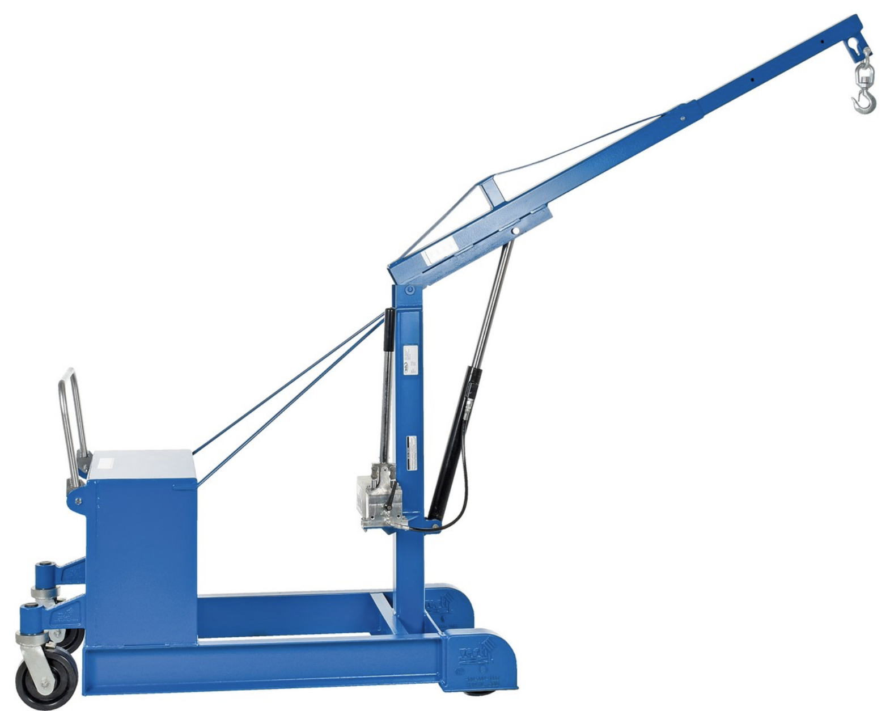
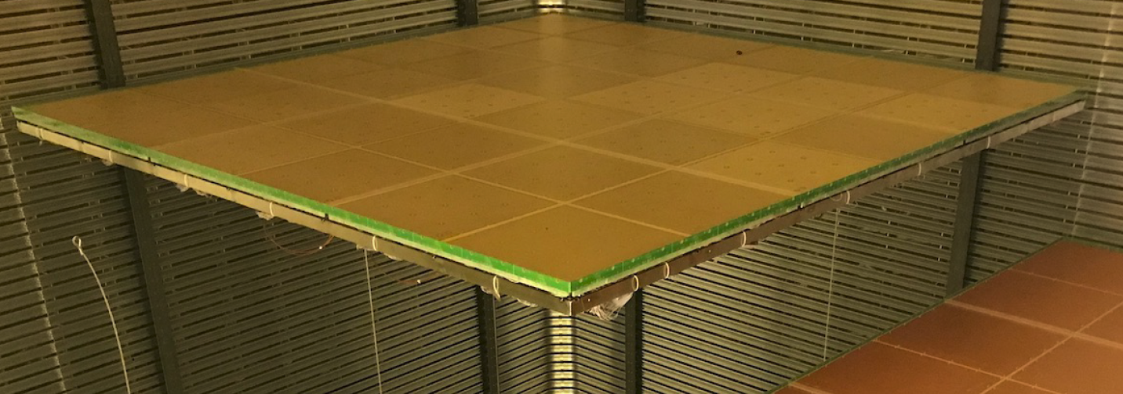
Step 4: Bottom CRPs
Removing floor sections
Practice maneuvering the bottom CRPs into position. The bottom CRP are assembled similar to the top CRP, but the bottom CRP tooling must be able to invert a CRP.
Cabling is underneath the CRP around the edge, this task has not been defined by some sort of “table” to allow you to work under the load
Two B_CRPs
False Floor Panel

Slide 24
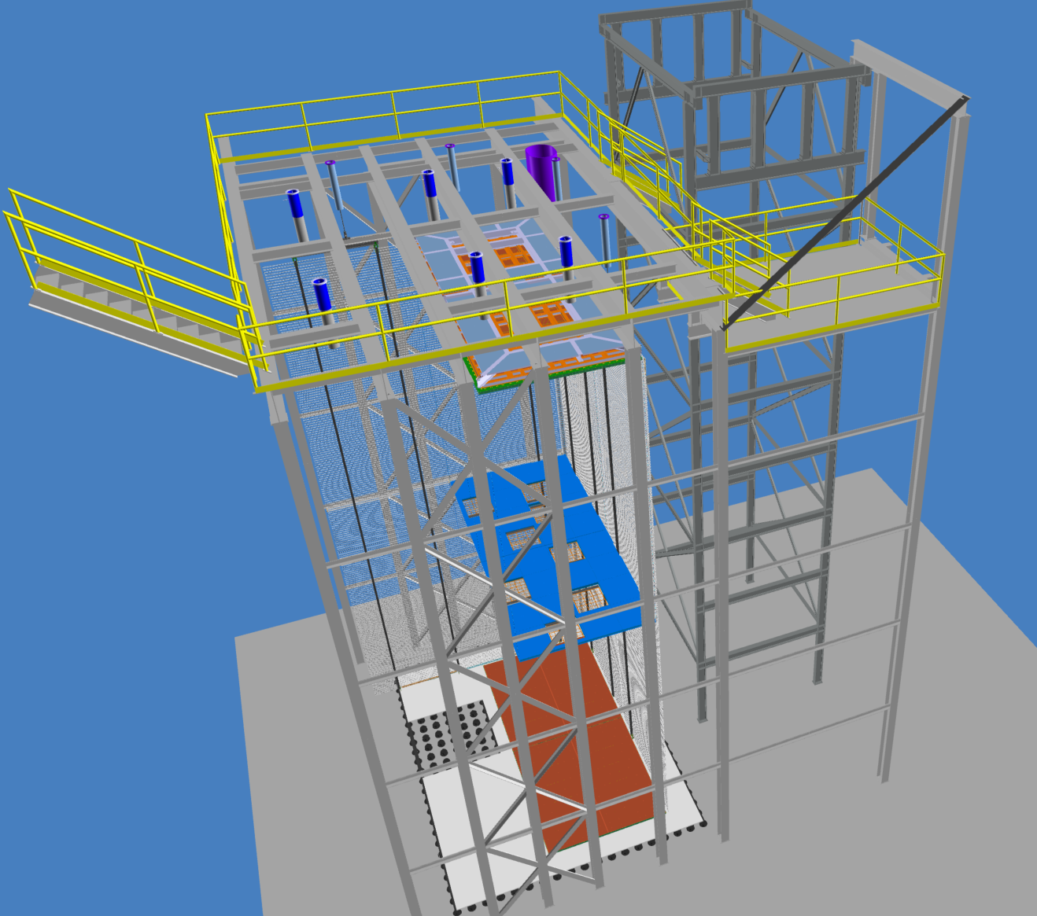
FD2 Trail Assembly at AR Summary
With minimal engineering and fabrication, the feed-throughs and winch systems could be installed and full-scale installation tests at height could be made
There would be some M&S deliverables from the CRP and HV consortia
We would “champion” the documentation of engineering documents and approvals, procedures and HAs written, Approval from Fermilab and University of Minnesota ES&H to proceed with tests
Small work shops with the appropriate consortia could be held to verify and test all the installation procedures
Alternative proposal is to have Ash River collaborate with FD2 consortia on installation efforts abroad
  Annecy, CERN, etc

Slide 25
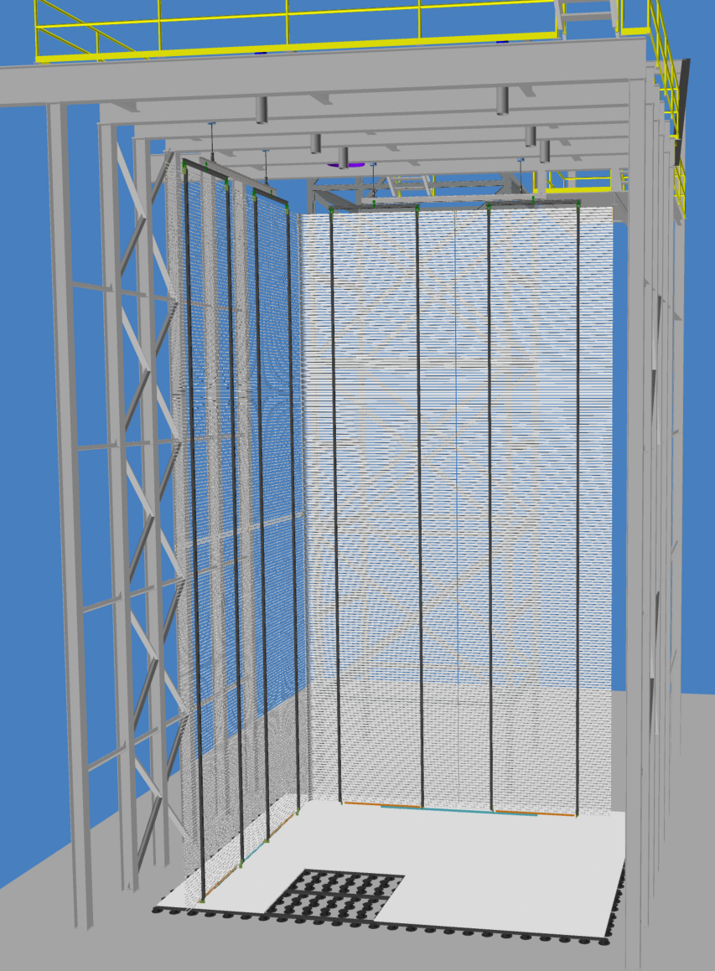
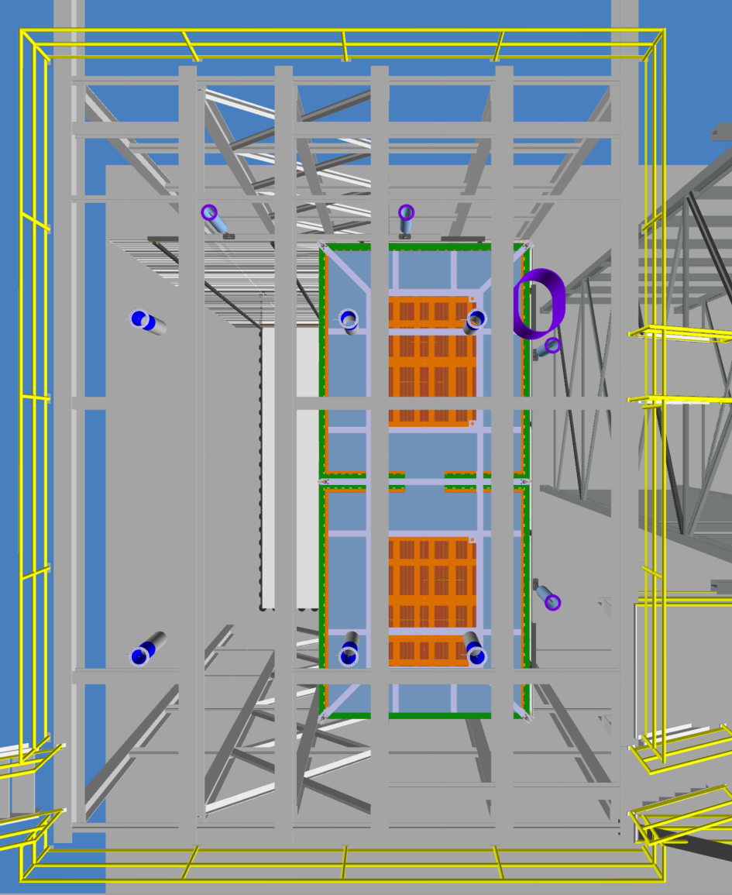
CRP Support Hangers
HV-FC Support Hangers
Access Port
HV-Field Cage modules
Top View of feed-throughs needed

