Slide 1
APA transport strategy
Justin Evans & Olga Beltramello
4-4-2022

Slide 2
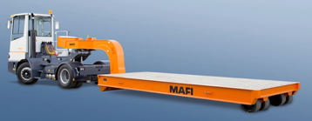
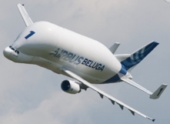
Points to consider
Minimize APA stresses, accelerations, deformations
- design and constructed first shipping frames
- tested and measured on the transport CERN-Liverpool
- excellent results
Minimize number of manipulations
- each manipulation is potentially problematic (4 -5 g shock levels observed)
- it requires a continuous monitoring and presence in situ (critical handling required by DOE)
Minimize costs
    transport via air (2 shipping frames = 4 APA), possible but costly ~ 50K$/transport = 1.65M$, at least 6 manipulations, not clear storage at the airports
    transport via sea on MAFI trailer (2 shipping frames = 4 APA), possible ~ 30 $/transport= 0.96M$, at least 6 manipulations, not clear local storage and handling at the various harbors, risk of shocks at the ports
    Beluga air solution possible but costly ~450K$/shipment of 13 shipping frames = 2.25M$, at least 6 manipulations

Slide 3
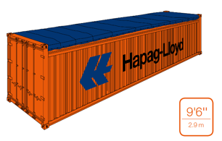
Proposed solution
Transport of 2 shipping frames inside a High Cube Open
Top container container
- we have an offer for 15.5 KCHF/shipment, DAP FNAL = 0.51M$
- 2 manipulations of the ASF (insertion and extraction from the container)
- transport under better control, but needs to be discussed
- Negociation required with the company to have the container inside the vessel
- Possible routing via the Great Lakes ?
We are proposing some modification to the shipping frame base structure

Slide 4
Current results of the ASF testing campaign
The goals are :
  Validation of the structural behaviour of the WRAs, the base frame and the ASF structure under transport conditions, dynamic response of the APAs
  Validation of the transport route and means (sea / air freight / ports / routes)
  Assessment of the capability of the transport stakeholders to garanty “critical transport” and ”critical handling conditions”
  Stockage and handling in FERMILAB
  Unloading and handling at SURF, lowering of the ASF in the Ross Shaft at several speed and emergency stops (no upside down rotation at the bottom of the shaft)

Slide 5
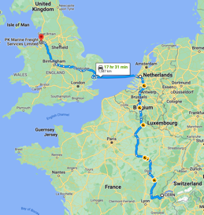
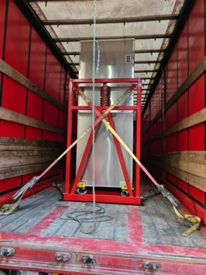
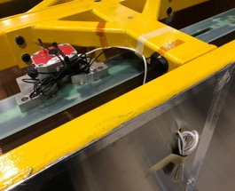
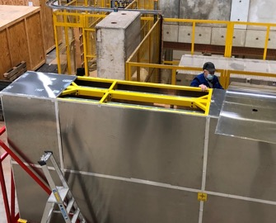
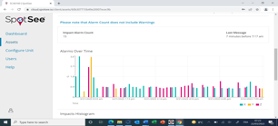
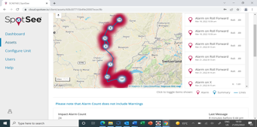
Results obtained during the transport CERN-Liverpool
The first prototype new transport frame was loaded with two ProtoDUNE-1 APAs
Instrumented with Shocklogs on base frame and on top of APA
Shipped from CERN to Liverpool on a lorry
  With the lorry on a ferry from Rotterdam to Felixstowe

Slide 6
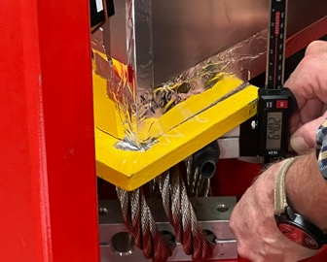
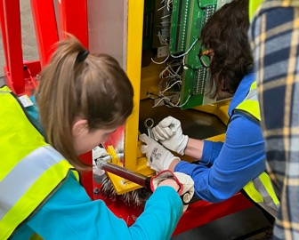
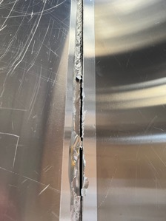
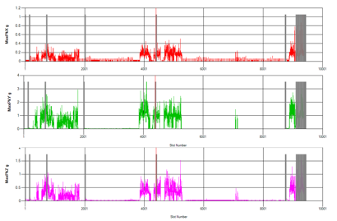
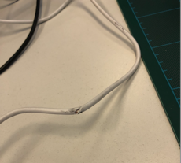
Results obtained during the transport CERN-Liverpool
Shipping frame arrived in good shape, set of checks performed (bolts, WRAs)
  Aluminium panels had vibrated and ripped the tape – not a major issue
  APA shocklog cable damaged during handling – not a problem

Slide 7
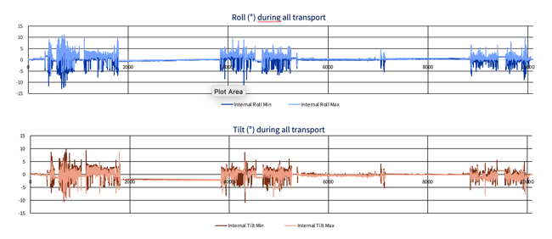
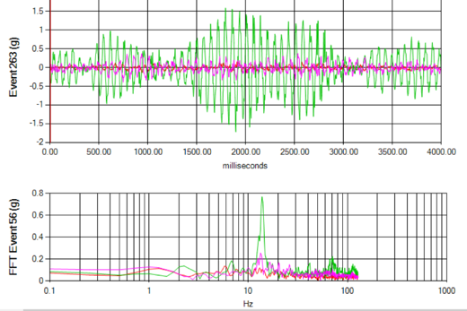
Results obtained during the transport CERN-Liverpool
Y: Transverse
X
Z
The Tilt and Roll are lower than 15 degrees
  This is not of concern
There is a clear 12 Hz transverse mode of the APA supported at 4 points

Slide 8
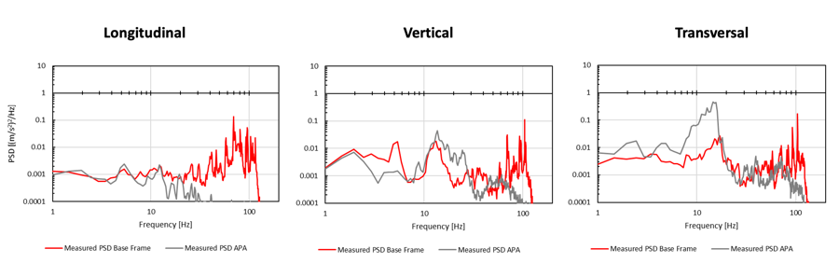
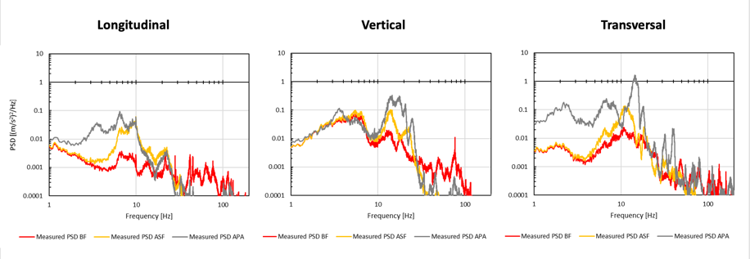
Results obtained during the transport CERN-Liverpool
UK Transport Measured PSDs
CERN Transport Measured PSDs

Slide 9
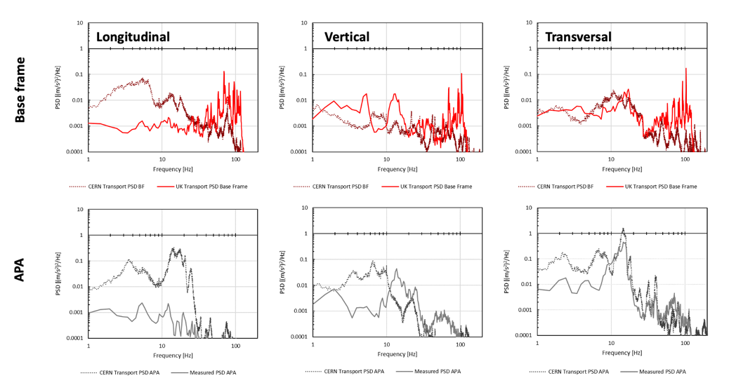
CERN versus UK Transport Measured PSDs
Results very similar to the ones measured during the truck transport around CERN area
Even if there is an amplification of the accelerations on the APA frame around 12 -15 Hz
this remains lower than the design values

Slide 10
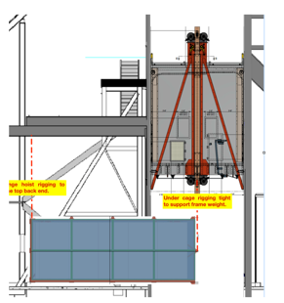
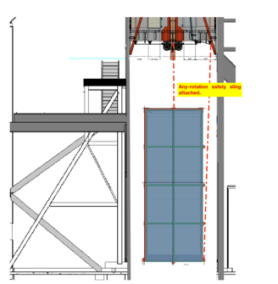
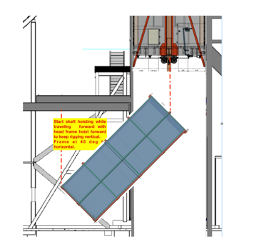
A draft of procedure for the SURF test received
Expected 3 days of tests :
Unloading from the truck
Tests in the Crusher Room
Transport to Ross shaft, rotation,
Loading on the truck for a transport to Ash River
To be clarified :
Test procedure in the shaft (speeds, stops)
Responsibilities !

Slide 11
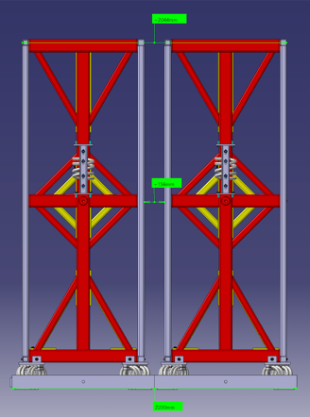
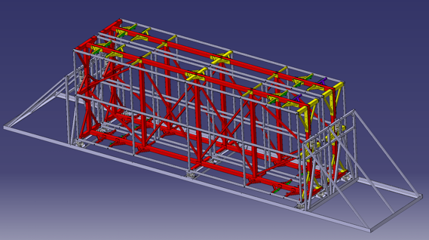
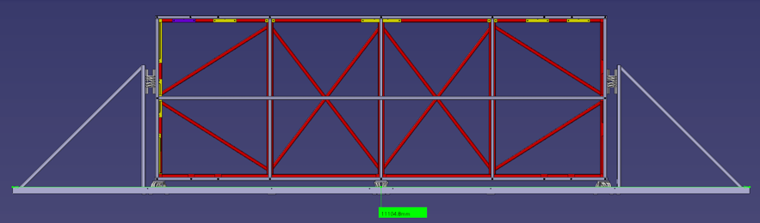
Base frame new design

Slide 12
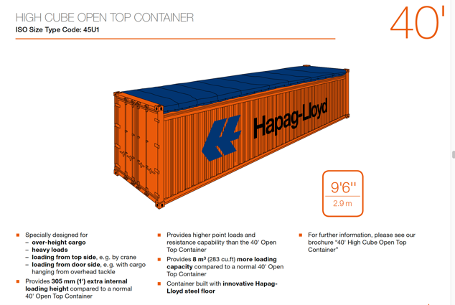
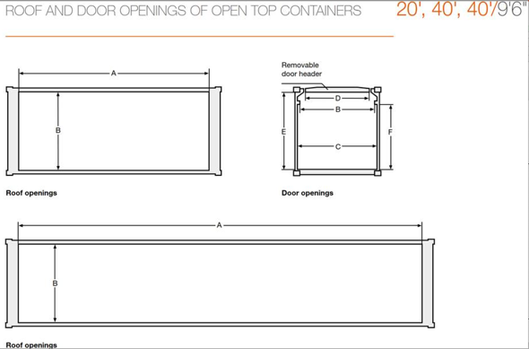
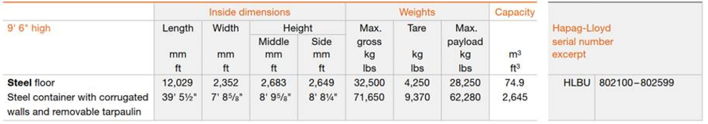
It fits in a container

Slide 13
Next Steps
  Agree on the preferred way of transporting for the ASF/APAs (sea MAFI / sea Container / airfreight)
  Modify the BF design and assess the detail installation plan at Dareshbury
  Detail the lashing and installation plan of the BF/ASF inside the container
  Adapt the prototype testing campaign route and validation plan to the selected route / transport
  If container choice is selected :
    Assessment of the capability of the port stakeholders to guaranty ”critical handling conditions” for the container manipulation (Felixstowe seems more appropriate but will require additional truck transport through UK)
    Assess the port of unloading (on going)
  Determine who is in charge of storage in FERMILAB and who takes responsibility of critical handling
  Assess the critical handling plan proposed by AMTT group at SURF and clarify responsibilities
  Agree with P. Weber on a schedule for the Ross shaft utilization this summer (to be negociated with CF)

