Slide 1
Cryostat Access Ladders / Egress
6-Apr-22

Slide 2
Agenda
Current Scenario and usage
ESH Requirements
Alternate Proposal

Slide 3
Cryostat access
Access needed during the initial construction
Initial leak test
After construction there will be periodic inspection of features on the exterior of the cryostat
  Bolts and fasteners
  Possible Ice accumulation
No immediate need for inspecting rock surface but may be needed as things age

Slide 4
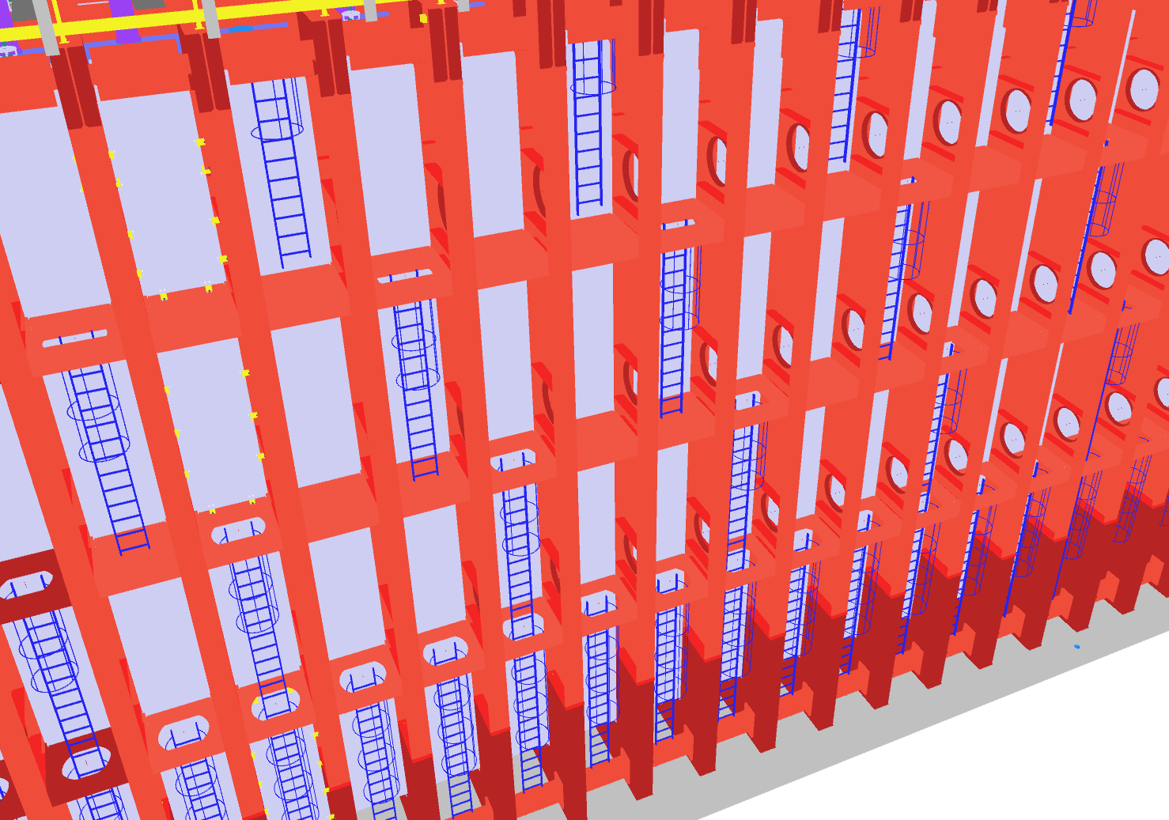
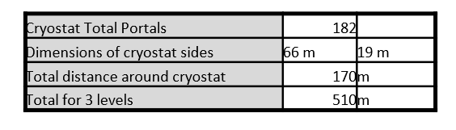
Current Scenario
Cryostat Total Portals | 182 |  |  |  | Cryostat levels
Dimensions of cryostat sides | 66 m | 19 m
Total distance around cryostat | 170 | m
Total for 3 levels | 510 | m |  |  | X | portal with opening
SOUTH | Bay #
Level | 40 | 39 | 38 | 37 | 36 | 35 | 34 | 33 | 32 | 31 | 30 | 29 | 28 | 27 | 26 | 25 | 24 | 23 | 22 | 21 | 20 | 19 | 18 | 17 | 16 | 15 | 14 | 13 | 12 | 11 | 10 | 9 | 8 | 7 | 6 | 5 | 4 | 3 | 2 | 1
Roof |  |  | X |  |  | X |  |  | X |  |  | X |  |  | X |  |  | X |  |  | X |  |  | X |  |  | X |  |  | X |  |  | X |  |  | X |  |  | X |  | 13
Sub 1 |  |  |  | X |  |  | X |  |  | X |  |  | X |  |  | X |  |  | X |  |  | X |  |  | X |  |  | X |  |  | X |  |  | X |  |  | X |  |  |  | 12
Sub 2 |  |  | X |  | X |  |  | X |  |  | X |  |  | X |  |  | X |  |  | X |  |  | X |  |  | X |  |  | X |  |  | X |  |  | X |  |  | X |  |  | 13
Sub 3 |  | X | X | X | X | X | X | X | X | X | X | X | X | X | X | X | X | X | X | X | X | X | X | X | X | X | X | X | X | X | X | X | X | X | X | X | X | X | X |  | 38
 |  |  |  |  |  |  |  |  |  |  |  |  |  |  |  |  |  |  |  |  |  |  |  |  |  |  |  |  |  |  |  |  |  |  |  |  |  |  |  |  | 76
NORTH | Bay #
Level | 40 | 39 | 38 | 37 | 36 | 35 | 34 | 33 | 32 | 31 | 30 | 29 | 28 | 27 | 26 | 25 | 24 | 23 | 22 | 21 | 20 | 19 | 18 | 17 | 16 | 15 | 14 | 13 | 12 | 11 | 10 | 9 | 8 | 7 | 6 | 5 | 4 | 3 | 2 | 1
Roof |  |  | X |  |  | X |  |  | X |  |  | X |  |  | X |  |  | X |  |  | X |  |  | X |  |  | X |  |  | X |  |  | X |  |  | X |  |  | X |  | 13
Sub 1 |  |  |  | X |  |  | X |  |  | X |  |  | X |  |  | X |  |  | X |  |  | X |  |  | X |  |  | X |  |  | X |  |  | X |  |  | X |  |  |  | 12
Sub 2 |  |  | X |  | X |  |  | X |  |  | X |  |  | X |  |  | X |  |  | X |  |  | X |  |  | X |  |  | X |  |  | X |  |  | X |  |  | X |  |  | 13
Sub 3 |  | X | X | X | X | X | X | X | X | X | X | X | X | X | X | X | X | X | X | X | X | X | X | X | X | X | X | X | X | X | X | X | X | X | X | X | X | X | X |  | 38
 |  |  |  |  |  |  |  |  |  |  |  |  |  |  |  |  |  |  |  |  |  |  |  |  |  |  |  |  |  |  |  |  |  |  |  |  |  |  |  |  | 76
WEST(TCO) | Bay #
Level | AB | C | D | E | F | H | I | J | K | LM
Roof |  |  |  | X |  |  | X |  |  |  | 2
Sub 1 |  |  | X |  |  | X |  | X |  |  | 3
Sub 2 |  |  |  | X |  |  | X |  |  |  | 2
Sub 3 |  | X | X | X | X | X | X | X | X |  | 8
 |  |  |  |  |  |  |  |  |  |  | 15
EAST | Bay #
Level | AB | C | D | E | F | H | I | J | K | LM
Roof |  |  |  | X |  |  | X |  |  |  | 2
Sub 1 |  |  | X |  | X |  |  | X |  |  | 3
Sub 2 |  |  |  | X |  |  | X |  |  |  | 2
Sub 3 |  | X | X | X | X | X | X | X | X |  | 8
 |  |  |  |  |  |  |  |  |  |  | 15

Slide 5
ESH Requirements
Description | Code Section & title
OSHA defines Hole means a gap or open space in a floor, roof, horizontal walking-working surface, or similar surface that is at least 2 inches (5 cm) in its least dimension. | OSHA 1910.21(b) Definitions
 | OSHA 1910.22 General Requirements
Design and installation of ladders minimum clear step width of 10 inches (25 cm) | OSHA 1910.23 Ladders
Design and installation of ladders in vaults/manholes minimum clear step width of 10 inches (25 cm) | OSHA 1910.24 Step bolts & manhole steps
Minimum 22-inches width for stairs access to equipment | OSHA 1910.25, Stairways for mechanical equipment access – NFPA 101, Section 40.2.5.3, is similar; however, restricts occupant load to 20 people
Scaffolds points to 1926 Subpart L, descent rope systems must be designed to 5,000 lbs (not applicable) | OSHA 1910.27 Scaffolds & Rope Descent Systems
Requires employers to provide protection for each employee exposed to fall and falling object hazards. | OSHA 1910.28 Duty to have fall protection & falling object protection
42-inches height Guardrail with mid-rail can be utilized as fall protection mitigation | OSHA 1910.29 Fall protection systems & falling object protection-criteria & practices
Employer must provide fall protection, other sections in OSHA requires the employer to provide hazard training | OSHA 1910.30 Training Requirements

Slide 6
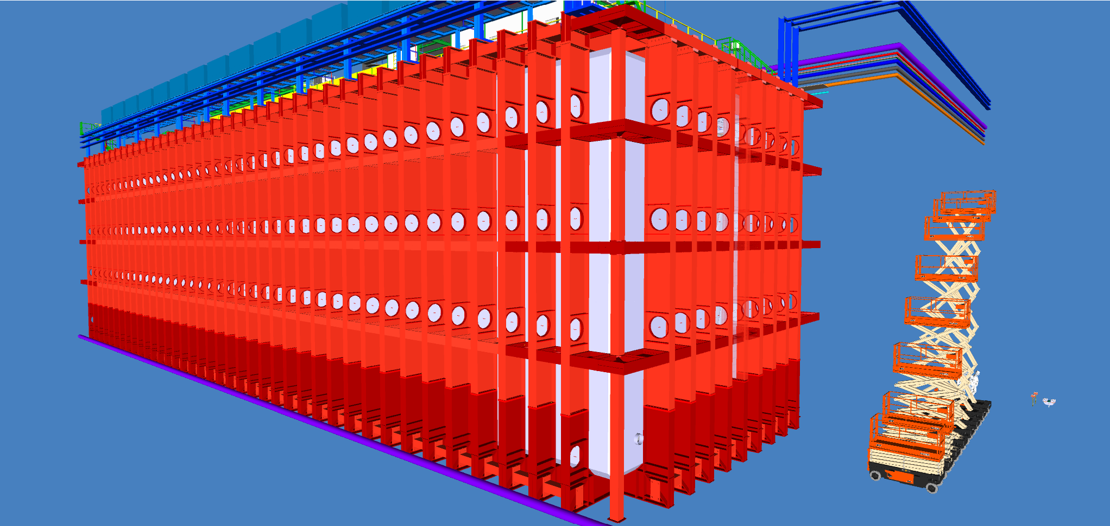
Access to the outer cryostat labyrinth
Level 4
Level 3
Level 2
Non-permit confined space
  configuration control the access to the labyrinth
  Require a rescue plan
Levels 2, 3, & 4 require fall protection
Level 1

Slide 7
Access to the outer cryostat labyrinth.
Level 4
Level 3
Using multiple vertical ladders to access the 4 levels of the outer cryostat areas, complicates emergency egress and emergency extraction.
Also uses a lot of ladders.
Level 2
Level 1

Slide 8
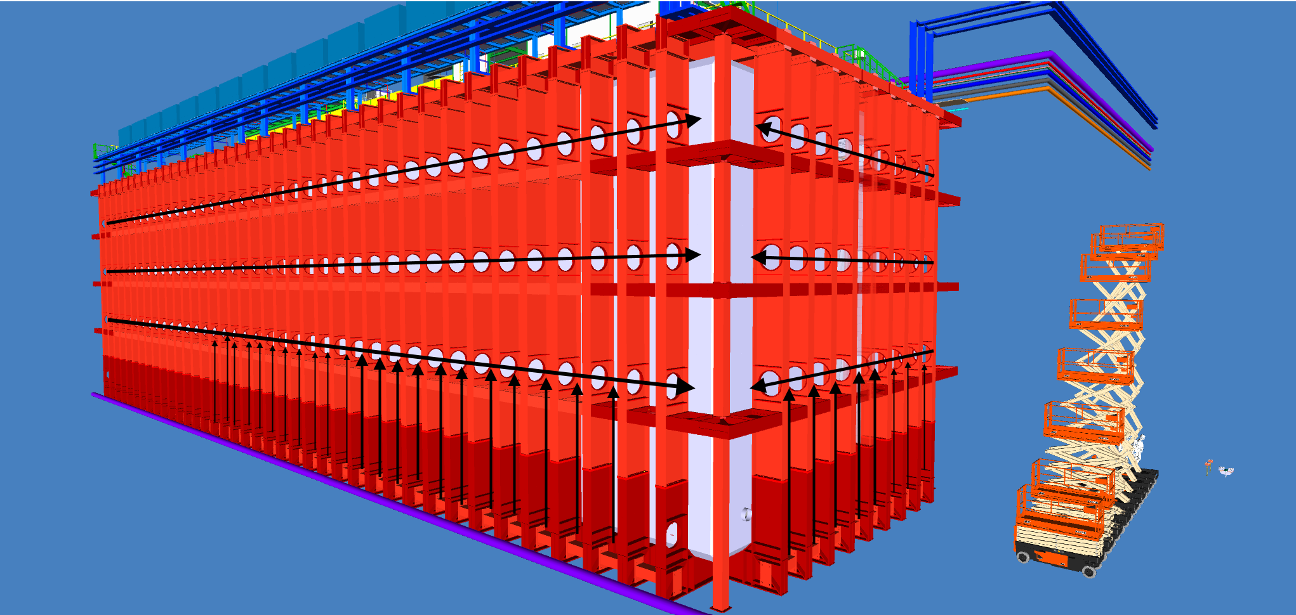
Focusing on horizontal access at each level
Level 4
Level 3
Level 2
Configuring the outer cryostat to focus on horizonal access/egress simplifies the emergency extraction/escape.
  Level 1 is unique.
Eliminates many ladders.
Level 1

Slide 9
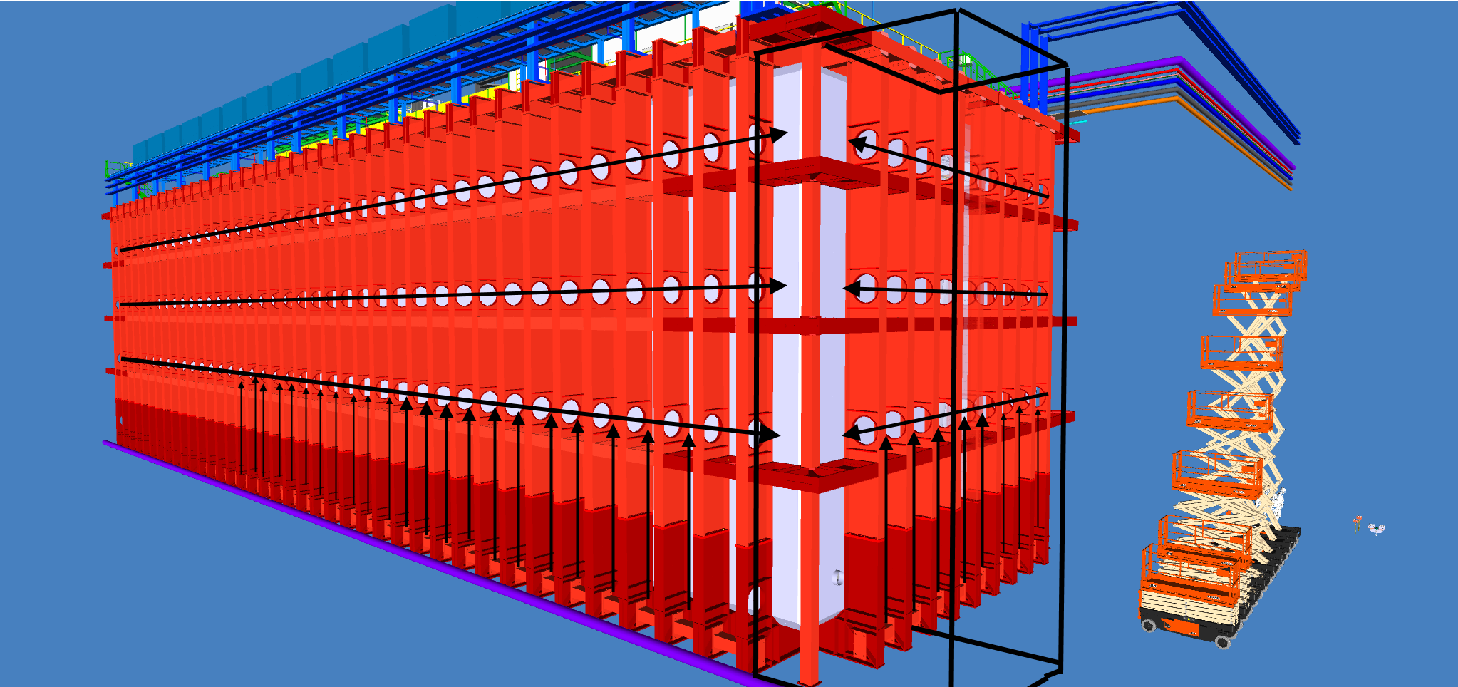
Access/Egress off the cryostat outer area
Level 4
Level 3
Level 2
Level 1
Scaffold or stairwell at one end to allow access/egress to levels 2, 3, & 4

Slide 10
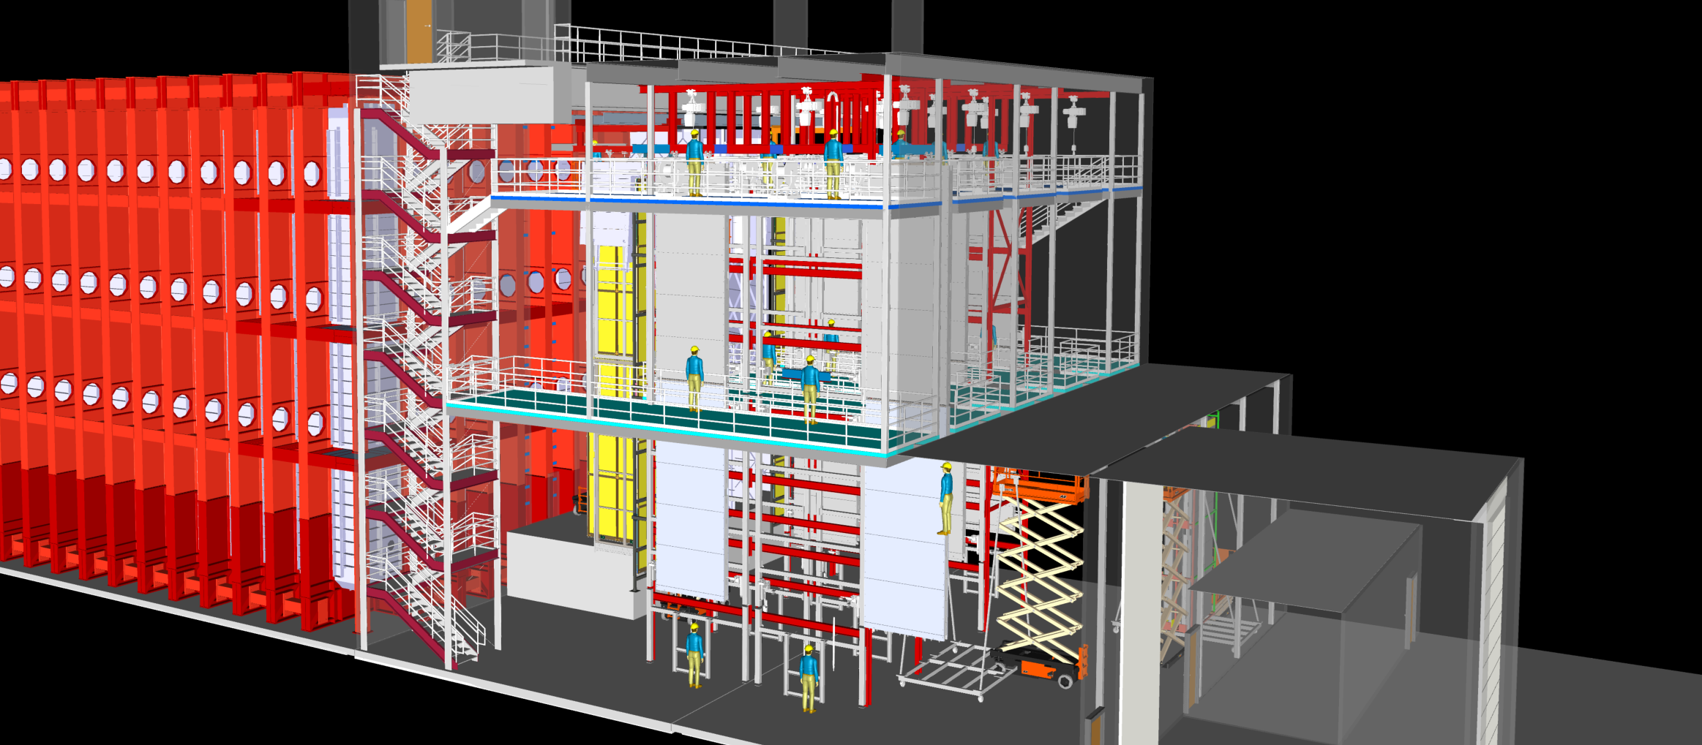
Conveniently there is a stairwell located in the corner
Would need to modify the transitions from the existing stairwell and the cryostat levels

Slide 11
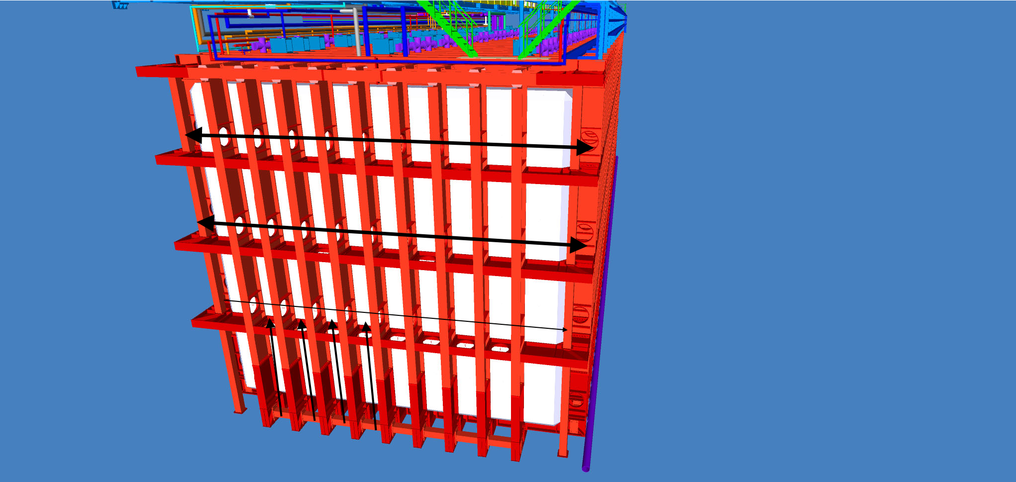
Back of detector
Level 4
Level 3
Level 2
Horizontal access can be used as well
  Could be difficult to make the corner with a backboard.
Level 1

Slide 12
Back of detector
Level 4
Level 3
Level 2
A plan for vertical egress could be helpful
  Ideally a single route from top to bottom
Level 1

Slide 13
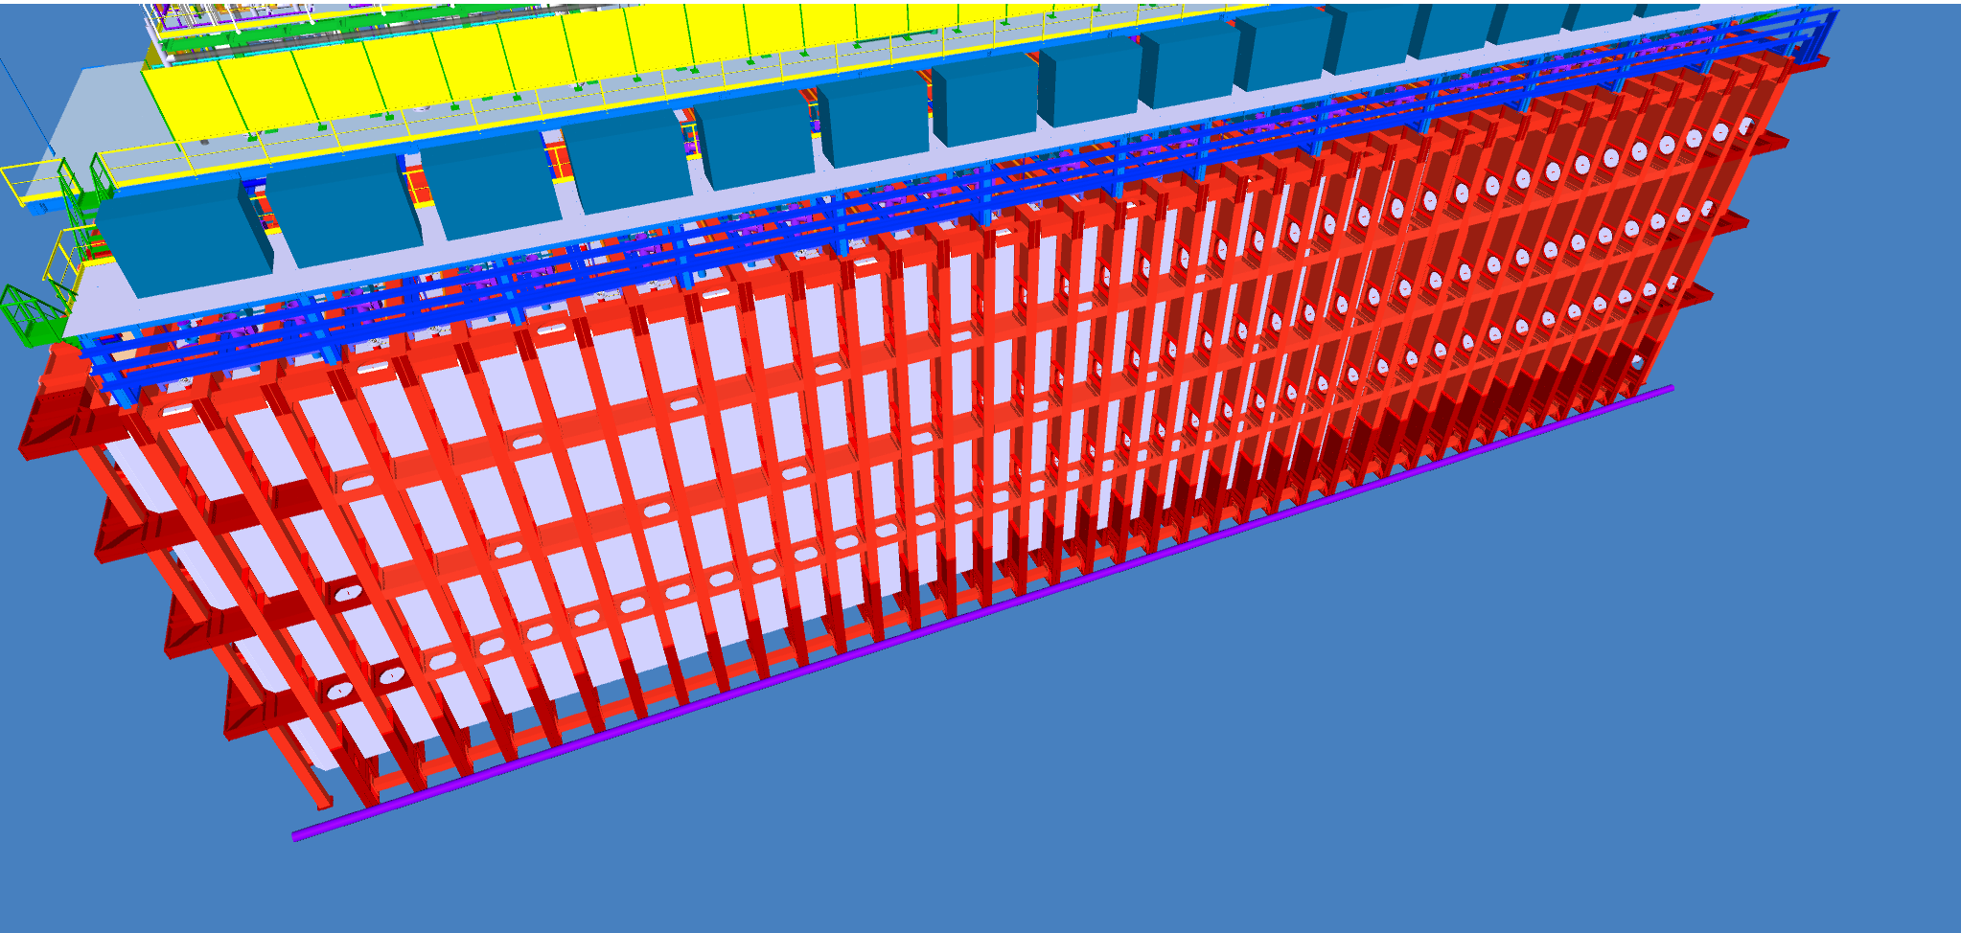
Holes in the walking surface
Level 4
Level 3
Level 2
Level 1
The holes will have to be addressed.

Slide 14
Covering holes in the walking surface
Level 4
Level 3
Level 2
Level 1
Level 3 & 4 (yellow) can be permanently bolted or welded
Level 2 (black) must be removable to access Level 1.

Slide 15
Covering holes in the walking surface
Level 4
Level 3
Level 2
Level 1
Does there need to be some vertical access available?
  Level 4 to top?

Slide 16
Summary
Non-permit confined space
  Configuration control the access to the labyrinth
  Require a rescue plan
Levels 2, 3, & 4 require fall protection
Horizontal (4 level) access
  Simplify access and egress in an emergency
  Use fewer ladders
  Some modifications required
Description | Code Section & title
OSHA defines Hole means a gap or open space in a floor, roof, horizontal walking-working surface, or similar surface that is at least 2 inches (5 cm) in its least dimension. | OSHA 1910.21(b) Definitions
 | OSHA 1910.22 General Requirements
Design and installation of ladders minimum clear step width of 10 inches (25 cm) | OSHA 1910.23 Ladders
Design and installation of ladders in vaults/manholes minimum clear step width of 10 inches (25 cm) | OSHA 1910.24 Step bolts & manhole steps
Minimum 22-inches width for stairs access to equipment | OSHA 1910.25, Stairways for mechanical equipment access – NFPA 101, Section 40.2.5.3, is similar; however, restricts occupant load to 20 people
Scaffolds points to 1926 Subpart L, descent rope systems must be designed to 5,000 lbs (not applicable) | OSHA 1910.27 Scaffolds & Rope Descent Systems
Requires employers to provide protection for each employee exposed to fall and falling object hazards. | OSHA 1910.28 Duty to have fall protection & falling object protection
42-inches height Guardrail with mid-rail can be utilized as fall protection mitigation | OSHA 1910.29 Fall protection systems & falling object protection-criteria & practices
Employer must provide fall protection, other sections in OSHA requires the employer to provide hazard training | OSHA 1910.30 Training Requirements

