Slide 1

ILL
Manon Letiche
RADNEXT 1st Annual Meeting – 8-9 June 2022
https://indico.cern.ch/e/radnext-2022

Slide 2
1. Completed TA campaigns
N/A

Slide 3
2. Scheduled TA campaigns
N/A

Slide 4
3. Accepted and assigned TA campaigns, to be scheduled
N/A

Slide 5
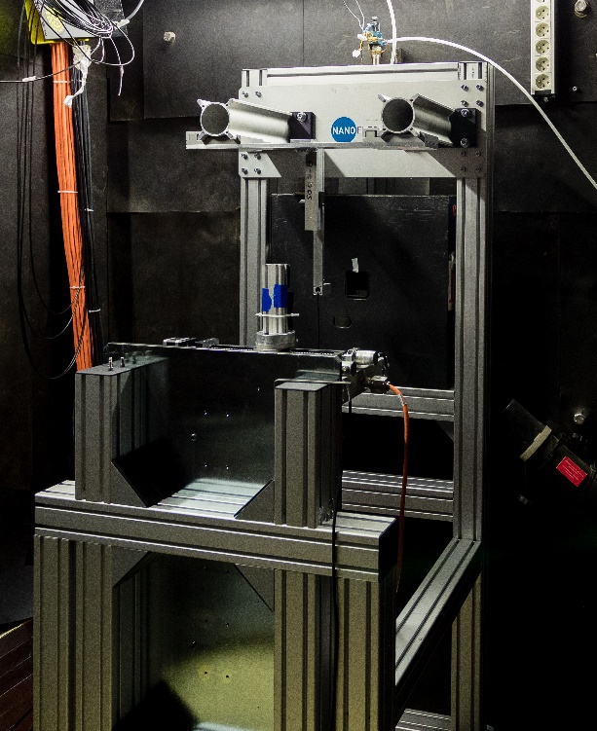
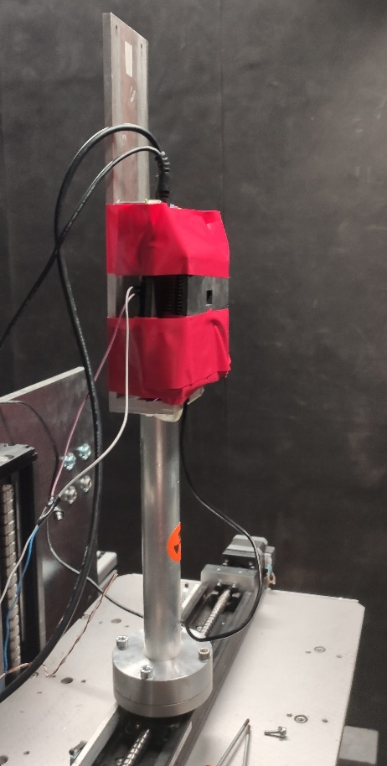
TENIS: Thermal and Epi-thermal Neutron Irradiation Station
  Beam characteristics
    Beam with a fission spectrum: large component of thermal neutrons
    Flux _{thermal-equivalent}: 2,4 n.cm⁻².s⁻¹ estimated by Au foils activation at the sample position for a reactor power of 55MW
    Adjustable beam size from 1x1 mm² to 50 x 50 mm²
  A calculated flux of gamma coming from the reactor, compatible with TID test
    Φγ = 7.5x10⁸ γ/cm²/s
    Dose Rate = 18 Gy/h (1,8 KRad/h)
    Maximum dose rate reachable using Cd: 115 Gy/h (11,5 kRad/h)
@P. Jayet CEA LETI
TIMA set-up

Slide 6
4. TA time already awarded VS Total facility TA quota
ILL HFR reactor shutdown: October 2021 – “January” 2023
Very few proposals for thermal neutrons have been received
  Is it due to our large communication about the shutdown?
  Is it due to a lack of communication about thermal neutrons applications?
100h through TA at TENIS facility to be granted during RADNEXT project

Slide 7
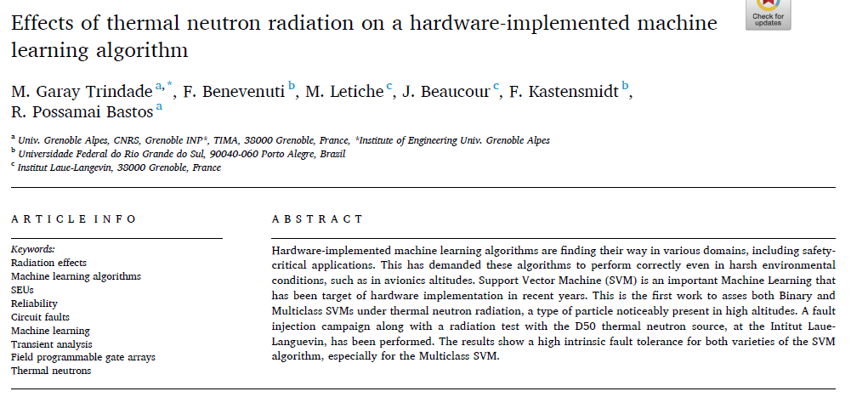
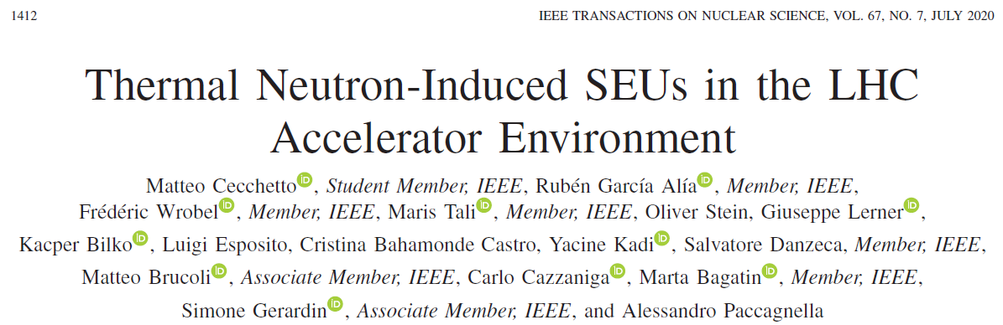
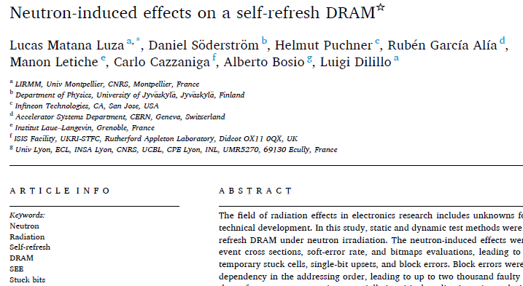
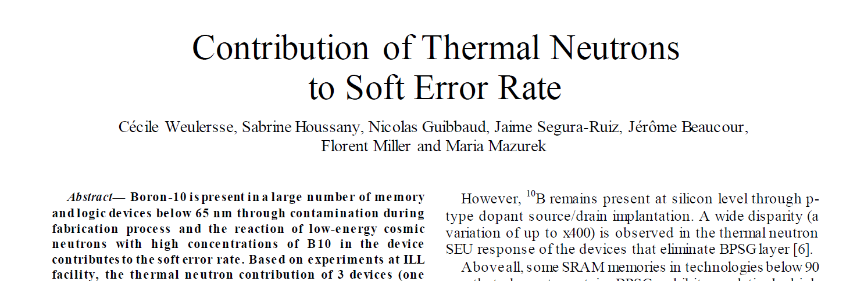
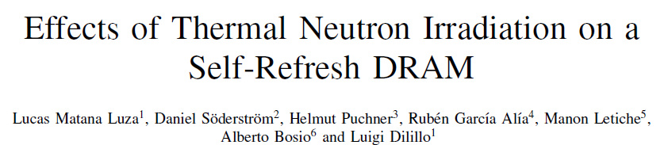
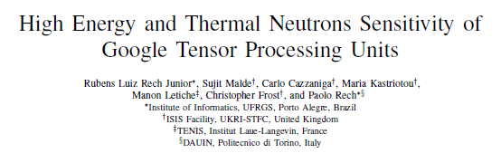
Ground floor and avionic applications

Slide 8
5. Approach for user (financial) support
N/A

Slide 9
6. Overall feedback about TA workflow
This 6th point can be covered in 1 slide.

Slide 10
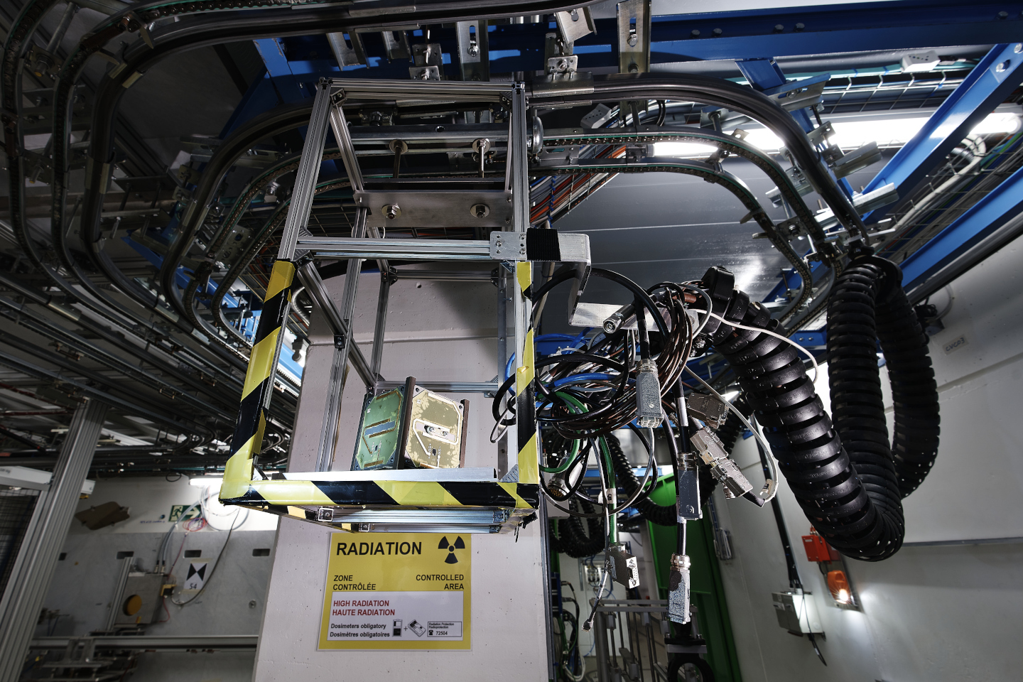
Thanks for your attention!
Image Source: CERN

