Slide 1
Electron source systems for AWAKE Run 2
LWFA4AWAKE meeting, 11.4.2022
Steffen Doebert, BE-RF

Slide 2
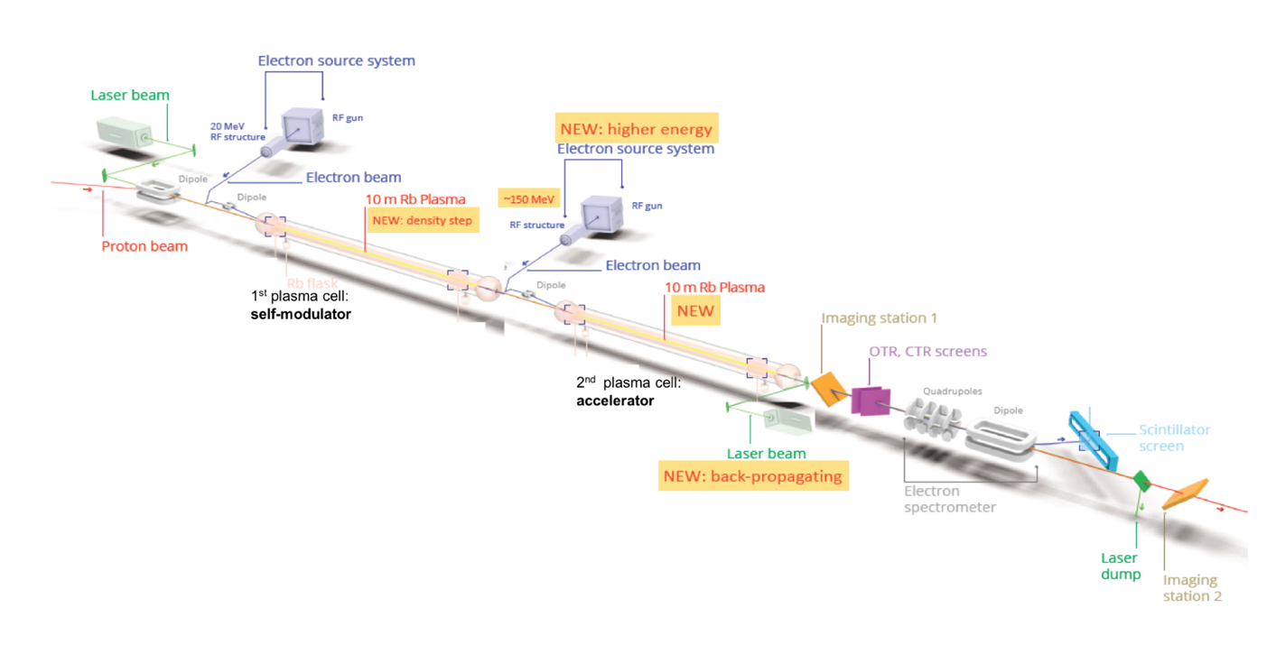
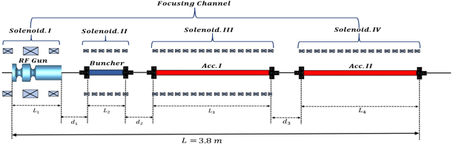
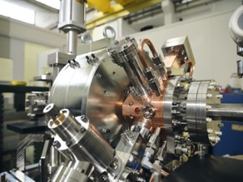
AWAKE Run 2
Demonstrate possibility to use AWAKE scheme for high energy physics applications in mid-term future!
Start 2021! Staged program for ~ 10 years
  Need to work in blow-out regime and do beam-loading
  New electron beam based on x-band:
  150 MeV, 200 fs, 100 pC, σ = 5.75 µm
Goals:
Accelerate an electron beam to high energy (gradient of 0.5-1GV/m)
Preserve electron beam quality as well as possible (emittance preservation at 10 mm mrad level)
Demonstrate scalable plasma source technology (e.g. helicon prototype)

Slide 3
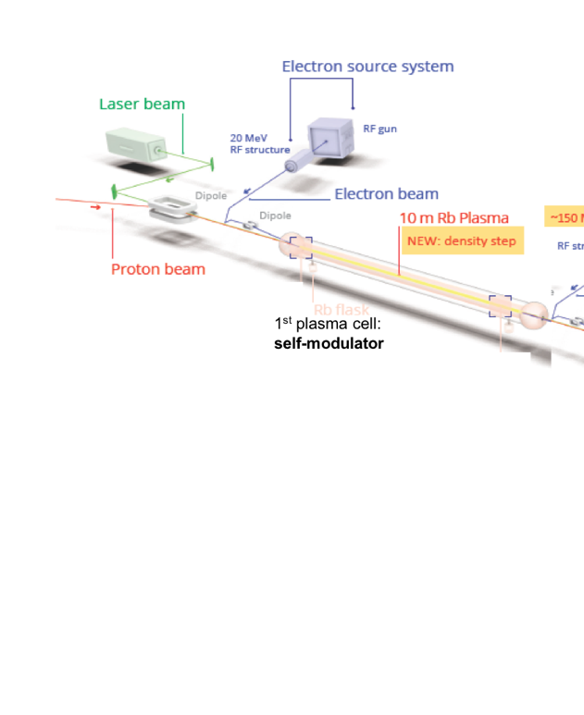
AWAKE Run 2a: Demonstrate Electron Seeding of Self-Modulation in First Plasma Cell
Why electron bunch seeding:
→ Modulates entire proton bunch with phase reproducibility
→ Run 2a: use the existing AWAKE Facility
→ Physics program in ~2021/2022

Slide 4
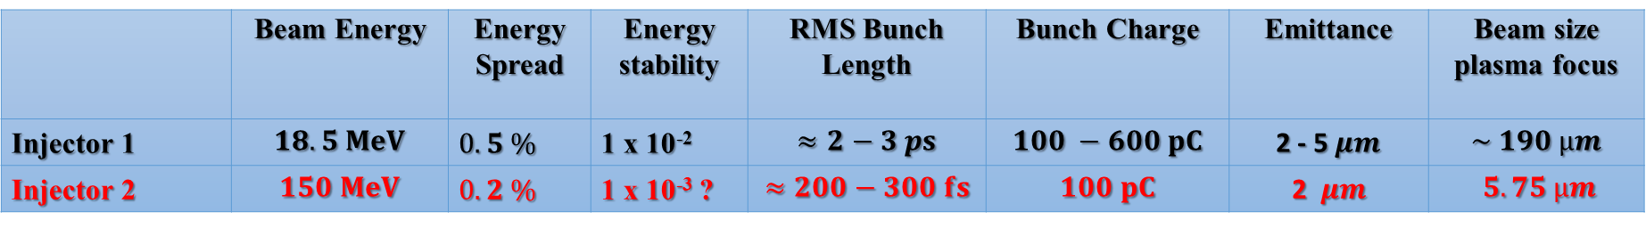
Parameters for both injectors
Working documents held by Rebecca (Injector 2, EDMS 2378918) and John (Injector 1, EDMS 2417022,2588263)
 | Beam Energy | Energy Spread | Energy stability | RMS Bunch Length | Bunch Charge | Emittance | Beam size plasma focus
Injector 1 | $$18.5 MeV$$ | $0.5 \%$ | 1 x 10⁻² | $$≈2−3 ps$$ | $$100 −600 pC$$ | 2 - 5$μm$ | $$\sim 190 µm$$
Injector 2 | $$150 MeV$$ | $0.2 \%$ | 1 x 10⁻³ ? | $$≈200−300 fs$$ | $$100 pC$$ | 2 $μm$ | $$5.75 µm$$
Energy as high as affordable ?
Energy spread as low as possible
Energy stability as good as possible
Emittance reasonably low, no need for ultra-low

Slide 5

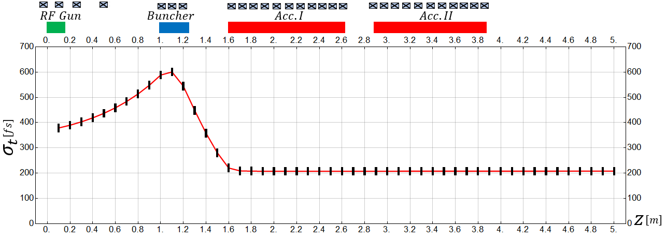
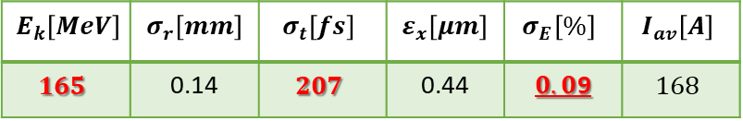
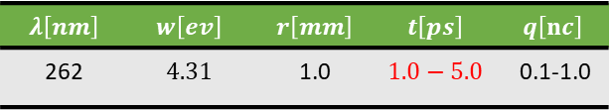
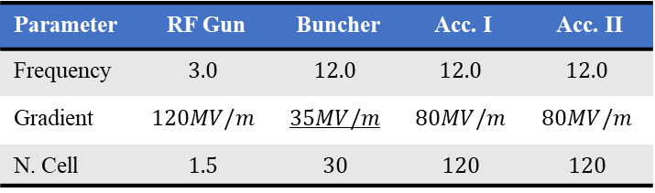
Reference design
Well advanced concept and beam dynamics design
Laser parameters
$$λ\left[nm\right]$$ | $$w\left[ev\right]$$ | $$r\left[mm\right]$$ | $$t\left[ps\right]$$ | $$q\left[nc\right]$$
262 | $$4.31$$ | 1.0 | $$1.0−5.0$$ | 0.1-1.0
RF parameters
Parameter | RF Gun | Buncher | Acc. I | Acc. II
Frequency | $$3.0$$ | $$12.0$$ | $$12.0$$ | $$12.0$$
Gradient | $$120MV/m$$ | $$35MV/m$$ | $$80MV/m$$ | $$80MV/m$$
N. Cell | $$1.5$$ | $$30$$ | $$120$$ | $$120$$
$$E_{k}\left[MeV\right]$$ | $$σ_{r}\left[mm\right]$$ | $$σ_{t}\left[fs\right]$$ | $$ε_{x}\left[μm\right]$$ | $$σ_{E}\left[\%\right]$$ | $$I_{av}\left[A\right]$$
$$165$$ | 0.14 | $$207$$ | 0.44 | $0.0$9 | $$168$$
Mohsen Dayyani Kelisani

Slide 6
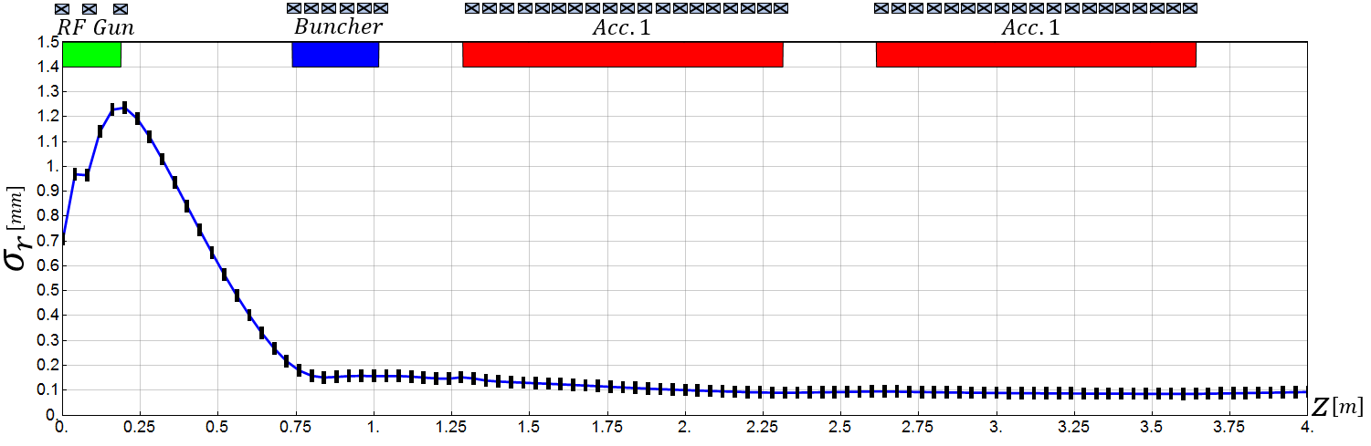
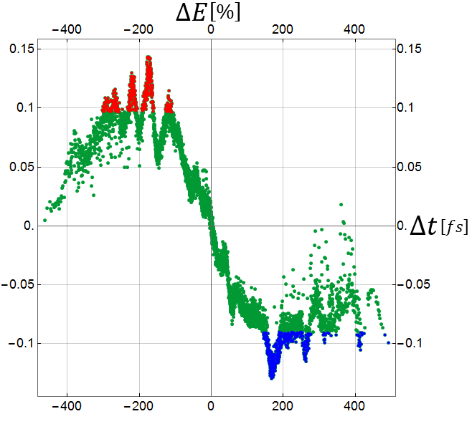
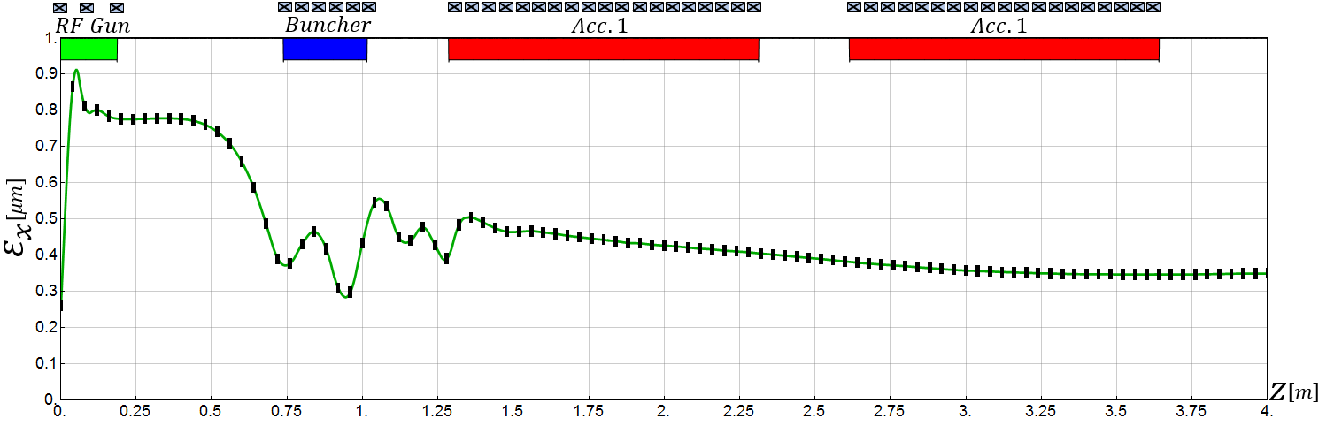
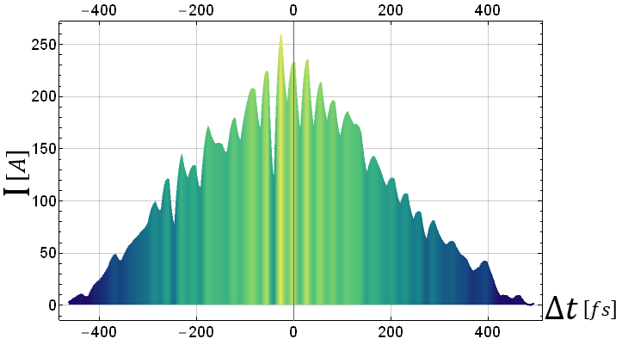
Reference design
Mohsen Dayyani Kelisani

Slide 7
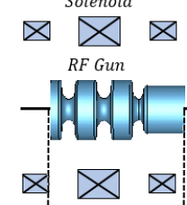

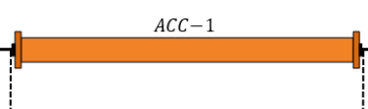
Awake schematic RF layout
Mini klystron
7-10 MW, S-band
Mini klystron
5-10 MW, x-band
50 MW klystron, x-band
PC, 15 -20 MW
PC, 160 -200 MW
Possibly long waveguides 30 m
Round or double height WG needed
Or 2 klystrons
Solenoid
X
X
X
X
X
X
X
X
X
X
X
X
X
X
~ 80 MV/m
Option with 3 structures at 55 MV/m
Total Energy 150- 160 MeV, 10 Hz rep. rate, single bunch
Will try to use CLIC developed x-band components as much as possible

Slide 8
Other requirements
A certain flexibility in the beam parameters which can be delivered keeping good energy spread and emittance
Energy: +- 10%, Charge +400% ?, Bunch length: 100%, beam size : see transport
Constraint space for hardware
Excellent timing stability and synchronisation with laser and self modulation device
30 fs stability

Slide 9
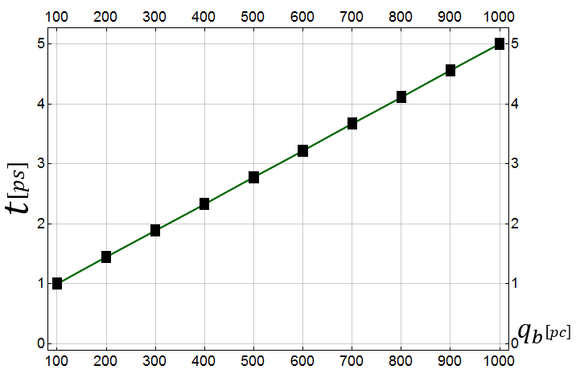
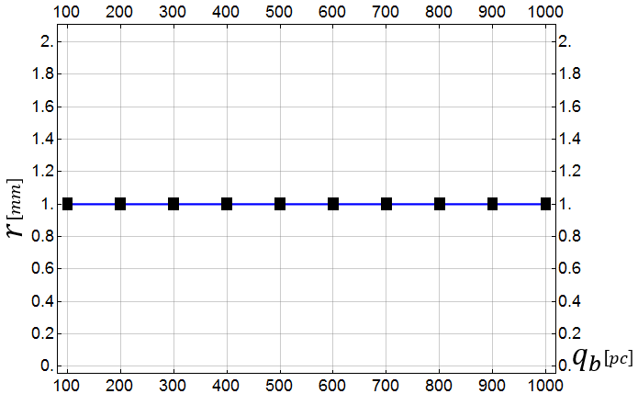
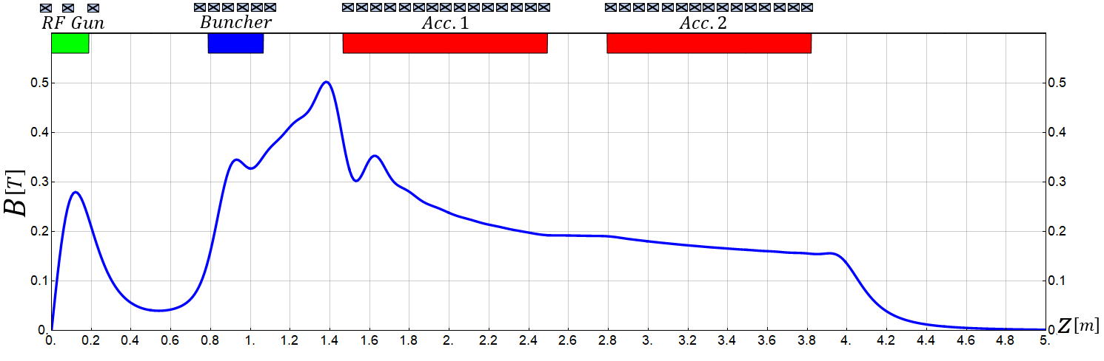
3. High Current Operation
Flexibility to produce higher charge
(for lower plasma density or experimental reasons)
3.1 100pC-1000pC
Changing only laser pulse length and adapting magnetic field slightly
Laser Pulse Duration
Laser Spot Size
Mohsen Dayyani Kelisani

Slide 10
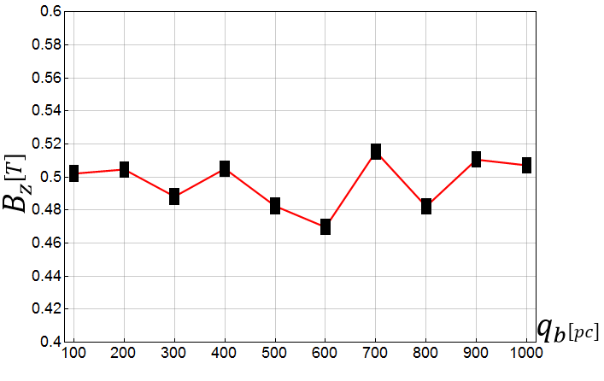
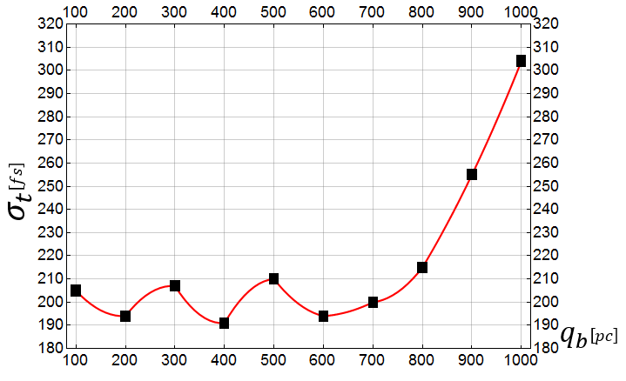
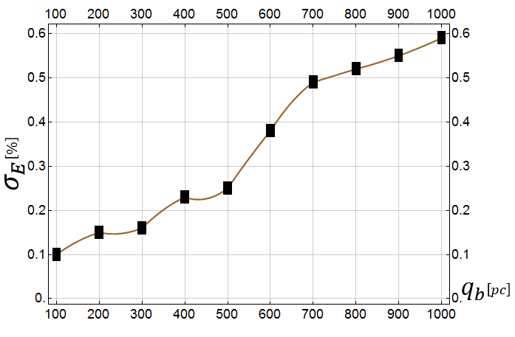
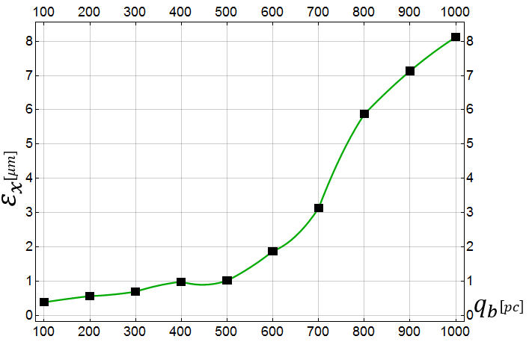
3. High Current Operation
Flexibility to produce higher charge
0.1 to 1 nC per bunch
3.1 100pC-1000pC
Max_$B_{z}$
Bunch Length
Energy Spread
Bunch Emittance
Mohsen Dayyani Kelisani

Slide 11
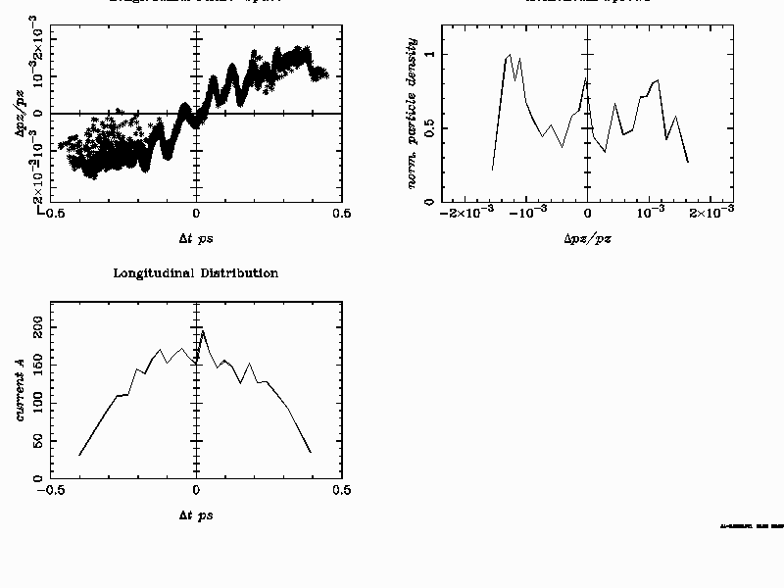
Tentative RUN 2 injector parameter for 150 MeV
Only scaled down accelerating gradient, identical initial distributions,
no new optimization
Energy: 151.8 MeV
Energy Spread: 144.5 keV rms
Emittance: x/y: 0.7 mm mrad
Bunch length: 60 um rms
Bunch Charge: 100 pC

Slide 12
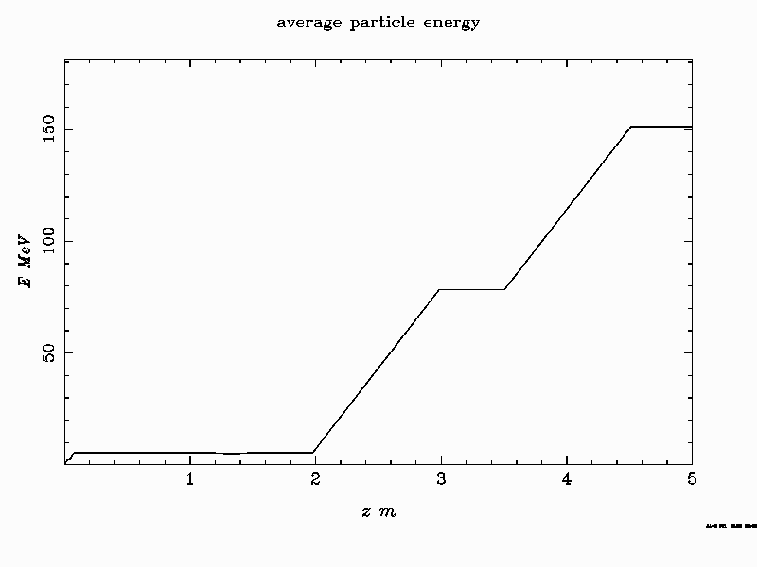
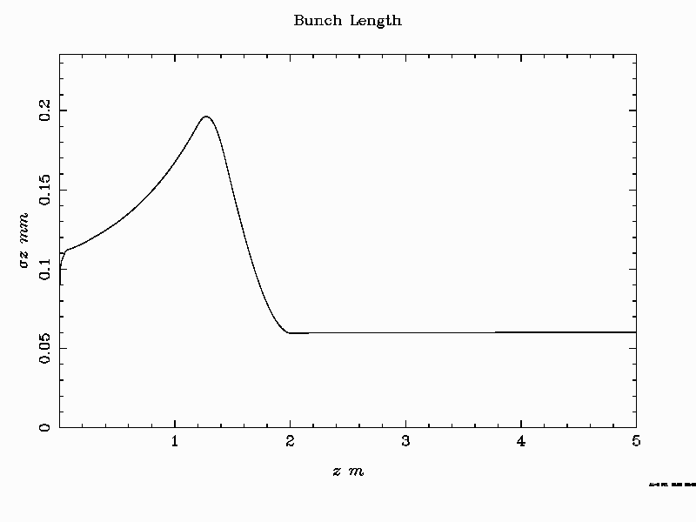
Tentative RUN 2 injector parameter for 150 MeV

Slide 13
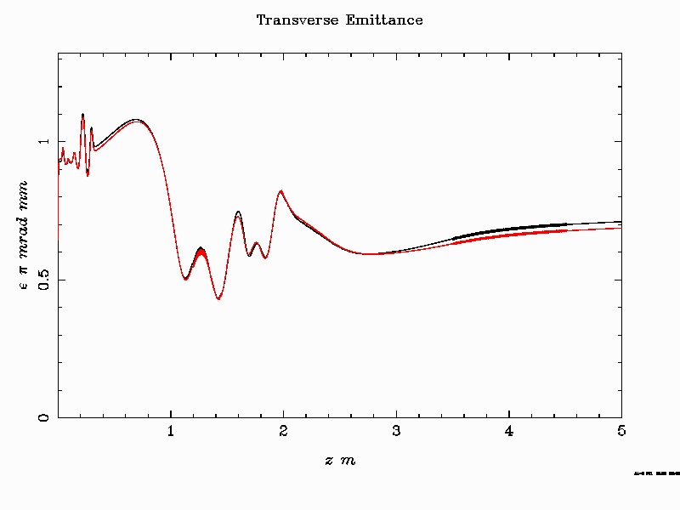
Tentative RUN 2 injector parameter for 150 MeV

Slide 14

Original tentative RUN 2 injector parameter for 160 MeV
Energy: 161.8 MeV
Energy Spread: 172.8 keV rms
Emittance: x/y: 0.7 mm mrad
Bunch length: 60 um rms
Bunch Charge: 100 pC

Slide 15
TT41
TCC4
TSG41
TCV4
KLYSTRON AREA
RF GUN 1
RF GUN 2

Slide 16
Collaborations:
- Uppsala, rf hardware and personnel
Lancaster, personnel
CLIC in kind contribution
CLEAR support for the prototype (infrastructure, services, laser)
INFN Frascati, RF-gun, acc-structure design

Slide 17
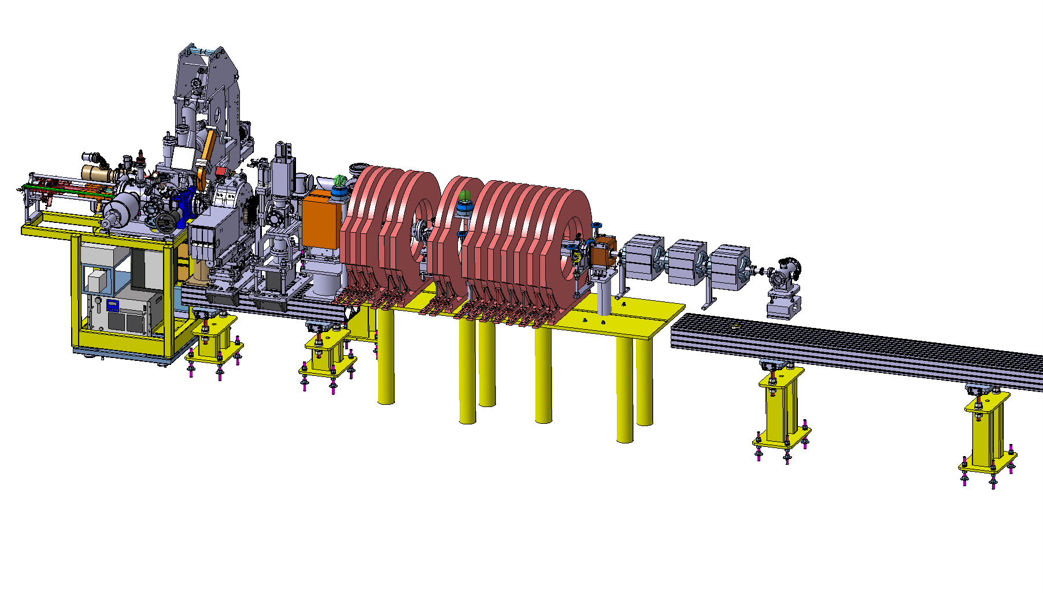
Injector prototype in CTF2
for CLEAR and AWAKE
ARTI (AWAKE Run2 Test Injector)
Reduced scale prototype, 60 MeV, INFN RF-GUN, T24 as buncher and PSI-structure for acceleration.
Goal: demonstrate the velocity bunching and emittance preservation with x-band

Slide 18
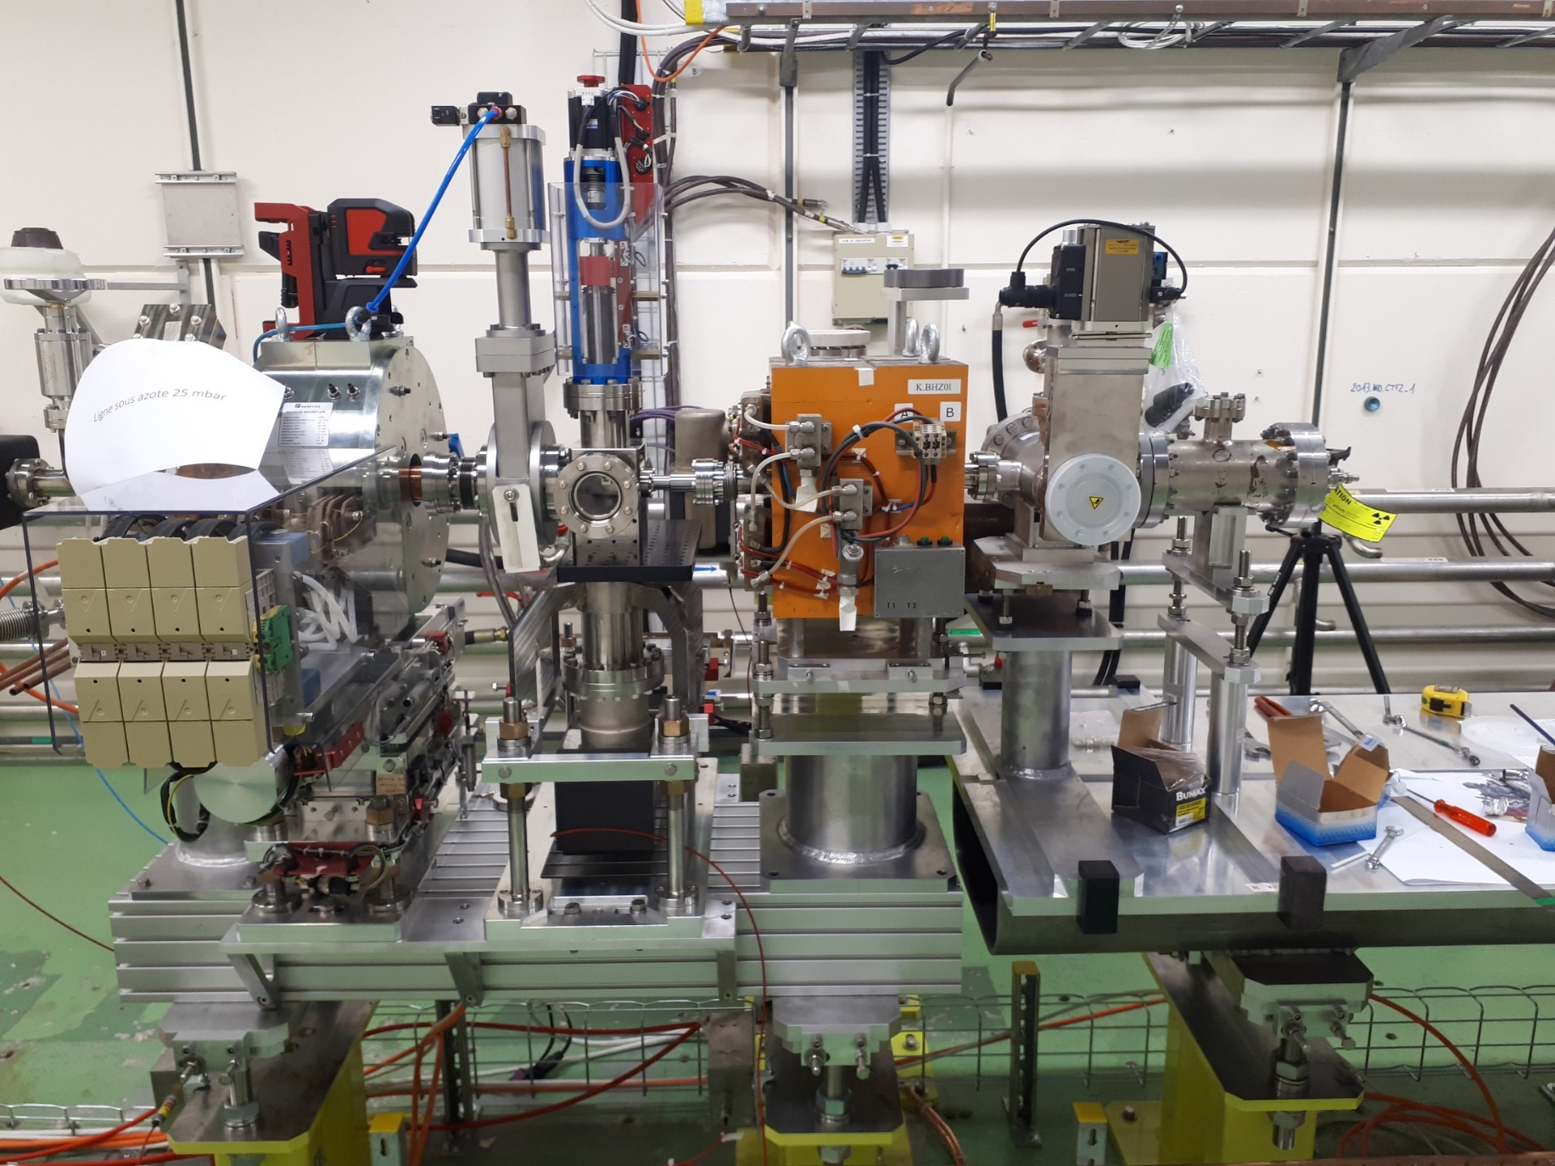
ARTI in CTF2

Slide 19
Conclusion and Outlook
Solid baseline of the new injector is existing
Technical Design, Integration and Parameter optimisation for both injectors ongoing
Prototyping of key elements (rf-gun, acc-structures, RF –system, diagnostics) and corresponding test injector already well advanced
Several important and active collaborations in place to support the tasks with significant contributions.

Slide 20
Additional material

Slide 21
Schedule
No more conflicts with CLEAR for time being

Slide 22
New layout proposal from Uppsala
TCV4
K. Pepitone, V. Clerc

