Slide 1
12 T Robust
Magnetic design
Lucio Fiscarelli, Stephan Russenschuck
27/04/2022

Slide 2
Preliminary work on the magnetic design
Focus on the cross section
Cable 40 strands of 1 mm
  Alternative design (discussed at the last meeting)
  Genetic algorithm in ROXIE (new)

Slide 3
Alternative cross section
5 blocs
Mid-plan wedges
34 turns (2 less)
22 kA (1 kA more)
Inner and outer optimized individually
*Calculations without iron

Slide 4
Alternative cross section
Current 22 kA
*Calculations with iron

Slide 5
Genetic algorithm in ROXIE
Cable 2x20 strands of 1 mm
2 layers, 7 blocks
Parameters:
  Number of turns per block
  Phi angle
  Alpha angle
  Mid plane wedge on outer layer
Objectives

Slide 6
Genetic algorithm in ROXIE
1.
2.
Given the cable
The optimization of the field leads to:
  A “small” alpha angle of the innermost block of the inner layer
  The midplane wedge helps
  Number of turns vs field quality
3.
4.
5.
6.

Slide 7
Some considerations
Given cable geometry and aperture radius, we have limited possibilities for tuning the field quality
We explored the possibilities given by changing the number of turns and adding a mid-plane shim/wedge: improvement on b3, b5, b7, and on the angle of blocks 3 and 5.
Solutions from genetic algorithm (ROXIE) show the limitations of the cable/aperture dimensions as well
Different cable? Grading?

Slide 8
Cable
40 strands
Strand diameter 1 mm
Height 21.42 mm
Width 1.797 – 1.989 mm (after reaction)
Insulation 0.15 mm
Cu/SC 0.9
Jc 2800 A/mm² at 12 T, 4.2 K
Transposition 120 mm
Check the fit parameters

Slide 9
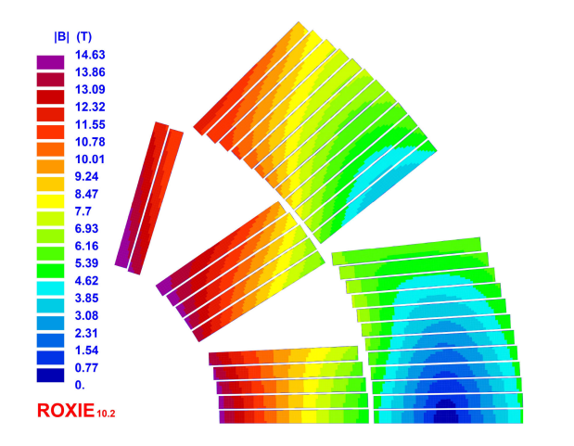
FalconD from INFN
Aperture radius 50 mm
5 blocks (3 inner + 2 outer)
36 turns
A. Pampaloni et al., "Preliminary Design of the Nb3Sn $\cos\theta$ Short Model for the FCC," in IEEE Transactions on Applied Superconductivity, vol. 31, no. 5, pp. 1-5, Aug. 2021, Art no. 4900905, doi: 10.1109/TASC.2021.3061334.

Slide 10
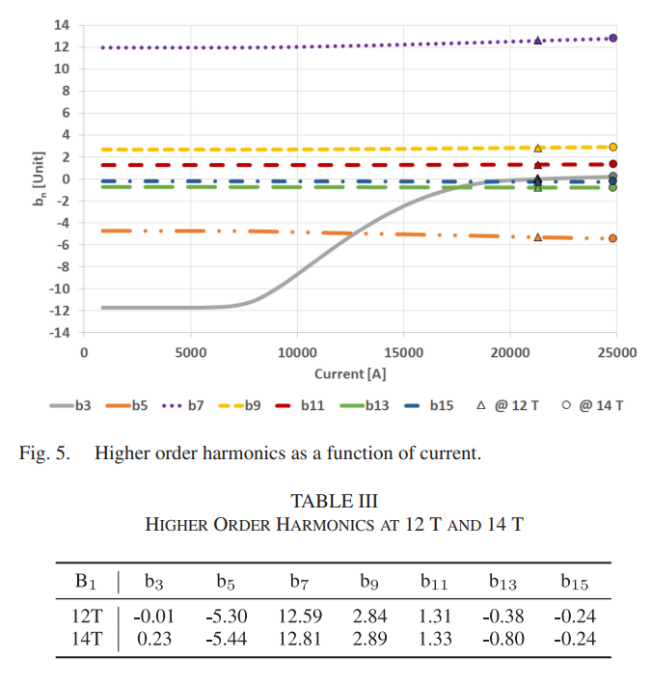
FalconD from INFN
A. Pampaloni et al., "Preliminary Design of the Nb3Sn $\cos\theta$ Short Model for the FCC," in IEEE Transactions on Applied Superconductivity, vol. 31, no. 5, pp. 1-5, Aug. 2021, Art no. 4900905, doi: 10.1109/TASC.2021.3061334.

