Slide 2
Operation of the new synchrotron radiation extraction
E. Bravin
MPP 1 April 2022

Slide 3
New BSRTM motivations
For the HL-LHC era the synchrotron radiation based diagnostics need to be extended
Need a second SR extraction point
Identified location requires a new tank design
  Taking advantage to improve functionalities

Slide 4
Scope of present installation
Verify with beam that the RF heating is under control
Study the properties of the new SR source
Validate the design in general
One device (B1 in 4L) is sufficient for this
ECR document https://edms.cern.ch/document/2610870/1.0

Slide 5
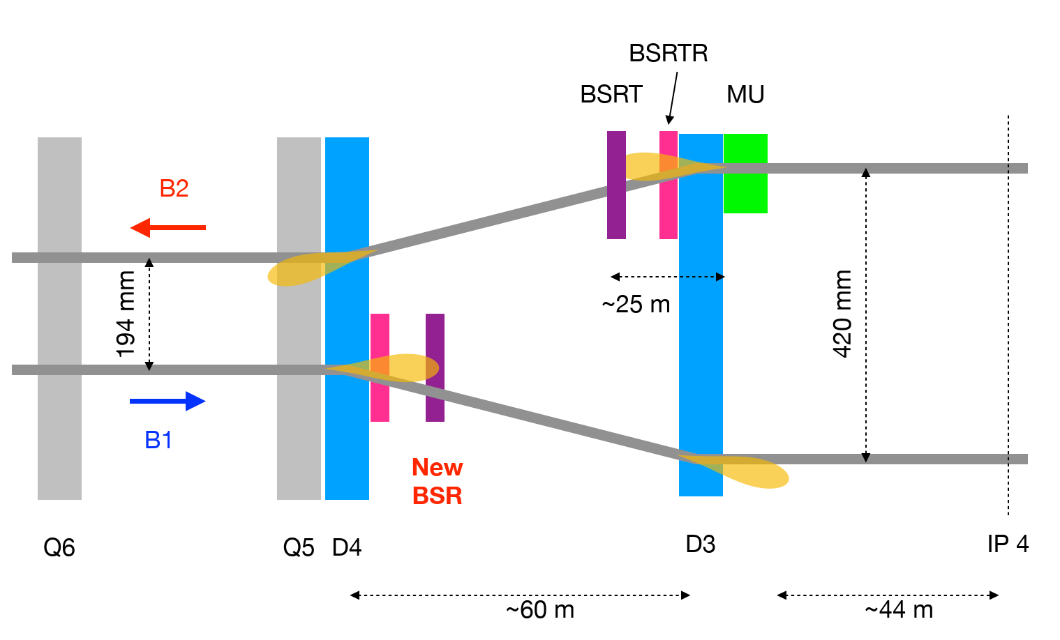
New SR source(s) location

Slide 6
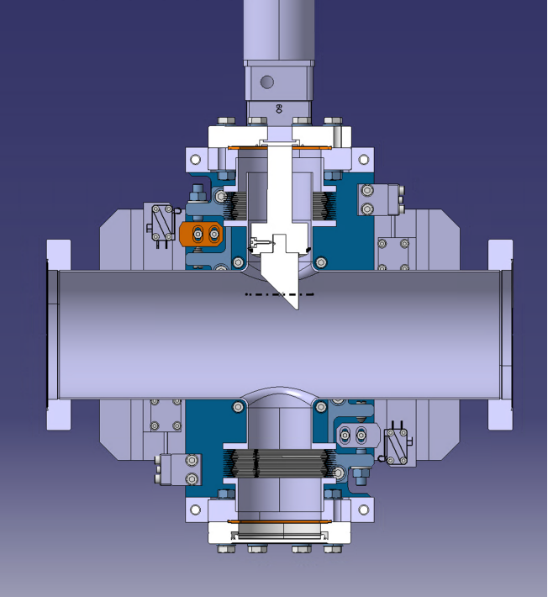
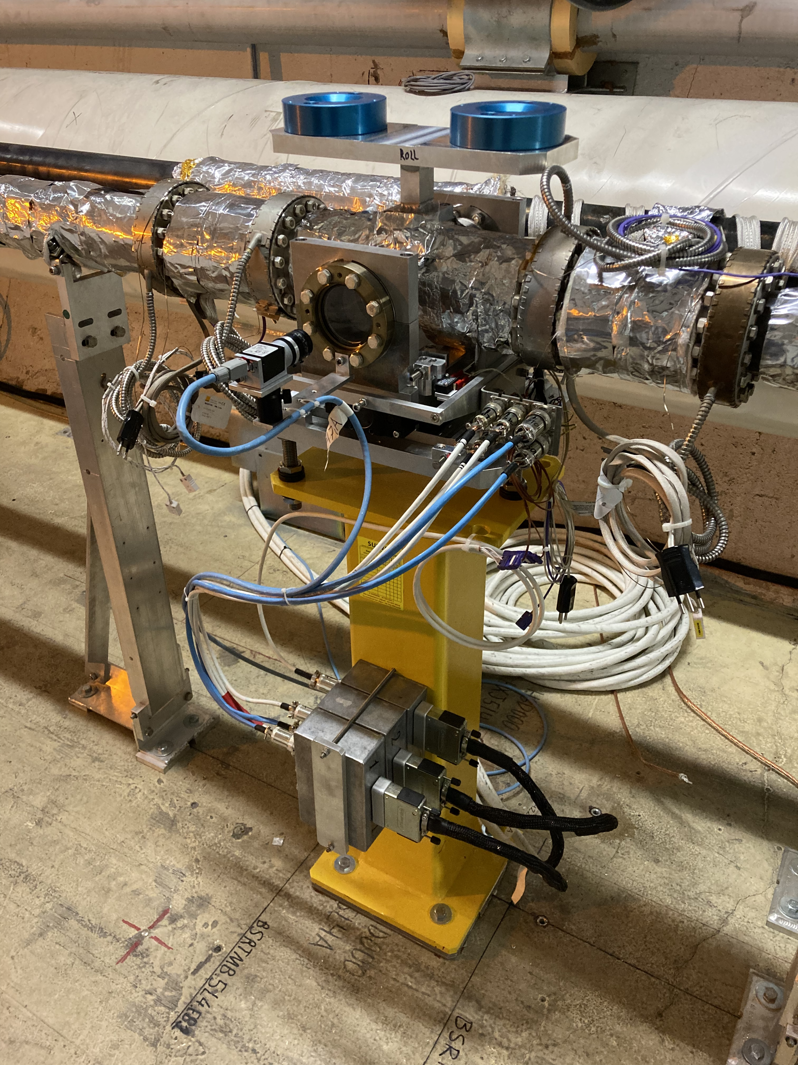
New BSRTM
SR
Beam

Slide 7
New source timeline
Design and install new extraction tank
Validate RF impedance
  Simulations, stretched wire, beam tests
Enlarge beam pipe between D4 and new BSRTM
Install shielding, optics and instruments
<LS3
LS3

Slide 8
Aperture restriction
Mirror can be moved IN/OUT
  Max IN ~11mm from beam axis
  Max OUT ~35mm from beam axis
Mirror can become an aperture restriction
Need to control and interlock the actuator that controls the position of the mirror
Mirror will be always placed in safe position

Slide 9
Beam aperture at injection
Aperture limits calculated by APB
  emittance_norm = 2.5e-6 um
  sigma error = 5%
  dispersion error = 14%
  orbit_error = 0.002
  energy = 450 GeV
  energy_error = 0.00086
  N1 = 13 sigma
 | BSRTM.5L4.B1 | BSRTM.5R4.B2
Aperture [mm] | 22.9 | 22.9
Beta x [m] | 381.2 | 381.2
Beta y [m] | 263.4 | 243.1
Sigma x [mm] | 1.409 (16.2 sigma aperture) | 1.409 (16.2 sigma aperture)
Sigma y [mm] | 1.172 | 1.1255

Slide 10
Beam aperture at FLATTOP
Aperture limits calculated by APB
  emittance_norm = 2.5e-6 um
  sigma error = 10%
  dispersion error = 10%
  orbit_error = 0.002
  energy = 6500 GeV
  energy_error = 0.0002
  N1 = 20 sigma
 | BSRTM.5L4.B1 | BSRTM.5R4.B2
Aperture [mm] | 11.2 | 11.2
Beta x [m] | 381.2 | 381.2
Beta y [m] | 263.4 | 243.1
Sigma x [mm] | 0.371 (30.2 sigma aperture) | 0.371 (30.2 sigma aperture)
Sigma y [mm] | 0.308 | 0.296

Slide 11
Actuator
Actuator controlled by stepping motor
  Resolver on motor axis
  Two limit switches to limit the stroke and indicate the fully retracted/inserted position
  Two linear potentiometers that monitor real position of mirror support
  Mechanical stop limits insertion to ~10 mm (can be adjusted)

Slide 12
Control
Motor, resolver and potentiometers controlled by two PXI (Motion and potentiometer) systems from BE-CEM
StepperAxis FESA class
Mirror position controlled by sequencer tasks
Position vs. energy limits stored in LSA as MCS
Mirror temperature monitor by SY-BI FESA class and logged in NXCALS
  One probe inside mirror itself
  One probe on mirror support (both inside vacuum)

Slide 13
Interlock
The interlock is based on the potentiometer readings
  Two redundant sources (two FESA devices)
If the position read is outside of limits a maskable BIS channel is triggered
  Limits are functions of beam energy
    For now we only need one value < FT and one value >= FT
  MCS role allowed to change the settings?

Slide 14
Operation
Before injection mirror sent to injection position: 23mm + δ
At FLATTOP (after end of ramp) mirror sent to FT position: 11.2mm + δ
δ to be determined based on readout noise of potentiometers (avoid spurious dumps)

Slide 15
Conclusions
A new BSRTM device has been installed for validation
New design can pose aperture restriction danger
Actuator position precisely monitored and connected to BIS
Safe position values calculated by ABP vs. energy
System fully installed
Software configuration ongoing (LSA, sequencer etc.).
MP document being prepared.

