Slide 1
Impact of non-copper TCLM on longitudinal stability
Ivan Karpov
Acknowledgements:
Theodoros Argyropoulos, Rama Calaga, Heiko Damerau,
Nicolas Mounet, Sigurd Nese, Elena Shaposhnikova, and Helga Timko
Special Joint HiLumi WP2/WP4 Meeting, 05 Apr. 2021

Slide 2
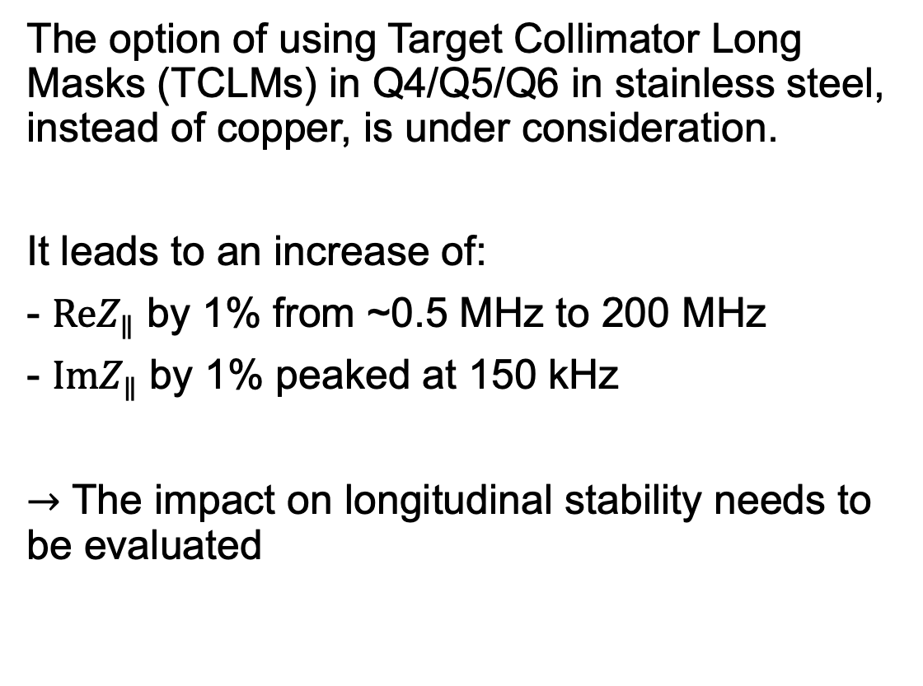

Introduction
Longitudinal impedance with stainless steel vs copper TCLMs (input from N. Mounet)
The option of using Target Collimator Long Masks (TCLMs) in Q4/Q5/Q6 in stainless steel, instead of copper, is under consideration.
It leads to an increase of:
- $ReZ_{∥}$ by 1% from ~0.5 MHz to 200 MHz
- $ImZ_{∥}$ by 1% peaked at 150 kHz
$→$ The impact on longitudinal stability needs to be evaluated
$$k=f/f_{0}$$

Slide 3
Introduction
Longitudinal impedance with stainless steel vs copper TCLMs (input from N. Mounet)
The option of using Target Collimator Long Masks (TCLMs) in Q4/Q5/Q6 in stainless steel, instead of copper, is under consideration.
It leads to an increase of:
- $ReZ_{∥}$ by 1% from ~0.5 MHz to 200 MHz
- $ImZ_{∥}$ by 1% peaked at 150 kHz
$→$ The impact on longitudinal stability needs to be evaluated

Slide 4
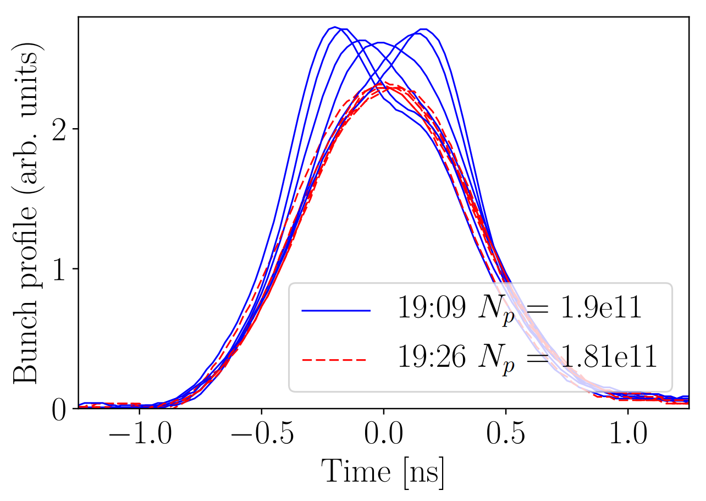

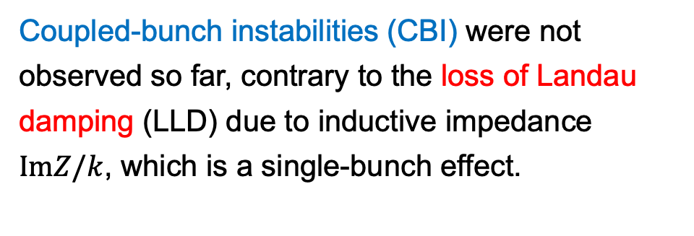
Recap on longitudinal stability studies
Coupled-bunch instabilities (CBI) were not observed so far, contrary to the loss of Landau damping (LLD) due to inductive impedance $ImZ/k$, which is a single-bunch effect.
Persistent oscillations after injection
LHC MD
2017
$V_{rf}=6$ MV
(H. Timko et al., HB2018)

Slide 5
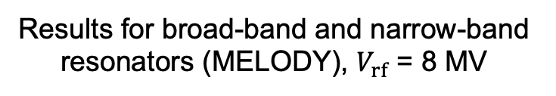
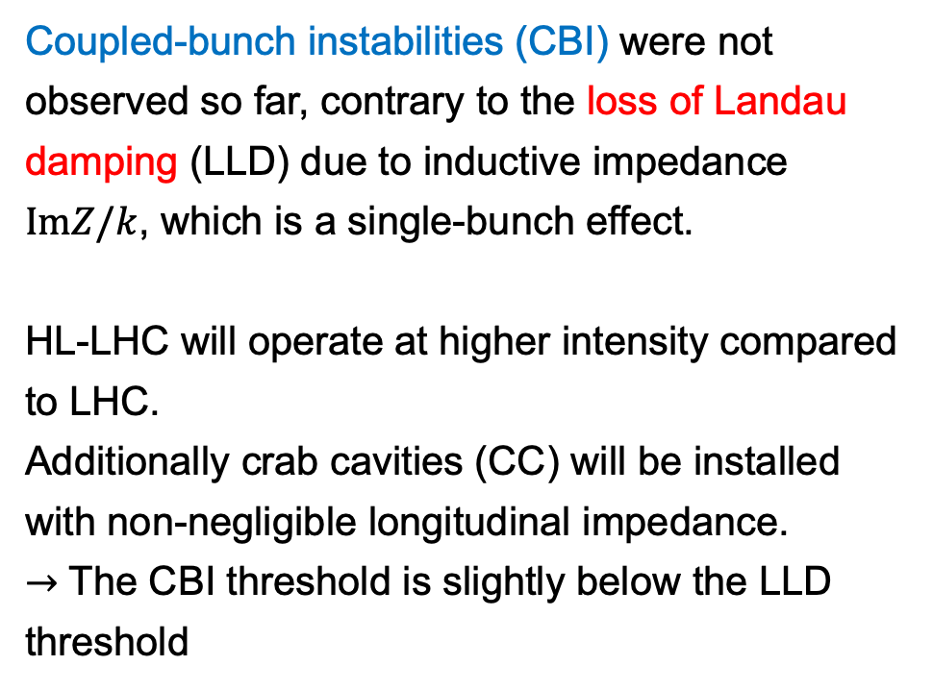


Recap on longitudinal stability studies
Coupled-bunch instabilities (CBI) were not observed so far, contrary to the loss of Landau damping (LLD) due to inductive impedance $ImZ/k$, which is a single-bunch effect.
HL-LHC will operate at higher intensity compared to LHC.
Additionally crab cavities (CC) will be installed with non-negligible longitudinal impedance.
$→$ The CBI threshold is slightly below the LLD threshold
Results for broad-band and narrow-band resonators (MELODY), $V_{rf}$ = 8 MV
$R_{sh} = 4×71 kΩ$, $f_{r}$ = 582 MHz
${\left(ImZ/k\right)}_{eff}≈0.075 Ω$, $f_{r}$ = 5 GHz
(I. Karpov, WP2/WP4 Meeting, 30.11.2021)

Slide 6

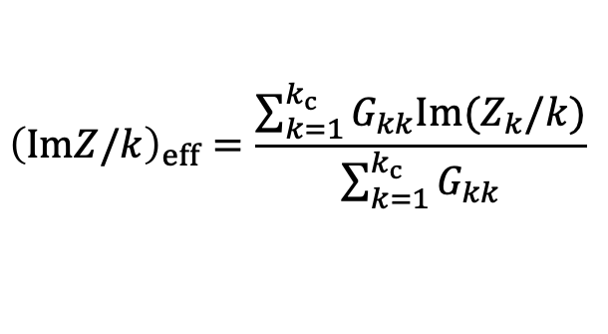

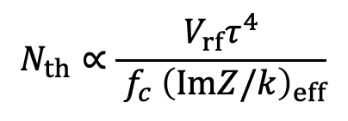

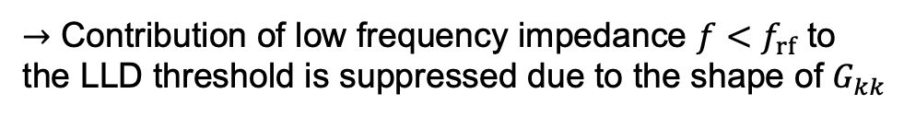
LLD threshold
LLD threshold is defined by*
400 MHz imp. + direct & one-turn delay feedback
CC HOMs
$$N_{th}∝\frac{V_{rf}τ^{4}}{{{ f}_{c} \left(ImZ/k\right)}_{eff}}$$
Effective impedance
$${\left(ImZ/k\right)}_{eff}=\frac{\sum_{k=1}^{k_{c}}{G_{kk}Im(Z_{k}/k)}}{\sum_{k=1}^{k_{c}}{G_{kk}}}$$
$$f_{c}$$
$G_{kk}=\frac{1}{2}−J_{0}^{2}\left(y\right)−J_{1}^{2}\left(y\right)+\frac{J_{0}\left(y\right)J_{1}\left(y\right)}{y}$, $y=πkf_{0}τ$
$τ_{4σ} = 1.3$ns
The maximum of nominator is reached at $k_{c}=f_{c}/f_{0}$**
$→$ Contribution of low frequency impedance $f<f_{rf}$ to the LLD threshold is suppressed due to the shape of $G_{kk}$
*I. Karpov, T. Argyropoulos, E. Shaposhnikova, PRAB 2021
**S. Nese, Tech. Rep. CERN-STUDENTS-Note-2021-214, 2021

Slide 7
LLD threshold
LLD threshold is defined by*
400 MHz imp. + direct & one-turn delay feedback
CC HOMs
$$N_{th}∝\frac{V_{rf}τ^{4}}{{{ f}_{c} \left(ImZ/k\right)}_{eff}}$$
Effective impedance
$${\left(ImZ/k\right)}_{eff}=\frac{\sum_{k=1}^{k_{c}}{G_{kk}Im(Z_{k}/k)}}{\sum_{k=1}^{k_{c}}{G_{kk}}}$$
$$f_{c}$$
$G_{kk}=\frac{1}{2}−J_{0}^{2}\left(y\right)−J_{1}^{2}\left(y\right)+\frac{J_{0}\left(y\right)J_{1}\left(y\right)}{y}$, $y=πkf_{0}τ$
$τ_{4σ} = 1.3$ns
The maximum of nominator is reached at $k_{c}=f_{c}/f_{0}$**
$→$ Contribution of low frequency impedance $f<f_{rf}$ to the LLD threshold is suppressed due to the shape of $G_{kk}$
*I. Karpov, T. Argyropoulos, E. Shaposhnikova, PRAB 2021
**S. Nese, Tech. Rep. CERN-STUDENTS-Note-2021-214, 2021

Slide 8
LLD threshold
LLD threshold is defined by*
400 MHz imp. + direct & one-turn delay feedback
CC HOMs
$$N_{th}∝\frac{V_{rf}τ^{4}}{{{ f}_{c} \left(ImZ/k\right)}_{eff}}$$
Effective impedance
$${\left(ImZ/k\right)}_{eff}=\frac{\sum_{k=1}^{k_{c}}{G_{kk}Im(Z_{k}/k)}}{\sum_{k=1}^{k_{c}}{G_{kk}}}$$
$$f_{c}$$
$G_{kk}=\frac{1}{2}−J_{0}^{2}\left(y\right)−J_{1}^{2}\left(y\right)+\frac{J_{0}\left(y\right)J_{1}\left(y\right)}{y}$, $y=πkf_{0}τ$
$τ_{4σ} = 1.3$ns
The maximum of nominator is reached at $k_{c}=f_{c}/f_{0}$**
$→$ Contribution of low frequency impedance $f<f_{rf}$ to the LLD threshold is suppressed due to the shape of $G_{kk}$
*I. Karpov, T. Argyropoulos, E. Shaposhnikova, PRAB 2021
**S. Nese, Tech. Rep. CERN-STUDENTS-Note-2021-214, 2021

Slide 9
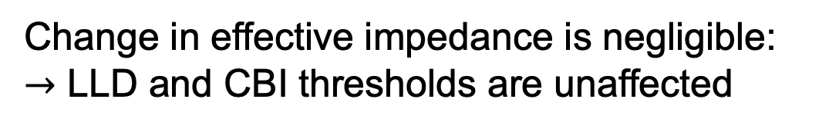
Impact of TCLM material on effective impedance
Change in effective impedance is negligible:
$→$ LLD and CBI thresholds are unaffected

Slide 10
Summary
Thresholds of loss of Landau damping and couple-bunch instability due to CC HOMs are closely related.
The LLD threshold is defined by the effective impedance.
Stainless steel TCLMs have a negligible impact on the effective impedance and thus on longitudinal stability.
Thank you for your attention!

Slide 11
Spare slides

Slide 12
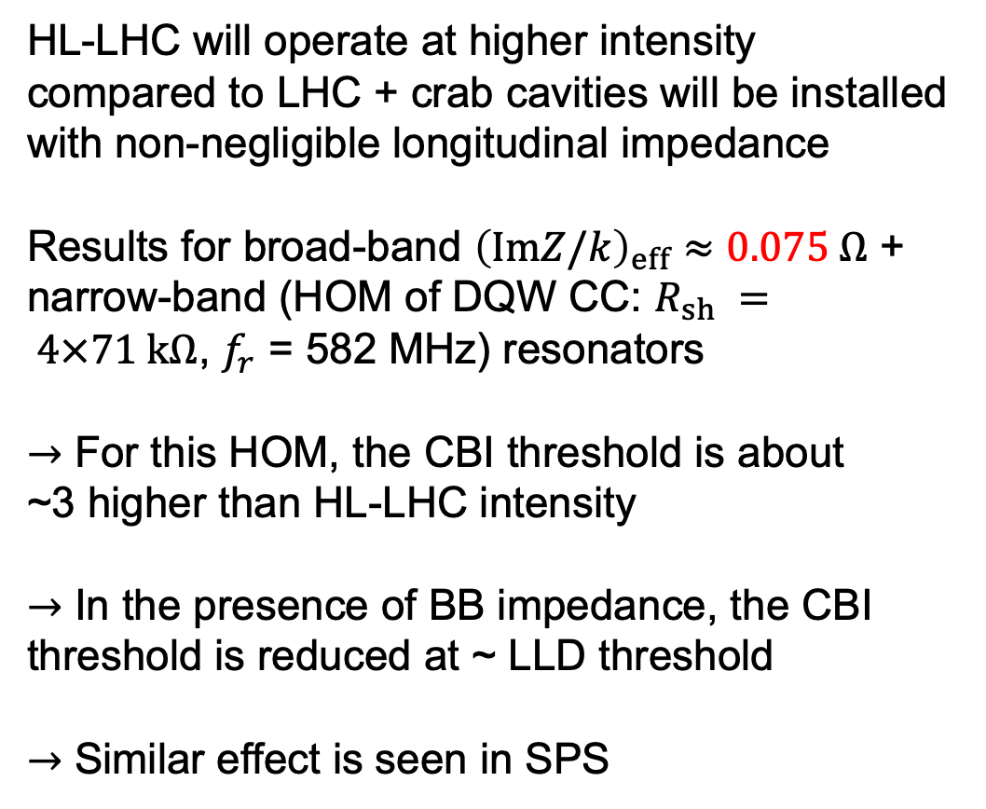
Reduction of CBI threshold due to ImZ/k
HL-LHC will operate at higher intensity compared to LHC + crab cavities will be installed with non-negligible longitudinal impedance
Results for broad-band ${\left(ImZ/k\right)}_{eff}≈0.075 Ω$ + narrow-band (HOM of DQW CC: $R_{sh} = 4×71 kΩ$, $f_{r}$ = 582 MHz) resonators
$→$ For this HOM, the CBI threshold is about
~3 higher than HL-LHC intensity
$→$ In the presence of BB impedance, the CBI threshold is reduced at ~ LLD threshold
$→$ Similar effect is seen in SPS
Coupled-bunch instability in HL-LHC (MELODY)
CBI threshold
LLD threshold at ~2.9e11
$E = 450$ GeV, $V_{rf} = 8$ MV, $μ=2, τ_{4σ}≈1.3$ ns

