Slide 1
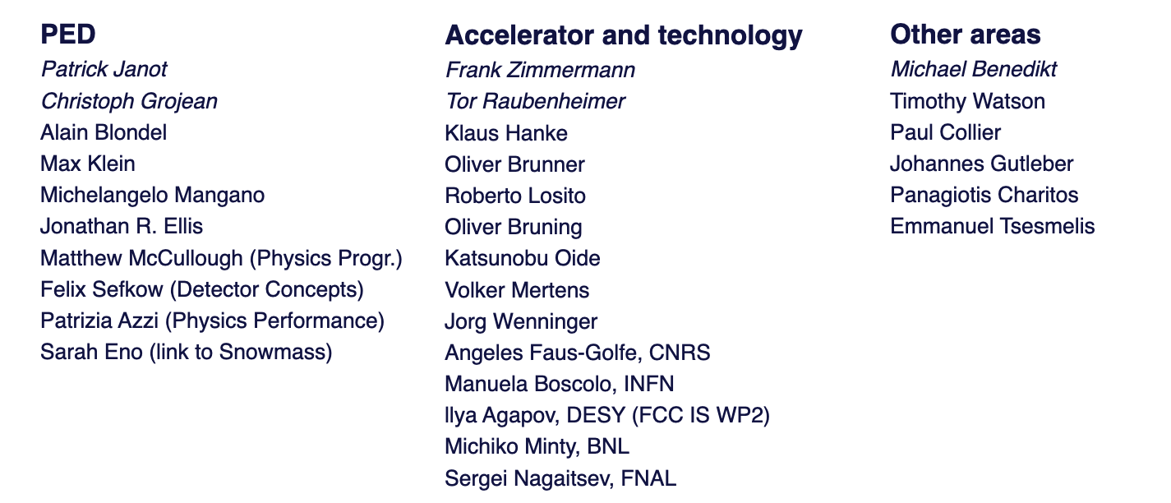
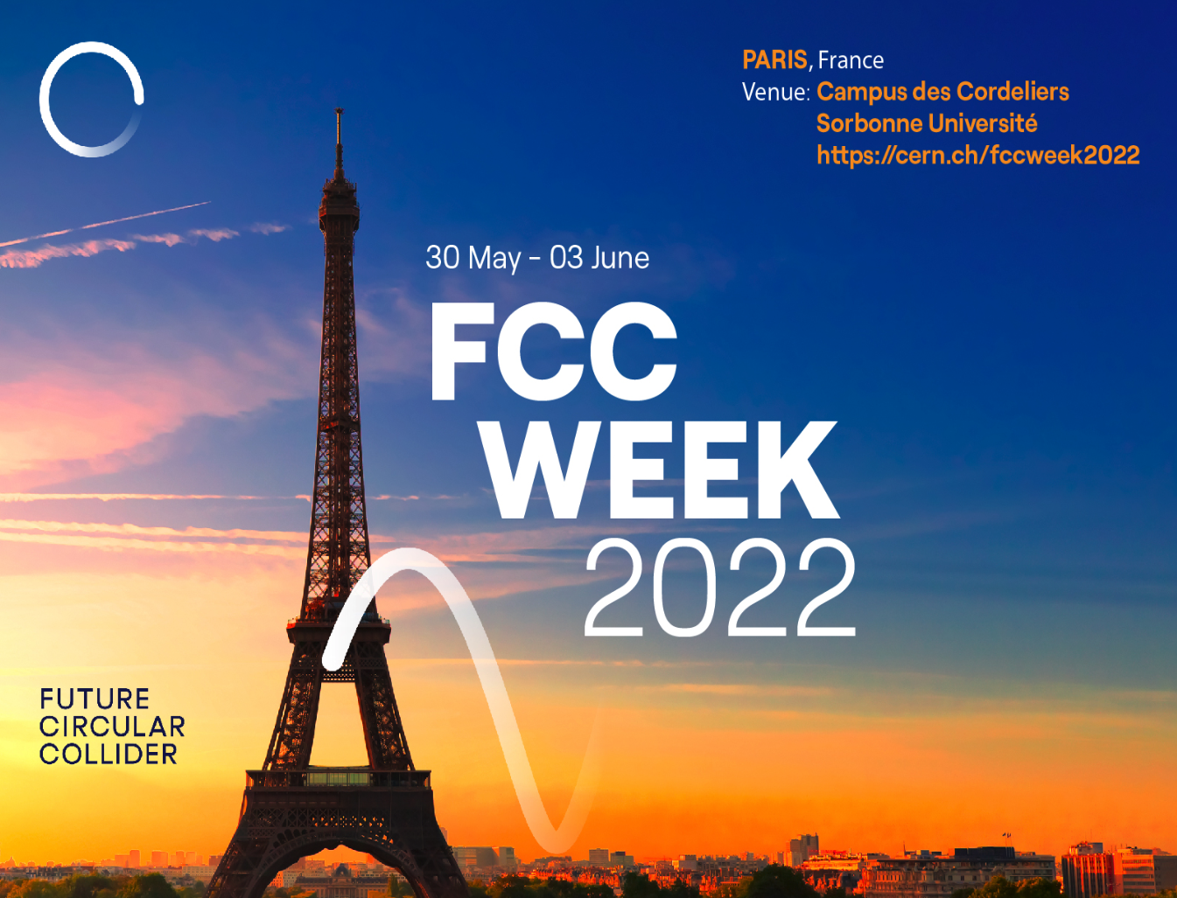
FCC Week: PED Programme Committee
Committee members
Registration
  Registrations are open https://indico.cern.ch/e/fccw2022

Slide 2
What do we want from this FCC Week ?
Mostly kick-off activities for the feasibility study (towards a sound FSR, due in 2025)
  We just gathered Detector Concepts coordinators
  We just gatherer Physics Group conveners (or thereabout)
    Experimental and theoretical physics studies can ramp up
  The Software Task Force is completing its mandate
  Case Studies need a new boost
  EPOL meetings just restarted
  MDI activities need our participation for the IR design
  “Strengthen your physics case”
Coordinators and conveners ought to come to Paris, if at all possible
Young physicists need to be invited to start owning the project

Slide 3
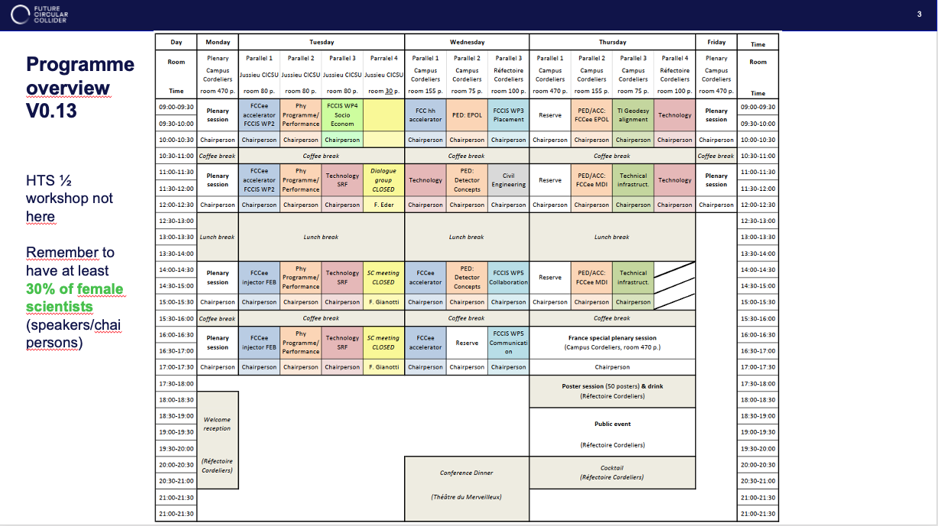

Slide 4
Plenary sessions on Monday
Current proposal (can be discussed and amended)
  9h30: Welcome addresses (CNRS, CEA, CERN: Fabiola)
  10h00: View from France
  10h30: View from European Commission
        Coffee
  11h30: Status of PED studies, a theory perspective (C. Grojean has been suggested)
  12h15: Feasibility Study status (M. Benedikt)
        Lunch
  14h00: Accelerator overview (F. Zimmermann, T. Raubenheimer)
  14h45: PED overview
    Could be several short talks from the WP coordinators: Physics, Detectors/MDI, EPOL, Software
      Could also be the usual presentation from Alain or Patrick (but I prefer the first option)
        Coffee
  16h00: TBD
  16h45: The high-field magnet development programme

Slide 5
Parallel sessions (Tuesday-Wednesday-Thursday)
Discussed in the following presentations
  Original plan was as follows
    3 to 3.5 sessions for Physics Group conveners (vision, plans for activities, collaborators, …)
    0.5 to 1 session for ongoing Case Studies
    2 sessions for detector concepts (+MDI)
    1 session for PED/MDI (+detector concepts)
    1 PED/EPOL session
  There is one reserve session on Wednesday afternoon, 4.00 – 5.30 pm.
    Booked for FCC-IS WP5 (Leverage and Engage: P. Charitos, M. Chrzaszcz)
    We could suggest to use (part of) this session to discuss the communication of our physics case
        (Strengthen your physics case)
      How is the FCC-ee (FCC-hh) physics case seen from outside ?
      How can we mitigate the negative impressions ?
      Ideas for presentations to a wider audience: scientists, general public, funding agencies

Slide 6
Plenary sessions on Friday and other aspects
Plenary sessions on Friday are devoted to summary presentations
  We need to nominate a volunteer for the PED summary
Friday afternoon available for mini-workshops, if we want to
  Any wishes ?
A poster session is foreseen on Thursday evening (5:30 – 6:30pm)
  How do we get organized? What do we want to show?
    Could be useful to have young physicists present in Paris.
Call for abstracts [Deadline 6 May]
  Do we want to encourage people to submit abstracts/posters?
In general, we need to identify/invite speakers & chairs very soon for the whole week
  Message from the management: at least 30% (!) of female scientists …

