Slide 1
Beam Gas Curtain Monitor
Sedlacek Ondrej
01.04.2022

Slide 2


Outline
Gas Jet monitor & Hollow Electron lens
History and future of Gas Jet Monitor Version 3
Distributed gas measurements at LHC
  Planning
  Assembly
  Control application

Slide 3
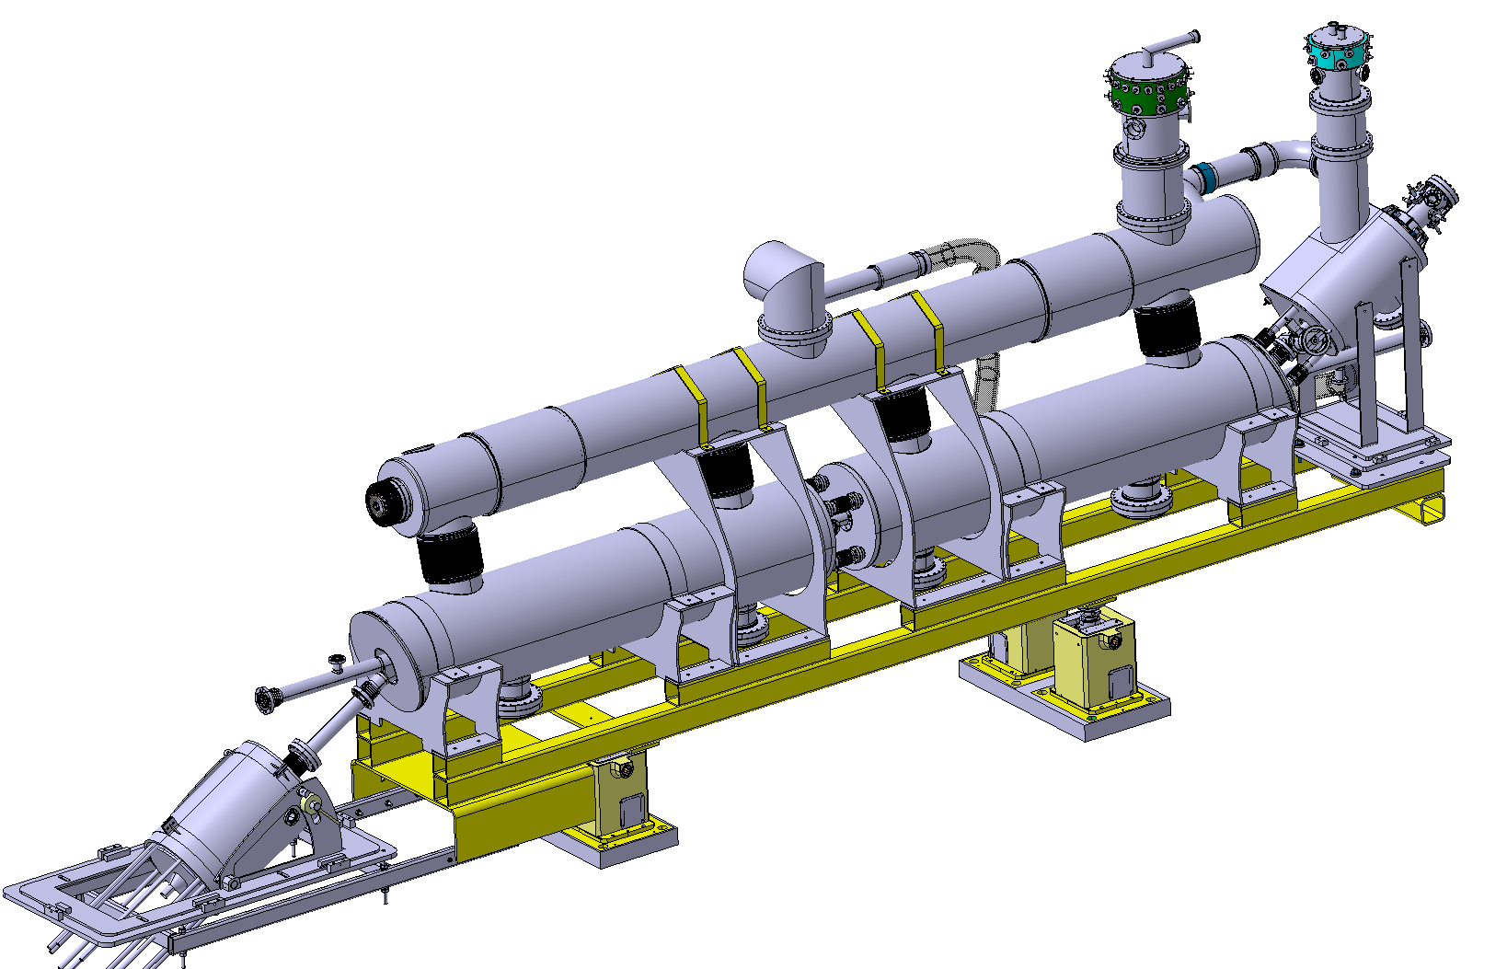
Motivation -
Hollow Electron Lens

Slide 4
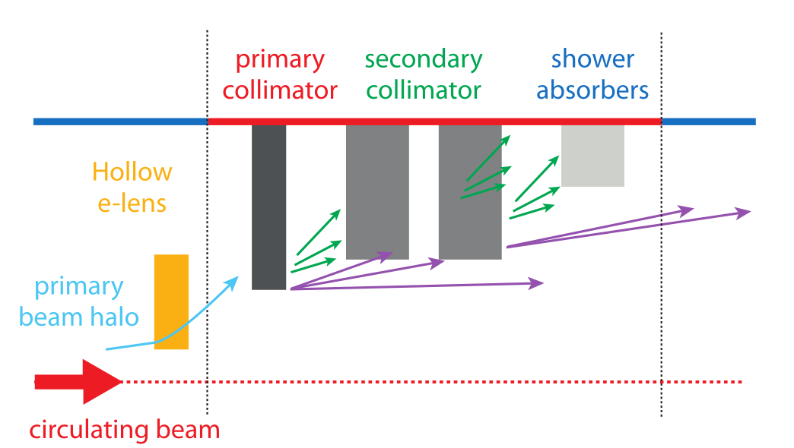
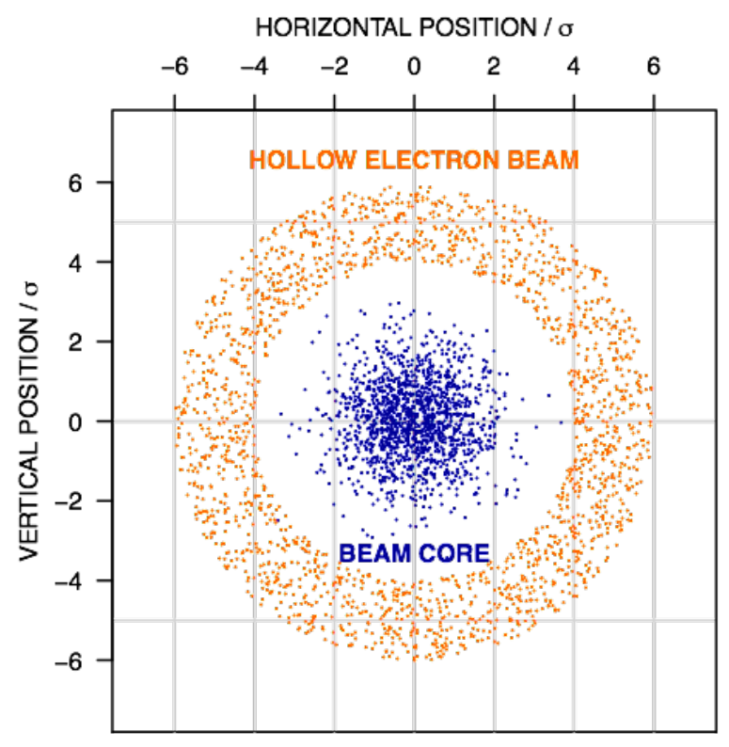


Hollow Electron lense (HEL)
High-current, low energy Hollow Electron beam
LHC Beam core - experiences no field
Proposed new stage of HL-LHC collimation system
Beam Halo - experiences nonlinear transverse kicks

Slide 5
Hollow Electron lense (HEL)
High-current, low energy Hollow Electron beam
LHC Beam core - experiences no field
Proposed new stage of LHC collimation system
Beam Halo - experiences nonlinear transverse kicks
Essential to maintain concentricity

Slide 6
Gas Jet monitor

Slide 7

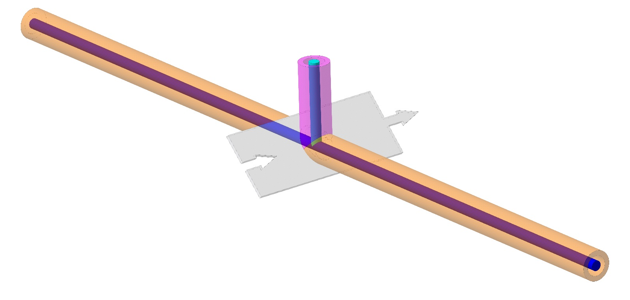


Working principle
Image
Photon distribution - beam distribution
Fluorescence
Beam gas collision
LHC Beam & Hollow Electron Beam
Gas Jet
Supersonic sheet of gas
At 45°

Slide 8
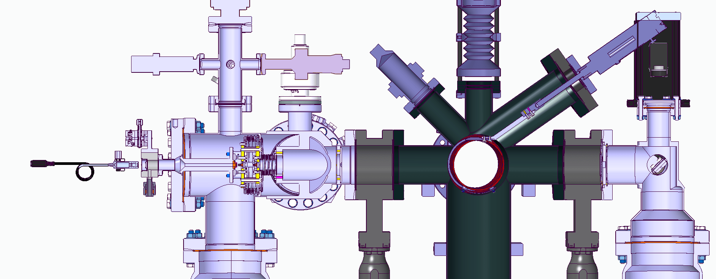

Gas Jet monitor Version 3
Gas Jet formation
Nozzle, 1st and 2nd skimmer - all circular
3rd skimmer - rectangle slit shaping the final gas jet
Camera - observing fluorescence photons
Gas input - 5bar
Interaction point
Beam

Slide 9

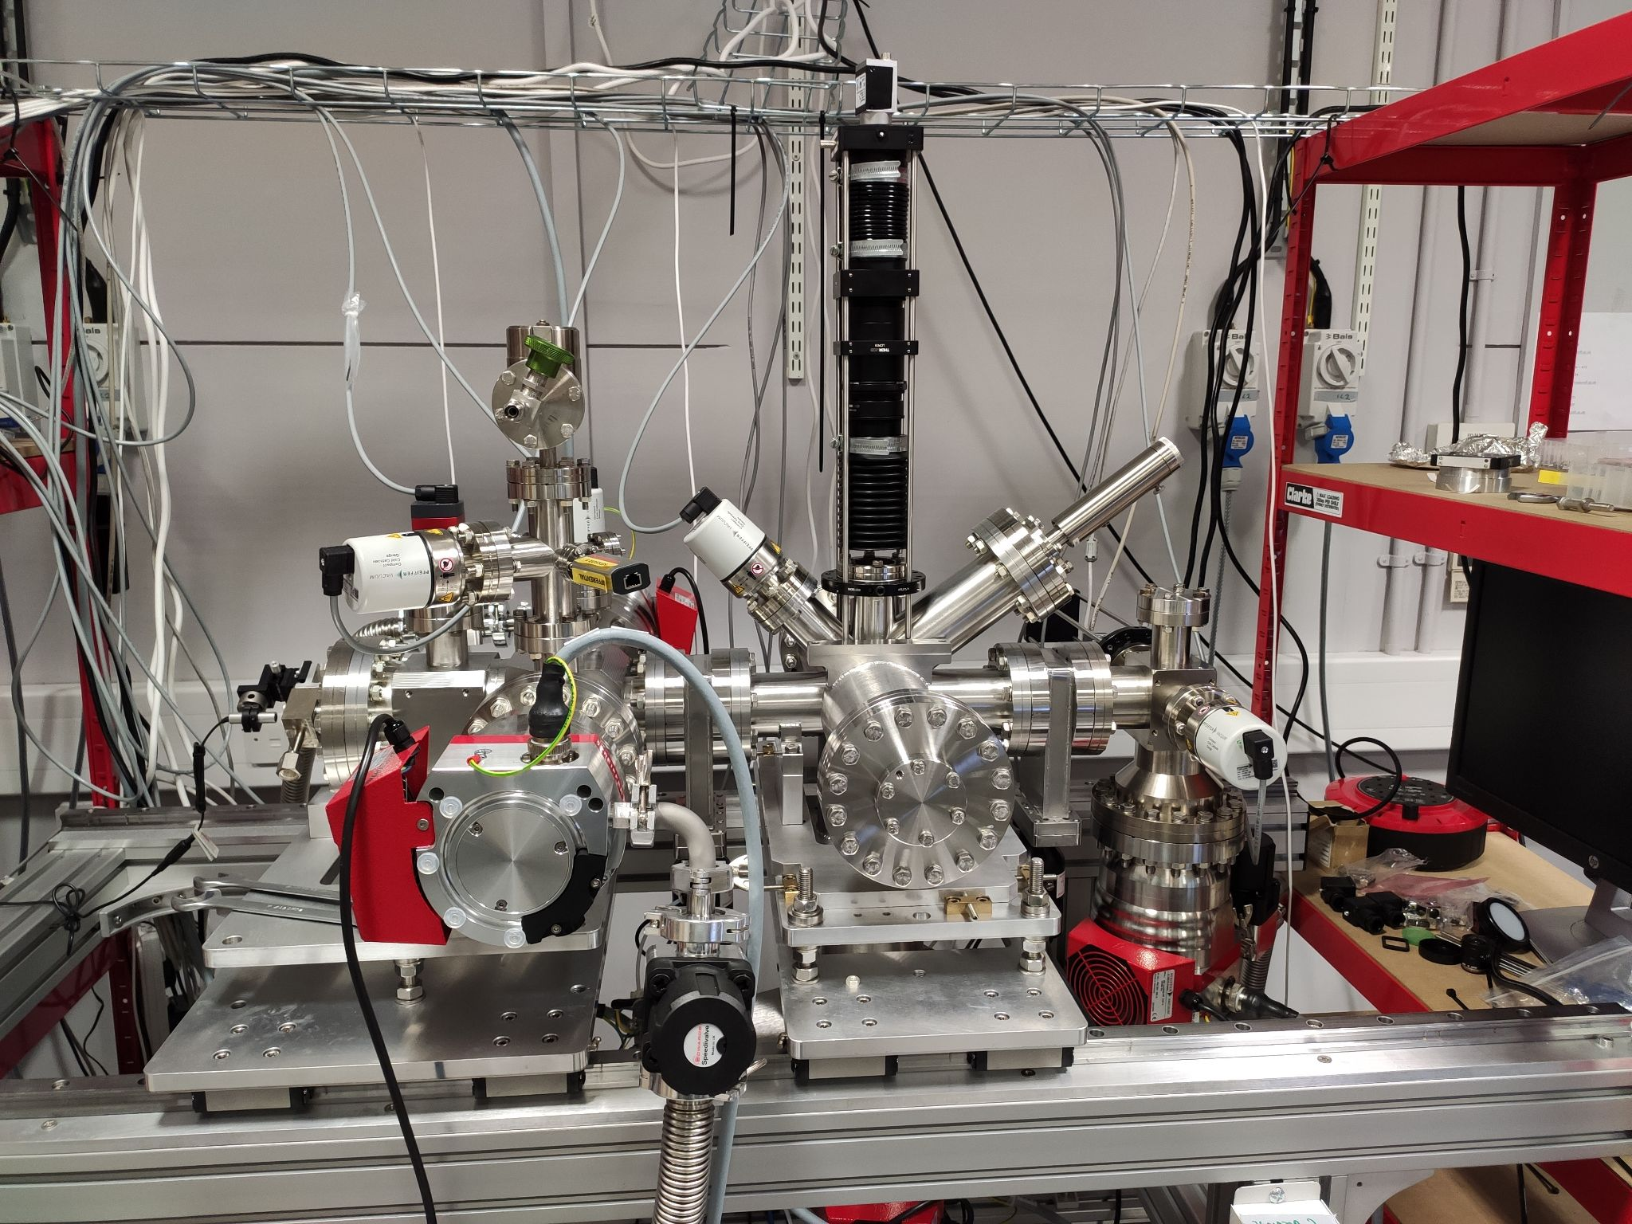
Want big impact? Use big image.
Version 3 of Gas Jet monitor at Cockcroft Institute

Slide 10
Journey of Gas Jet monitor Version 3
V3 developed and assembled at CI
Transport of V3 to CERN
Installation and commissioning of V3 on EBTS
Installation of V3 at LHC
2021-2022
1
Last week!
3
Summer 2022
5
End of 2022 or 2023
Version 2
-> 2021
2021-2022
Currently!
2022-2023?
2
4
6
Tested, optimized at CI
Installation and commissioning as a stand-alone
Experiments of V3 on EBTS

Slide 11
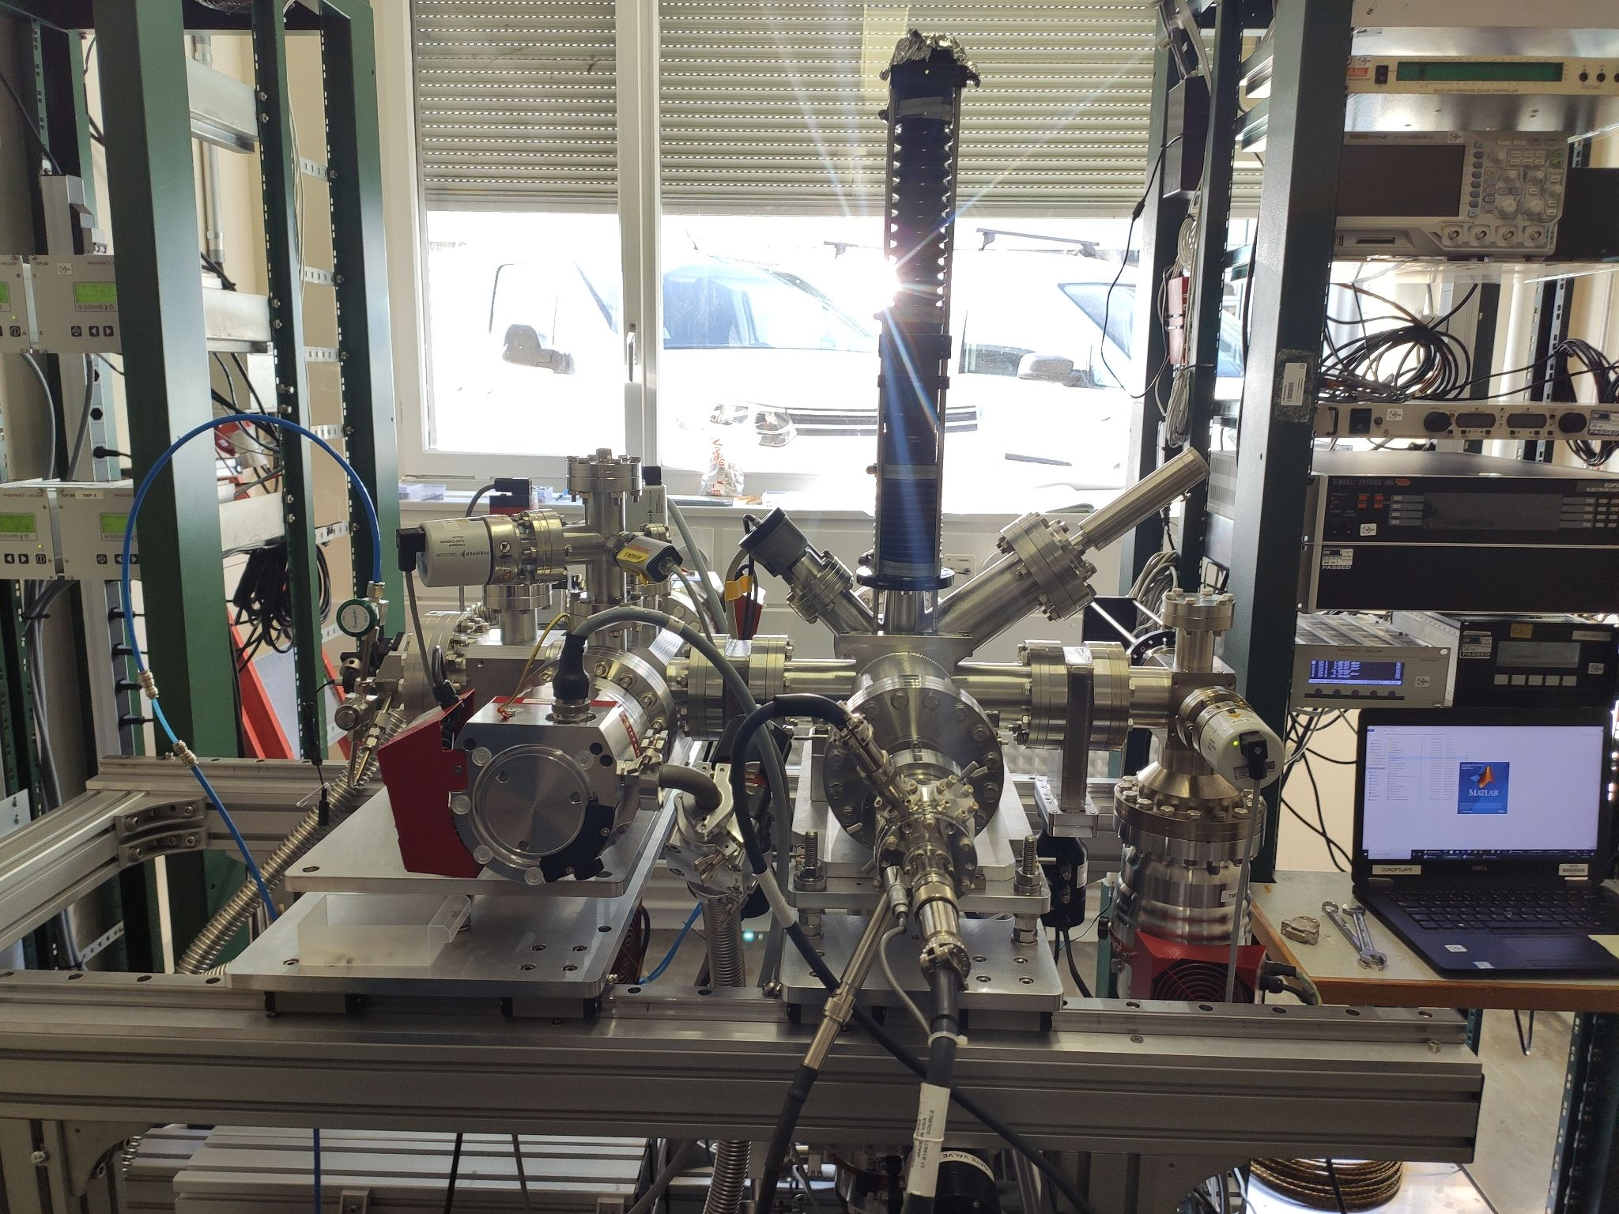
Want big impact? Use big image.
Version 3 of Gas Jet monitor installed at CERN!

Slide 12
Current status of V3 at CERN
Nozzle-Skimmer assembly realigned
  Alignment setup in lab 865/1-A04
  Alignment laser on V3 check successful!
System assembled and closed
  Last Friday (25.3.) pumping started
  After cca 25min - pressures ~ 10⁻⁷mbar
  After cca 70h - pressures ~10⁻⁸ - 10⁻⁹ mbar
-> Successful system pump down!
Notes:
Picture of the alignment setup. Should I mention that most screws were changed to the silver coated AT? 100 grade? What about the malfunctioning pressure gauge 1?

Slide 13
Current status of V3 at CERN
Intensified camera
  Hamamatsu camera installed
  Custom mount
  Focused on the target
Gas Jet tested - Successful!
  Pressures:
Electron gun
  Tested and ready
-> System ready for gas jet measurements!
Notes:
Figure of the camera an the custom mount. Fill in the pressures with gas jet on

Slide 14
Distributed gas experiments at LHC

Slide 15
Aim of the experiments
Fluorescence cross-sections & LHC beam profile
Neon - working gas
  Locally distributed to LHC pipe
  Max pressure - 5x10⁻⁸ mbar
Protons
  Flat top - 6.8 TeV
  Injection - 450 GeV
Lead beam - end of 2022
Notes:
What is gonna be the energy of the lead beam? Should I put it here since it is interesting from fundamental science point of view, but not really to our project?
Should I put all the numbers here? Or just the expected number of photons/bunch/s and photons/s and then putting all the numbers into backup slides? Maybe also include the expected integration times? Which is rather hard to estimate I guess since we don’t know the bacground…

Slide 16
Planned experiments at LHC - 2022
Background light
Synchrotron radiation
Distributed gas measurements
Max pressure - 5x10⁻⁸ mbar
First injection
  Carefully observing BLMs, and local RadMONs
  In contact with OP
When: (May? ->)
Commissioning:
  First nominal bunch
  450 GeV train
  First stable beam
Proton physics field
Ion beam
Injection tests
First injection
Main measurements
Interesting physics
Notes:
What kind of OP? Is the style clear and not overcrowded?

Slide 17
Camera module at LHC

Slide 18
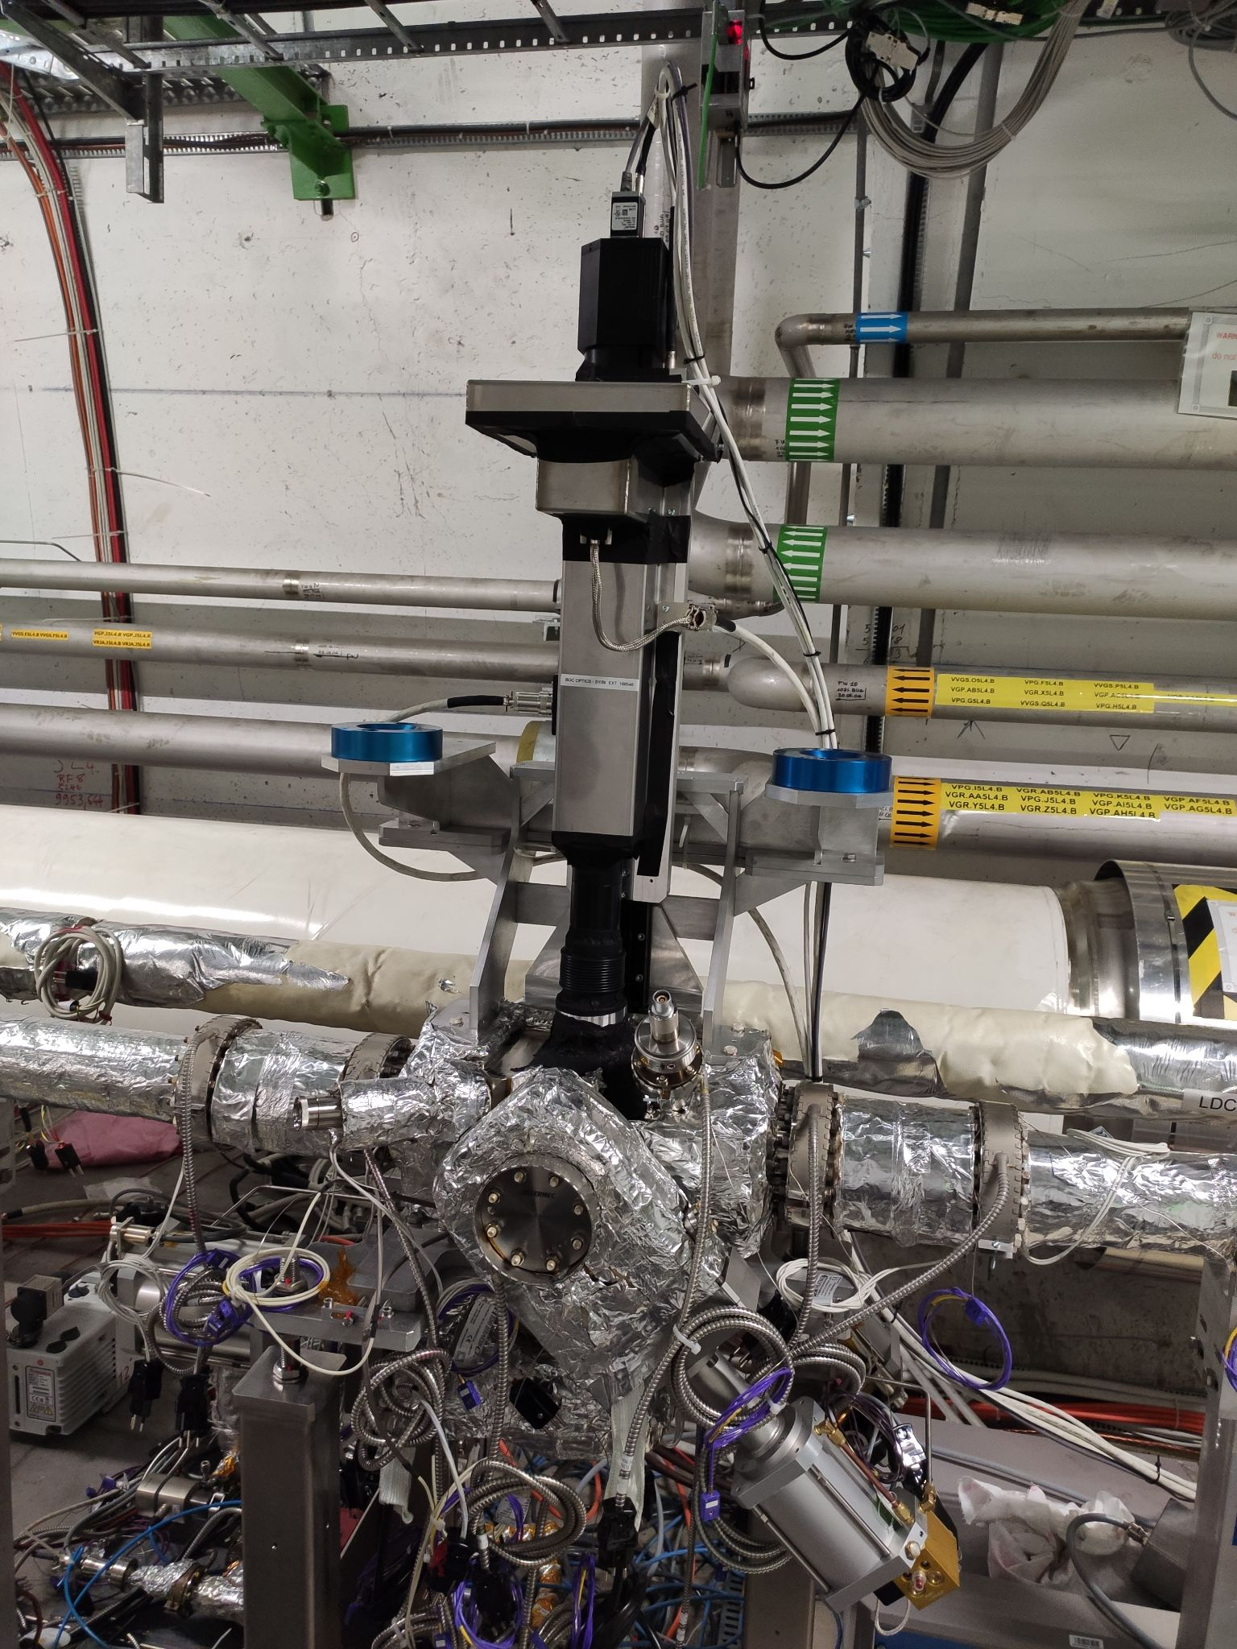
Camera Assembly
Filter wheel
585∓10nm
UV
ND3
Block
Through
Intensified camera
From V3
Lens
Apochromatic triplet
Motorized vertical mover
Adjusting the position of focal plane
Target
For focusing
Insertable
Notes:
What else should be described here? Pressure gauge?, Gas injection? What is the UV filter wavelength?

Slide 19
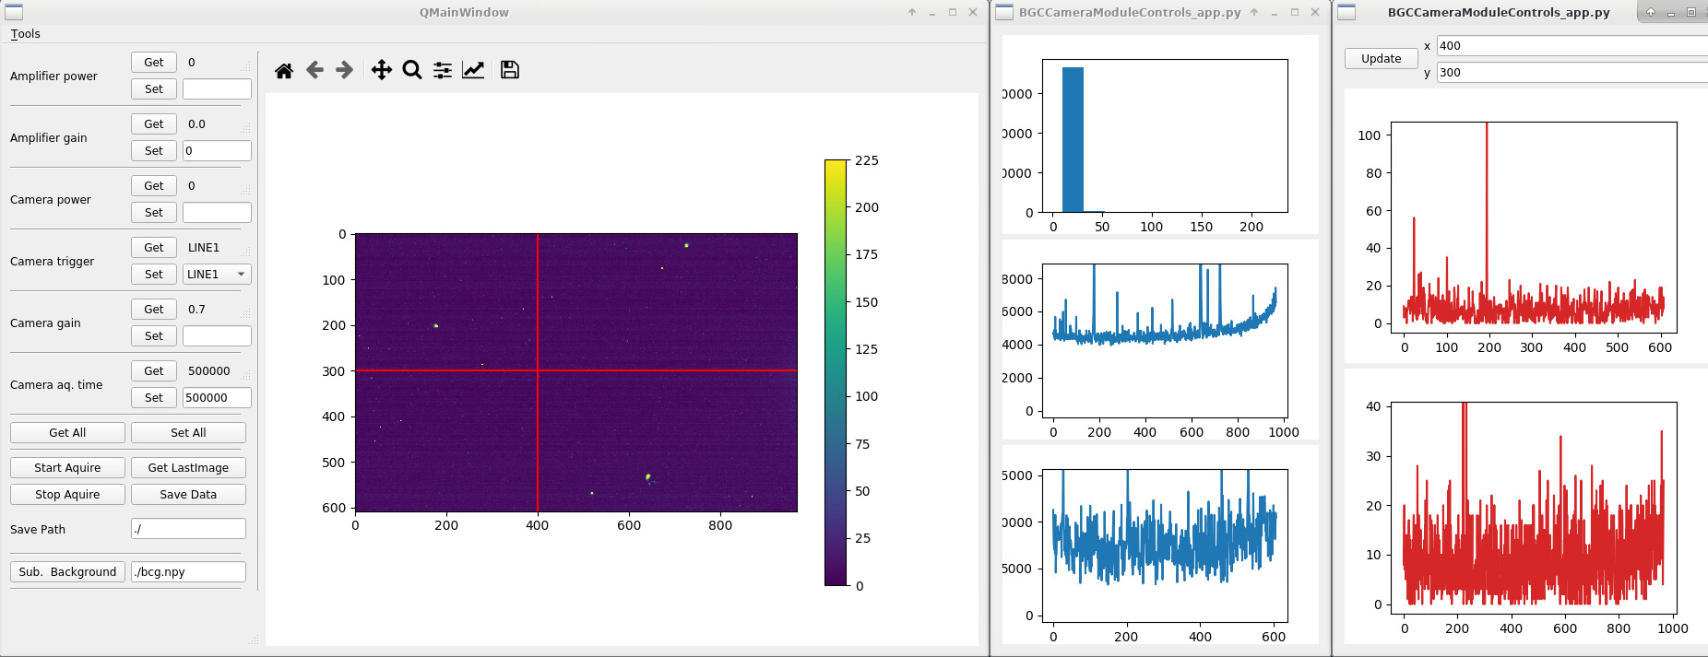
Control application

Slide 20
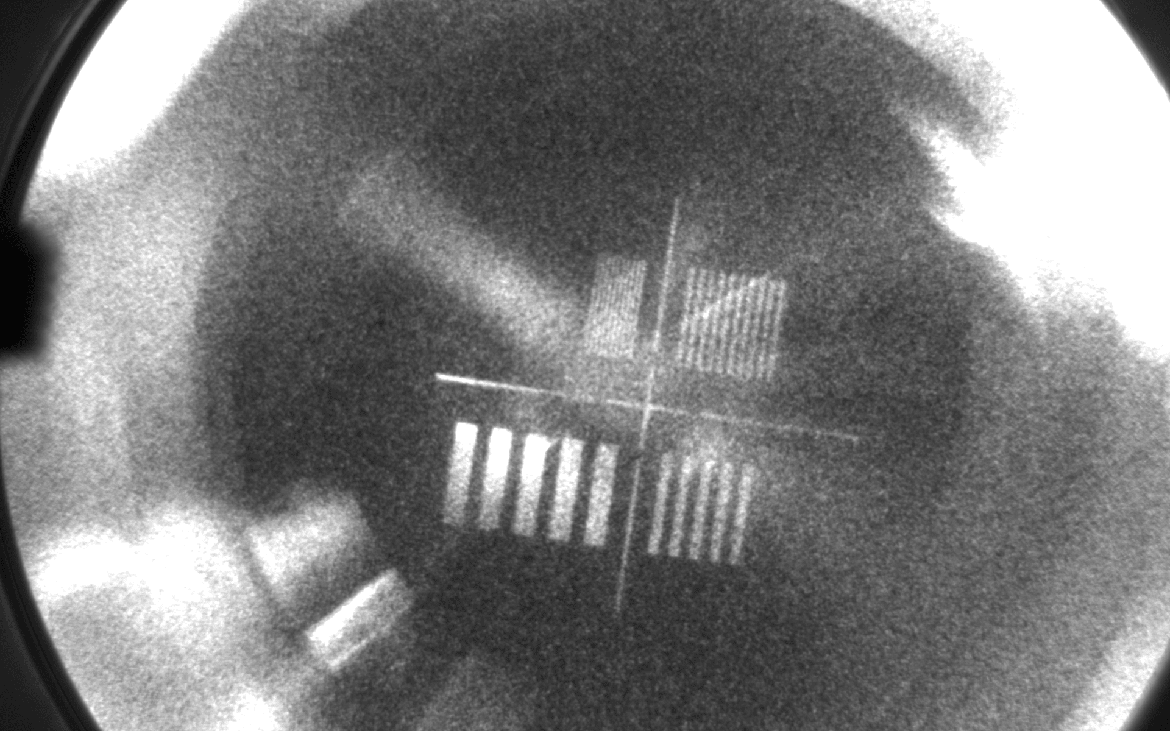
Optical system
0.25 mm/line
Optics focused
System ready for measurements
0.125 mm/line
1.0 mm/line
0.5 mm/line
Magnification | 0.205
Pixels/300um | 10.5
Out-pipe background
Window flange
In-pipe background
Notes:
Should there be also the optical curve of the setup measured at the lab? (or maybe just the visibility for 300um?)

Slide 21
Thank you for your attention!
Any questions?
ondrej.sedlacek@cern.ch

