Slide 1


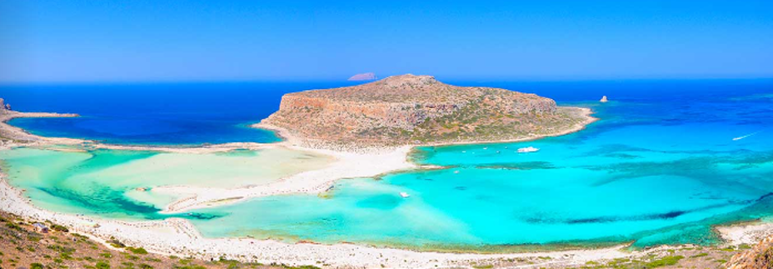
2nd MODE Workshop
Kolymbari, Sep 13-15 2022
Opening Remarks
Tommaso Dorigo, INFN - Padova

Slide 2
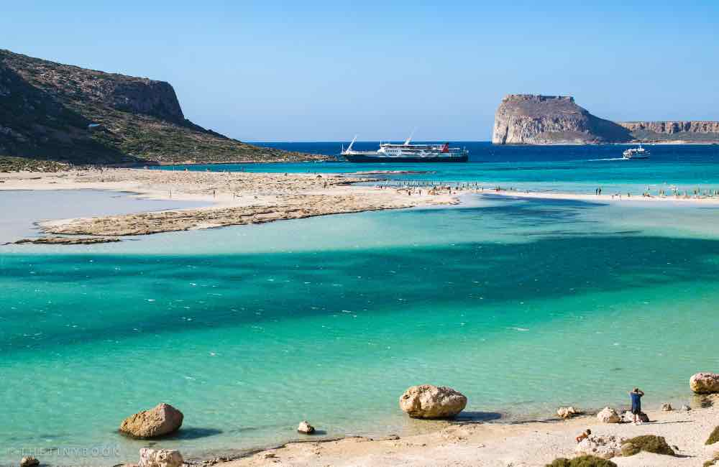
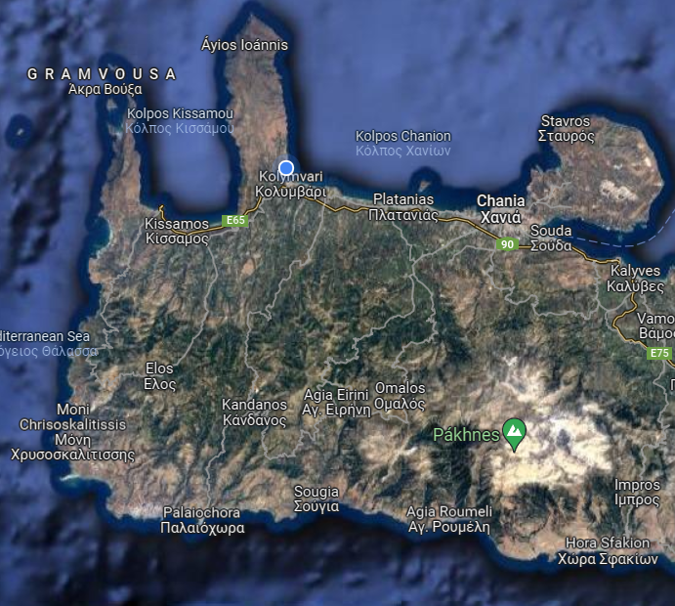
Welcome to Kolympari!

Slide 3
Goals of this workshop
Discuss progress in end-to-end optimization of experiments
Identify potential problems of common interest
Bring more attention to DP techniques from fundamental science practicioners, involve them
Create the conditions for successful grant applications
Strengthen synergies between computer scientists and physicists, LEARN stuff from CS experts

Slide 4
How we got here
To introduce this workshop, I thought I would give you my very personal, very brief, recollection of how we got to organize our efforts and create the MODE collaboration
As with any personal recollection, it will be full of ex-post adjustments and slight mischaracterisations...
The advantage is to have a story to support and motivate our action!

Slide 5
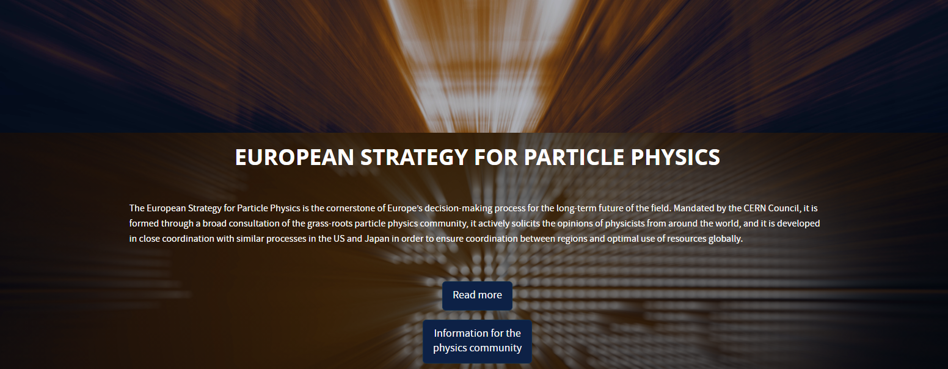

How we got here – 1: thinking long term

Slide 6
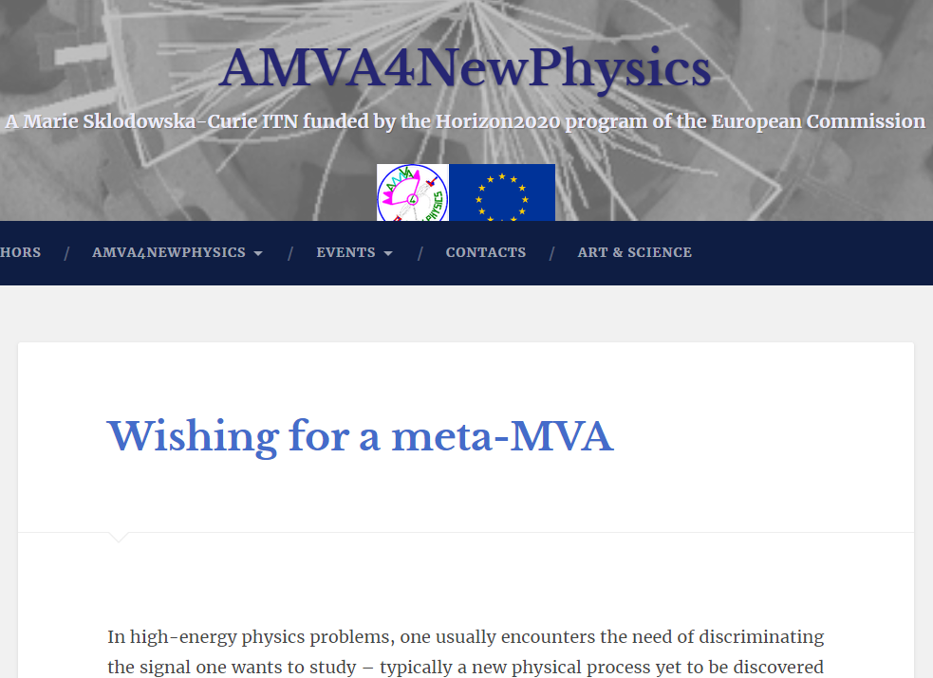
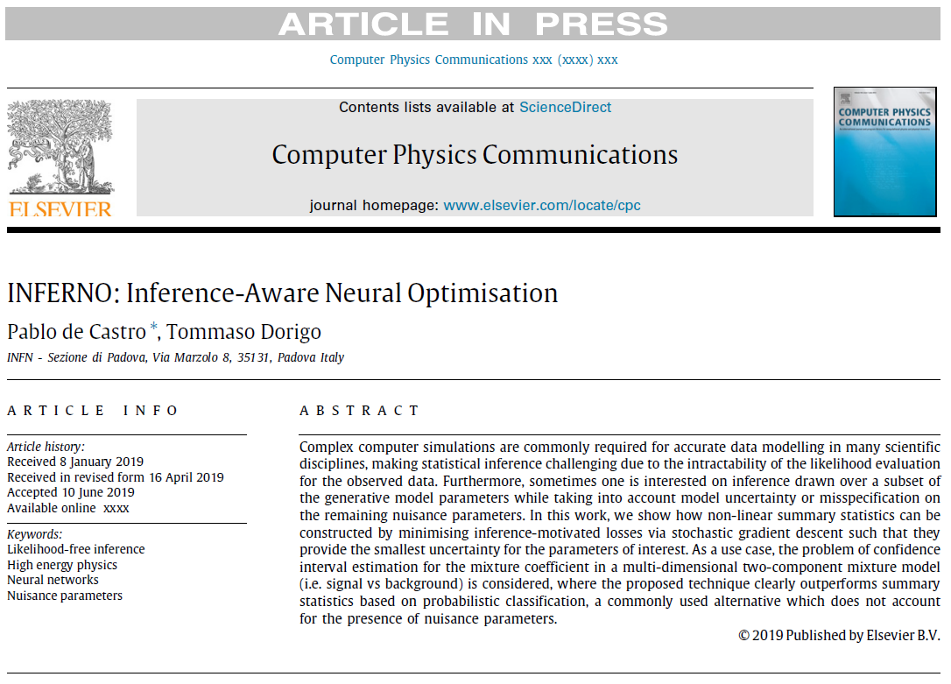
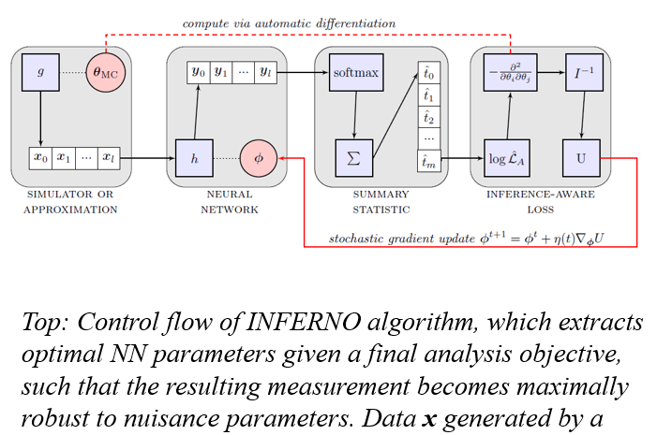
How we got here – 2: INFERNO

Slide 7
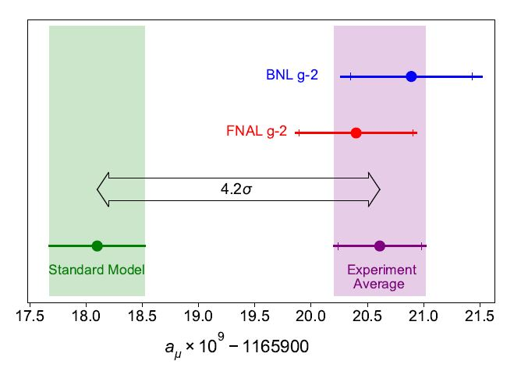
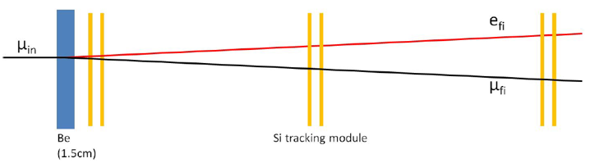
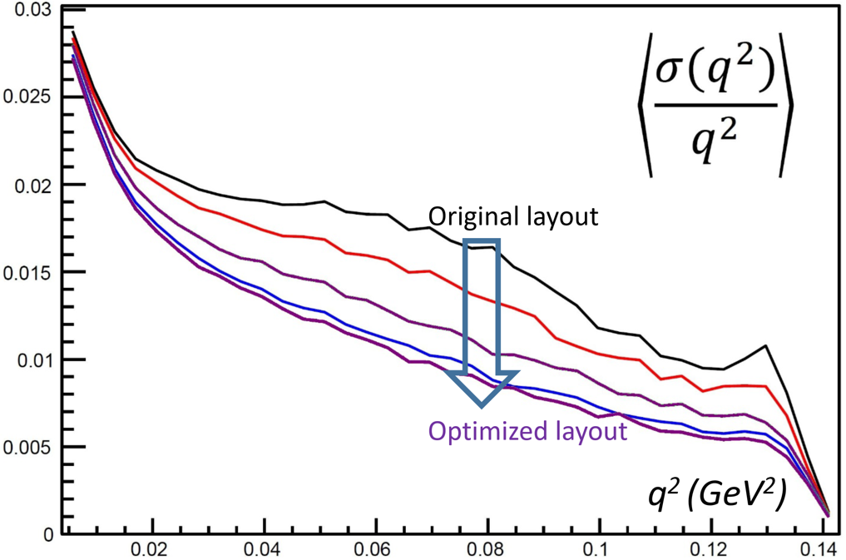
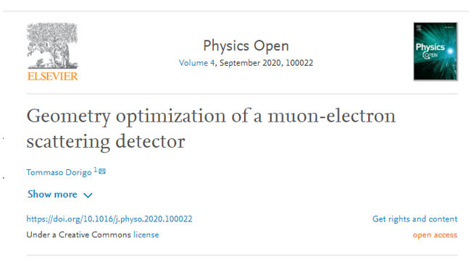
How we got here – 3: MUonE

Slide 8
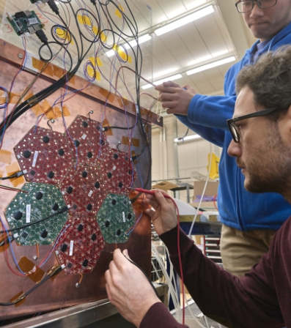
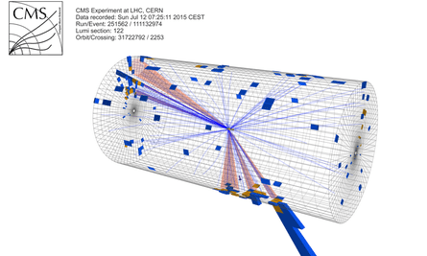
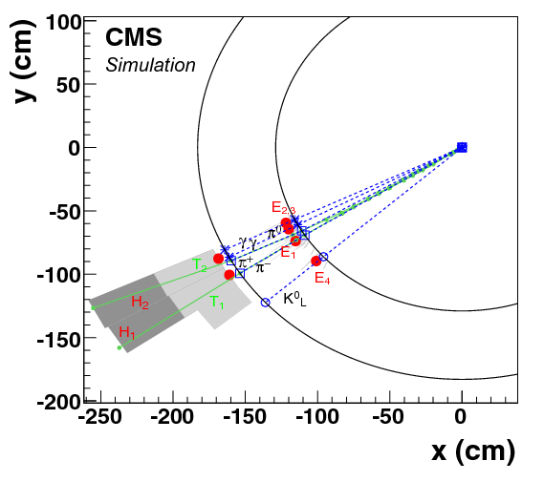
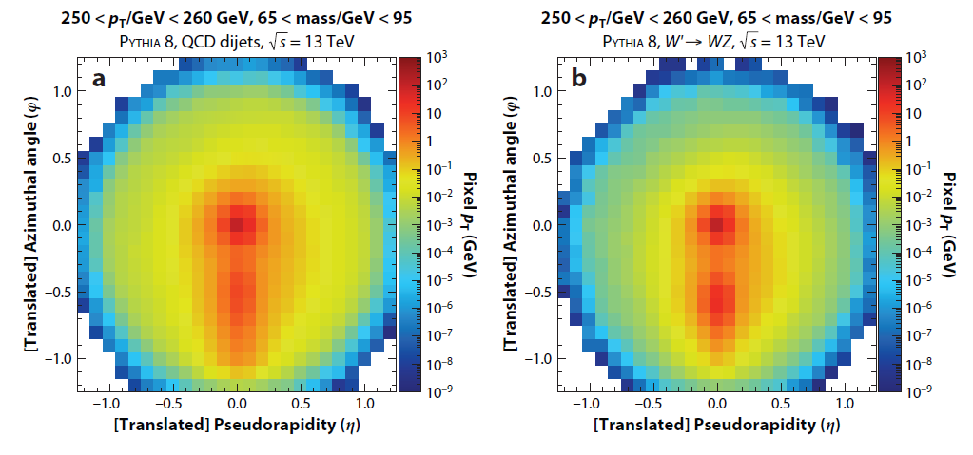
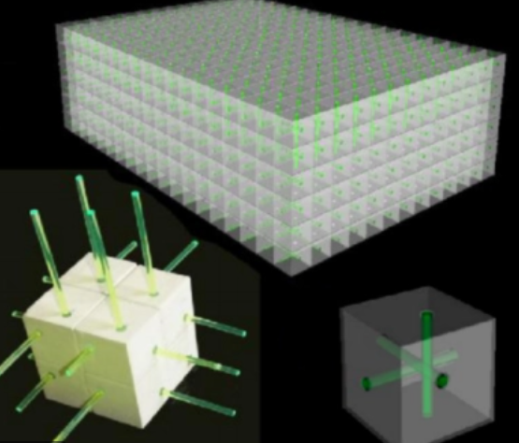
How we got here – 4: misalignments, serendipity, and opportunities

Slide 9
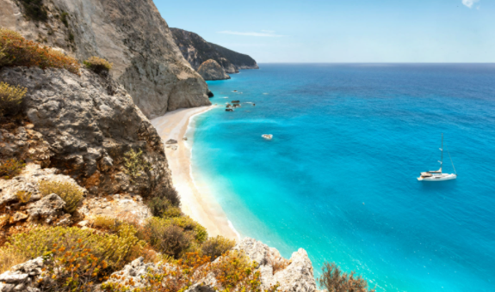
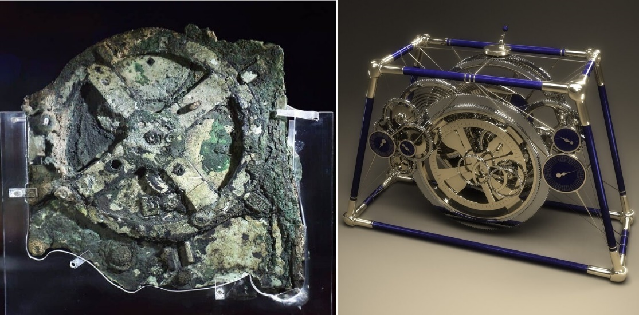
How we got here – 5: when technology exists, and it is not used...
The 1901 discovery of a wrecked ship in front of Antikythera, a Greek island south of the Peloponnese, brought evidence that the ancient Greeks could craft very complex instruments to predict eclipses and the position of planets, moon and sun at the turn of a crank
It has been argued that such technological marvels could have spurred a revolution that would have brought us to the technology level we’re at now in 300 years, but it did not – there were not enough use cases to attract those early inventors’ wits, nor resources to support basic research.
I’m not saying we run the same risks as the Greeks (and humanity) of 2500 years ago, but revolutions do not start by themselves – we have to take the new technology and adapt it to our use cases!

Slide 10





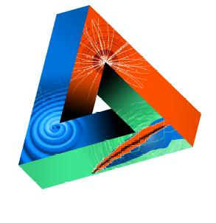












Machine-Learning Optimized
Design of Experiments
MODE Collaboration
https://mode-collaboration.github.io
A. G. Baydin⁵, A. Belias¹⁰, A. Boldyrev⁴, K. Cranmer⁸, P. de Castro Manzano¹, T. Dorigo^{1,14}, C. Delaere², D. Derkach⁴, J. Donini³, F. Fanzago¹, A. Giammanco², C. Glaser¹¹, L. Heinrich¹², J. Kieseler⁷, C. Krause¹³, M. Lagrange², M. Lamparth¹², G. Louppe⁶, L. Layer¹, F. Nardi^{3,14}, P. Martinez Ruiz del Arbol⁹, F. Ratnikov⁴, P. Stowell¹⁵, G. Strong¹, M. Tosi^{1,14}, A. Ustyuzhanin⁴, P. Vischia², H. Yarar¹ ,H. Zaraket¹⁶
1 INFN, Italy
2 Université Catholique de Louvain, Belgium
3 Université Clermont Auvergne, France
4 Laboratory for big data analysis of the HSE, Russia
5 University of Oxford
6 Université de Liege
7 CERN
8 New York University
Sponsored by
9 IFCA, Spain
10 GSI, Germany
11 Uppsala Universitet, Sweden
12 TU Munchen, Germany
13 Rutgers University, US
14 Università di Padova, Italy
15 Durham University, UK
16 Lebanese University, Lebanon
JENAS

Slide 11
Seeking support: it’s hard!
As with any new, far-fetched, vague good idea, it is difficult to win the support of the community
Short history of failures:
(pre-)MODE asked to be part of AIDA++ → lots of pats in the back but no
MODE proposed to be an EoI of JENAS → accepted
MODE proposed an italian group in INFN → rejected
ERC proposal by TD → rejected
Funding for workshops asked to INFN → rejected
The reason of the generally negative feedback we are getting is that the detector building community is not very receptive of the kinds of innovations we propose to develop.
This workshop is full with bright young people who will be the leaders in the future
Please remember, when you will get tenure, to keep an open mind and support bold new initiatives – we are researchers, so don’t settle to pushing your cart!

Slide 12
Where we stand today
Significant progress in a number of applications of interest, e.g.
Optimization of EM calorimeter for upgrade of LHCb
Scattering tomography with cosmic muons
Proof of INFERNO on LHC data
Optimization of pCT
More such studies have started / are planned:
Optimization of EM calorimeter for Muon Collider project
Optimization of SWGO water tanks and layout
Optimization of LEGEND detector for double beta decay studies

Slide 13
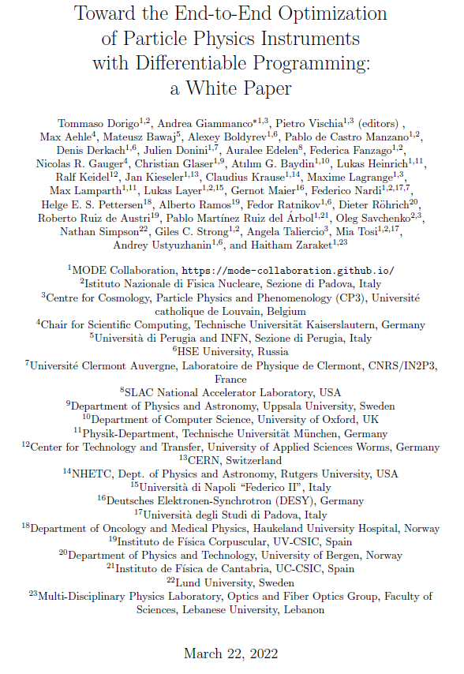
Our White Paper...
Ended up being a very nice, fat (107 pages) document, thanks to the effort of a few (especially Andrea Giammanco who drew the strings)
... But there are some rough edges to smoothen before we submit it to a journal
- we are working on it
Meanwhile, we plan to produce another publication.
Like the white paper, it will contain material from selected contributions to this workshop

Slide 14
The 2022 «progress» paper
We propose that the new article be titled «Progress in end-to-end optimization of experiments with differentiable programming» or something similar.
Rules of the game:
we are happy with an author list as long as it can be
contributions should be strictly on topic (thus a subset of the contributions to this workshop)
I propose that there be four ways to be authors of this article:
We invite you to submit 2/4 pages summarizing a contribution to the workshop we found belongs to the scope of this article
You propose to write 2/4 pages on a topic that aligns with the proposed article contents, and we give a green light
You offer to review at least two contributions from other authors
  - this means that you are (partly) responsible for the content as well as for the style and editing of the contributions
You participate in other ways in the organization of the effort (to be decided by the MODE SB)

Slide 15
The 2022 «progress» paper / cont’d
Similarly to how we organized matters for the white paper, we plan to have «editors» as first signatories of the article. Last time we had myself, Andrea, and Pietro.
I propose that editors be a subset of the reviewers who also contributed text. Editors should define the format and contents, accept proposals for contributions, define deadlines etc.
- natural candidates for editorship are session conveners and topic experts, but we will consider your volunteering anyways
- you can volunteer to be an editor, but I would ask that you become a member of MODE if you aren’t already
All these are details subject to be finalized, but I think they summarize the way we want to handle this.

Slide 16

Huge thanks to our sponsors!!
This workshop could not have happened if not for the generous support of Iris-HEP and JENAS
Iris-HEP is the Institute for Research and Innovation in Software for High Energy Physics (IRIS-HEP), https://iris-hep.org/about/overview
JENAS is a consortium of Appec-NuPeCC-ECFA, https://www.appec.org/implementation/joint-ecfa-nupecc-appec-activities
We should also acknowledge Pietro Vischia’s contribution with personal research funds from U. cath. Louvain!

Slide 17
Enjoy the workshop!

