Slide 1
GitOps in MONIT
Luca Bello
27.04.2022

Slide 2
Our history with GitOps
Flux1 QA Cluster
September 2021
Flux2 QA Cluster
February 2022
Flux2 Dev Clusters
April 2022
July 2021
First Flux1 Deployment
January 2022
Investigating Flux2
March 2022
OCI Cluster
Kubernetes 1.22
Flux2 in production
Today
Presentation!
  Over time, we started managing more and more services in Kubernetes
  The cluster growth made us face Flux1 limitations: poor multi-environment support, monolithic release configurations, no internal monitoring, weird interactions with Helm3, and more
  Flux2 solved all those issues, allowing for smooth and simple Kubernetes operations

Slide 3
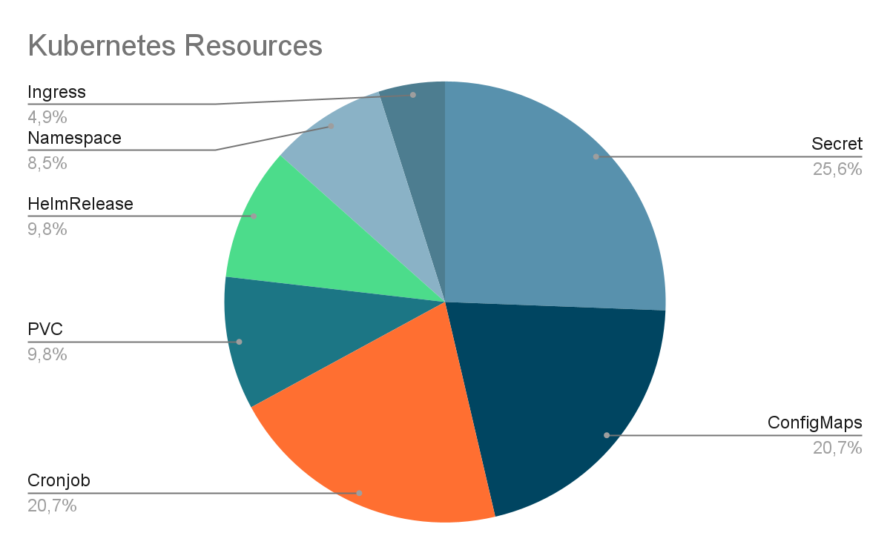
Tools and resources
Flux2
  Repository as single source of truth
  Extremely flexible
Helm3
  Simple configurable deployments
GitLab CI
  YAML linting and validation
  Automatic QA rebase for remote-probes
SOPS
  Secrets encryption with AGE keys

Slide 4
Clusters
Multiple clusters and environments
  Production, QA, Development, OCI
  Extremely flexible
Development environment in 3 clusters
  Dedicated cluster for bigger namespaces
  Better isolation for component changes
  Allows for cleaner release process
Production
monit-cortex
monit-cron
monit-mom
monit-remote
monit-sli
monit-snappy
QA
monit-cortex
monit-cron
monit-mom
monit-remote
monit-sli
monit-snappy
Oracle Cloud Infrastructure
monit-remote
Development
dev-default
monit-cron
monit-mom
monit-sli
Development
dev-cortex
monit-cortex
Development
dev-remote
monit-remote

Slide 5

Flux2 Folder Structure
Things to deploy on Kubernetes
HelmReleases
Cronjobs
Secrets
Ingress
PVCs
PVs
Flux configuration for each cluster, and more cluster-specific resources
Kustomizations
Ingress
Common infrastructure tools that are necessary for apps
Namespaces
Helm Sources
apps/
clusters/
infrastructure/
apps/base/
clusters/base/
apps/production/
clusters/production/
apps/qa/
cluster/qa/
apps/dev/
clusters/dev-default/
apps/oci/
clusters/dev-cortex/
clusters/dev-remote/

Slide 6
Flux2 Files
Flexible inner file structure
  Files are explicitly included in Kustomization resources
apps and infrastructure split by namespace
  Quick identification and localization of errors
  Errors in a namespace don't stop the reconciliation for the others
  Reconciliation can be suspended with finer granularity
Clear separation between default configurations and patches
  Higher degree of modularity which makes for a better development process
  Makes our multi-environment setup very easy to manage
DEMONSTRATION

Slide 7
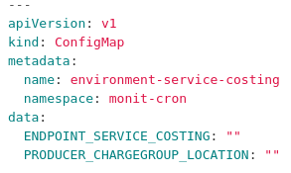
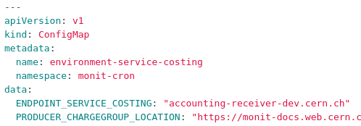
Releases
Helm based configurations are shared across environments
  Environment-specific values can be specified with patches
  Our Cortex deployment shrank from 1500+ lines to only 60
Cronjobs patched by ConfigMaps
  ConfigMaps can be mounted to export environment variables

Slide 8
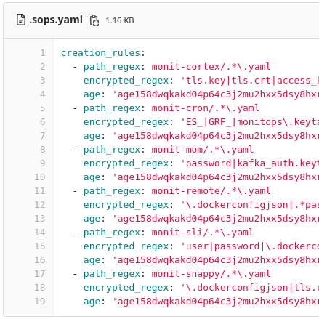
Secrets
Secrets are managed via Mozilla's SOPS
  Allows to encrypt parts of a file so it can be safely uploaded to the repository
  Identify secret fields with regular expressions
  Flux2 automatically decrypts the files in the reconciliation process
  Encryption using simple AGE keys, but lots of options are supported
Higher modularity means we can encrypt only what's necessary

Slide 9
Release Process
dev-default
MR
MR
MR
qa
MR
rebase
MR
master
Remote Probes

Slide 10
Continuous Integration
Automatic rebase of QA on master
  monit-remote-probes commits directly to master
  Helps to maintain QA and master in sync
YAML linting and validation
  Helps to spot early mistakes and ensures style consistency
  Possibility to perform validation against specific Helm chart schemas in the future

Slide 11
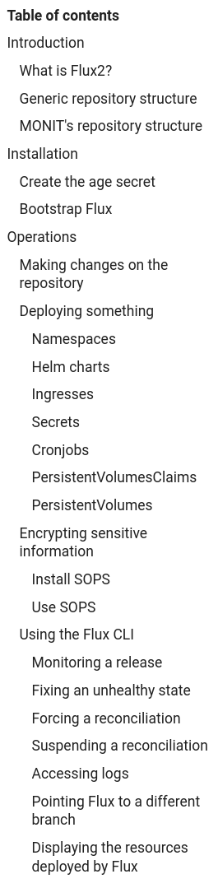
Documentation
Over time we wrote an extensive Flux2 documentation (3500+ words)
  Step-by-step guide and examples
  Includes a troubleshooting section for common issues
Currently internal as it includes MONIT-specific details
  We would be happy to generalize it and make it available to everyone!

Slide 12
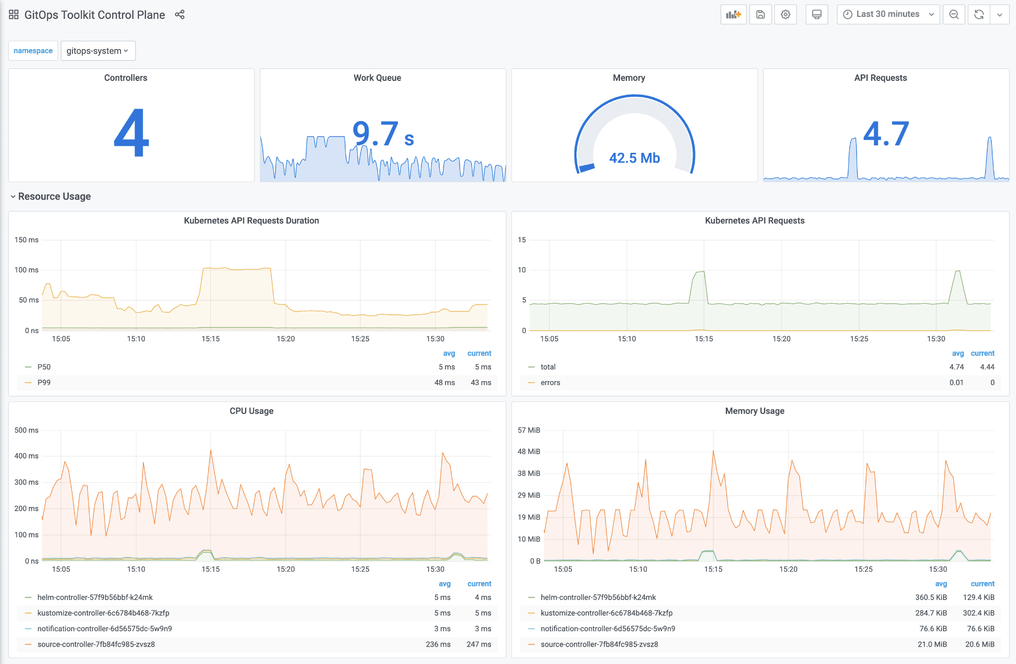
Future Plans
Flux2 internal monitoring
  Custom Grafana dashboards
  Supported out-of-the-box
  Useful to make sure Flux2 is always in a healthy state

Slide 13
What we are happy with
Easy and powerful multi-environment support
Familiar development process with one single source of truth
Explicit and declarative inclusion of resources
Actual separation between namespaces when reconciling
Modular resource configurations
  The files to maintain more frequently are very slim
Transparent integration with Helm3 and SOPS
Internal monitoring with Grafana

Slide 14
Q & A

