Slide 1
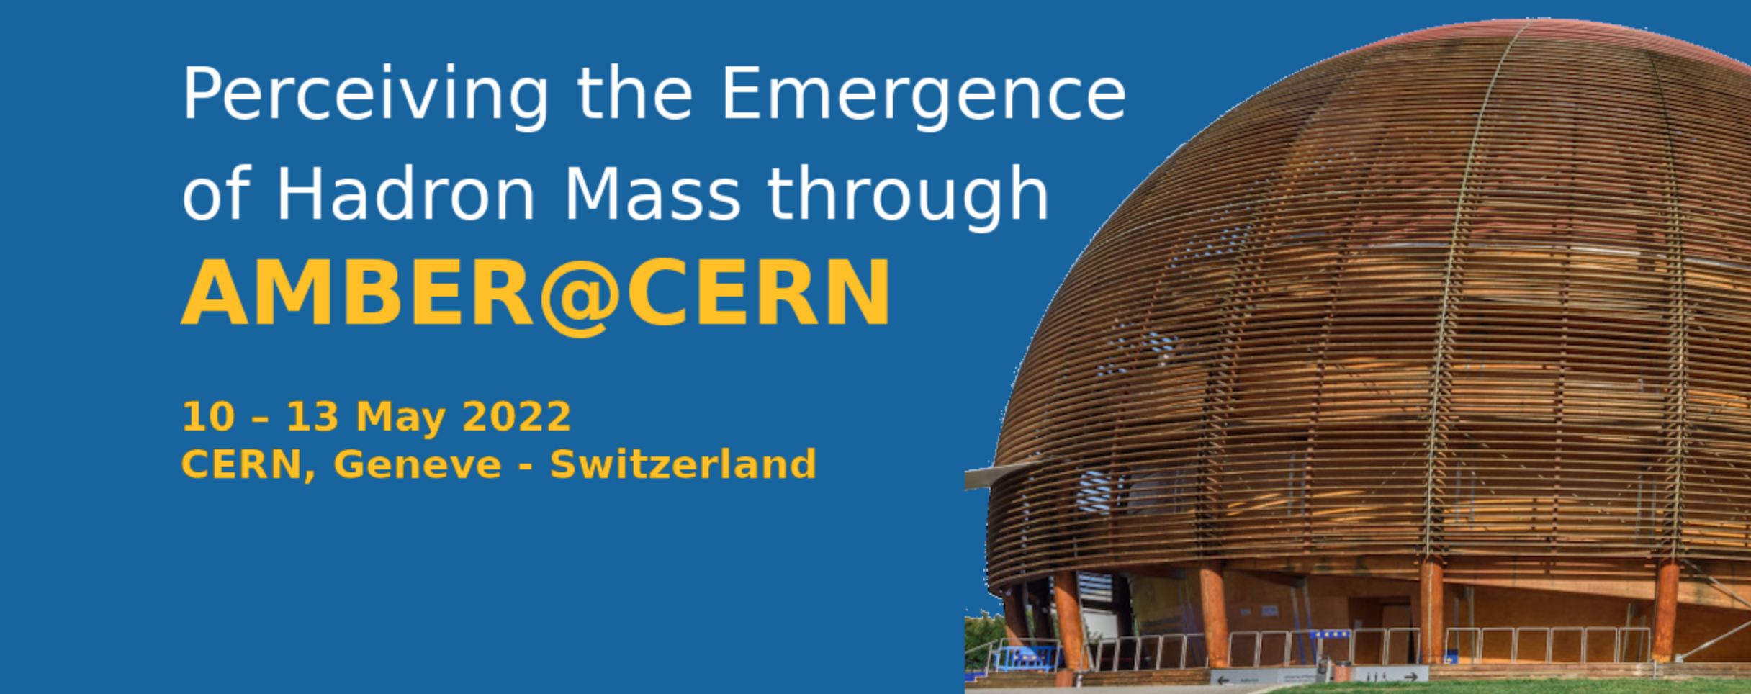




Insight into EHM from Results on Electroexcitation of Δ(1600)3/2⁺ Resonance
CSM concept for EHM and predictions for hadron structure observables
γ_{v}pN* electrocouplings from CLAS
Connecting γ_{v}pN* electrocouplings to EHM within CSM
Validation of the CSM concept for EHM from the γ_{v}pN* electrocoupling studies
Gaining insight into EHM from the CLAS12 data and after increase of JLab energy/luminosity
Conclusions and outlook
V.I. Mokeev
Jefferson Lab
(CLAS Collaboration)

Slide 2
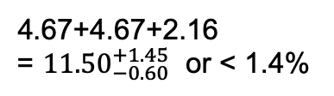
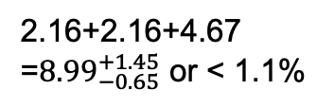
How do the Ground/Excited State Nucleon Masses Emerge?
Composition of the Nucleon Mass:
proton
neutron
M_{p}, MeV (PDG20)
M_{n}, MeV (PDG20)
938.2720813
±0.0000058
939.5654133
±0.0000058
Sum of bare quark
masses, MeV
Sum of bare quark
masses, MeV
2.16+2.16+4.67
=${8.99}_{−0.65}^{+1.45}$ or < 1.1%
4.67+4.67+2.16
= ${11.50}_{−0.60}^{+1.45}$ or < 1.4%
Higgs mechanism generates the masses of bare quarks
Dominant part of nucleon mass is generated in processes other than the Higgs mechanism
The Continuum Schwinger method (CSM) has conclusively demonstrated that the dominant part of hadron mass is generated by the strong interaction in the regime when the QCD running coupling becomes comparable with unity, the so-called strong QCD regime
2

Slide 3
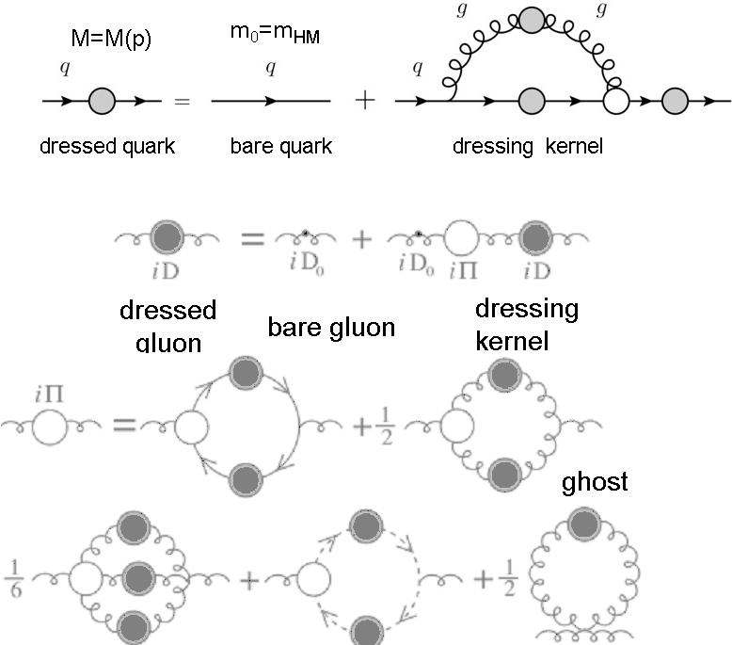
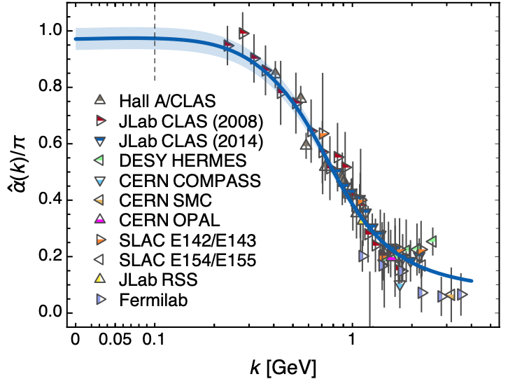
Basics for Insight into EHM: Continuum Schwinger Methods (CSM)
Emergence of Dressed Quarks and Gluons
D. Binosi, Few Body Syst. 63, 2 (2022)
QCD Running Coupling α(k)
Zh-F. Cui et al., Chin. Phys. C44, 083102 (2020)
In the regime of the QCD running coupling comparable with unity, the dressed quarks and gluons with distance (momentum) dependent masses emerge from QCD, as follows from the equations of the motion for the QCD fields depicted above.

Slide 4
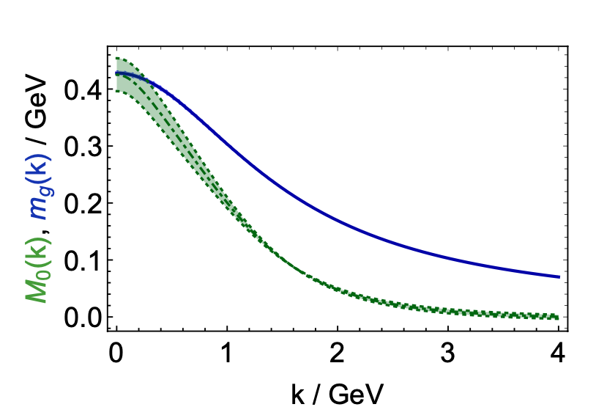
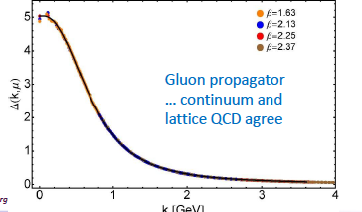
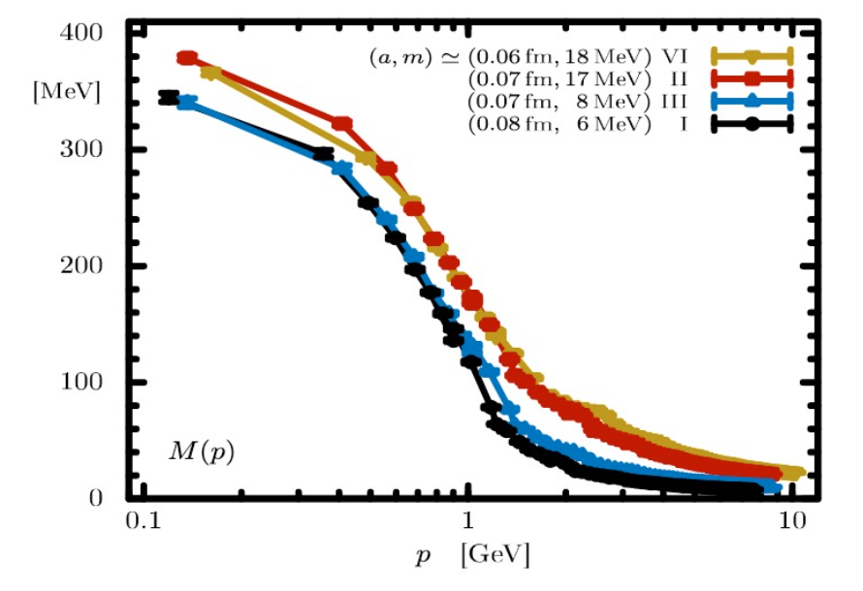
Basics for Insight into EHM: Continuum and Lattice QCD Synergy
Express the fundamental feature: emergence of the quark and gluon masses even in the case of massless quarks in the chiral limit and massless QCD gluons
Continuum QCD results get support from LQCD
Insight into dressed quark mass function from data on hadron structure represents a challenge for experimental hadron physics
Dressed Quark/Gluon Masses (continuum QCD)
C.D. Roberts, Symmetry 12, 1468 (2020)
Dressed
gluons
Dressed
quarks
Inferred from QCD Lagrangian with only Λ_{QCD} parameter
Dressed Quark Mass (lattice QCD)
O. Olivera et al., Phys. Rev. D 99, 094506 (2019)

Slide 5
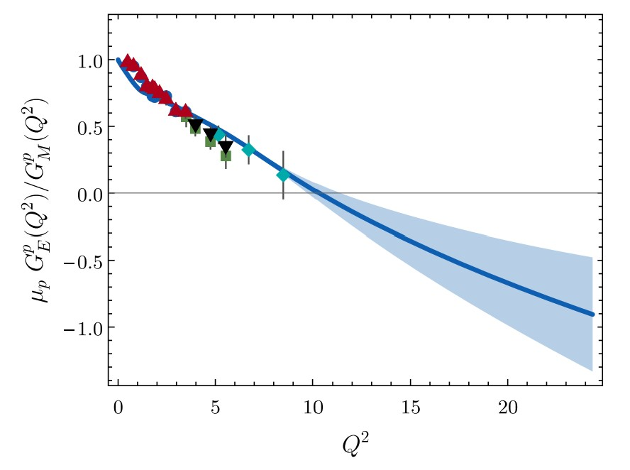
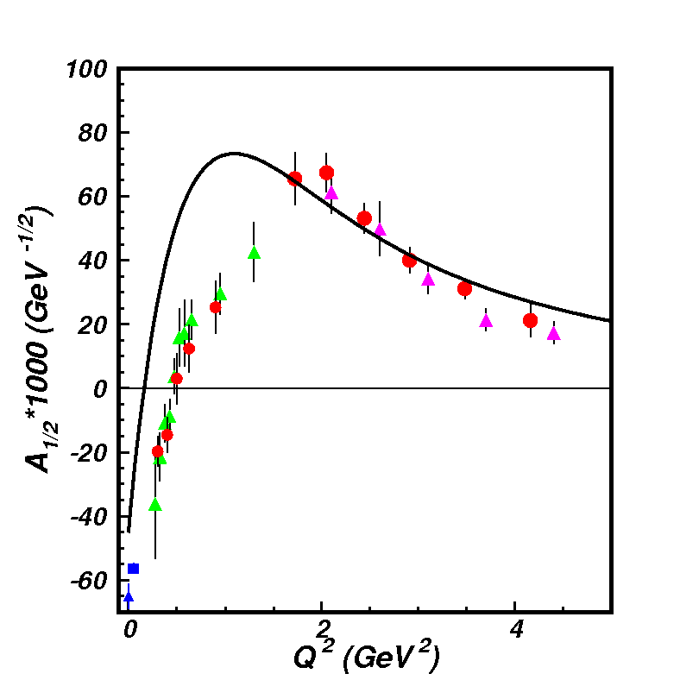
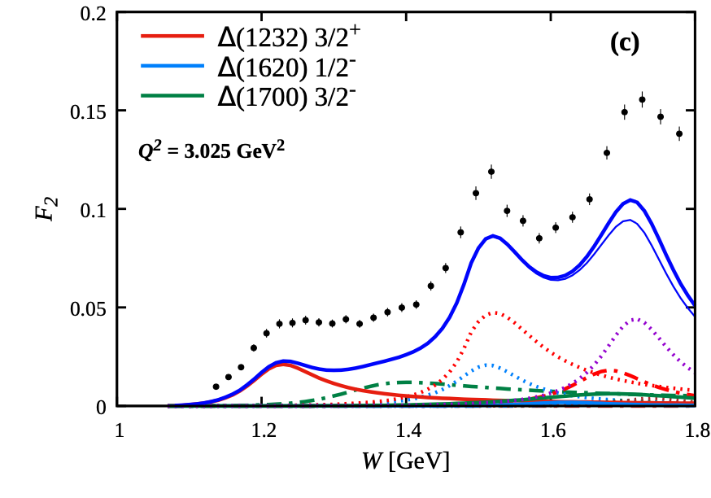
EHM from Global Hadron Structure Analysis
Will be extended by the future data from JLab in the 12 GeV era, AMBER@CERN, EIC, EicC
Nucleon Elastic FF
γ_{v}pN* Electrocouplings
(e,e’X) Inclusive Scattering
N(1440)1/2⁺
μ_{p}G_{E}/G_{M} (Q²)
in DSEQCD
New data from studies of D-Y at AMBER + Sullivan processes at JLab
Dressed Quark/Gluon
Running Masses
Pion Elastic FF
Pion PDF
Dressed
gluons
Dressed
quarks
Insight into the dressed quark/gluon running masses from the experimental results within the continuum QCD approach
4
5
3

Slide 6
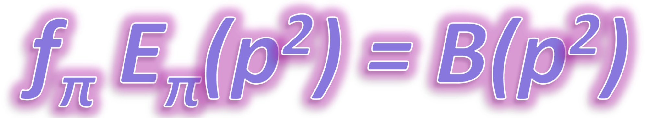
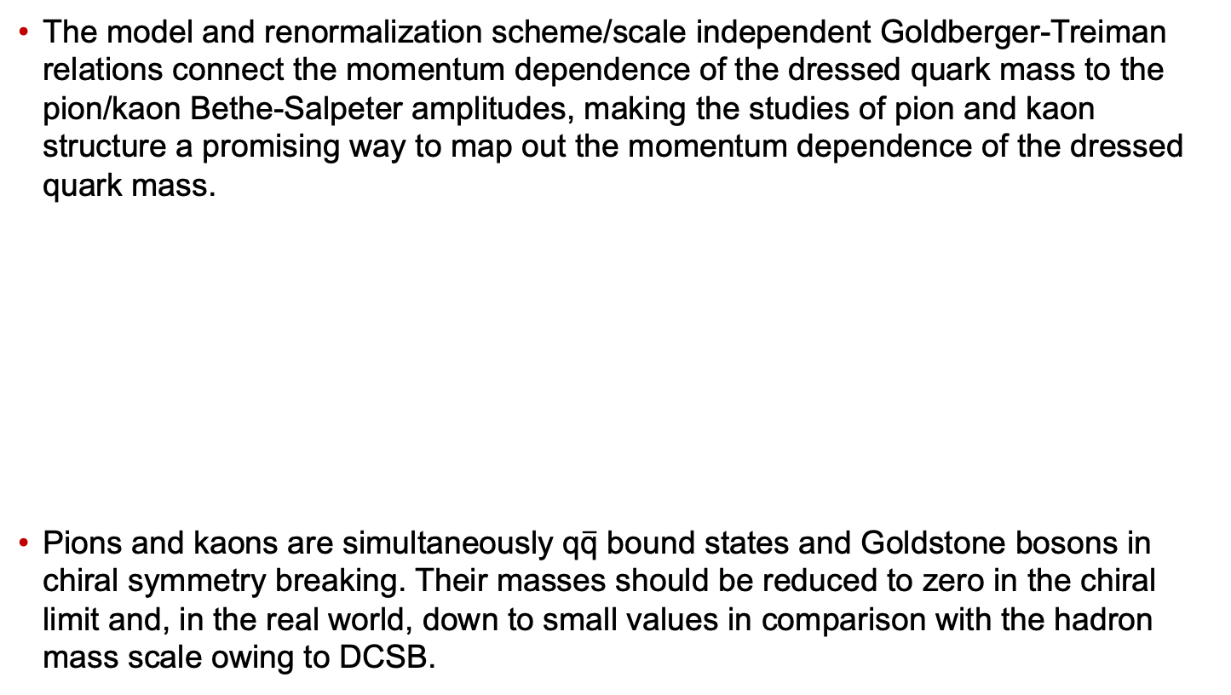
Insight into EHM from the Data on Pion/Kaon Structure
The model and renormalization scheme/scale independent Goldberger-Treiman relations connect the momentum dependence of the dressed quark mass to the pion/kaon Bethe-Salpeter amplitudes, making the studies of pion and kaon structure a promising way to map out the momentum dependence of the dressed quark mass.
Pions and kaons are simultaneously q$\overline{\text{q}}$ bound states and Goldstone bosons in chiral symmetry breaking. Their masses should be reduced to zero in the chiral limit and, in the real world, down to small values in comparison with the hadron mass scale owing to DCSB.
5
6

Slide 7
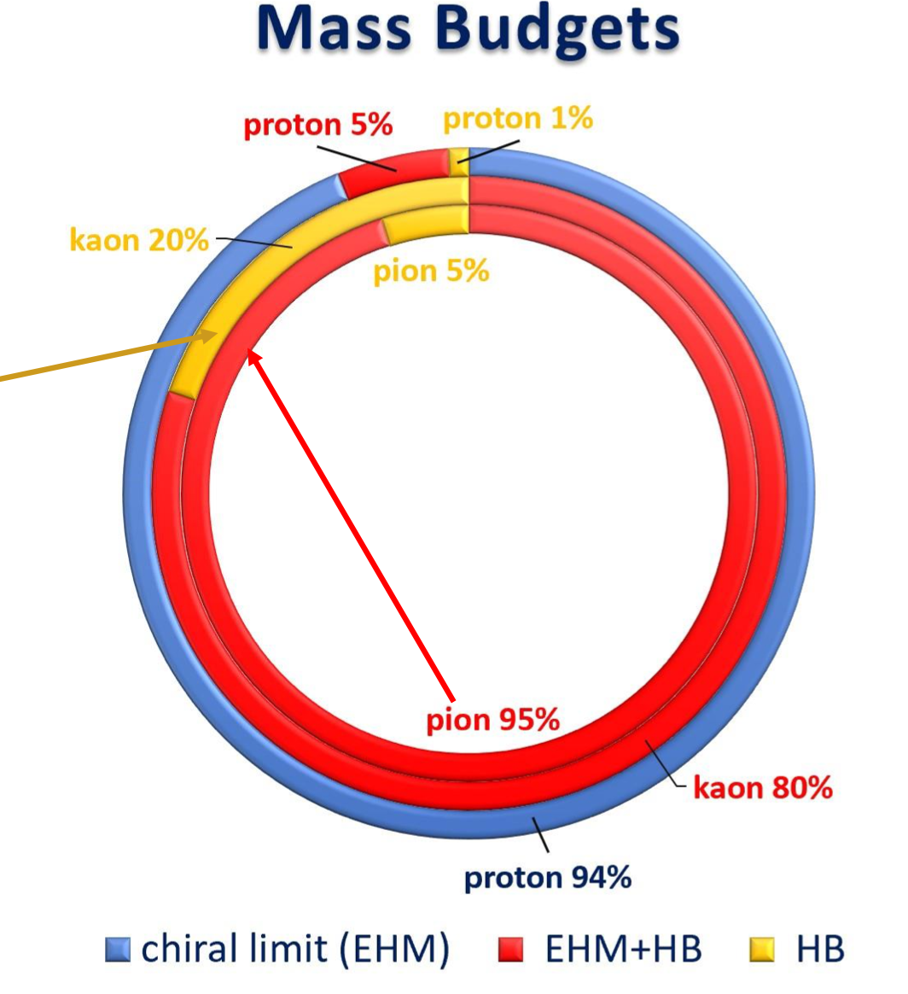
Insight into EHM from the Data on N/N* Structure
Studies of π/K structure elucidate the interference between emergent and Higgs mechanisms in EHM
Studies of ground/excited state nucleon structure allow us to explore the dressed quark mass function in a different environment where the sum of dressed quark masses is the dominant contribution to the physical masses of these states, offering insight into emergent mechanisms
Consistent results on the momentum dependence of the dressed quark mass function from independent studies of the pseudoscalar mesons and the ground and excited state nucleon structure are of particular importance for the validation of insight into EHM.
7

Slide 8
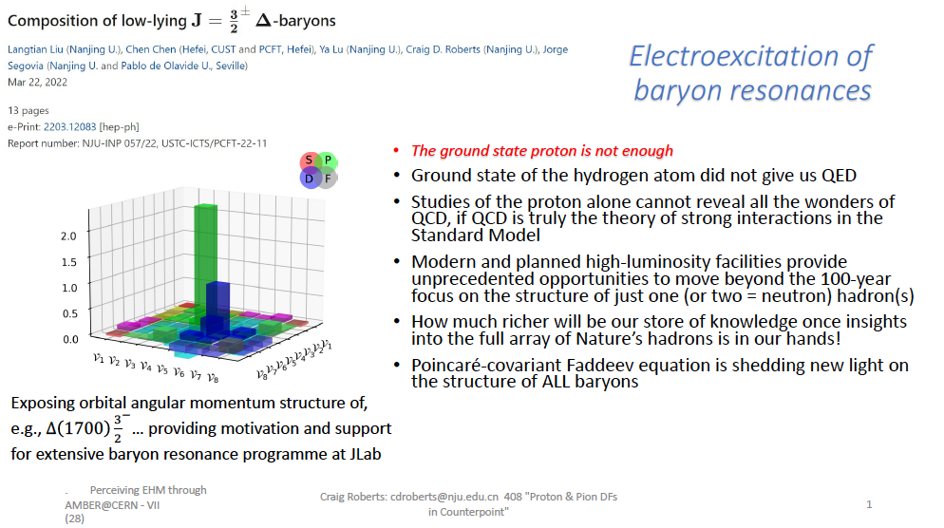
EHM in Particular Environments for Different Resonances
Borrowed from C.D. Roberts
A unique opportunity to explore either universality
or the environmental sensitivity of the dressed
quark mass function

Slide 9
N* Photo-/Electroexcitation Amplitudes (γ_{r,v}pN* Photo-/Electrocouplings)
and their Extraction from Exclusive Photo-/Electroproduction Data
Resonant amplitudes
Non-resonant amplitudes
e’
π, η, ππ, KY,…
π, η, ππ, KY,…
γ_{v}
e
*
N*,△
+
N
N’
N
N’
Definition of N* photo-/electrocouplings
employed in CLAS data analyses:
Real A_{1/2}(Q²), A_{3/2}(Q²), S_{1/2}(Q²)
I.G. Aznauryan and V.D. Burkert, Prog. Part. Nucl. Phys. 67, 1 (2012)
  Consistent results on the γ_{r,v}pN* photo-/electrocouplings from different meson photo-/electro-production channels allow us to validate reliable extraction of these quantities

Slide 10
Summary of Published CLAS Data on Exclusive Meson Electroproduction off Protons in N* Excitation Region
Hadronic final state | Covered W-range, GeV | Covered Q²-range, GeV² | Measured observables
π⁺n | 1.1-1.38 1.1-1.55 1.1-1.70 1.6-2.00 | 0.16-0.36 0.3-0.6 1.7-4.5 1.8-4.5 | dσ/dΩ dσ/dΩ dσ/dΩ, A_{b} dσ/dΩ
π⁰p | 1.1-1.38 1.1-1.68 1.1-1.39 1.1-1.80 | 0.16-0.36 0.4-1.8 3.0-6.0 0.4-1.0 | dσ/dΩ dσ/dΩ, A_{b},A_{t},A_{bt} dσ/dΩ dσ/dΩ, A_{b}
ηp | 1.5-2.3 | 0.2-3.1 | dσ/dΩ
K⁺Λ | thresh-2.6 | 1.40-3.90 0.70-5.40 | dσ/dΩ P⁰, P′
K⁺Σ⁰ | thresh-2.6 | 1.40-3.90 0.70-5.4 | dσ/dΩ P′
π⁺π⁻p | 1.3-1.6 1.4-2.1 1.4-2.0 | 0.2-0.6 0.5-1.5 2.0-5.0 | Nine 1-fold differential cross sections
dσ/dΩ−CM angular
distributions
A_{b},A_{t},A_{bt}-longitudinal
beam, target, and
beam-target asym-
metries
P⁰, P′ –recoil and
transferred polarization
of strange baryon
Over 150,000
data points!
Almost full coverage
of the final state hadron phase space
The measured observables from CLAS are stored in the
CLAS Physics Data Base http://clas.sinp.msu.ru/cgi-bin/jlab/db.cgi
Notes:
Исследования процессов электровозбуждения N* во всех эксклюзивных каналах электророждения мезонов в резонансной области стало возможным в экспериментах на детекторе CLAS , где была получена доминирующая чеать результатов по реакциям эксклюзивного электророждения мезонов на нуклонах.

Slide 11
Nucleon Resonance Electrocouplings from Data on Exclusive Meson Electroproduction with CLAS
Exclusive meson electroproduction channels | Excited proton states | Q²-ranges for extracted γ_{v}pN* electrocouplings, GeV²
π⁰p, π⁺n | Δ(1232)3/2⁺ N(1440)1/2⁺, N(1520)3/2⁻, N(1535)1/2⁻ | 0.16-6.0 0.30-4.16
π⁺n | N(1675)5/2⁻, N(1680)5/2⁺ N(1710)1/2⁺ | 1.6-4.5
ηp | N(1535)1/2⁻ | 0.2-2.9
π⁺π⁻p | N(1440)1/2⁺, N(1520)3/2⁻ Δ(1620)1/2⁻, N(1650)1/2⁻, N(1680)5/2⁺, Δ(1700)3/2⁻, N(1720)3/2⁺, N’(1720)3/2⁺ | 0.25-1.50 2.0-5.0 (preliminary) 0.5-1.5
The N* electroexcitation amplitudes (γ_{v}pN* electrocouplings) have become available in a broad range of Q²<5.0 GeV²
In the mass range W<1.6 GeV the γ_{v}pN* electrocoupling were obtained from independent studies of πN, ηp, and π⁺π⁻p electroproduction
Recent results can be found in: A.N. Hiller Blin et al, PRC100, 035201 (2019)

Slide 12


Insight to EHM From Resonance Electrocouplings
Dyson-Schwinger Equations (DSE):
J. Segovia et al., PRL 115, 171801 (2015)
J. Segovia et al., Few Body Syst. 55, 1185 (2014)
N→Δ(1232)3/2⁺ magnetic from factor
Jones-Scadron convention
Substantial
contributions
from meson-
baryon cloud
Quark core
dominance
Substantial
contributions
from meson-
baryon cloud
quark mass:
frozen
running
Good data description at Q²>2 GeV² achieved with the same dressed quark mass function for the ground pion/nucleon and two excited nucleon states of distinctively different structure validates the Continuum Schwinger Method (CSM) results on the momentum dependence of the dressed quark mass. The γ_{v}pN* electrocoupling data shed light on the strong QCD dynamics underlying hadron mass generation.
One of the most important achievements in hadron physics of the last decade in synergistic efforts between experimentalists, phenomenologists, and theorists.
Notes:
The experimental results from CLAS on electrocouplings of low-lying resonances have a profound impact on the development of the continuum QCD approaches which are capable to relate the phenomenological information on Q2-evolution of the resonance electrocouplings to the momentum dependence of dressed quark mass M(p). For the first time elecrocouplings of D(1323)3/2+ amd N(1440)1/2+ resonances were successfully described at Q2>2.0 GeV2 within continuum QCD approaches under a traceble connection to the QCD Lagrangian. Studies of the nucleon resonances with CLAS demonstrated that their structure is coming from a complex interplay between inner core of three constituent quarks and the external meson-baryon cloud. Currently, the continuum QCD approaches account for the contributions from quark core only. Therefore they can be directly confronted to the data only at higher enough Q2 where the contributions from quark core become the biggest.
The leading p→D megnetic transition form factor (left plot) was computed within continuum QCD within two ansatz for qq-interaction. In the first exploratory evaluations the simplifies contact qq-interaction was used. This interaction results in frozen momentum independent dressed quark mass, however account for the generation of 360 MeV quark mass in the dressing processes. The transition N-→D magnetic form factors computed with frozen quark mass is shown in magenta on the left plot. The computation overestimate the data at Q2>1.0 GeV2. The discrepancies between the data and computations increases with Q2. Eventually, contact ansatz for qq interaction has been replaced by the most advances ansatz inferred from the QCD Lagrangian within the continuum QCD approach. This advanced ansatz results in the momentum dependent mass of dressed quark. The N-→D magnetic form factor computed with running quark mass is shown in the left plot in blue. Use of running quark mass allow us to reproduce the CLAS data in entire range of Q2>0.8 GeV2. Analysis of the CLAS results wqithin the continuum QCD approaches conclusively demonstrated that dressed quark mass function is in fact running.
Remarkably, a successful description of Roper resonance electrocouplings (right part) has been achieved with exactly the same dressed quark mass function M(p) as used previously for a successful description of the pion, nucleon elastic form factor and D(1322)3/2+ electroexcitation amplitude. The structure of D(1323)3/2+ and N(1440)1/2+ resonances are completely different. The D(1232)3/2+ state represents the spin-isospin fl;ip for three quarks in the ground nucleons, while N(1440)1/2+ state is the first radial excitation of three dressed quarks. Consistent results on the dressed quark mass function from independent studies of pion/nucleon elastic amplitudes and from the electroexcitation amplitudes for the resonances of distinctively different structure strongly suggest the relevance of dressed quark with running mass computed within comtinuus QCD approaches as active degrees of freeom in the structure of pion, ground, and excited nucleon states. This success also demonstrated the capability to map out the momentum dependence of dressed qirak mass from the experimental resultson nucleon elastic form factors and the nucleon resonance electroexcitation amplitudes

Slide 13
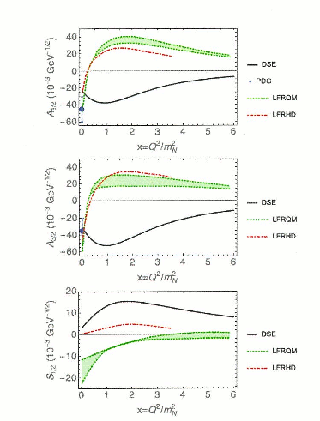
Electrocouplings of the Δ(1600)3/2⁺: CSM prediction vs. Data Determination
Extraction of Δ(1600)3/2⁺ electrocouplings from the CLAS π⁺π⁻p electroproduction data at 2 GeV²<Q²<5 GeV² within the JM reaction model, January-March, 2022
Parameter-free CSM predictions for Δ(1600)3/2⁺ electrocouplings
Ya Lu et al., Phys. Rev. D 100, 034001 (2019)
Notes:
Continnum QCD approaches provided parameter free prediction on D(1600)3/2+ electrocopuplings. The CLAS p+p-p electroproduction data at 2.0 < Q < 5.0 GeV2 (current and next slides) are comsistent with the contribution of D(1600)3/2+ resonance with electrocouplings predicted within continuum QCD approach. The extraction of these electrocouplings from the data without any model bias is in progress. If expectations from continuum QCD on electrocouplings of this state will be confirmed, the access to dressed quark mass function from the data on resonance electrocouplings will be fully validated.

Slide 14
N(1440)1/2⁺ Parameters from π⁺π⁻p Data at 2<Q²<5 GeV²
Γ_{tot}, MeV | ΓπΔ, MeV | Γ ρp, MeV | Mass, GeV
331±50 343±40 352±37 | 129±48 142±39 120±41 | 5.6±1.9 5.6±1.0 4.9±2.2 | 1.45±0.010 1.45±0.015 1.45±0.011
BF, % | 21-62 27-60 20-52 | 1.0-2.7 1.2-2.2 <2
The data fit 1.51<W<1.61 GeV:
in black:
in red: 3.0<Q²<5.0 GeV²
π⁺π⁻p at 0.5<Q²<1.5 GeV²
V.I. Mokeev, et al., PRC 93,
025206 (2016)
2.0<Q²<3.5 GeV²
Electrocouplings:
red: Nπ
I.G. Aznauryan et al., PRC 80, 055203 (2009)
blue: π+π⁻p
JM21 preliminary
Consistent results on N(1440)1/2⁺ electrocouplings from Nπ/π⁺π⁻p electroproduction and good description of the π⁺π⁻p data with Q² independent πΔ /ρp decay widths demonstrate credible extraction of these quantities and the capability of reaction models for reliable extraction tools
13

Slide 15
Δ(1600)3/2⁺ parameters from π+π⁻p data fit
Γ_{tot}, MeV | Γ πΔ, MeV | Γ ρp, MeV | Mass, GeV
248±25 259±21 | 158.±25. 169±22 | 0 0 | 1.564±0.026 1.57±0.018
BF, % | 48-82 52-81 | 0 0
The data fit at 1.51<W<1.61 GeV:
in black: 2.0<Q²<3.5 GeV²
in red: 3.0<Q²<5.0 GeV²
continuum QCD predictions, Ya Lu et al., Phys. Rev. D 100, 034001 (2019)
CLAS results on Δ(1600)3/2⁺ electrocouplings confirmed the CSM prediction solidifying
evidence for insight into dressed quark mass function and, consequently, into EHM !
14

Slide 16
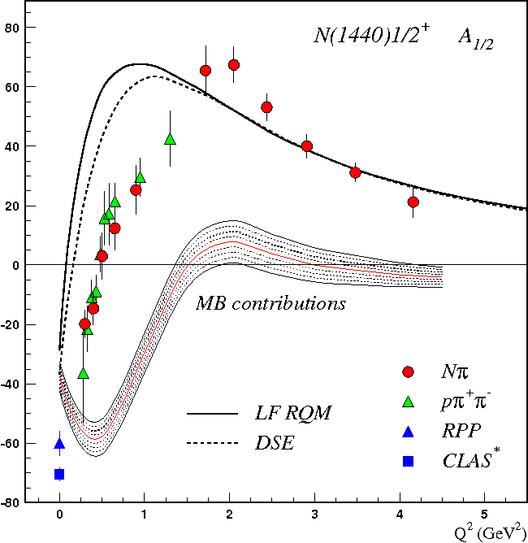
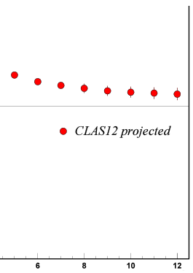
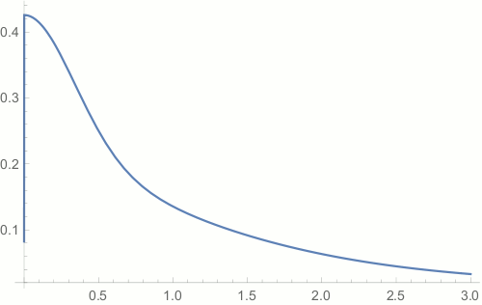
Emergence of Hadron Mass from the Data with CLAS12
N* electroexcitation studies at JLab during and after 12 GeV era will address the critical questions:
How is >98% of visible mass generated?
How does confinement emerge from QCD and how is it related to Dynamical Chiral Symmetry Breaking?
(S.J, Brodsky et al., Int. J. Mod. Phys. Rev. E29, 2030006 (2020))
Mapping-out quark mass function from the results on γ_{v}pN* electrocouplings of spin-isospin flip, radial, and orbital excited nucleon resonances at 5<Q²<36 GeV² is needed to explore the full range of distances where the dominant part of hadron mass is generated
Access to the dressed quark/hadron mass generation
//
N(1440)1/2⁺
$p_{q}$=$\sqrt{Q^{2}}$/3
CLAS12
range
Full range of quark momenta
where hadron mass is generated
A_{1/2} (GeV^{-1/2}) *1000
confinement (approaching
constituent quark mass)
Dressed Quark Mass, GeV
approaching bare Higgs quark mass and pQCD regime
//
Q² (GeV²)
CLAS results vs. theory expectations with running quark mass
Quark Momentum p_{q}, GeV
15

Slide 17
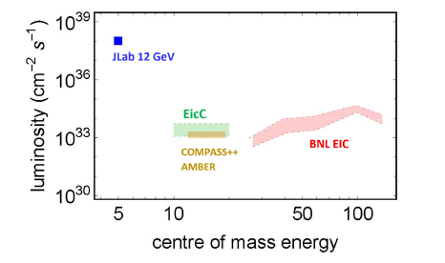
Studies of γ_{v}pN* Electrocouplings at Q² > 10 GeV²
Energy and luminosity increase up to >10³⁶ cm⁻²s⁻¹ are needed in order to obtain information on the γ_{v}pN* electrocouplings at Q²>10 GeV², allowing us to map out the momentum dependence of the dressed quark mass within the entire range of distances where the dominant part of hadron mass is generated
Both EicC and EIC would need much higher, unlikely feasible luminosity
The exclusive electroproduction
measurements foreseen at JLab after
completion of the 12 GeV program:
Beam energy at fixed target: 24 GeV
Nearly 4π coverage
High luminosity
Offer maximal achievable luminosity for extraction of γ_{v}pN* electrocouplings at Q²>10 GeV²
16

Slide 18
Conclusions and Outlook
EHM paradigm makes a broad array of predictions. Those for N/N* structure are worth testing to gain insight and understanding of hadron mass generation by mapping the momentum dependence of the dressed quark running masses.
The CLAS detector provided the dominant part of the data on most exclusive meson electroproduction channels in the resonance region. These high-quality data have allowed us to determine the electrocouplings of most resonances in the mass range up to 1.8 GeV with consistent results from analyses of the π⁺n, π⁰p, ηp, and π⁺π⁻p channels offering the experimental input needed for the validation of all available and foreseen approaches for the description of hadron mass.
A good description of CLAS results on the Δ(1232)3/2⁺ and N(1440)1/2⁺ electro-excitation amplitudes achieved with the same dressed quark mass function as used previously in the successful evaluations of the elastic ground nucleon and pion form factors, and the pion PDF validates insight into the dynamics that underlie the emergence of hadron mass.
The CSM parameter-free predictions on the Δ(1600)3/2⁺ electrocouplings obtained within the same framework as for the above-mentioned resonances have been confirmed by the first preliminary results on the electrocouplings of this state from π⁺π⁻p electroproduction data. Combined with the successful description of the hadron structure observables mentioned above, these results offer overwhelming evidence in support of the CSM concept for EHM.
17

Slide 19
Conclusions and Outlook
CLAS12 is the only facility in the world capable of obtaining the electrocouplings of all prominent N* states at the still unexplored ranges of the highest Q² for exclusive reactions from 5 GeV² to 12 GeV² from measurements of Nπ, π⁺π⁻p, and KY electro-production, allowing us to map out the dressed quark mass function at quark momenta < 1.3 GeV.
Extension of the results on the γ_{v}pN* electrocouplings into the Q² range from 10 GeV² to 36 GeV² from the measurements of exclusive meson electroproduction after the future JLab upgrade with 24 GeV beam energy and luminosity >10³⁶ cm⁻²s⁻¹ will provide information on the dressed quark mass function at the full range of distances where the dominant part of hadron mass is generated, addressing the most challenging problems of the Standard Model on the nature of >98% of hadron mass, quark-gluon confinement, and the emergence of the N* structure from QCD. It will make the future JLab at high energy/luminosity the ultimate QCD machine.
CSM approach is capable to predict the observables which describe the pion and kaon structure from the results on exploration of the ground and excited nucleon state structure and forge synergistic efforts between JLab and AMBER@CERN, EIC, EicC on gaining insight into the nature of hadron mass.
18

Slide 20
Back up

Slide 21
N* Structure in Experiments with CLAS/CLAS12
The experimental program on the studies of N* structure in exclusive meson photo-/electroproduction with CLAS/CLAS12 seeks to determine:
  γ_{v}pN* electrocouplings at photon virtualities up to 10 GeV² for most of the excited proton states through analyzing the major meson electroproduction channels from CLAS/CLAS12 data
  Explore hadron mass emergence (EHM) and elucidate the trace anomaly by mapping out the dynamical quark mass in the transition from almost massless pQCD quarks to fully dressed constituent quarks
An important part of the efforts on the exploration of strong QCD from the data of the experiments with electromagnetic probes:
S.J. Brodsky et al., Int. J. Mod. Phys. E29, 203006 (2020).
C.D. Roberts, Symmetry 12, 1468 (2020).
M. Barabanov et al., Prog. Part. Nucl. Phys. 103835 (2021).
A unique source of information on many facets of strong QCD in generating excited nucleon states with different structural features:
I.G. Aznauryan and V.D. Burkert, Prog. Part. Nucl. Phys. 67, 1 (2012).
D.S. Carman, K. Joo, and V.I. Mokeev, Few Body Syst. 61, 29 (2020).
V.D. Burkert and C.D. Roberts, Rev. Mod. Phys. 91, 011003 (2019).

Slide 22
Approaches for Extraction of γ_{v}NN* Electrocouplings from the CLAS Exclusive Meson Electroproduction Data
Independent analyses of different meson electroproduction channels:
π⁺n and π⁰p channels:
Unitary Isobar Model (UIM) and Fixed-t Dispersion Relations (DR)
I.G. Aznauryan, Phys. Rev. C67, 015209 (2003)
I.G. Aznauryan et al. (CLAS), Phys. Rev. C80, 055203 (2009)
I.G. Aznauryan et al. (CLAS), Phys. Rev. C91, 045203 (2015)
ηp channel:
Extension of UIM and DR
I.G. Aznauryan, Phys. Rev. C68, 065204 (2003)
Data fit at W<1.6 GeV, assuming N(1535)1/2⁻ dominance
H. Denizli et al. (CLAS), Phys. Rev. C76, 015204 (2007)
π⁺π⁻p channel:
Data driven JLab-MSU meson-baryon model (JM)
V.I. Mokeev, V.D. Burkert et al., Phys. Rev. C80, 045212 (2009)
V.I. Mokeev et al. (CLAS), Phys. Rev. C86, 035203 (2012)
V.I. Mokeev, V.D. Burkert et al., Phys. Rev. C93, 054016 (2016)
Global coupled-channel analysis of γ_{r,v}N , πN, ηN, ππN, KΛ, KΣ exclusive channels:
H. Kamano, Few Body Syst. 59, 24 (2018). Argonne-Osaka
H. Kamano, JPS Conf. Proc. 13, 010012 (2017). Argonne-Osaka
M. Mai et al., Phys. Rev. C103, 065204 (2021). Julich-Bonn-Washington
M. Mai et al., e-Print: 2111.04774 [nucl-th]
Notes:
Для извлечания амплитуд электровозбуждения N* из сечений и поляризационных асимметрий реакций эксклюзивного электророждения мезонов на
протонах были развиты как подходы для извлечения параметров N* из независимого анализа различных эксклюзивных каналов, так и из совместного анализа данных всех каналов в рамках многоканальных моделей реакций

Slide 23
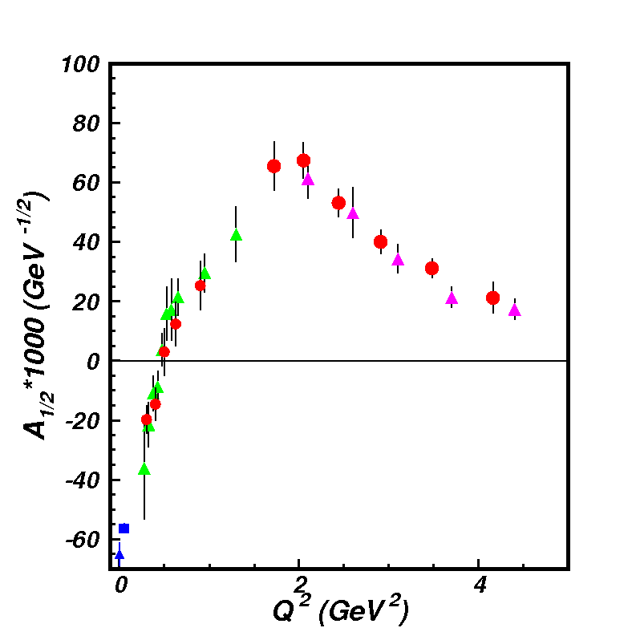
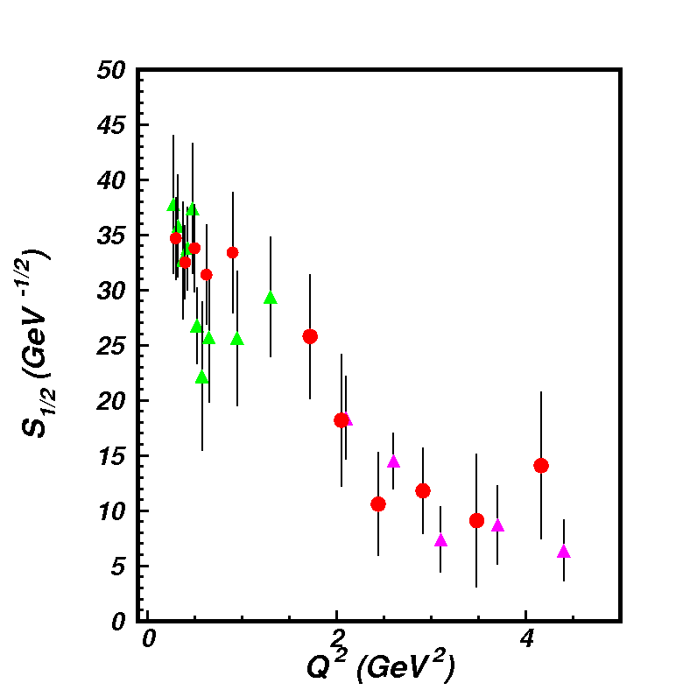
Electrocouplings of N(1440)1/2⁺ from πN and π⁺π⁻p
Electroproduction off Proton Data
A_{1/2}
pπ⁺π⁻ CLAS
preliminary
S_{1/2}
Consistent results on N(1440)1/2⁺ electrocouplings from independent studies of two major πN and π⁺π⁻p electroproduction channels with different non-resonant contributions allow us to evaluate the systematic uncertainties of these quantities in a nearly model-independent way

Slide 24
Toward Exploration of EHM from Orbital Nucleon Excitations
Continuum QCD Breakthrough: N(1535)1/2⁻ electrocouplings computed under a traceable connection to the QCD Lagrangian (green area).
C.D Roberts et al, private communication
The first preliminary continuum QCD evaluation of electro-excitation amplitudes of the [70,1⁻] supermultiplet resonances (L_{3q}=1) with the same dressed quark mass mass function as used for the resonances with L_{3q}=0
lQCD+LCSR
V. Braun et al.
Studies of electroexcitation amplitudes for the resonances in the second region suggest the universality of the dressed quark mass function for the ground and different excited states of the nucleon, including the first spin-isospin flip, the first radial, and the first orbital (L_{3q}=1) excitations.

Slide 25
Resonant Contributions into Inclusive F₁(W,Q²) Structure Functions & the Contributions from the PDF in the Ground State of the Nucleon Evaluated from the Data in DIS Region
Resonant contributions:
A.N. Hiller Blin et al.,
PRC 100, 035201 (2019)
Data points are from
interpolation of the
CLAS results re-evaluated
with the σ_{L}/σ_{T} ratio
from Hall C data
CLAS data:
M. Osipenko et al., PRD 67, 092001 (2003)
Hall C data:
Y. Liang, PhD thesis of
American University (2003)
Green dot-dashed lines: F₁ from JAM PDF
Other smooth curves: F₁ from JAM PDF after target mass corrections within different
prescriptions

Slide 26
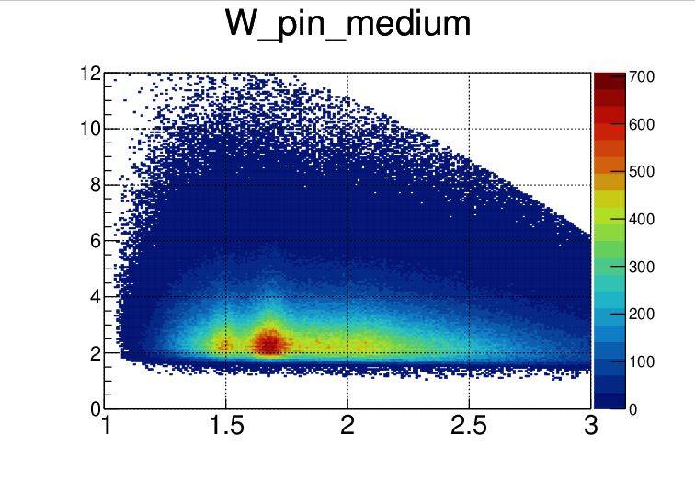
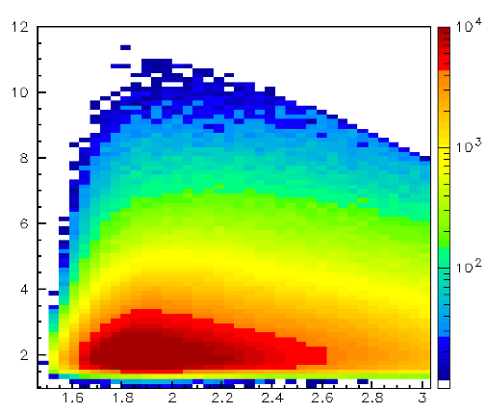
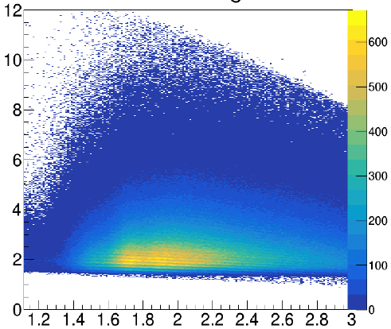
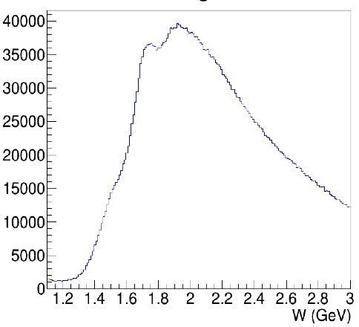
N* Electroexcitation to high Q² with CLAS12
Expected outcome: The first results on the γ_{v}pN* electrocouplings of most N* states from data in the range W < 2.5 GeV and Q² > 5.0 GeV² for exclusive reaction channels: πN, ππN, KY, K*Y, KY*
kinematic coverage for RG-A data @ 10.6 GeV
π⁺n
K⁺Y
π⁺π⁻p
π⁺π⁻p
Q² (GeV²)
Q² (GeV²)
Q² (GeV²)
resonances?
3rd
resonance
regions
2nd
W (GeV)
W (GeV)
W (GeV)
W (GeV)
Expected events per Q²/W bin for full RG-A dataset
Collecting the remainder of the approved RG-A beam time will give a factor of two more statistics
This will extend the Q² range of the γ_{v}pN* electrocouplings to 8-10 GeV² for each of these channels – the data collected so far will limit us to 6-8 GeV²
π⁺n |  |  | K⁺Λ & K⁺Σ⁰ |  |  |  |  | π⁺π⁻p
Q² [GeV²] | W [GeV] 1.5-1.55 | W [GeV] 1.7-1.75 | Q² [GeV²] | W_{Λ} [GeV] 1.7-1.75 | W_{Σ} [GeV] 1.7-1.75 | W_{Λ} [GeV] 1.9-1.95 | W_{Σ} [GeV] 1.9-1.95 | Q² [GeV²] | W [GeV] 1.7-1.75 | W [GeV] 1.9-1.95
 |  |  | 1.4-2.2 | 63417 | 6012 | 66564 | 33170
 |  |  | 2.2-3.0 | 72144 | 5364 | 77443 | 28720
5.2-5.8 | 15272 | 4175 | 3.0-4.0 | 52358 | 3945 | 51991 | 18936 | 5.2-5.8 | 2813 | 2808
5.8-6.5 | 10737 | 2637 | 4.0-5.0 | 24833 | 3103 | 26690 | 5925 | 5.8-6.5 | 1822 | 1969
6.5-7.2 | 7367 | 1684 | 5.0-6.0 | 11203 | 1598 | 11160 | 2642 | 6.5-7.2 | 1159 | 1294
7.2-8.1 | 4567 | 1290 | 6.0-7.0 | 5566 | 648 | 6300 | 943 | 7.2-8.1 | 661 | 924
8.1-9.1 | 2742 | 540 | 7.0-8.0 | 2606 | 338 | 3276 | 633 | 8.1-9.1 | 364 | 414
9.1-10.5 | 1453 | 194 | 8.0-9.0 | 1440 | 244 | 936 | 86 | 9.1-10.5 | 118 | 179

