Slide 1
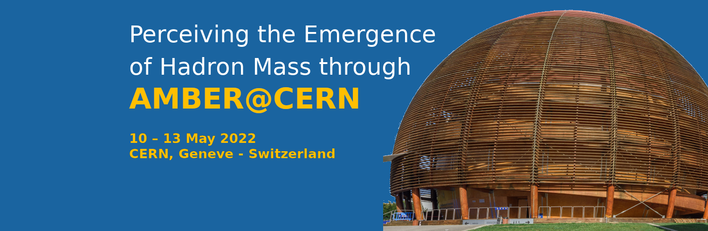
Dimuon production
with RF separated beams
Stephane Platchkov
Paris-Saclay University, CEA/IRFU, France

Slide 2
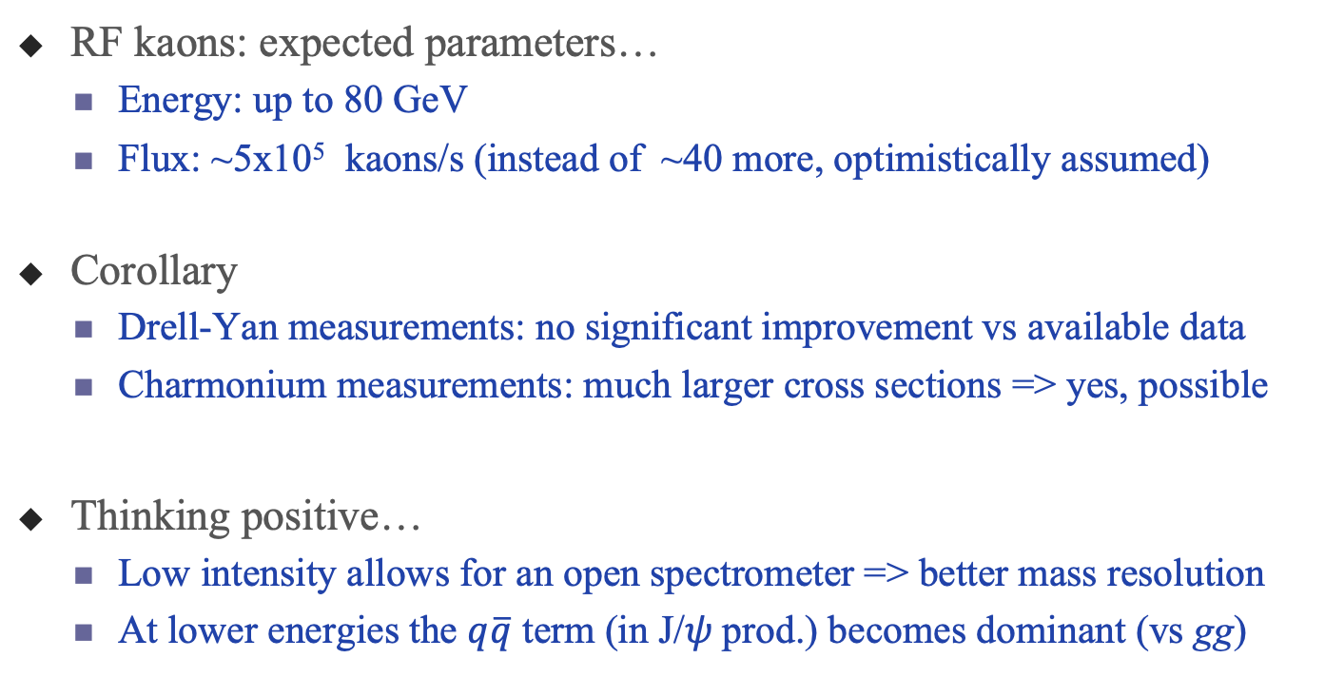
RF-separated beam parameters
RF kaons: expected parameters…
  Energy: up to 80 GeV
  Flux: ~5x10⁵ kaons/s (instead of ~40 more, optimistically assumed)
Corollary
  Drell-Yan measurements: no significant improvement vs available data
  Charmonium measurements: much larger cross sections => yes, possible
Thinking positive…
  Low intensity allows for an open spectrometer => better mass resolution
  At lower energies the $q\overline{q}$ term (in J/𝜓 prod.) becomes dominant (vs gg)

Slide 3
The celebrated 40y old kaon data from NA3
Kaon DY data (actually a K/𝜋 ratio)
  only information on the kaon PDF.
  AMBER RF: marginal improvement…
  A good news: K⁻ and 𝜋⁻ same beam
Kaon-induced J/𝜓 production data
  also from NA3, no PDF information
NA3, CERN 1980

Slide 4
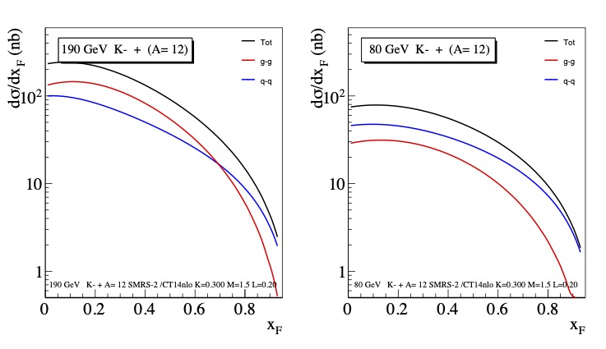
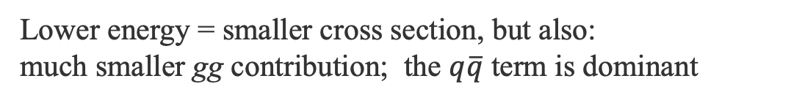


Beam energy dependence: 190 GeV vs 80 GeV
190 GeV
80 GeV
Integrated cross section
$$q\overline{q}$$
NRQCD fit
$$q\overline{q}$$
gg
gg
☞ talk by W.-C. Chang(Thu)
Lower energy = smaller cross section, but also:
much smaller gg contribution; the $q\overline{q}$ term is dominant

Slide 5
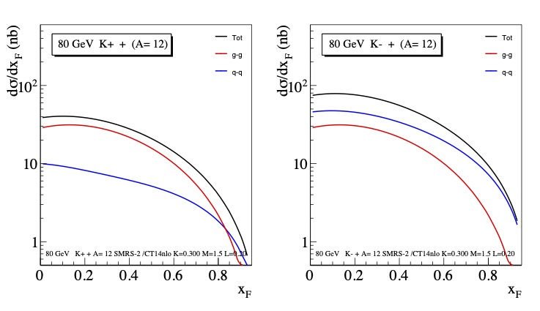


Beam charge dependence: K⁺ vs K⁻ 80 GeV
K⁺ beam
K⁻ beam
$$q\overline{q}$$
identical gg contributions
$$q\overline{q}$$
gg
gg
u-valence term dominates for K⁻; absent for K⁺
The K⁺ cross section is smaller than the K⁻ one
Charge symmetry: the gg contributions are equal

Slide 6
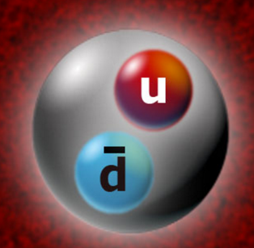
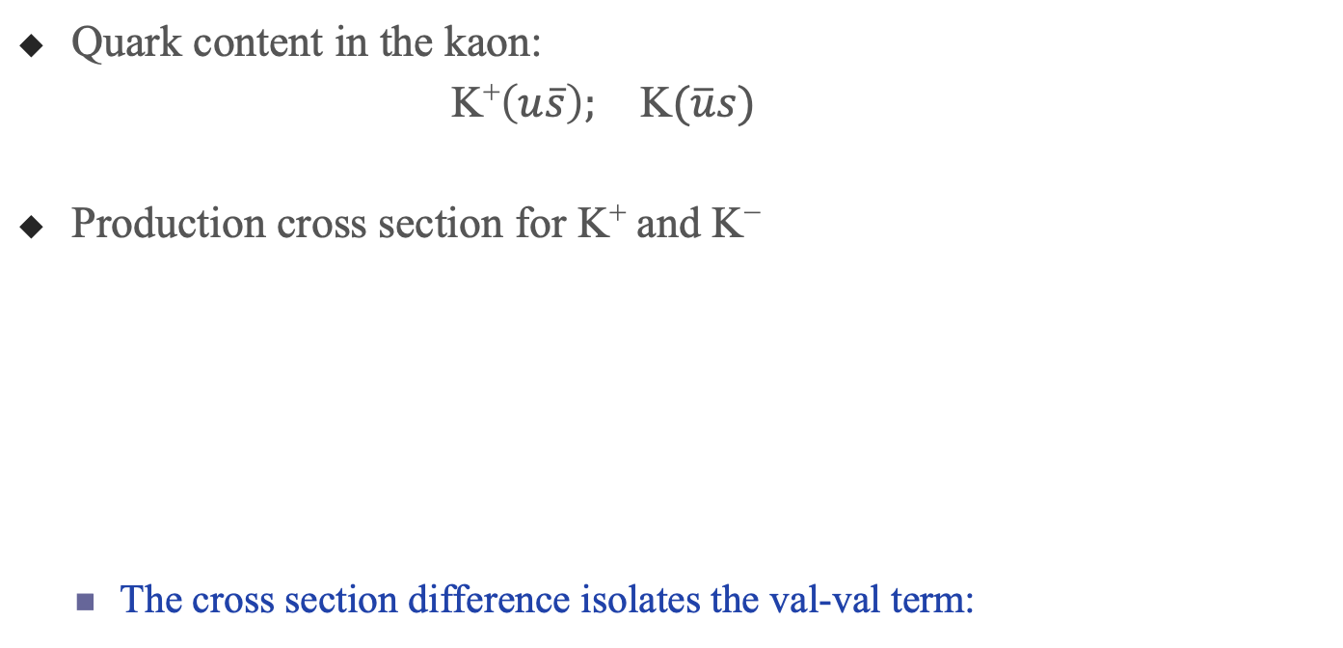

J/𝜓 – access to the kaon valence PDF
Quark content in the kaon:
K⁺$\left(u\overline{s}\right);$ K$(\overline{u}s)$
Production cross section for K⁺ and K⁻
  The cross section difference isolates the val-val term:
$$\overline{S}$$
val-val val-sea sea-val sea-sea

Slide 7
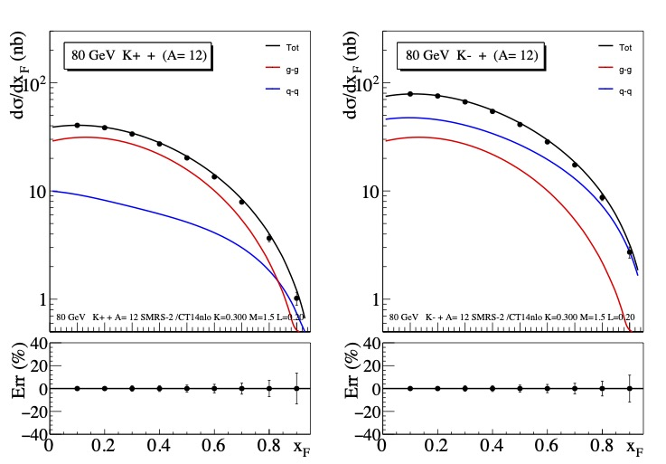
Error estimates FOR K⁻ and K⁺ J/𝜓 cross sections: 80 GeV
Assumptions
  Flux: 5.10⁵/s
  ~10 000 events for each beam (conservative number)
  Beam sharing: ~70 d of K− and ~210 d of K+
  3 carbon targets, length of 25cm each
  x_{F} coverage: 0.00 – 0.95
Lower panel: statistical errors in %
K⁺ beam
K⁻ beam

Slide 8
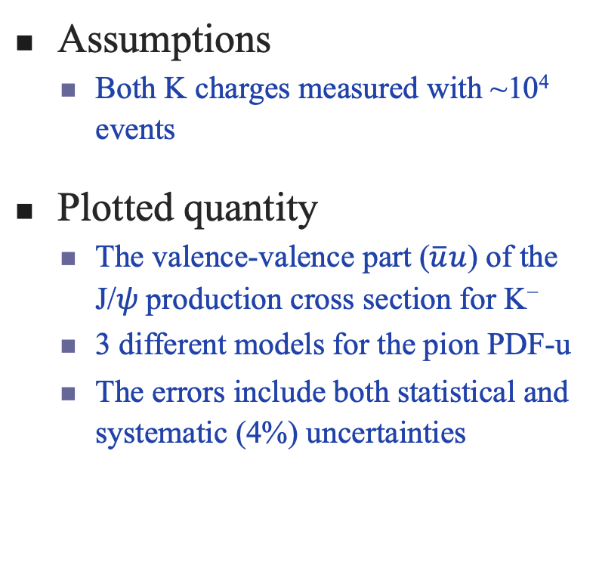
The difference between K⁻ and K⁺ -induced J/psi production
Assumptions
  Both K charges measured with ~10⁴ events
Plotted quantity
  The valence-valence part ($\overline{u}u$) of the J/𝜓 production cross section for K⁻
  3 different models for the pion PDF-u
  The errors include both statistical and systematic (4%) uncertainties
valence-valence term of K- only.

Slide 9
Additional opportunities
J/𝜓
Kaon-induced 𝜓’ production
  Unknown: can be measured for both kaon charges
χ_{c} production and decay to J/𝜓
  detect photons in coincidence
  not known for kaon beams
𝜓’
Compass
☞ talk by J.-C. Peng (Thu)
Beam absorber
J/𝜓
𝜓’
E771
Open spectrometer

Slide 10
Conclusions on RF separated K beams
Drell-Yan data: very limited statistics
  Only marginal improvement of the available data
Charmonium production: mass resolution=> good J/𝜓 and 𝜓’ separation
  J/𝜓 production: can be used to determine the kaon valence PDF with very good accuracy
  𝜓’ production: has never been measured with kaon beams. Brings information on the kaon structure
  χ_{c} production: never measured for kaons; can be done by detecting photons in coincidence.

