Slide 1
Test Beam:
Preliminary results
R. Santoro, on behalf of the SPD project
ITS upgrade meeting 29/11/2010

Slide 2
Outlook
Setup and Beam Condition
Measurements
First Results
What next

Slide 3
Test beam condition
Beam
  Positive beam (pions, protons), 350 GeV/c, up to 10⁴ particles/spill
  The spill duration is 46-49s with a flat top of ≈ 9 s (trigger rate ≈3KHz in the flat top)
  Beam slot from 8/11 to 15/11
Telescope
  4 half-staves with crossing geometry (2 HS before and 2 HS after the test plane)
  Estimated tracking precision ≈ 10µm both in x and y axis
Trigger
  4 scintillators (2 before and 2 after the telescope) to monitor the beam
  FastOr logic used for the read-out (1 hit per tracking plane)
Hybrid assemblies with the sensors flip-chip bonded to standard SPD FEE chip (AliceLhcb1)
Assembly ready to be used in the test beam:
  2 3D Double-type-Column sensors, 250 µm thick
  2 epitaxial planar sensor, 110 µm thick
  1 planar sensor 300 µm thick
Two Devices Under Test (DUTs) at the same time for the measurements

Slide 4
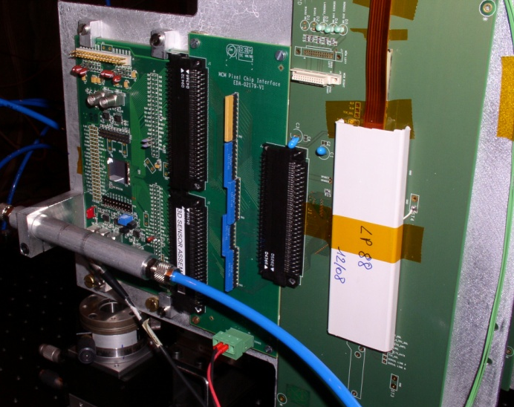
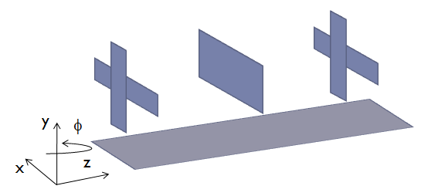
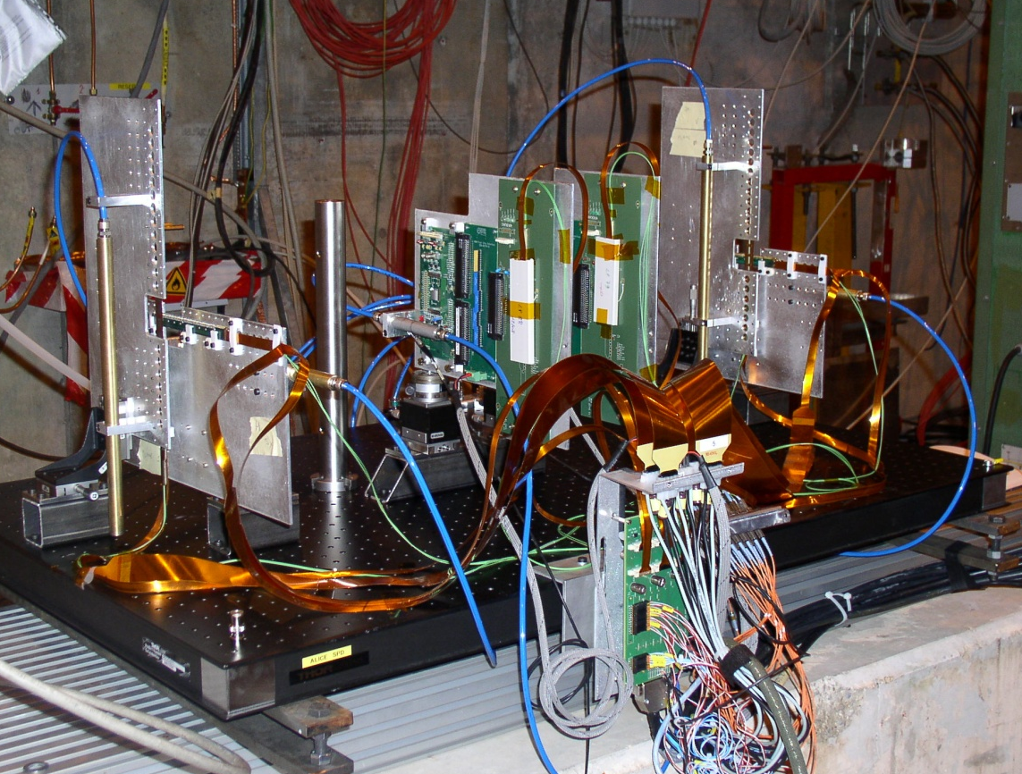
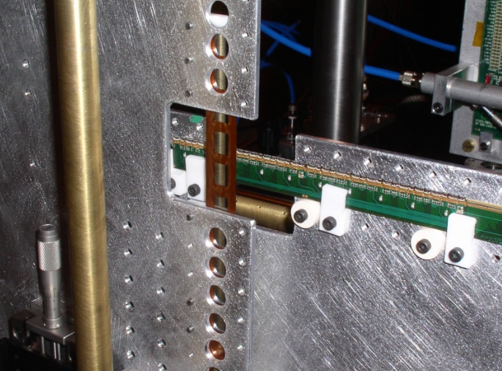
Telescope
Device Under Test
Crossing geometry (pixel dimension 50x425µm²)
  10µm of tracking precision in both x and y directions
Micrometric positioning:
  x-y movements for the tracking planes
  x-y-φ for the Device Under Test (DUT)
Beam
Tracking Planes

Slide 5
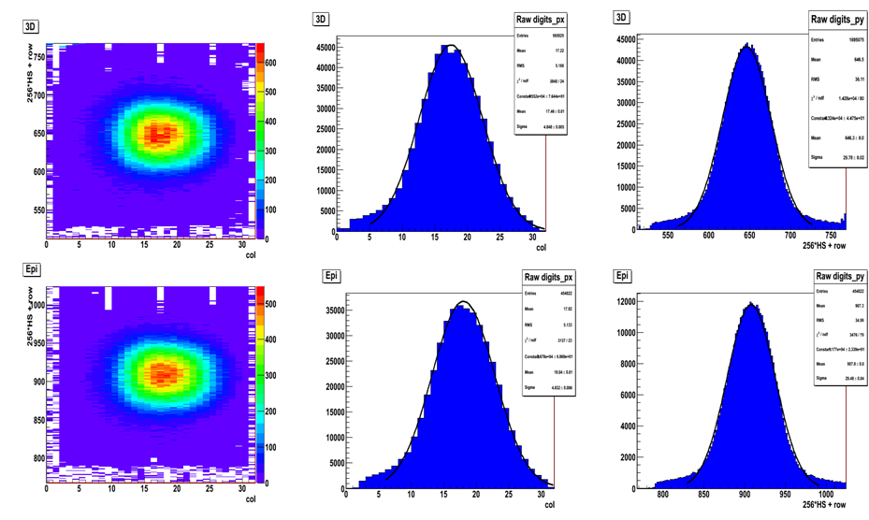
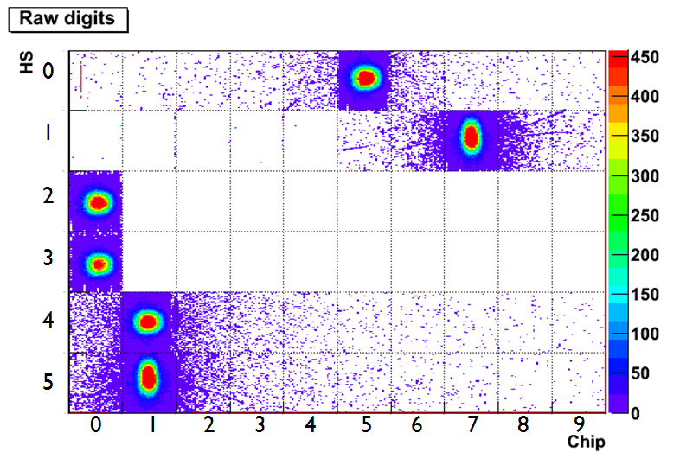
First data …
Beam Spot on DUTs
3D-sensor
First days to finalize the set-up
  Geometers, mechanics and cooling
A couple of hours to see the beam for the first time and to align all the planes
5 days for the measurements
  All the qualified assemblies has been tested: 2 3D, 2 epitaxial and one planar
  2 assemblies in the beam line at the same time
Epi-sensor
Beam Spot on the 2 tracking stations

Slide 6
Test Beam measurements
Main performances under study
  Track Efficiency
  Cluster size
  Space accuracy
VS
  Bias
  Threshold
  Angle
The results will be compared wrt the different sensor technologies
The results will be compared wrt the different thickness (300 and 200 µm ) of planar sensors from the previous beam tests
  Some measurements with a planar sensor (300 µm thick) has been performed during this test as reference and cross check

Slide 7
On-Line efficiency
On-line measurements to monitor the data quality
  Efficiency: events with at least 1 hit / triggered events
  The interests is in the trend. The absolute value has to be corrected (i.e. alignments are not taken into account)
Epi sensor
Bias = 18V
It looks like the epitaxial sensor has a smaller plateau
The plot for the 3D ends at 180 Dac (the minimum threshold for this sensor)
3D sensor
Bias = 16V

Slide 8
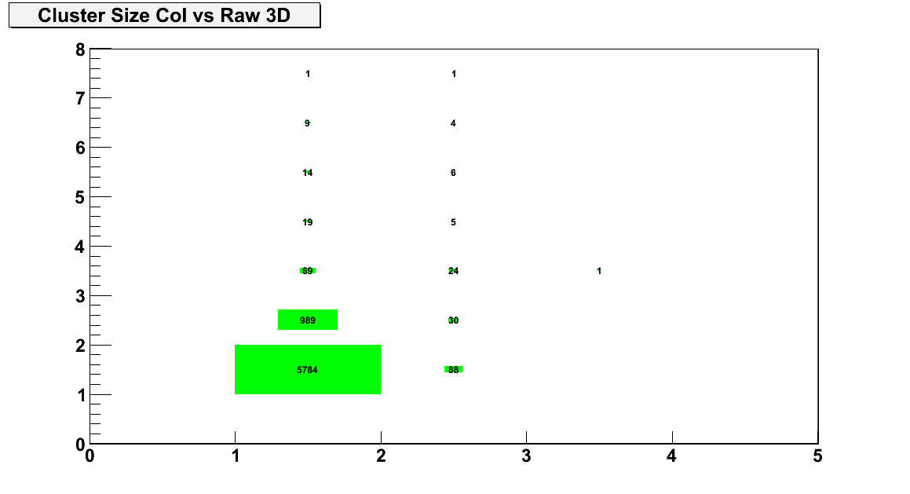
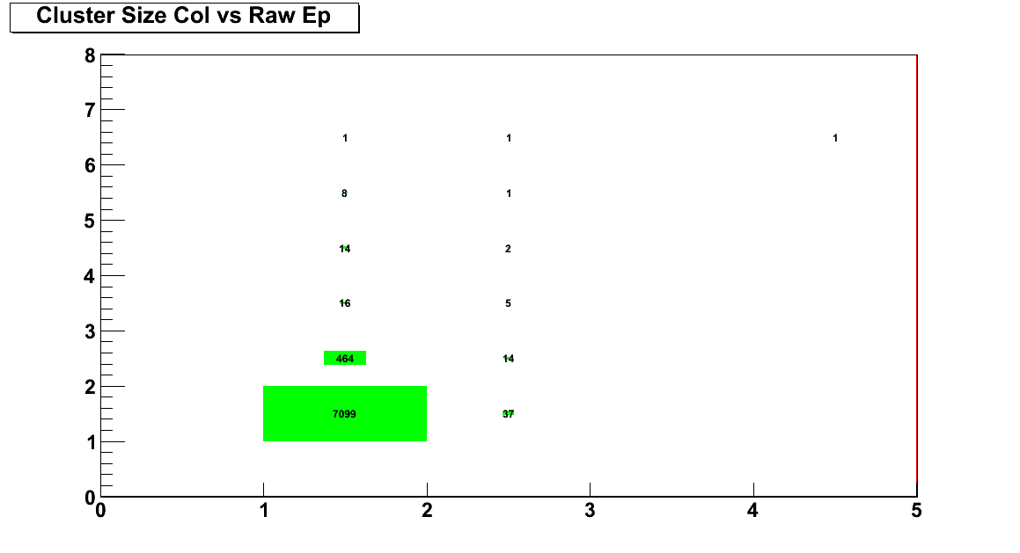
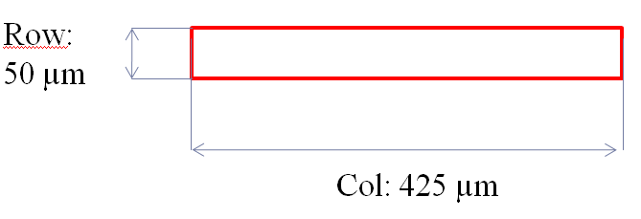
Cluster size: minTH and 0° tracks
No track selection
10k events per each run
Noisy pixels masked (if pixel fired more than 20 times)
Selection of the events with one cluster per plane in the telescope
3D sensor
Bias = 16V
TH = 180 Dac
no tracking
Nrow
Almost single and double cluster (≈ 97%):
3D = cl1 (≈ 82%) cl2 (≈ 15%)
Epi = cl1 (≈ 92%) cl2 (≈ 6%)
Ncol
Epitaxial sensor
Bias = 18V
TH = 200 Dac
no tracking
Nrow
Pixel dimension
Ncol

Slide 9
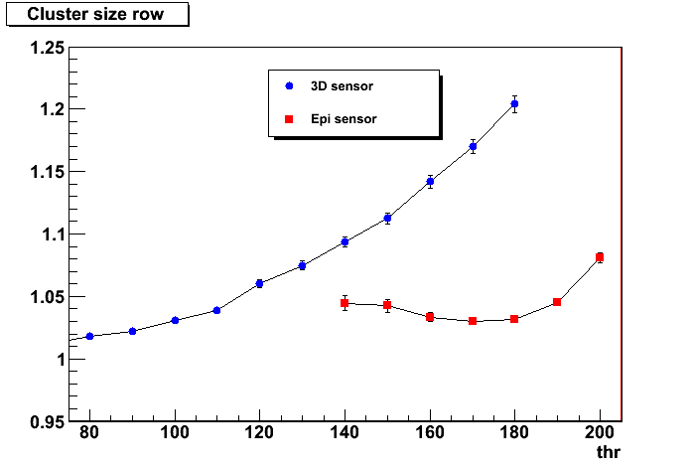
Cluster size VS thresolds @ 0° tracks
No track selection
10k events per each run
Noisy pixels masked (if pixel fired more than 20 times)
Selection of the events with one cluster per plane of the telescope
preliminary
no tracking
Mean cluster size
3D MinTh = 180 DAC
EPI MinTh = 200 DAC
Threshold (Dac unit)

Slide 10
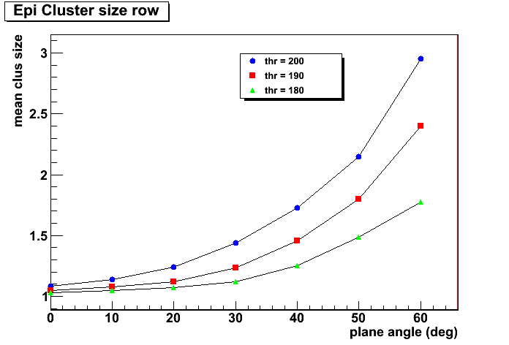
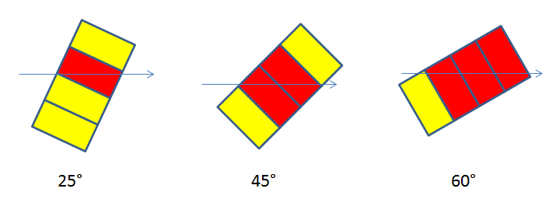
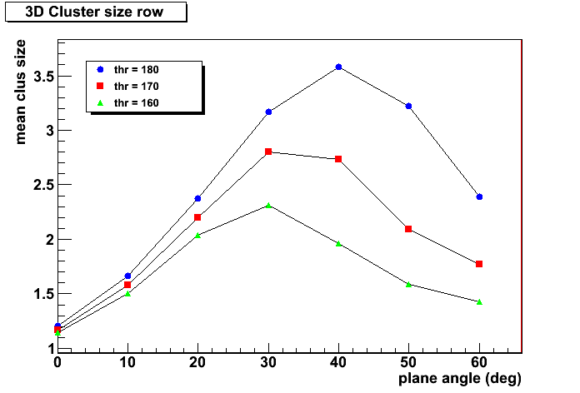
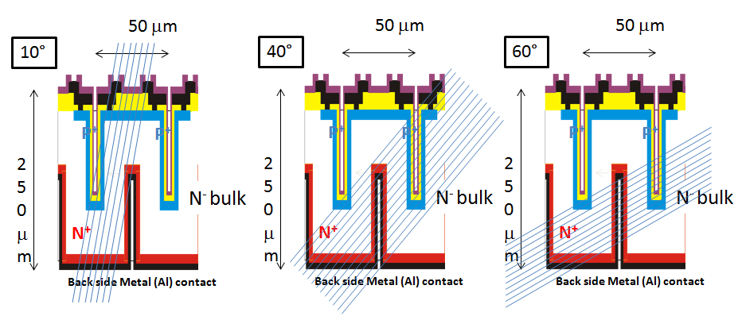
Cluster size VS Angles @ 3 thresholds
Epitaxial Sensor:
Sketch of pixels fired by tracks at different angles
Preliminary:
no tracking
Preliminary:
no tracking
3D Sensor:
Sketch of tracks inside the sensor at different angles

Slide 11
Telescope alignment: strategy
Track Selection:
Mask of noisy pixels
Clean event sample: event with one hit in each plane
Preliminary alignment (first results in the next slides)
Residuals without fit for the tracking stations
  Plane distance in each tracking station ≈ 1cm
  Tracks with small angles (less than 1°)
  Multiple scattering negligible
    Tracks at 350 GeV
    low material budget (≈1X₀ per layer)
  Very clean samples
Final alignment (on-going)
Residuals in each plane with the fit of the track
  Fit with all the points with the exclusion of the plane which has to be aligned
  Iterative procedure for all the planes

Slide 12
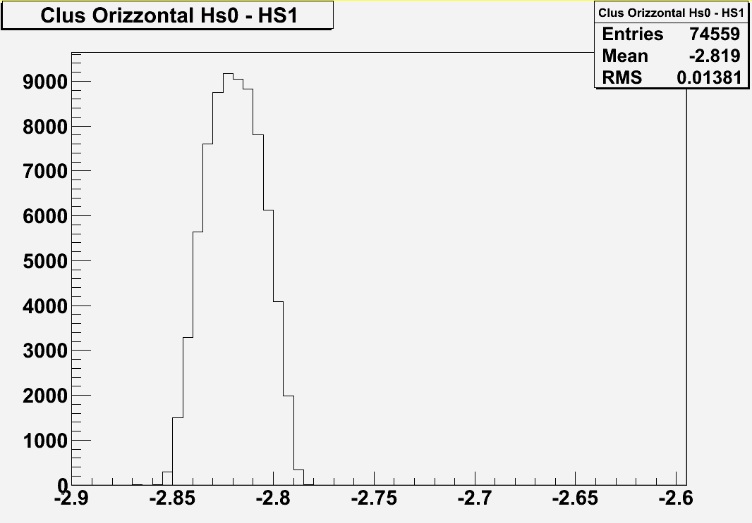
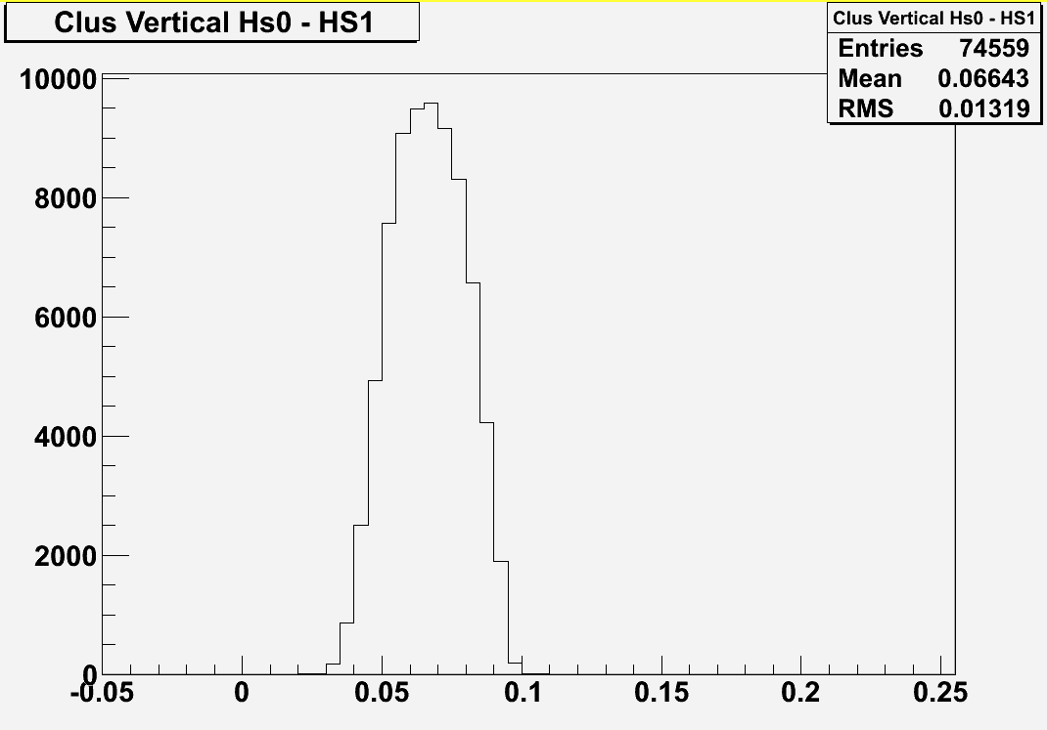
Plots for the preliminary alignment
Residual used to estimate the preliminary misalignment for the first tracking station
The preliminary shifts found for each plane are less than 1 mm
Preliminary misalignment :
2 chips and 260 µm
Preliminary misalignment:
665 µm
Xclus0 – Xclus1distribution (cm)
Yclus0 – Yclus1distribution (cm)

Slide 13
What next
Alignment
Cluster studies with track selection
Efficiency studies
Precision studies
  Simulation needed to estimate the telescope tracking precision

Slide 14
spares

Slide 15
On-Line efficiency VS angles
Epi sensor
Bias = 18V
On-line measurements to monitor the data quality
  Efficiency: events with at least 1 hit / triggered events
3D sensor
Bias = 16V

Slide 16
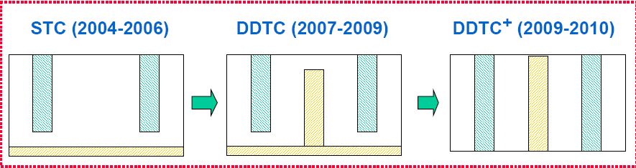
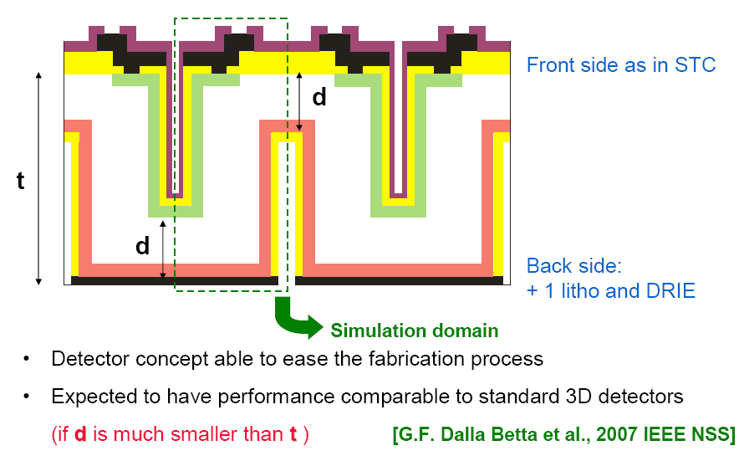

Slide 17
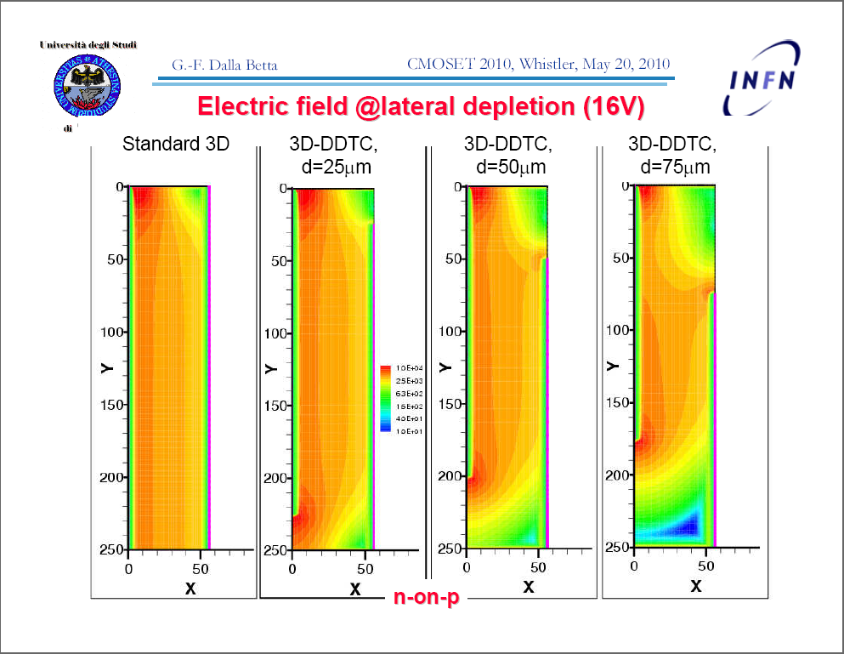

Slide 18
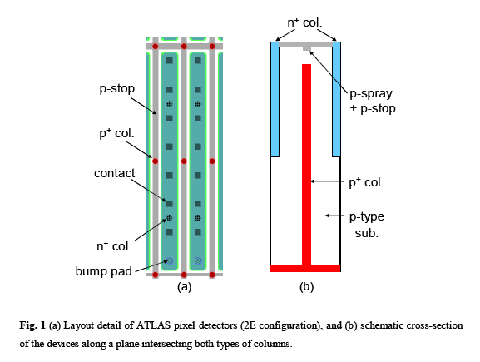
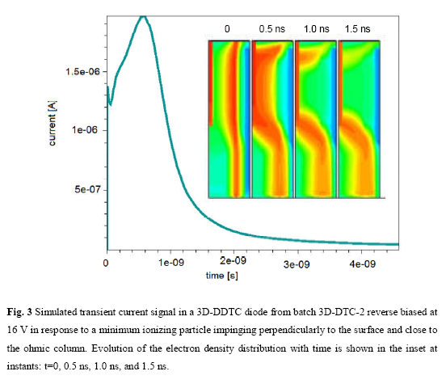

Slide 19
