Slide 1
Follow-Up on AWAKE Cost and Schedule Review and CERN MTP
Edda Gschwendtner, CERN
12th April 2022

Slide 2
AWAKE Cost and Schedule Review (18/11/22) Mandate
The Reviewers
Paul Collier (chair), Marzia Bernardini, Jean-Paul Burnet, Emmanuelle Delachenal, Massimo Ferrario, Mike Seidel (CMAC).
The Review Panel are asked to assess whether:
the required CERN contribution to achieve the Run 2 goals of the AWAKE project are clear, with the technical specifications and deliverables adequately defined and documented?
the material budget required to complete the CERN contribution to AWAKE Run 2 is properly estimated and available?
the personnel required to complete the CERN contribution to AWAKE Run 2 is available and adequate?
the overall schedule is realistic and in line with the availability of resources, with the milestones well defined?
the origin of the external resources (including those from other CERN projects) required to complete Run 2 are identified and assured?
the risks, impact and resources associated with alternative scenarios presented have been properly evaluated – in particular:
  the impact of a non-approval of CNGS dismantling?
  bringing forward the installation of a scalable plasma source to 2027?

Slide 3
AWAKE Run 2: Phases a) – d)
Run 2 Timeline
In existing AWAKE facility:
Run 2a: demonstrate electron seeding of self-modulation in first plasma cell
Run 2b: demonstrate the stabilization of the micro-bunches with a density step
In extended AWAKE facility:
Run 2c: demonstrate electron acceleration and emittance preservation
Run 2d: demonstrate scalable plasma sources
Cost and Schedule presentations:
Resources for Run 2a and Run 2b
Resources for Scalable Plasma Source R&D (until decision end 2024)
Resources for Run 2c
(Resources for Run 2d for scalable plasma source are not yet included in total budget → needs decision on technology in ~2024.)

Slide 4
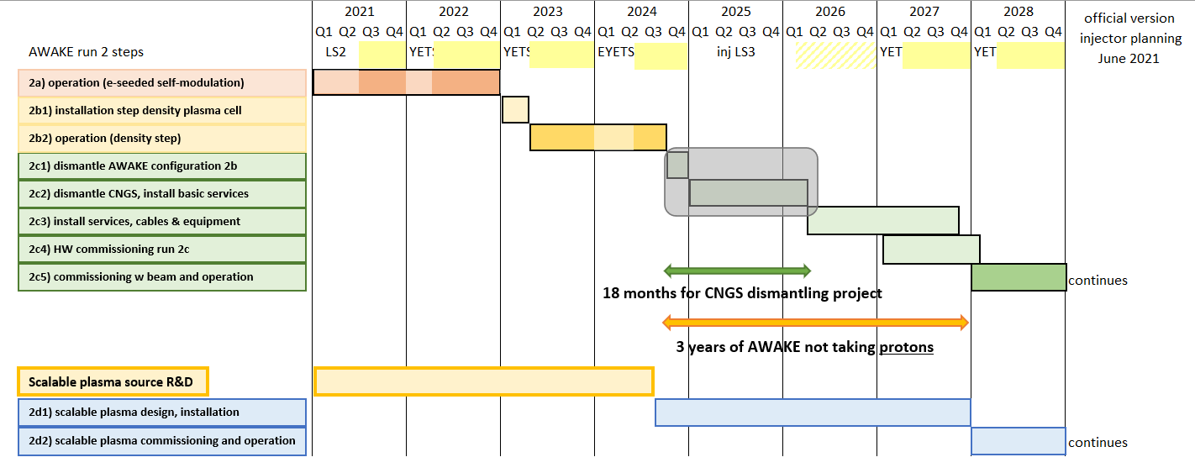
AWAKE Run 2 Global Schedule with Milestones
Present budget
Run 2a and Run 2b
CNGS Dismantling
Run 2c
Long Shutdown
Start equipment installation
(Nov. 2026)
Density step vapor source design ready
(April 2022)
All services installed
(Feb. 2027)
All equipment installed
(Nov. 2027)
Proton beam needed
(March 2028)
Start of operation
(May 2028)
Decision scalable plasma source in Run 2c
(Oct 2024)

Slide 5
Summary Cost and Schedule Review
AWAKE Run 2a and Run 2b and scalable plasma source R&D are fully funded in the MTP.
AWAKE Run 2c program is well defined and the resource requests are well estimated.
The collaborating institutes budget estimate is 20.5 MCHF, with 10 MCHF currently funded.
The total CERN AWAKE Run 2 (a+b+c+ scalable plasma source R&D) program is 31.6 MCHF:
Additional 15 MCHF are required to cover the AWAKE Run 2 total material costs.
  Possible savings from collaborating institutes and other projects (CLIC,…) are at the order of 4 MCHF.
CNGS dismantling is a separate project. Requests ~10 MCHF

Slide 6
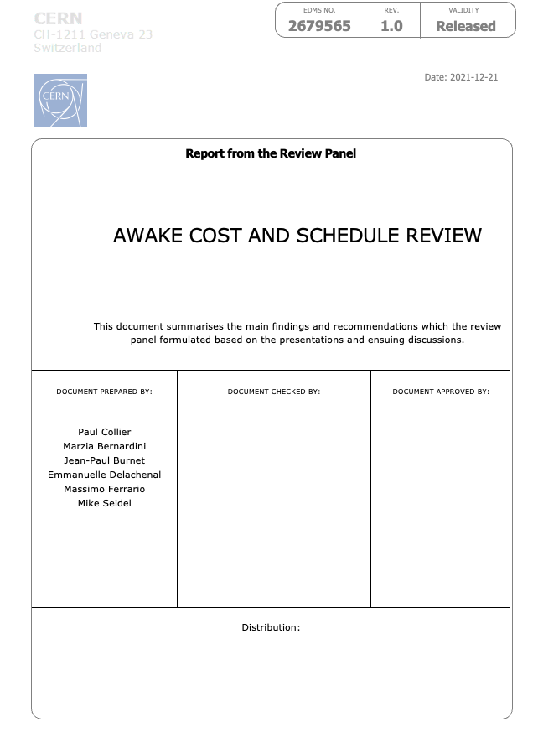

Slide 7
OVERALL RECOMMENDATIONS
CERN must make the strategic decision whether to support the AWAKE Run 2 by early 2022. Given this decision, the resources needed for CNGS dismantling and the additional resource request for AWAKE Run 2 will have to be secured. This decision is also important for the external collaborations to secure their remaining requests.
It is recommended that the CNGS dismantling project should be kept as a separate project. Given a positive decision above it is recommended that the detailed analysis of the cost and workforce needs for the dismantling are rapidly completed in time for the preparation of a 2022 MTP request. This is necessary if the schedule presented is to be met. It is further recommended that a cost and schedule review of the CNGS project be organized as soon as possible afterwards.
Potential synergies exist between the projects CLEAR, CLIC and AWAKE. Through the realization of such synergies and appropriate coordination the total CERN funding of these projects can be optimized. This, together with potential savings coming from external sources is needed to establish the precise additional CERN budget required by AWAKE to complete Run 2.

Slide 8
OVERALL RECOMMENDATIONS
Agreement between the technical groups and the project on the workforce resource requirements should be agreed by the departments concerned and incorporated into their workforce plan.
The identified missing workforce resource for a plasma physicist can be funded from the M2P budget of the project. As this post is well justified, it is recommended that this is approved by CERN.
As soon as possible a baseline should be established for the schedule and expenditure profile for the whole of Run 2. This should then be tracked using standard methods, such as EVM.
The jitter on the proton beam from the extraction and transfer line elements is an important point for AWAKE and could represent a limitation on Run 2c. Some improvements are funded within the project. However, additional countermeasures are being studied and appear to have significant synergies with LHC and North Area Operation. It is recommended that the priorities and schedule of such improvements be addressed globally for the SPS clients.
The CERN AWAKE Steering Board has still not been activated. Either this should be set-up, or the role should be taken by an existing entity, such as the ATSMB.

Slide 9
MTP
  Budget is now discussed during CERN’s MTP (Mid-Term-Planning) exercise.
  Usually MTP is approved by the council in June, however, this year due to the Russian invasion to Ukraine, the approval will be delayed until September.

Slide 10
Extra slides

Slide 11
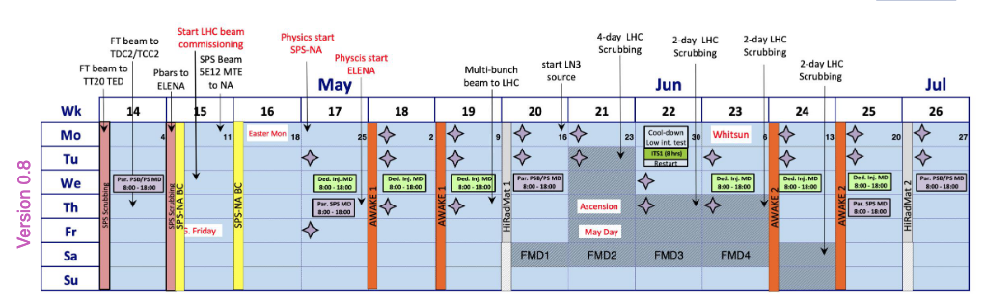
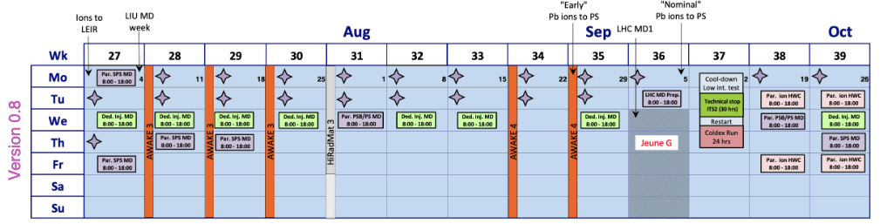
AWAKE Run 2022
AWAKE 1: May 2 – May 15 2022
AWAKE 2: June 13 – June 26 2022
AWAKE 3: July 11 – July 31 2022
AWAKE 4: August 22 – September 4 2022
AWAKE 5: November 17 – December 7 2022
LHC startup will be delayed by some weeks,
→ Possible some slight changes for AWAKE
→ Should be defined in the coming week(s).

