Slide 1
Beam instrumentation status, studies and upgrades for Run 2a
E. Senes for the BI AWAKE team
…. with many thanks to the colleagues from CERN, TRIUMF, CLEAR, MPP, UCL, Liverpool …
AWAKE collaboration meeting, 12-13 April 2022

Slide 2
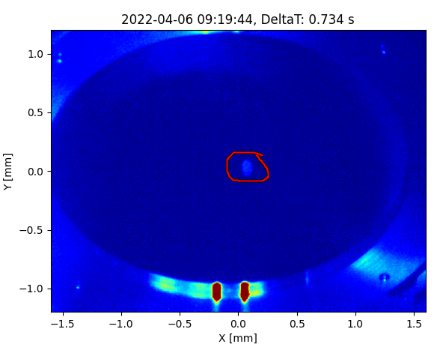
Where do we start ?
More or less the same talk was given at the last Collaboration Meeting. Very diverse activities and dramatic improvement (and a lot of work) on:
Digital cameras systems
New current transformer
High Frequency button BPM
Cherenkov Diffraction BPMs
Spectrometer camera array
DMD halo monitor
… plus filling the laser holes in the screens, motors, etc …

Slide 3
Digital cameras – systems
CERN to abandon analog cameras due to end of production and inferior performance
Two systems to replace the PXIs, up to 24 cameras each

Slide 4
Digital cameras – systems
CERN to abandon analog cameras due to end of production and inferior performance
Two systems to replace the PXIs, up to 24 cameras each
Beamline cameras (TSG41 + cs-ccr-awakecam)
10 devices: 6 BTVs + BTV54 + Exp. Volume + 2 Halos
8 non-standard: 2 DMD halos + 4 spectrometer cams + 2 streak monitoring cams
6 free
Laser cameras (TSG40 + cs-ccr-awakecam1)
8 devices: 5 Virtual line + UV laser room + IR laser room + UV cathode
16 free

Slide 5

Digital cameras – status
All the hardware currently installed
AWAKE
CCR
GiGE PoE SWITCH
64 CORE
SERVER
CAM1
10G
FIBRE LINK
CAM24
Support for Basler Ace Classic cameras, up to 1920x1200
Intense software development in 2022 – in parallel with testing

Slide 6
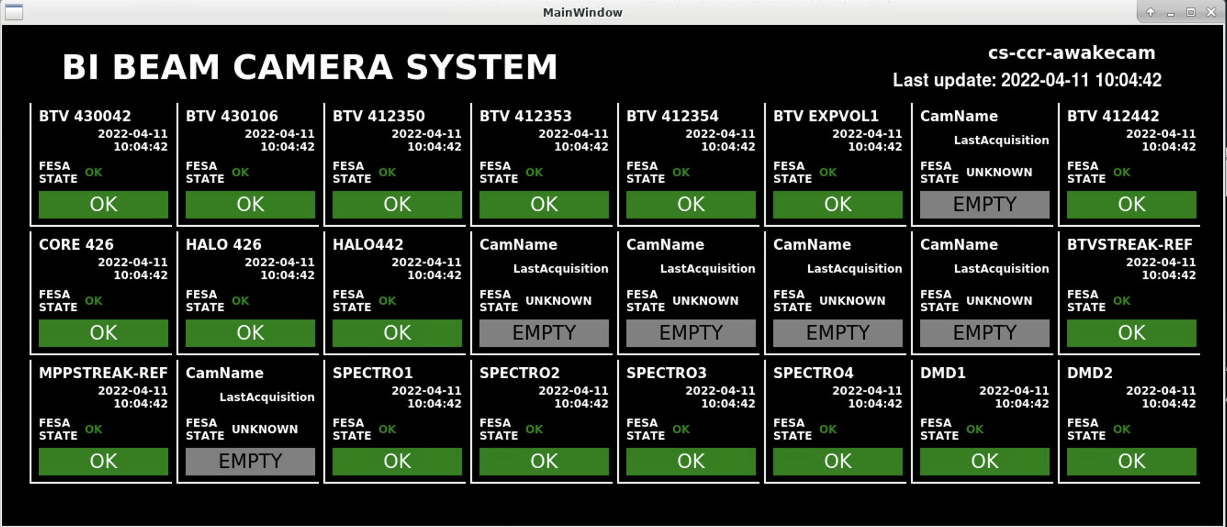
Digital cameras – testing
Many test campaigns in 2021 and 2022
Continuous improvement since the FESA deployment:
10 cameras constantly installed
18 cameras for large scale tests (today!)
New features added
Support for non-BI cameras under development
To launch camera diagnostic:
/user/esenes/bin/AWAKE-camera-monitor/launch_camera_monitor.sh

Slide 7

Digital cameras – testing
Many test campaigns in 2021 and 2022
… we are dangerously close to when …
Continuous improvement since the FESA deployment:
10 cameras constantly installed
18 cameras for large scale tests (now !)
THE BEST STRESS TEST IS YOU
New features added
Support for non-BI cameras under development

Slide 8
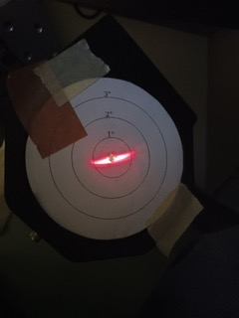
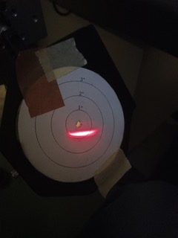
Streak camera line
Collaboration with the MPP team to improve the upstream streak camera optical line
Upcoming developments:
Motorization of a second mirror on the optical line
Check on screen flatness
Check on screen position repeatability
Work in progress …
1 inch angular difference after 6m of optical line

Slide 9
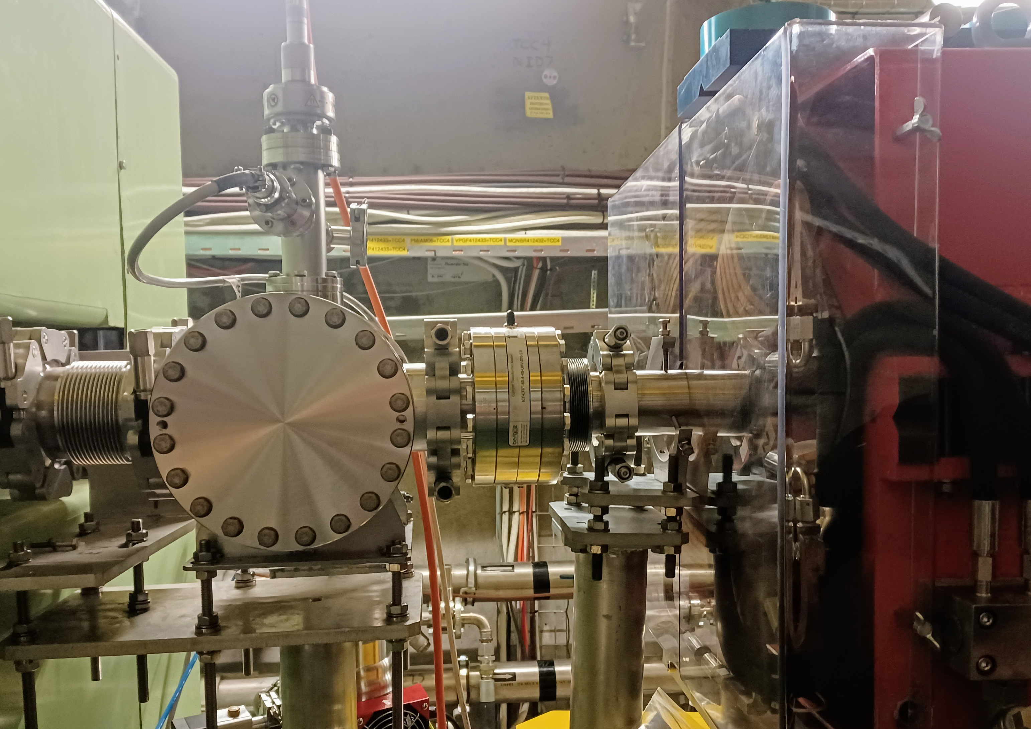
BCT downstream the plasma cell
Bergoz commercial BCT installed upstream the spectrometer
Goals:
Measure charge after the plasma
Calibrate the spectrometer scintillator
Installed in March with CERN readout electronics, currently under commissioning
For details AWK-BCTIA-EC-0001
https://edms.cern.ch/document/2714008/0.1
Spectrometer
BCT
Quadrupole

Slide 10
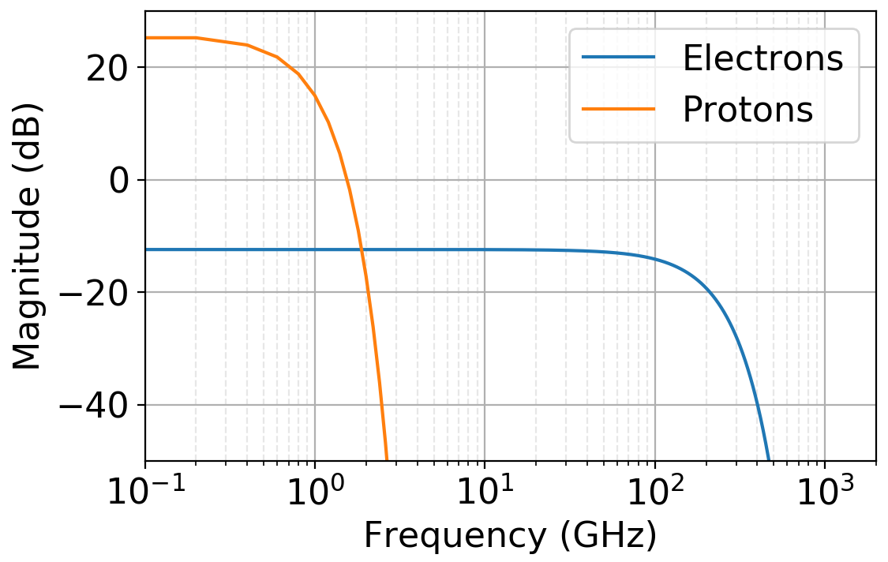
High-frequency BPM studies
STRONGER PROTONS
STRONGER ELECTRONS
In the common line, the protons blind conventional electron BPM systems
Need for a system performing the detection at sufficiently high frequency
It’s extremely difficult to build a well-behaved device that works at 10s of GHz
1
High frequency button BPMs
2
Cherenkov Diffraction Radiation BPMs
eBPM working frequency

Slide 11
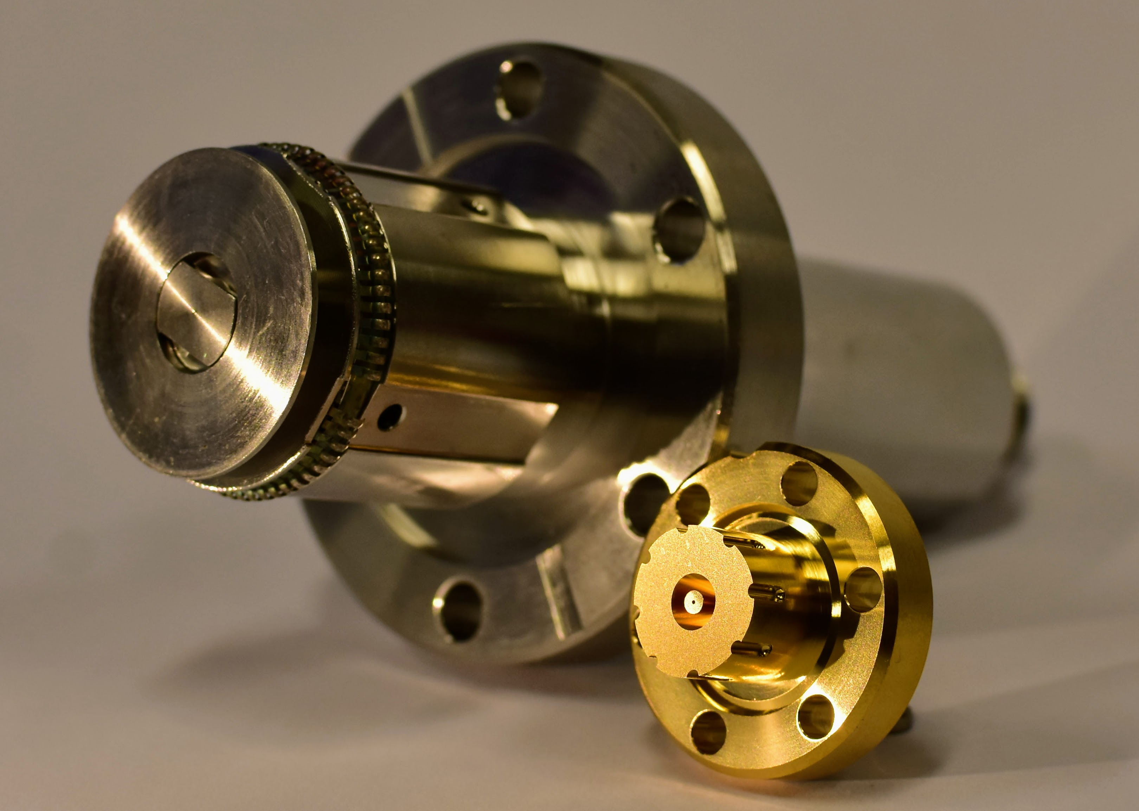
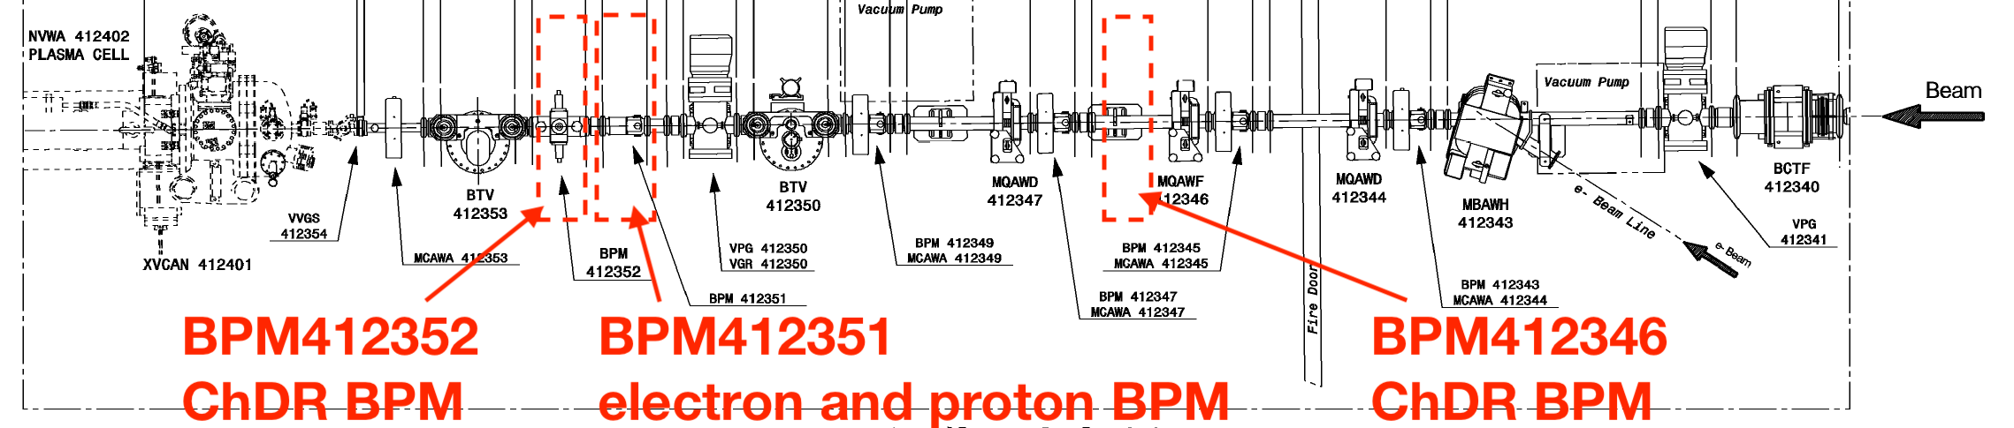
High-frequency button BPM
Commercial 40 GHz conical buttons by OMC on an adapted DESY design
See A. Angelovski et al., Phys. Rev. ST Accel. Beams 15, 112803 (2012)
Installed yesterday
Upcoming tests with electrons (dedicated) and protons (parasitic)
HF button vs traditional pBPM button
Initial setup:
- Bandpass filters and diode detectors
- Investigating bands at 11 and 26 GHz
HF BPM
For details AWK-BPM-EC-0003 https://edms.cern.ch/document/2713307/0.1

Slide 12
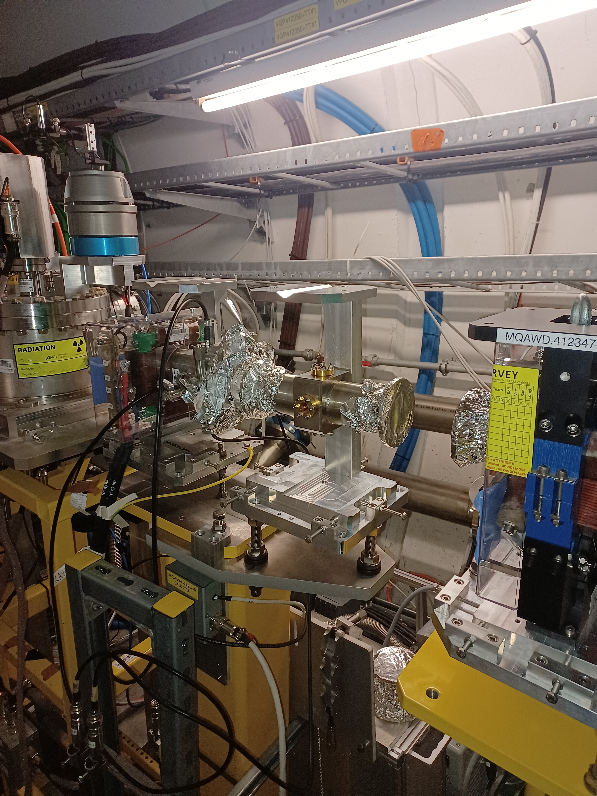
High-frequency button BPM
Commercial 40 GHz conical buttons by OMC on an adapted DESY design
See A. Angelovski et al., Phys. Rev. ST Accel. Beams 15, 112803 (2012)
Installed yesterday
Upcoming tests with electrons (dedicated) and protons (parasitic)
HF button vs traditional pBPM button
Initial setup:
- Bandpass filters and diode detectors
- Investigating bands at 11 and 26 GHz
HF BPM
For details AWK-BPM-EC-0003 https://edms.cern.ch/document/2713307/0.1

Slide 13
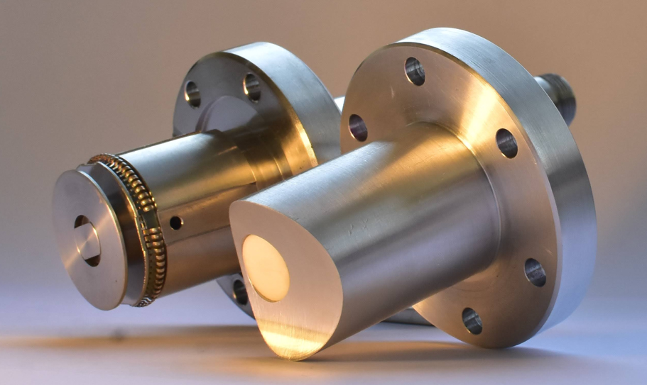
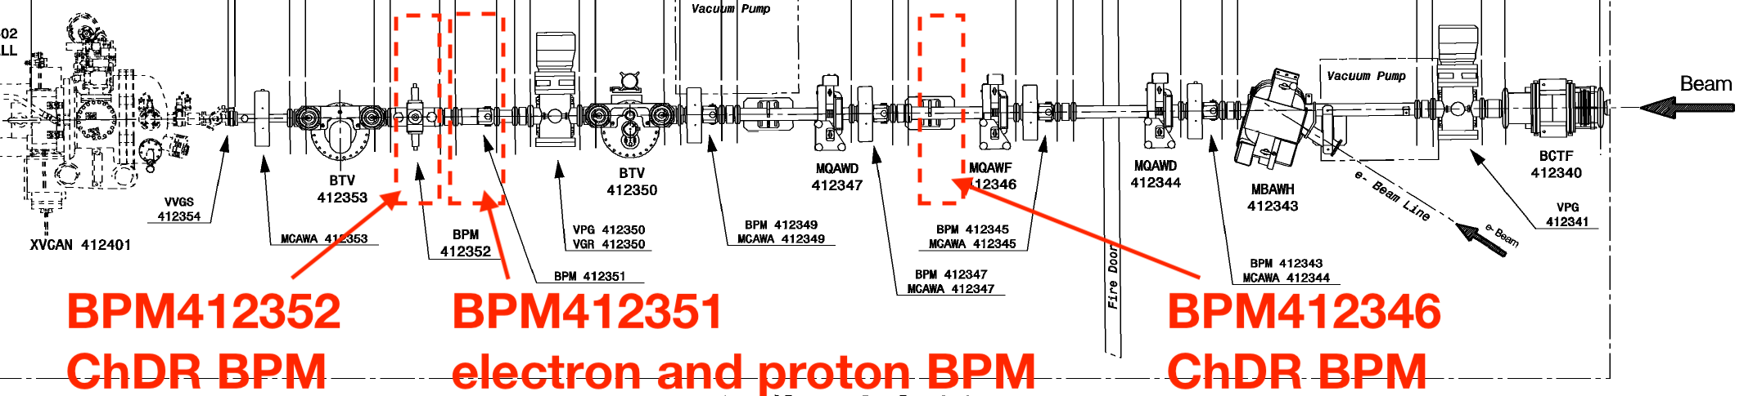
ChDR BPMs
See Collette’s presentation on Wednesday
Brazed ceramic inserts ø6 mm
High operating frequency of 30 GHz
Successful in-air test campaign at CLEAR in 2021
Body #1 installed yesterday
ChDR button vs traditional pBPM button
Detection electronics under production by TRIUMF
For details AWK-BPM-EC-0002 https://edms.cern.ch/document/2667362/0.1

Slide 14
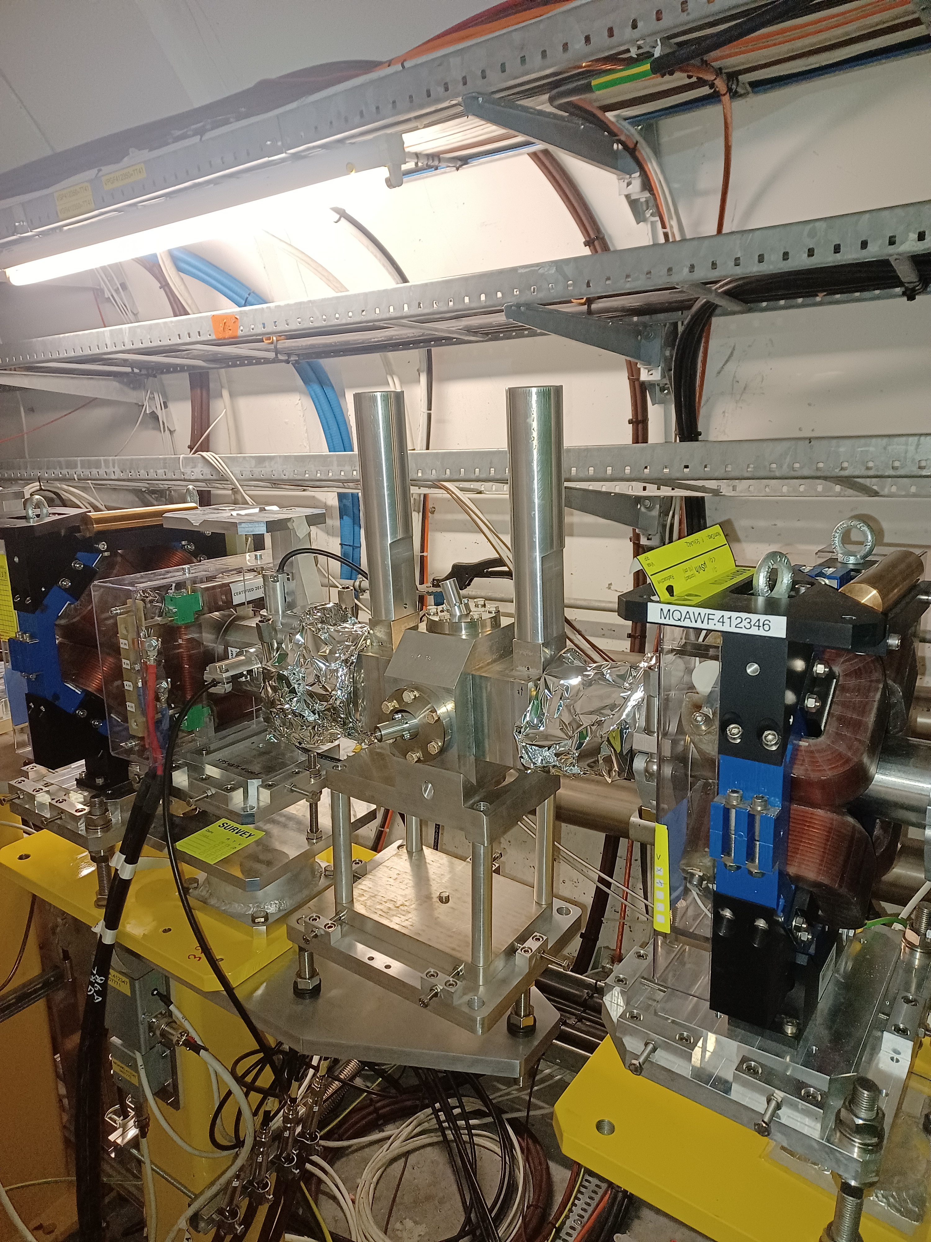
ChDR BPMs
Brazed ceramic inserts ø6 mm
High operating frequency of 30 GHz
Successful in-air test campaign at CLEAR in 2021
Body #1 installed yesterday
ChDR button vs traditional pBPM button
Detection electronics under production by TRIUMF
For details AWK-BPM-EC-0002 https://edms.cern.ch/document/2667362/0.1

Slide 15
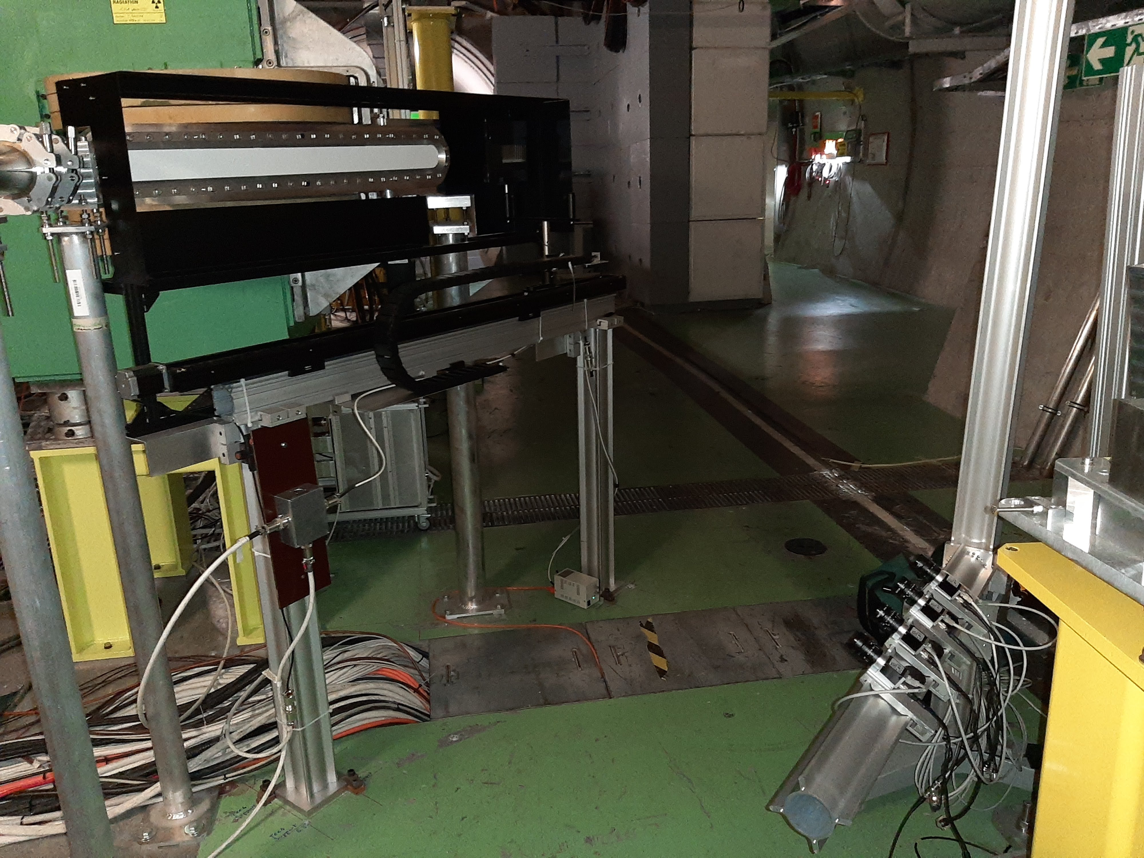
Spectrometer camera array
D. Cooke, F. Pannell, M. Wing (UCL)
Digital camera array at 150 cm
Spectrometer mirror
Permanently on the BI DAQ
New setup for the upcoming run with 4x 75mm f/2.8 lenses and 525 ± 46 nm filters
Scintillator tile
Goal: electron beam emittance measurement.
Factor x10 improvement on the existing spectrometer resolution
Camera array
See David’s presentation tomorrow

Slide 16
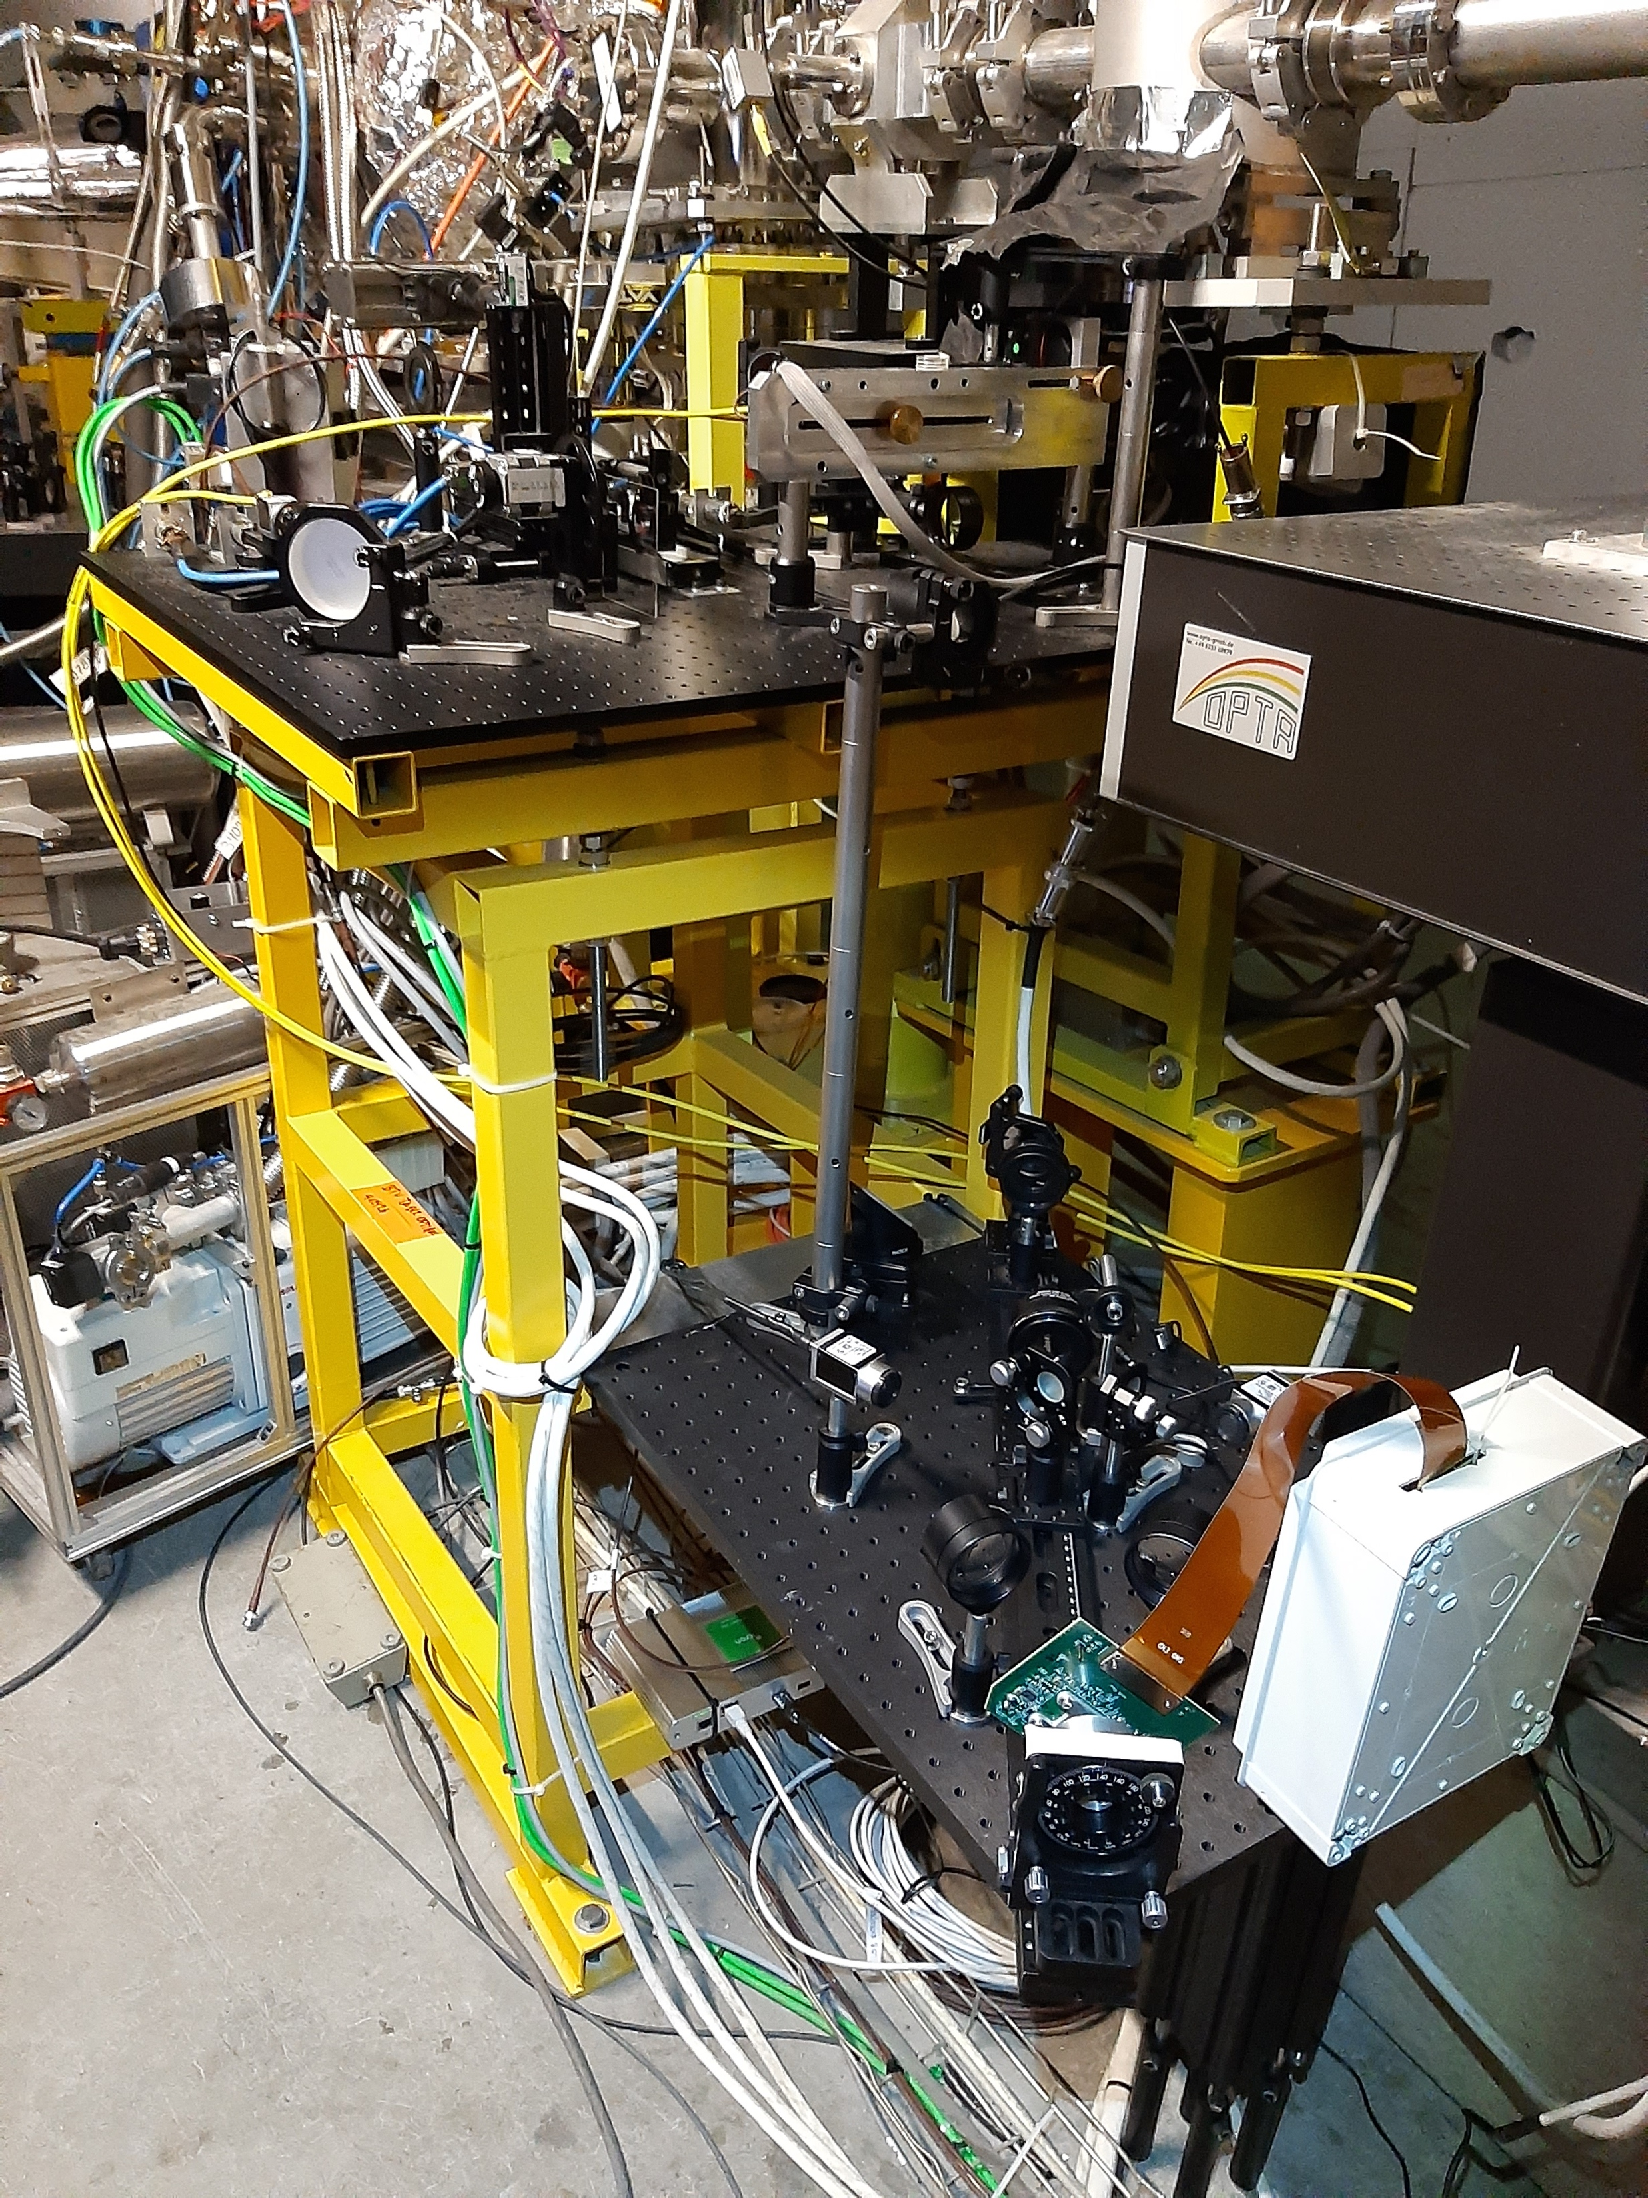
DMD halo monitor test
J. Wolfenden, C. Welsch (Liverpool U.)
Test of a Micro Mirror Device (DMD) to dynamically create masks for halo monitors
EXISTING HALO
PERISCOPE
Low installation to limit radiation damage
Successful test run in November 2021
Core camera
CAMERA
Lens
Screen
Lens
DMD
LENS
Halo camera
Lens
DMD

Slide 17
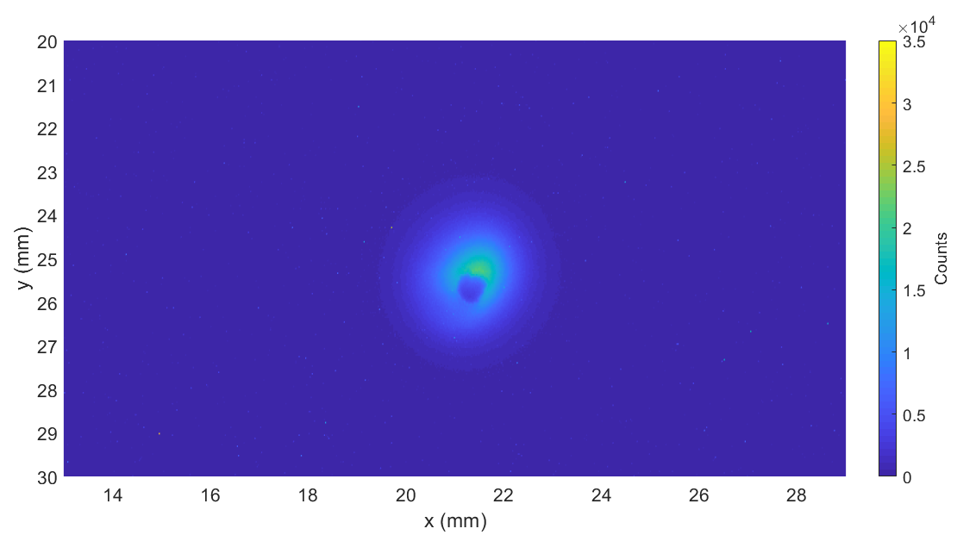
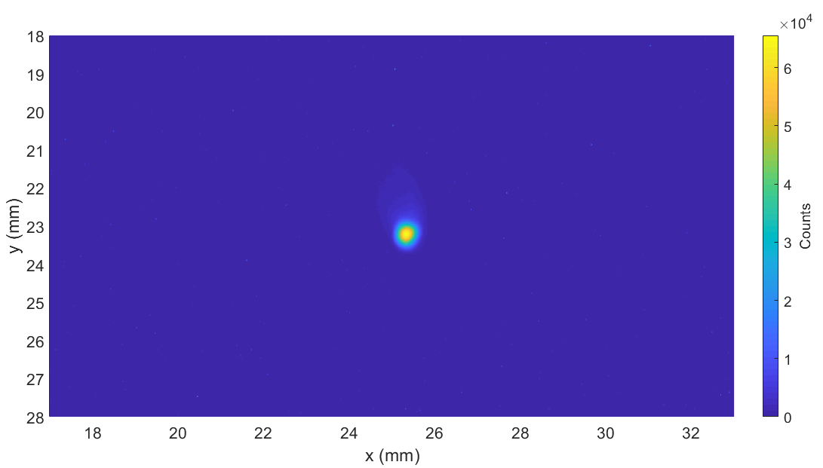
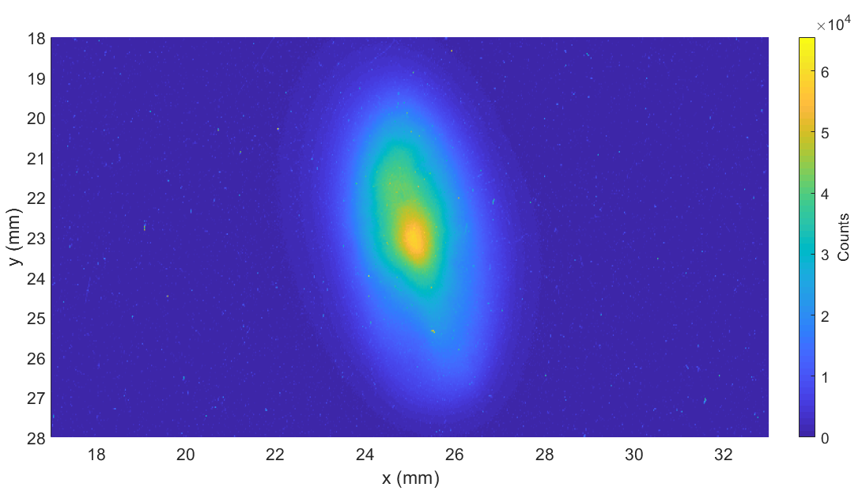
DMD halo monitor test
J. Wolfenden, C. Welsch (Liverpool U.)
Limited test beamtime as the September run was problematic & no plasma in November
PROTONS ONLY
HALO
CORE
Exciting prospects for measurements now that the system is installed and the technical issues are solved !
PLASMA ON

Slide 18
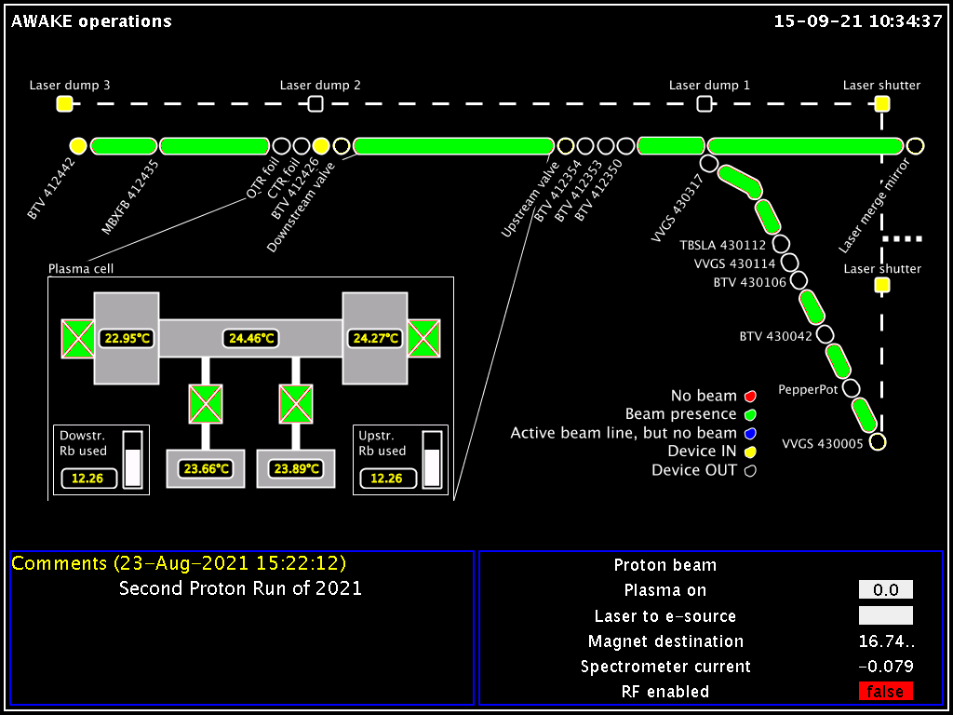
16-09-21 11:15:00
Comments (12-Apr-2022 12:00:00)
Thanks for your attention !

