Slide 1
High power RF system
13 April 2022
Kévin Pepitone, Dragos Dancila, Alireza M. Kasai, Kristiaan Pelckmans

Slide 2
Outline
Layout of the RF line
Solid state power amplifier
Low level RF mTCA

Slide 3
Layout of the RF line

Slide 4
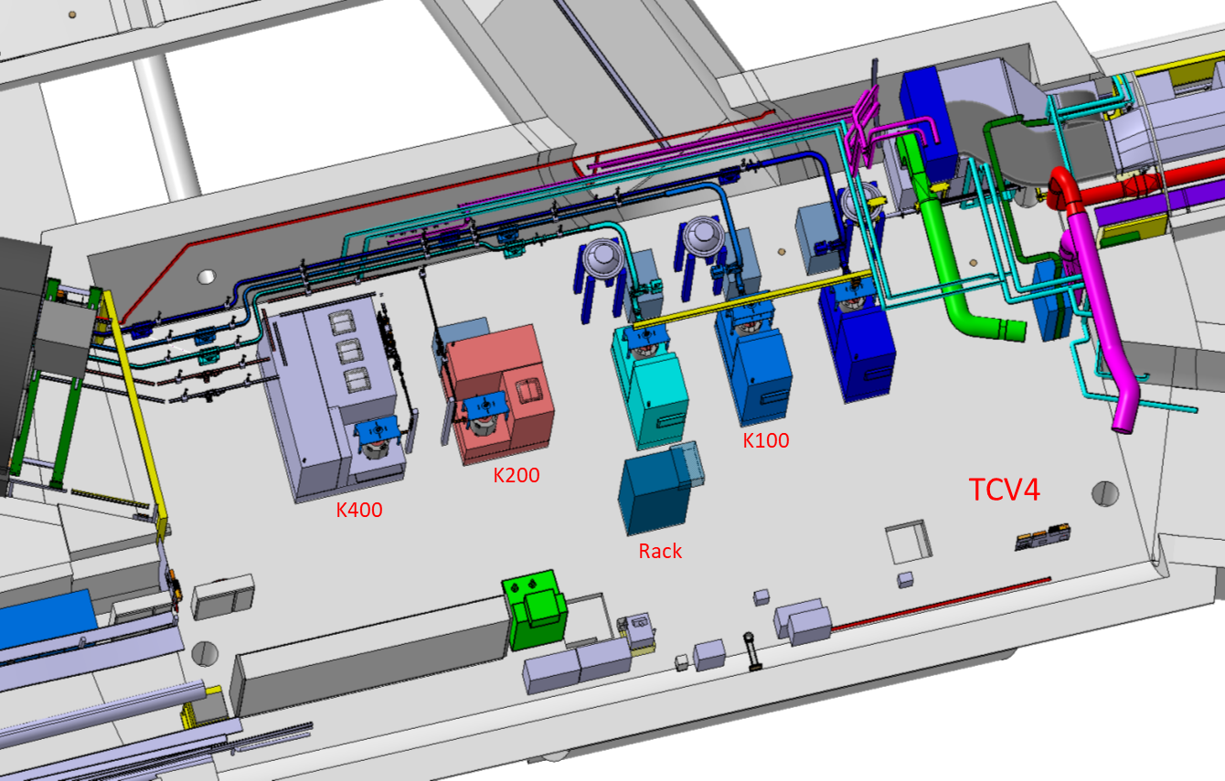
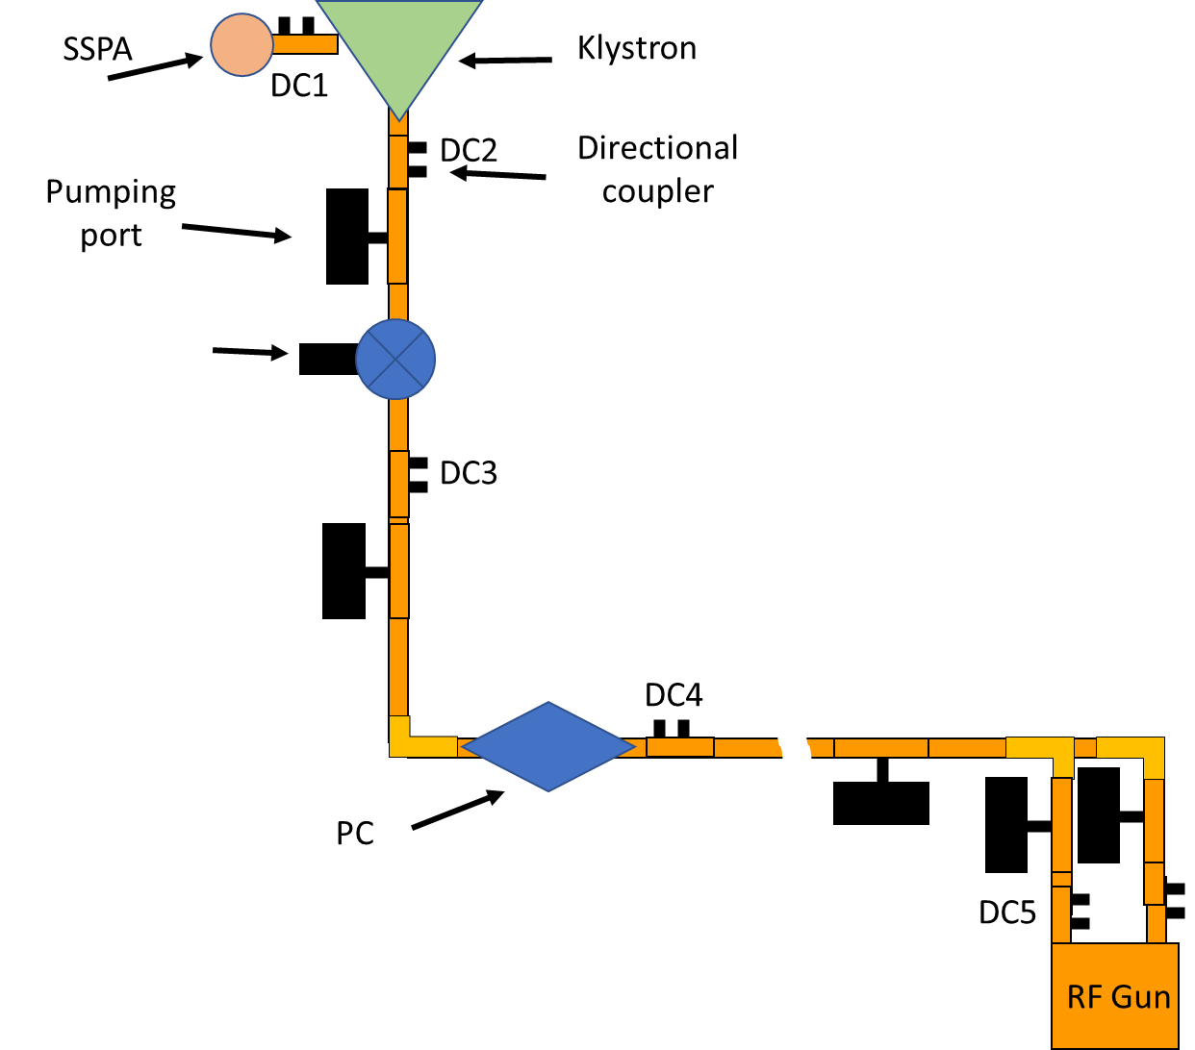
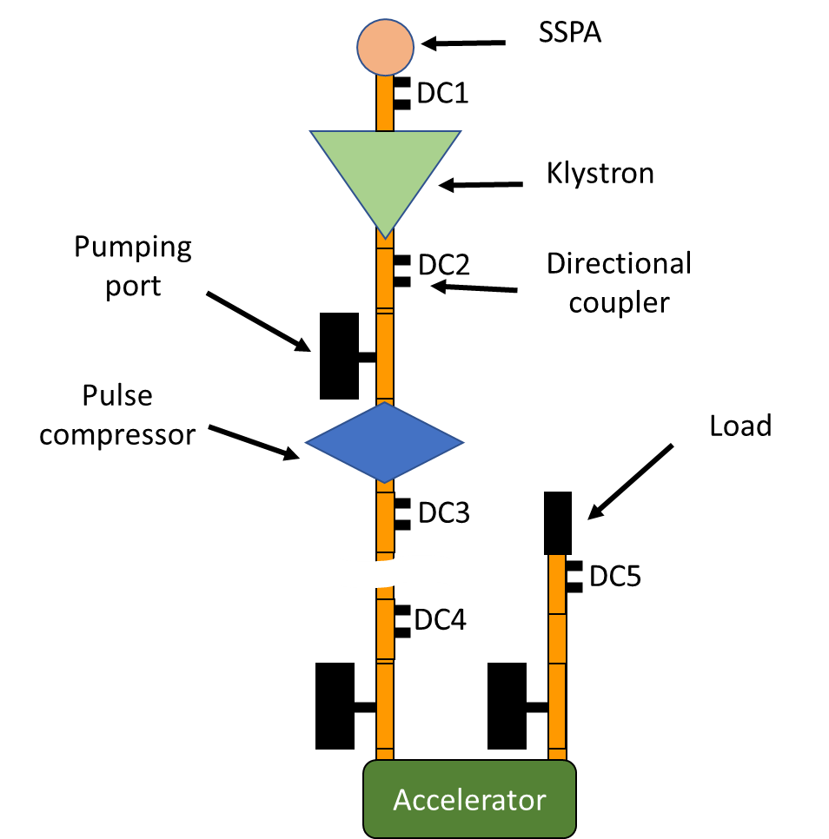
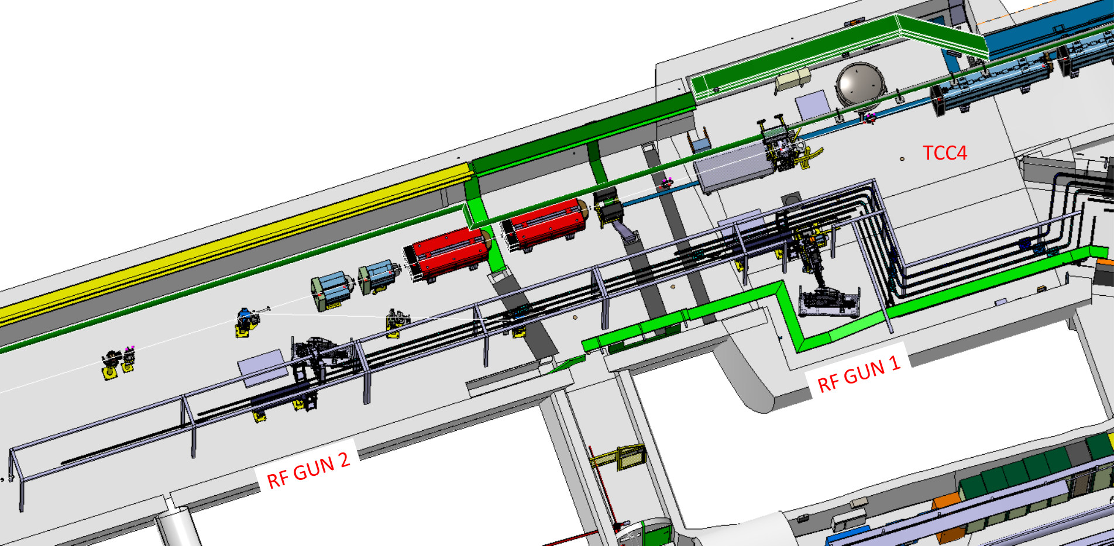
Modulators and klystrons – 1st line
2 Scandinova K100
2 Canon E37349 6 MW or E3779B 7.5 MW
CLERC Vincent BE-EA-DC

Slide 5
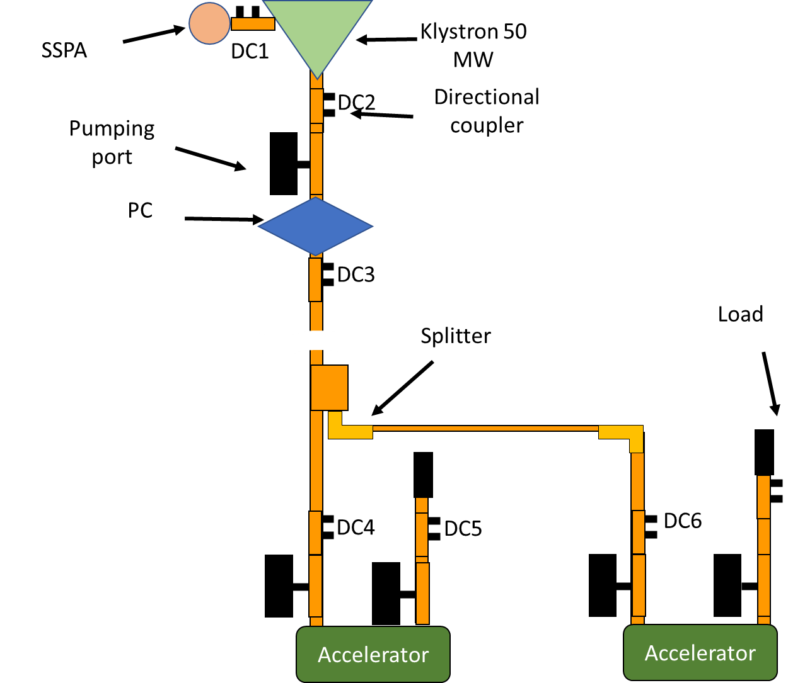
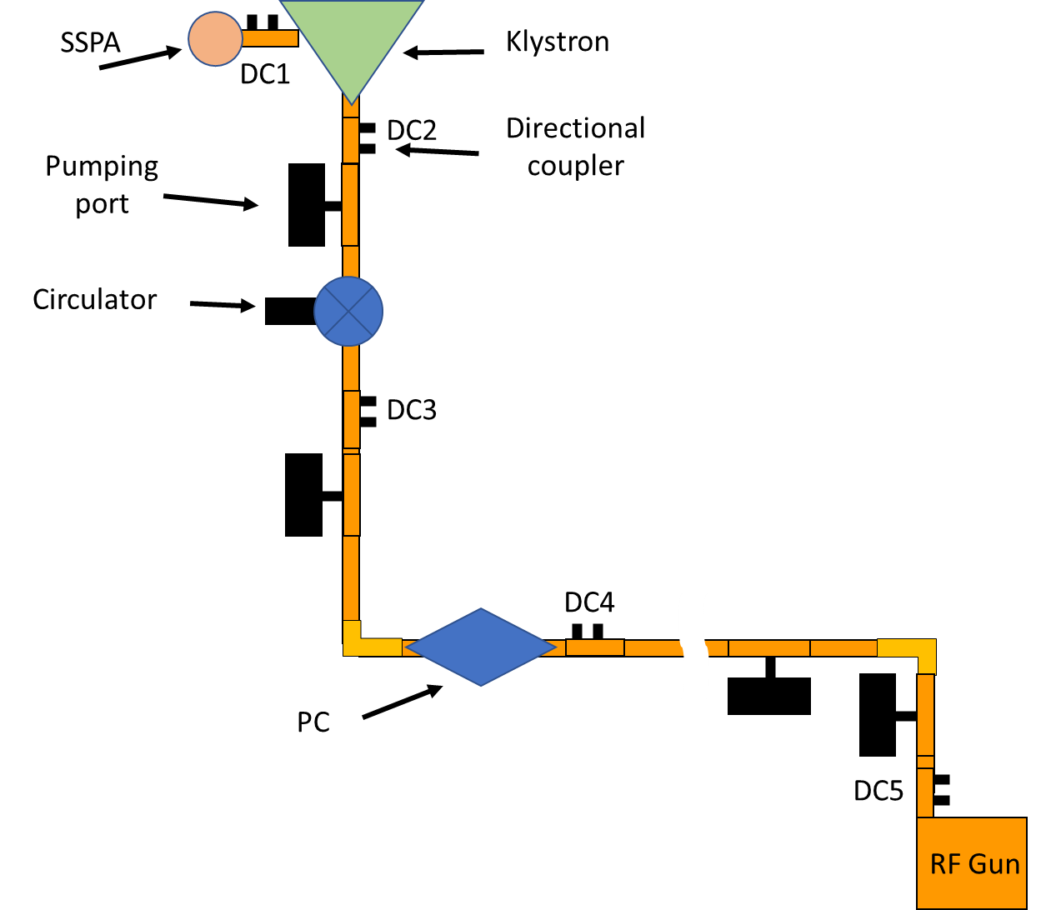
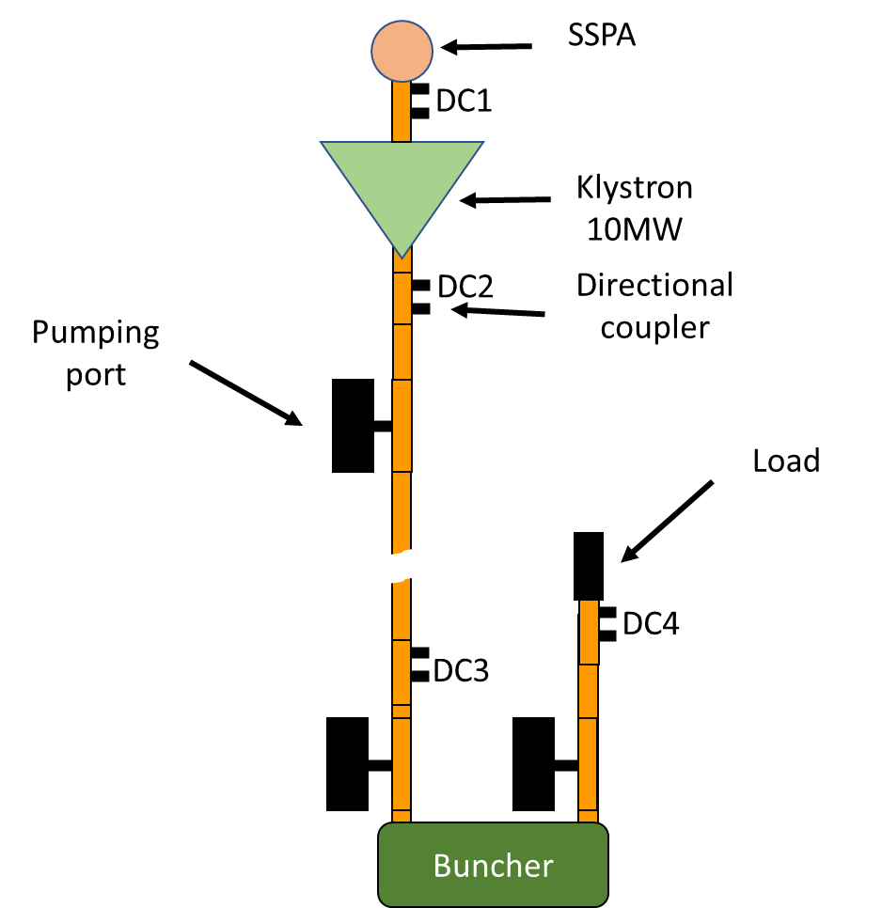
Modulators and klystrons – 2nd line
1 Scandinova K100 - Canon E37349 6 MW or E3779B 7.5 MW
1 Scandinova K200 - Canon E37118 10 MW
1 Scandinova K400 - CPI VKX-8311 50 MW
CLERC Vincent BE-EA-DC

Slide 6
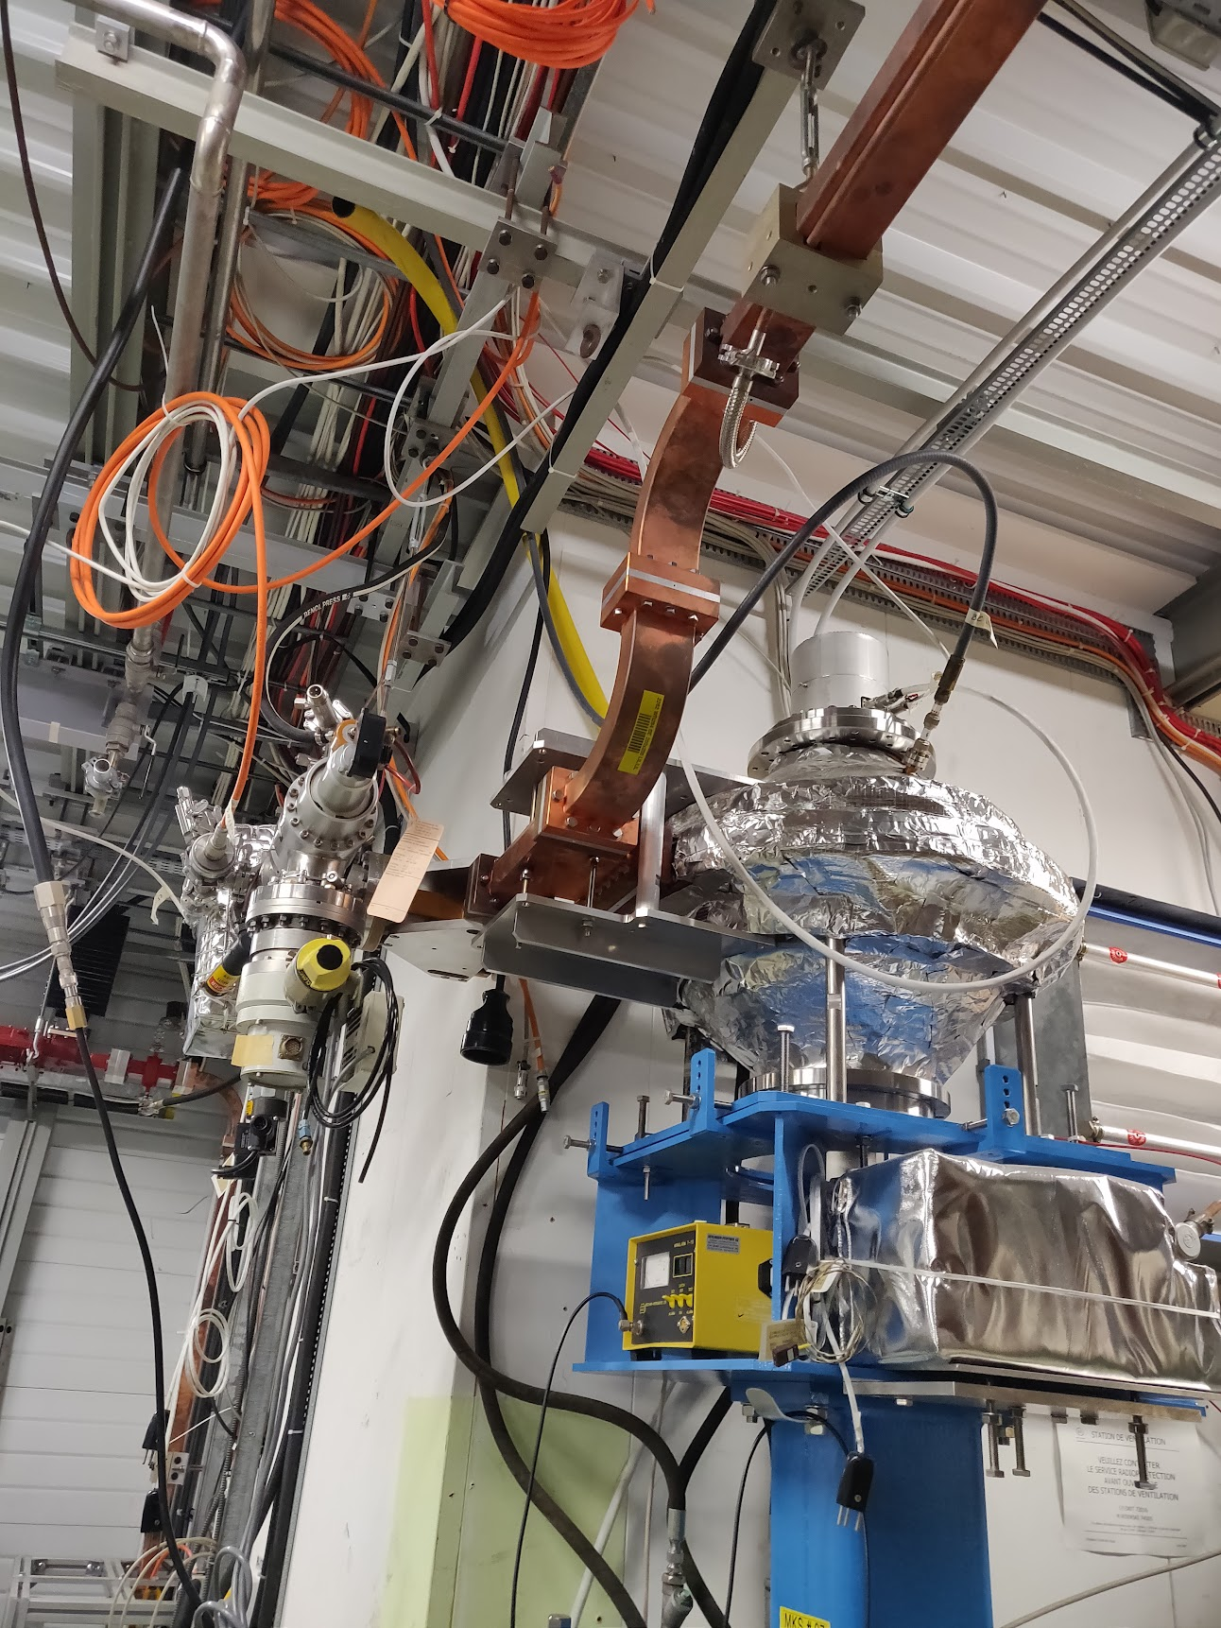
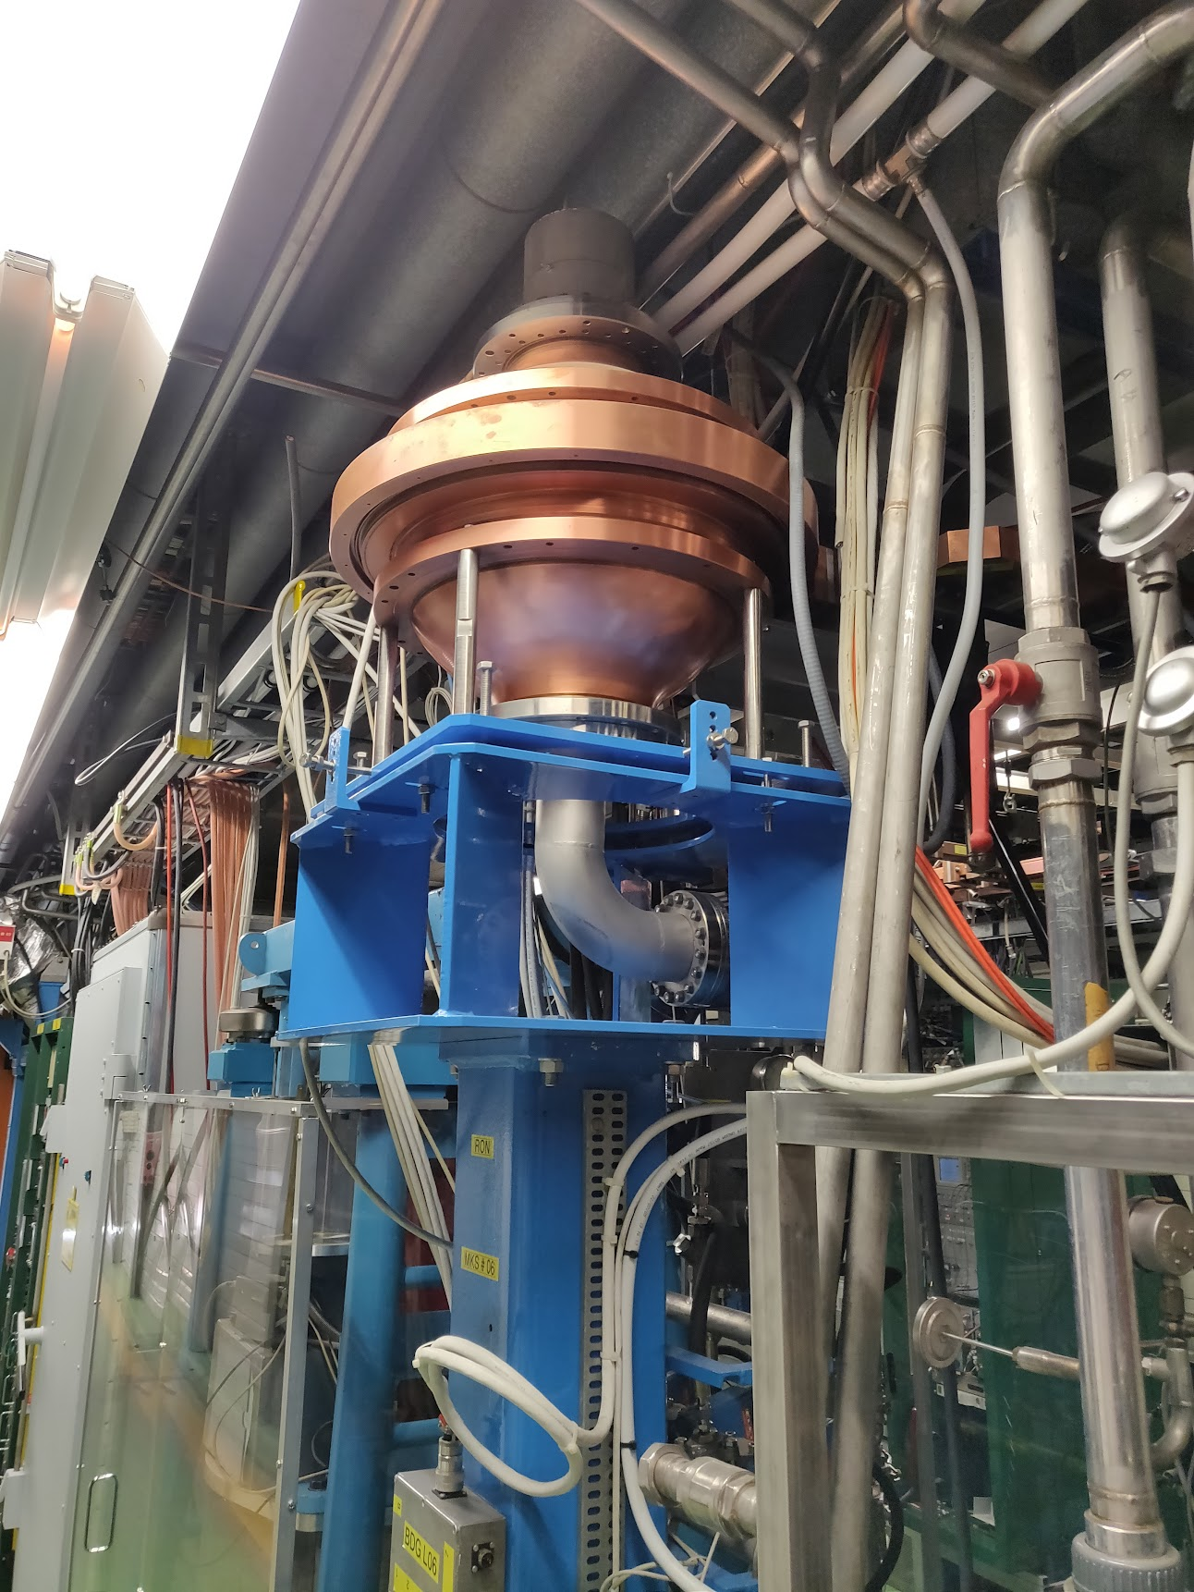
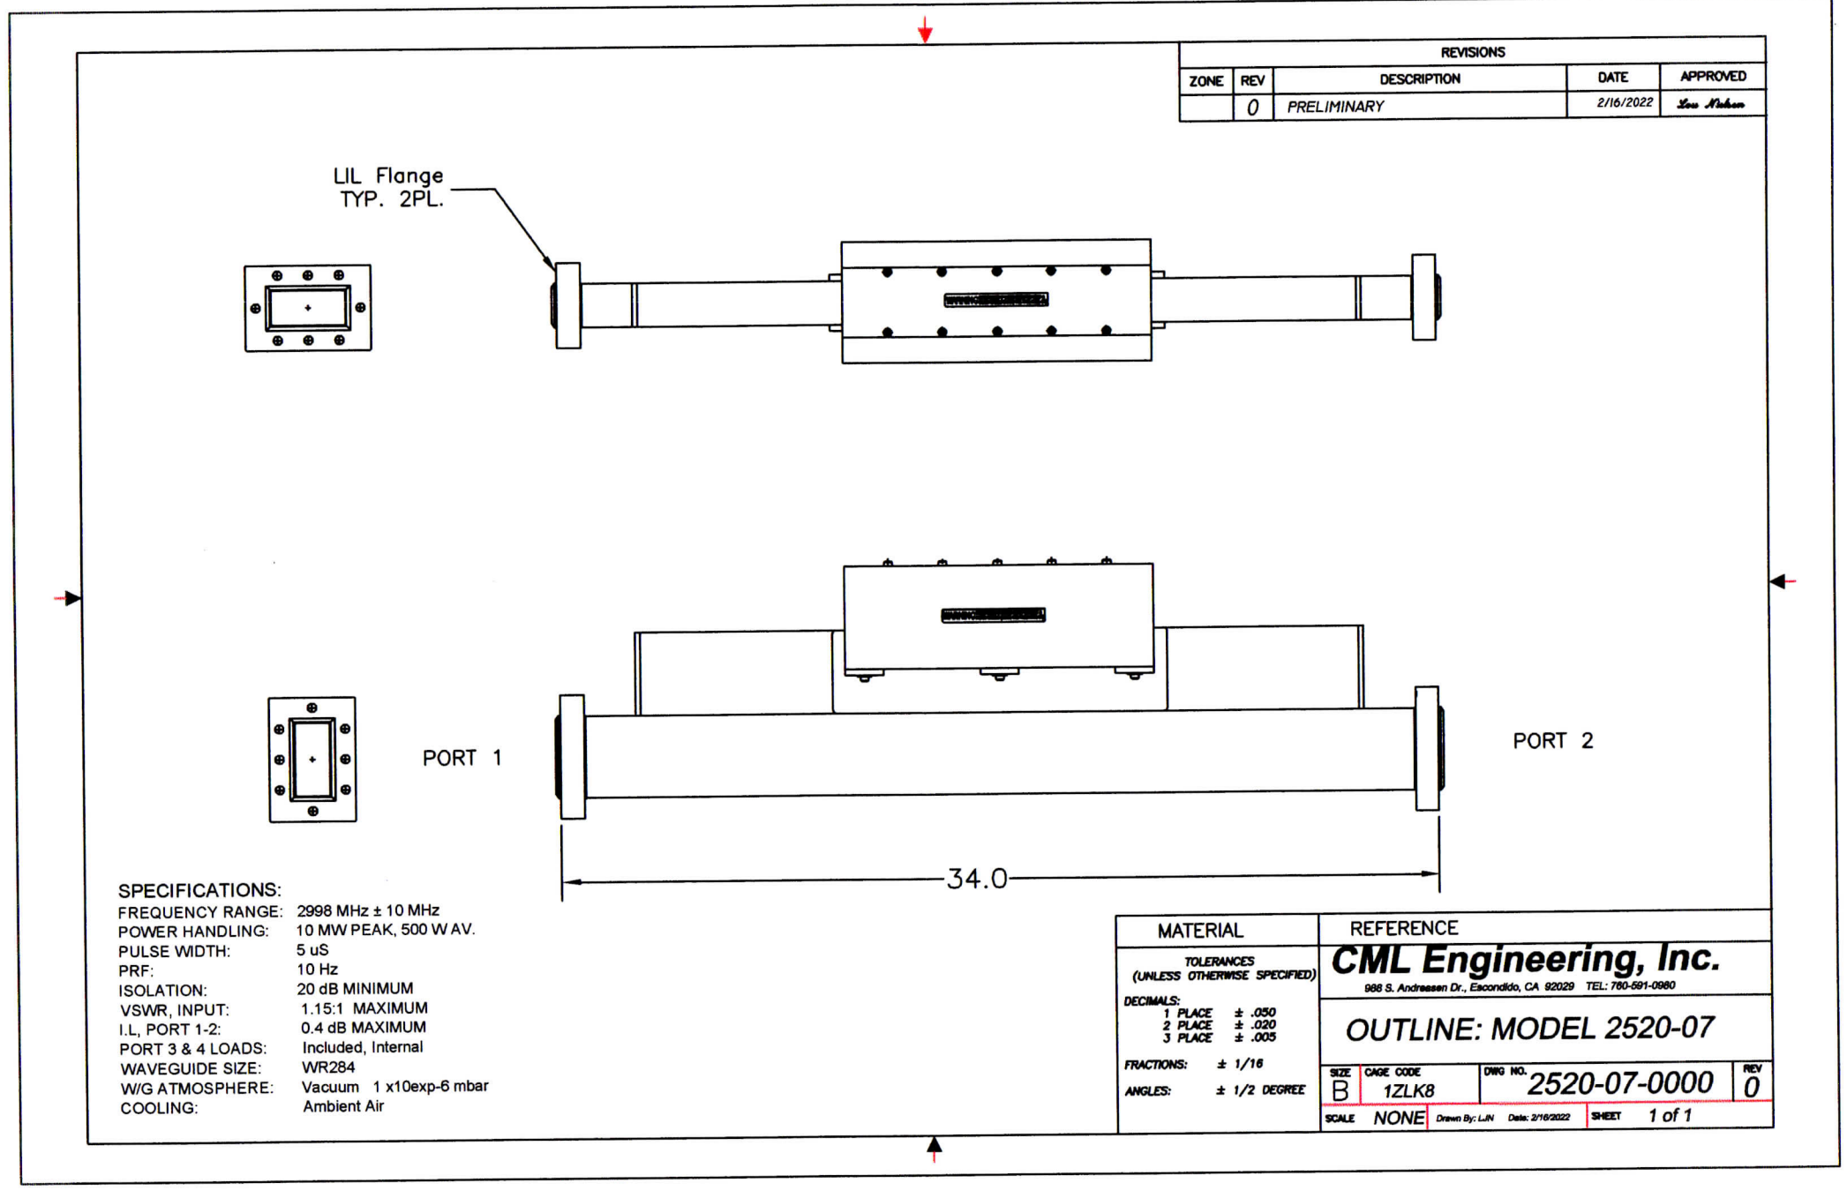
RF components
UHV circulator !!!
Pulse compressor BOC (CTF3)
SPECIFICATIONS: Model 2520-07 Vacuum Circulator
Frequency Range: 2998 MHz +/- 10 MHz
Peak Power: 10 MW maximum
Pulse Width: 5 uS
PRF: 10 Hz
Average Power: 500 Watts
Input VSWR: 1.15:1 maximum
Insertion Loss: 0.4 dB maximum
Isolation: 20 dB minimum
Waveguide Size: WR284
Waveguide Flanges: LIL
Waveguide Atmosphere: < 1 x 10-6 Torr
Cooling: Ambient Air
Materials: OFHC Copper waveguide (0.173” wall)
Stainless Steel, Alloy 316L, Ferrite
The design is with waveguides without SF6
SF6-free

Slide 7
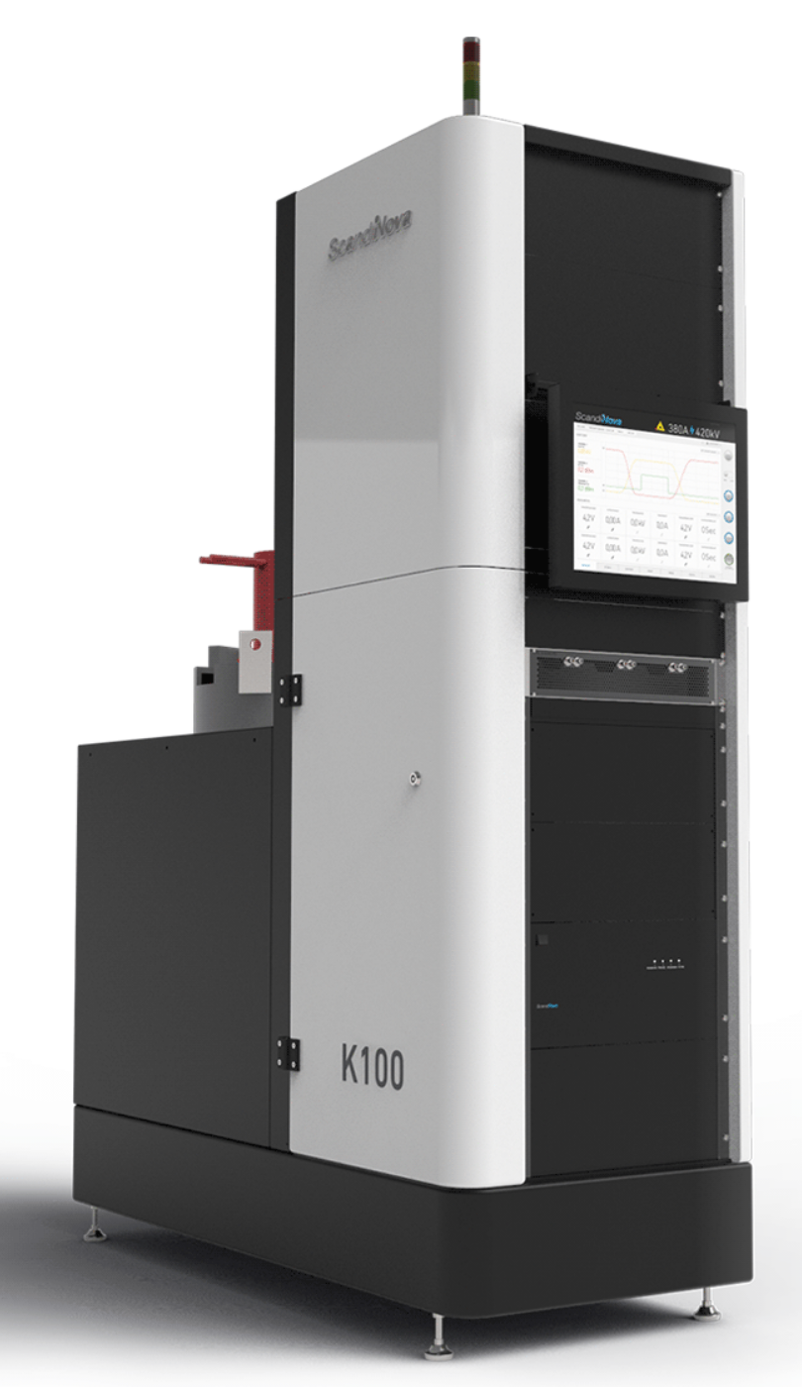
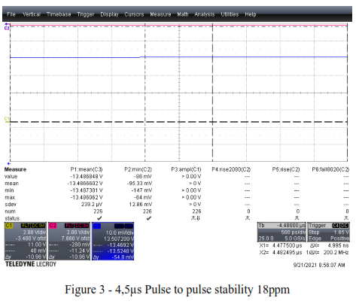
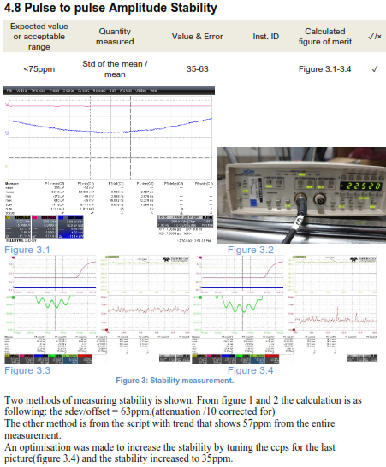
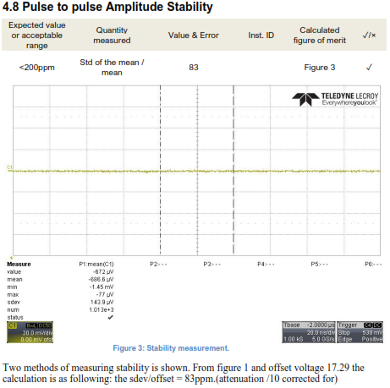
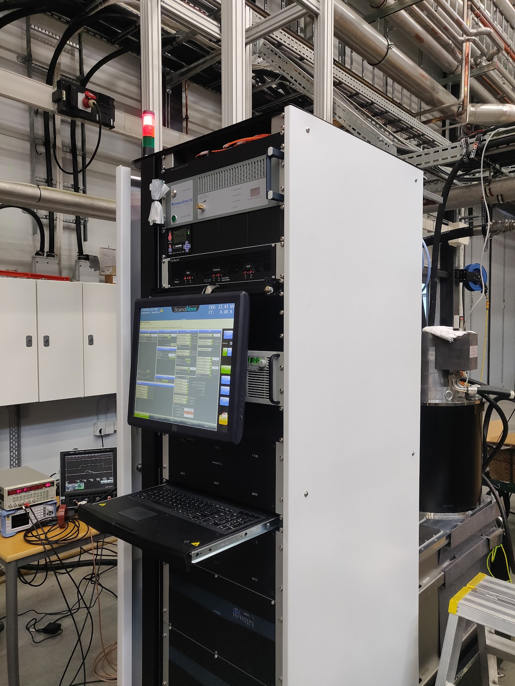
HV stability
50 Hz, 4.5 us
250 Hz, 4.0 us
K100 with 10 MW klystron
10 Hz, 3.0 us

Slide 8
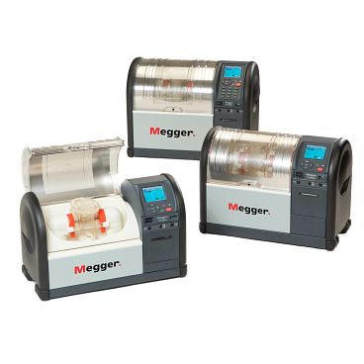
Future developments and tests
R&D on oil for the modulator August-November 2022
HV tests and RF tests of 15 different samples
Test of the UHV circulator with high power RF
RF stability measurement:
Pulse to pulse
Repeatability
Temperature
Compression
…

Slide 9
Solid state amplifiers

Slide 10
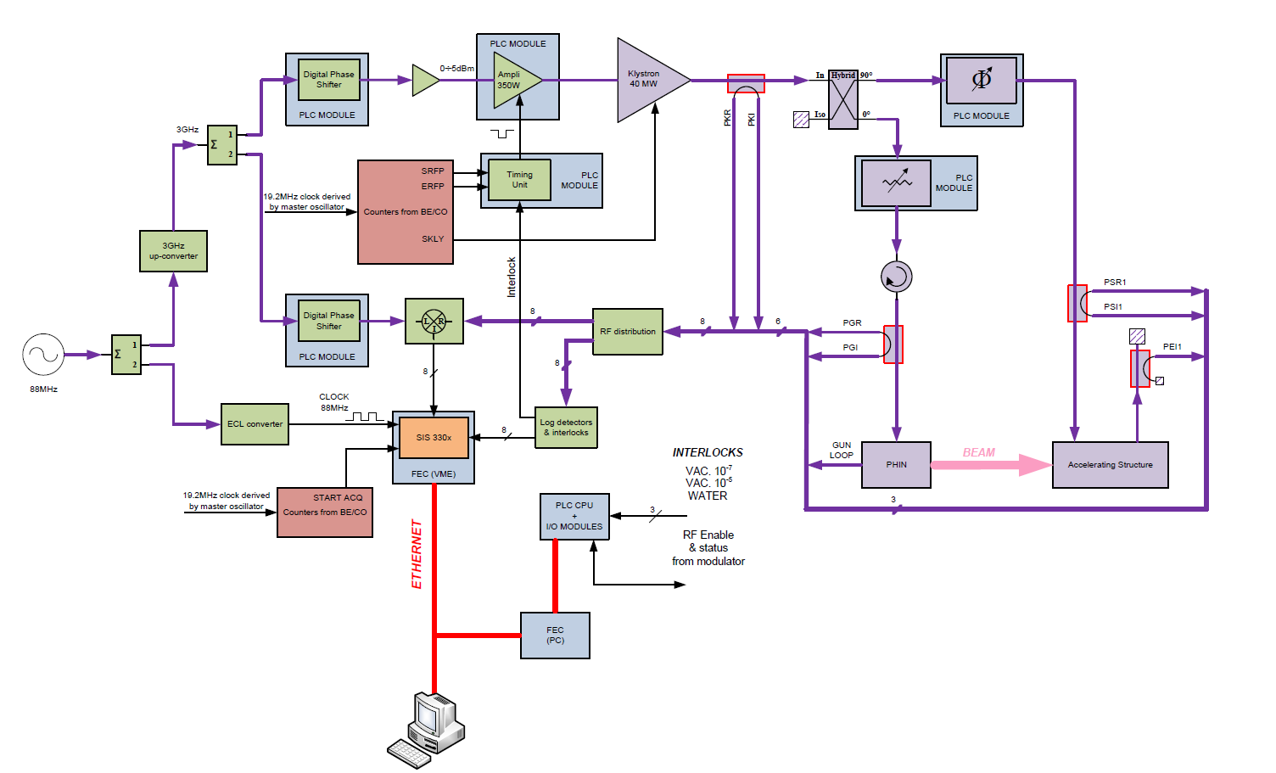
Development of SSPA as driver for the klystrons
SSPA
Specifications
@3 GHz
1) 200W at the input of the 6 or 7.5 MW S-band klystron
@12 GHz
2) 200 W at the input of the 6 MW X-band klystron
3) 1000 W at the input of the 50 MW X-band klystron

Slide 11
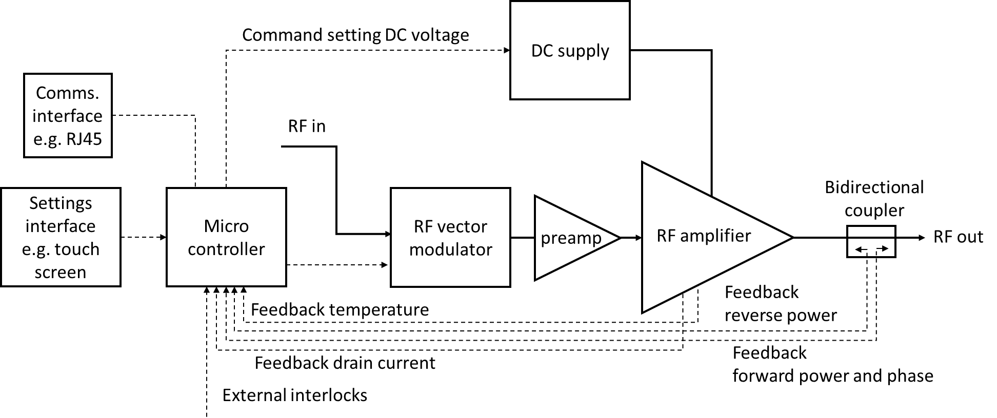
SSPA development at 3 GHz and 12 GHz
The development is planned to be incremental, starting with the high-power amplifiers, continuing with the integration of interlocks and finally with more advanced control.

Slide 12
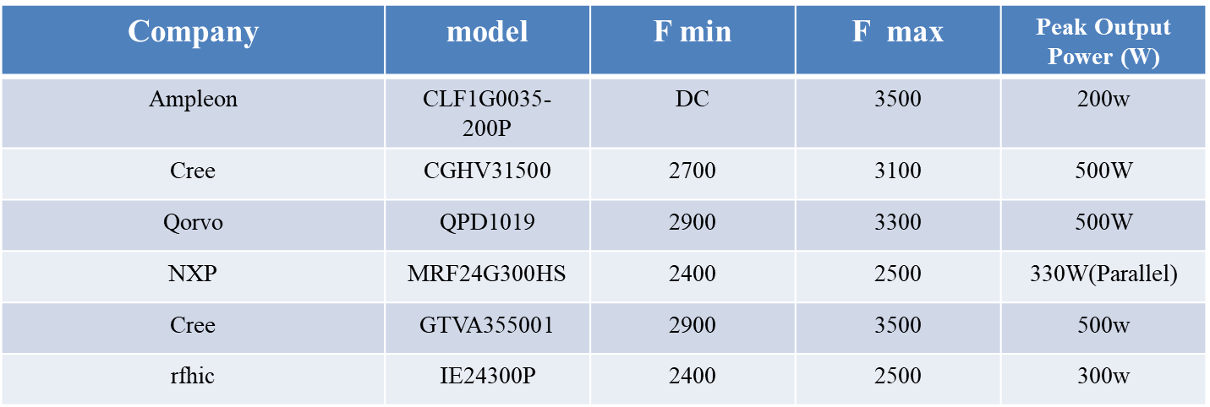
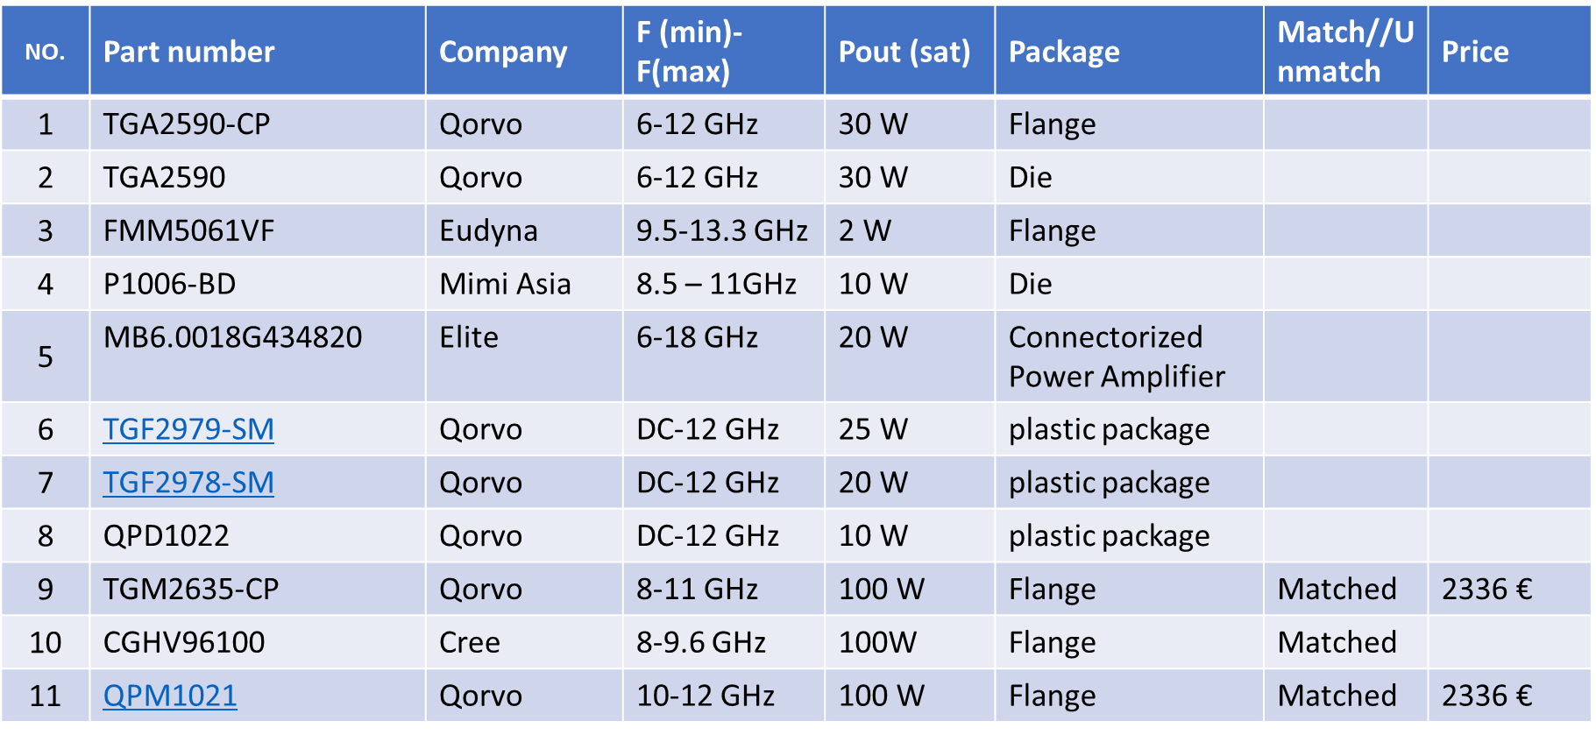
State of the art transistors
S-Band
GaN transistor will be chosen for the design
X-Band
100 W transistor chip are quite expensive -> alternative combining many at lower power levels

Slide 13
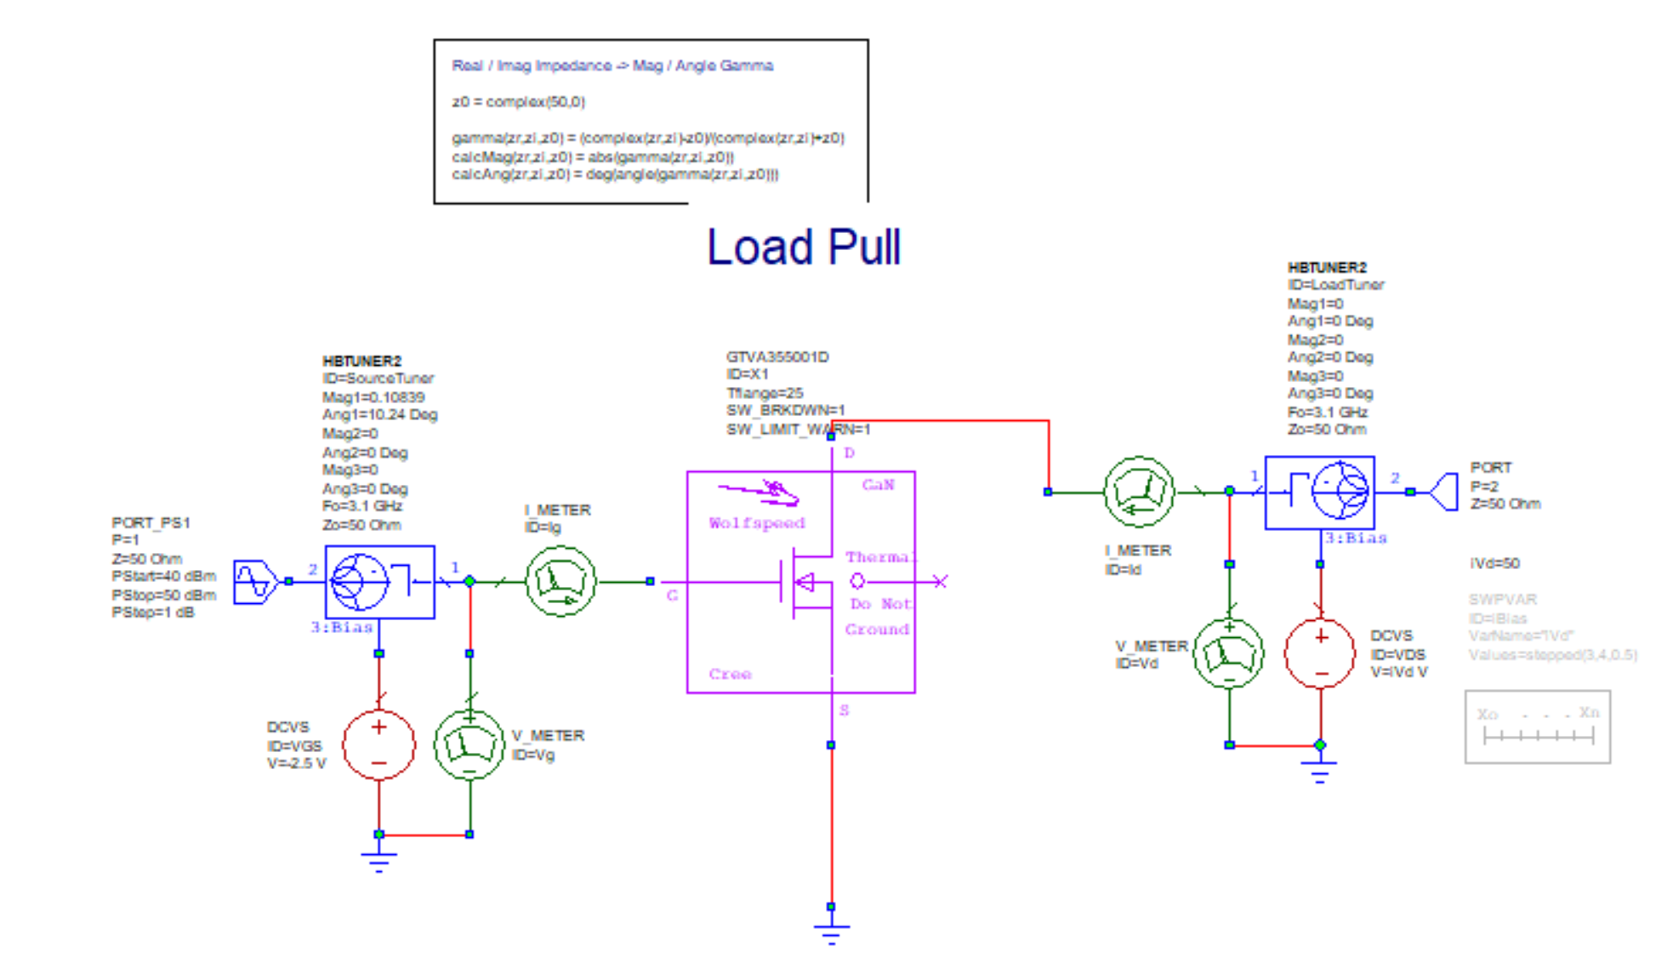
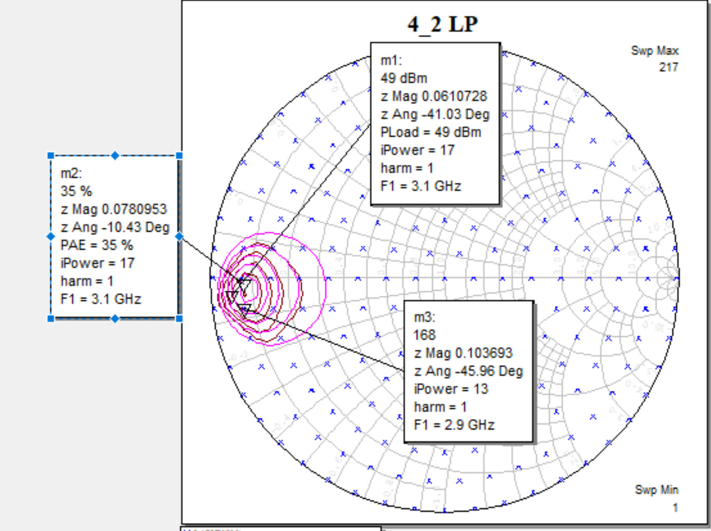
Design in progress

Slide 14
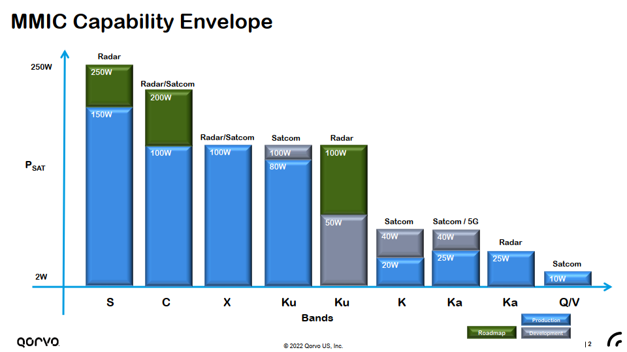
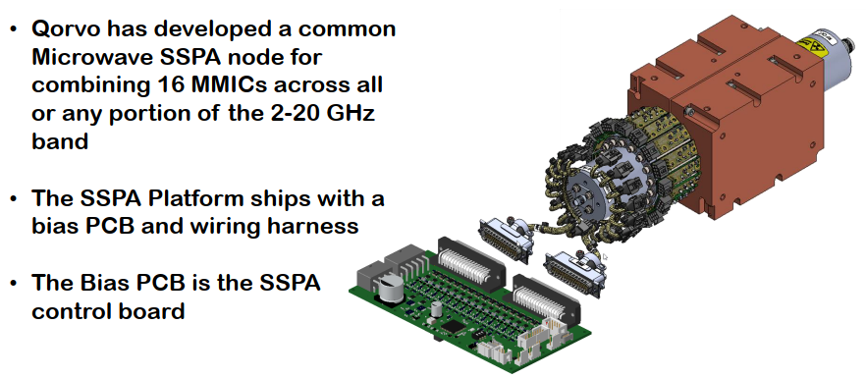
12 GHz – 100 W is the max power available per transistor
Low loss power combiners development is key.
Price tag of this 500 W amplifier is prohibitive, i.e. 50 k$ and we would need to combine 2 of them for the klystron needs, i.e. 1000 W.
Thus, we plan to develop our own power amplifier at X band, based on combining 40+ transistors of 25 W each.
MMICs (monolithic microwave/millimeter-wave IC) combine transistors and passive devices

Slide 15
Low level RF - mTCA

Slide 16

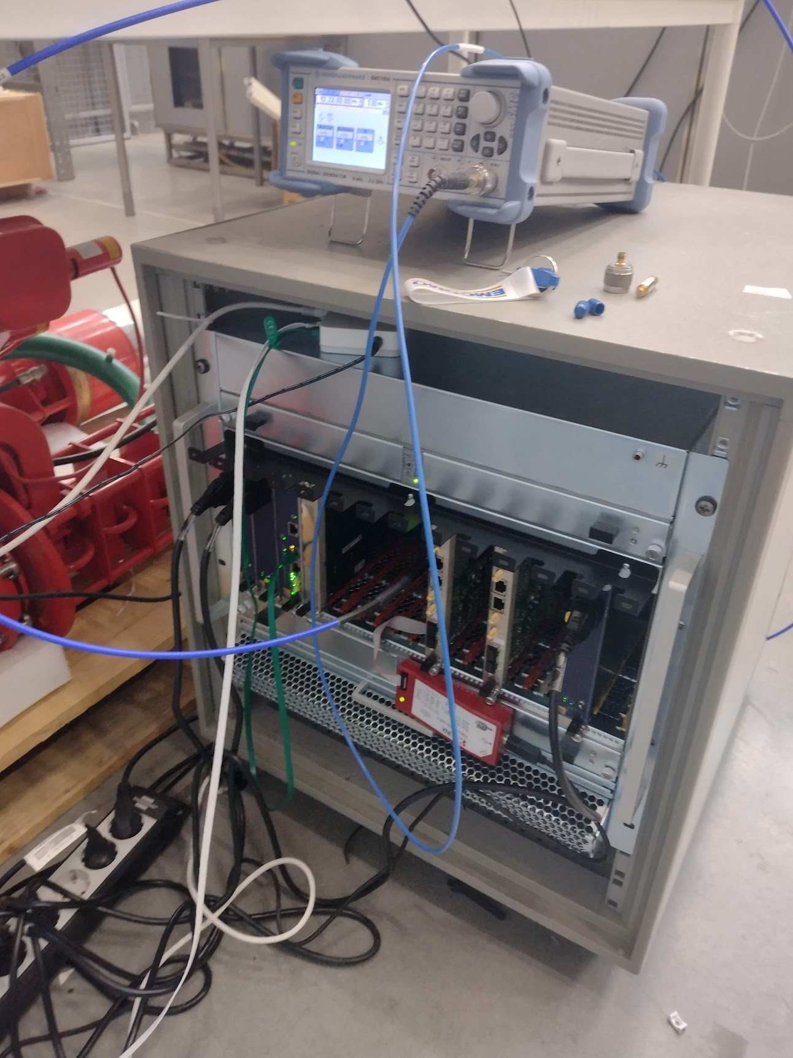
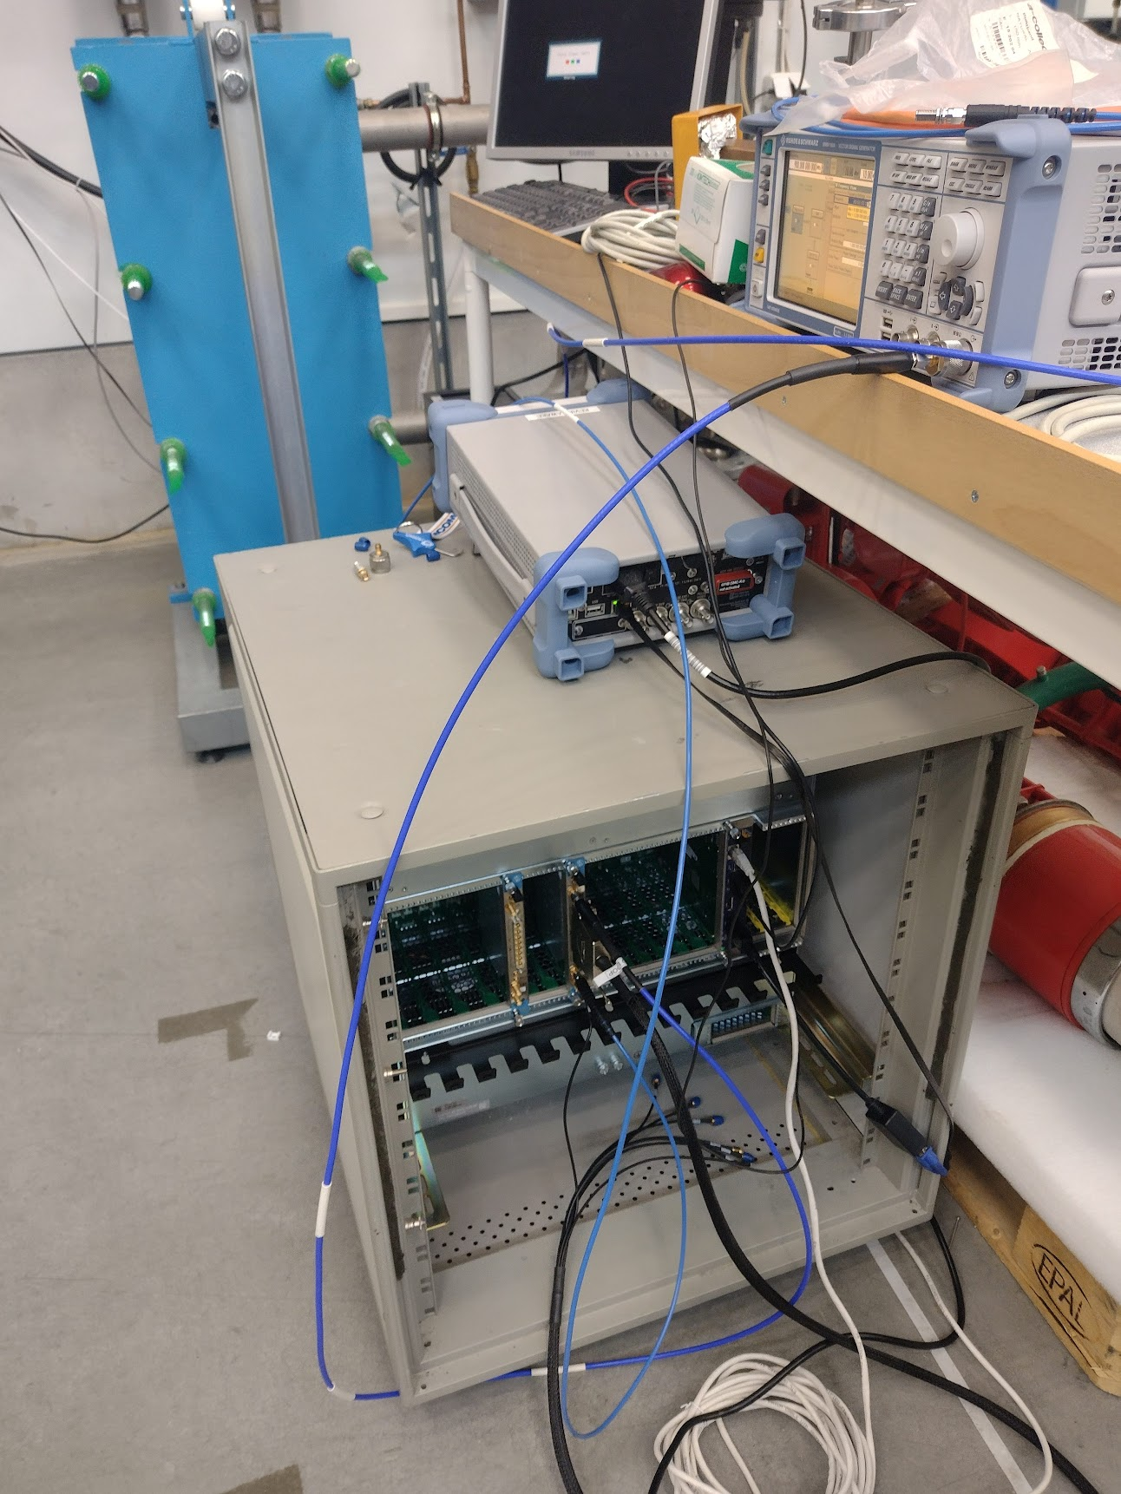
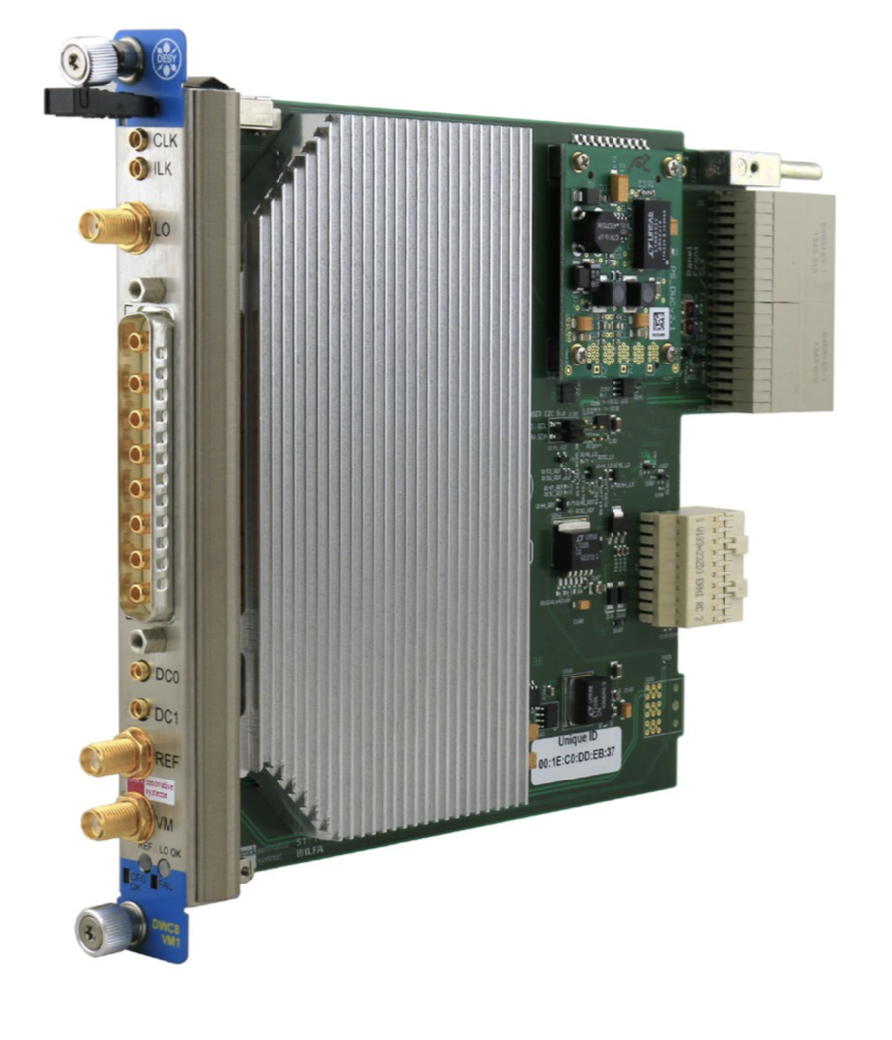
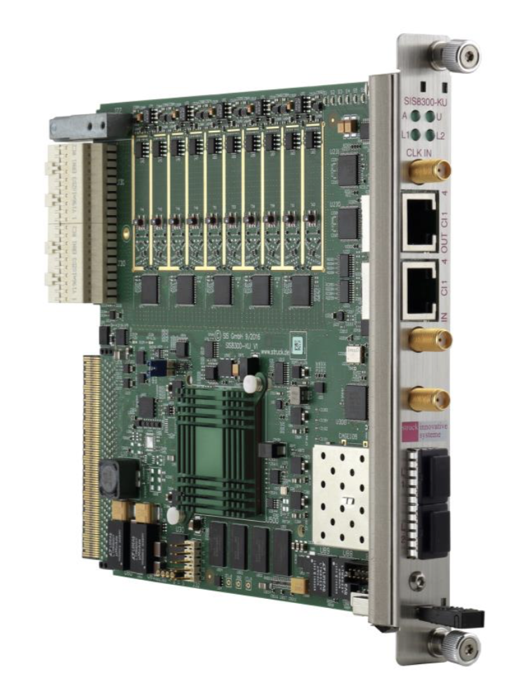
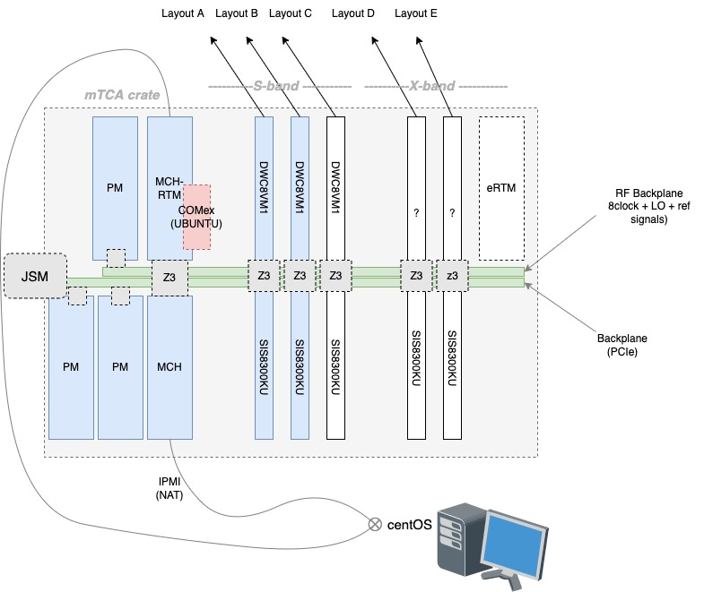
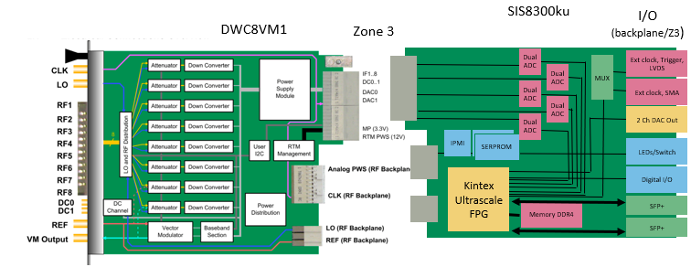
mTCA crate at FREIA
Zone 3
DWC8VM1
SIS8300ku

Slide 17
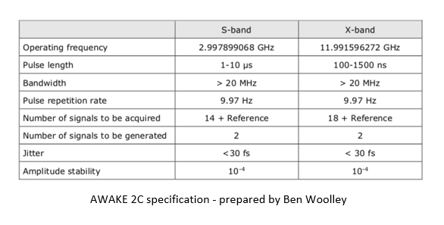
Specifications
Board Support Packages (BSPs):
CERN (SPS upgrade, 2019)
STRUCK demo (running, 2016)
DESY development (beta, 2022)

Slide 18
Current CERNs development for SPS
+
All open source + inhouse (e.g. wishbone module + LM32 soft core processor)
-
Large latency
Tight integration with eRTM/White Rabbit
SISO control loops
(Simple loops, not considering interactions between the channels)
Ad-hoc architecture
(subjective: we found it challenging to modify the code to our needs)

Slide 19
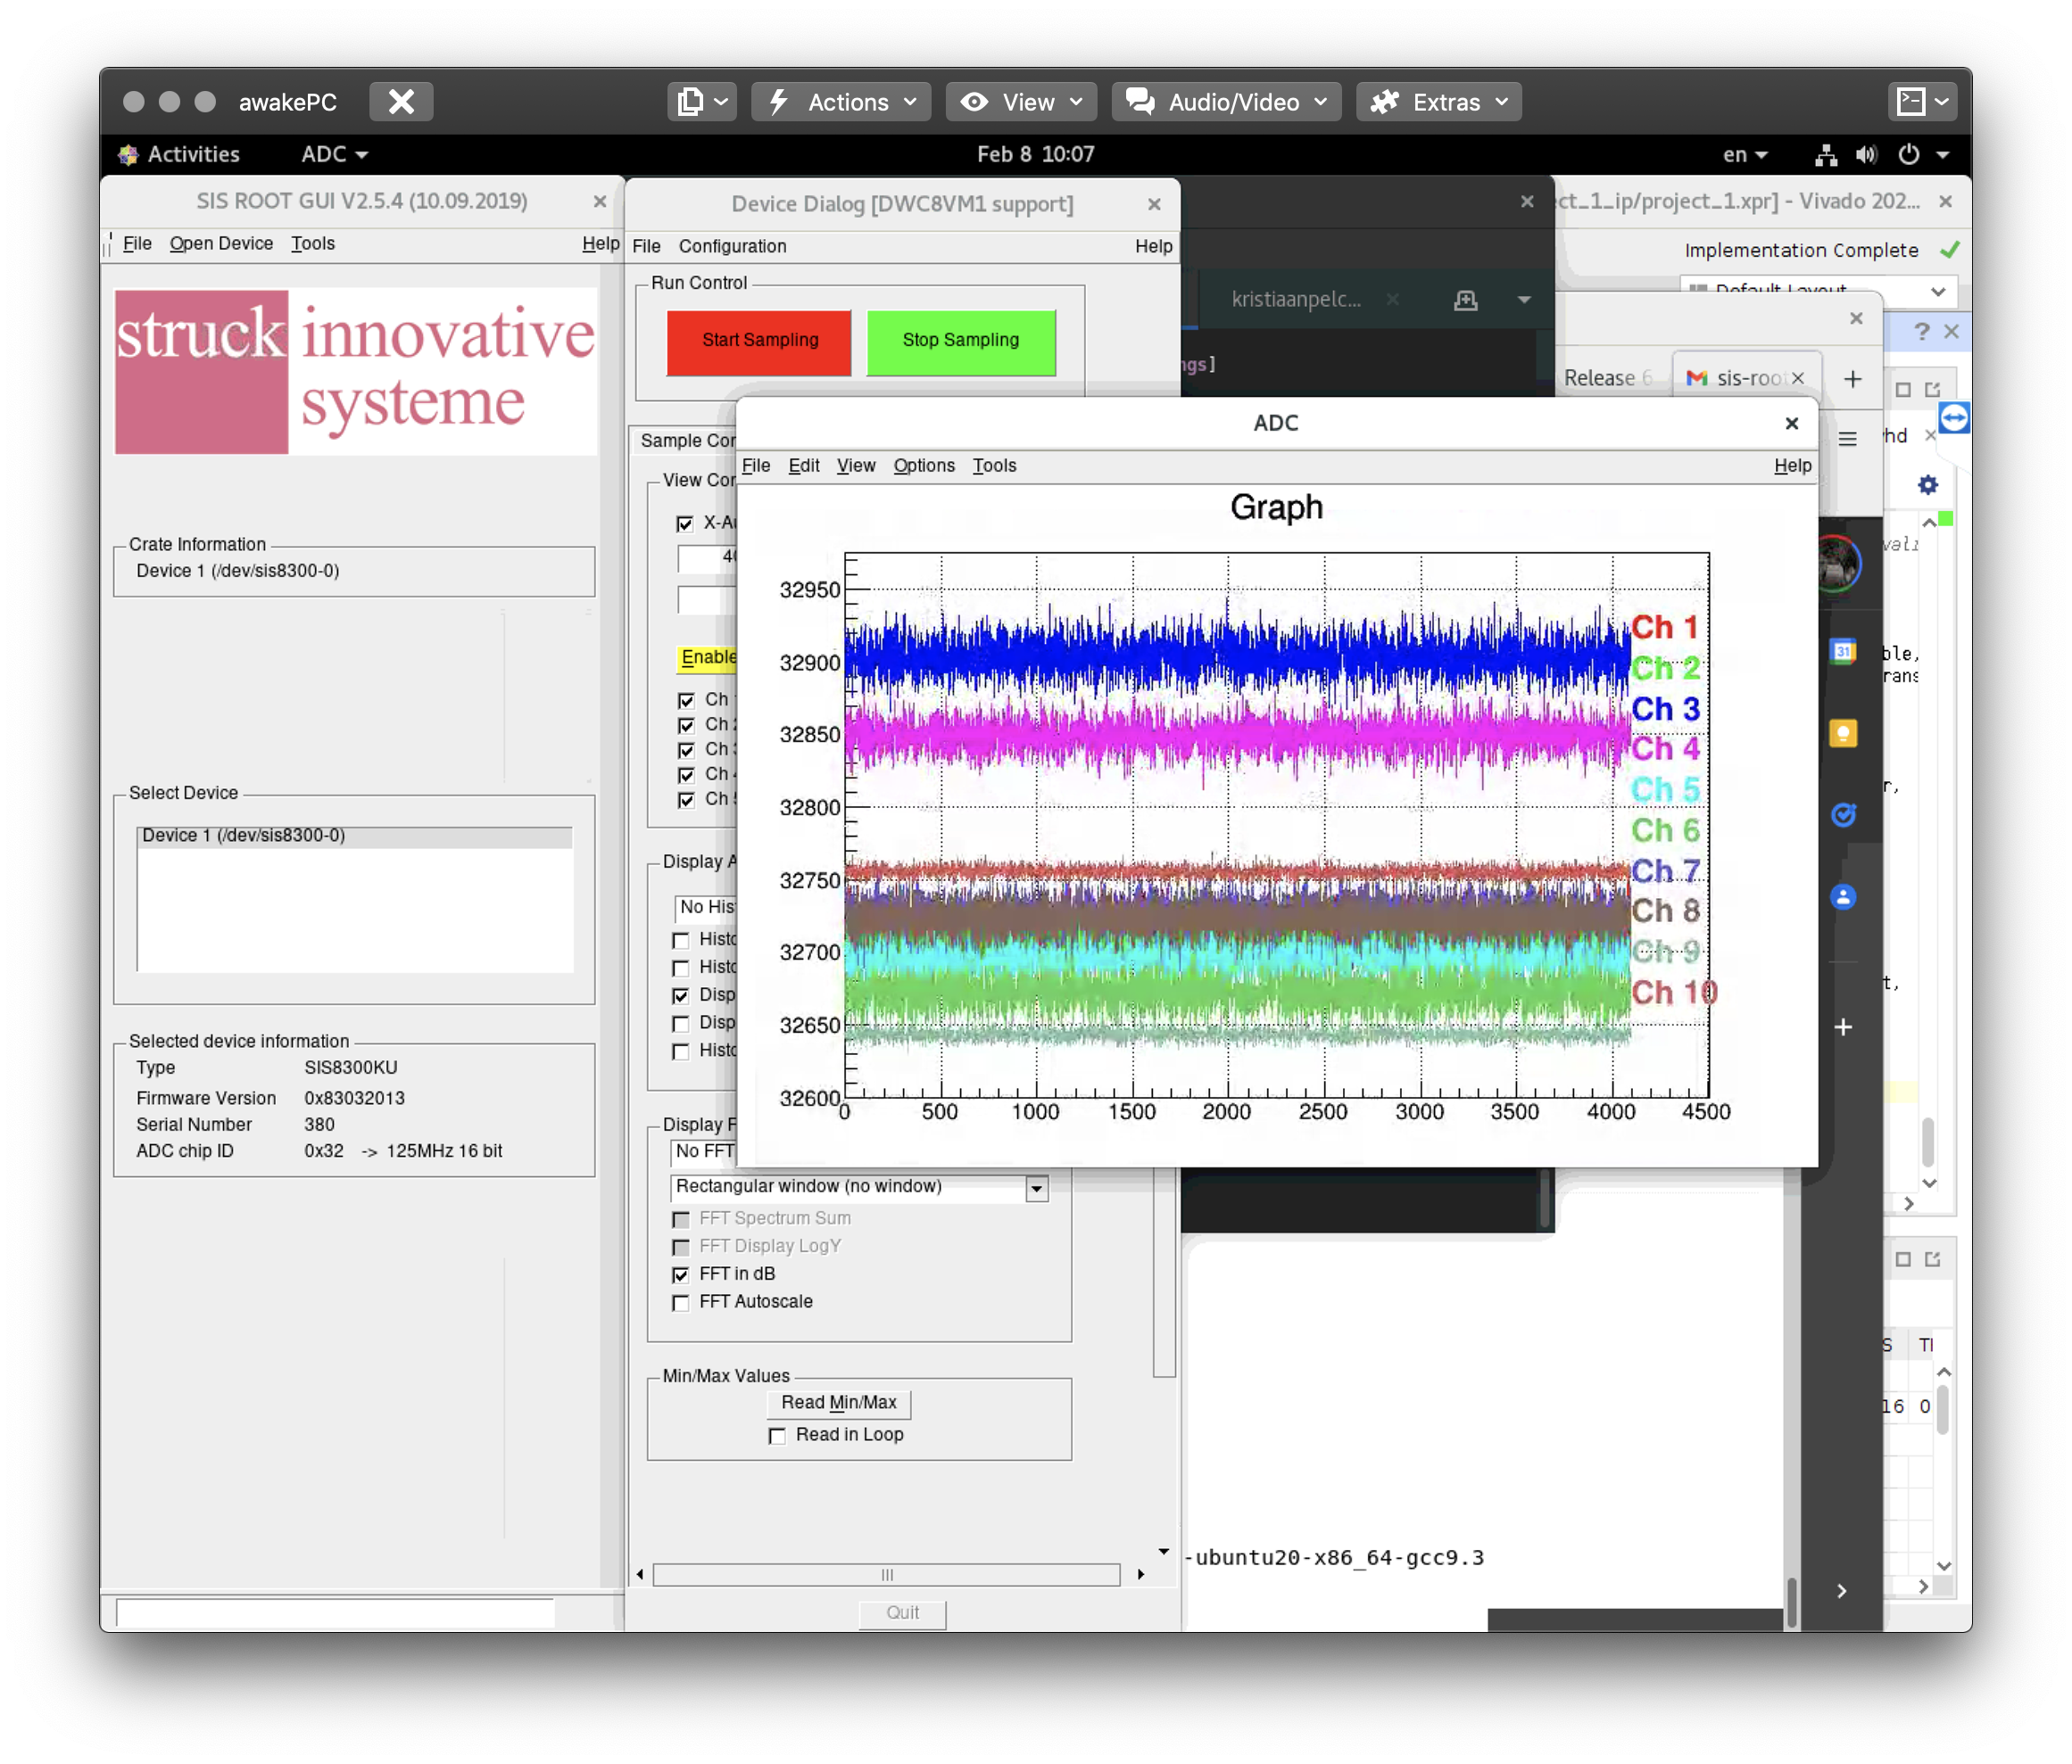
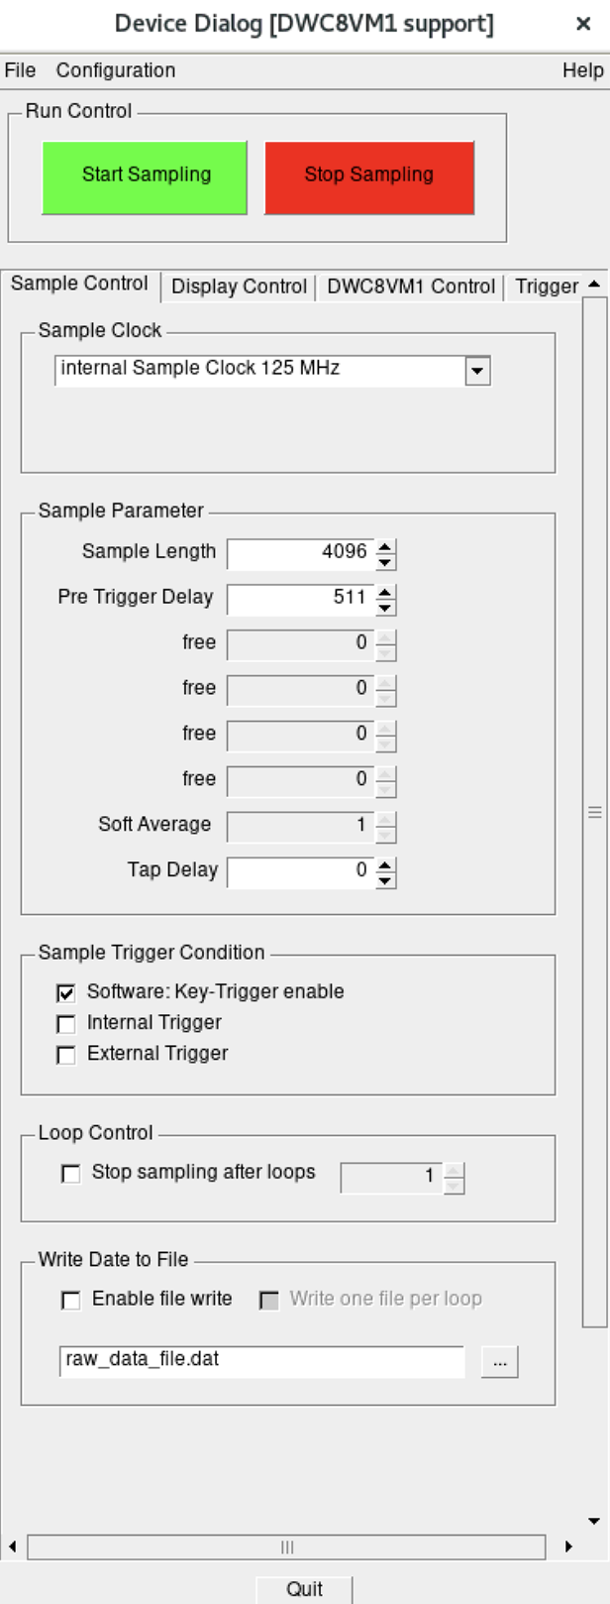
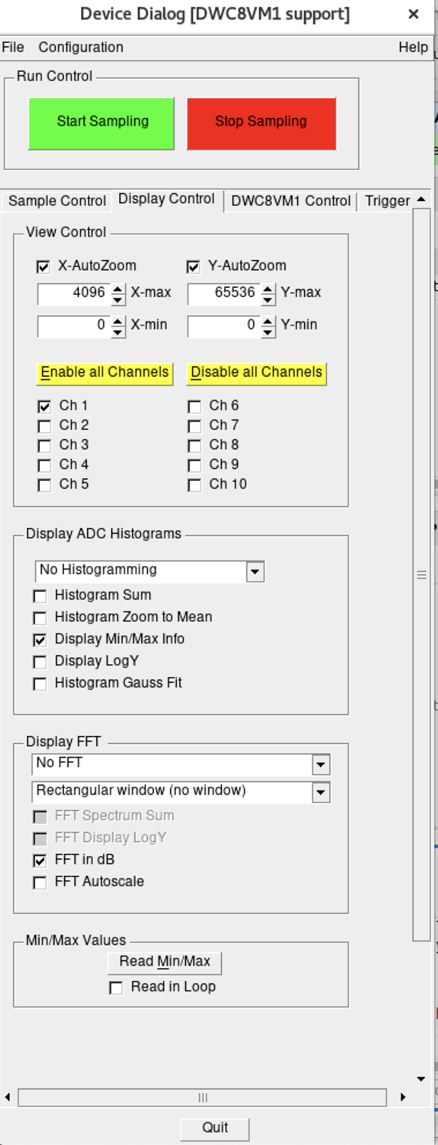
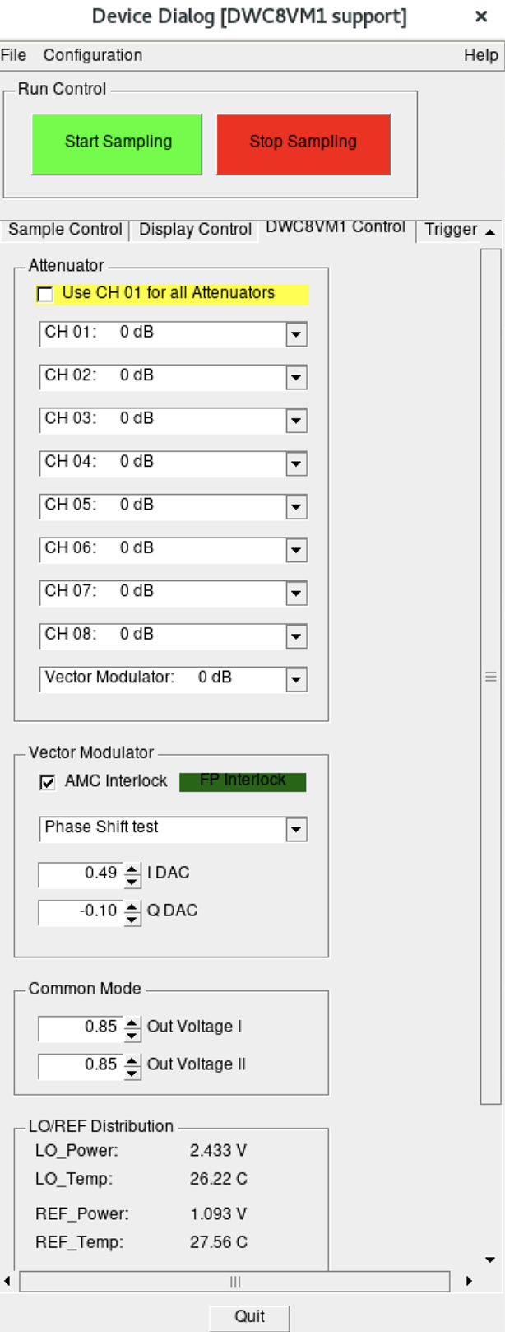
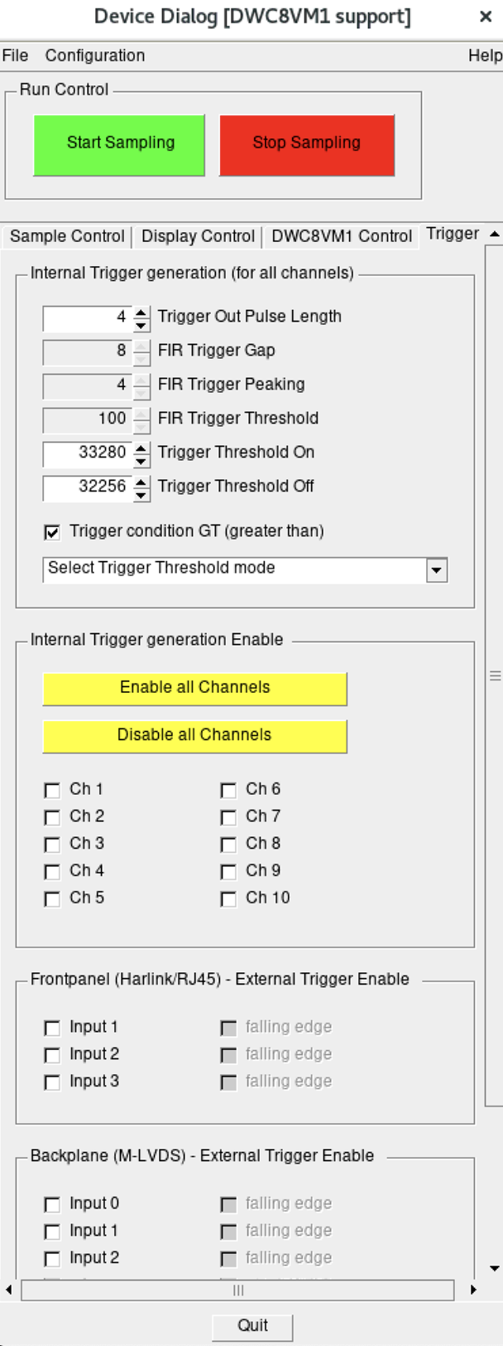
Current measurements at FREIA
STRUCK Board Support Package (BSP), 2016.
+
Operating
Direct support from STRUCK
ACQ
(reading/writing module, used for testing)
-
No closed loop.
Outdated IP-cores
(e.g. use of the microBlaze module, instead LM32).
Inflexibly organised
(not meant to be modified)
Unbounded latencies
+ Operating
Direct support
ACQ (testing)
- No closed loop
Outdated IP-cores.
Inflexibly organised
Unbounded latencies

Slide 20
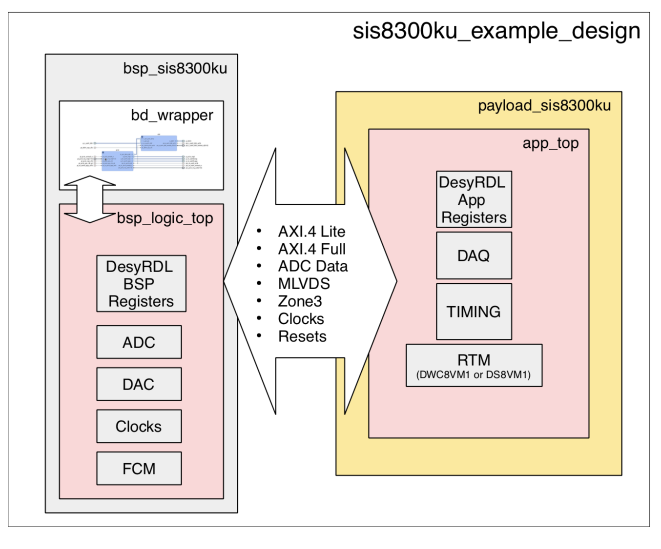
Open source mTCA software
DESY BSP, 2022 (beta)
+
Mostly Open Source.
Support from DESY/MTCA.
Flexibly implemented.
(easy to extend)
Allows for extremely low latencies.
(DESY reports 72 clock cycles)
-
Some Closed IP-cores.
(e.g. Xilinx xDMA)
No closed loop open sourced yet
(codebase will be used for FLASHFORWARD)
TODO:
8x1 MIMO Closed Loop (Controlling interactions between channels)
Control design + latency optimization
Timing/interlocks
Measuring performance

Slide 21
Planning
… preparation since oct 2021
Working LLRF system
Implementation/
testing/simulation/
documentation
LLRF system

Slide 22
Conclusions

Slide 23
Conclusions
RF lines well defined
Choice of the transistor is done
Work ongoing on the LLRF
The choice of the components is well advanced
R&D ongoing on different topics
Many material bought for the Xband and Sband SSPAs
Test of the Sband SSPA very soon
Material at FREIA
Good contact with Struck and DESY

Slide 24
Thank you for your attention

