Slide 1



Evolution of equilibrium particle beams in plasma under external wakefields
Mikhail Baistrukov,
Konstantin Lotov
BINP SB RAS
NSU
AWAKE Collaboration

Slide 2

Motivation
This study originated from one of the old versions of Run2.
The first section, laser ionization
The second section is pre-ionized
≈c
What is the problem? The front part (head) self-modulates (with a random phase) in the second section and destroys the rear part (tail).
≈c
≈c
How is the tail destroyed? How long does it take? What value of a perturbation can the sequence "resist"? What value of perturbation can the front part create?

Slide 3
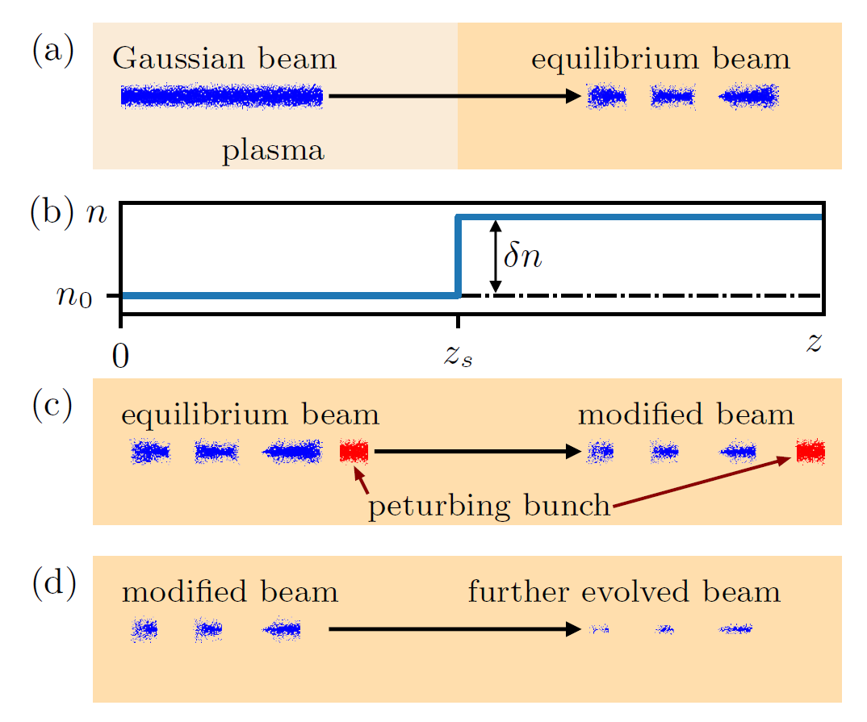
A new task
How does the external wakefield perturbation affect the equilibrium bunch train?
A study plan
a) We generate the equilibrium bunch train by self-modulating a long beam ((b) is plasma density step).
c) Then we create a perturbation by a hard bunch and analyze how the sequence is destroyed.
d) After that we remove the perturbation and analyze further bunch train destruction.

Slide 4
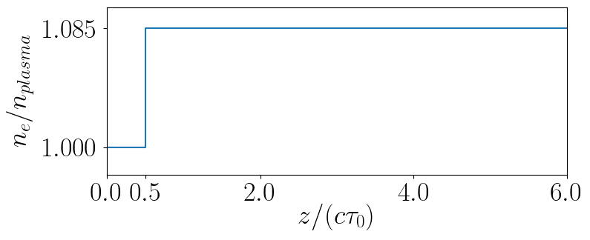
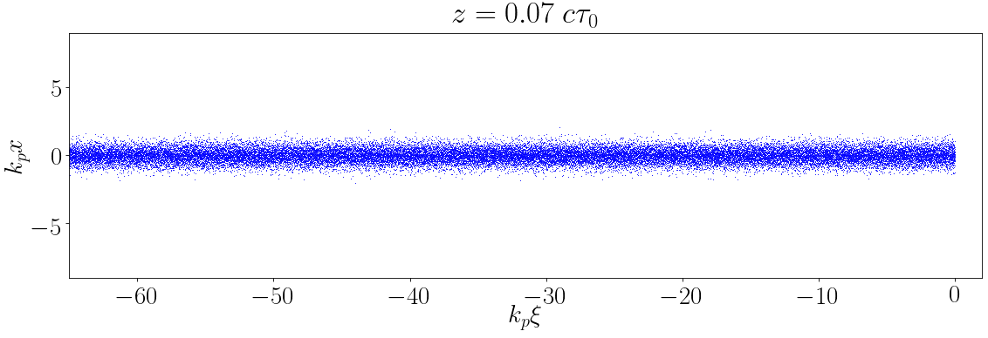


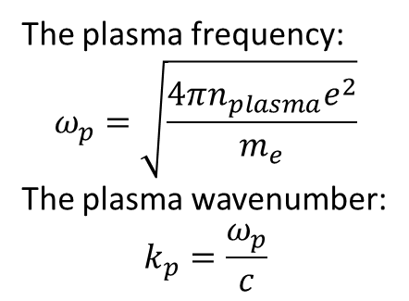
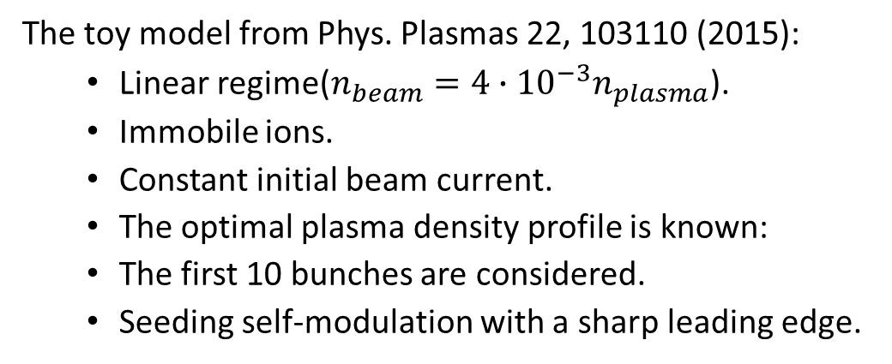
A model bunch train
The toy model from Phys. Plasmas 22, 103110 (2015):
  Linear regime($n_{beam}=4∙{10}^{−3}n_{plasma}$).
  Immobile ions.
  Constant initial beam current.
  The optimal plasma density profile is known:
  The first 10 bunches are considered.
  Seeding self-modulation with a sharp leading edge.
Plasma density step
The plasma frequency:
$$ω_{p}=\sqrt{\frac{4πn_{plasma}e^{2}}{m_{e}}}$$
The plasma wavenumber:
$$k_{p}=\frac{ω_{p}}{c}$$
$$x$$
$$ξ=z−ct$$

Slide 5
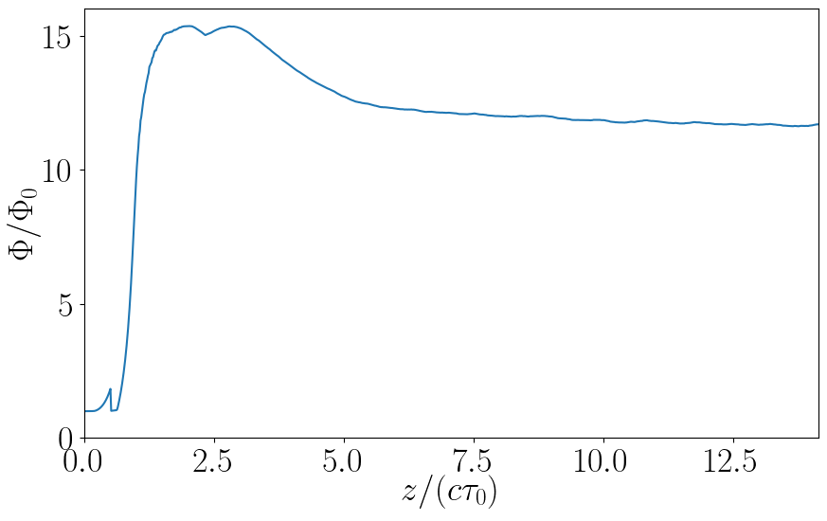
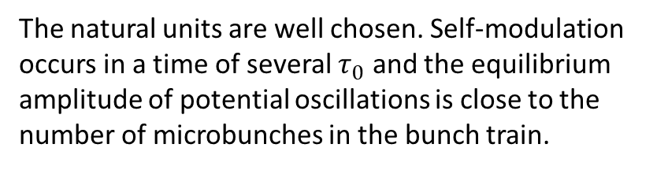
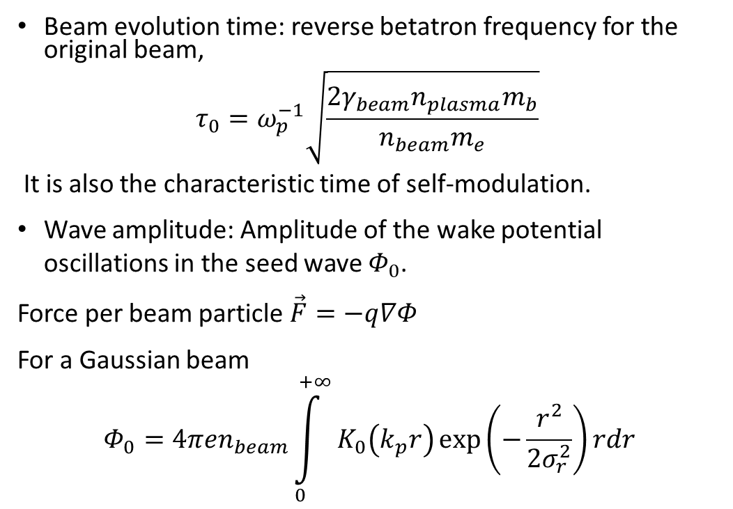
Natural units of the problem
Beam evolution time: reverse betatron frequency for the original beam,
$$τ_{0}=ω_{p}^{−1}\sqrt{\frac{2γ_{beam}n_{plasma}m_{b}}{n_{beam}m_{e}}}$$
It is also the characteristic time of self-modulation.
Wave amplitude: Amplitude of the wake potential oscillations in the seed wave $Φ_{0}$.
Force per beam particle $\vec{F}=−q∇Φ$
For a Gaussian beam
$$Φ_{0}=4πen_{beam}\int_{0}^{+∞}{K_{0}\left(k_{p}r\right)\exp\left(−\frac{r^{2}}{2σ_{r}^{2}}\right)rdr}$$
Plasma density step
Amplitude of potential oscillations in the process of self-modulation
The natural units are well chosen. Self-modulation occurs in a time of several $τ_{0}$ and the equilibrium amplitude of potential oscillations is close to the number of microbunches in the bunch train.

Slide 6
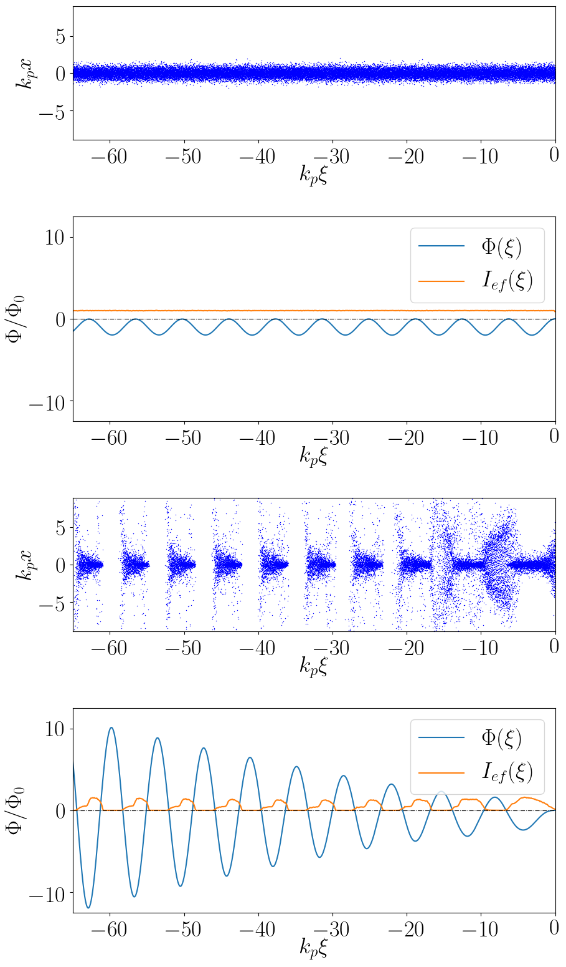
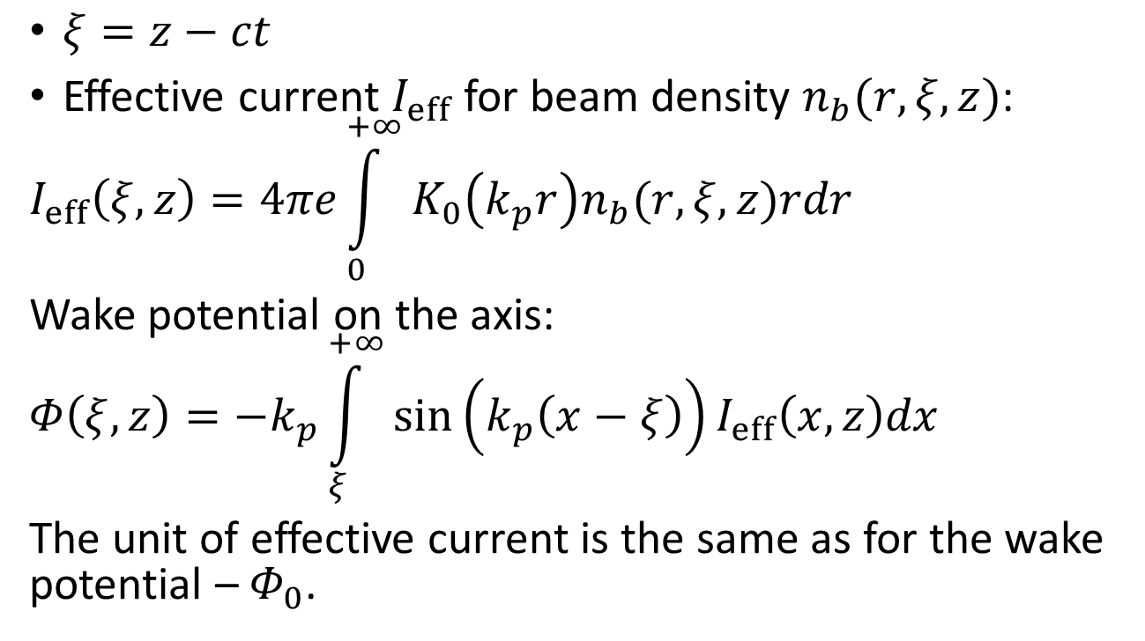



Effective current
z = 0
$ξ=z−ct$
Effective current $I_{eff}$ for beam density $n_{b}(r,ξ,z)$:
$$I_{eff}\left(ξ,z\right)=4πe\int_{0}^{+∞}{K_{0}\left(k_{p}r\right)n_{b}(r,ξ,z)rdr}$$
Wake potential on the axis:
$$Φ\left(ξ,z\right)=−k_{p}\int_{ξ}^{+∞}{\sin\left(k_{p}\left(x−ξ\right)\right)I_{eff}\left(x,z\right)dx}$$
The unit of effective current is the same as for the wake potential – $Φ_{0}$.
$$Φ(ξ)$$
$$I_{eff}(ξ)$$
Для z=0:
Пучок, нарисованный частицами.
Эффективный ток.
Потенциал.
Для последнего момента:
Пучок, нарисованный частицами.
Эффективный ток.
Потенциал.
Одинаковый масштаб для оси потенциала.
z ≈ 14 $cτ_{0}$
$$Φ(ξ)$$
$$I_{eff}(ξ)$$

Slide 7
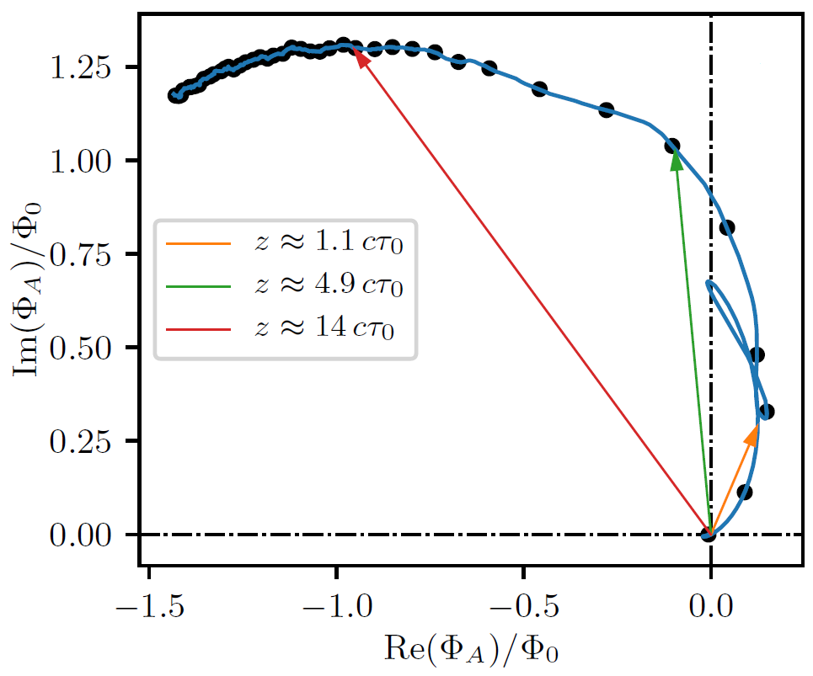
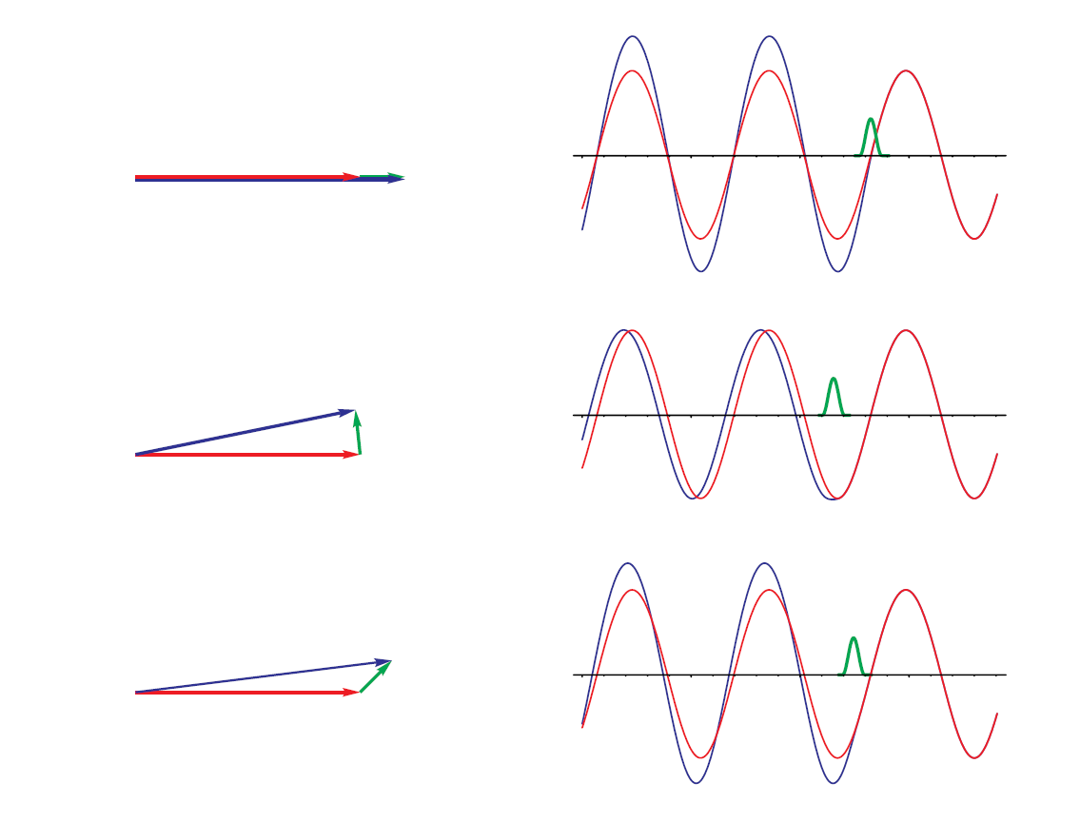









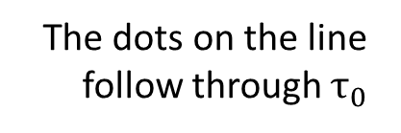


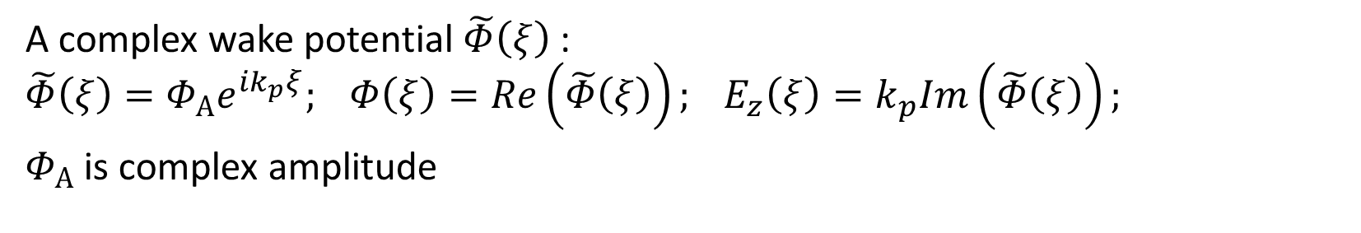







Complex amplitude
A complex wake potential $\tilde{Φ}\left(ξ\right)$:
$$\tilde{Φ}\left(ξ\right)=Φ_{А}e^{ik_{p}ξ}; Φ\left(ξ\right)=Re\left(\tilde{Φ}\left(ξ\right)\right); E_{z}\left(ξ\right)=k_{p}Im\left(\tilde{Φ}\left(ξ\right)\right);$$
$Φ_{А}$ is complex amplitude
$$n_{b}$$
$$Φ_{0}$$
$$Φ_{A0}$$
$$∆Φ_{A}$$
$$ξ$$
$$Φ_{A}$$
$$n_{b}$$
$$Φ_{0}$$
$$Φ_{A}$$
$$∆Φ_{A}$$
$$ξ$$
The dots on the line follow through $τ_{0}$
$$Φ_{A0}$$
$$n_{b}$$
$$Φ_{0}$$
$$Φ_{A}$$
$$Φ_{A0}$$
$$∆Φ_{A}$$
$$ξ$$
Contribution of the first microbunch

Slide 8
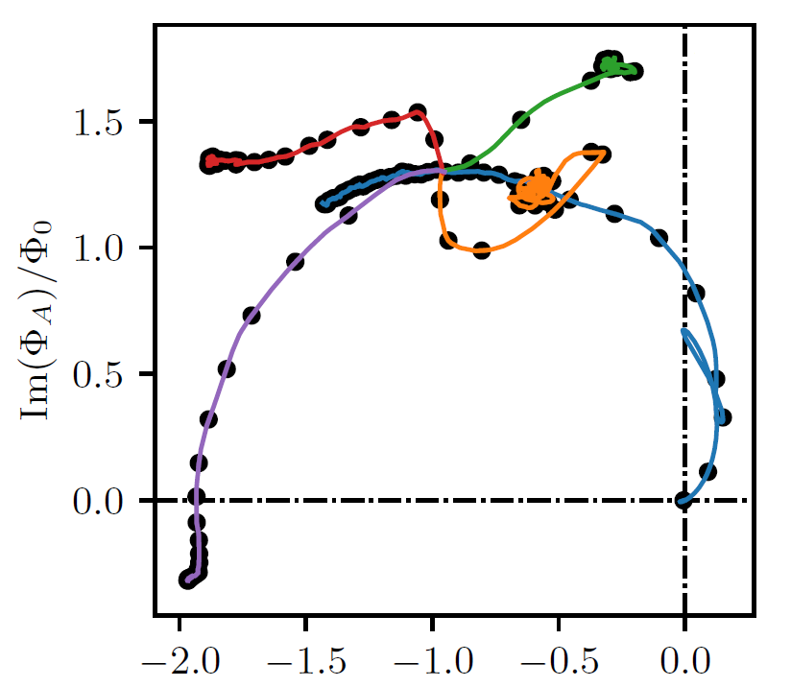
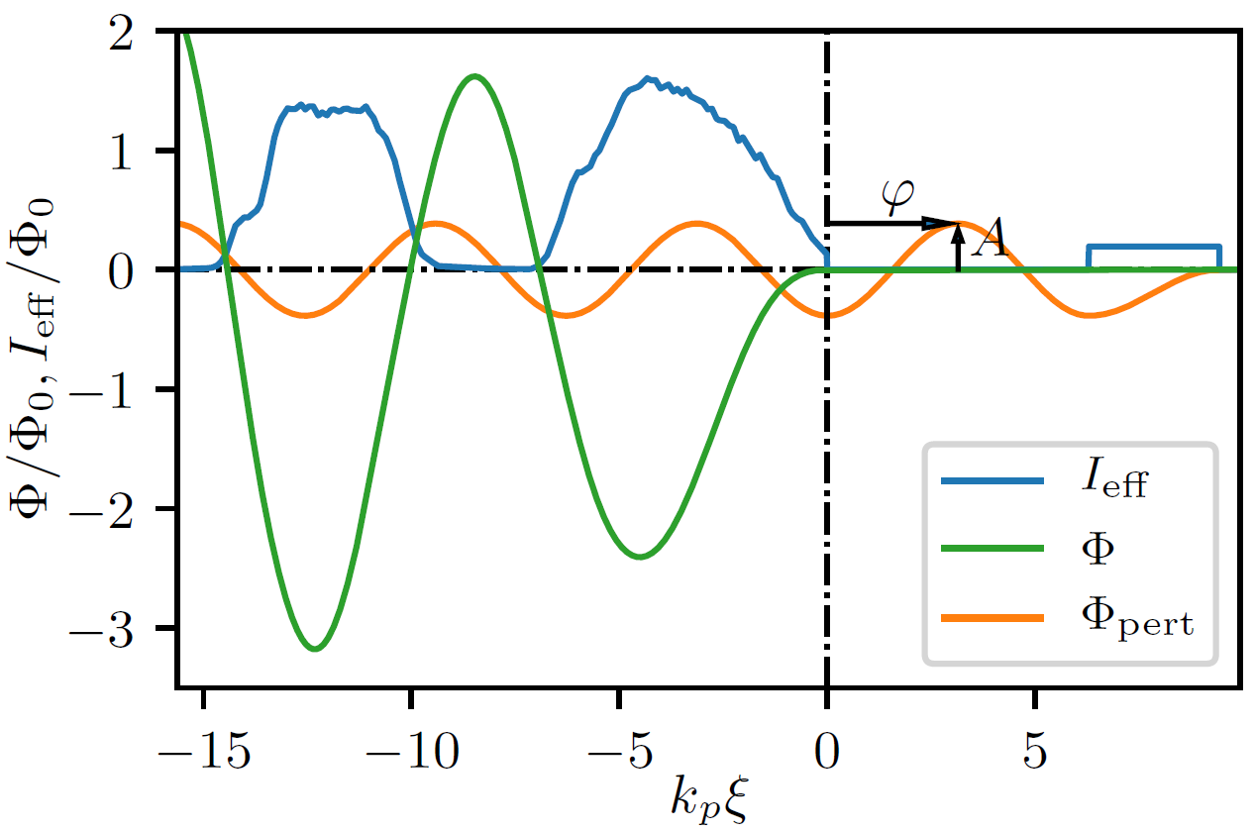
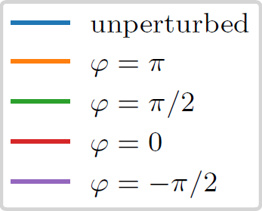

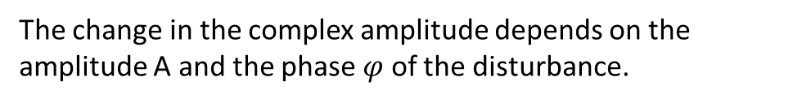

The effect of a disturbance on the first microbunch
We add an external disturbance at $t=14.14 τ_{0}$
perturbation
perturbation field
Microbunches field
The change in the complex amplitude depends on the amplitude A and the phase $φ$ of the disturbance.

Slide 9
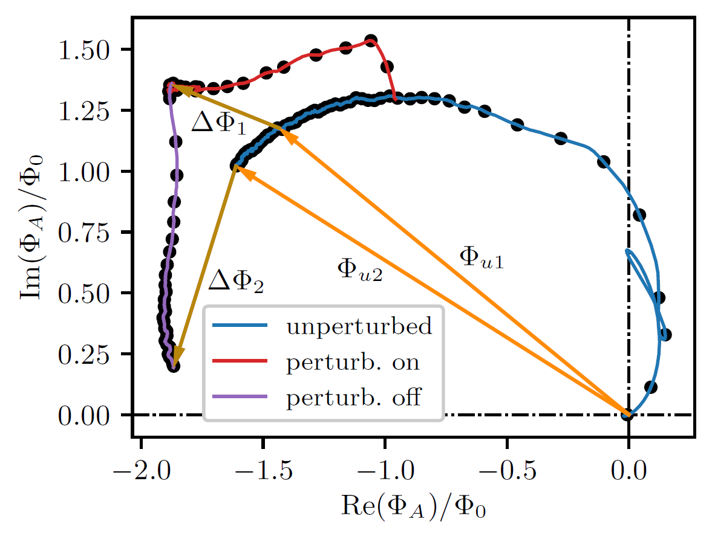
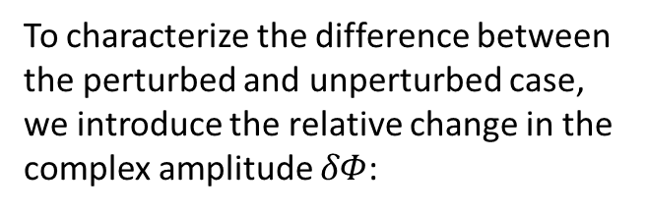


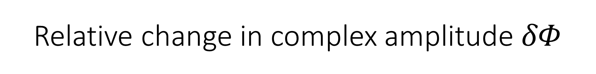

Relative change in complex amplitude $δΦ$
To characterize the difference between the perturbed and unperturbed case, we introduce the relative change in the complex amplitude $δΦ$:
$$δΦ_{i}=\frac{\left|∆Φ_{i}\right|}{\left|Φ_{u i}\right|}$$
Where the index i corresponds to two points in time:
$$i=1⇒ z_{1}≈42cτ_{0}$$
$$i=2⇒ z_{2}≈71cτ_{0}$$

Slide 10
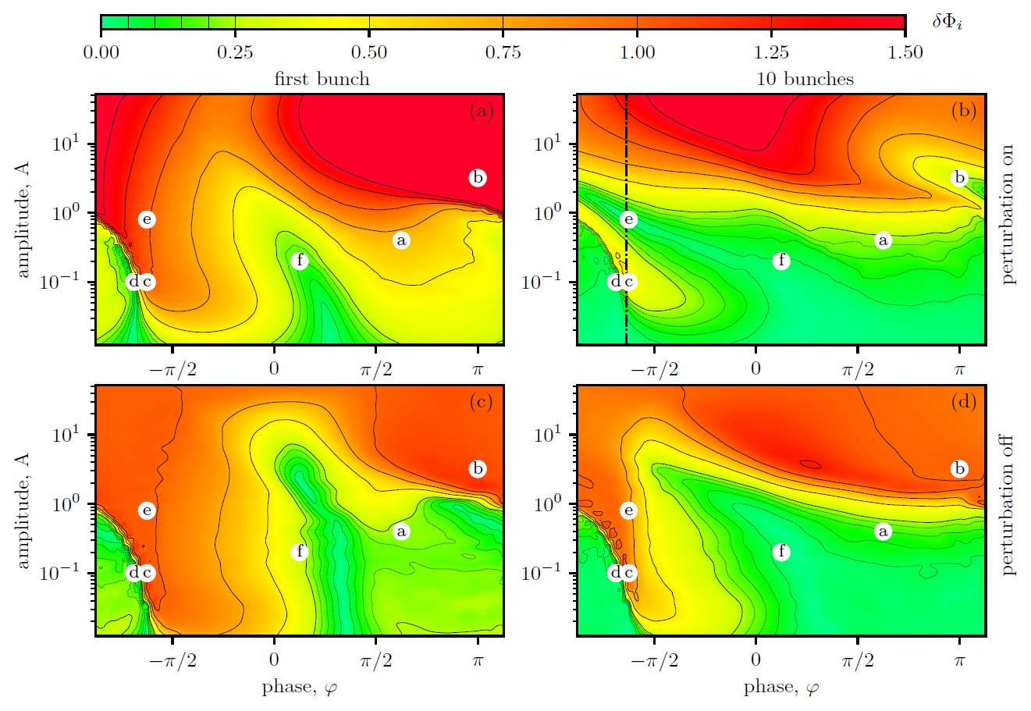

Results for $δΦ$
There is the critical level of perturbation
A bunch train is significantly more stable than a single bunch
There are the especially dangerous perturbation phases
There is the critical level of perturbation

Slide 11
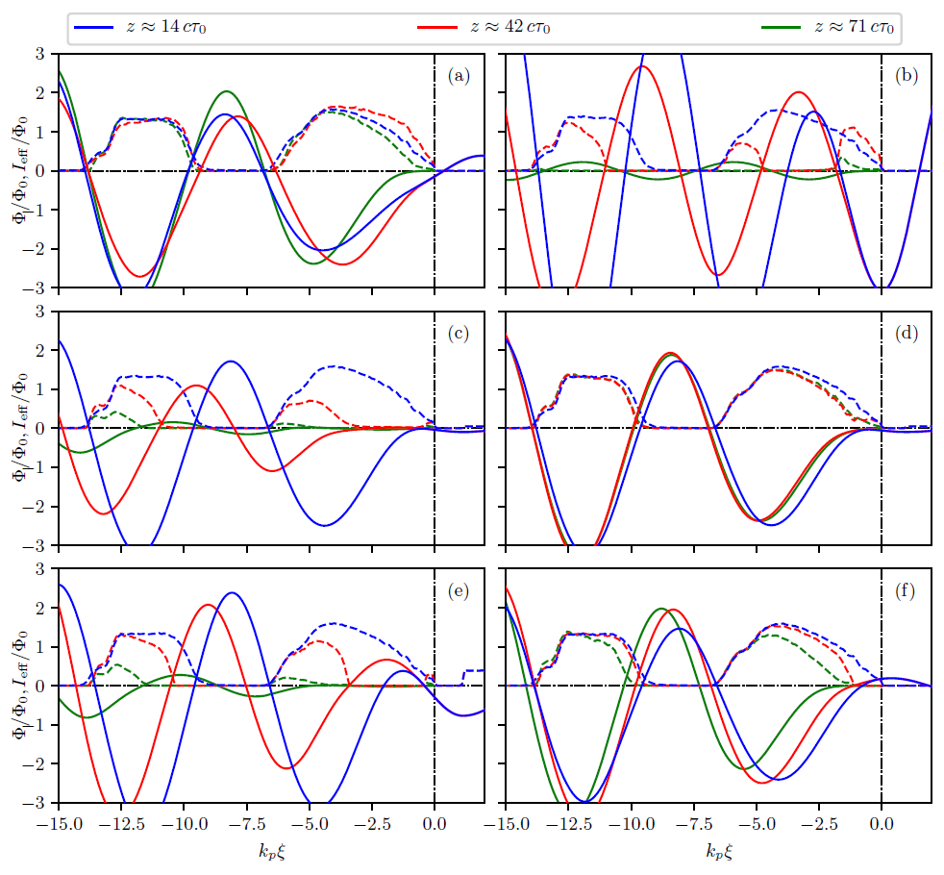
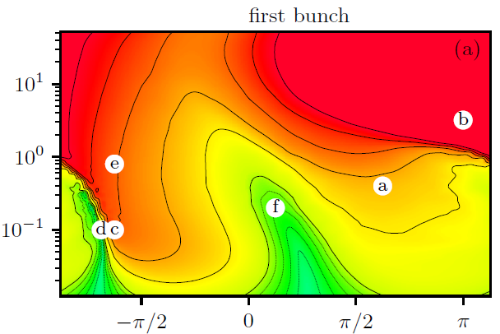
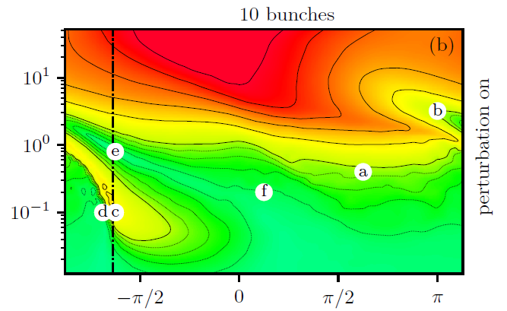
The mechanisms of evolution
The front part of the first bunch is focused. The bunch train resists.
The first bunch is destroyed. But the external wave partially compensates for this for the sequence.
The front part of the first bunch is destroyed. But the external wave compensates for this for the sequence.
The front part of the first bunch is partially destroyed. But bunch train don't feel it

Slide 12
The mechanisms of evolution
The front part of the first bunch is destroyed by the weak perturbation. The bunch is defocused layer by layer because as the layer disappears, so does the focusing force (domino effect).
But when the perturbation moves slightly to the left, the front layer of the first bunch enters the focusing phase of the perturbation. And this layer protects the bunch from destruction by generating a high enough focusing field.

Slide 13
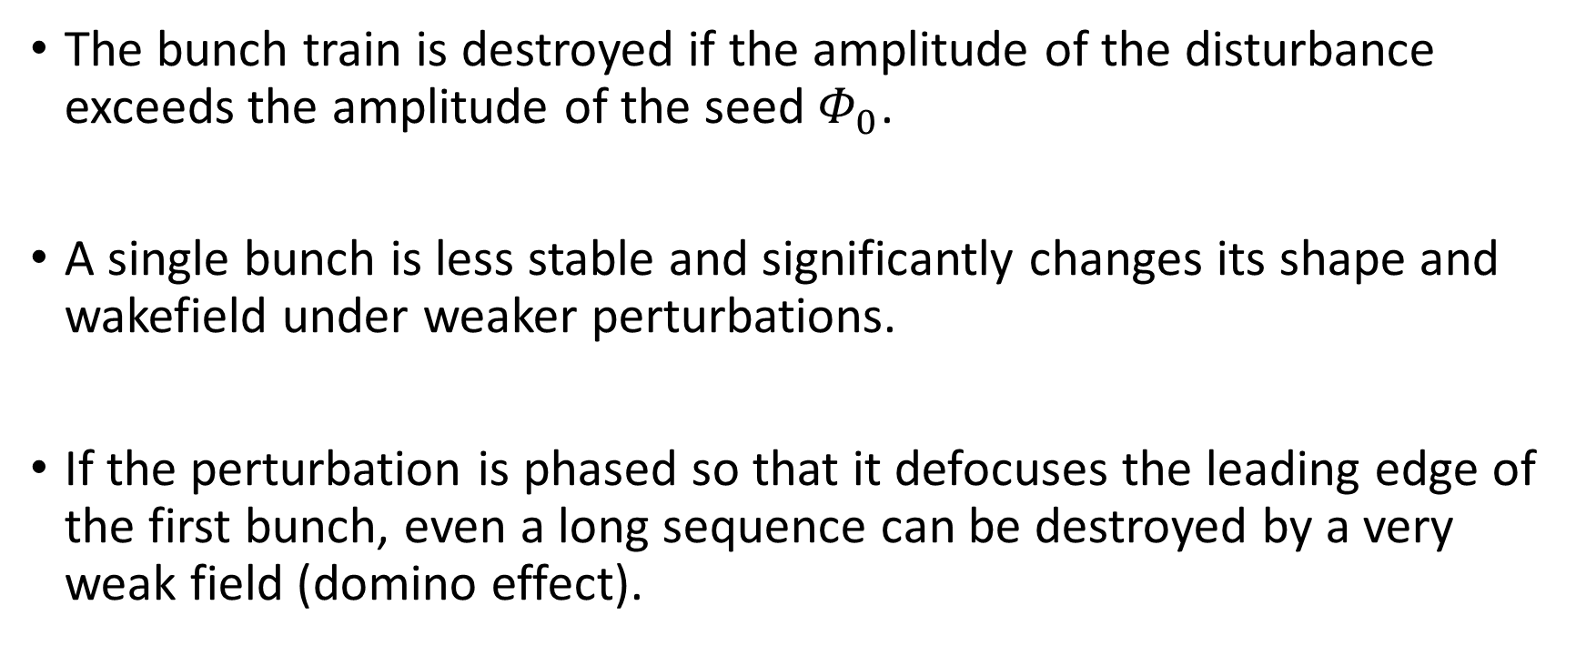
Results
The bunch train is destroyed if the amplitude of the disturbance exceeds the amplitude of the seed $Φ_{0}$.
A single bunch is less stable and significantly changes its shape and wakefield under weaker perturbations.
If the perturbation is phased so that it defocuses the leading edge of the first bunch, even a long sequence can be destroyed by a very weak field (domino effect).
Thank you

Slide 14
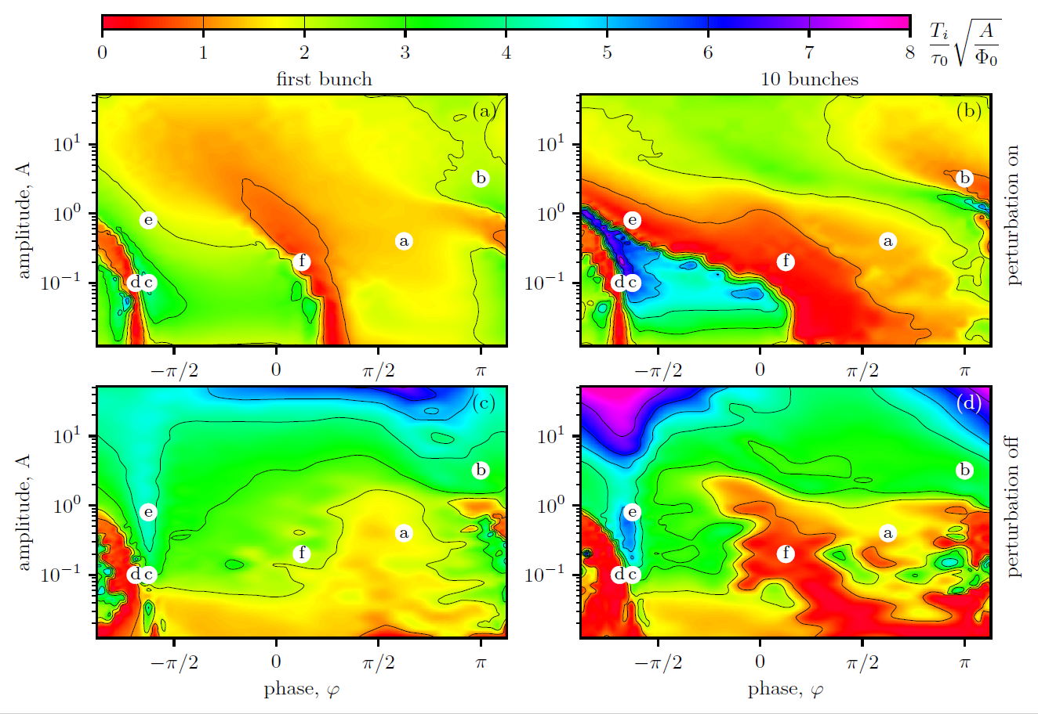
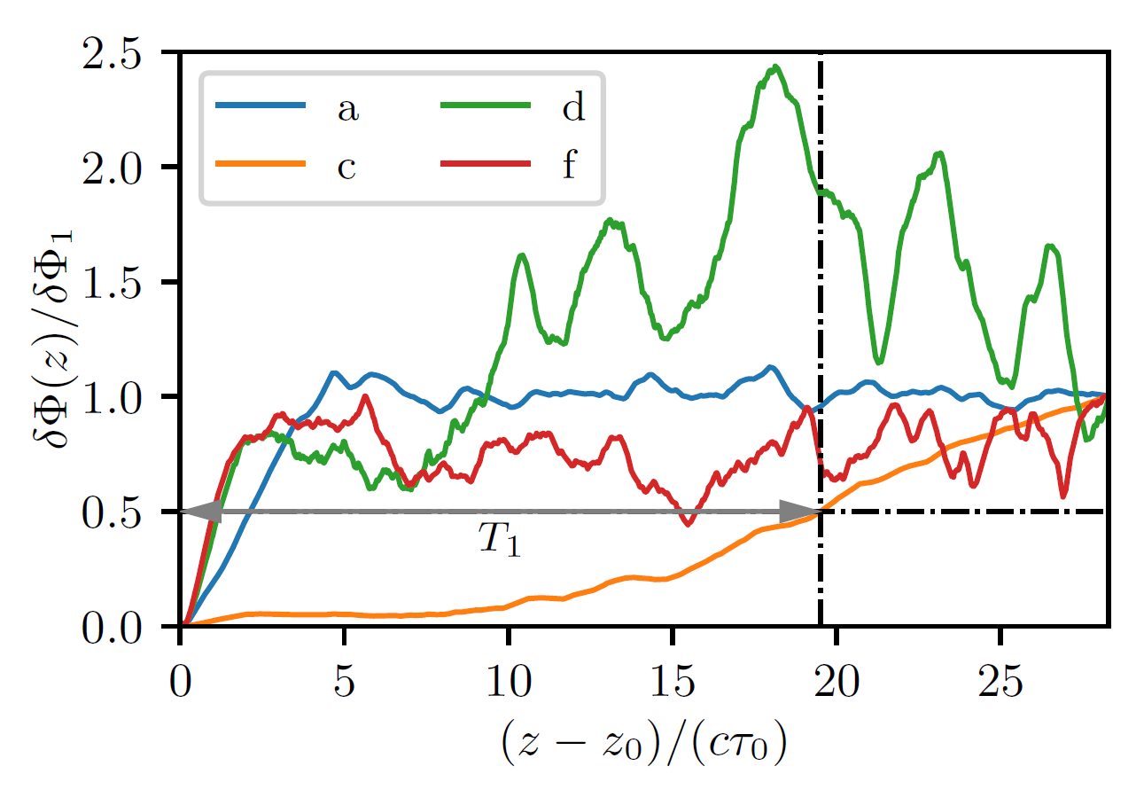
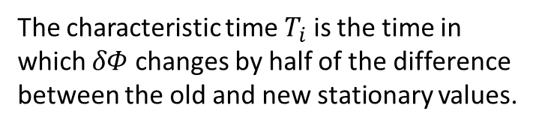
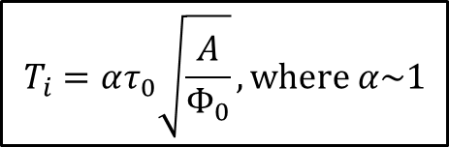
Characteristic change times
The characteristic time $T_{i}$ is the time in which $δΦ$ changes by half of the difference between the old and new stationary values.
$$T_{i}=ατ_{0}\sqrt{\frac{A}{Φ_{0}}},where α\sim 1$$

