Slide 1



Electron Bunch Seeding from Inside the Proton Bunch
Experiment: front-SMI-back-SSM
Pablo I. Morales Guzmán
Supervisors: Patric Muggli, Allen Caldwell
13/04/2022

Slide 2
Outline
Introduction
Possible issue: expulsion of the e- bunch from axis
e- bunch leaves transverse momentum imprint on the proton bunch
Effect of the e- bunch charge on seeding the self-modulation

Slide 3
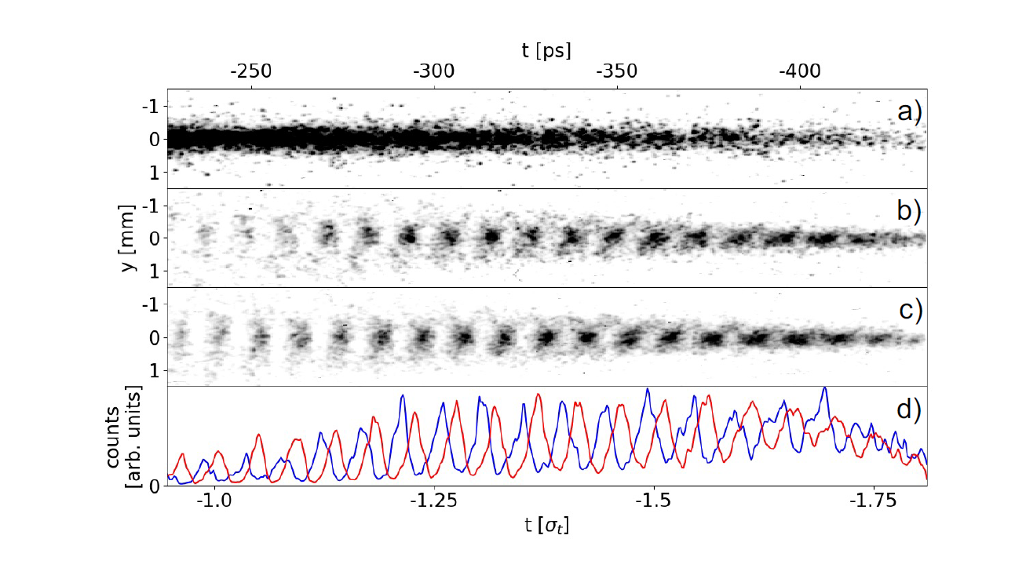
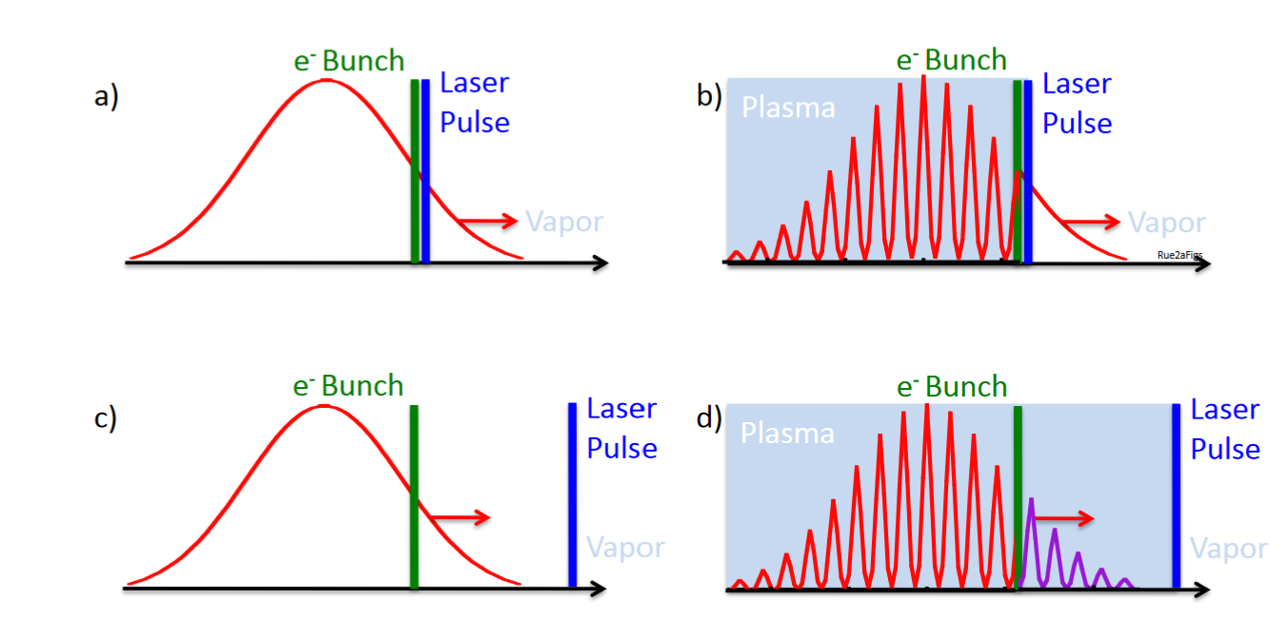

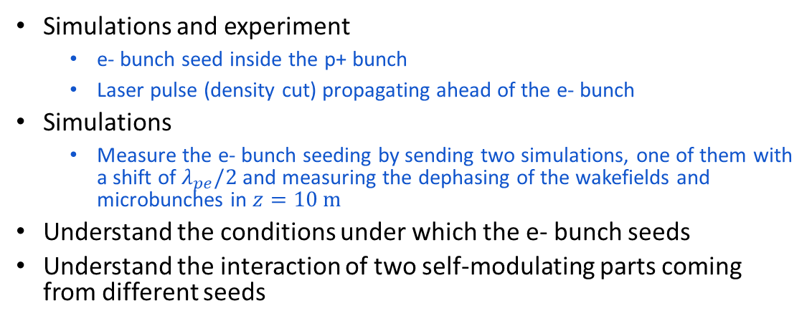
Run 2a
Experiment
© P. Muggli
L. Verra et al, arXiv:2203.13752
Simulations (LCODE 2D axisymmetric)
Simulations and experiment
e- bunch seed inside the p+ bunch
Laser pulse (density cut) propagating ahead of the e- bunch
Simulations
Measure the e- bunch seeding by sending two simulations, one of them with a shift of $λ_{pe}/2$ and measuring the dephasing of the wakefields and microbunches in $z=10 m$
Understand the conditions under which the e- bunch seeds
Understand the interaction of two self-modulating parts coming from different seeds
seed e- bunch
density cut (seed)
p+
seed e- bunch shifted by $λ_{pe}/2$
p+
p+ propagates to the right

Slide 4
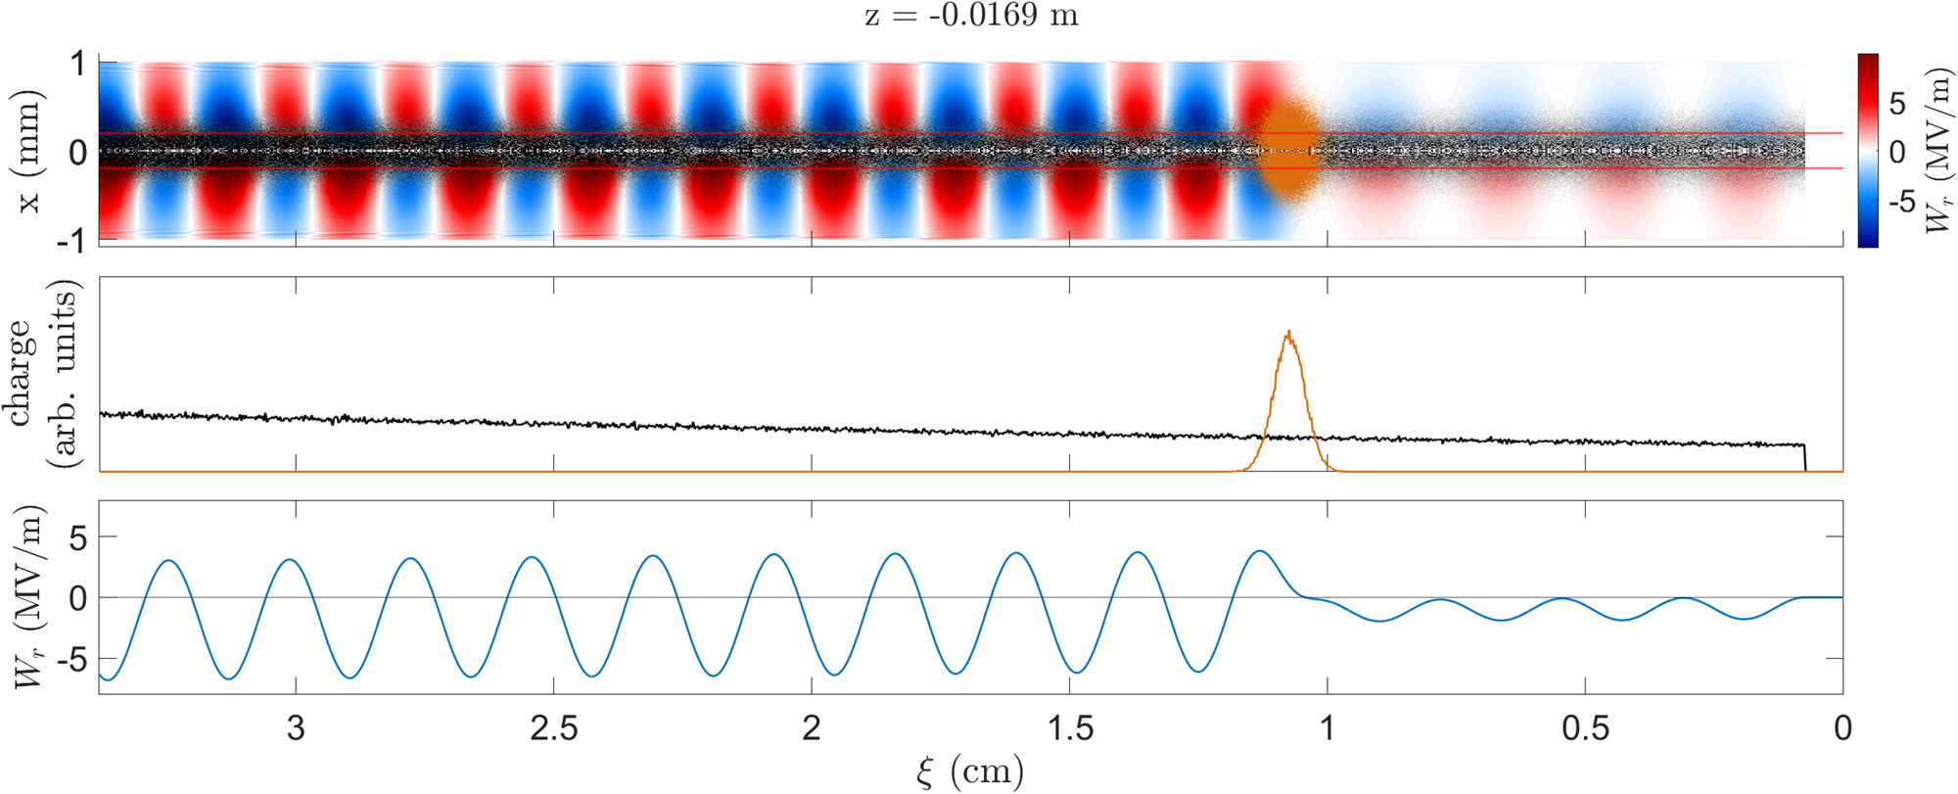
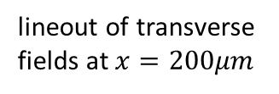
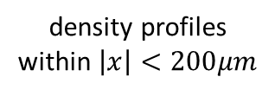
Run 2a
seed e- bunch
density cut (seed)
p+ propagates to the right
Simulations
Beginning of the plasma
e- bunch
transverse fields and p+ and e- bunch densities
density profiles
within $\left|x\right|<200μm$
lineout of transverse fields at $x=200μm$

Slide 5

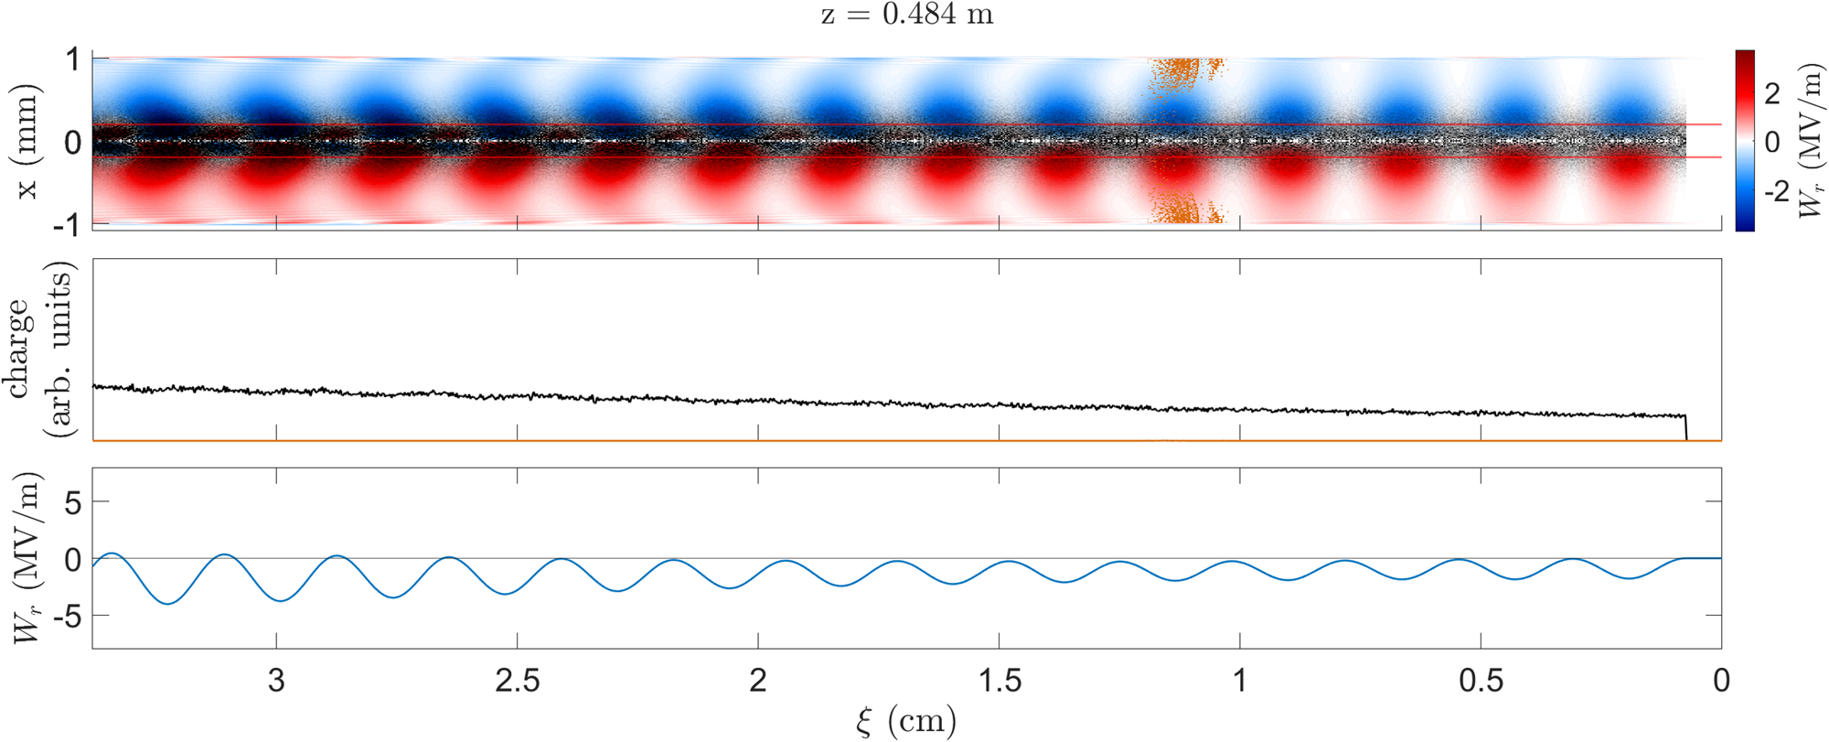
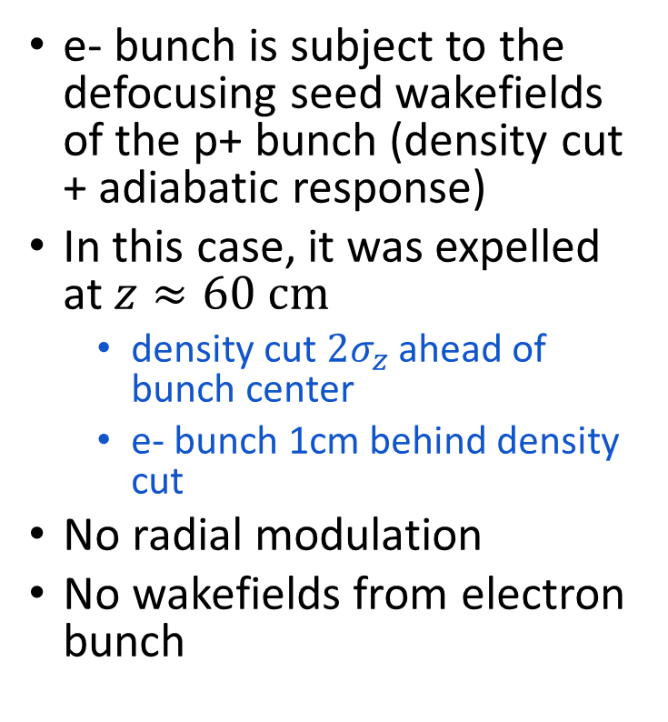
Electron bunch is expelled from axis early in the plasma
beginning of plasma
e- bunch is subject to the defocusing seed wakefields of the p+ bunch (density cut + adiabatic response)
In this case, it was expelled at $z≈60 cm$
density cut $2σ_{z}$ ahead of bunch center
e- bunch 1cm behind density cut
No radial modulation
No wakefields from electron bunch

Slide 6
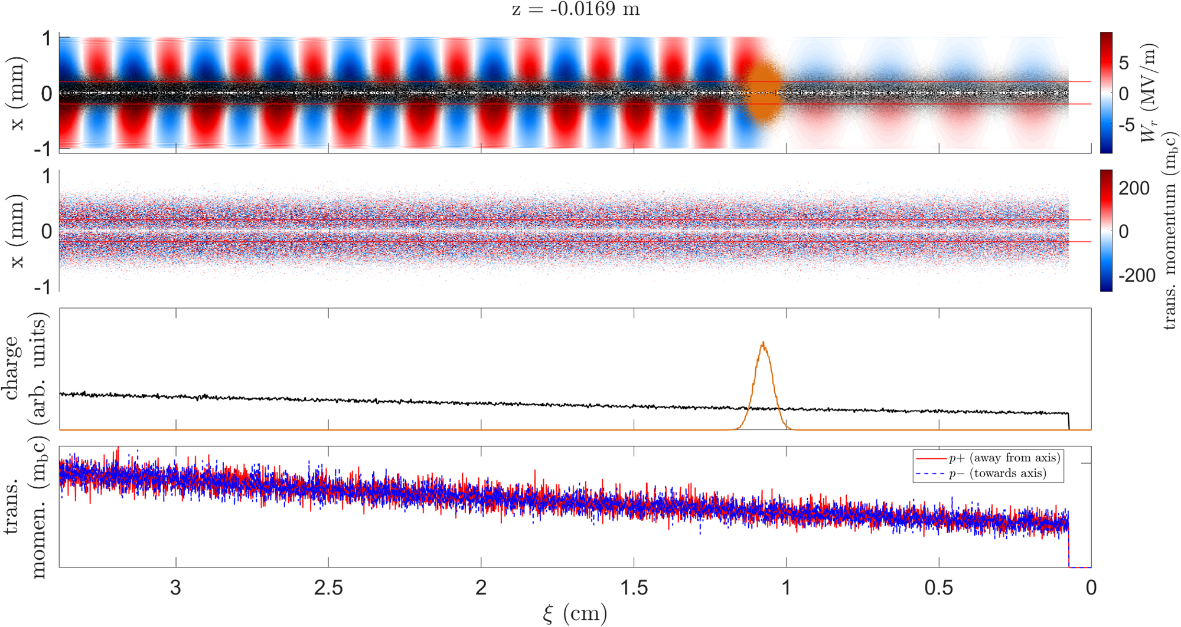
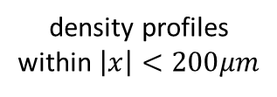
Transverse momentum
density cut (seed)
seed electron bunch
Simulations
Beginning of the plasma
p+ propagates to the right
e- bunch
transverse fields and densities
protons transverse momentum
red
blue
density profiles
within $\left|x\right|<200μm$
sum of transverse momentum per slice

Slide 7
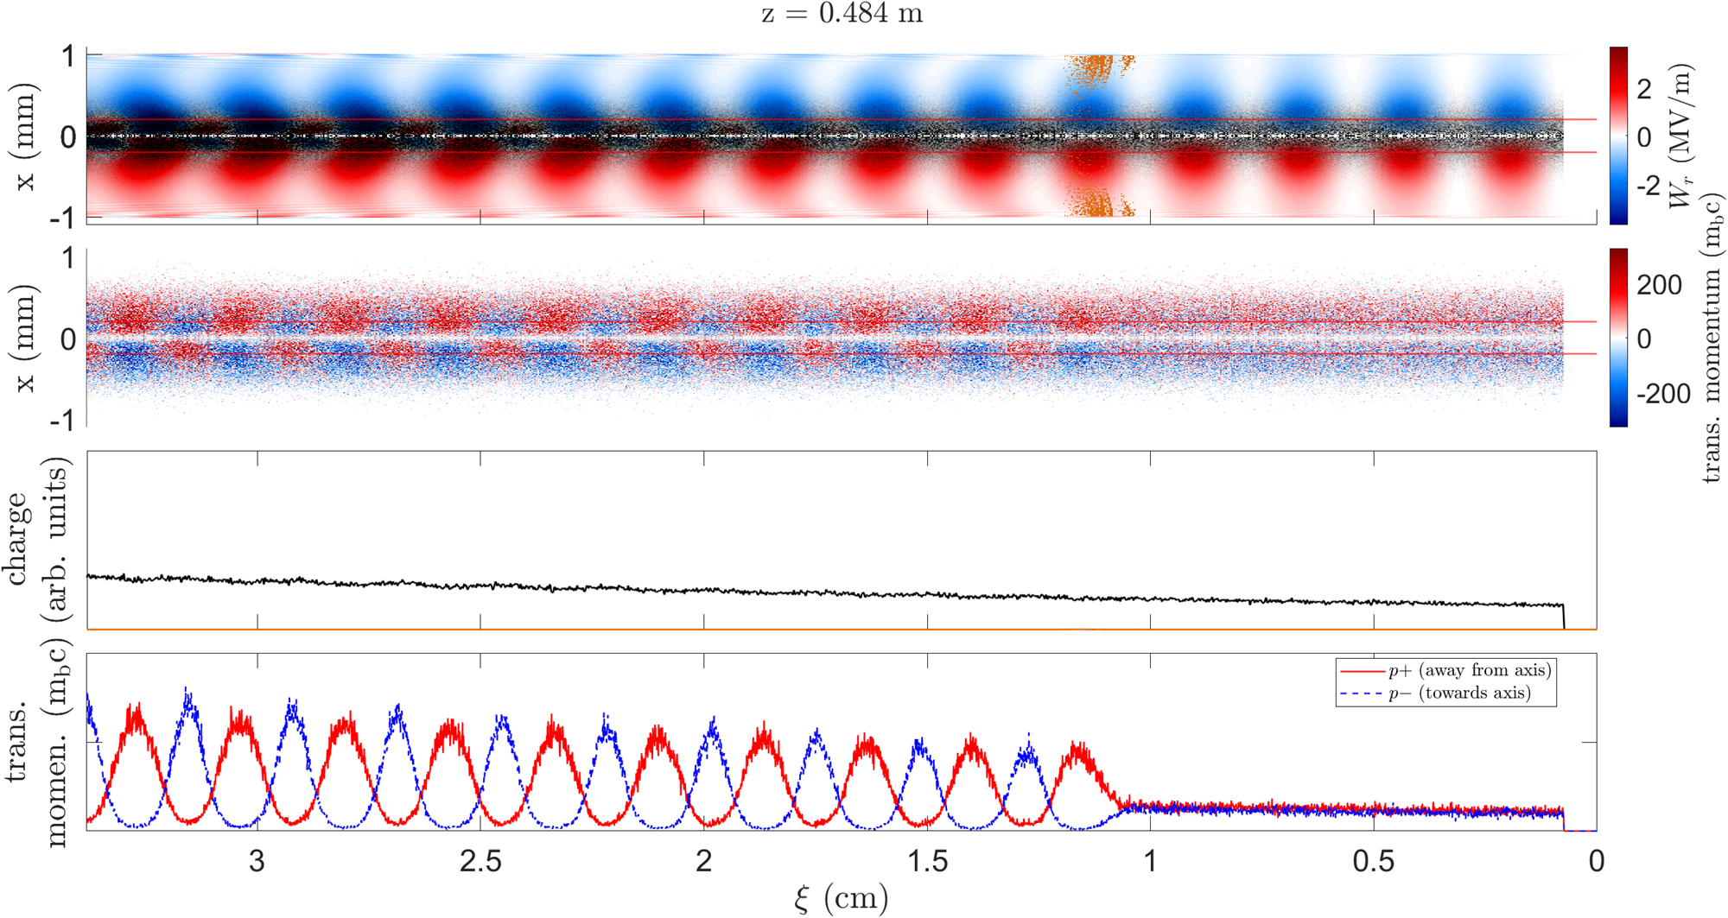
Electron bunch leaves momentum imprint
beginning of plasma
60 cm of propagation
fields and density
fields and density
momentum
momentum
e- bunch leaves a transverse momentum imprint in the proton bunch
If the momentum imprint is high enough, the radial modulation will follow it, despite the seed wakefields from the density cut

Slide 8
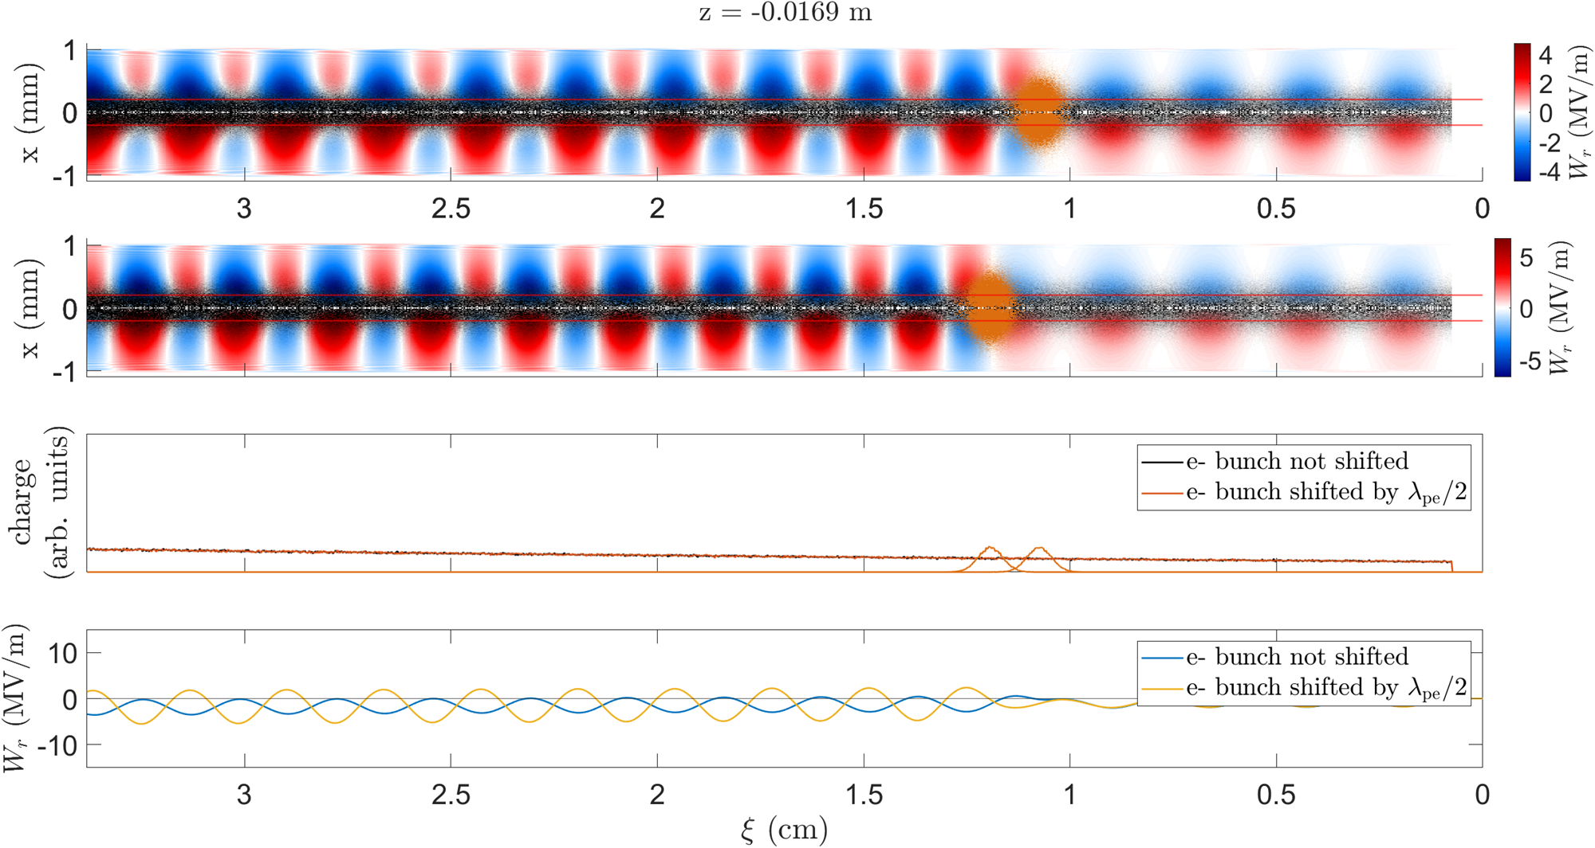
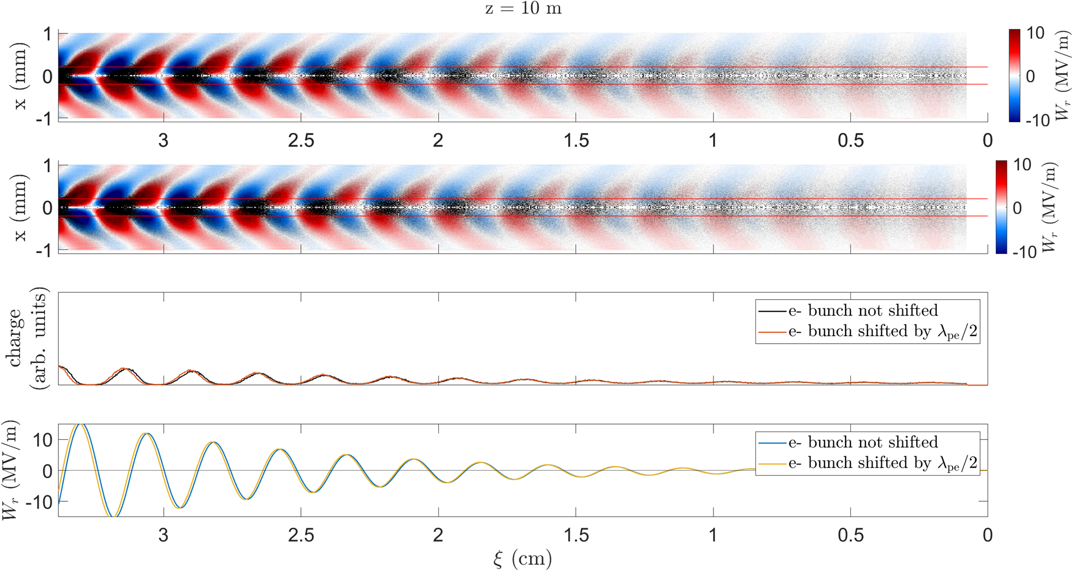
Phase by the end of the plasma low charge (100 pC)
beginning of plasma
end of plasma
Low e- bunch charge → low amplitude wakefields
not enough momentum is transferred to protons
no seeding

Slide 9
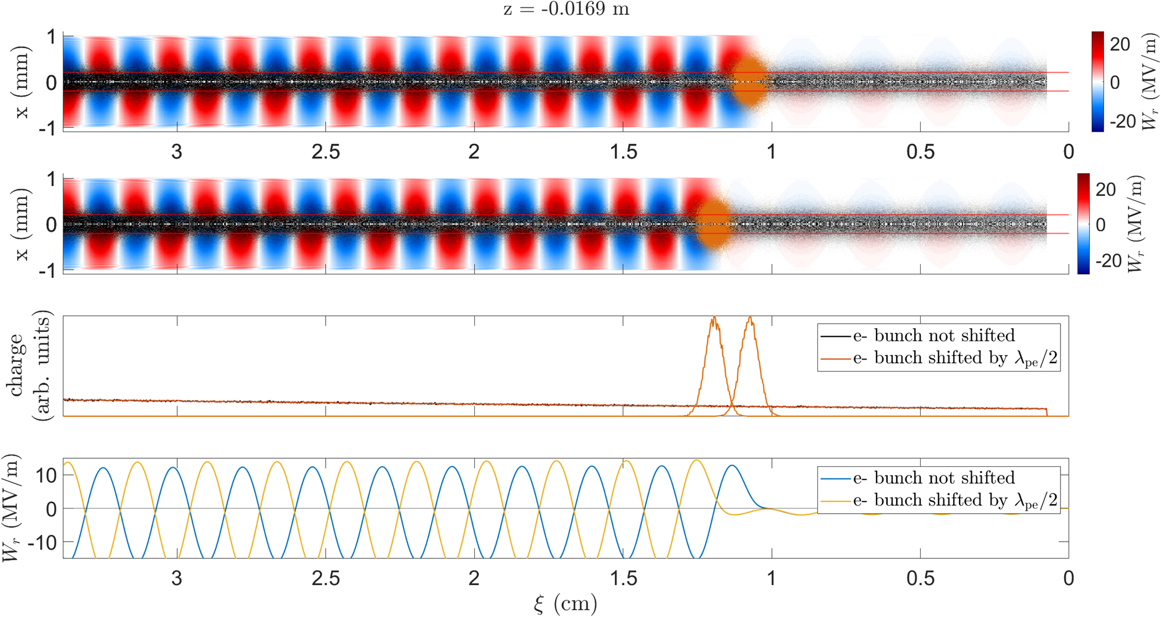
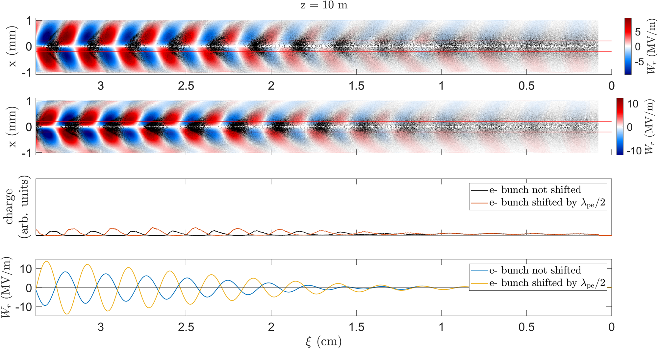
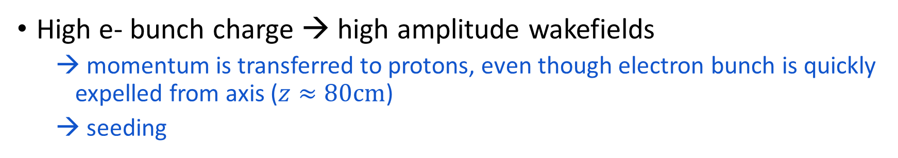
Phase by the end of the plasma high charge (550 pC)
beginning of plasma
end of plasma
High e- bunch charge → high amplitude wakefields
momentum is transferred to protons, even though electron bunch is quickly expelled from axis ($z≈80cm$)
seeding

Slide 10
Conclusions
The e- bunch is expelled from the axis early in the plasma when propagating inside the p+ bunch.
e- bunches seed by modulating the transverse momentum of the proton bunch.
e- bunches seed when they have sufficient charge
higher charge → larger amplitude wakefields → faster transfer of the energy of the e- to the p+
Next
Study the interaction between the self-modulation of the bunch front and back

Slide 11
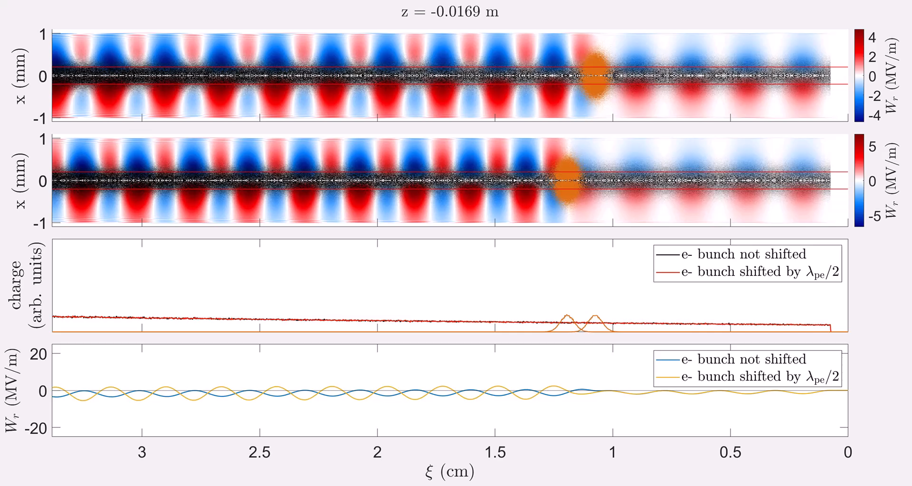
low charge (110 pC) animation

Slide 12
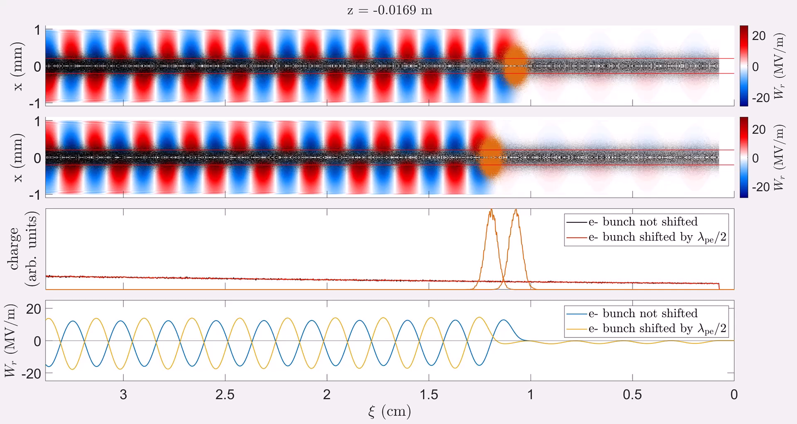
high charge (550 pC) animation

