Slide 1
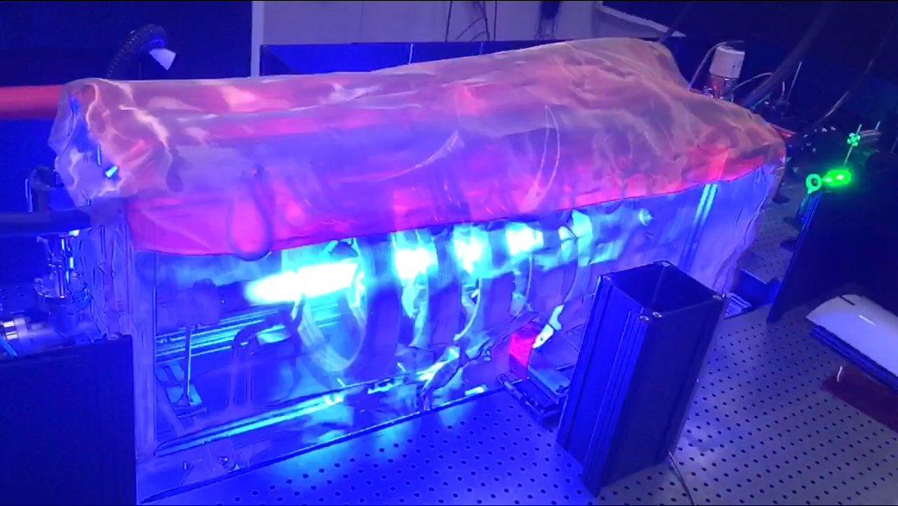
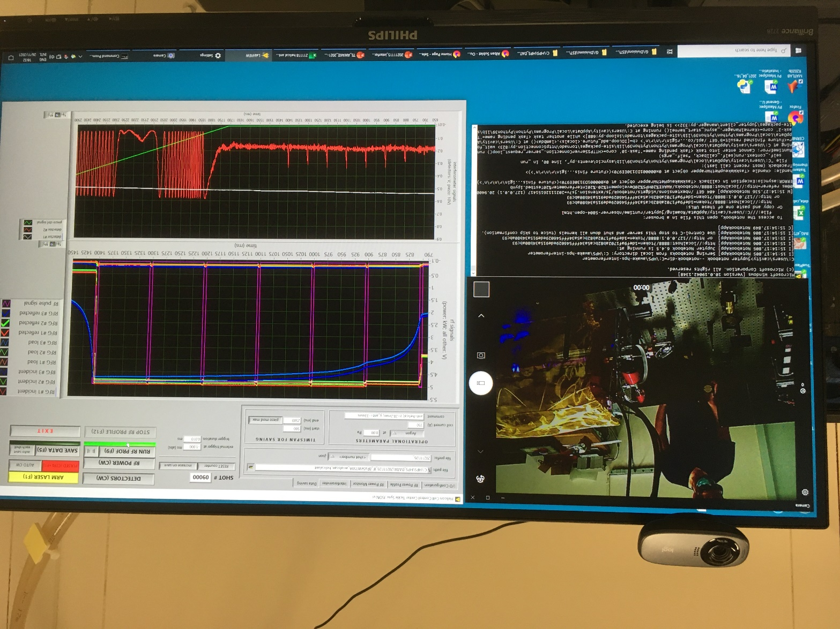
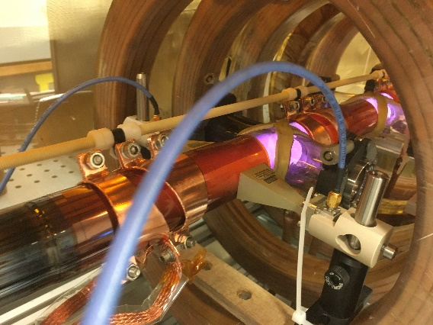
Status of the Helicon Plasma Source (HPS) R&D activities
Thomson scattering
CO2 interferometer
A. Sublet, on behalf of the HPS team
AWAKE Collaboration meeting 13th April 2022
MW cut-off frequency

Slide 2
Updates since last collaboration meeting
CERN lab:
→ Thomson scattering (TS) and CO2 interferometer (IF) campaigns in October 2021, November 2021 and March 2022
  With focus on diagnostic benchmarking (TS and IF) and trying to reach AWAKE nominal density
  Compare different type of antennas and get a first idea of axial density homogeneity
Technical campaign for RF-related topics
Preparation of LIF setup
EPFL:
Focus on diagnostics preparation/operation and RF simulations
Univ. Wisconsin:
Finalization of MAP setup, preparation of LIF and RF simulations
IPP-Greifswald/MPP-Munich:
IF campaigns and MW cut-of frequency test

Slide 3
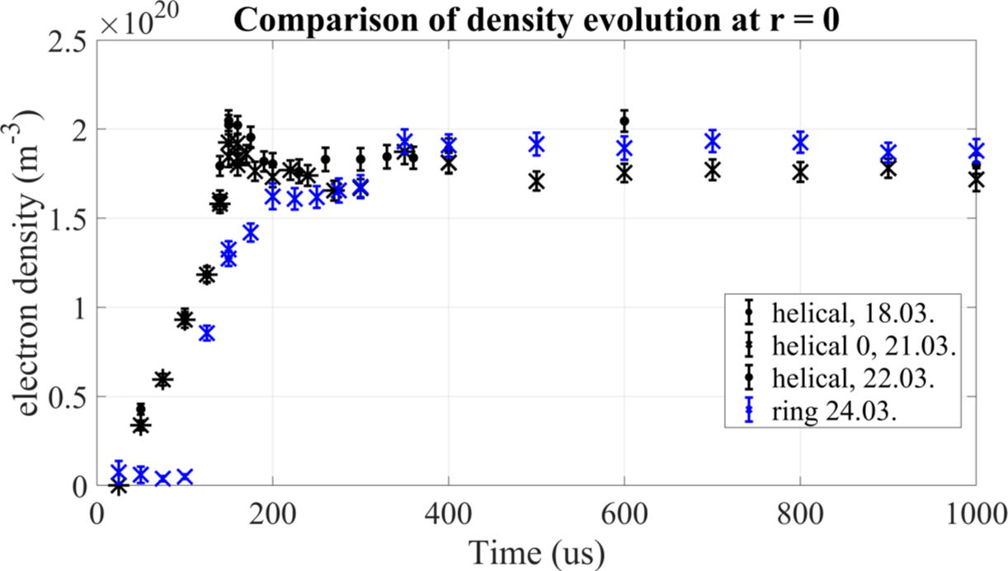
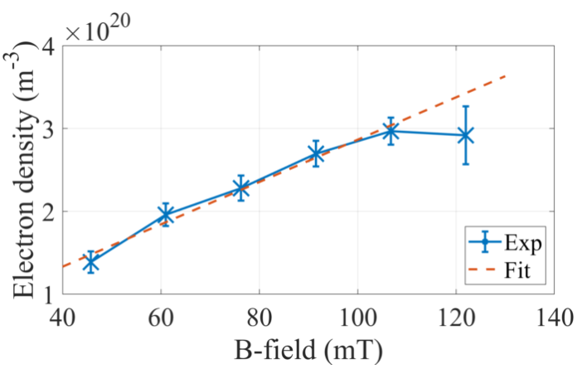


Outcomes → TS antenna comparison and B-field scan
Time evolution of density with helical and ring antennas
Ring antennas
150
350
At low power, peak density is comparable for both antennas ~ 2x10²⁰ m⁻³
However the dynamic of the plasma is quite different: max at 150 or 350 us
Helical antenna limited in power to 4 kW before arcing threshold!
Helicon wave dispersion relation is verified
Saturation close to the lower hybrid frequency
Low density maximum → limitation of ring antenna?

Slide 4
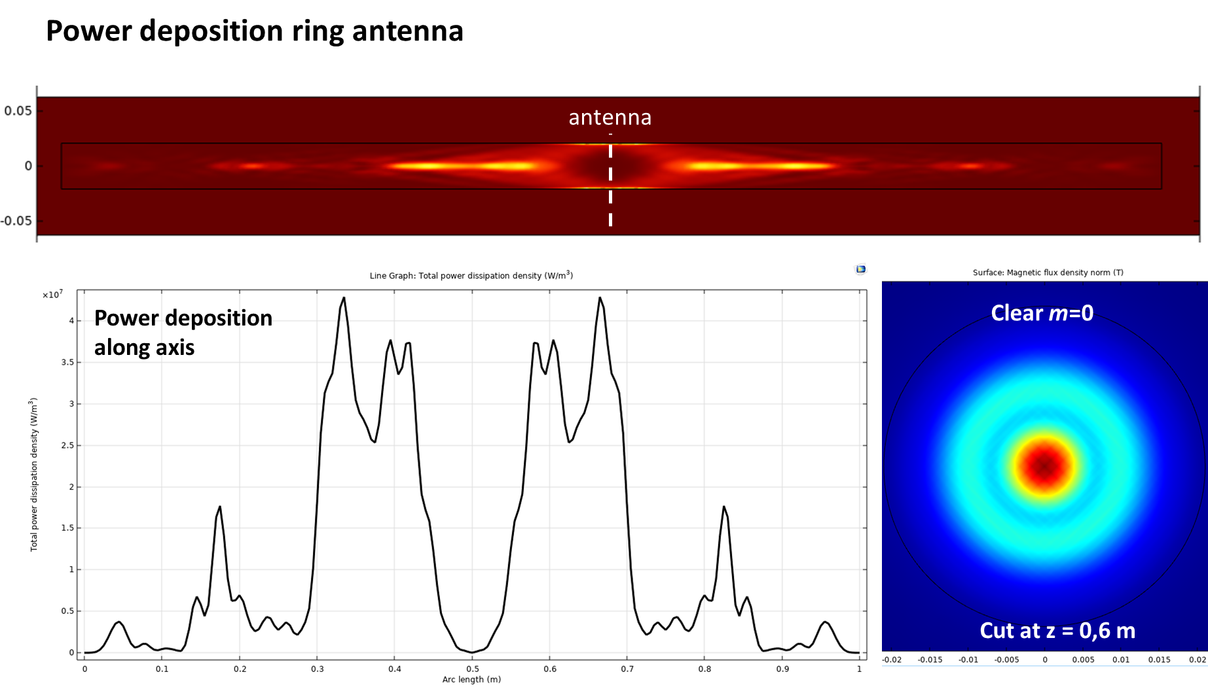
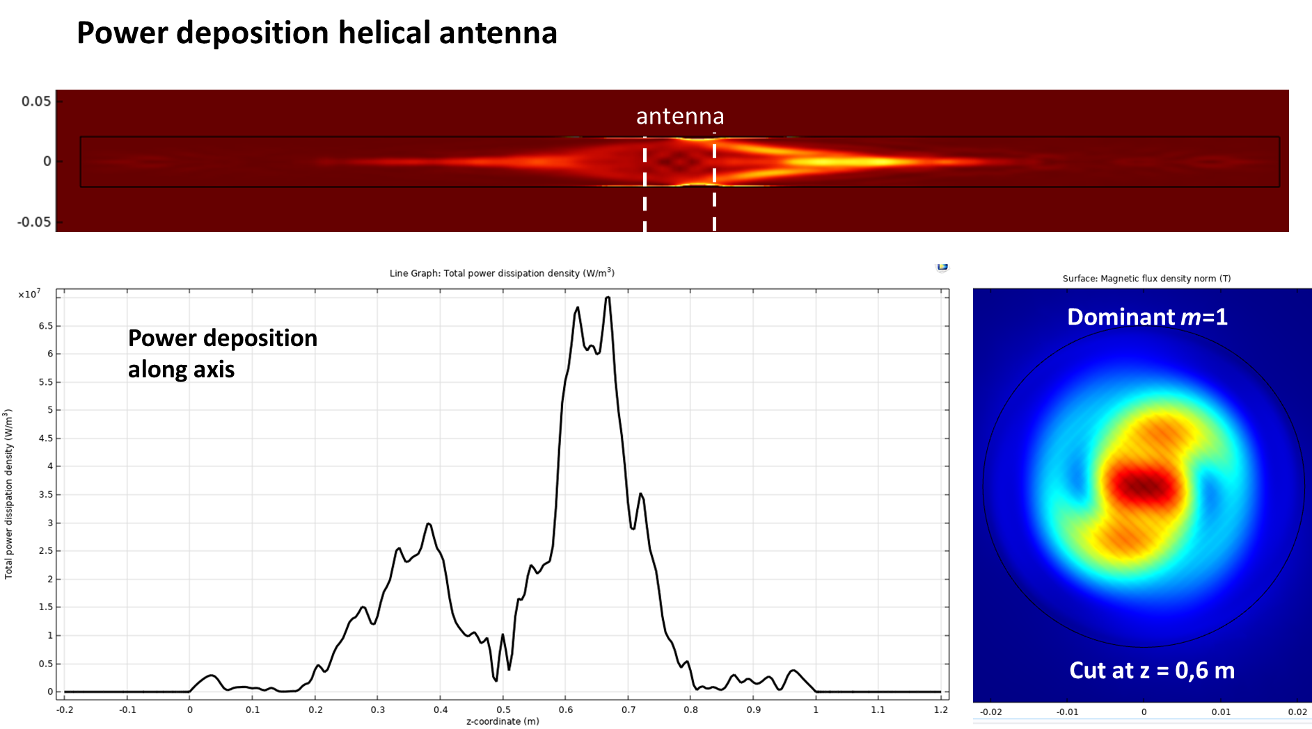
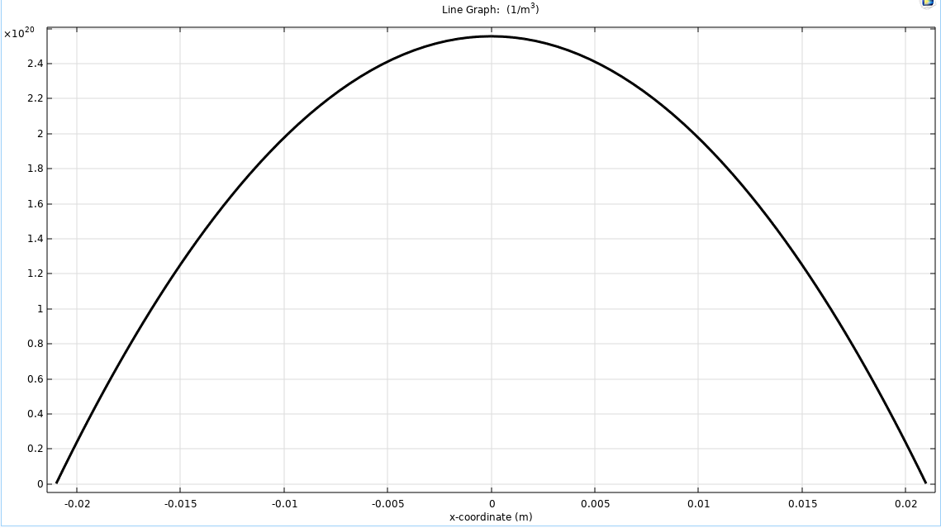
Outcomes → antenna comparison: RF modelling (courtesy P. Guittiennne – EPFL/SPC)
B₀ = 106 mT
B₀ = 106 mT
2,5 10²⁰ m⁻³
Considering a parabolic density profile:

Slide 5
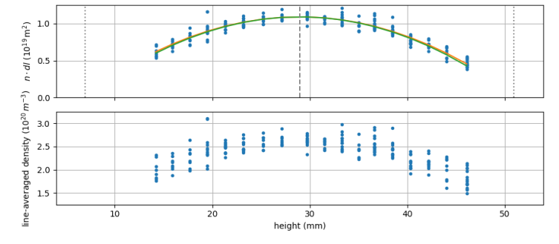
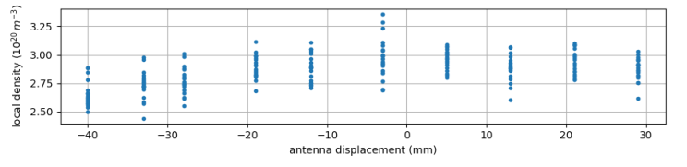
Outcomes → IF radial and “axial” profiles with helical antennas
Axial profile by moving the antenna (7 cm span) in a non-uniform B-field and static diagnostic
Less than 10% variation (assuming no profile change!)
Profile identical to 2018 measurements in Greifswald
Parabolic shape of line-integrated density → credible inversion of profile
BUT: peak local density 2.5-3x10²⁰ m⁻³ significantly lower than expected for 6 kW input power (5x10²⁰ m⁻³)
AND arcing on antennas! Work in progress...

Slide 6
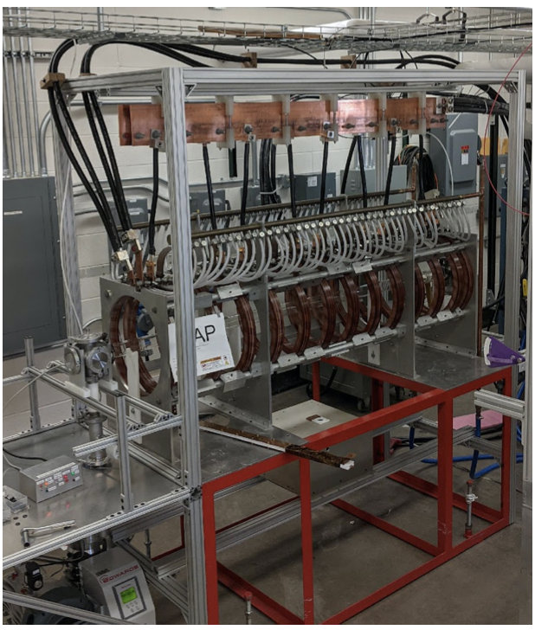
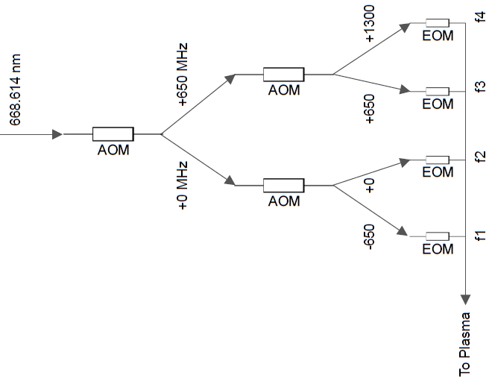
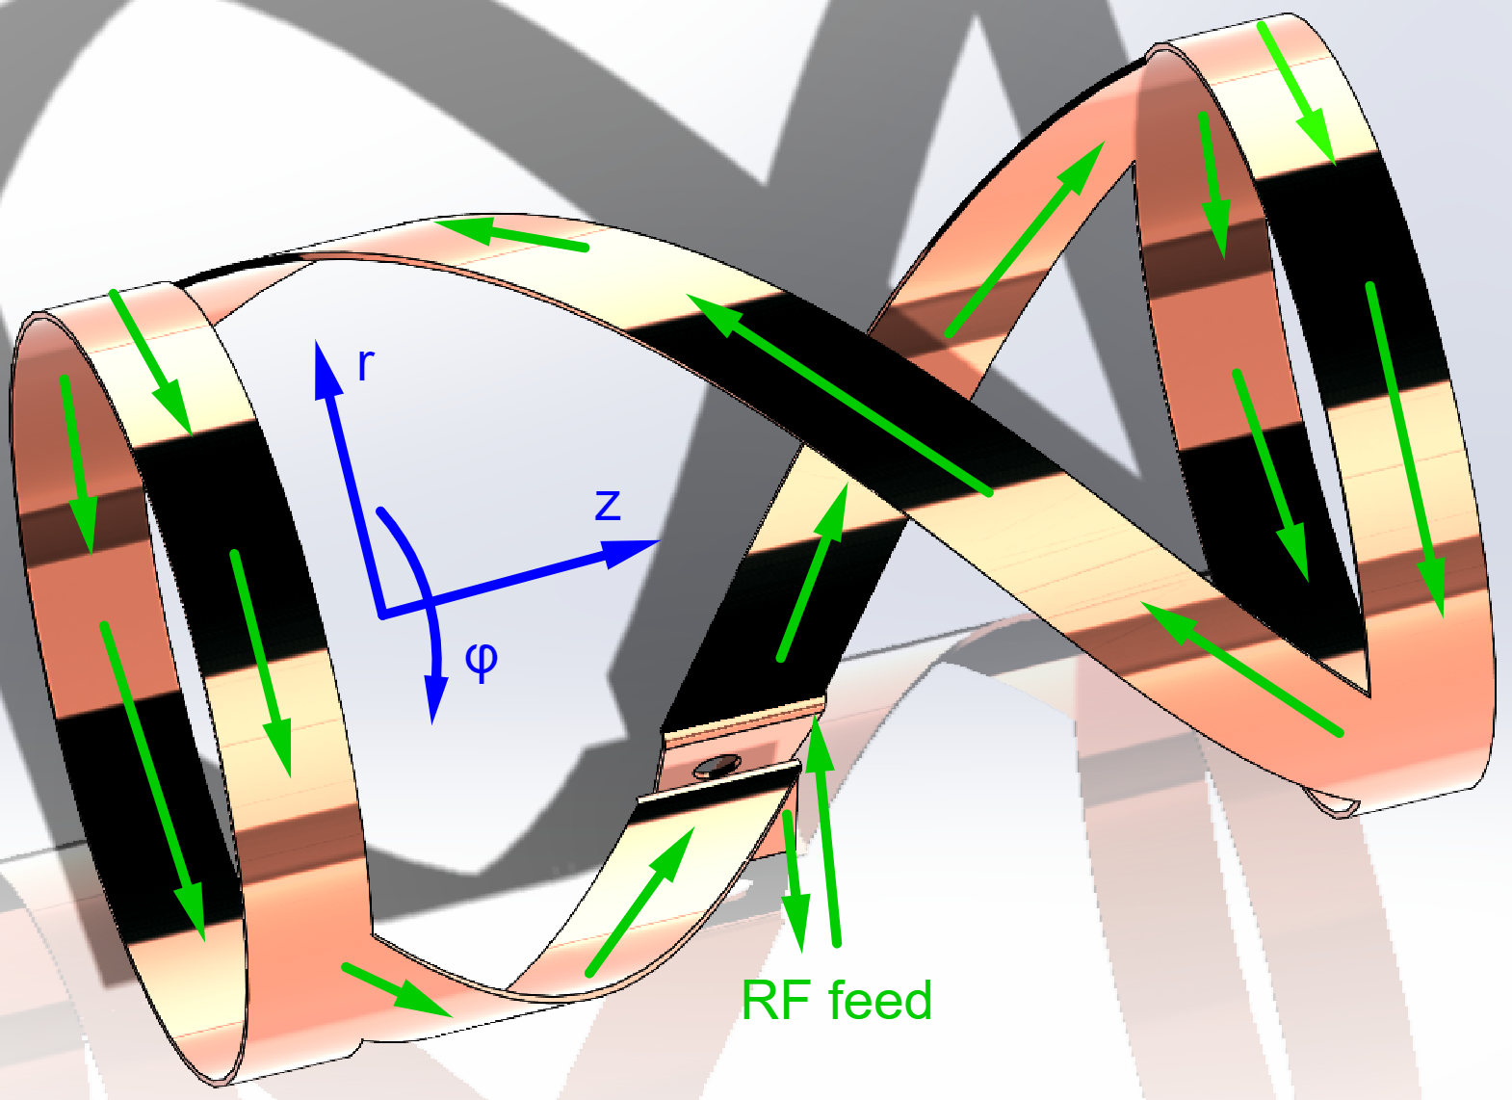
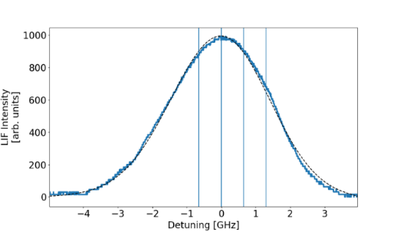
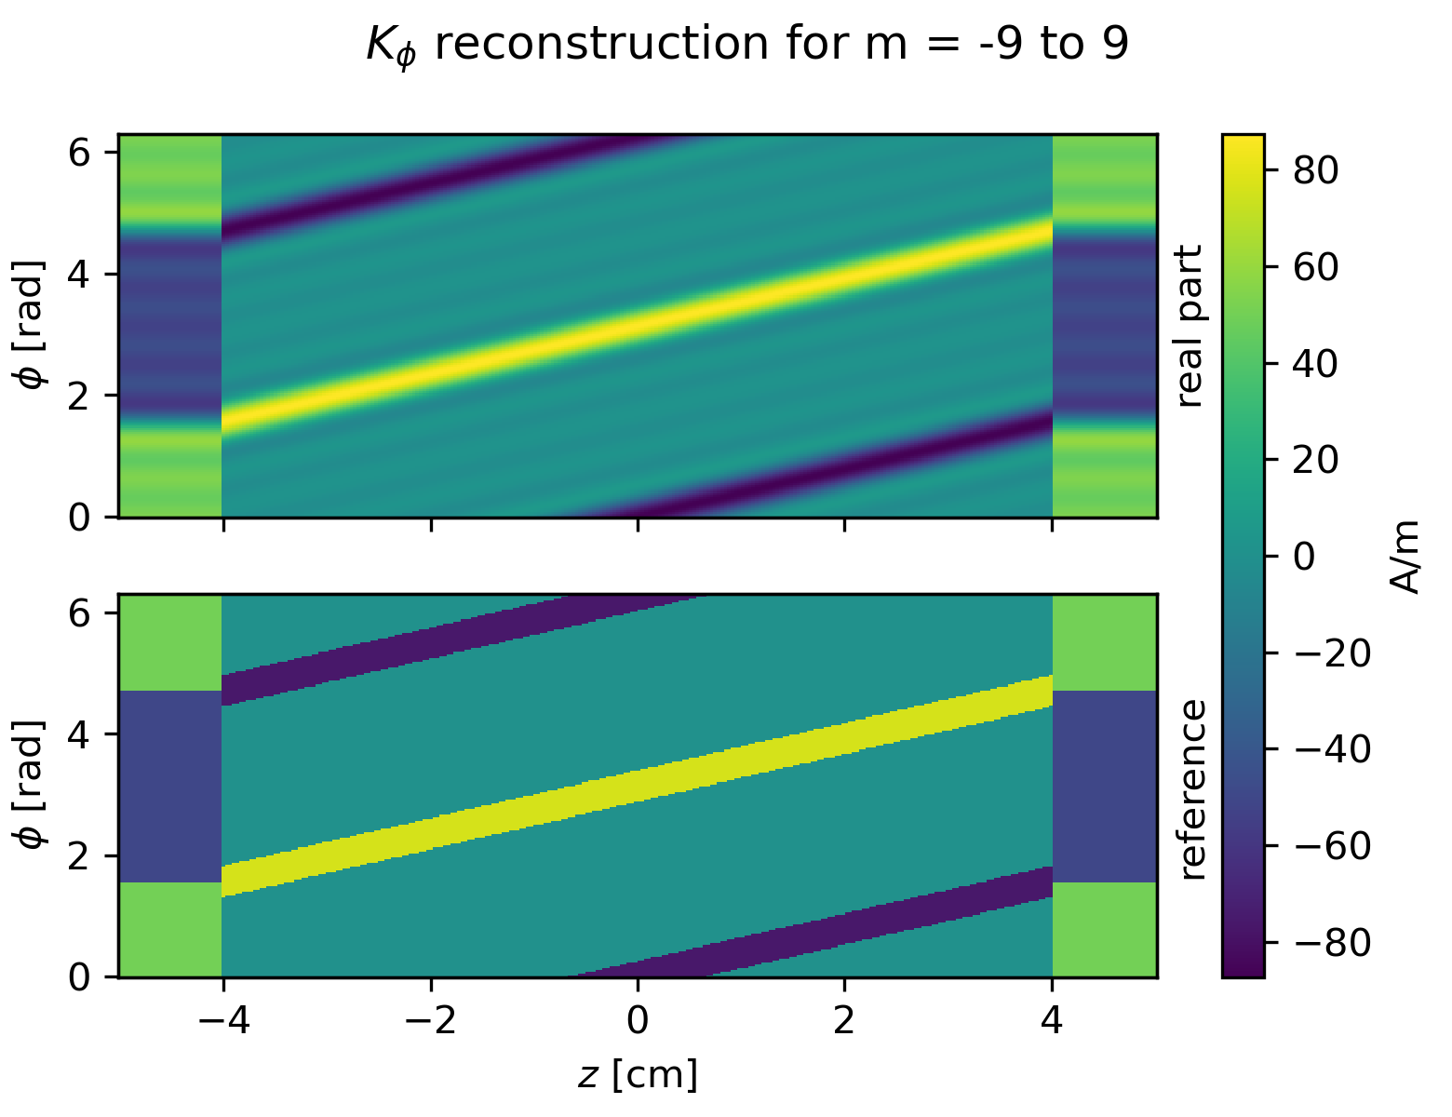
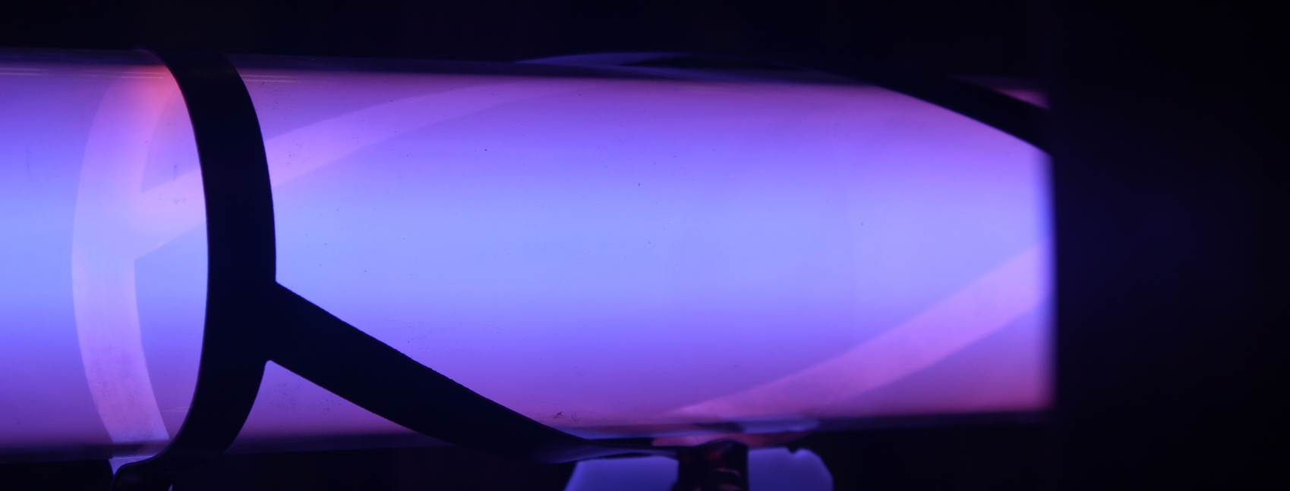
Outcomes → MAP/LIF/RF modelling (courtesy O. Schmitz – Univ. Wisonsin)
narrow k-antenna
[M. Zepp, Preliminary defense thesis, UW Madison, 2022]
1 kW helicon plasma
Four-point LIF for fast measurement of particle flows → ms resolution, to be tested on MAP
CERN LIF setup ordered and received, to be installed in May
F. Siddiki
[M. Granetzny, Preliminary Defense, 2022]
Plasma dimensions: 2 m long tube, 5.1 cm diameter
Magnetic field: ~ 50 mT
RF power: 3x10 kW at 13.56 MHz (final stage), currently 1 antenna in CW operation
Diagnostics: passive spectroscopy, interferometer, LIF, RF comp. Langmuir probe
Analytical decomposition of half helical antenna into azimuthal modes
Allowed description by 2D axisymmetric equation for each azimuthal mode number m
→ 3 antennas produced to be tested at CERN

Slide 7
R&D program of first half 2022
Date | Week | Duration | What | Who | Goal
February | 6 to 10 | 4 weeks | HW update | Trumpf | - Software update of RF generators #1 and #2 (#3 updated in 2019, need update to be done at CERN) - Repair of generator (SN201079984) faulty power stage - Returned to CERN lab on 10th March, reinstalled, gen. 3 new IL194 firmware updated, all tested and ok.
March 2-3 | 9 | 2 half days | Meeting | All | AWAKE TB+PEB meetings https://indico.cern.ch/event/1115606/ https://indico.cern.ch/event/1122324/
March 7 at 16:30 (GVA) | 10 |  | Meeting | All | 14th HPS coordination meeting: - Align on first half 2022 plan - Oliver presentation for NSF ECLIPSE meeting
March 9-11 | 10 | 3 days | Meeting | Oliver (Univ. Wisconsin) | NSF ECLIPSE meeting invited talk
March 14 at 16:30 (GVA) | 11 |  | Meeting | All | 15th HPS coordination meeting: - RF-modelling -> status at Madison (Marcel) and EPFL (Philippe to be confirmed by Ivo)
March 14-18 | 11 | 1 week | Physics Campaign | Christine + Renat (EPFL)/Alban/Barret | - Teaching Renate Thomson Scattering (TS) setup - TS measurement of ring vs half helical antennas with 1 RF-generator/antenna (hopefully 3)
March 22 at 17:00 (GVA) | 12 |  | Meeting | Olaf(s)/David/Birger/Alban/Michelle | MW cut-off measurement meeting
March 28 - April 23 | 13 to 16 | 4 weeks | Technical Campaign | Barret (Univ. Wisconsin) | - Re-install updated RF power supplies, check compatibility with LabView VI to control the cell, - Test short Greifswald RF-cable, - RF-measurement and voltage/current on the antenna, working on RF-issues - Learn how to operate the HPS, - Preparation work for LIF setup (collect missing parts, pre-assembly of parts, interface with Michael etc.)
April 4 at 16:30 (GVA) | 14 |  | Meeting | All | HPS coordination meeting: updates on HW + TS campaign + MW cut-off + presentations for collaboration meeting + plans for 2nd half 2022
April 1-8 | 14 | 1 week | Technical Campaign | Olaf Reimann + David Fink (MPP)/Michelle/Alban | - Hardware setup end of March (Olaf Reimann venue to CERN) - First week of April (4th April), first test/proof of principal measurements on HPS with David Fink
April 12-13 | 15 | 2 days | Meeting | All | AWAKE collaboration meeting (online)
April (2nd half) | 16 to 17 | 2 weeks | Physics Campaign | Birger (IPP)/Alban/Barret/Marcel | CO2 interferometer (IF) campaign, new piezo stage, updated RF-generators/cables/etc. towards nominal AWAKE density
May 9 at 16:30 (GVA) | 19 |  | Meeting | All | HPS coordination meeting: updates on IF campaign summary + LIF setup
May 15-18 | 20 | 4 days | Workshop | Michael, Marcel, Christine | https://www.we-heraeus-stiftung.de/veranstaltungen/science-and-applications-of-plasma-based-accelerators/main/ - abstract deadline = 13th March (poster presentation mandatory)
May | 20 to 22 | 3 weeks | Technical Campaign | Barret + Michael/Marcel (2 weeks after HERAEUS workshop) | - Install LIF - Calibration - First local density measurements - Prepare for longitudinal density measurement - OES -> LRS data NN training (if time allows)
May 22-26 | 21 | 6 Days | Conference | Christine | ICOPS (49th IEEE International Conference on Plasma Science), http://icops2022.org/Topics.html
June 13 at 16:30 (GVA) | 24 |  | Meeting | All | HPS coordination meeting: updates on LIF setup/campaign + TS/IF
June | 23 to 25 | 3 weeks | Physics Campaign | Christine + Renat (EPFL)/Alban | - TS campaign -> measurement at high power / benchmarking with IF, longitudinal uniformity?

Slide 8
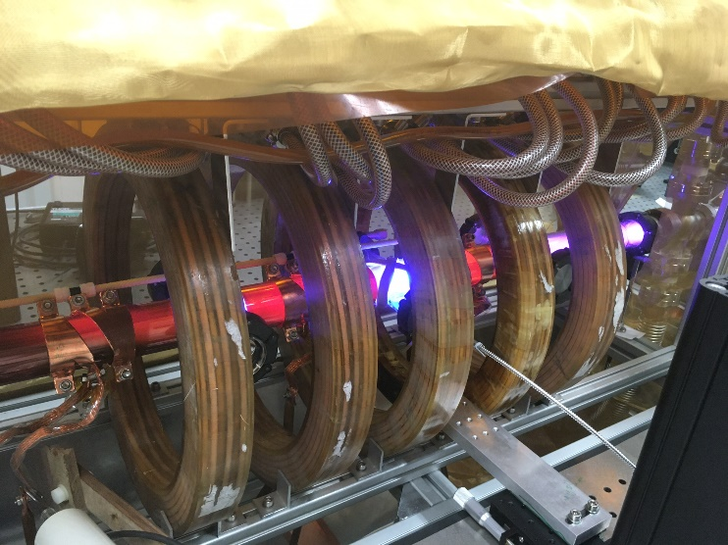
Summary
Active and dense program since September last year,
2 diagnostics installed and running: IF and TS, benchmarking once system limitation overcome
2 more diagnostics in the pipeline: MW cut-off frequency tested in March and LIF in May
Greifswald results no yet matched due to system limitation (arcing, RF), on going program to recover these results → April IF campaign next two weeks.
Active support from institutes, with Christine/Renat/Barret/Marcel/Birger/David/Olaf at CERN and on going activities in EPFL/Madison
Presence in different workshop (Heraeus)/conference (ICOPS)/NSF-meeting...
Thank you for your attention!

