Slide 1
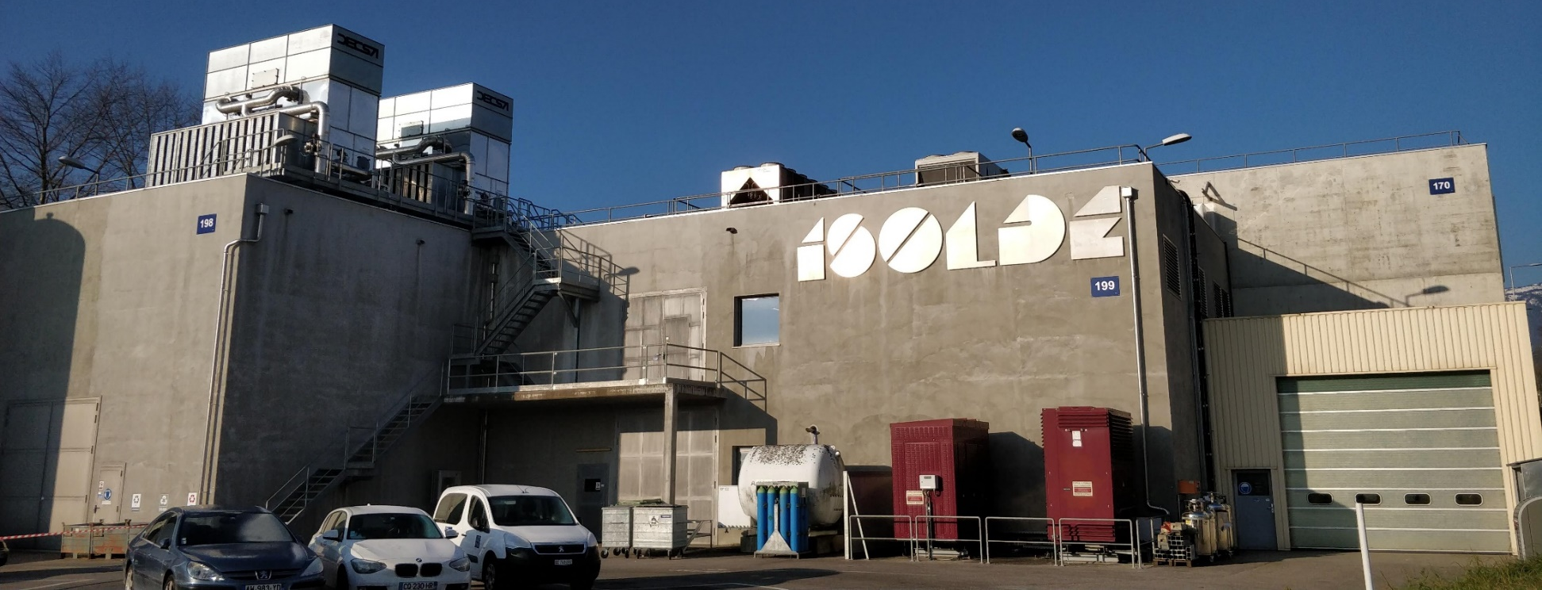
Danish research at ISOLDE
Lars Hemmingsen, lhe@chem.ku.dk, Dept. of Chemistry, University of Copenhagen
on behalf on Danish ISOLDE users
rECFA meeting, Copenhagen, May 12-13 2022

Slide 2


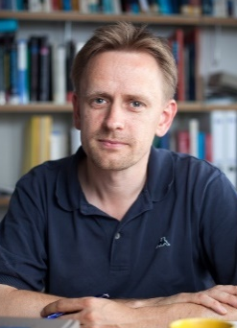




Overview
The ISOLDE facility
Nuclear physics
  Nuclear astrophysics
  ⁸He and ⁹Li decays
Chemistry and biophysics
  Biomolecular structure and function
  Quadrupole moments from molecular
  experiments
Other applications of radionuclides
  ISOLDE helping ESS
  Medical radionuclides
  (MEDICIS/PRISMAP)
Karsten Riisager
Hans Fynbo
Lars Hemmingsen
Mikael Jensen

Slide 3
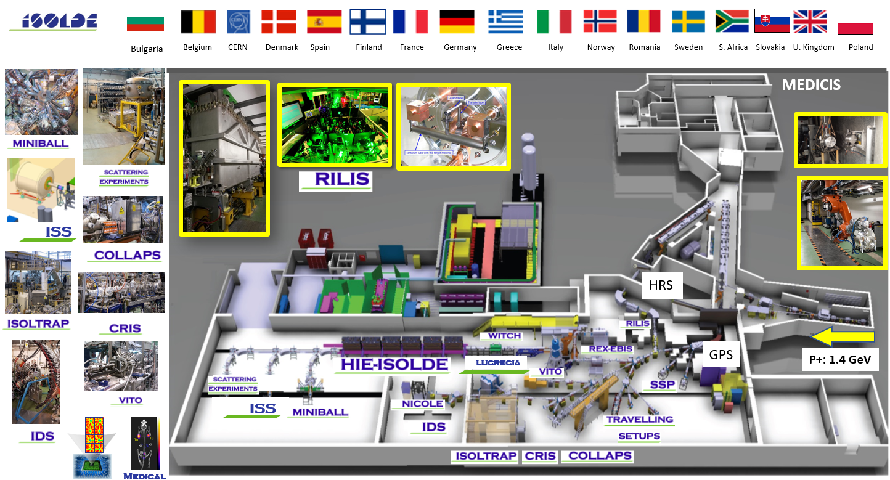
The ISOLDE facility

Slide 4
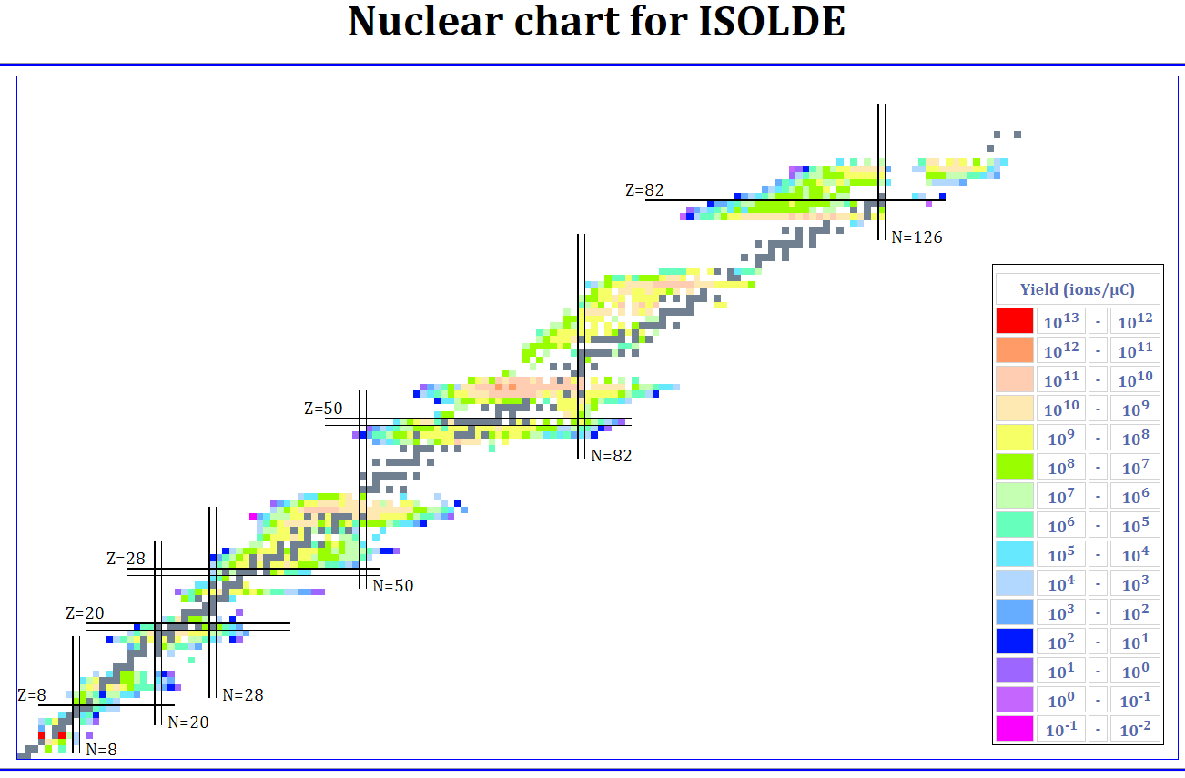
The ISOLDE facility
ISOLDE today offers the largest range of available isotopes of any ISOL facility worldwide.
1200 isotopes of ~74 elements
Novel (and usually unique) isotopes for a wide scientific community

Slide 5
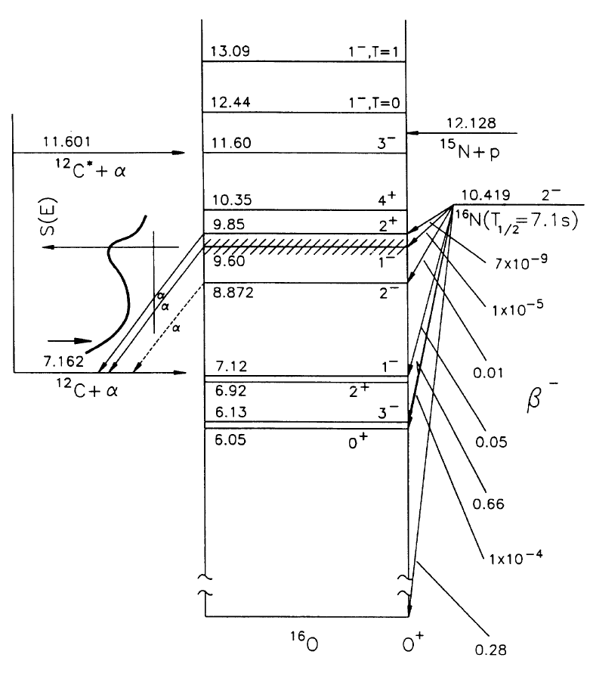
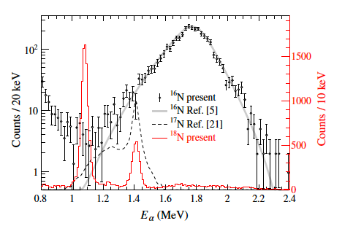
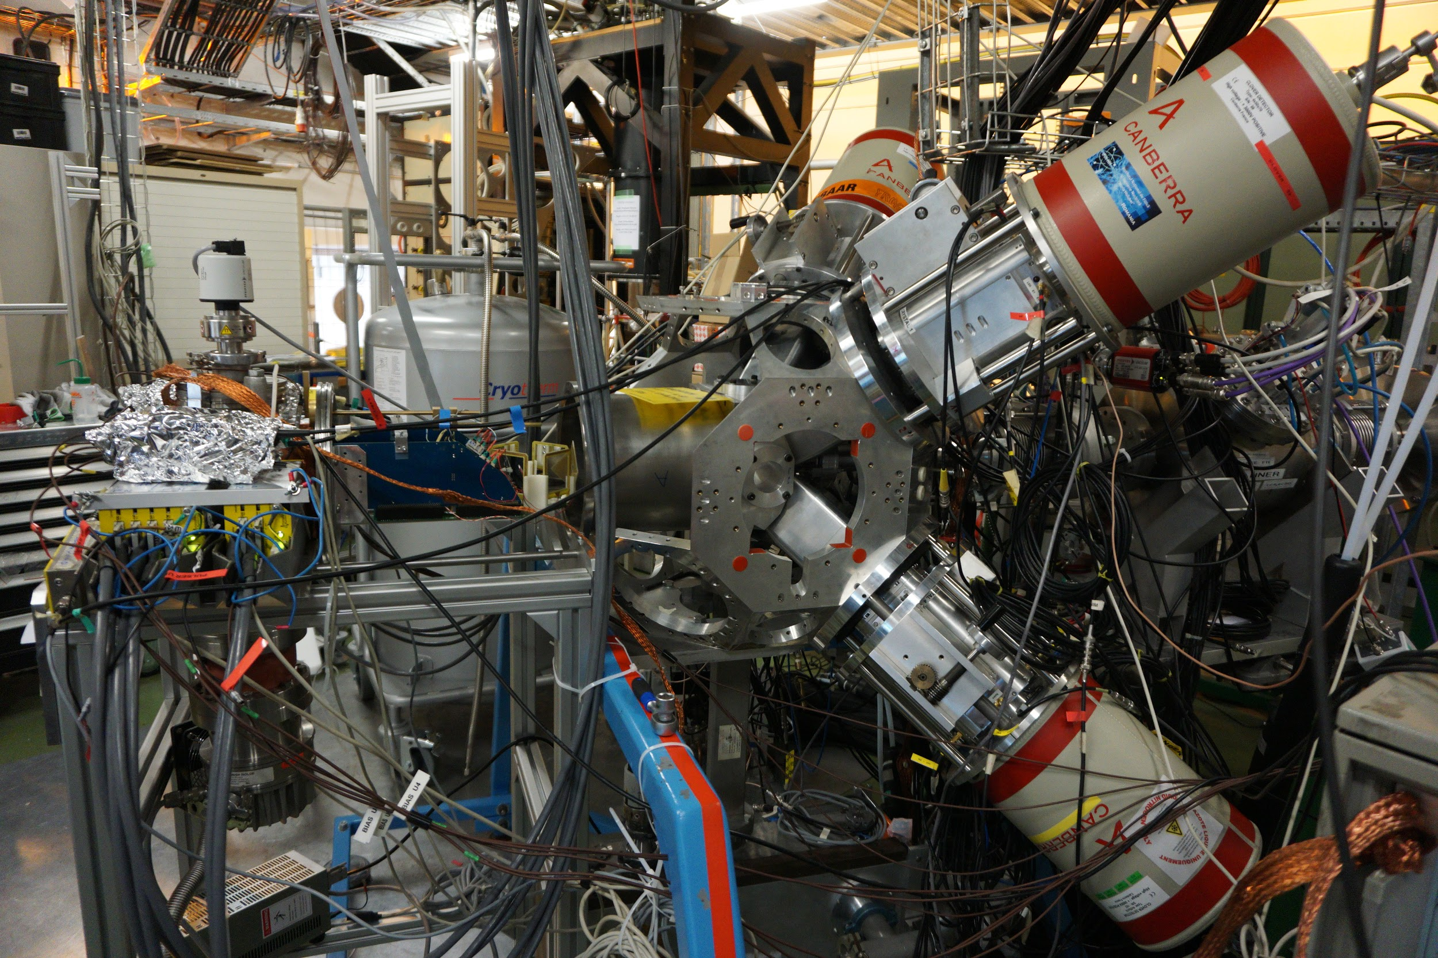
Nuclear astrophysics
¹⁶N decay and ¹²C(α,γ)¹⁶O
KVI : Refsgaard et al. PLB 752, 296
CERN: Kirsebom et al., PRL 121, 142701

Slide 6
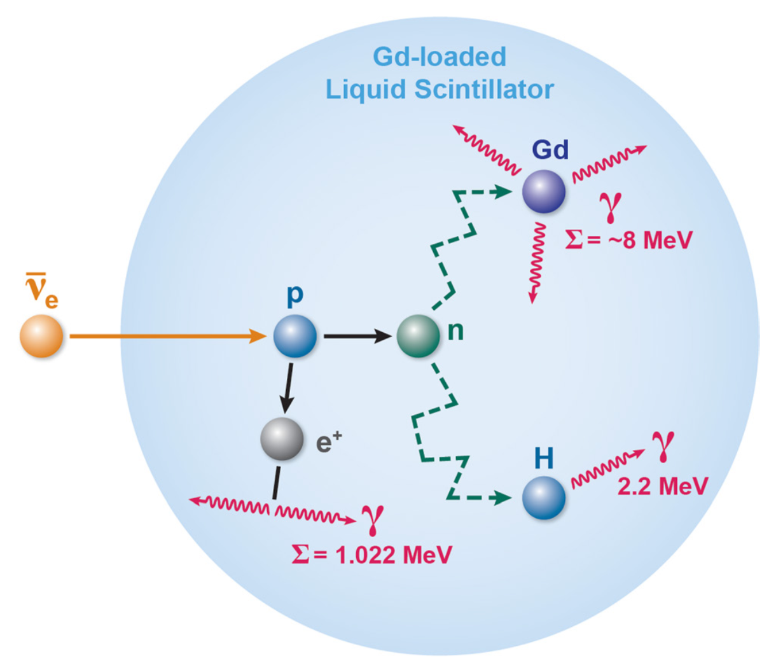

Nuclear physics
Low-energy neutrinos: ⁸He, ⁹Li background
Beta-delayed n emission mimics neutrino-signal
Need complete experimental characterization (for GEANT4)
Running now at
NIM A949, 162904
arXiv:2204.09215

Slide 7
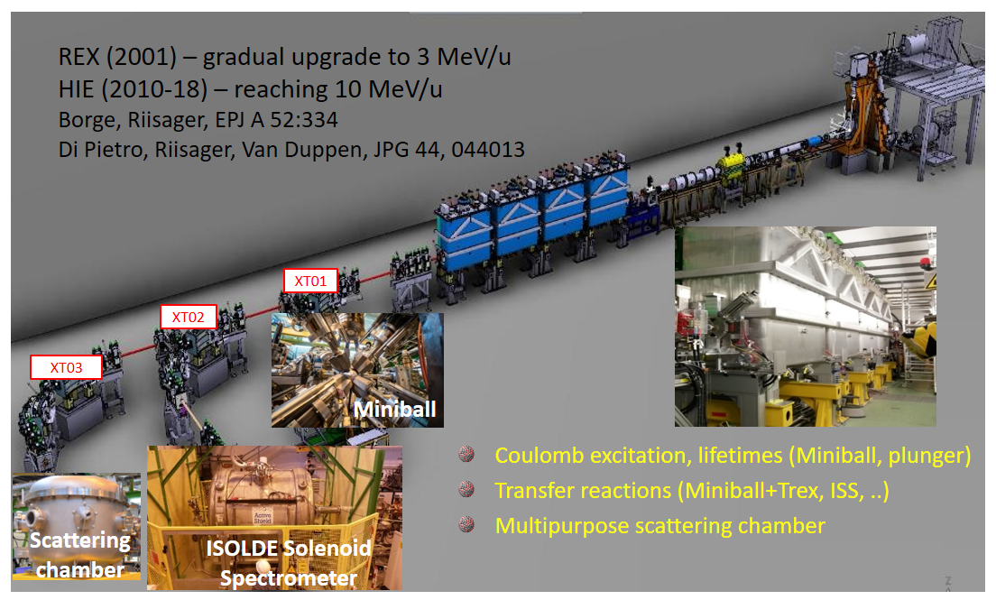
Post accelerated beams

Slide 8
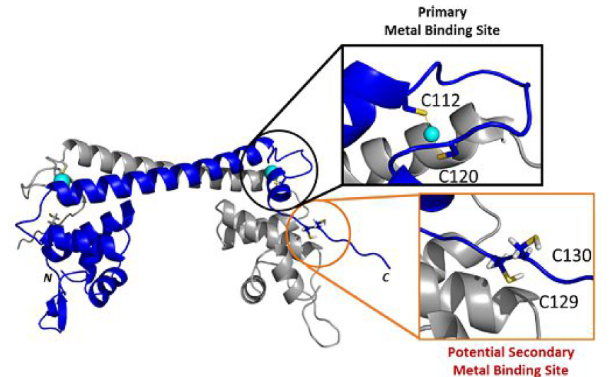

From nuclear physics to molecular properties
Intracellular control of metal ion concentration by metallosensor proteins – CueR senses Cu(I):
But does not respond to divalent metal ions, potentially because a secondary
metal site provides auxiliary ligands – a ^{199m}Hg Perturbed angular correlation of
γ-rays (PAC) study.
Balogh et al. Chem. Eur. J. 2019, 25, 15030 – 15035
Fromsejer et al. Phys.Chem.Chem.Phys 2021, 23, 25689-25698
ISOLDE/CERN
Uni of Copenhagen
Uni of Szeged
Biological Research Centre of the Hungarian Academy of Sciences

Slide 9
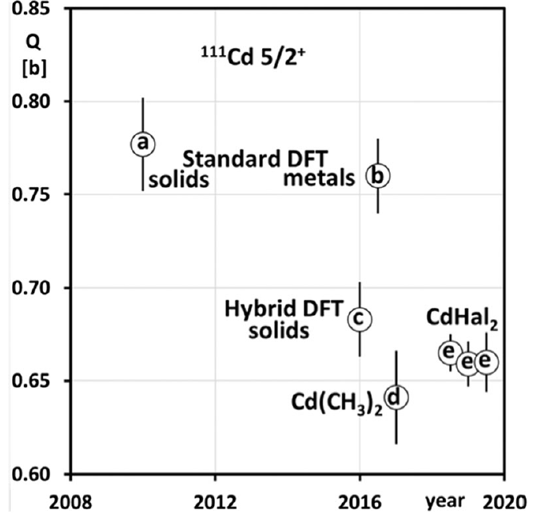
From molecular properties to nuclear physics
The first gas phase PAC experiments combined with state of the art (CCSD(T)) electronic structure calculations (project lead by H. Haas, CERN)
provided most accurate determination of excited state nuclear quadrupole moments of ¹⁹⁹Hg and ¹¹¹Cd:
Q(¹⁹⁹Hg, 5/2⁻) = +0.674(17) b and Q(¹¹¹Cd, 5/2⁺) = +0.664(7) b.
Haas et al., Phys. Rev. Lett. 126, 103001 (2021)
Fromsejer et al., 2022, Chem. Phys. Lett., Accepted
ISOLDE/CERN
Uni of Copenhagen
Uni of Bonn
Uni of Duisburg-Essen
Uni of Aveiro
Uni of Lisbon
CdHal₂ is:
CdCl₂
CdBr₂
CdI₂

Slide 10
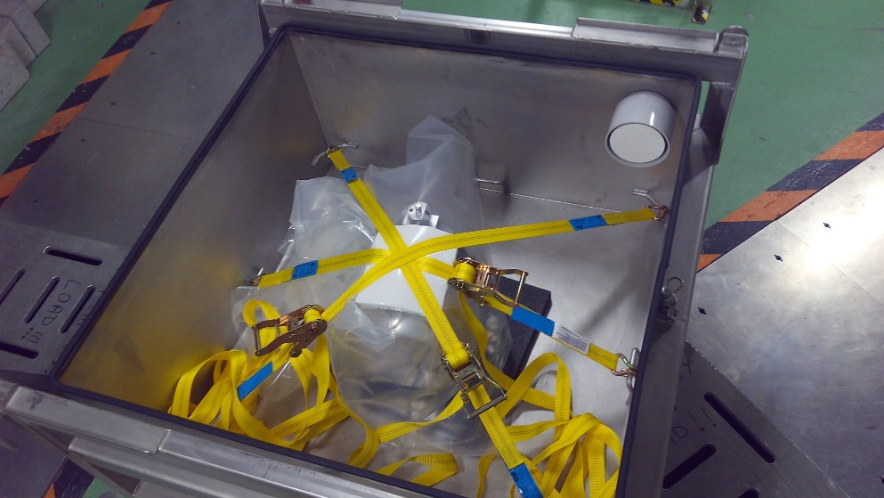
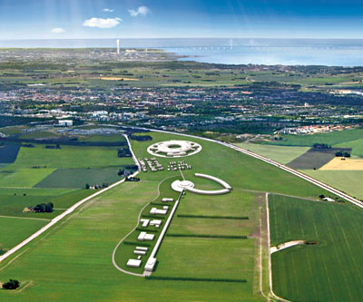
ISOLDE helping ESS
Irradiation of W blocks at ISOLDE – ESS safety check of their target: measure amount of emission of ¹²⁵I, noble gases and ³H (prof. Mikael Jensen, Hevesy Lab, DTU)

Slide 11
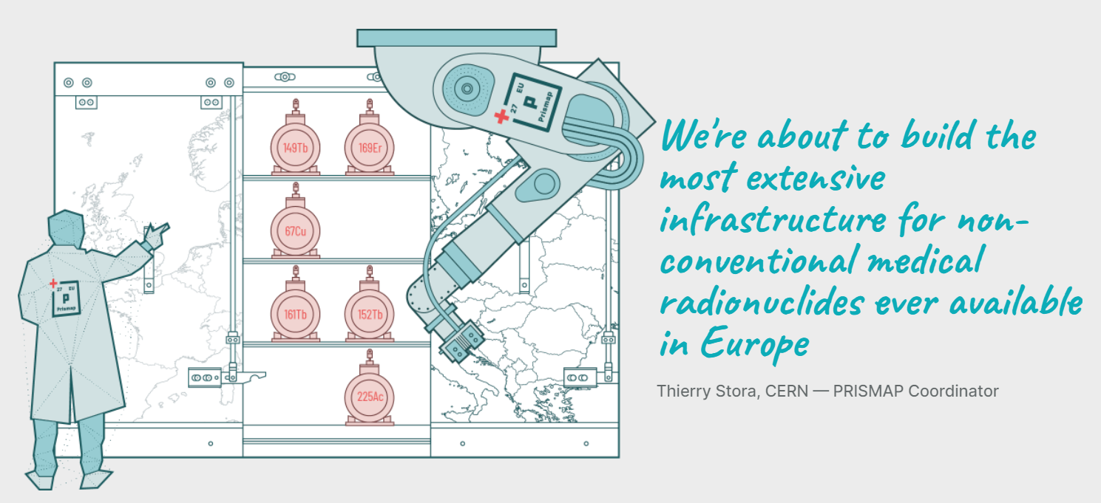
Medical radionuclides
ISOLDE/MEDICIS is an important part of the new European isotope production program: Prismap (www.prismap.eu)
Which also includes the Hevesy Lab, DTU, Denmark (prof. Mikael Jensen)

Slide 12
Collaborations
Spain, CSIC, Madrid – Maria Jose G. Borge, Olof Tengblad, …
Sweden, Chalmers, Göteborg – Björn Jonson, Thomas Nilsson, …
Spain, Universidad Complutense, Madrid – Luis M. Fraile
Sweden, Lund Universitet, Lund – Joakim Cederkäll
USA, University of Tennessee, Knoxville – Miguel Madurga
Romania, IFIN-HH, Bucharest – Razvan Lica, Christof Sotty
Poland, University of Warsaw – Marek Pfützner,…
USA, University of Michigan – Vincent L. Pecoraro
Hungary, University of Szeged – Attila Jancso, Bela Gyurcsik
Switzerland, University of Zurich, Roland K. Sigel, Eva Freisinger, Silke Johannsen
Canada, TRIUMF / UBC - Andrew McFarlane, Iain McKenzie, Monika Stachura
USA, University of Northern Kentucky - Matthew Zacate
France, ILL – Ulli Köster
…

Slide 13
Science – summary and future
“Small science” addressing fundamental questions from nuclear physics to biochemistry => extensive international collaboration
Run more / longer experiments per year
  Fulfil high demand for beam time
Better quality beams (intensity/purity)
  e.g. around ¹³²Sn : region of interest for astrophysics r-process path (link to origin of elements, neutron-star mergers, gravitational waves)
Faster release
  Shorter lived (thus more exotic) isotopes
  Those are typically of highest interest (astrophysics, nuclear modelling, …)
Expand the user group, and re-initiate eMS collaboration including Danish Research

Slide 14
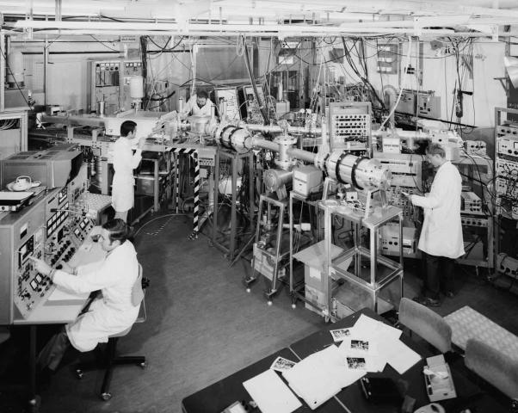

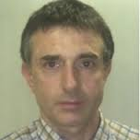
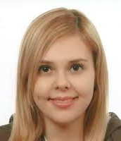
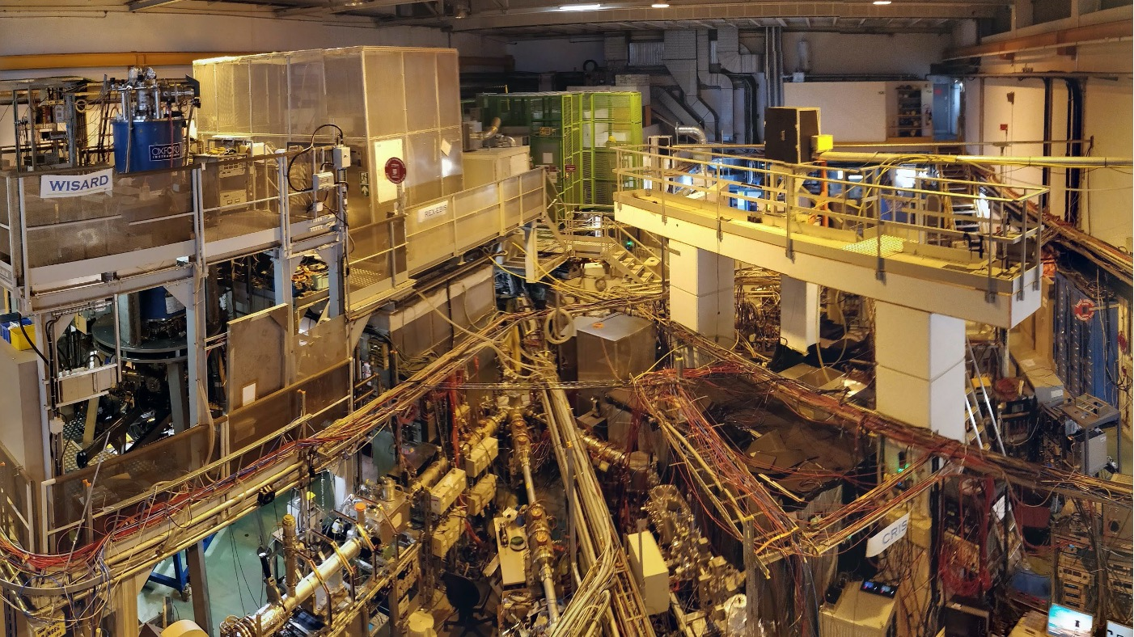
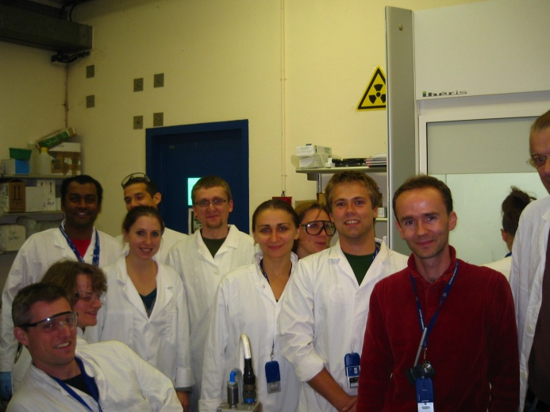
Thank you for your attention !
ISOLDE 1967
First proton
beam
Karl Joao Juliana
Johnston G.M. Correia Schell
ISOLDE now

