Slide 1
NICE
National Instrument Center for CERN Experiments
JJG: dir. of NICE and CERN-UP, scientific delgate to CEREN Council.

Slide 2
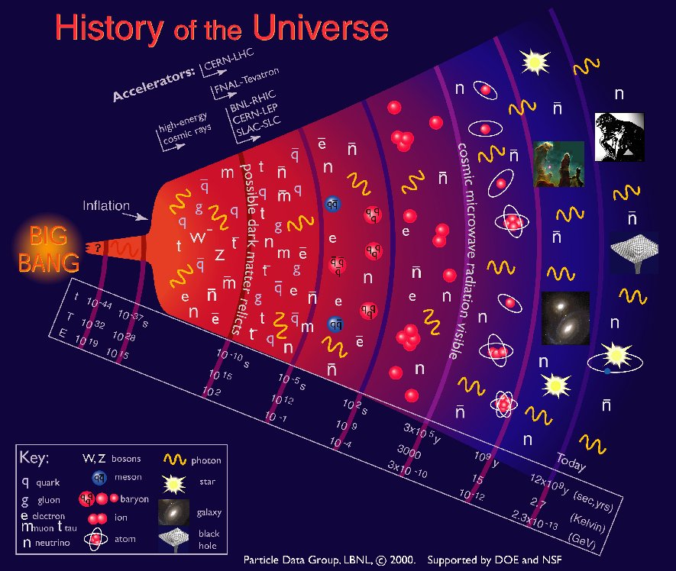

Obs. Astronomy
The Particle era:
The Particle era:
CMB
The Particle era:
Nuclear Physics
Nuclear Physics
The Particle era:
The Particle era:
The Particle era:
The Particle era:
10⁻⁶ s

Slide 3
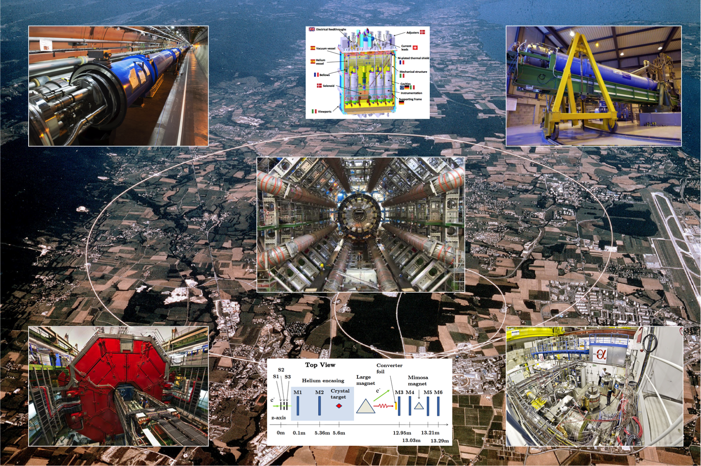
Danish science at CERN & NICE= National Instrumentcenter for CERN Experiments
LHC
HIE-ISOLDE
CAST/IAXO
ATLAS
ALICE
ALPHA
NA63

Slide 4
WHAT is NICE?
‘National Instrument Center for CERN Eksperimenter’
The NICE center is one of currently 3 ‘følgeforskningscenters’ (= ‘follow-up research centers’) funded by the Ministry –with a ‘line’ in the national Budget – with the purpose to support and promote the use of the CERN infrastructure, which DK co-owns together with 22 other member states.
The NICE board is composed of the group leaders of recognized CERN-DK experiments. NICE decides the scientific program. NICE also covers intl. memberships, common activities and has an advisory role to the Ministry.
The Danish membership of CERN is about 20 MCHF/yr based on GDP and provides access to the CERN accelerator infrastructure etc.
The physics exploitation and research must be funded by other sources, i.e. in competition with all natural science sectors (public, private and international).
NICE exists to make it possible for DK researchers to gain access to state-of-the art experiments at CERN and to develop and maintain long term scientific projects.

Slide 5
What does NICE do?
NICE funds:
  Membership fees of selected recognized experiments with DK partipation (M&O cat A&B) according to MoU
  Travel to the experimental facility and to relevant activities connected with running and maintaining the experiments
  A limited number (currently 4 FTE to ALICE and ATLAS) of scientific technical experts to develop, maintain and run the experimental facility.
  Running costs, memberships (IPPOG, NUPECC), summer students, strategic meetings, yearly community retreat, small equipment.
Current NICE funding: 7.4 MDKK/yr (≃ 1 M€/yr)
Larger equipment (i.e. upgrades) must be funded separately, f.ex. via competitive applications to National Infratructure Roadmap (4-5 years). The CERN-UP project (upgrade of ALICE, ATLAS, ISOLDE, ALPHA) is partially funded in this way. Requures 50% co-funding from Universituies.
Upgrade funding: 11.2 MDKK (1.5 M€). Part of ATLAS-Phase 2 missing (0.6 M€).
A proposal to develop advanced detector technology across danish universities (SUPER-DETECT) was not succesful.

Slide 6
The Danish CERN community
Registered CERN users’: 58
Census among DK experimental groups (2018) including students, comp. and tech: ≃100
Permanent staff : 15
This number has declined will decline further in the next 3-8 yrs due to age retirements. Serious challenge!
Important theoretical communities exist at NBI Copenhagen-U and Odense- U. Southern Denmark (not NICE)
Census among DK theory groups (2018) including students, comp. : ≃90
Permanent staff (2018): 15
Theo. community also works on related topics e.g. gravitation, neutrino etc.

Slide 7
DK research funding landscape
Characterised by:
  Intense competitiveness in grant process (since Y2000): 5-15% successrate.
  Large contribution to research from private donors/foundations. Main funding sources are:
  Public:
    FNU ( Natl Res. Council for ‘Natur og Univers’: max grants 6.5 MDKK = 0.9 M€ f. 4yrs. Strategy: bottom-up, ‘free’ research council.
    DNRF (Danish National Research Foundation) : max grants 120 MDKK =16 M€ f. 10 years Strategy: Center of excellence.
    Infrastructure Roadmap: larger equipment & facilities of broad cross-national interest (several universities)
  Private:
    Carlsberg, Villum, NOVO etc. : max grants similar to public sources, although very large& special grants may be negotiated.
    Strategy: fund small, medium, large grants, centers of excellence, high risk projects, explorative projects. Often there are boundary conditions related to the charter of the foundations(pharma, health, etc.) but also interest in STEM.
  National Strategic Calls:
    Special calls targeting (political) national strategies , i.e. Green transformation, Climate action, Innovation, etc.
The support for research at Universities has declined & almost vanished.
  PhD fellowships, junior postdocs, smaller research support are no longer available at Universities, but must be obtained via competitive applications to public or private organizations. Permanent positions open to internal competition.

Slide 8
Funding to experimental CERN research
Base funding from ministry (natl. budg) (2022): 7.4 MDKK/yr (1 M€/yr)
Corresponding to ≃ 5% of Dk annual membership fee.
Competitive grants from public, EU and private funds varies significantly
Total funding about 27 MDKK/yr (3.6 M€/yr) in 2018 and 20 MDKK/yr in 2022 (2.7 M€/yr).
Compare to ‘rule of thumb’: 1/3 of membership fee should exist nationally for ‘good use’ of membership (≃6.7 m€/yr), i.e. ½ even in best years.

Slide 9
DK national ‘følgeforskning’ funding 1996-2021 to NICE & precursors.
MDKK/yr
Nom. grant
1 M€
+ CVI
Purchasing value corrected for price index and CHF/DKK exchange rate.
+ Exch. rate

Slide 10
Summary. Main Challenges & Bottlenecks
NICE provides crucial baseline funding for exploiting CERN membership, but does not support research projects.
All research funding comes from competitive grants, public and private.
Long term stability crucial but NICE & most public and private funds have short time horizons ( < 4 yrs) .
Large fluctuations in yearly funding=>difficult to plan for long term projects => increase baseline funding.
Roadmap committee recommendation: ‘Følgeforskning’ should be 15% of membership fee (is about 5%). CERN Rule of Thumb: 30%.
Big exp. projects (upgrades etc.) are difficult to fund: no dedicated mechanism
(full HL-LHC upgrades ATLAS phase-2 not secured yet)
Universities have no PHD & postdoc programs. Educational opportunities not exploited optimally. Big opportunities for technical Universities.
Age profile of permanent staff is ticking bomb. Rejuvenation plan must be discussed with Universities (need alignment of natl. strategic priorities and University
Ministry has launched a “Goal Plan” exercise to be followed by a “Plan of Action” 😀

