Slide 1

Coil efficiency and sensitivity on design parameters
Ezio Todesco
Magnet Superconductors and Cryostat Group
Technology Department
European Organization for Nuclear Research (CERN)

Slide 2
CONTENTS
Coil efficiency
  Optimizing field quality
  Coil efficiency definition and computation
Sensitivity of short sample field on design parameters
A parade of designs

Slide 3
COIL EFFICIENCY
The question of the first part: coil efficiency
  Given a quantity of conductor, how to define in a quantitative way what is the arrangement of the cables to produce the highest field for a given current density
  This question is a general one for electromagnets (not related to superconducting magnets, critical surface, short sample …)
  This question is answered via the definition of the “coil efficiency”: how much field is generated by a quantity of conductor, given a current density
  This concept can be used to benchmark different magnet designs
    Note that this is the first brick of the design efficiency, then there are other factors are iron contribution, grading, and two-in-one configuration
    The final comparison must include everything, and this is what has been done for instance in the FCC case by D. Tommasini et al
    Nevertheless, knowing the contribution of each brick can give a powerful insight on the design, slicing the problem

Slide 4
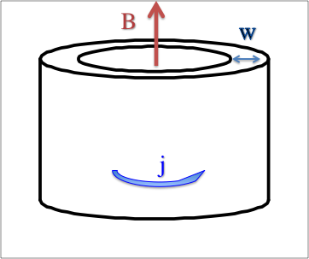
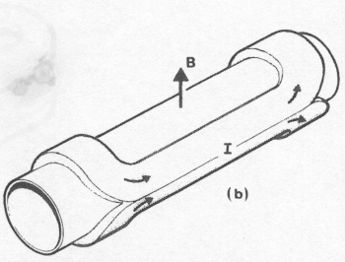
STARTING FROM THE BASICS
Field in a solenoid
For a dipole, one has “about” half of this (see next slides)
  This first part of this seminar is devoted to quantifying the “about”
Solenoid
Dipole

Slide 5
STARTING FROM THE BASICS
Cos theta distribution
  A current density distribution proportional to the angle
  Academic case, impossible to realize with a real cable, but very popular in the literature
  Exactly half of a solenoid
Cos theta distribution

Slide 6
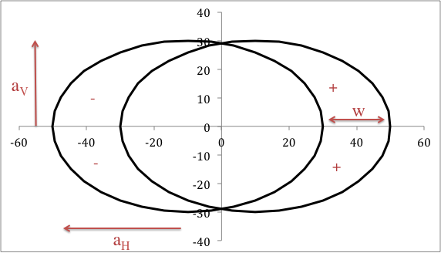
STARTING FROM THE BASICS
Intersecting ellipses
  A uniform current density in the area of two intersecting ellipses produces a pure dipolar field
  Better model since current density is constant, but still academic since impossible to achieve with the same cable
  For a_{H}=a_{V} (intersecting circles)
Intersecting ellipses

Slide 7
SECTOR COILS
60° sector coil
  This layout has zero b₃, but non negligible b₅ (order of 100 units)
  It can be wound with a cable having perfect keystoning (for instance the case of Tevatron dipoles, without wedges)
  So this is 10% more than the “half of the solenoid” (μ/2, i.e. 2π)

Slide 8
SECTOR COILS
Sector coil at 72° with one wedge between 48° and 60°
  This layout has zero b₃ and b₅ , and the same quantity of conductor as a 60° coil
  Computations give
  So canceling b₅ we lose about 5% in the field for a given current density (field quality costs about 5% - but we are still 5% above the “half of the solenoid”)

Slide 9
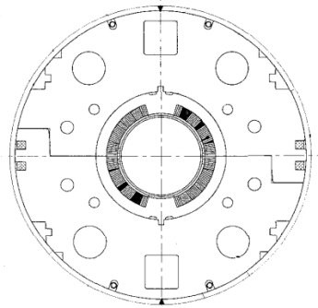
SECTOR COILS
With a better choice of the wedge position we can also set to zero b₇
  The angles of the blocks are ∼(0°-43.2°) (53.2°-67.3°)
  And with two wedges you can cancel up to b₁₁ – this is the lay-out used for RHIC dipole
  However, these layouts cannot be directly compared to the previous two since the angular development is different and therefore one has a different quantity of cable
One wedge optimal solution
Two wedges optimal solution
RHIC dipole cross-section
RHIC dipole coil

Slide 10
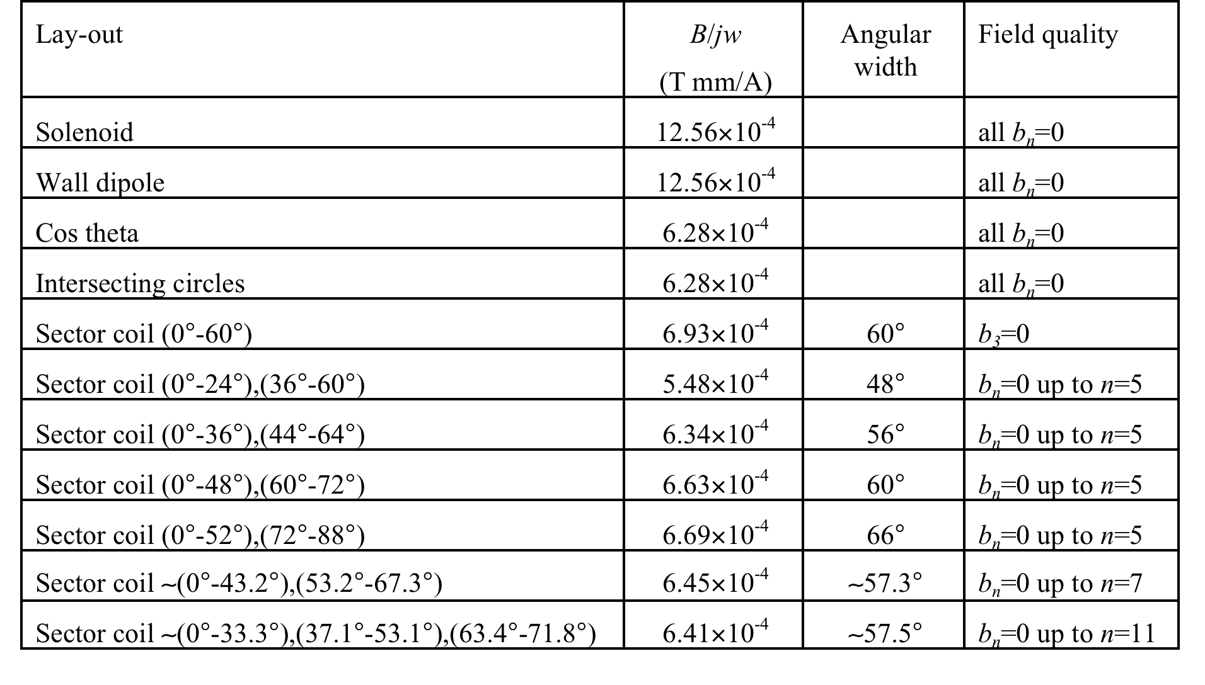
SECTOR COILS
This is a summary of solutions, and for the case with wedges we give the angular width of the cable blocks
Less field ..
But less
cable …

Slide 11
CONTENTS
Coil efficiency
  Optimizing field quality
  Coil efficiency definition and computation
Sensitivity of short sample field on design parameters
A parade of magnet designs

Slide 12
COIL EFFICIENCY
We take 60° as the reference angular development, and for a coil layout of surface A we define the equivalent coil width
  That corresponds to the width of a 60° sector coil that would have the same quantity of insulated cable
  For a generic layout, having equivalent coil width w_{eq}, we can define the coil efficiency as
  in practical units coil efficiency is in T mm/A

Slide 13
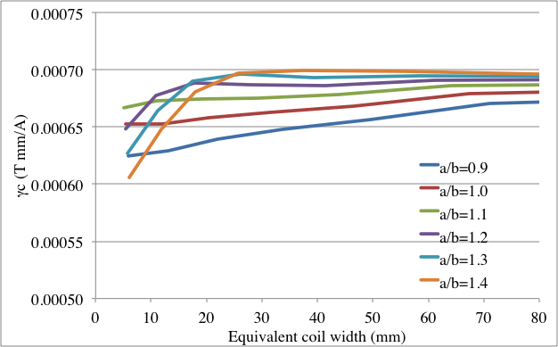
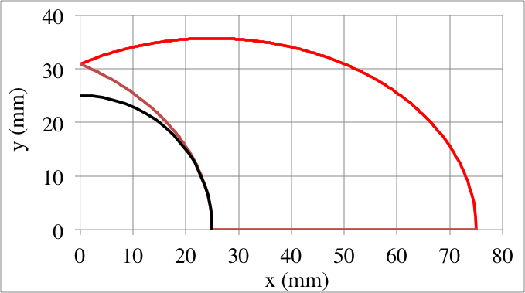
COIL EFFICIENCY COMPUTATIONS
We first compute the efficiency of intersecting ellipses for an aperture radius of 25 mm
  One can select the best ratio between the axes, and finds efficiencies between 6.7 and 7.0×10⁻⁴ T mm/A – a bit larger than the sector coil … but not windable
    In the figure on the right, the optimal case for a 40 mm coil width is shown (the ideal for a ∼12 T dipole)
6.9
6.6
6.28
The most efficient case for 25 mm aperture and 40 mm width
Efficiency versus coil width for different ratio between axes

Slide 14
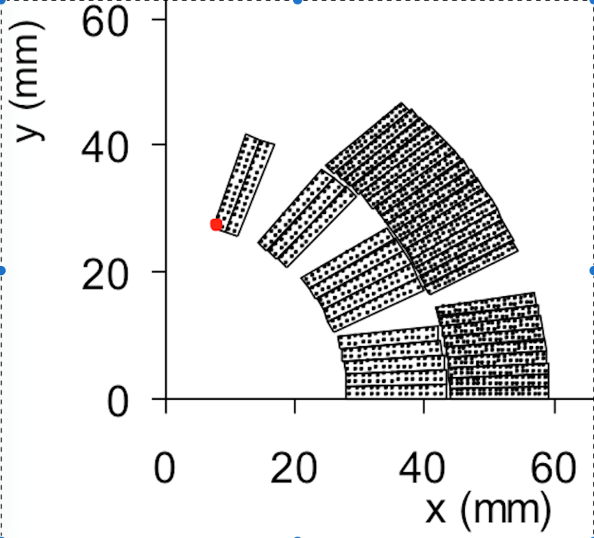
TWO REAL CASES
We carry out the computation for two real cross-sections
  Tevatron dipole: 6.89×10⁻⁴ T mm/A (without iron)
  LHC dipole: 6.57×10⁻⁴ T mm/A (without iron, without double aperture, and assuming the same current density in the inner and in the outer)
Tevatron main dipole coil
LHC main dipole coil

Slide 15
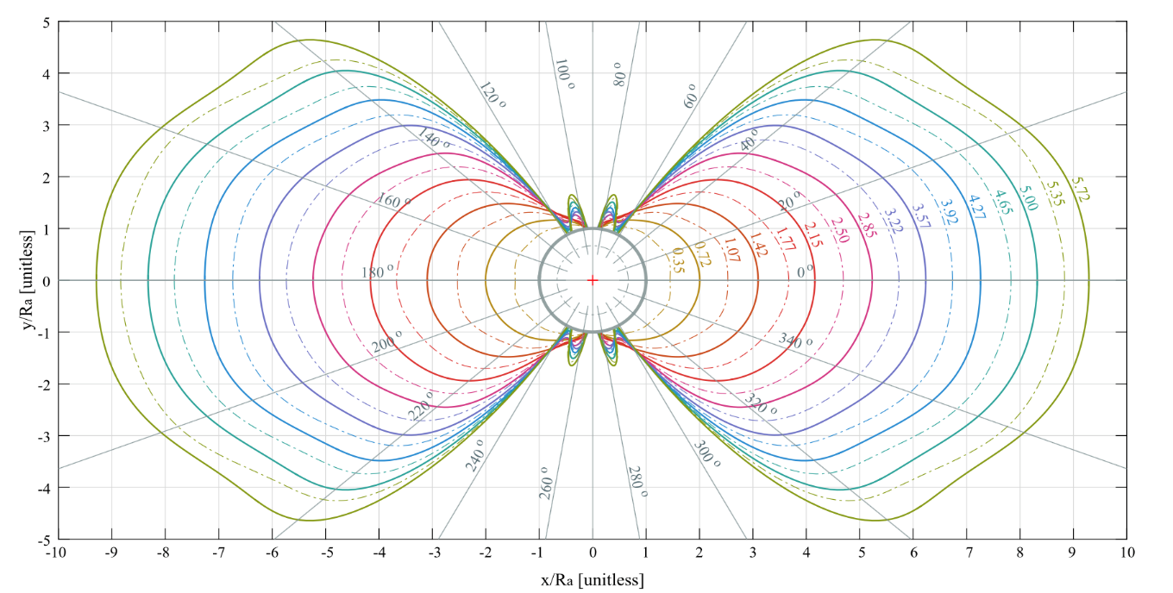
THE BEST POSSIBLE SHAPE
In 2017, J. v. Nugteren solves the problem of finding the best possible efficiency via a numerical code
  Shapes are first similar to intersecting ellipses, and then tend to a blockish shape for larger widths
  Last year, I estimated the efficiency of Jeroen shapes, finding values between 7.1 and 7.3×10⁻⁴ T mm/A – few percent above intersecting ellipses
  Even though the shapes are not windable, this gives a solid ground to say that one cannot do much better
Most efficient shapes of coil (J. v. Nugteren IEEE TAS 28 (2017) 4000205

Slide 16
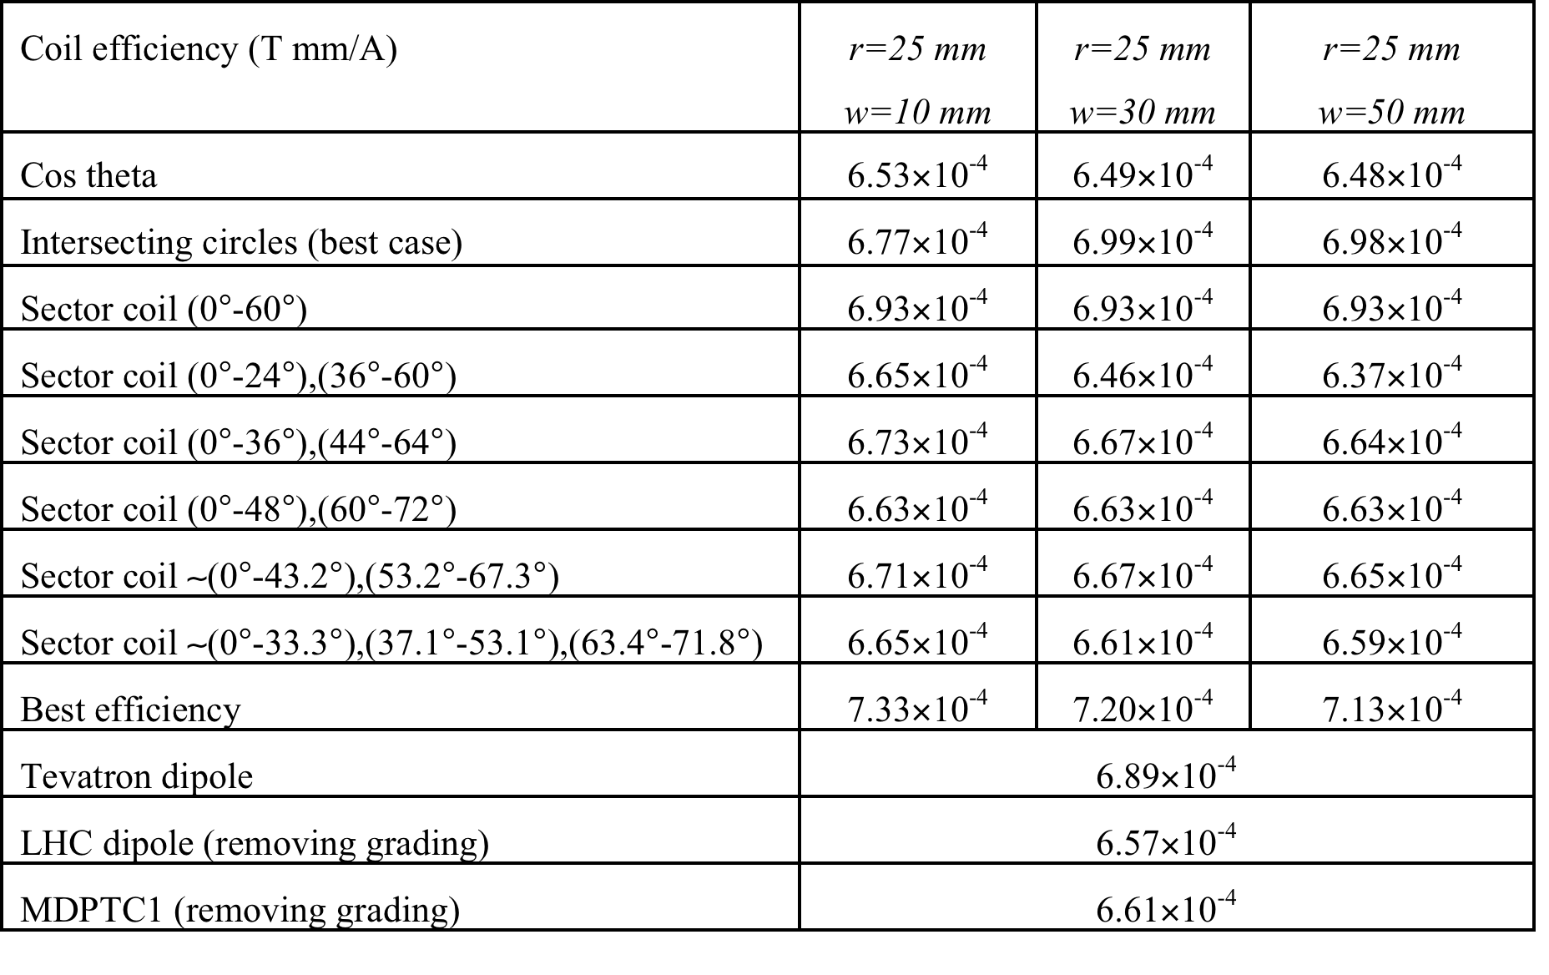
COIL EFFICIENCY SUMMARY
We consider an aperture radius of 25 mm, and 3 coil widths: 10, 30 and 50 mm
  For windable sector coil, with field quality, 6.6×10⁻⁴ T mm/A can be achieved, about 10% lower than the theoretical maximum

Slide 17
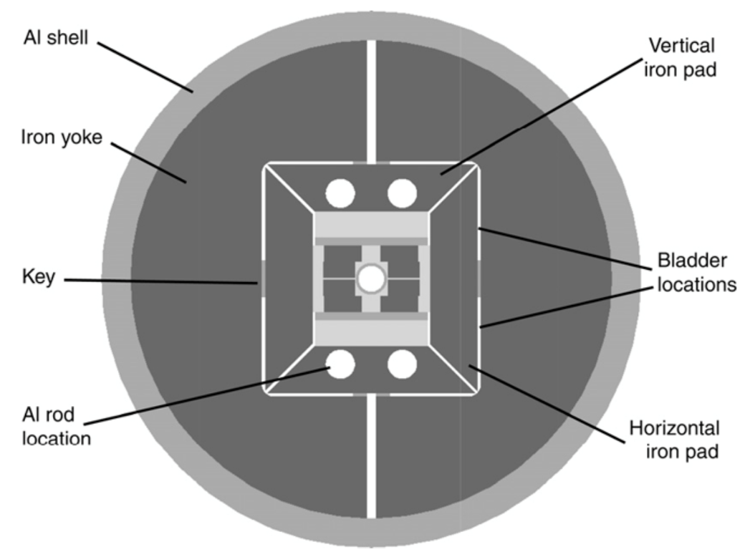
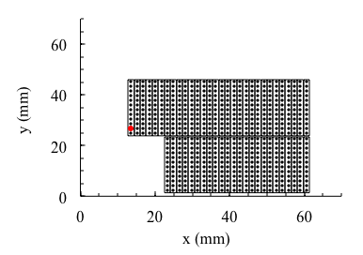
SOMETHING ABOUT BLOCK EFFICIENCY
We conclude with estimation of three block coils
  HD2: Nb₃Sn dipole, 35 mm aperture, 45 mm coil width: coil efficiency is 5.9×10⁻⁴ T mm/A (10% lower than our 6.6 benchmark)
  This magnet had the record of 13.4 T in Nb₃Sn (at 4.5 K, never tested at 1.9 K)
HD2 dipole cross-section (G. L: Sabbi et al, )
HD2 dipole coil cross-section

Slide 18
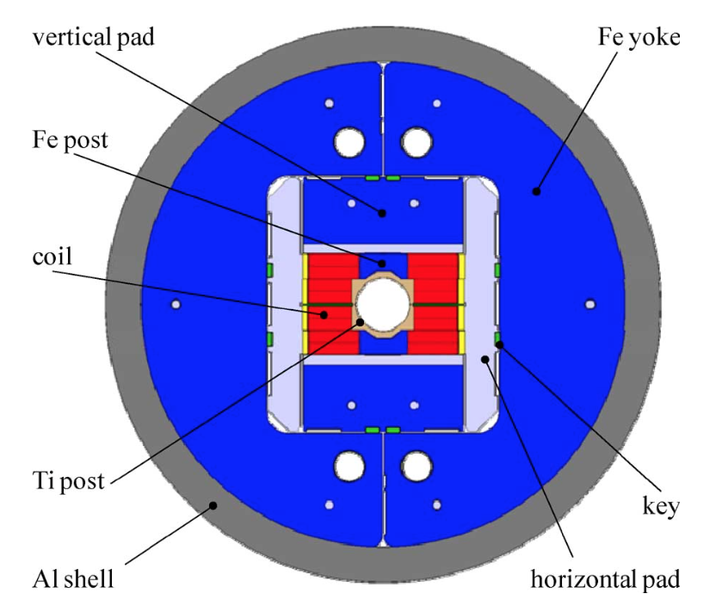
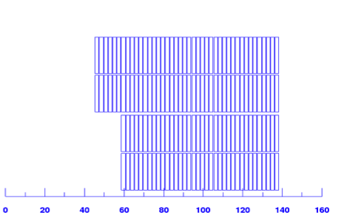
SOMETHING ABOUT BLOCK EFFICIENCY
We conclude with estimation of three block coils
  Fresca2: Nb₃Sn, 100 mm aperture, 80 mm coil width: coil efficiency is 6.1×10⁻⁴ T mm/A (7% lower than than our 6.6 benchmark)
  New record for accelerator magnets of 14.5 T
Fresca2 dipole cross-section (G de Rijk et al, )
Fresca2 dipole coil cross-section

Slide 19
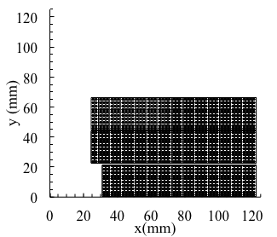
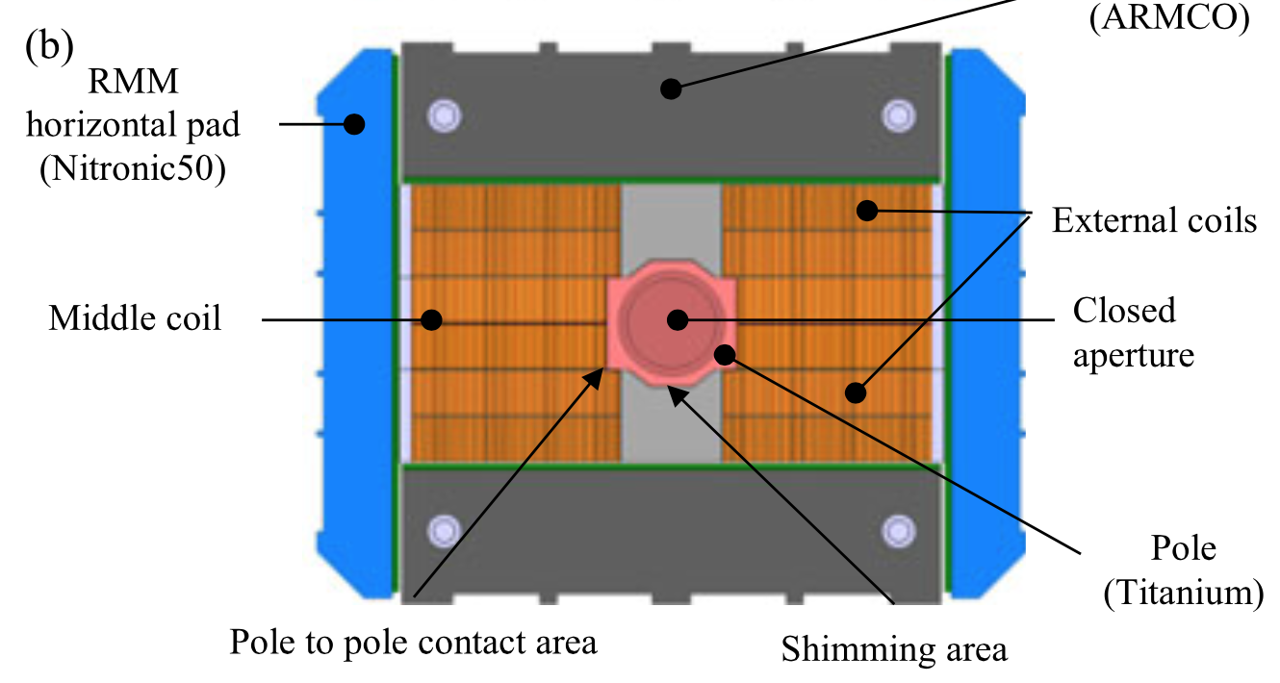
SOMETHING ABOUT BLOCK EFFICIENCY
We conclude with estimation of three block coils
  RMM: Nb₃Sn, 50 mm aperture, 100 mm coil width: efficiency is 6.4×10⁻⁴ T mm/A (3% lower than sector)
  Record of 16.5 T but this magnet does not include the complexity of the coil heads

Slide 20
A FINAL RECALL
Recall on how to compute coil efficiency
  Calculate the area of the insulated cable – multiply by the number of turns - and multiply by four to get the cross-section A of the insulated cable (excluding wedges) – use mm²
  Compute the equivalent coil width with the equation
  where r is a aperture radius (mm)
  Take a Roxie model, remove the iron, grading, double aperture, place 1 A/mm² of current density in the insulated cable – compute numerically the field B
  The coil efficiency is
    If you get around 6.6×10⁻⁴ T mm/A you made a good work
    If you get around 6.0×10⁻⁴ T mm/A you could improve or you have a difficult case (very large cable w.r.t aperture for instance)
    If you get a very different number you made a wrong calculation

Slide 21
CONCLUSIONS
Conclusion on coil efficiency
  We find that given the constraints of field quality, windability, etc., in a sector coil and in a block coil the efficiency does not vary by more than ±5% - at first order, most of the coil lay-outs have the the same efficiency
    I do not have results for common coil (to be done)
    The benchmark value is 6.6×10⁻⁴ T mm/A
  However, variation of order of ±5% can be found, and since with cents one can make millions, this should not be neglected when designing new magnets
  An exception is the canted cos theta lay-out, whose efficiency can be significantly lower (20% to 50%)
    More detailed analysis on the lectures on magnet design of May-October 2020, Unit 4 https://indico.cern.ch/event/915752/ (see the pdf notes https://indico.cern.ch/event/915752/attachments/2047343/4083420/Chapter4.pdf )

Slide 22
CONTENTS
Coil efficiency
  Optimizing field quality
  Coil efficiency definition and computation
Sensitivity of short sample field on design parameters

Slide 23
HOW TO BUILD THE LOADLINE
What we showed is just the first step (coil only)
Then you have the iron contribution
  For instance about 18% in the LHC dipole, Δ_{I}=1.18
And if you have a two-in-one, the contribution of the other aperture
  Positive for fields in opposite direction (as in the LHC main dipoles), negative for fields in same direction (as in HL-LHC recombination dipole D2)
And finally, only a fraction κ of insulated cable contains superconductor
Where filling factor depends on Cu ratio ν and typically ranges between 1/4 and 1/3

Slide 24
HOW TO BUILD THE LOADLINE
The critical surface can be linearized as
And one can solve to find the short sample field
j_{sc}
j_{sc}=s(b-B)
Note: the indicates the short sample
bore field, not the operational field
j_{sc,ss}
j_{sc}=B/(γ_{c}Δ_{l}Δ_{t}w_{eq}κ)
j_{sc}=B/(λγ_{c}Δ_{l}Δ_{t}w_{eq}κ)
B_{ss}
B_{p,ss}
b
B

Slide 25
THE FACTOR X
Typical questions of a sensitivity analysis
  If we increase 20% the cable width, how much we gain in short sample ?
  If we decrease the critical current of 10%, how much we lose in short sample ?
  Etc etc
An answer based on critical surface linearization:
Let us define the factor X as
Then one has
  λ is the ratio peak field bore field

Slide 26
THE FACTOR X
The factor X is a adimensional number, characteristics of the coil and of the superconductor
  Slope of critical surface divided by the slope of the loadline
Geometrically is just related to the angle between the loadline and the critical surface and it is 1 if they are perpendicular
j_{sc}
j_{sc}=s(b-B)
j_{sc,ss}
j_{sc}=B/(γ_{c}Δ_{l}Δ_{t}w_{eq}κ)
B_{ss}
b
B

Slide 27
THE FACTOR X
Larger and larger coil give larger and larger X
  Tevatron dipole (two layers 8 mm): 1.2
  LHC dipole (two layers 15 mm): 2.24
  Fresca2: 4 (block, 80 mm equivalent width): ∼5
Note: the indicates the short sample bore field,
not the operational field
j_{sc}
Nb-Ti
Nb₃Sn
MCBXF
LHC
FrescaII
B

Slide 28
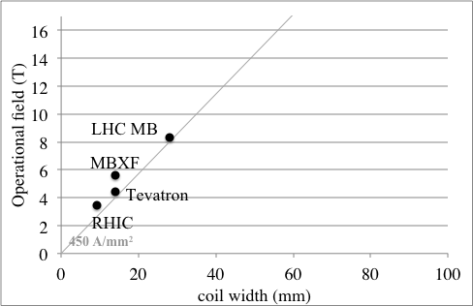
THE FACTOR X
Larger and larger coil give larger and larger X
  LHC dipole (two layers 15 mm): 2.24

Slide 29
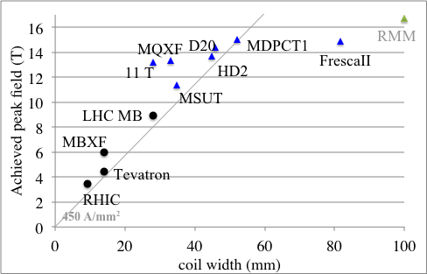
THE FACTOR X
Larger and larger coil give larger and larger X
Fresca2: 4 (block, 80 mm equivalent width): ∼5

Slide 30
DEPENDENCE OF SHORT SAMPLE
ON LOADLINE
Let make a derivative: one has
Any relative increase of X produces a relative increase of short sample field reduced by a factor (1+λX)
  Increasing X means increasing the slope of the loadline, i.e. 1) coil width 2) copper content 3) iron contribution 4) two-in-one contribition
j_{sc}
j_{sc}=s(b-B)
j_{sc}=B/(γ_{c}Δ_{l}Δ_{t}w_{eq}κ)
b
B

Slide 31
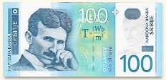
DEPENDENCE OF SHORT SAMPLE
ON LOADLINE
Example: 11 T has factor X of 2.6
  If we increase the strand width from 0.7 mm to 0.85 mm, keeping the same 40 strands, the coil width w_{eq} increases by 20%, and the short sample by 20%/3.6=5.6%
  Now the factor X has increased from 2.6 to 3.1 – if we further increase the strand from 0.85 to 1 mm (18%), the coil width w_{eq} increases by 18%, and the short sample by 18%/4.1=4.4%
This is well known effect: the last tesla are very expensive – but this approach allows quantifying all this

Slide 32
DEPENDENCE OF SHORT SAMPLE
ON CRITICAL SURFACE
A relative increase of the critical surface (for a fixed b) produces a relative increase of short sample field reduced by (1+X)
j_{sc}
j_{sc}=s(b-B)
j_{sc}=B/(γ_{c}Δ_{l}Δ_{t}w_{eq}κ)
b
B

Slide 33
DEPENDENCE OF SHORT SAMPLE
ON CRITICAL SURFACE
  On the other hand, an increase of b (indicative of B*_{c2}) is totally transformed in an increase of short sample field
j_{sc}
j_{sc}=s(b-B)
j_{sc}=B/(γ_{c}Δ_{l}Δ_{t}w_{eq}κ)
b
B

Slide 34
DEPENDENCE OF SHORT SAMPLE
ON COPPER RATIO
Example: the 12 T dipole of INFN collaboration assumes a 0.9 of copper ratio
  Factor X for this magnet can be around 3.0 (depending on iron , two in one, etc)
  If we go to 1.2 of copper, as in MQXF, we change the sc content from 1/1.9=0.526 to 1/2.2=0.455, i.e. a 14% decrease
  The short sample field will decrease by 14%/(1+3)=3.5%

Slide 35
SENSITIVITY ANALYSIS ON λ
The dependence on the ratio peak field/bore field is different
Going to higher and higher coil widths, what you gain in the peak field/central bore field ratio Δλ is nearly all gained by the short sample X/(1+X)
When you do high field magnets, optimize the ratio peak field bore field as much as possible
For example: if for a 12 T dipole, having X=3, we reduce the ratio peak field/bore field from 1.04 to 1.02 we increase the short sample field by
To obtain the same gain with a coil width increase, one would need 1.5%×4 = 6% large cable width, i.e. from 20 mm to 21.2 mm

Slide 36
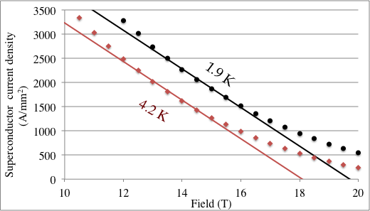
FIRST REMARK ON VALIDITY LIMITS: CRITICAL SURFACE SLOPE FOR NB₃SN
Nb₃Sn has a non negligible curvature of the critical surface
In the domain interesting for HL-LHC and 12 T dipole, slope is s~400 [A/(T mm²)]
  When you go to higher fields, slope decreases and therefore the X factor decreases (around 250 [A/(T mm²)] for 16-18 range)

Slide 37
SECOND REMARK ON VALIDITY LIMITS: NONLINEARITIES
This is an analysis based on derivatvces, and therefore valid for small variations of the parameters (order of 10-20% max)
Do not use for very large variation (e.g. doubling the coil width), since then also second order plaxs a role – in this case you can use the full equation on a spreadsheet
However, this analysis gives the main trends and an analytical insight on the mechanicsm ruling dependence of short sample field on all design parameters

Slide 38

A REMARK ON THE CONCEPT
OF ULTIMATE FIELD
The concept of ultimate field should be used with extreme care for accelerator magnets intended to be built in large quantities (main dipoles)
  Obviously, for a Nb-Ti dipole ultimate field is at 13 T, with a lot of coil and zero margin – but nobody is interested in this region for this application

Slide 39
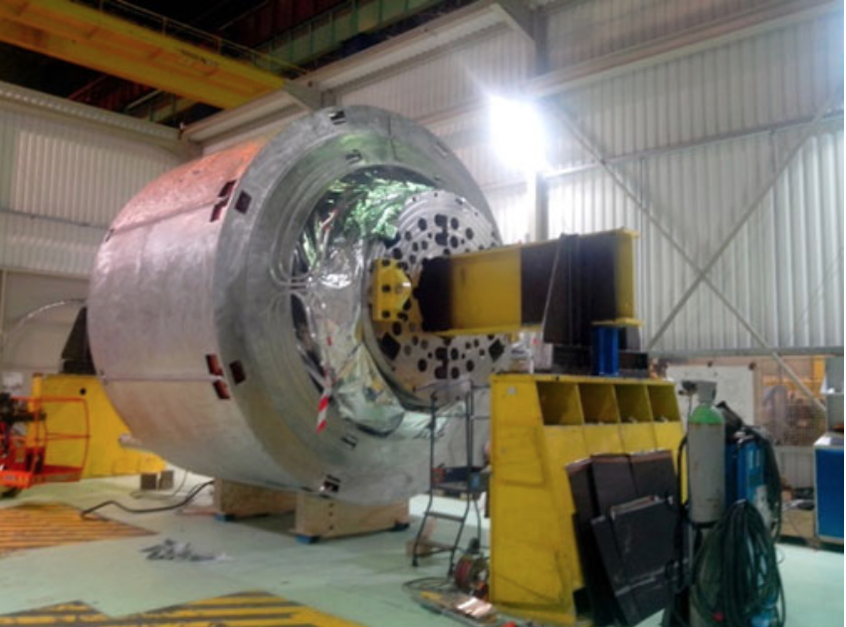
A REMARK ON THE CONCEPT
OF ULTIMATE FIELD
On the other hand, for other applications this can be interesting
  For instance, Iseult solenoid is operating at 11.7 T with all Nb-Ti coils (150 tons of magnet)
Iseult solenoid (L. Quettier, et al. IEEE TAS 30 (2020) 4400604)

Slide 40
CONCLUSIONS ON SENSITIVITY
We developed an analytical approach to the sensitivity of short sample parameters on design features
The problem can be solved defining a simple parameter (factor X) related to the angle between the loadline and the critical surface
This parameter is about 3 for a 12 T magnet, and grows linearly with the coil width
Each gain in the loadline given by larger coil width, less copper, more iron contribution, better critical surface, is weighted by 1/(1+X) – so higher fields are accessible but a a very high cost
In this design domain, minmizing the ratio peak field/bore field gives a direct improvement on short sample field

