Slide 1
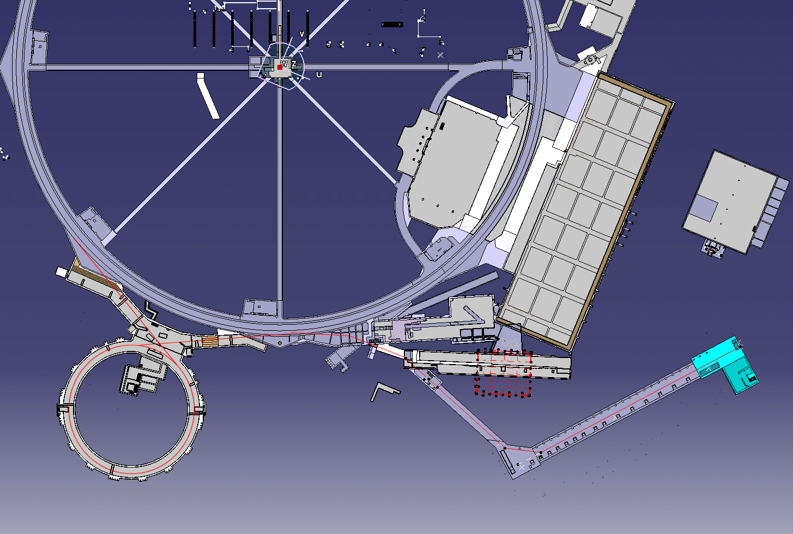
BI
LTB
LT
PSB
L4T
Linac 4
177.31 m from PIMS to foil: 69.83 m new line (to BHZ20) + 107.48 m present Linac2 line
Active elements : 4+2bendings; 16+18 quads, 11+11 steerers, 1 RF cavity

Slide 2
Coordination teams
LTP
LTB
BE/ABP-HSL
R.Scrivens
Linac2
PS Booster
Linac4
EN/MEF-LPC
J.Coupard
EN/MEF-ABA
N.Gilbert
4 access zones (Linac4, Linac2, inflector, PSB)

Slide 3
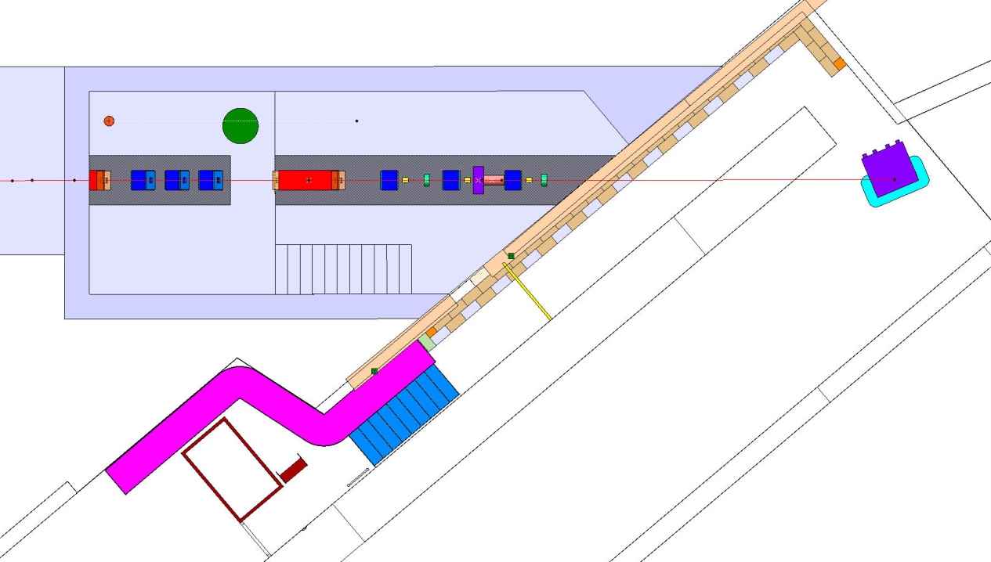
Coordination teams
buildings 400 and 410 (till the wall at the end of transfert tunnel Transfert line)
EN/MEF-LPC
Julie Coupard
Serge Grillot
Building 363, LTP and LTB line
BE/ABP-HSL
Richard Scrivens
Cristiano Mastrostefano

Slide 4
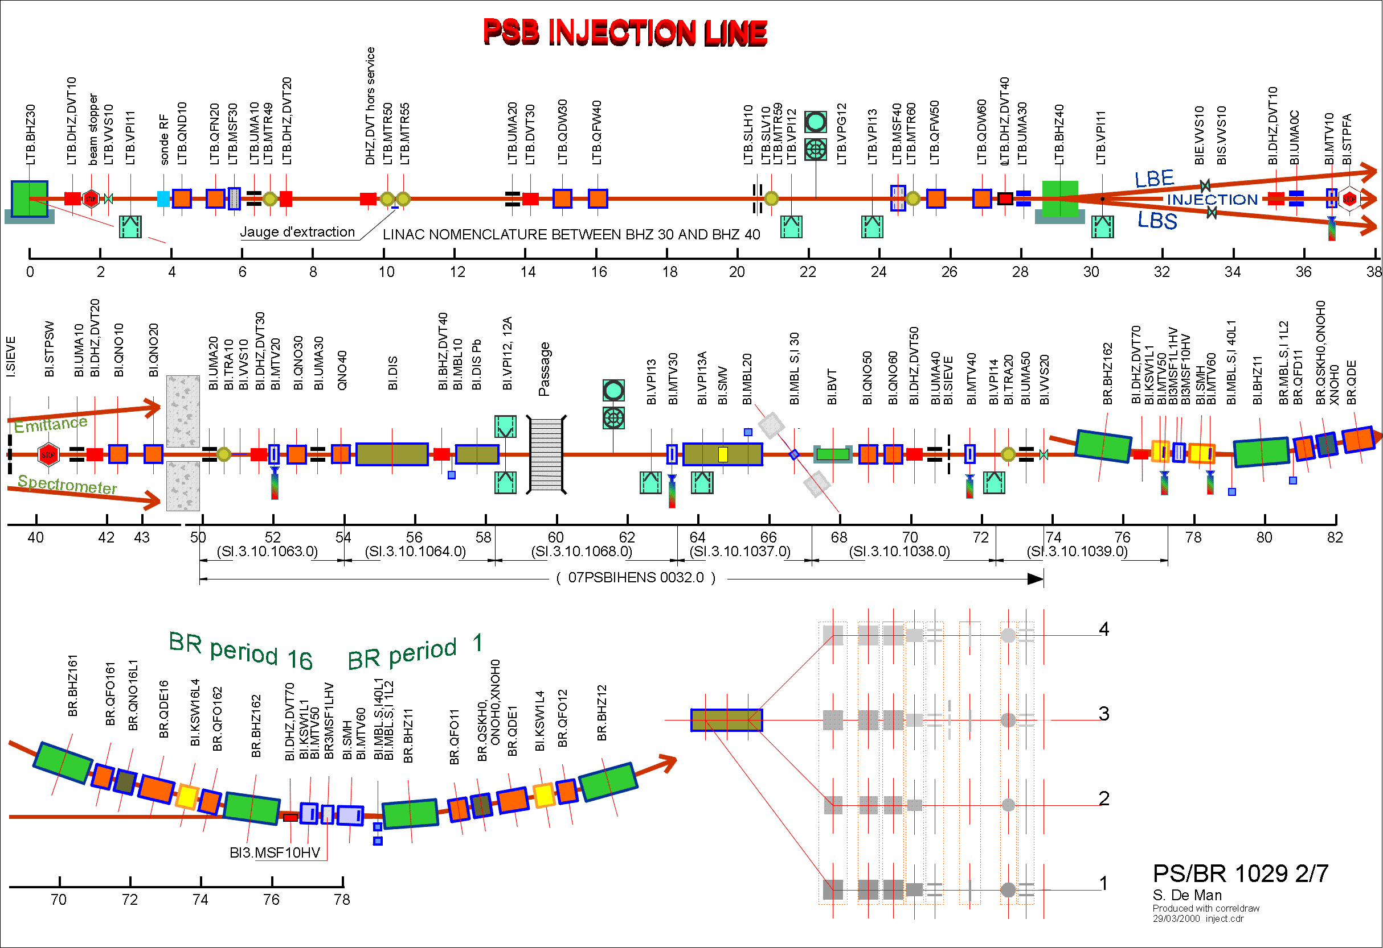
present limit

Slide 5
PRESENT LIMITS OF TRANSFER LINE LINAC4/PSB:
Beam optics: to stripper foil (AL)
Installation, coordination: to PSB wall
No reason to have a common boundary at the distributor flange:
1. zoning (common line would extend over 2 access zones).
2. coordination responsibility.
3. control system and naming (existing limit LTB/BI).
4. elements bw. present boundary and distributor are used by the PSB operators for matching to PSB and alignment on distributor.
In any case, linac beam optics goes further than the distributor…

Slide 6
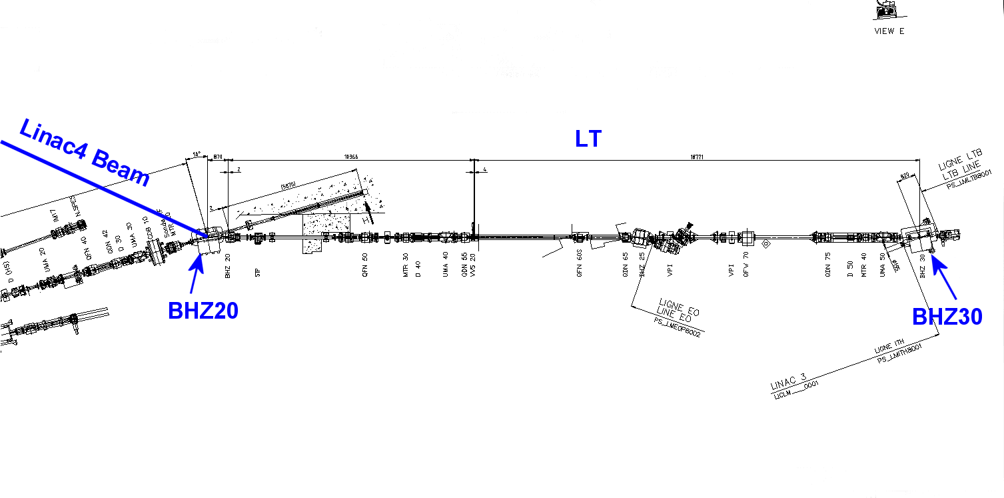
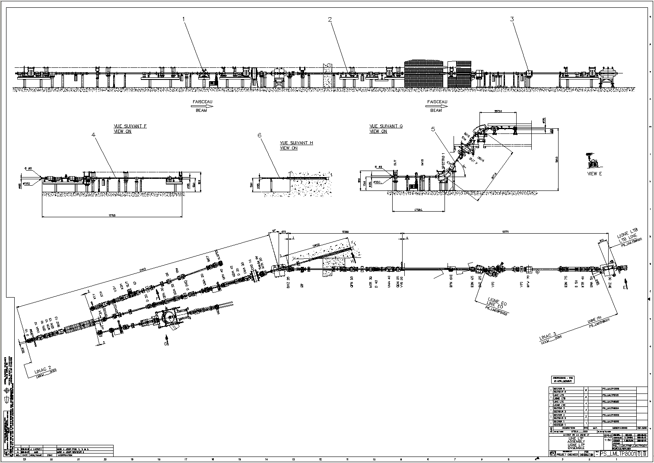

Slide 7
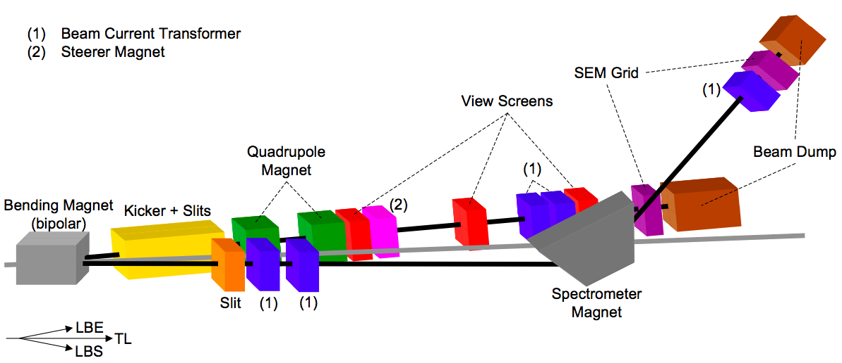
Measurement lines LBE, LBS
LBE:
  Layout fixed. Compatible with ion operation.
  Laser scanning done to prepare an integration drawing.
  Equipment specifications provided; EDMS document released.
Still to be done before installation:
  Final screen and camera design (same as for Linac4 dump line), equipment and support drawings and layout.
  Add water-cooling to quadrupoles, exchange power converters
  Move steerer dipole.
  Dump design.
  Beam pipes.
LBS:
  Layout proposed, compatible with ion operation. To be adapted in case slit dimensions and equipment positions (dump!) change.
  Equipment specifications partially provided (depend on final layout); EDMS document on beam dump specifications has been released, slit specifications under approval.
  Laser scanning done to prepare an integration drawing.
Still to be done before installation:
  Propose slit and dump designs, check compatibility with RP restrictions.
  Finalize SEM grid and spectrometer magnet specifications.
  Integration drawings needed in addition to layout drawings.
  Prepare software application.
  Solve problem of lifting existing/new equipment over BI line.

Slide 8
Responsibilities
Coordination of installation: ok (J. Coupard, R. Scrivens/C. Mastrostefano)
Layout to be frozen beginning 2011
General coordination (beam parameters, consistency, progress): C. Carli (was S. Maury)
Beam optics: A. Lombardi
Measurement lines: B. Mikulec (Th. Hermann)
Magnets: Th. Zickler
Power supplies: D. Nisbet
Vacuum: G. Vandoni
Diagnostics: U. Raich
Question of the Pakistani contribution: design will be integrated with design office, but who will supervise the (potential) construction?

Slide 9
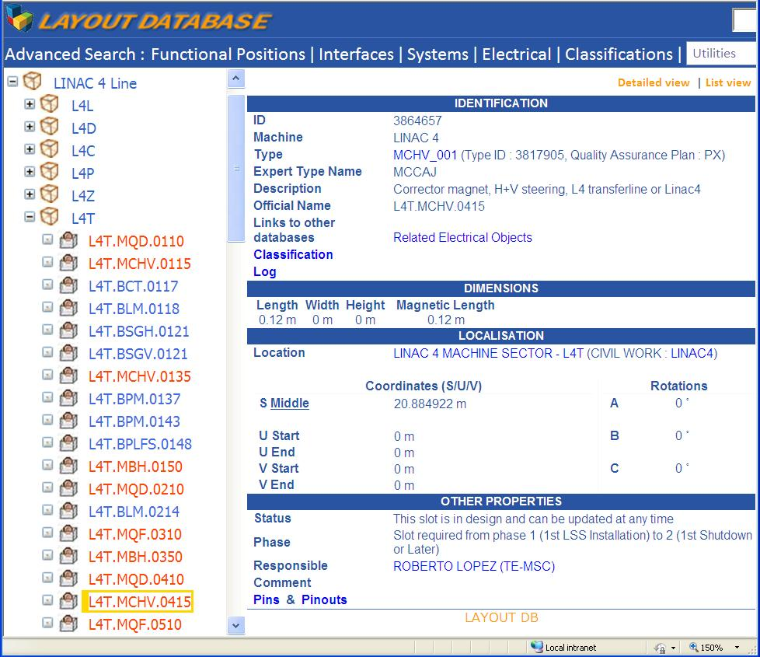

Slide 10
L4 Project meeting
The LINAC4 machine and the PSB had their own review several years ago. The part between LINAC4 and the PSB was never reviewed.
During the construction of the LINAC4 building a new LINAC2 building wall has been discovered with a direct impact on the position of quadrupoles and instrumentation of the transfer line.
A designer to start working at the beginning of 2011 is strongly desired in order to be ready for installation at the end of 2012.
C. Carli has kindly accepted to take the responsibility of the transfer line as from January 2011.
10
10

Slide 11
Conclusion1
The coordination/installation teams have been precise for each different sector of the LINAC4 project :
EN/MEF-LPC takes the responsibility of the coordination and installation inside the new Linac4 building, the new transfer line until BHZ20 in the LINAC2 building.
BE/ABP-HSL takes the responsibility of the in-situ coordination and installation or modification between BHZ20 and the PSB separation wall with the general coordination under EN/MEF-LPC responsibility.
EN/MEF-ABA takes the responsibility of the coordination and installation or modification of the PSB machine after the separation wall.

Slide 12
Conclusion2
The positions of the Pick-Ups and the BCT, before BHZ20, should be redefined.
3D scans between Linac2 and PSB are vital to provide accurate and complete view of the environment.
All the drawings released for production should be completed by the end of 2012, the requests have to be addressed to the design office by the end of 2010.
For all the different parts of the transfer line (L4T, LT, LTB, BI, LBE/LBS, PSB injection), an exhaustive list of the equipments, their responsible person, the deliverables and deadline should be built as soon as possible.

Slide 13
Conclusion3
Up to now there is no technical show-stoppers or specific difficulties of the design of the transfer line magnet.
3D CAD model and 2D specification drawings and design for magnets will be complete by April 2011 (but needed now to make a hole in L2 Building?).
  The collaboration with Pakistan will be reactivated in order to start the drawings under MME supervision in April 2011.
Some clarifications on dump and slit design and position are still needed in order to finalize the design and the integration of the LBS line.
There is a lift problem for the installation of the LBS line, a visit of the zone is organized.

Slide 14
Conclusion4
Procurement of flanges, bellows and raw pipes, as well as the definition of apertures, instrumentation interfaces and magnet chamber shape should be done as soon as possible.
18 powering solutions should be defined (waiting for magnet parameters) and resources allocated.
A proposal for the racks installation in 361-1-12 is still need to be confirmed.
Integration studies are required for BS[1,2,3,4] the 4 bending magnets around the stripper foil chicane.

Slide 15
Conclusion5
A strategy needs to be defined for the production of the supports and vacuum chamber in Pakistan:
Pakistan+MME should complete the drawings by the end of 2011
Construction should proceed in 2012 with delivery in dec/2012
If not, CERN WS in 01/2013
The project management should confirm beam loss assumptions taken into account in the design. The radiological aspects of the H0/H- dump for the PSB should be studied.
Important to have all the RP information as soon as possible.

Slide 16
Schedule
The new installation planning has been presented. In order to avoid any interference with the LINAC2 runs, some shutdown periods have been indentified for possible installation. The modification in the existing transfer line and the upgrade of the PSB are depending of the General Schedule and will be precise at the next LHC workshop in January 2011. For the moment, the earliest date for transfer line readiness is beginning of 2013.
The coordination teams have been precise for each different sector of the LINAC4 project :
EN/MEF-LPC takes the responsibility of the coordination and installation inside the new Linac4 building, the new transfer line until BHZ20 in the LINAC2 building.
BE/ABP-HSL takes the responsibility of the in situ coordination and installation or modification between BHZ20 and the PSB separation wall and the general coordination is under the responsibility of EN/MEF-LPC.
EN/MEF-ABA takes the responsibility of the coordination and installation or modification of the PSB machine after the separation wall.
16
16

Slide 17
Optics
    The new Linac4 transfer line optics has been presented: two quadrupoles doublets were replaced by a triplet and the buncher cavity was moved downstream. The bottlenecks of the line are the distributor, RF cavity and the septum magnet. The new transfer line will be send for the integration.
The static alignment errors can be corrected with the steerers and the jitter in the bending power supplies should be below 10-4.
17
17

Slide 18
Integration
      All the positions of equipments are now defined.
  The LTP, LTB and LBI lines will be modified and some elements will be inserted. Only 2D AUTOCAD drawings are available for these lines. Some 3D scans are performed to provide accurate and complete view of the environment.
  The positions of the Pick-Ups and the BCT, before BHZ20, should be redefined.
  As the energy of the beam is different of the present Linac2, a decision about the removal of the C-collimators installed in the present transfer line should be taken soon (next BCC meeting).
18

Slide 19
Design Office Plans
For all the different parts of the transfer line (L4T, LT, LTB, BI, LBE/LBS, PSB injection), an exhaustive list of the equipments, their responsible person, the deliverables and deadline should be built as soon as possible.
As all the drawings released for production should be completed by the end of 2012, the requests have to be addressed to the design office by the end of 2010.
It has been underlined that Design Office is not simply a drawing office and all drafting of mechanical designs not under Design Office responsibility will be carried out by sub-contractors following a procedure.
It has been reminded that the Design Office will be overloaded during the next years 2011 to 2013.
19

Slide 20
Magnet Status
For the new part of the transfer line, 5 bendings, 20 quadrupoles and 6 steering magnets are required. Detailed parameters list exists for all the magnets.
The 2D design for dipole and quadrupoles is available. The 3D magnetic design of the dipoles will be finished by the end of 2010. 3D CAD model and 2D specification drawings for dipole will be complete by April 2011.
In parallel, the 3D magnetic design of quadrupoles and correctors are prepared.
The tendering procedure will start in June 2011.
Up to now there is no technical show-stoppers or specific difficulties of the design of the transfer line magnet.
  All the supports and vacuum chambers of the transfer line will be designed and produced within the Pakistanese in-kind contribution. A provisional budget was allocated to face any major issue. The collaboration will be reactivated in order to start the drawings under MME supervision in April 2011.
20
20

Slide 21
Measurements and dump lines
  The design of the Linac4 dump line and LBE line are complete.
  Some clarifications on dump and slit design and position are still needed in order to finalize the design of the LBS line.
  An integration study is needed once the slit and spectrometer magnet design will have been finished.
  Specifications have been provided for the three dumps, the slit, quadrupoles and the emittance measurement screens. SEM grid and spectrometer magnet specifications need finalization once all equipment positions in the LBS line will be fixed.
  There is a lift problem for the installation of the LBS line, a visit of the zone is organized.
21

Slide 22
Power converters
  There are 130 power converters circuits between Linac4 and PS Booster (more than 50% will be installed or modified for Linac4 operation).
  18 powering solutions are not yet defined (waiting for magnet parameters) and resources have not been yet allocated.
  A proposal for the racks installation in 361-1-12 is still need to be confirmed.
  Integration studies are required for BS[1,2,3,4] the 4 bending magnets around the stripper foil chicane.
22

Slide 23
Status of vacuum
A draft layout for the vacuum in the L4T line already exists.
Still need to define the exact position of every vacuum objects with the integration team.
Procurement of flanges, bellows and raw pipes, as well as the definition of apertures, instrumentation interfaces and magnet chamber shape should be done as soon as possible.
A strategy needs to be defined for the production of the vacuum chamber in Pakistan.

Slide 24
Status of beam Instrumentation
A list of the available diagnostics in the transfer line has been presented.
The BCTs will be identical to the one used in Linac4 and the new electronics will be tested at the 3 MeV test stand.
According to energy deposition simulation, SEMGrids will be built with carbon wires.
The BSM (Feschenko) construction is almost finished.

Slide 25
Radio protection
  The higher part of the transfer tunnel will be classified as a supervised radiation area during LINAC2 operation.
  Temporary shielding on the LINAC2 side has to remain in place. The shielding requirements in the LINAC2-4 area for Linac4 operation will be specified by RP (end of 2010).
  The project management should confirm beam loss assumptions taken into account in the design. The radiological aspects of the H0/H- dump for the PSB should be studied.

