Slide 1

Role of the ILO
Portugal@CERN – June 20-21, 2022
José Antão (PT ILO)

Slide 2
Role of the ILO
CERN Financial Rules:
“The term 'Industrial Liaison Officer' (ILO) means a representative of a CERN Member state responsible, inter alia, for ensuring the proper contacts and flow of information between CERN and the firms in the Member State concerned".
In particular, ILOs shall:
raise awareness and transmit information to potential suppliers;
advise CERN about potential suppliers and contractors in their countries;
keep themselves informed about CERN’s procurement rules;
advise potential suppliers and contractors on any general technical, organisational and procedural aspects of CERN;
promote the registration of potential suppliers in CERN’s supplier data base;
promote exchange of information and meetings;
encourage long-term participation of industry in CERN’s mission.

Slide 3

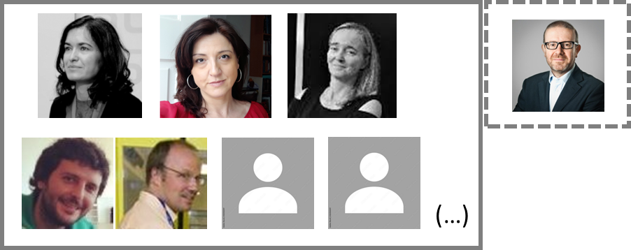
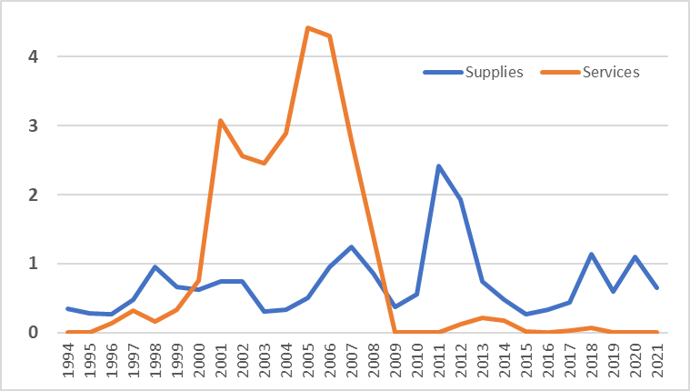
ILO supports Industry and CERN
ILO
CERN finds suitable suppliers and competition
Portugal balances Industrial Return for membership
Industrial Return coefficient (2017-2020)
Supplies: 0,82 (target = 1);
Services: 0,03 (target = 0,4).
Portuguese Industry

Slide 4
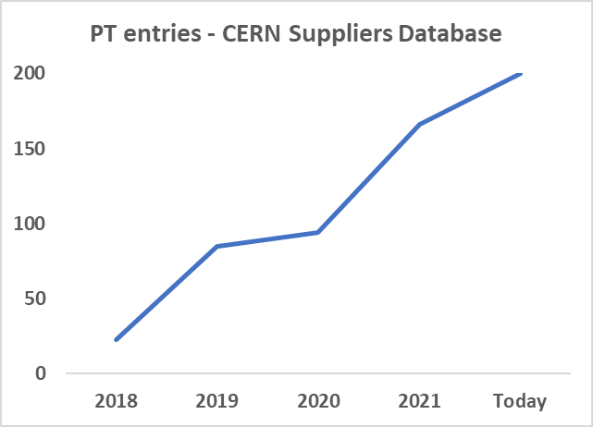

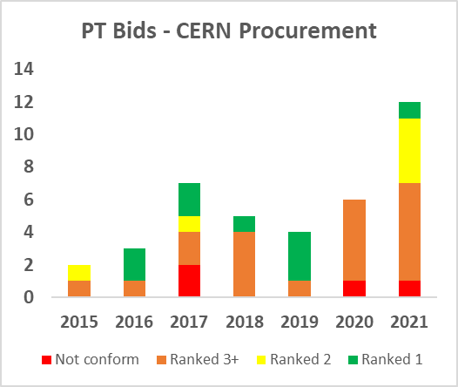
Some good-looking trends
Number of Portuguese entries in CERN Supplier Database grew almost 10X in 3 years (now 200);
2021 was the record year for Portuguese ranked bids in Price Enquiries and Invitations to Tenders (1 ranked 1st, 4 ranked 2nd);

Slide 5
This AM session – short-term
CERN Financial Rules:
“The term 'Industrial Liaison Officer' (ILO) means a representative of a CERN Member state responsible, inter alia, for ensuring the proper contacts and flow of information between CERN and the firms in the Member State concerned".
In particular, ILOs shall:
raise awareness and transmit information to potential suppliers;
advise CERN about potential suppliers and contractors in their countries;
keep themselves informed about CERN’s procurement rules;
advise potential suppliers and contractors on any general technical, organisational and procedural aspects of CERN;
promote the registration of potential suppliers in CERN’s supplier data base;
promote exchange of information and meetings;
encourage long-term participation of industry in CERN’s mission.

Slide 6

What is CERN to your company
CERN can be a strategic client, but it will often be just a client – lowest compliant bids;
The “CERN Supplier” claim is useful for any company.
Many future industrial needs are now being researched and developed – some with the involvement of industry
CERN is part of a wider market of “Big Science” organizations
Combined, the capabilities of Portuguese Research organizations and industry could develop some of the most technologically advanced systems for CERN (et al.);
Use these 2 days to look around, inquire, discuss; see where you could fit.

Slide 7
Obrigado
jose.antao@ani.pt

Slide 8
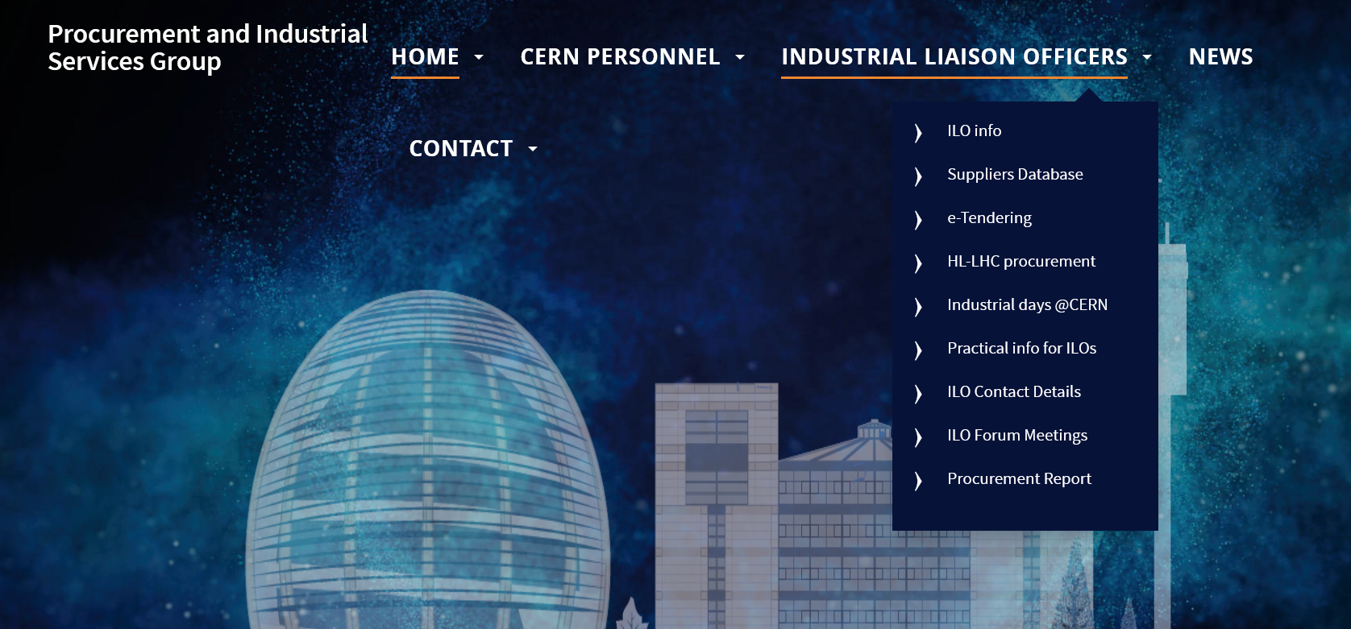
ILOs have access to information
Data from past and ongoing procurement procedures
Beefed-up version of Suppliers Database
Documentation from all past ILO Forum meetings (2/year)
Procurement Reports
https://procurement.web.cern.ch/

Slide 9
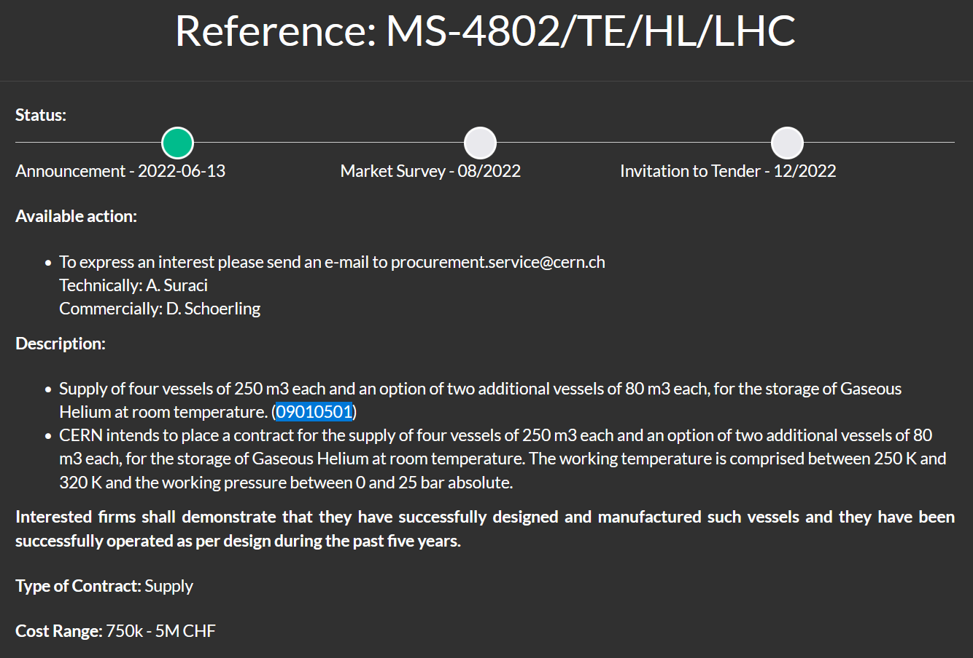
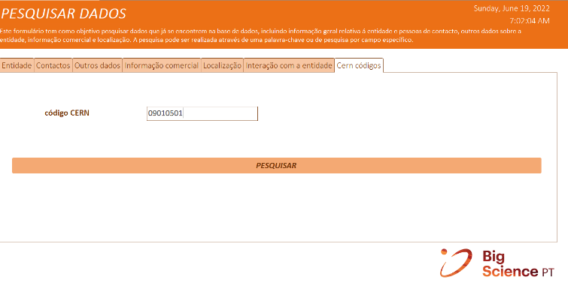



ILO tools – national ecosystem
09010501: Pressure vessels (> 0.5 bar)

