Slide 1
MP3 report : W49
(6 slides, 6’)
Since oral report last week (24th of November)
J.Ph Tock for the MP3 team

Slide 2
Minor actions (1/2)
25/11: RQ9.R2 Trip
Caused the entire sector 23 to go down.
The quench loop opened.
No correlation with beam loss (Q9) but not 100 % coverage of BLMs
Clear symmetric voltage increase then asymmetric behaviour so threshold crossed and quench heaters were fired.
This is clearly a quench signal of the circuit but not the magnet
It was on B1 so coherent with debris coming from ALICE
26/11: Sector 8-1 trip.
The quench loop opened but no detector showed a signal
No PM file created
No QH fired
Not a spurious opening of the EE
Origin not traced
27/11: RCBCV7.L2B2
Issue with the power converter / solved by EPC piquet with access

Slide 3
Minor actions (2/2)
29/11 (S67 & 78) + 30/11 (S34 but no effect)
For Sector 67: DQAMCMB in B9L7, sent at 07:44:25.605 (During Squeeze)
For Sector 78: DQAMCMB in B9R7, sent at 03:31:30.836 (During Stable Beams)
The super-lock was effectively initiated in both cases by the automated powering analysis server. The origin of the circuit-lock is for both events the reception of a QPS buffer from a local quench detector on a main dipole magnet:
Location suggests a link with beam losses
The super-locking mechanism has been disabled, the server will continue to run in 'monitor' mode until the reason of the spurious data sending is understood/fixed or a more refined logic has been implemented.
It was the case in S34 this night
The analysis module will be improved, avoiding superlocking if beam is in.
Will be useful for later operation

Slide 4
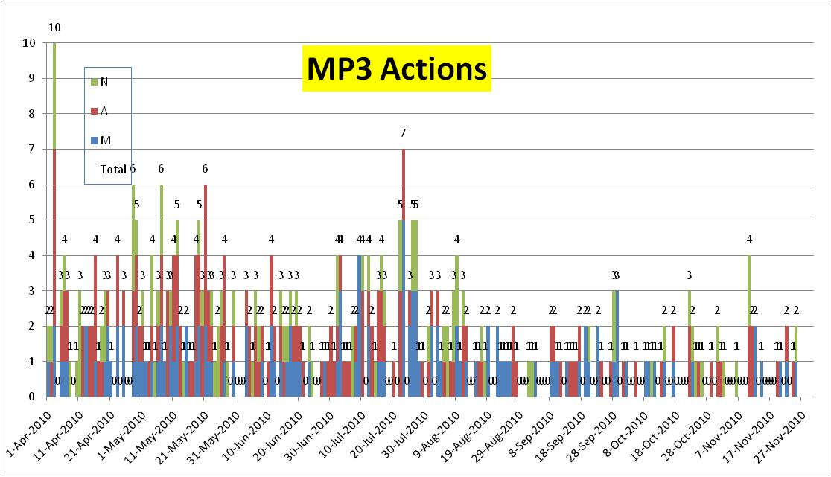
Average: 1.6/24h, stabilized
Technical Stops – Recovery from TS

Slide 5
Parallel activities
Review of procedures for re-commissioning and inventory of specificities
13 kA:
RB draft available, to be complemented ;
RQ to be done but similar (no snubber capacitors)
IPQ:
Draft available
IPD:
Draft available, some minor corrections to include, no specificity
IT:
No change; possibility of special tests to be discussed with EPC
600A:
List of specificities updated
60-80-120 A :
Draft available

Slide 6
Conclusions
Relatively quiet week for MP3
Limited downtime due to QPS
Procedures for recommissioning after Christmas break are well on track (priority on beg 2011)
MP3 working mode to be adapted
Thank you for your attention

