Slide 1
CHUV Test Film Processing
Wilfrid Farabolini
March 22

Slide 2
Irradiated films
 | 22/03 Batch 1 |  | 22/03 Batch 2 |  | 23/03 Batch 1 |  | 23/03 Batch 2 |  | 23/03 Batch 3 | 24/03 ZFE
1 | N 01/02 |  | O 01/02 |  | J 13/14 |  | J 29/30 |  | K 09/10 | D 01/02
2 | N 03/04 |  | O 02/03 |  | J 15/16 |  | J 31/32 |  | K 11/12 | D 03/04
3 | N 05/06 |  | O 02/03 |  | J 17/18 |  | J 33/34 |  | K 13/14 | D 05/06
4 | N 07/08 |  | O 02/03 |  | J 19/20 |  | I 31/32 |  | K 15/16 | D 07/08
5 | N 09/10 |  | O 02/03 |  | A 15/16 |  | B 19/20 |  | K 17/18 | D 09/10
6 | N 11/12 |  | O 02/03 |  | A 17/18 |  | B 21/22 |  | K 19/20 | D 11/12
7 | N 13/14 |  | O 02/03 |  | A 19/20 |  | B 23/24 |  | K 21/22 | D 13/14
8 | N 15/16 |  | O 02/03 |  | A 21/22 |  | B 25/26 |  | K 23/24 | D 15/16
9 | N 17/18 |  | O 02/03 |  | A 23/24 |  | B 27/28 |  | K 25/26 | D 17/18
10 | N 19/20 |  | O 02/03 |  | A 25/26 |  | B 29/30 |  | K 27/28 | D 19/20
11 | N 21/22 |  | O 02/03 |  | A 27/28 |  | B 31/32 |  | K 29/30 | D 21/22
12 | N 23/24 |  | O 02/03 |  | A 29/30 |  | B 33/34 |  | K 31/32 | D 23/24
13 | N 25/26 |  | O 02/03 |  | A 31/32 |  | C 01/02 |  |  | D 25/26
14 | N 27/28 |  | O 02/03 |  | J 21/22 |  | K 01/02 |  |  | D 27/28
15 | N 29/30 |  | O 02/03 |  | J 23/24 |  | K 03/04 |  |  | D 29/30
16 | N 31/32 |  | O 02/03 |  | J 25/26 |  | K 05/06 |  |  | D 31/32
17 | N 33/34 |  | O 33/34 |  | J 27/28 |  | K 07/08 |  |  | D 33/34
18 | M 24/25 |  | A 01/02 |  | A 34/35 |  | C 03/04 |  |  | E 01/02
19 | M 26/27 |  | A 03/04 |  | B 01/02 |  | C 05/06 |  |  | E 03/04
20 | M 29/28 !! |  | A 05/06 |  | B 03/04 |  | C 07/08 |  |  | E 05/06
21 | M 30/31 |  | A 07/08 |  | B 05/06 |  | C 09/10 |  |  | E 07/08
22 | M 32/33 |  | A 09/10 |  | B 07/08 |  | C 11/12 |  |  | E 09/10
23 | M 34/35 |  | A 11/12 |  | B 09/10 |  | C 13/14 |  |  | E 11/12
24 | N 34/O 35 |  | A 13/14 |  | B 11/12 |  | C 15/16 |  |  | E 13/14
25 | H 32/33 |  | I 25/26 |  | B 13/14 |  | C 17/18 |  |  | E 15/16
26 | H 34/35 |  | I 27/28 |  | B 15/16 |  | C 19/20 |  |  | E 17/18
27 | I 22/23 |  | I 29/30
31 | L 13/14 |  | H 22/I 24 |  | B 17/18 |  | C 21/22

Slide 3
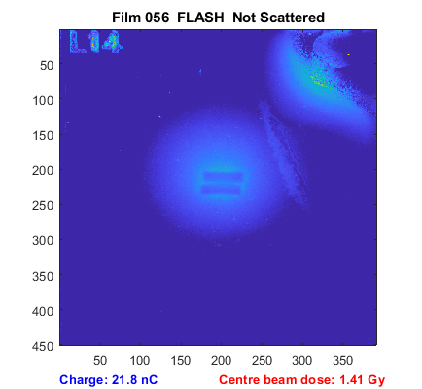
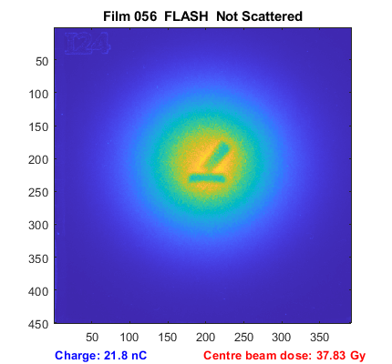
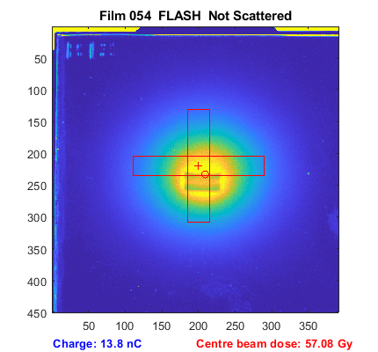
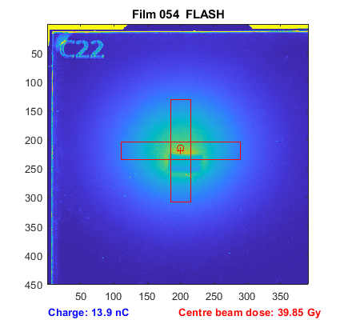
Beam position check

Slide 4
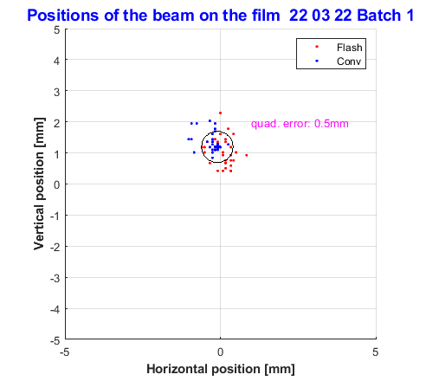
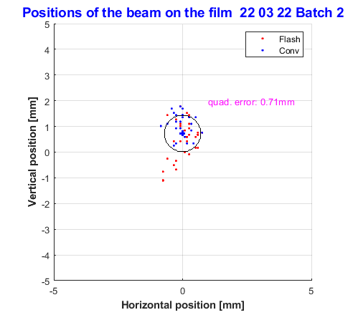
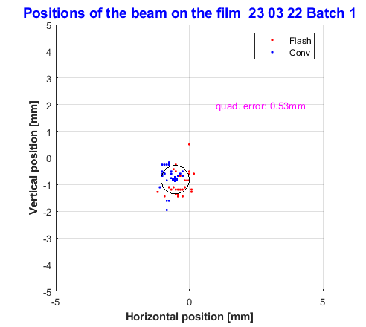
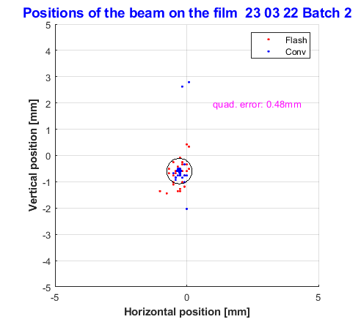
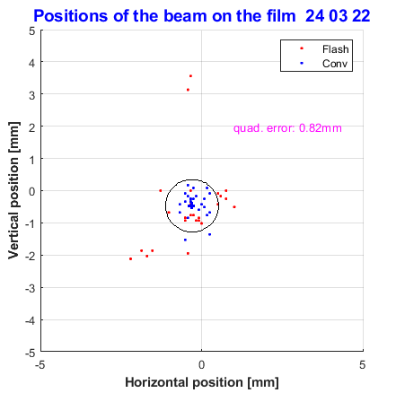
Beam position stability

Slide 5
Beam size and Dose 22 March 22

Slide 6
Beam Size and Dose 23 March 22

Slide 7
24 March 22 - ZFE

Slide 8
ZFE

