Slide 1



Dosimetry Results from CHUV March Experiments
Joseph Bateman, Vilde Rieker, Wilfrid Farabolini

Slide 2
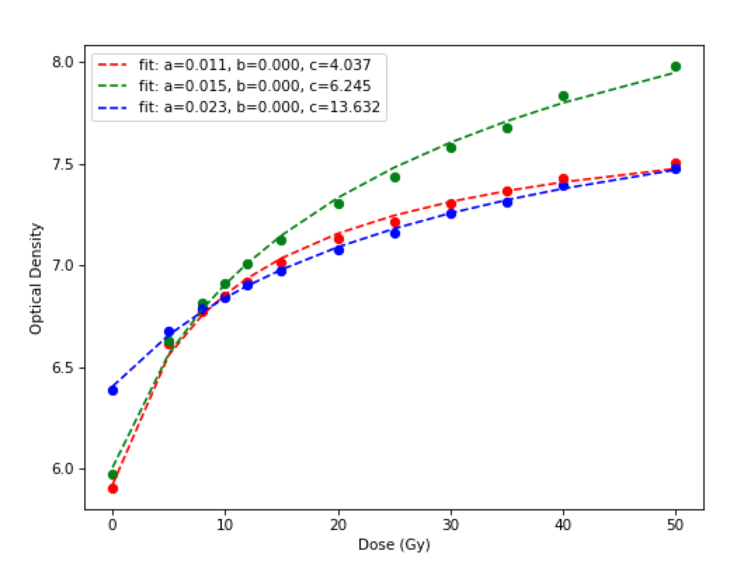
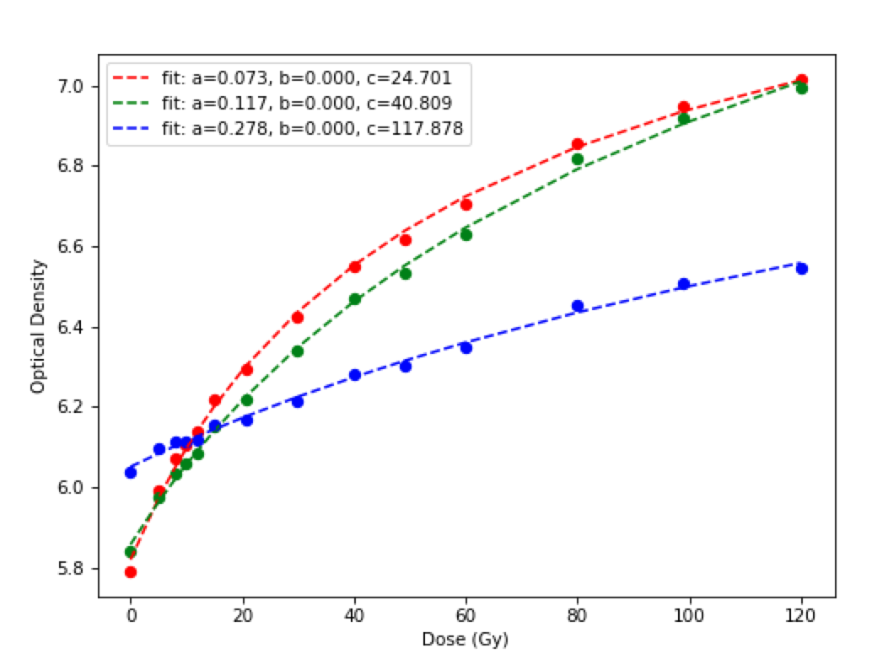
Calibration Curves
OD = (a + bD) / (c + D)
EBT3
OD = - log (PV/35655)
MDV3

Slide 3
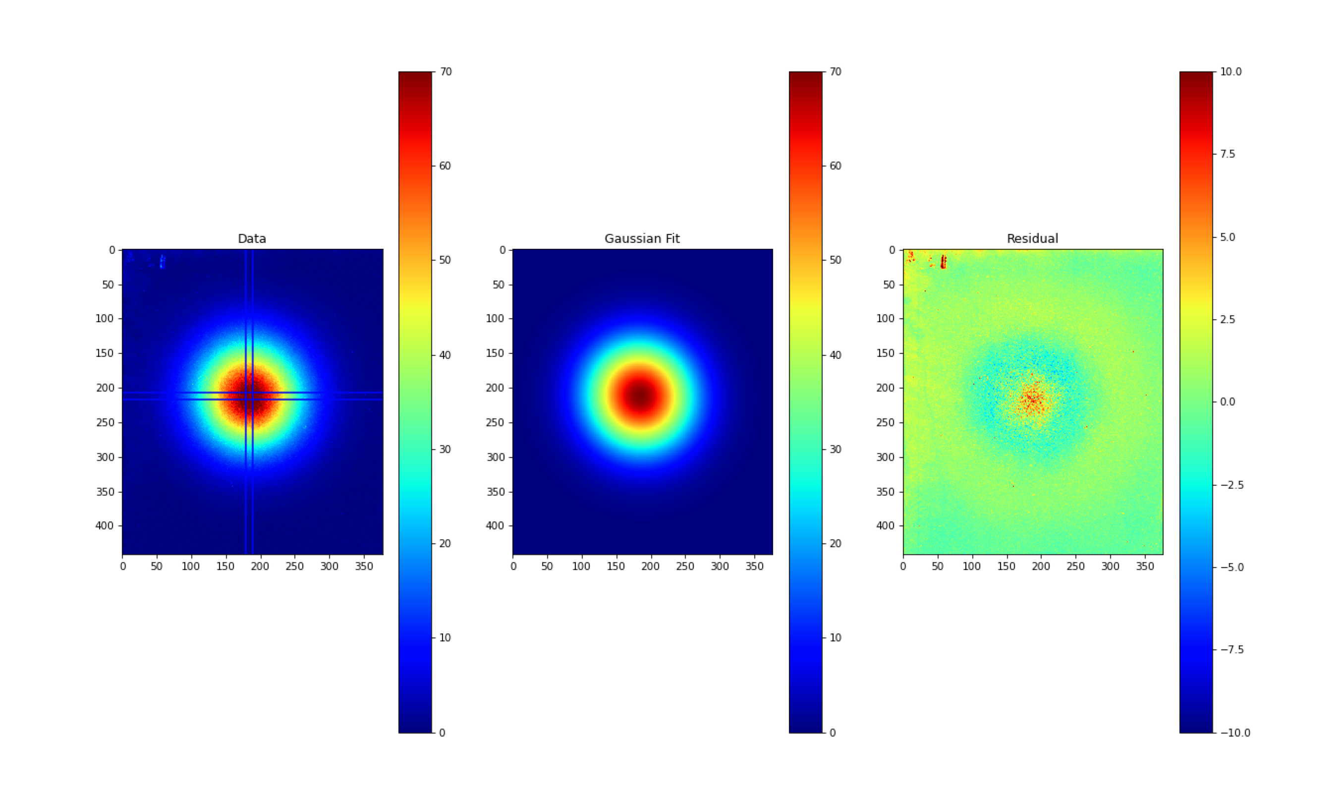

Slide 4
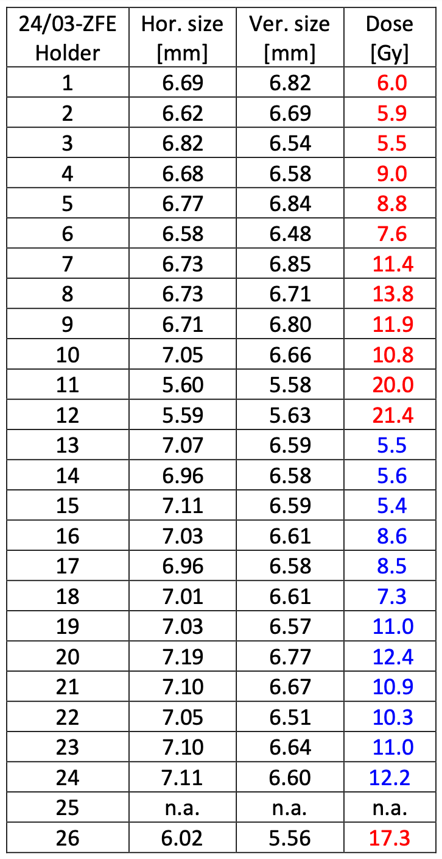
Zebra Fish Eggs – 24/03
Holder # | Hor. Size (mm) | Ver. Size (mm) | Dose (Gy)
1 | 8.41 | 8.38 | 7.06
2 | 8.19 | 8.12 | 7.08
3 | 7.94 | 8.19 | 6.67
4 | 8.35 | 8.26 | 9.89
5 | 8.22 | 8.16 | 9.68
6 | 8.14 | 8.16 | 8.65
7 | 8.44 | 8.12 | 12.18
8 | 8.17 | 8.14 | 14.31
9 | 8.24 | 8.17 | 12.55
10 | 8.37 | 8.32 | 11.59
11 | 6.41 | 6.37 | 21.02
12 | 6.42 | 6.39 | 22.64
13 | 8.28 | 8.24 | 6.63
14 | 8.32 | 8.26 | 6.72
15 | 8.53 | 8.06 | 6.50
16 | 8.53 | 8.48 | 9.51
17 | 8.63 | 8.26 | 9.47
18 | 8.42 | 8.34 | 8.33
19 | 8.44 | 8.40 | 11.68
20 | 8.58 | 8.53 | 12.81
21 | 8.39 | 8.67 | 11.64
22 | 8.64 | 8.25 | 11.09
23 | 8.70 | 8.28 | 11.70
24 | 8.55 | 8.51 | 12.94
25 | na | na | na
26 | 7.00 | 6.48 | 17.91
FLASH
CONV

Slide 5
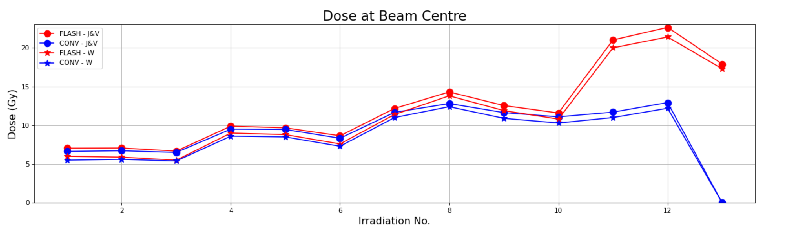
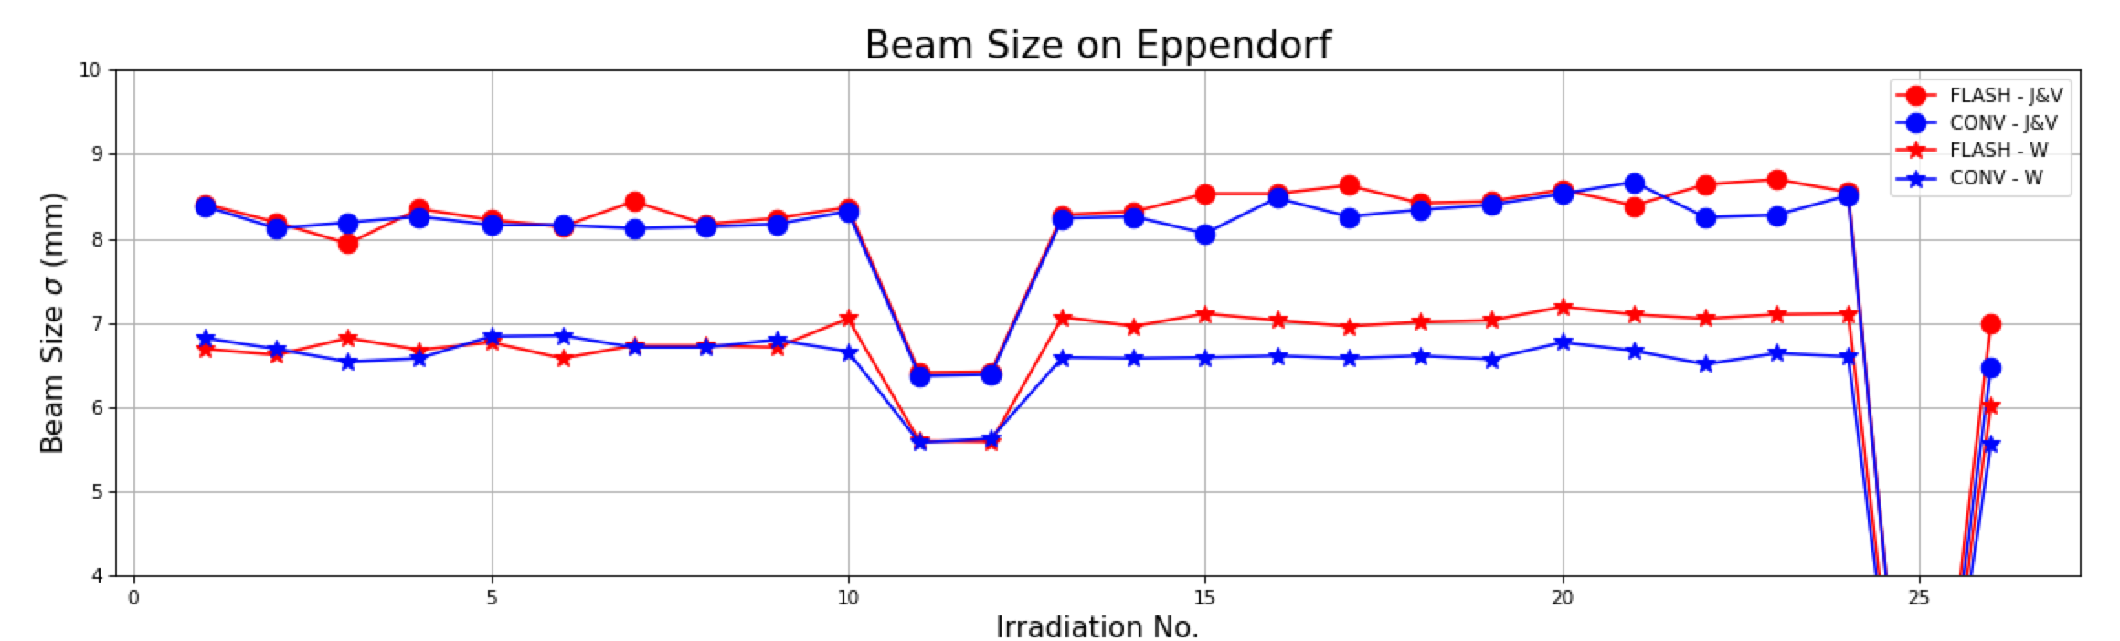
Zebra Fish Eggs – 24/03

