Slide 1
First-principles calculations on investigating the behavior of metal surfaces under high electric field
Ye Wang
Institute of technology, University of Tartu
CERN 20.04.2022

Slide 2
Outline
Field-induced atomic strcuture modifications:
  The behavior of Cu nanoparticles under electric field
  Carburized W surface reconstructions:
    The application of WC surfaces
    Identify the atomic structures of WC surfaces
    Investigate the properties of WC surfaces with electric field
Conclustions and Outlook

Slide 3
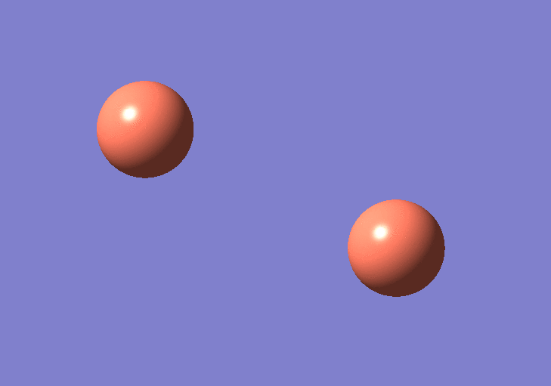
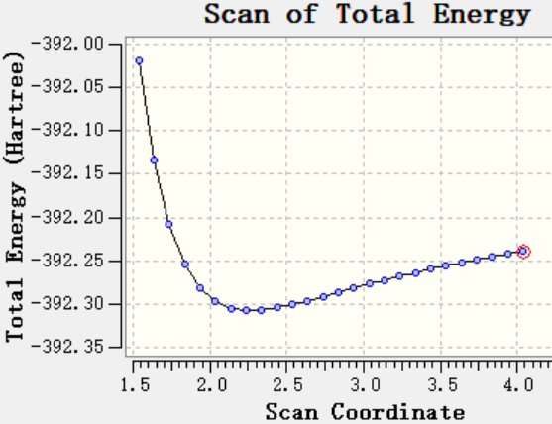
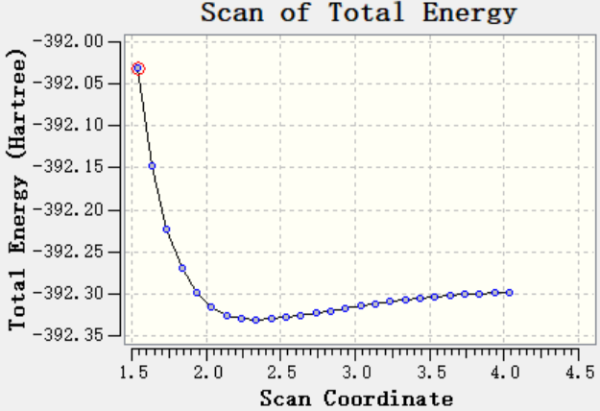
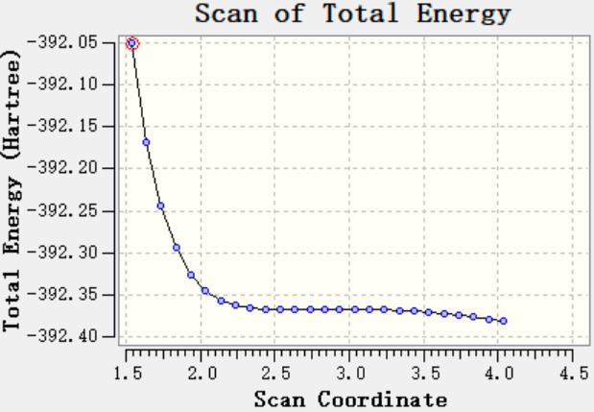
Preliminary Estimates
Increase the bond distance between Cu pair
potential well
potential well
potential well
without electric field
with electric field(10.28GV·m⁻¹)
with electric field(15.42GV·m⁻¹)

Slide 4
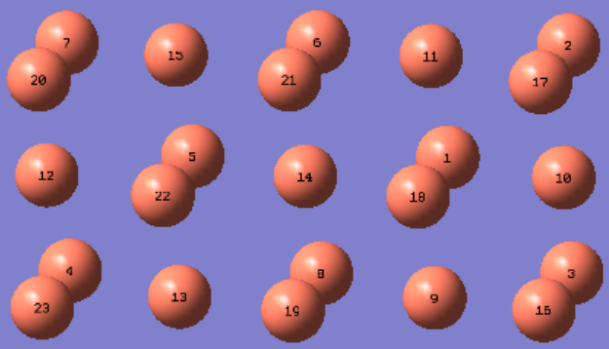
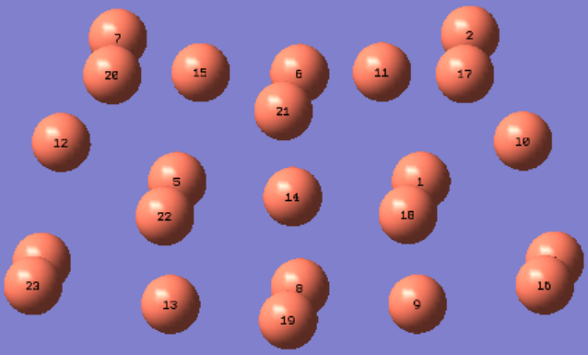
Cu nanoparticles
Electric Field
without electric field
with electric field (5.14GV·m⁻¹)

Slide 5
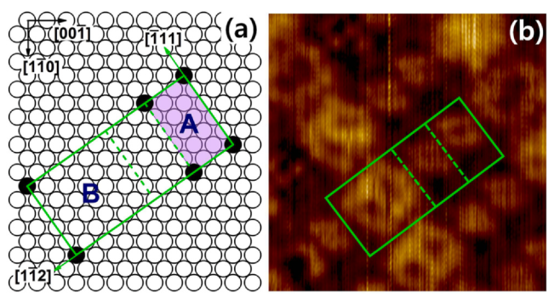
Motivation
Carburized W{110} surfaces are known to produce two globally ordered reconstructions, R(15 × 3)-C/W(110) and R(15 × 12)-C/W(110)
R(15 × 3)-C/W(110):
Violet Rectangle
R(15 × 12)-C/W(110):
Large Rectangle with
Solid Green Line
W(110)/C-R(15×3) and W(110)/C-R(15×12) have been extensively studied both experimentally and theoretically since 1960s​
Both structures have been nicely used as the templates for the growth and self-assembly of metal nanostructures, for instance, Ag, Au, Co, Cu and C60, etc.​

Slide 6
Motivation
Interesting behavior under high electric field:
  The work function of W(110)/C-R(15×12) seems to be lowered
  What is the main reason causing this behavior?
The application of WC surfaces for nanotechnology:
  Promising for nanofabrication due to their nano-patterned periodicity
  Electric fields induce surface rearrangement and diffusion, their behavior need to be understood
Problem: the exact atomic structure of W(110)/C-R(15×12) surface is still unknown
  Find out what the structure is
  Identify the W(110)/C-R(15×3) surface and reconstruction mechanism

Slide 7
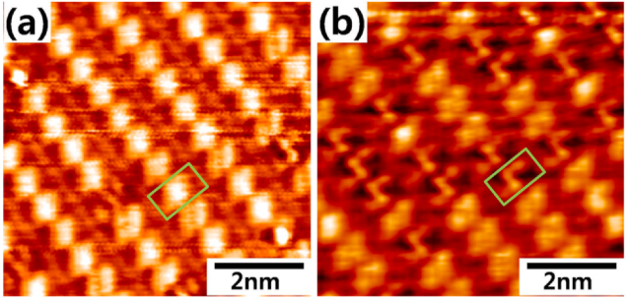
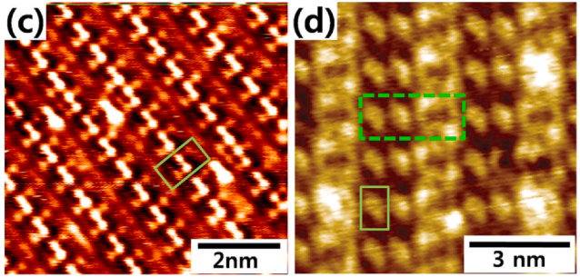
STM image of carburized W{110}
1h
2h
5h
16h
(a)-(c) shows the temporal evolution of the STM images of R(15 × 3) reconstruction,
(d) denotes the STM image of the R(15 × 12) reconstruction
by Kim et. Al

Slide 8
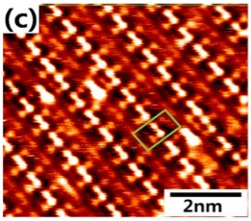
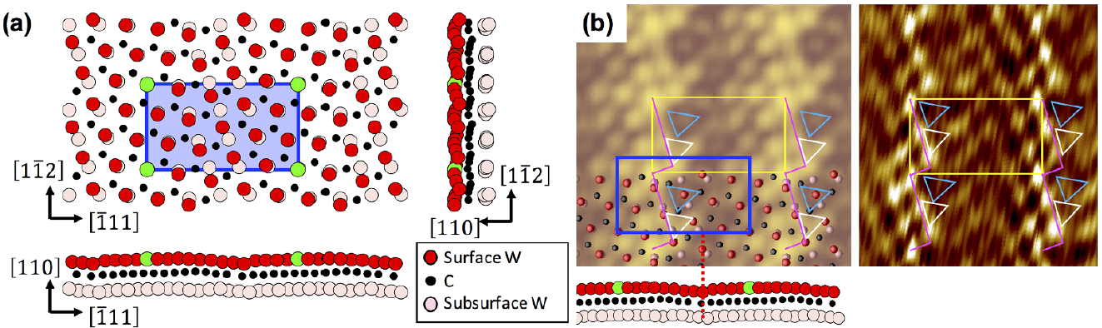
R(15×3)-C/W(110)
Large-scale STM image
Close-up STM image
The Simulated STM image within the Tersoff-Hamann approximation
the number of the W atoms at the surface layer of R(15×3)-C/W(110) is 14
Atomic Structure

Slide 9
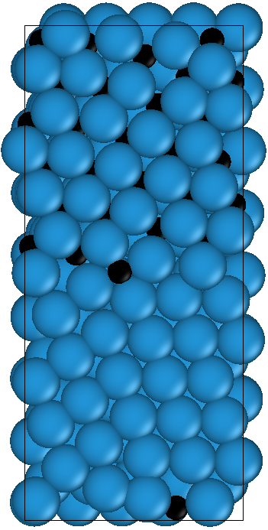
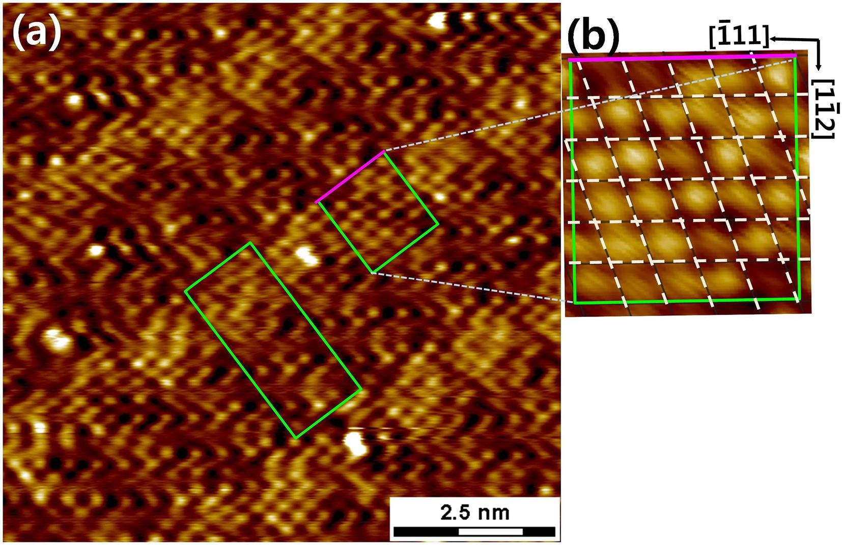
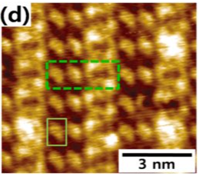

R(15×12)-C/W(110)
Large-scale STM image
Close-up STM image
Atomic Structure within DFT calculations
A
A
B
According to the hypothesis of Kim et al., Block B is a clean W slab, and it is originated from two neighboring A-blocks by removing the subsurface carbons.
Thus, the total number of W on the R(15×12) surface is 56.
A: R(15×3)-C/W(110)
B: clean W(110)

Slide 10
STM image of carburized W{110}
1h
2h
5h
16h
(a)-(c) shows the temporal evolution of the STM images of R(15 × 3) reconstruction,
(d) denotes the STM image of the R(15 × 12) reconstruction
Our Hypothesis: the unit cell of R(15×12)-C/W(110) is composed of C+C+B
by Kim et. Al

Slide 11
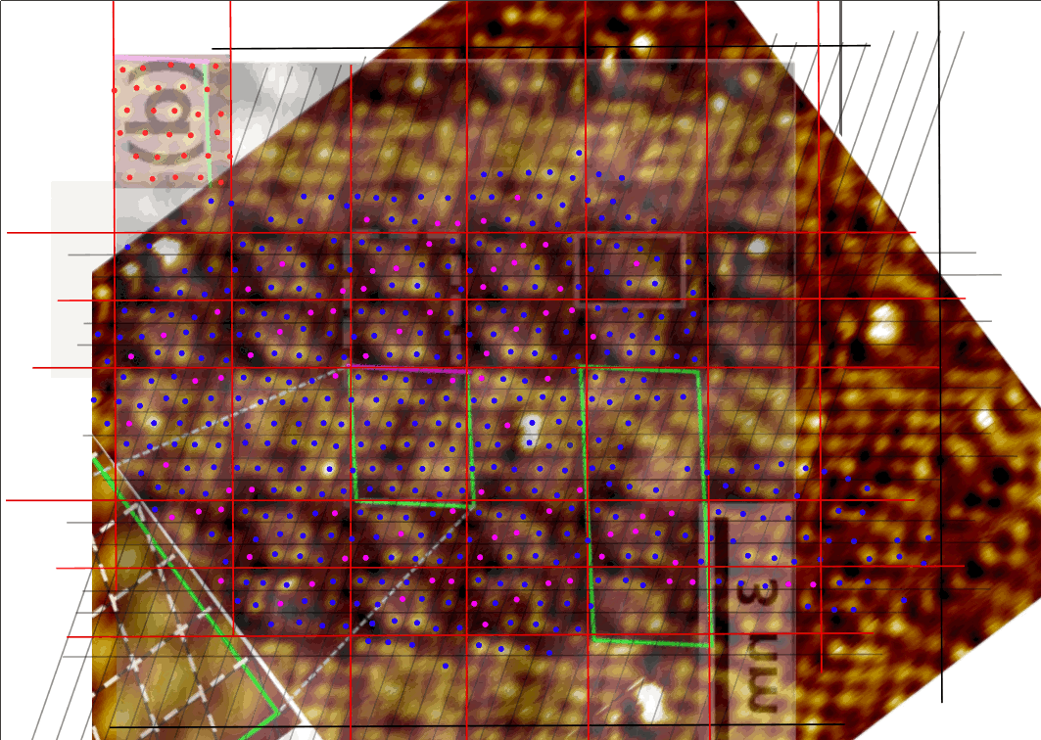
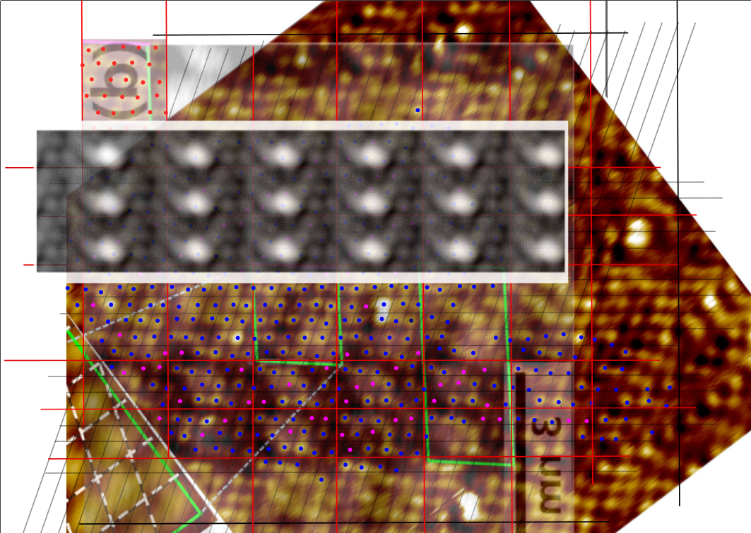
C block – a metastable structure of R(15×3) reconstruction

Slide 12
Conclusions and Outlook
We identify the atomic structure of the R (15 × 12) surface and reveal the reconstruction mechanism of the R (15 × 3)
Our results provide an important understanding of the carburized W{110}, open a new avenue for exploring self-organization properties of various metal nanostructures
Outlook: After we have confirmed the atomic structure, we aim to explain experimental results about metastable hypothesis under electric field

Slide 13


Thank you for your attention!
Achnowledgments
ERA Chair ”MATTER”

Slide 14
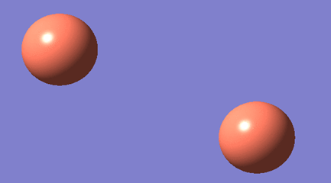

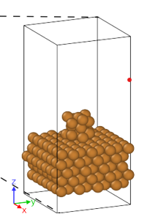
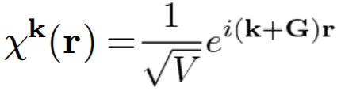
DFT to study the properties of metal surfaces under electric field
Gaussian:
Object: metal nanoparticles, non-periodic
Method: localized basis sets
Result analysis: Molecular Orbital Theory
VASP:
Object: metal surfaces, periodic in x, y z direction
Method: plane wave basis sets
Result analysis: Band Structure

