Slide 1
Multi-scale modelling of electrical breakdown in vacuum:
Influence of electromagnetic power
Tauno Tiirats
Tartu University, Institute of Technology
ERA Chair MATTER
CERN, 20.04.2022

Slide 2
Outline
Introduction
  Motivation & Goal
Multiscale breakdown simulations
  FEMOCS
Electromagnetic power supply
  Inclusion strategy
  ToDo list
Conclusions & Outlook

Slide 3
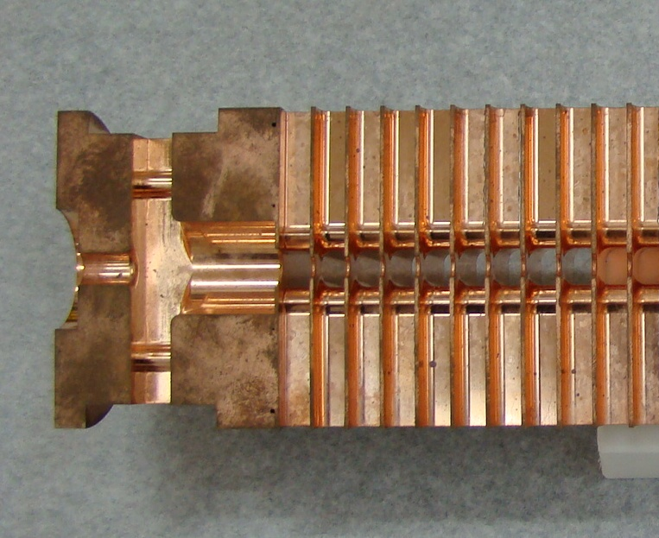
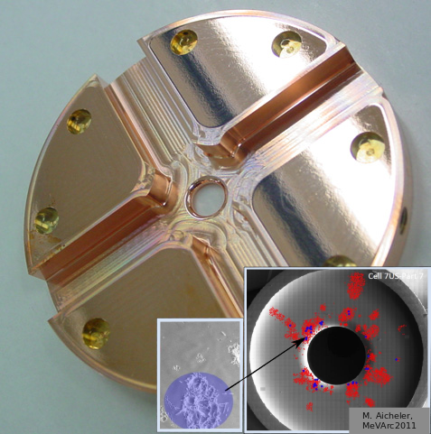
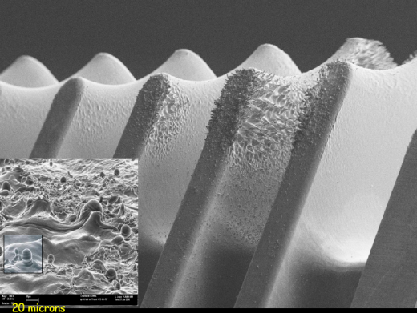
Motivation
Introduction:
CLIC
Theoretical understanding of VBD
Actual VBD mitigation techniques:
  Controlling relevant characteristics
    electric field strength
    surface roughness
    contamination of material surface
  Limiting the available EM power [1,2]
High electric field (>100 MV/m)
Vacuum Breakdown (VBD)
Beam distorted and luminosity lost !
Accelerating structure (CLIC)
Surface damage in CLIC accelerating structures after the breakdown
Images: Walter Wuensch, CERN
[1] W. Wuensch. The Scaling of the Traveling-Wave RF Breakdown Limit. Technical Report CERN-AB-2006-013. CLIC-Note-649, CERN, Geneva, Jan 2006.
[2] A. Grudiev, S. Calatroni, and W. Wuensch. New local field quantity describing the high gradient limit of accelerating structures. Phys. Rev. ST Accel. Beams, 12:102001, Oct 2009.

Slide 4
Introduction:
Research project
Dedicated Research project
  Estonian Research Council (submitted)
  Horizon 2020 ERA Chair MATTER
  2 years
The hypotheses:
  The power supply limitation hinders the development of plasma exactly at the moment plasma initiates (stage 2-3)
  The VBD can be described by multi-scale simulations
The goal:
  Describe quantitatively the EM power dependence of VBD initiation
Accelerating structure (CLIC)
Surface damage in CLIC accelerating structures after the breakdown
Images: Walter Wuensch, CERN

Slide 5
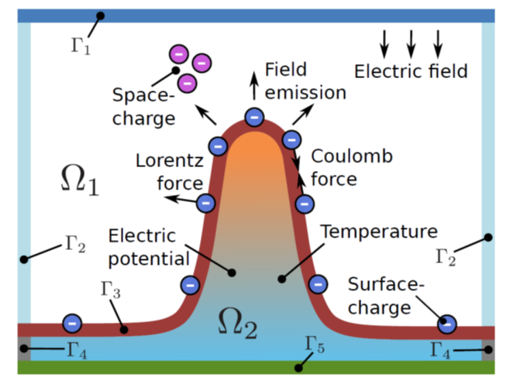
Multiscale breakdown simulations
VBD involves various phenomena in various space scales:
  Emission spot formation
  Thermal runaway
  Field emission
  Plasma formation
  Surface damage
Need for concurrent, multi-scale, multi-physics simulations
  Atomistic simulations
    Molecular Dynamics (MD)
    Particle Dynamics (PIC)
  Continuum simulations
    Thermomechanics (FEM)
    Electromagnetics (FEM)
Scheme of considered physics in VBD simulation
Images: Mihkel Veske, UH&UT

Slide 6
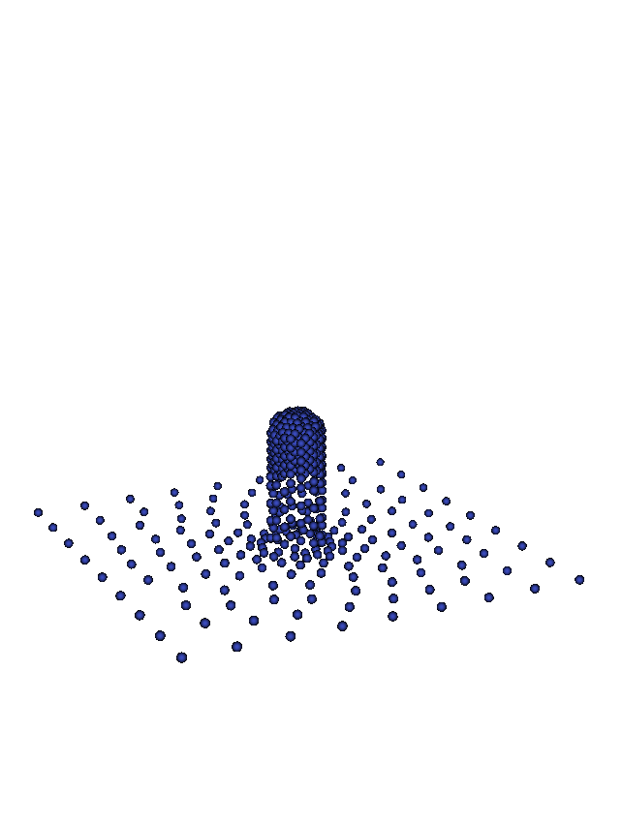
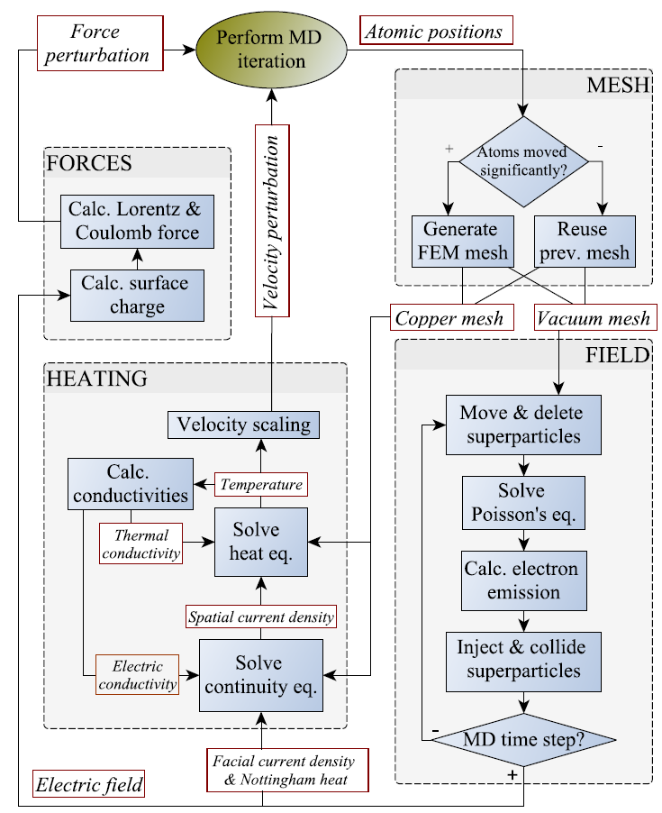
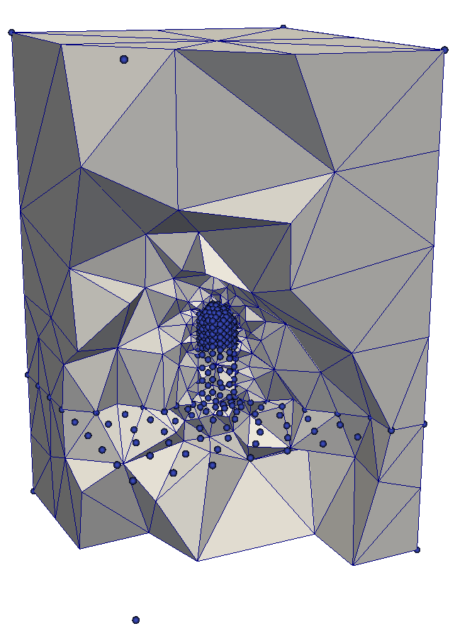
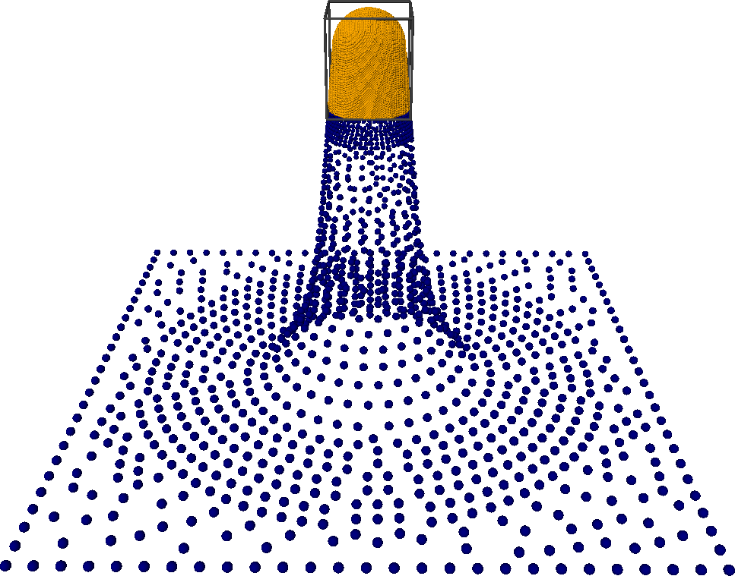
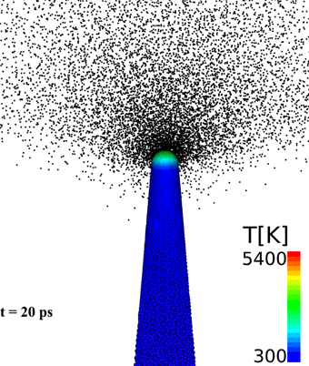
Multiscale breakdown simulations:
FEMOCS
FEM solution for field calculations
Molecular Dynamics model
Particle in Cell calculations
Images: Mihkel Veske, UH&UT

Slide 7
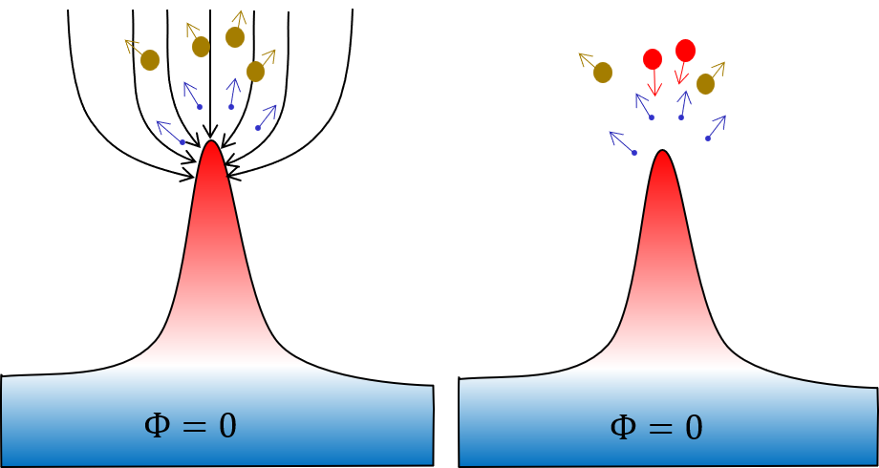
Electromagnetic power supply
Peak power demand during VBD onset
voltage
current
„Experimental data from CERN, SLAC and KEK suggests High-Gradient limit depends on power flow, not only E field“ [3]
  Plasma initiation requires a large influx of power
Ultimate VBD limit is a function of available power
  During VBD onset, not before!
  Local power flow
    Local surface E field decreases under VBD loading
[3]
power
time
Field emission,
no plasma, tiny currents
Fully formed plasma
Voltage collapse
[3] J. Paszkiewicz, A. Grudiev, and W. Wuensch. Breakdown-loaded electric field as a high gradient limit. 2019 International Workshop on Mechanisms of Vacuum Arcs (MeVAarc), 2019.
Stage 2:
Field emitter Thermal Runaway
Stage 3: Ionization runaway & Plasma onset​
Notes:
A large number of charge particles is produced in the process – accelerating these particles requires a large influx of power

Slide 8
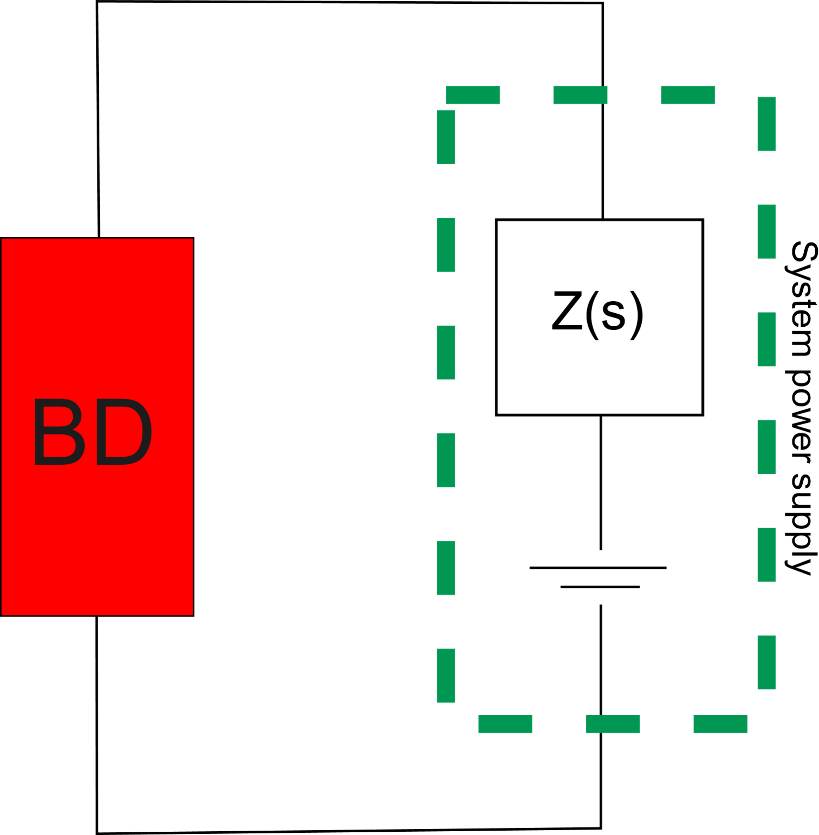
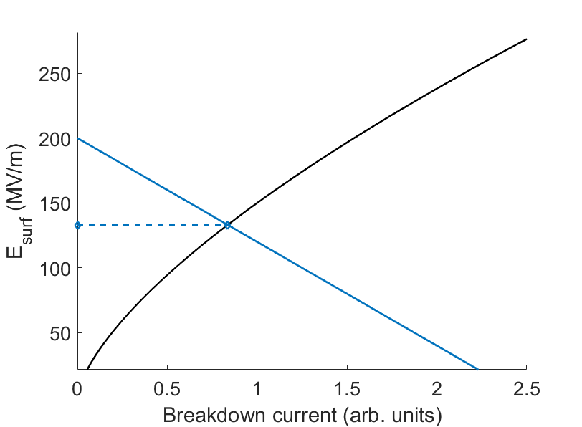

Electromagnetic power supply:
Inclusion strategy
Jan Paszkiewicz’s solution [3]:
  Simplified circuit
  VBD dynamics approximated by a "simple" non-linear circuit element (Child-Langmuir law)
  For any point in the domain evaluate:
    dependence of local field on test current
    assumed function for VBD site emitted current
    Find quasi-equilibrium point
Elegant, but …
During BD onset
I
(BD current)
Unloaded field
$$I∝E^{\frac{3}{2}}$$
surface field, E
Unloaded field
E
BD loaded field
I
Slope depends on available power
[3]
[3] J. Paszkiewicz, A. Grudiev, and W. Wuensch. Breakdown-loaded electric field as a high gradient limit. 2019 International Workshop on Mechanisms of Vacuum Arcs (MeVAarc), 2019.

Slide 9
Electromagnetic power supply:
Inclusion strategy
?
Jan Paszkiewicz’s solution [3]:
  Simplified circuit
  VBD dynamics approximated by a "simple" non-linear circuit element (Child-Langmuir law)
  For any point in the domain evaluate:
    dependence of local field on test current
    assumed function for VBD site emitted current
    Find quasi-equilibrium point
DOES NOT ACCOUNT FOR THE FULL PHYSICS OF VBD!!!
Unloaded field
Unloaded field
E
BD loaded field
I
Slope depends on available power
[3]
[3] J. Paszkiewicz, A. Grudiev, and W. Wuensch. Breakdown-loaded electric field as a high gradient limit. 2019 International Workshop on Mechanisms of Vacuum Arcs (MeVAarc), 2019.

Slide 10
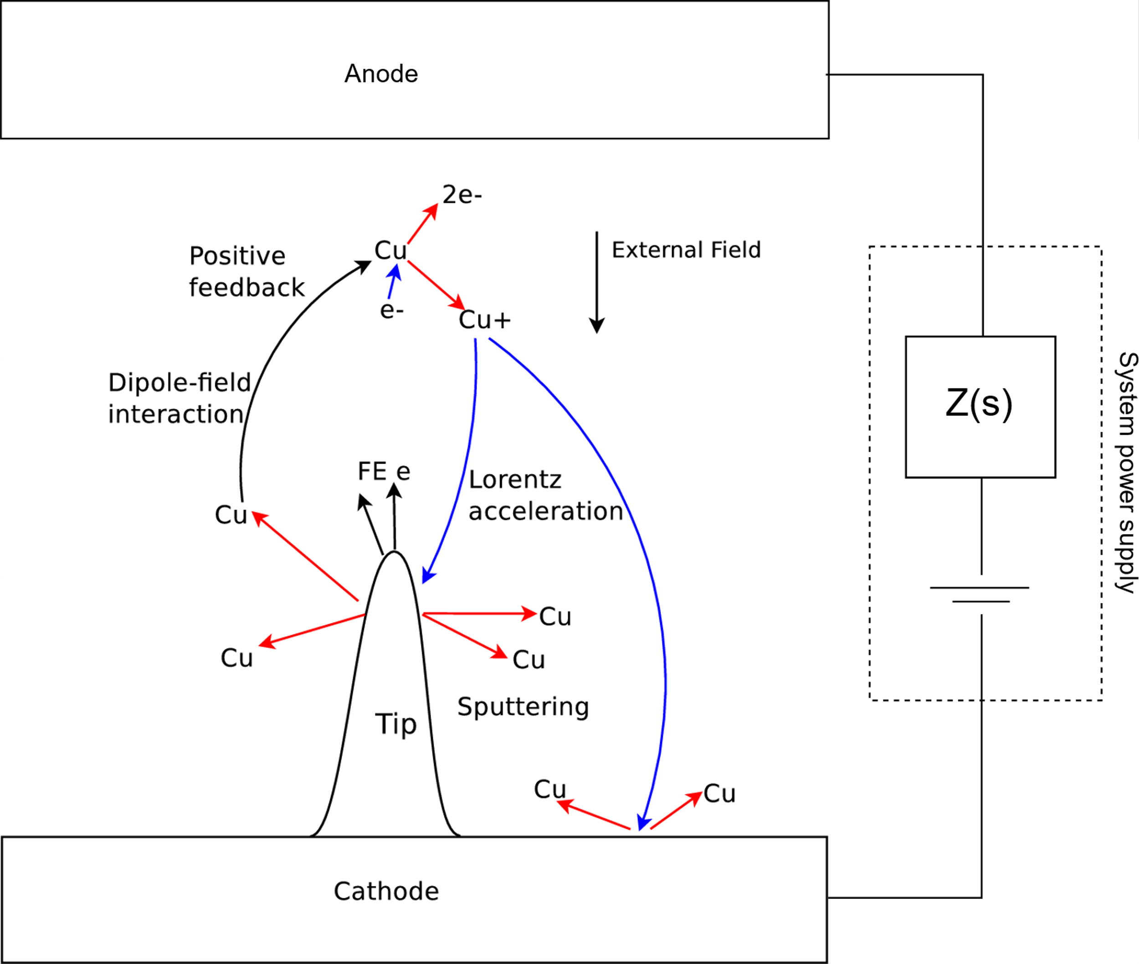
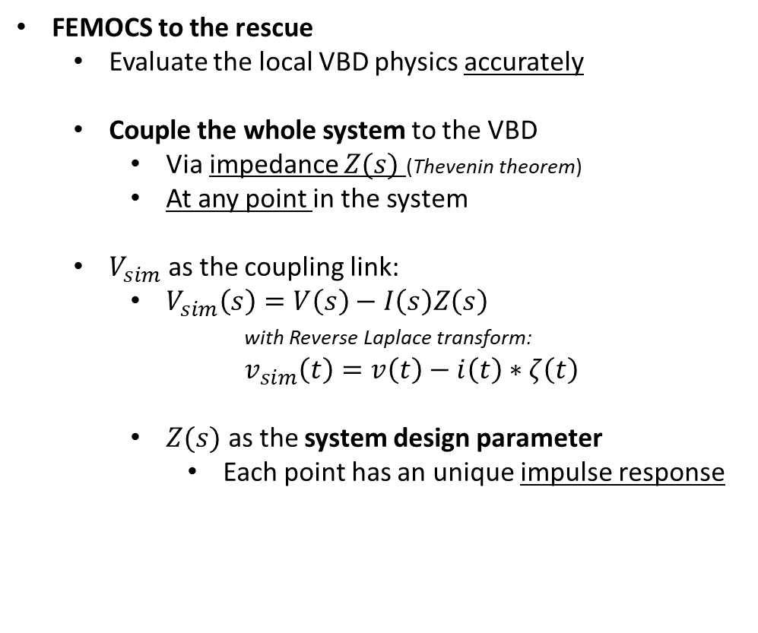
Electromagnetic power supply:
Inclusion strategy
FEMOCS to the rescue
  Evaluate the local VBD physics accurately
  Couple the whole system to the VBD
    Via impedance $Z(s)$ (Thevenin theorem)
    At any point in the system
  $V_{sim}$ as the coupling link:
    $V_{sim}\left(s\right)=V\left(s\right)−I\left(s\right)Z\left(s\right)$
    with Reverse Laplace transform:
    $v_{sim}\left(t\right)=v\left(t\right)−i\left(t\right)∗ζ\left(t\right)$
    $Z(s)$ as the system design parameter
      Each point has an unique impulse response
Impulse response

Slide 11
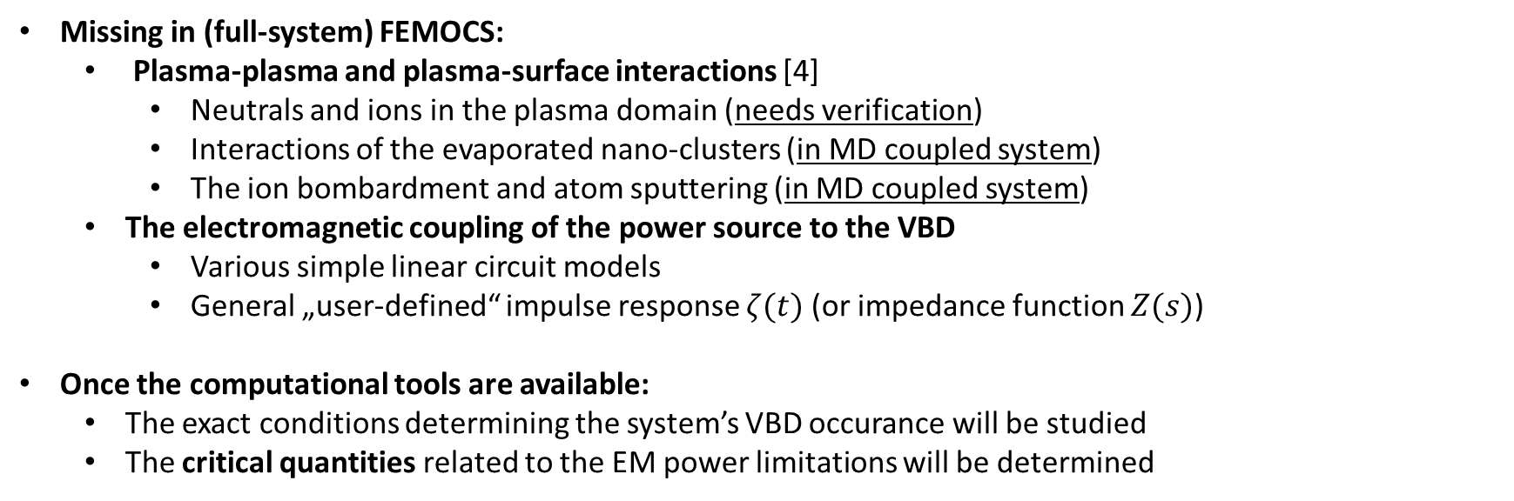
Electromagnetic power supply:
ToDo list
Missing in (full-system) FEMOCS:
  Plasma-plasma and plasma-surface interactions [4]
    Neutrals and ions in the plasma domain (needs verification)
    Interactions of the evaporated nano-clusters (in MD coupled system)
    The ion bombardment and atom sputtering (in MD coupled system)
  The electromagnetic coupling of the power source to the VBD
    Various simple linear circuit models
    General „user-defined“ impulse response $ζ(t)$ (or impedance function $Z(s)$)
Once the computational tools are available:
  The exact conditions determining the system’s VBD occurance will be studied
  The critical quantities related to the EM power limitations will be determined
[4] R. Koitermaa, Master thesis (in progress), University of Helsinki
Notes:
Neutrals and ions (and their collisions) in the plasma domain (needs verification)
The interaction of the evaporated nano-clusters with the field and emitted electrons (in MD coupled system)
The ion bombardment and atom sputtering (in MD coupled system)

Slide 12
Conclusion & Goals
Join FEMOCS with the „full system“
  Investigation of the VBD dependence on system power flow
  Deeper insight on:
    the exact conditions required for VBD initiation
    the critical quantities defining VBD initiation for various materials and geometries
    the physics behind VBD dependence on available EM power
  Direct outcome:
    Quantification of the VBD power flow dependence and related quantities
  Provide tools for:
    mitigating VBD occurance through improved design of HEF applications
    „full system“ multi-physics simulations of VBD phenomen

Slide 13




Thank you for your time!
Acknowledgements:
ERA Chair ”MATTER”
FEMOCS Publications:
M. Veske, A. Kyritsakis, F. Djurabekova, K. N. Sjobak, A. Aabloo, and V. Zadin. Dynamic coupling between particle-in-cell and atomistic simulations. Phys. Rev. E, 101:053307, May 2020.
M. Veske, A. Kyritsakis, K. Eimre, V. Zadin, A. Aabloo, and F. Djurabekova. Dynamic coupling of a finite element solver to large-scale atomistic simulations. Journal of Computational physics, 367:279 – 294, 2018.
M. Veske, "Multiscale-multiphysics modelling of metal surfaces." Report Series in Physics, PhD thesis (2019).

Slide 14
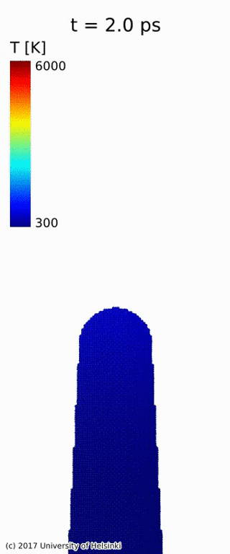
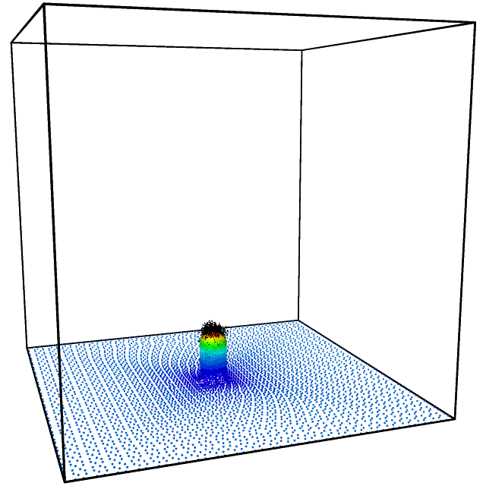
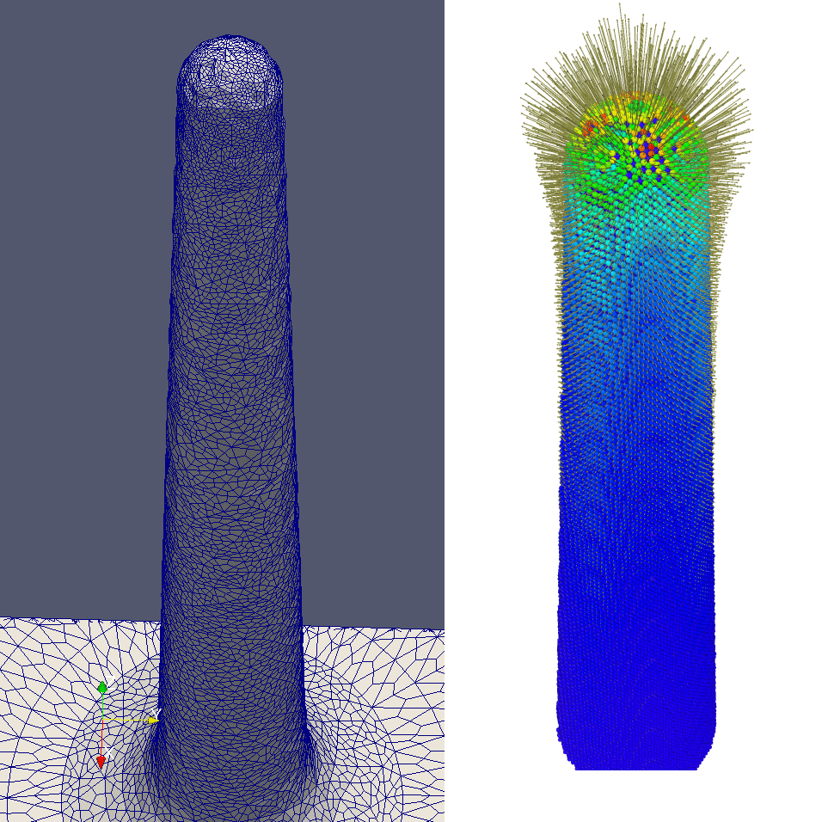
Multiscale breakdown simulations:
FEMOCS
Surface charge (FE mesh + MD)
Field emissioon (FEM + PIC)
Thermal runaway (MD)
Images: Mihkel Veske, UH&UT

