Slide 1
Microscopic analysis of Cu electrodes from the Large Electrode System
S. Oras
Tartu University, Institute of Technology
MATTER laboratory
CERN, 20.04.2022

Slide 2
Outline
Characterization of Cu electrodes
  Description of electrodes
  SEM
  EDX
  AFM + FEM
Heat-induced growth of CuO nanowires
Future plans

Slide 3
Characterization of
Cu electrodes

Slide 4
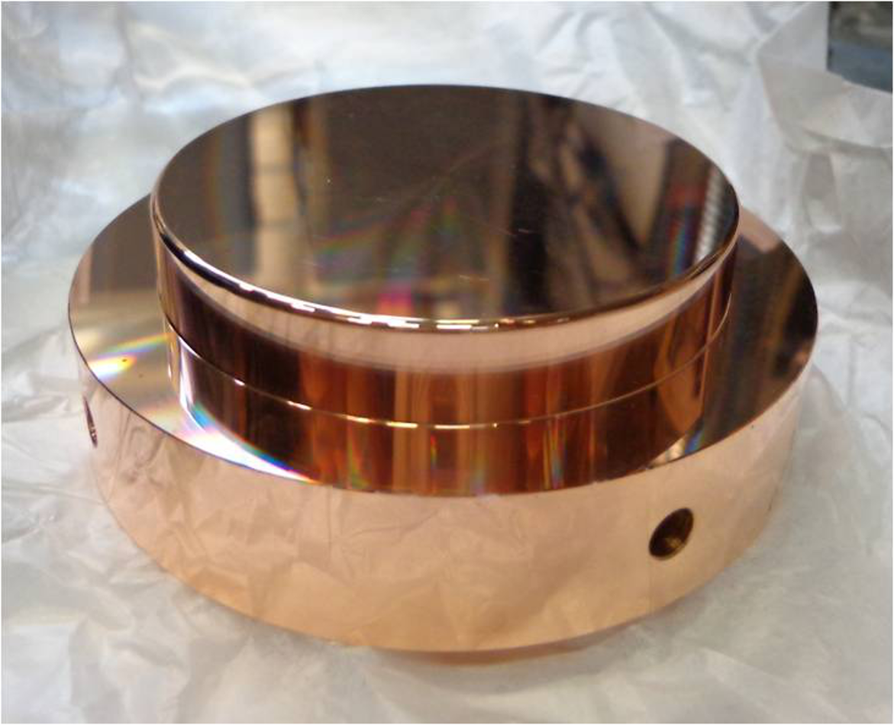
Description of electrodes
We have received 3 pairs electrodes in total.
  2 Pairs of soft and hard Copper with different conditioning and plasma treatment history from Helsinki.
  And another pair without conditioning and plasma treatment from CERN.
Phys. Rev. Accel. Beams 23, 033102

Slide 5
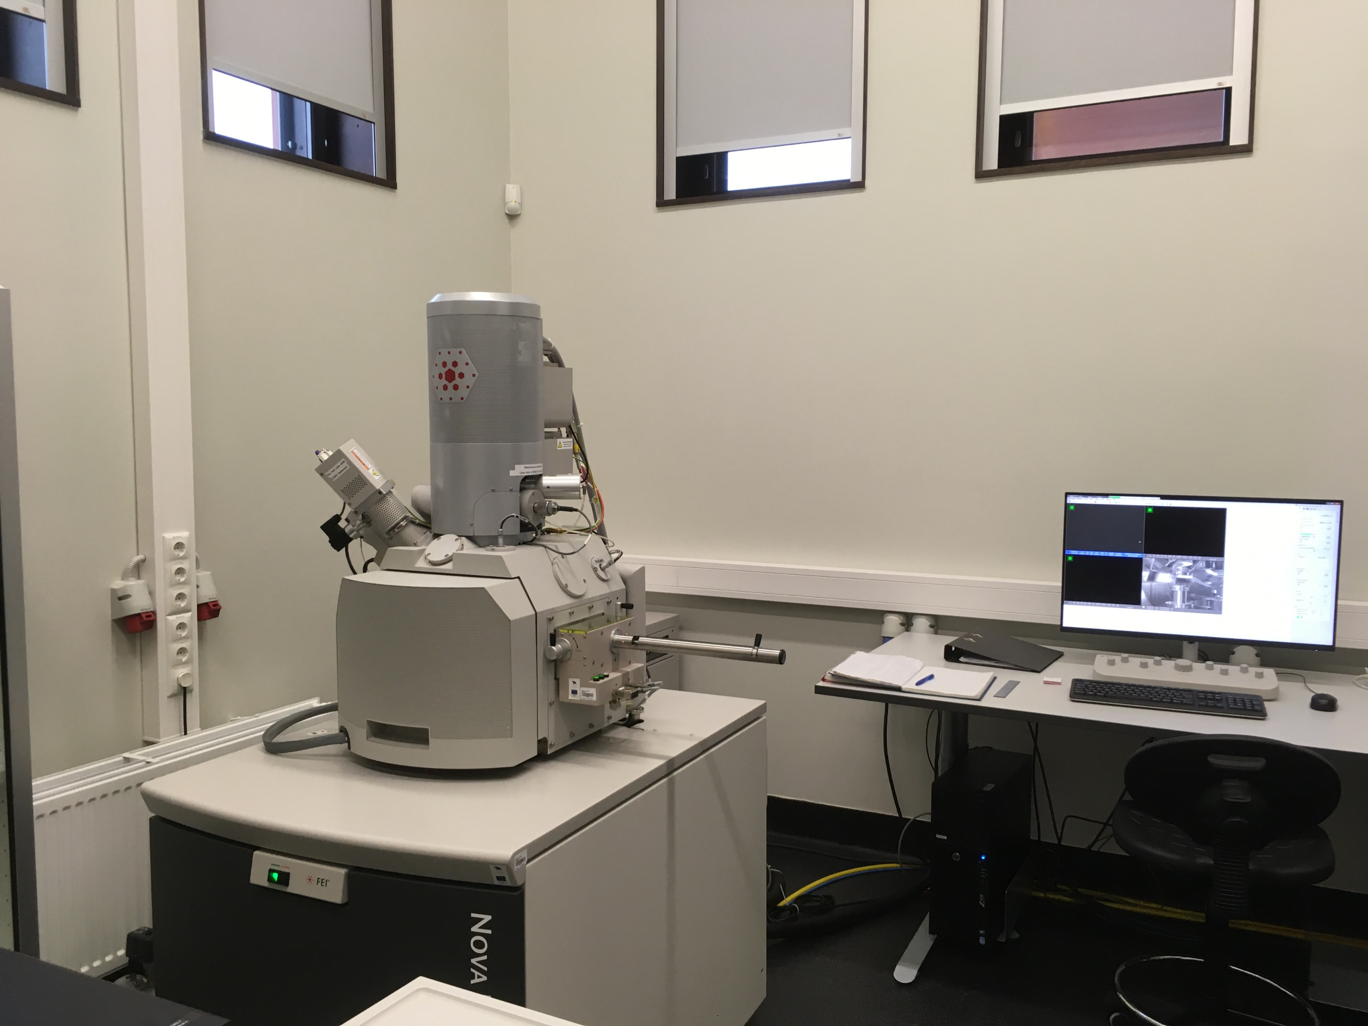
SEM

Slide 6
SEM: Cathode
Soft Cu
Soft Cu

Slide 7
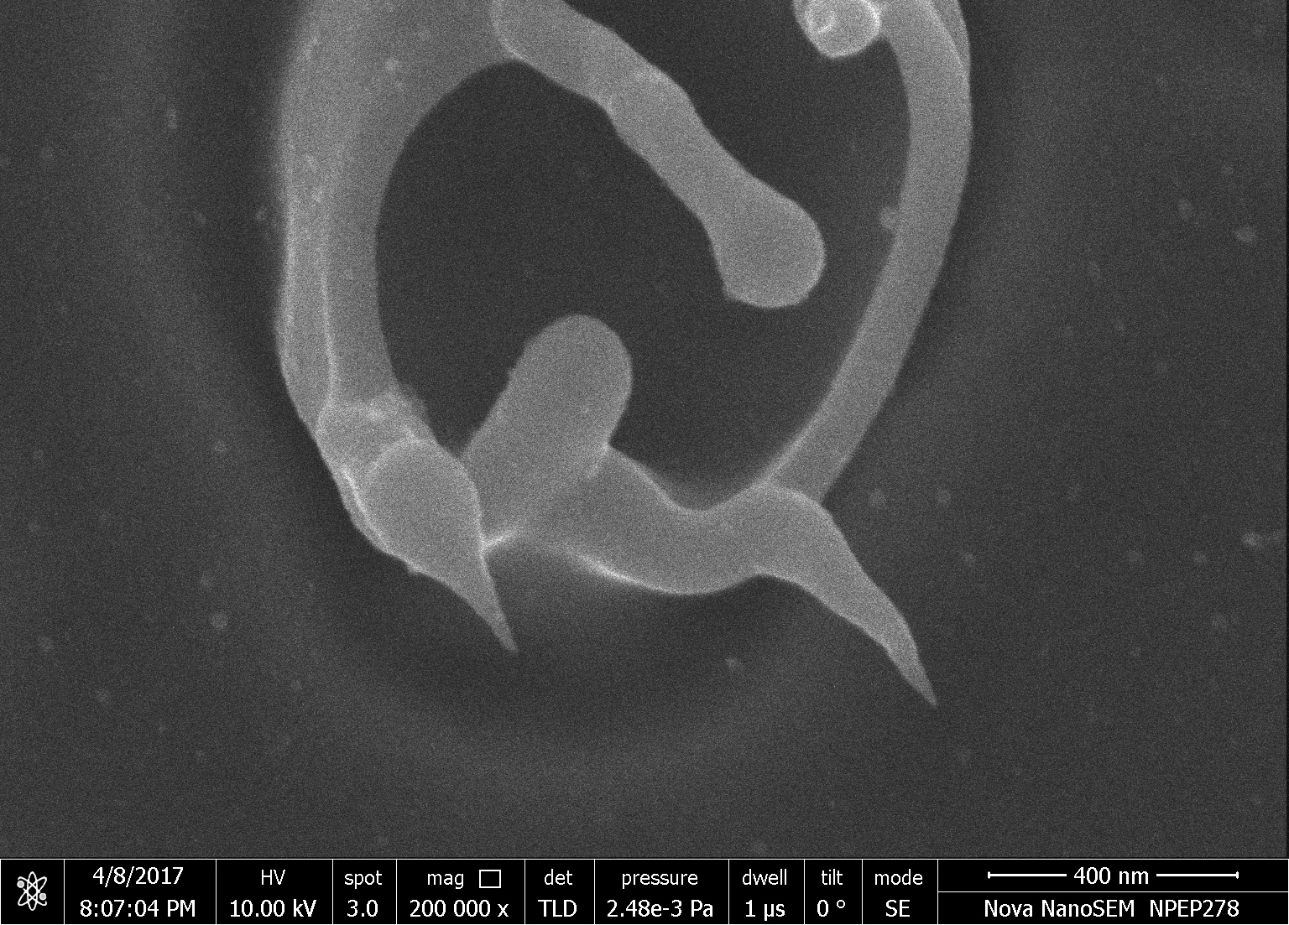
SEM: Anode
Soft Cu
Soft Cu
Hard Cu

Slide 8
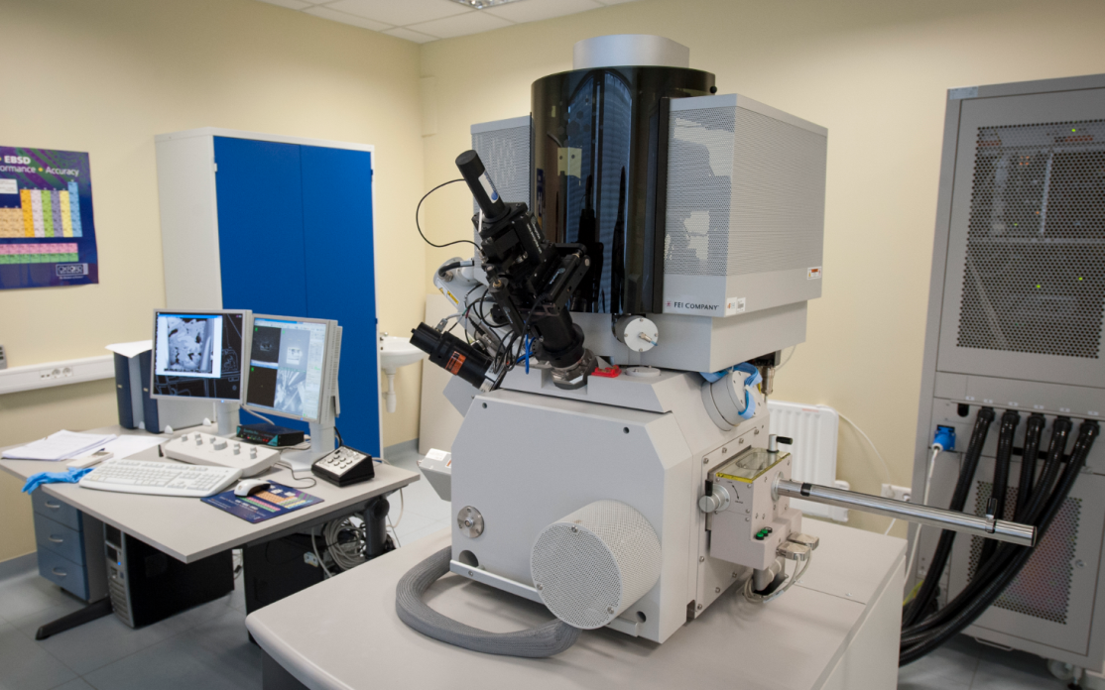
EDX
EDX (Energy-dispersive X-ray spectroscopy) inside SEM.
Performed by Aile Tamm and Helle-Mai Piirisoo.

Slide 9
EDX: Mapping
Spectrum A
Mapping was done in several locations on both electrodes.
(This spectra is from cathode.)
Spectrum B
Spectrum | C | O | Na | Mg | S | Cl | K | Ca | Ti | Cu | Total
Spectrum A | 2.89 | 0.61 |  |  |  |  |  |  | 0.28 | 96.22 | 100.00
Spectrum B | 2.79 | 0.63 |  |  |  |  |  |  | 0.36 | 96.22 | 100.00

Slide 10
EDX: Summary
Elemental composition of a regular surface of untreated Cu electodes 0185 and 0186 in wt.%:
High amount on C especially on anode.
 | C | O | Ti | Cu | Total
0185 (cathode | 2.90 | 0.73 | 0.32 | 96.06 | 100.0
0186 (anode) | 7.57 | 0.91 | 0.78 | 90.74 | 100.0

Slide 11
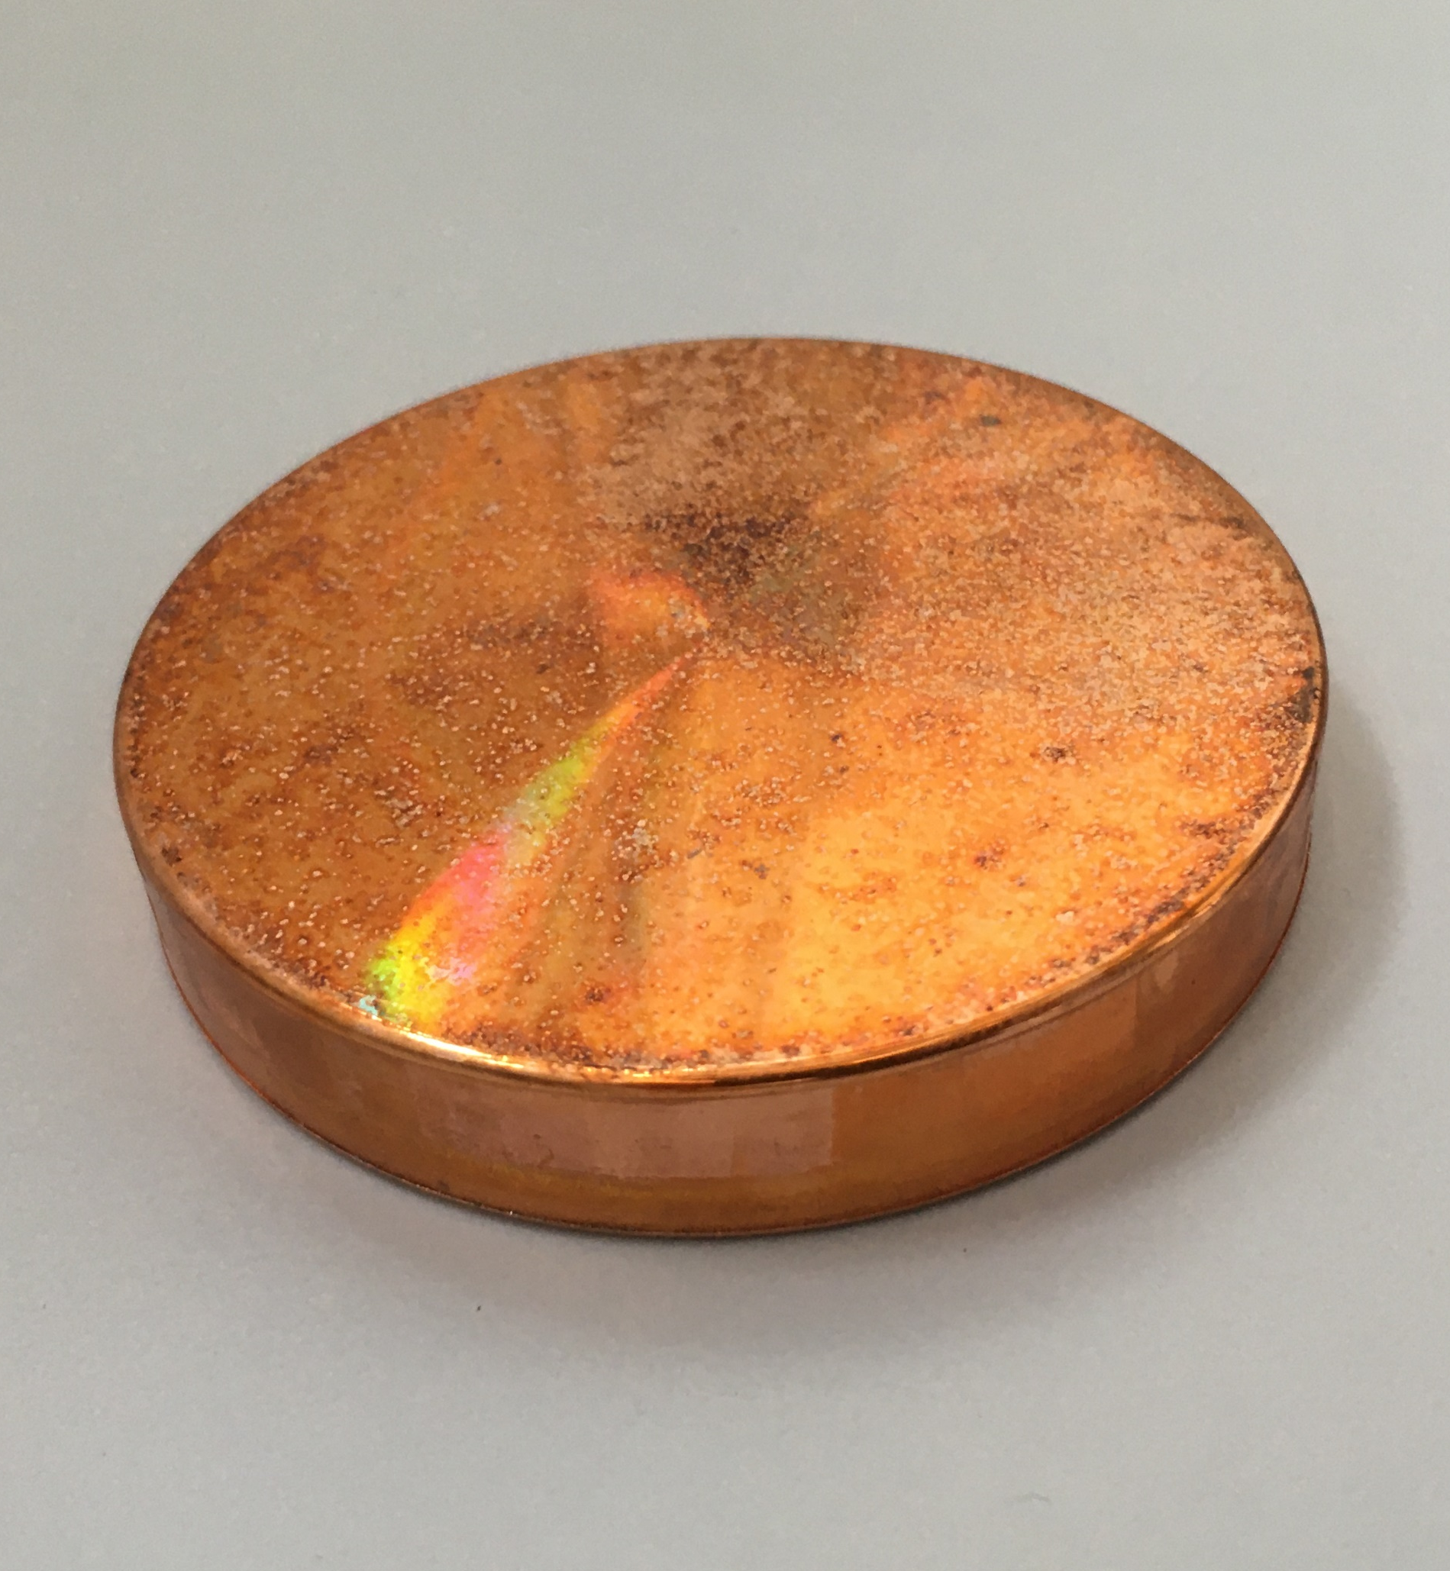
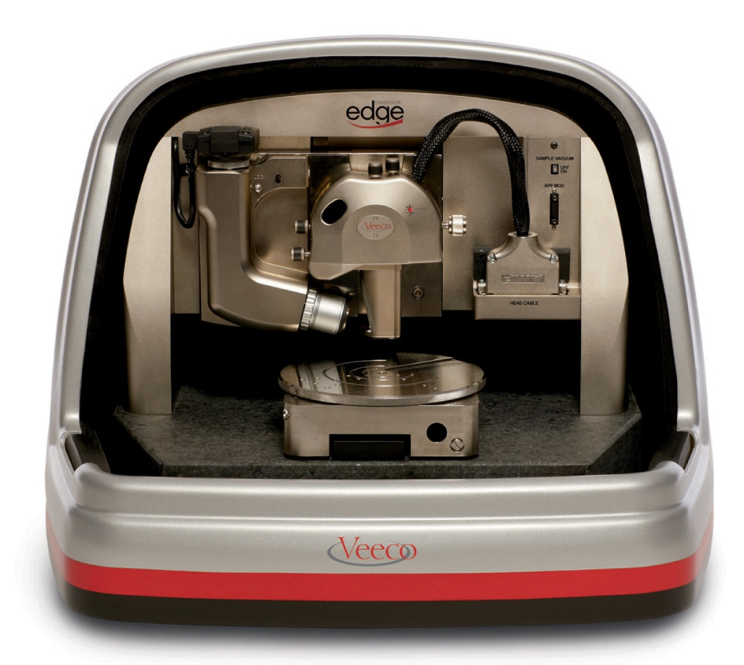
AFM
Atomic Force Microscope (AFM)
(Dimension Edge by Bruker/Veeco)
equipped with Kelvin probe
(mapping the work function)

Slide 12
AFM: Crater topography vs work function
Topography
Work function

Slide 13
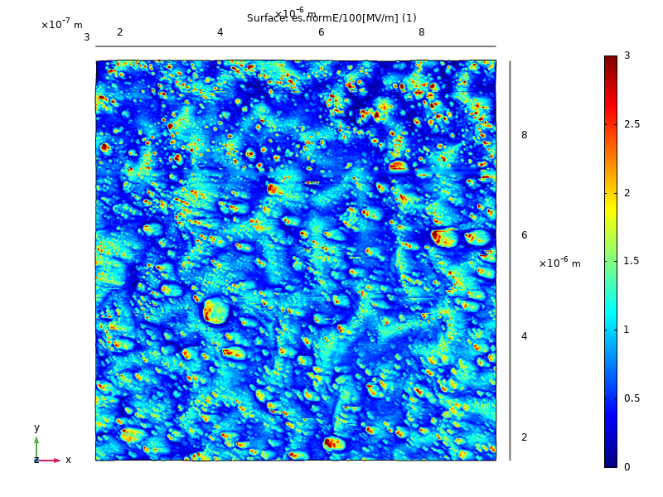
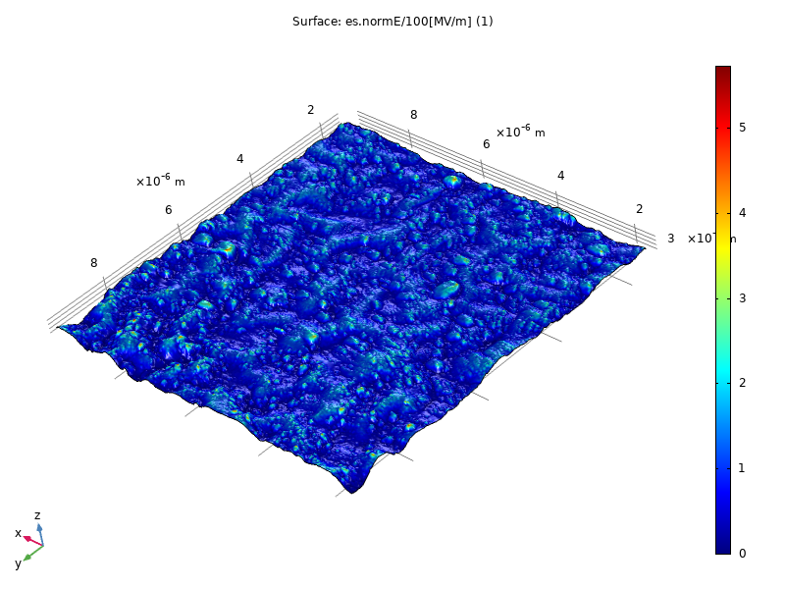
AFM+FEM: Field enhancement
AFM images as input for Finite Element Method (FEM) simulation
Field enhancement up to 5 times due to topology.
Field enhancement simulation
Field enhancement capped at 3

Slide 14
Heat-induced growth of
CuO nanowries

Slide 15
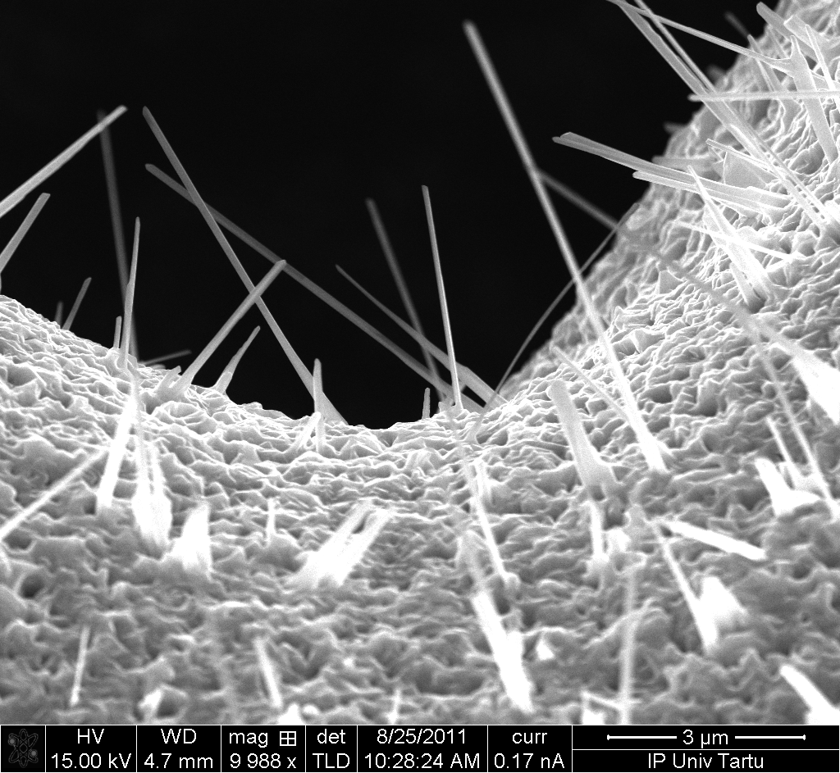
Growth of CuO nanowires
CuO nanowires can be synthesized by heating Cu in the presence of oxygen* in the temperature range 400°C-700°C.
*Nano Lett., Vol. 2, No. 12, 2002

Slide 16
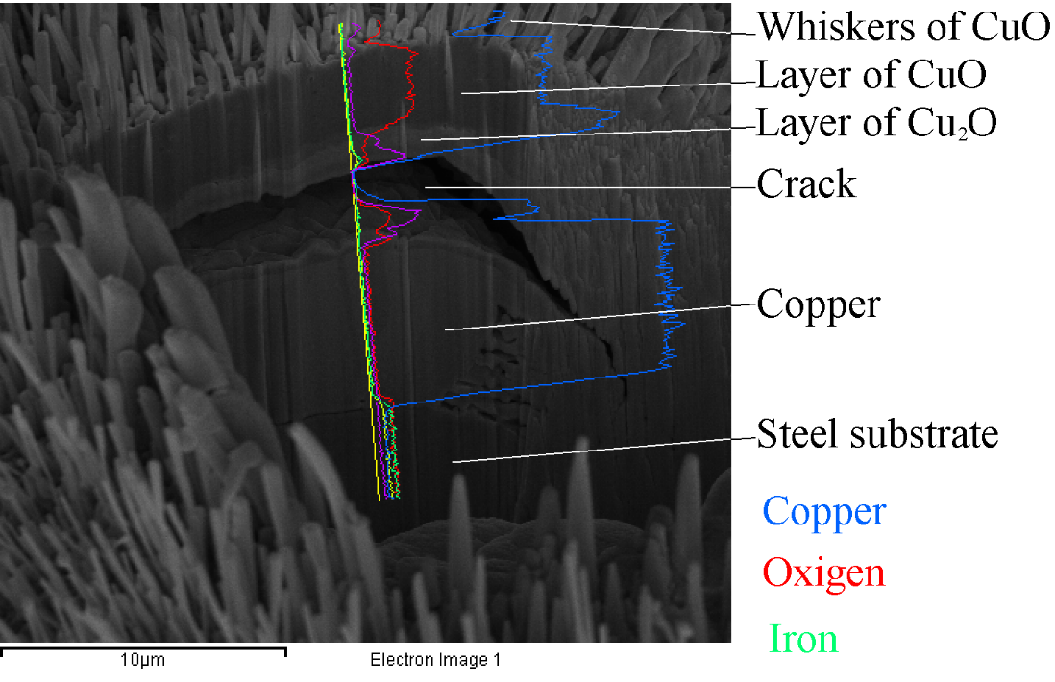
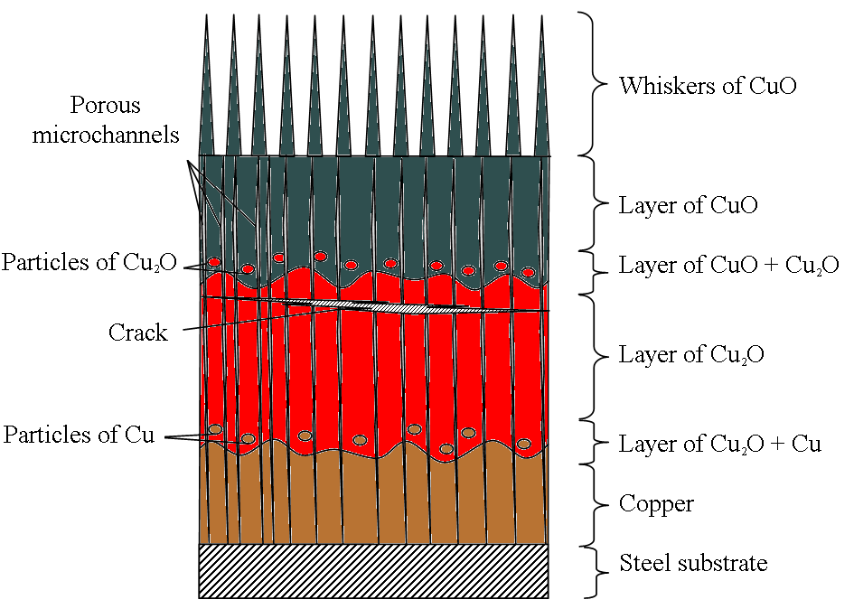
Cu sample with CuO nanowires:
Inner structure after heat-treatment
Cut by Focused Ion Beam (FIB), analysed by EDX (NSFL, IPUT)
Dorogov, et. al, Appl. Surf. Sci. 246, 423 (2015).

Slide 17
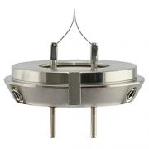



Tungsten oxide nanowires
Tungsten Oxide nanowires grown in vacuum on tungsten filament used in SEM.
Estimating the amount of molecules in CLIC
$$T=293K$$
$$P={10}^{−9}mbar$$
$$\frac{n}{V}=\frac{P}{R∙T}={2∙10}^{14}\frac{molecules}{m^{3}}$$

Slide 18
Future plans
Plans with current electrodes:
  Cut the electrode to see if the carbon is on the surface or is it in bulk.
Plans for new electrodes:
  We need a new pair of electrodes without excessive C.
  We make EDX and microscopy in Tartu. Then we do conditioning and/or plasma in Helsinki. We look at results in Tartu.
We receive heating stage for microscope in September. We can observe in real-time IF growth of CuO wires happen in Cu in vacuum.

Slide 19


Achnowledgments
ERA Chair ”MATTER”

Slide 20
Mapping large craters
Mapping of the most interesing part is almost impossible.
¾ of image with dull tip
Image of crater with artefacts

